Slide 1
Machine Detector Interface at CEPC
Dou Wang, Hongbo Zhu, Huamin Qu, Jianli Wang, Manqi Ruan, Qinglei Xiu, Sha Bai, Shujin Li, Weichao Yao, Yanli Jin, Yin Xu, Yiwei Wang, Yingshun Zhu, Zhongjian Ma
Institute of High Energy Physics
23-26 January 2017
HKUST Jockey Club Institute for Advanced Study, Hong Kong

Slide 2
Outline
Introduction to MDI
Requirements of the MDI at CEPC
Progresses of sub-projects
Final focusing magnets
Luminosity measurement
Mechanical support
Beam induced backgrounds
Summary

Slide 3
Machine Detector Interface
Machine
Beam Induced
Backgrounds
Detector
Luminosity
Degrade
Mechanical supporting
Shielding
. . .
Mutual influence between the machine and the detector
Luminosity degraded by the detector solenoid field
Beam induced backgrounds
. . .
Integration of machine and detector
Global design: confliction between the machine and the detector
Mechanical Support
Shielding

Slide 4
Requirements of MDI at CEPC
Requirements of the machine
$L^{∗}=1.5m$( $L^{∗}↓ → L↑$)
Compensating solenoid and screening solenoid
Accurate installation and stable mechanical support
Requirements of the detector
Larger acceptance in polar angle
Lower beam induced backgrounds
Accurate measurement of the luminosity
Challenges of MDI at CEPC
Many devices will be piled up in IR
Size of devices are limited (Space is very tight)

Slide 5
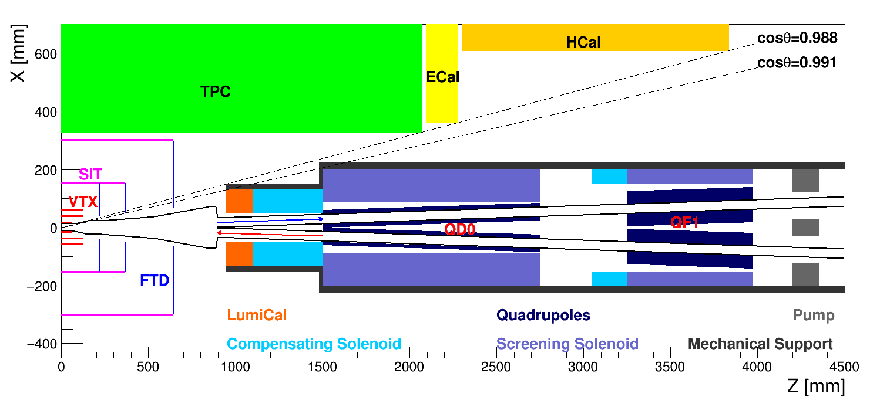
Proposed Layout of IR
$L^{∗}=1.5m$
$Crossing angle=30 mrad$ (in the double ring scheme)
QD0
double aperture superconducting magnet
surrounded by compensating solenoid and screening solenoid
All forward devices are hoped to be as small as possible

Slide 6
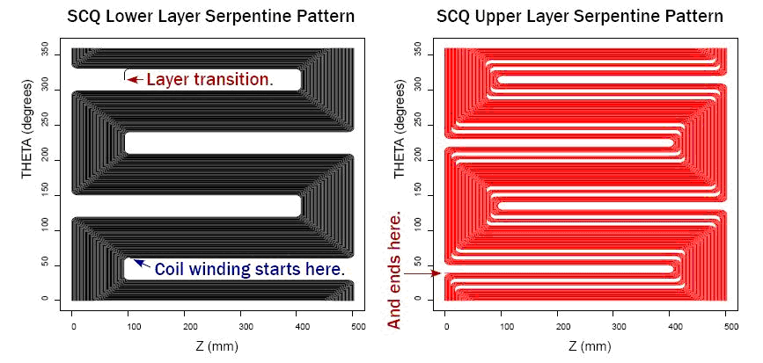
Requirements for QD0
Double aperture superconducting magnet
Field gradient: 200 T/m
Coil inner radius: 12.5 mm
Serpentine winding coil using direct winding technology, developed at BNL, is selected for its high efficiency and high compactness

Slide 7
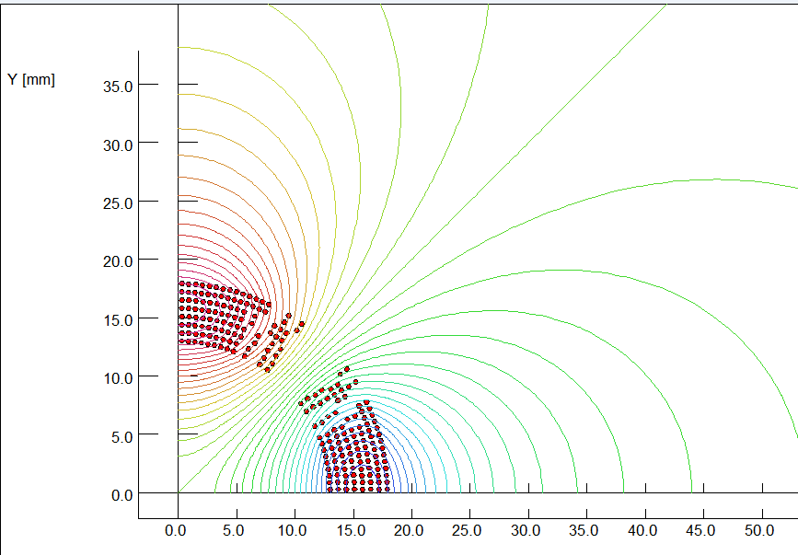
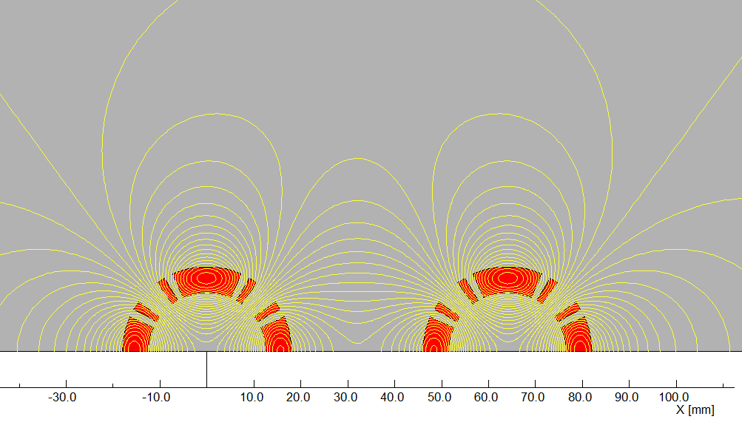
Preliminary Design of QD0
By Yingshun Zhu
The coils will be made of 0.5mm round NbTi-Cu conductor using direct winding technology.
Eight Serpentine coil layers are used for the QD0 coil.
The field in one aperture is affected due to the field generated by the coil in another aperture.
Field cross talk of the two apertures is modelled and studied

Slide 8
Effect of the Detector Solenoid
Detector Solenoid $→$ Beam coupling$→ L↓$
Flat beam at CEPC
Coupling between horizontal and vertical betatron motion will increase the transverse beam size
To cancel the coupling: $∫B_{z}ds=0$
Before quadrupoles: $∫B_{z}ds=0$ (Compensating solenoid)
Inside quadrupoles: $B_{z}=0$ (Screening solenoid)
The length of the compensating solenoid is hoped to be as shorter as possible if the beam stability is satisfied
Designing a 13 T compensating solenoid with NbTi technology
By Yingshun Zhu, Weichao Yao
Detector Solenoid: 3.5T
$$∫B_{z}ds=0$$
$$B_{z}=0$$
L = 1m, B=5.25T
L = 0.7m, B=7.5T
Compensating
solenoid
QD0
Screening solenoid

Slide 9
Feedback
In the right plot, the $B_{z}$ inside screening solenoid is not 0.
The fringe field of 13T compensating solenoid will be too strong.
It will cause the emittance blow up at IR
${∆ε}_{y}=3.83×{10}^{−13}\frac{γ^{2}}{J_{y}}\frac{I_{5,IP}}{I_{2}}$
1MeV critical energy SR won’t work
Detector Solenoid: 3.5T
$$∫B_{z}ds=0$$
$$B_{z}=0$$
L = 1m, B=5.25T
L = 0.7m, B=7.5T
Compensating
solenoid
QD0
Screening solenoid

Slide 10
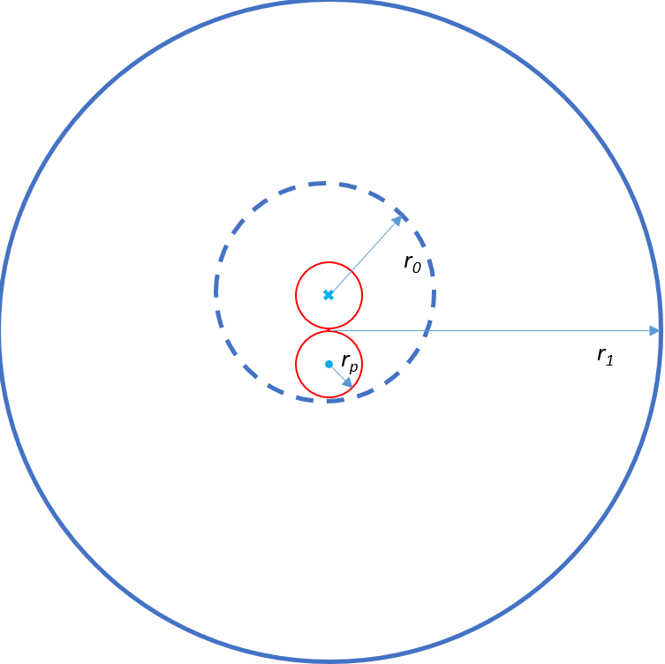
Luminosity Calorimeter (LumiCal)
$$cross angle=30mrad$$
$$θ_{min}$$
$$Z$$
The uncertainty of luminosity measurement is being studied.
The hardware of the LumiCal hasn’t been studied yet
Space limitation in both radial direction and longitudinal direction
Geometry will be asymmetric in manufacture and installation

Slide 11
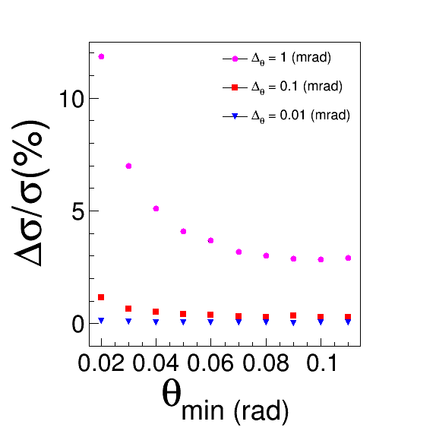
Luminosity Measurement
Required precision:
1e-3 ?
Method:
Process: $e^{+}e^{−}→e^{+}e^{−}$
$L=\frac{N}{σ⋅ε}$
$\frac{ΔL}{L}=|\frac{Δσ}{σ}|$
Systematical uncertainty sources：
Detector resolution
Detector geometry
Background events
Installation accuracy
……
By Liu Yang, Kai Zhu

Slide 12
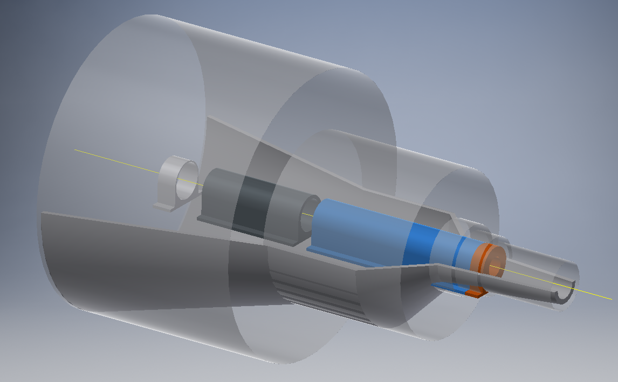
Mechanical Support for the Machine
By Shujin Li, Jianli Wang, Huamin Qu
Elements | Mass (kg)
LumiCal | 130
QD0(Including solenoids) | 900
QF1 | 600
Pump | 20
The support point will be at about 6 m away from the IP
The deformation and vibration might be a problem for the beam stability
The feasibility of the mechanical support has been preliminary studied

Slide 13
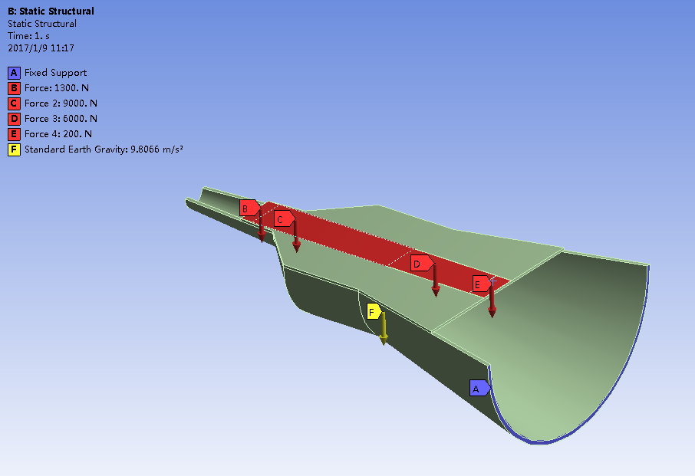
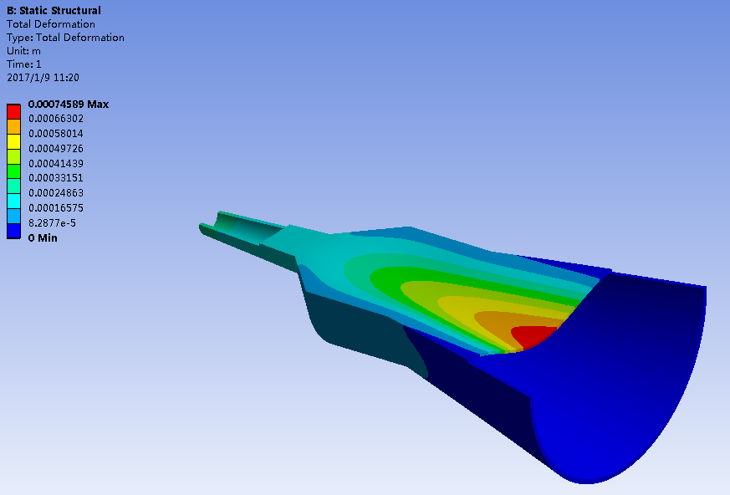
Very Preliminary Results
The gravity force of accelerator elements are applied to a virtual plane on the support structure
The deformation at the IP is about 300~400 micron meters
More forces and effects will be considered to improve the design and simulation

Slide 14
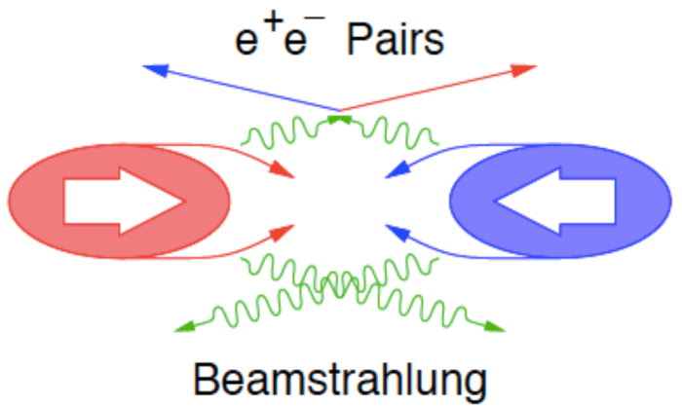
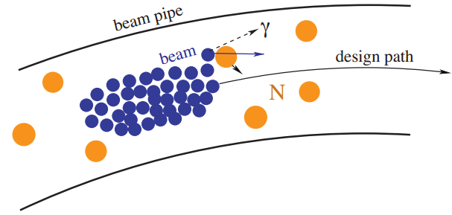
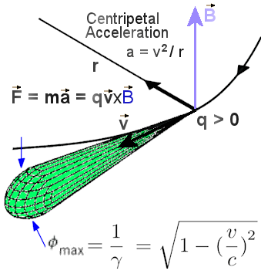
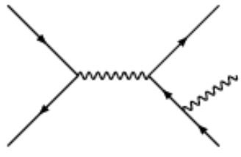
Beam Induced Backgrounds at CEPC
Beam-Gas
Scattering
IP1
Beamstrahlung
50 bunches
Revolution frequency: 5475.46 Hz
$3.7×{10}^{11}$ particles/Bunch
L: $2×{10}^{34}{cm}^{−2}s^{−1}$
Beam Lost Particles
Energy Loss > 2%
IP3
Synchrotron Radiation
Radiative Bhabha

Slide 15
Procedures for Background Simulation
By Qinglei Xiu, Sha Bai, Yiwei Wang, Dou Wang, Hongbo Zhu, Zhongjian Ma
All kinds of beam induced backgrounds will firstly be simulated by proper generators
Background particles will be tracked in the accelerator (SAD) and the detector (Geant4 & Fluka)
SAD: Strategic Accelerator Design
Extract hit information and analysis the results
Generate primary particles (Generators)
Tracking in the accelerator
(SAD)
Tracking and interaction in the detector (Geant4 & Fluka)
Analysis (Marlin)

Slide 16
Tolerable Hit Density for the Vertex Detector
Required occupancy of vertex detector: ~ a few %
Assuming
Pixel pitch: $25 μm$
Average cluster size: 4
Occupancy: 1% (Pre-CDR)
Tolerable hit density: less than a few tens ~ a few hundreds [${Hits}/{{{cm}^{2}}/{BX}}$]
 | Time Spacing [$μs$] | Hit Density Readout Time [${Hits}/{{{cm}^{2}}/{BX}}$] [$μs$] No. of Bunch | 5 | 10 | 20 | 30
Pre-CDR | 3.6 | 50 | 288 | 144 | 72 | 48
H-high lumi | 0.6 | 555 | 48.05 | 24.02 | 12.01 | 8.01
H-low power | 1.0 | 333 | 80.08 | 40.04 | 20.02 | 13.35
 | 1.58 | 211 | 126.38 | 63.19 | 31.60 | 21.06
W | 0.33 | 1000 | 26.67 | 13.33 | 6.67 | 4.44
Z | 0.02 | 16666 | 1.60 | 0.80 | 0.40 | 0.27
 | 0.0051 | 65716 | 0.41 | 0.20 | 0.10 | 0.07

Slide 17
Backgrounds Level of Single Ring Scheme
Background type | Simulation software | Sub-type | Particle flux at VTX [${cm}^{−2}{BX}^{−1}$] | Particle energy [GeV] | Priority
Synchrotron radiation | Geant4; BDSIM | Dipole | ~ ${10}^{10}$ | ~ 0.001 | ★★★
 |  | Quadrupole | ~ ${10}^{6}$ | ~ 0.007
Beam lost particles | BBBrem; SAD | Radiative Bhabha | ~ 10 | ~ 120 | ★★
 |  | Beam Gas Scattering | ↑ | ↑
Beamstrahlung | Guinea-Pig++; PYTHIA6 | Pairs | ~ ${10}^{−2}$ | ~ 0.05 | ★
 |  | Hadrons | ~ ${10}^{−5}$ | ~ 2
Backgrounds level of the single ring scheme without shielding
A very preliminary version of machine lattice
The synchrotron radiation level is too high
To suppress the background level
Insert shielding and collimator
Improve the machine design to reduce the SR power at IR

Slide 18
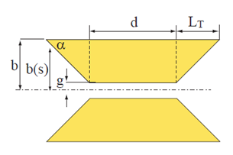
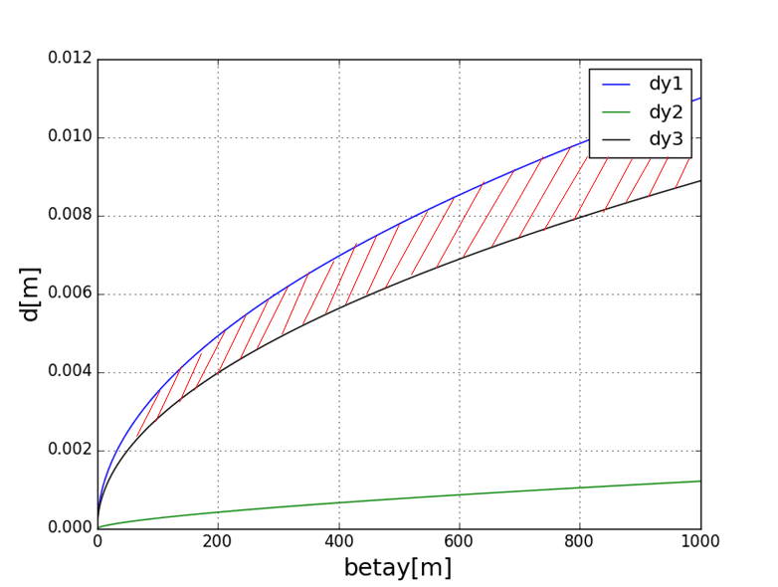
Preliminary Design of Collimators
Shape and Material
Trapezium
Tungsten
Position and Aperture $d_{c}$
Shielding efficiency →Upper limit
TMCI (Transverse mode coupling instability) → Lower limit
Vertical injection → Lower limit
Will study more limitations
Vertical
Feasible Region
$$r_{IP}=12mm$$
Upper Limit:
TMCI:
Injection:

Slide 19
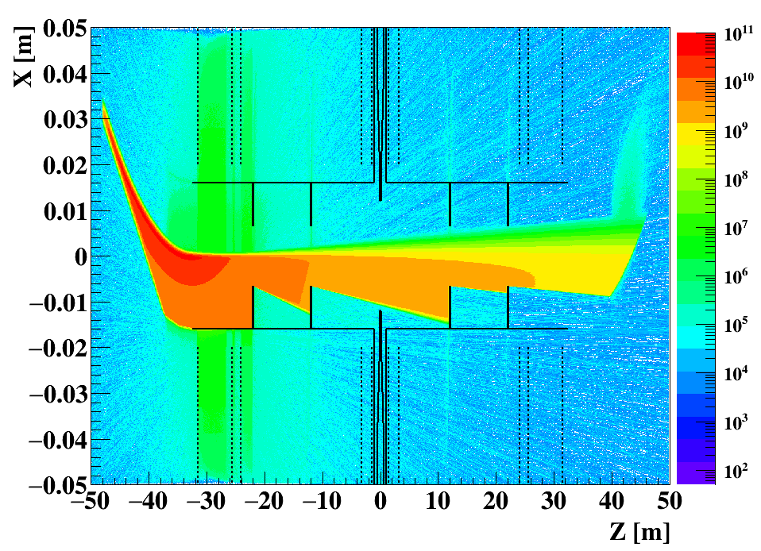
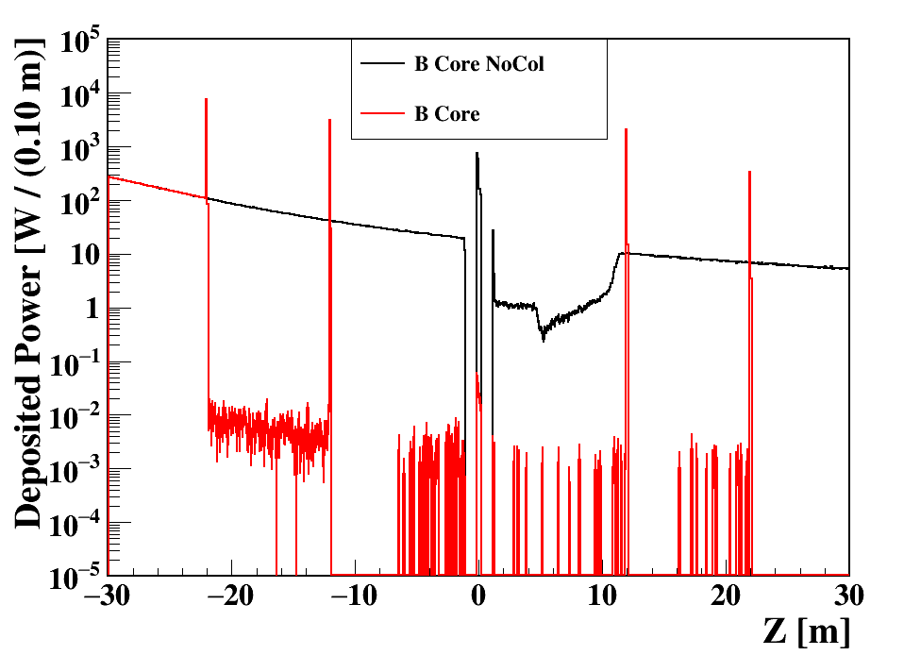
Synchrotron Radiation from the Last Dipole
The synchrotron radiation are generated and simulated by the model embedded in Geant4
Collimators for synchrotron radiation from dipole are designed
Material: Tungsten
Thickness: 10 cm
The synchrotron radiation can be suppressed by the factor of ${10}^{4}$
Critical energy: ~ 1 MeV

Slide 20
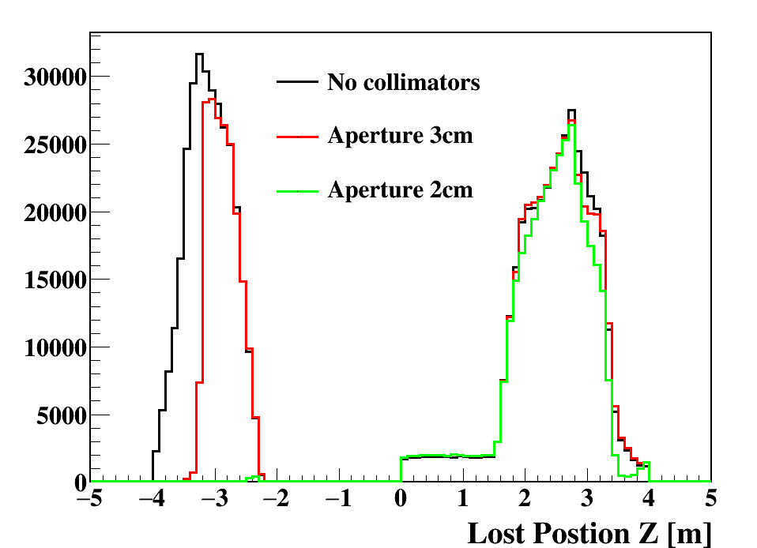
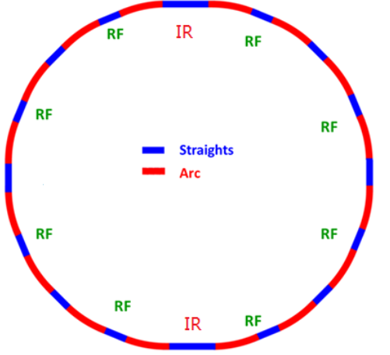
Lost Particles (Radiative Bhabha)
Energy acceptance: 2%
Tracking particles with SAD (Strategic Accelerator Design)
Add collimators to stop lost particles before they enter the IR

Slide 21
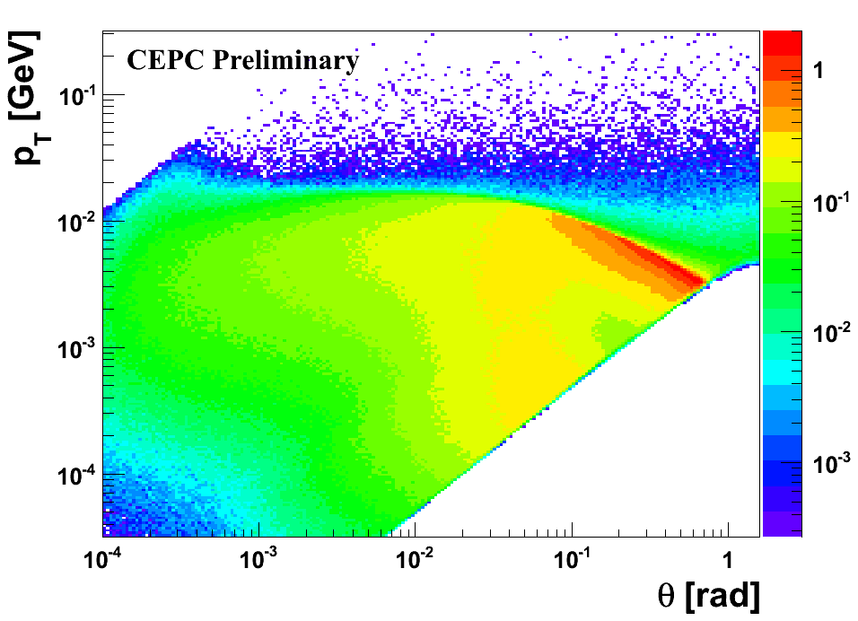
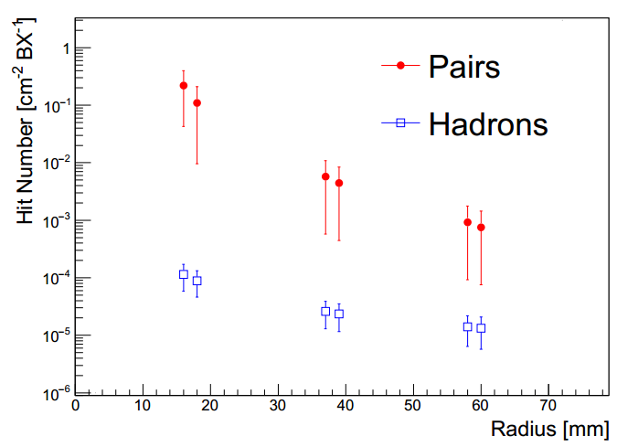
Beamstrahlung
Symbol | LEP2 | CEPC | ILC 250GeV
Ecm [GeV] | 209 | 240 | 250
N [$×{10}^{10}$] | 58 | 37.1 | 2
$$σ_{x} /{ σ}_{y}\text{ [}nm\text{]}$$ | 270000/3500 | 73700 / 160 | 729 / 7.7
$$σ_{z} [μm]$$ | 16000 | 2260 | 300
$$β_{x} /{ β}_{y}\text{ [}mm\text{]}$$ | 1500/50 | 800 / 1.2 | 13 / 0.41
$${γε}_{x} /{ γε}_{y}$$ $$\text{[}mm∙mrad\text{]}$$ | 9.81/0.051 | 1594.5 / 4.79 | 10 / 0.035
$$\left\langle Υ\right\rangle$$ | 2.5e-5 | 4.7e-4 | 0.02
Characterized by: $\left\langle Υ\right\rangle =\frac{5}{6}\frac{Nr_{e}^{2}γ}{α(σ_{x}+σ_{y})σ_{z}}$
The effects of beamstrahlung at CEPC should be much smaller than ILC
Secondary particles of beamstrahlung are generated by Guinea-Pig++

Slide 22
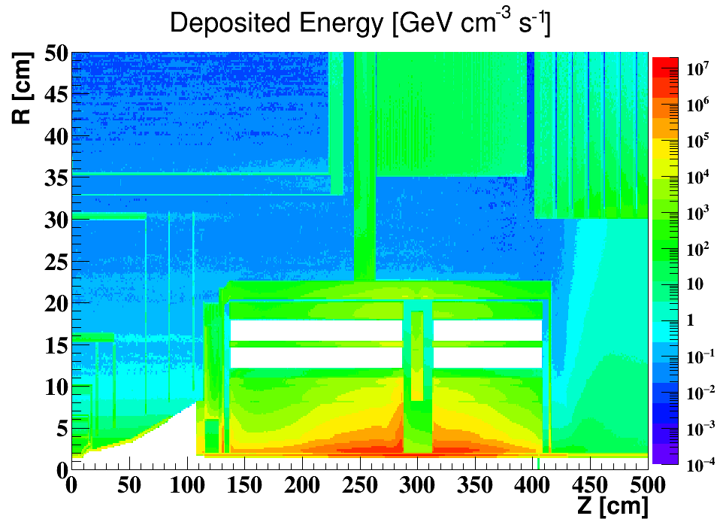
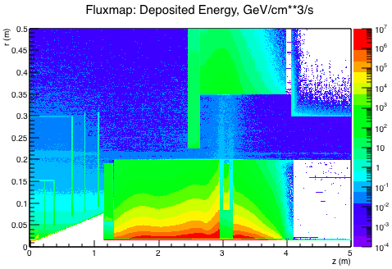
Compare between Geant4 and Fluka
By Yanli Jin, Yin Xu, Manqi Ruan
Geant4
Fluka
The radiation level in the detector have been evaluated with both Geant4 and Fluka
The results of the 2 software are roughly consistent with each other
The geometry setup are slightly different in above plots
Use Geant4 to evaluate hit density and Fluka to evaluate radiation dose

Slide 23
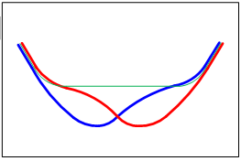
Improve the Lattice Design of IR
The synchrotron radiation has been considered in the IR design of double ring scheme
Weaker dipoles at the upstream of IR to reduced the synchrotron radiation power
The backscattered backgrounds at the downstream need be carefully evaluated

Slide 24
Summary
The mutual influences between machine and detector have been evaluated.
The L* of CEPC is set as 1.5 m to achieve the required luminosity.
The compensating solenoid and the screening solenoid are designed to shielding the detector solenoid field
Beam induced backgrounds of CEPC have been evaluated. Useful software and tools were developed
The error of luminosity measurement has been studied
The mechanical support has been preliminary studied
The shielding and collimators need be further studied.
The beam pipe and hardware of LumiCal haven’t been studied

Slide 25
Thanks

