Slide 1
Comparison of the final focus design
Yiwei Wang, Sha Bai, Dou Wang
CEPC AP meeting, 17 Feb 2017

Slide 2
Outline
Functions and requirements of final focus design
Related parameters
Linear lattice design and lowest order correction
High order correction
IR layout
Summary

Slide 3
Functions and requirements of final focus design
Provide small beam sizes at the interaction point (IP)
The large chromaticity generated by the final doublet (FD) must be compensated locally in order to achieve a large momentum acceptance of 2% for the whole ring
Crab-waist sextupole to control synchrotron-betatron resonance
The solenoid field from the detector compensated to minimize its perturbation on the beam motion
The size of the accelerator equipment inserted into the detector should be constrained to provide the largest possible angular acceptance for the detector
The beam-induced background should be acceptable for the detector
Compatible for different engergy operation

Slide 4
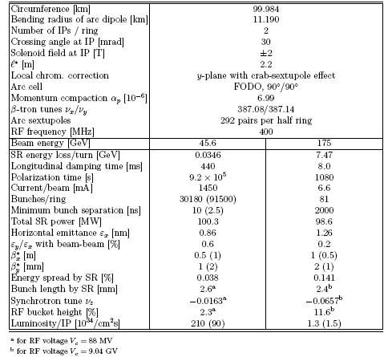
Related parameters (FCC-ee)

Slide 5
Related parameters (CEPC-DR)
D. Wang, 20161202-100km
 | Pre-CDR | H-high lumi. | H-low power | W | Z
Number of IPs | 2 | 2 | 2 | 2 | 2 | 2
Energy (GeV) | 120 | 120 | 120 | 80 | 45.5 | 45.5
Circumference (km) | 54 | 100 | 100 | 100 | 100 | 100
SR loss/turn (GeV) | 3.1 | 1.67 | 1.67 | 0.33 | 0.034 | 0.034
Half crossing angle (mrad) | 0 | 15 | 15 | 15 | 15 | 15
Piwinski angle | 0 | 2.9 | 2.9 | 3.57 | 5.69 | 5.69
N_{e}/bunch (10¹¹) | 3.79 | 0.97 | 0.97 | 1.05 | 0.46 | 0.46
Bunch number | 50 | 644 | 425 | 1000 | 10520 | 65716
Beam current (mA) | 16.6 | 29.97 | 19.8 | 50.6 | 232.1 | 1449.7
SR power /beam (MW) | 51.7 | 50 | 33 | 16.7 | 8.0 | 50
Bending radius (km) | 6.1 | 11 | 11 | 11 | 11 | 11
Momentum compaction (10⁻⁵) | 3.4 | 1.3 | 1.3 | 3.1 | 3.3 | 3.3
β_{IP} x/y (m) | 0.8/0.0012 | 0.144 /0.002 | 0.144 /0.002 | 0.1 /0.001 | 0.12/0.001 | 0.12/0.001
Emittance x/y (nm) | 6.12/0.018 | 1.56/0.0047 | 1.56/0.0047 | 2.68/0.008 | 0.93/0.0049 | 0.93/0.0049
Transverse σ_{IP} (um) | 69.97/0.15 | 15/0.097 | 15/0.097 | 16.4/0.09 | 10.5/0.07 | 10.5/0.07
ξ_{x}/ξ_{y}/IP | 0.118/0.083 | 0.0126/0.083 | 0.0126/0.083 | 0.0082/0.055 | 0.0075/0.054 | 0.0075/0.054
RF Phase (degree) | 153.0 | 131.2 | 131.2 | 149 | 160.8 | 160.8
V_{RF} (GV) | 6.87 | 2.22 | 2.22 | 0.63 | 0.11 | 0.11
f _{RF} (MHz) (harmonic) | 650 | 650 (217800) | 650 (217800) | 650 (217800) | 650 (217800)
Nature σ_{z} (mm) | 2.14 | 2.72 | 2.72 | 3.8 | 3.93 | 3.93
Total σ_{z} (mm) | 2.65 | 2.9 | 2.9 | 3.9 | 4.0 | 4.0
HOM power/cavity (kw) | 3.6 (5cell) | 0.64 (2cell) | 0.42 (2cell) | 1.0 (2cell) | 1.0 (1cell) | 6.25(1cell)
Energy spread (%) | 0.13 | 0.098 | 0.098 | 0.065 | 0.037 | 0.037
Energy acceptance (%) | 2 | 1.5 | 1.5
Energy acceptance by RF (%) | 6 | 2.2 | 2.2 | 1.5 | 1.1 | 1.1
n_{γ} | 0.23 | 0.26 | 0.26 | 0.26 | 0.18 | 0.18
Life time due to beamstrahlung_cal (minute) | 47 | 52 | 52
F (hour glass) | 0.68 | 0.95 | 0.95 | 0.84 | 0.91 | 0.91
L_{max}/IP (10³⁴cm⁻²s⁻¹) | 2.04 | 3.1 | 2.05 | 4.08 | 11.36 | 70.97

Slide 6
Linear lattice design and lowest order correction (FCC-ee)

Slide 7
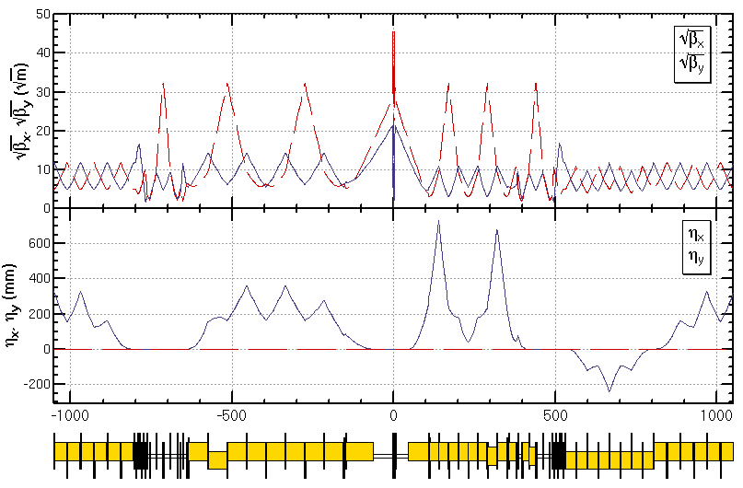
Linear lattice design and lowest order correction (CEPC-DR)
L*= 1.5m
βx*= 0.144mm
βy*= 2mm
GQD0= -200T/m
GQF1= 200T/m
LQD0=1.69m
LQF1=0.90m
IR of IP upstream
Ec < 100 keV within 280m
IR of IP downstream
Ec < 500 keV within 200m
Notes:
New IR bends

Slide 8
High order correction
all 3rd and 4th RDT due to sextupoles almost cancelled
up to 3rd order chromaticity corrected with main sextupoles, phase tuning and additional sextupoles
tune shift dQ(Jx, Jy) due to finite length of main sextupoles corrected with additional weak sextupoles
Break down of –I, high order dispersion could be optimized with odd dispersion scheme or Brinkmann sextupoles

Slide 9
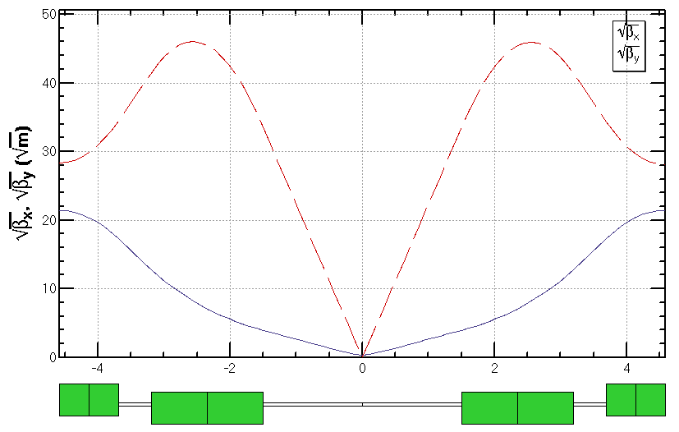
IR layout
L*= 1.5m
βx*= 0.144mm
βy*= 2mm
GQD0= -200T/m
GQF1= 200T/m
LQD0=1.69m
LQF1=0.90m

Slide 10
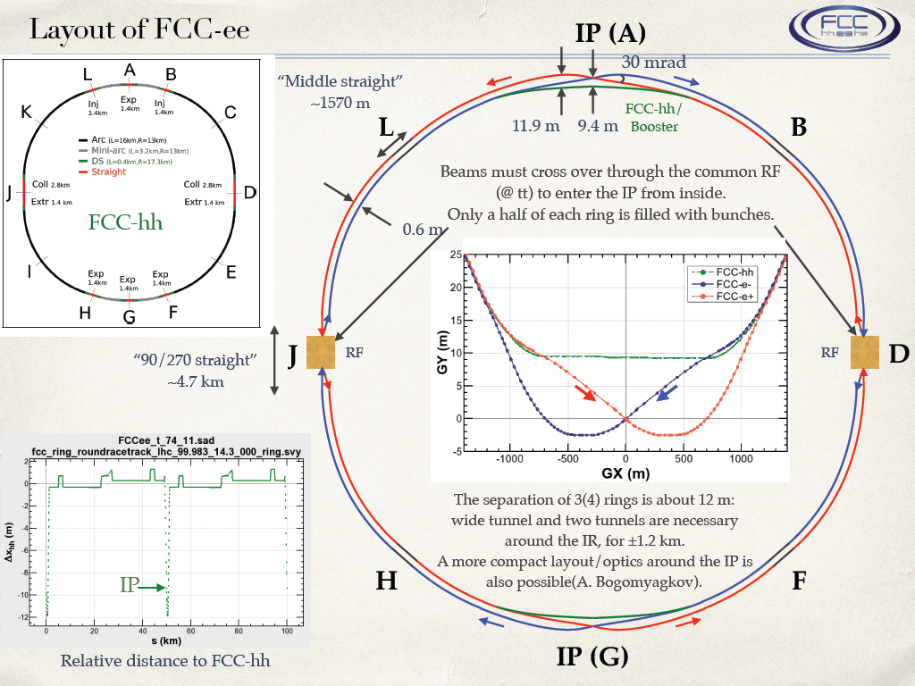
Geometry of whole ring

Slide 11
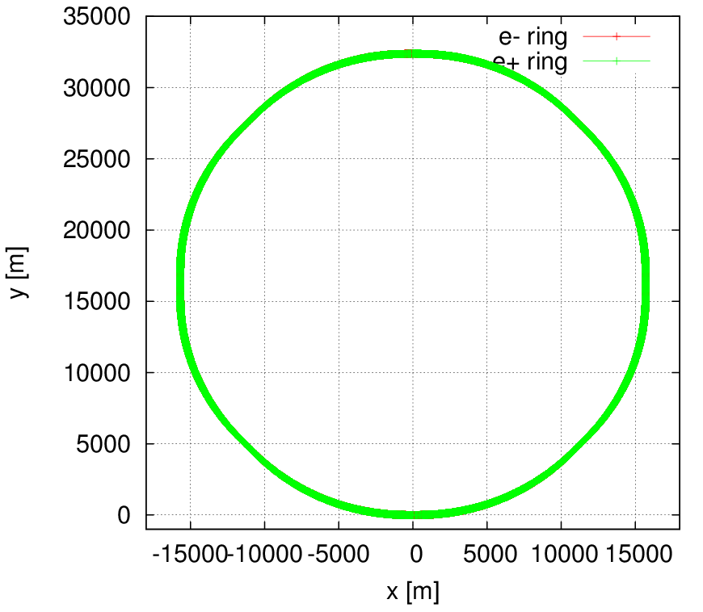
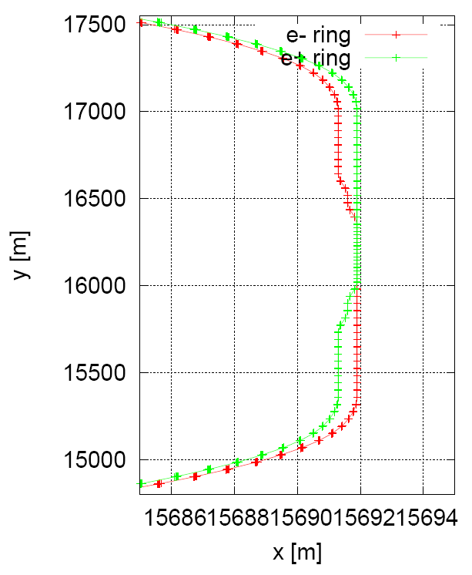
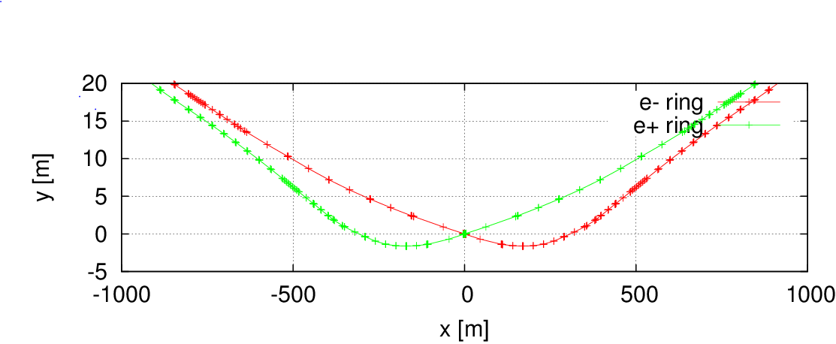
Geometry of whole ring
Length=100624.25 m
Qx=307.08
Qy=307.22
εx=1.8 nm
IP1
IP3
L*= 1.5 m
βx*= 0.144 mm
βy*= 2 mm
crossing angle=30 mrad

Slide 12
Summary
Machine | Parameters | Requirements on FFS design | Features of FFS lattice | Reference
CEPC-DR) | E=120GeV L*=1.5m β*=0.144m/2mm ε=1.56nm κ=0.3% Bz=3.5T θc=30mrad | Local chromaticity correction Gradient of FD ≤ 200 T/m SR from the dipoles within 280 m upstream of the IP Eγ,c ≤ 100 keV. | Dedicated region for Crab waist sextupole Asymmetrical IR lattice with large number of ARC sextupoles and Brinkmann sextupoles to optimize momentum acceptance | Y. Wang, HKUST, IAS 2017
FCC-ee | E=175GeV L*=2.2m β*=1m/2mm ε=1.26nm κ=0.2% Bz=2T θc=30mrad | Local chromaticity correction Gradient of FD ≤ 100 T/m SR from the dipoles within 500 m upstream of the IP Eγ,c ≤ 100 keV. | Combined crab waist and chromaticity correction sextupole Asymmetrical IR lattice with large number of ARC sextupoles to optimize momentum acceptance | K. Oide, ICHEP 2016

Slide 13
Reserved

Slide 14
Machine | Author | Parameters | Requirements on FFS design | Features of FFS lattice | Reference
CEPC (PDR) | Dou Wang | L*=1.5m β*=0.25/0.00136 ε=2.45 κ=0.3% Bz=3.5T θc=30mrad | Local chromaticity correction Gradient of FD ≤ 200 T/m SR from the dipoles within 500 m from IP Eγ,c ≤ 190 keV. | Crab waist collision Anti-symmetrical IR lattice need multipoles to correct chromaticity order by order need large number of ARC sextupoles to optimize momentum acceptance | D. Wang, IPAC16, THPOR010
CEPC (SR) | Yiwei Wang | L*=1.5m β*=0.8m/3mm ε=6.12nm κ=0.3% Bz=3.5T θc=0 | Local chromaticity correction Gradient of FD ≤ 300 T/m | Head on collision Symmetrical IR lattice with Brinkmann sextupoles to optimize momentum acceptance | Y. Wang, IPAC16, THPOR012
FCC-ee | Katsunobu Oide | L*=2.2m β*=1m/2mm ε=1.26nm κ=0.2% Bz=2T θc=30mrad | Local chromaticity correction Gradient of FD ≤ 100 T/m SR from the dipoles within 500 m upstream of the IP Eγ,c ≤ 100 keV. | Crab waist collision Asymmetrical IR lattice with large number of ARC sextupoles to optimize momentum acceptance | K. Oide, IPAC16, THPOR022
FCC-ee | Anton Bogomyagkov | L*=2.0m β*=0.5m/1mm ε=2.1nm κ=0.2% Bz=? θc=26mrad | Local chromaticity correction Gradient of FD ≤ 100 T/m SR from the dipoles within 250 m from IP Eγ,c ≤ 100 keV. | Crab waist collision Asymmetrical IR lattice With additional sextupoles to correct chromaticity up to 3rd order | A. Bogomyagkov et. al., IPAC16, THPOR019
a Higgs factory | Yunhai Cai | L*=4.0m β*=0.2m/2mm ε=4.5nm κ=0.1% Bz=? θc=0 | Local chromaticity correction | Head on collision Symmetrical IR lattice with multipoles to correct chromaticity order by order | Y. Cai, Lattice for a Higgs Factory, FCC Week 2016

Slide 15
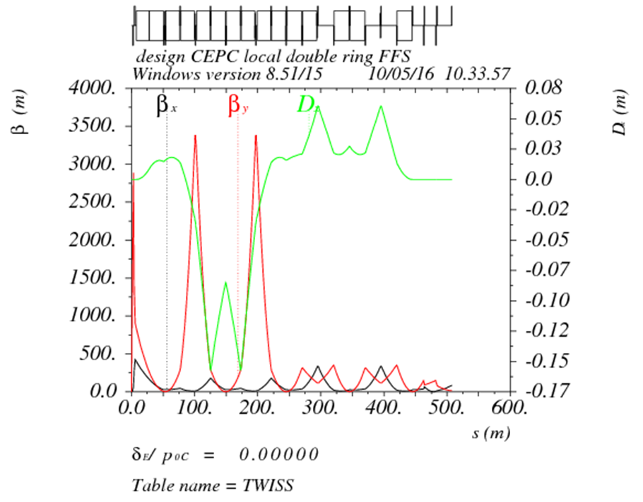
CEPC (PDR)
by Dou Wang*
Table: Key Parameters of the Interaction Region for CEPC Partial double ring Scheme
parameters | H-high lumi. | H-low power
Number of IPs | 2
Energy (GeV) | 120
L* (m) | 1.5
crossing angle (mrad) | 30
Emittance x/y (nm) | 2.45/0.0074 | 2.06 /0.0062
β_{IP} x/y (m) | 0.25/0.00136 | 0.268 /0.00124
Nature σ_{z} (mm) | 3.1 | 3.0
Energy spread (%) | 0.13 | 0.13
L_{max}/IP (10³⁴cm⁻²s⁻¹) | 2.96 | 2.01
*D. Wang et al., IPAC16, THPOR010

Slide 16
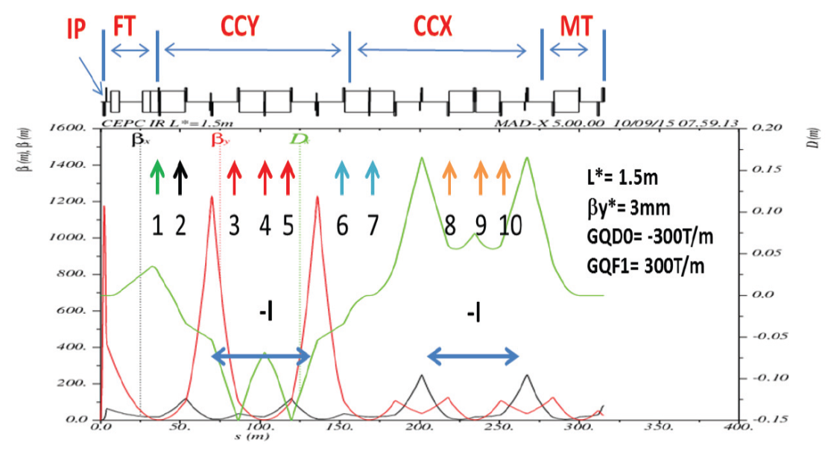
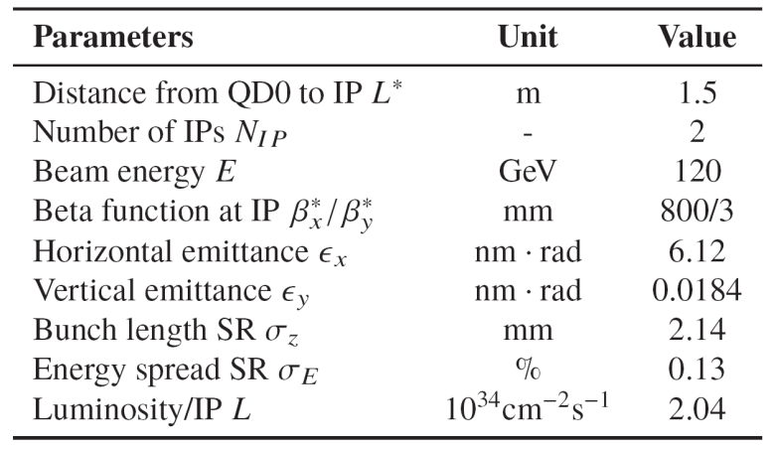
CEPC (SR)
by Yiwei Wang*
Table: Key Parameters of the Interaction Region for CEPC Single Ring Scheme
Figure: Optics of the interaction region for CEPC Single Ring Scheme @H
*Y. Wang, IPAC16, THPOR012

Slide 17
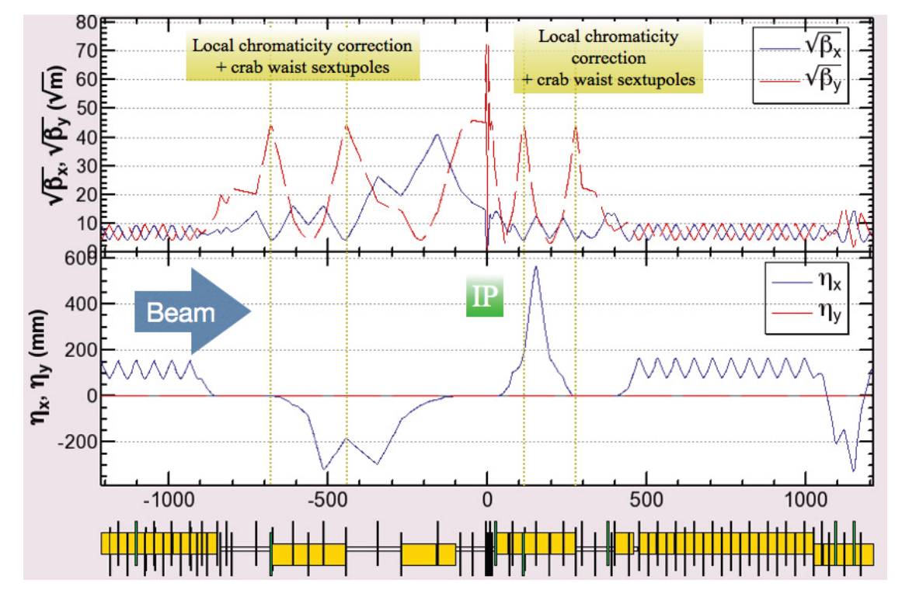
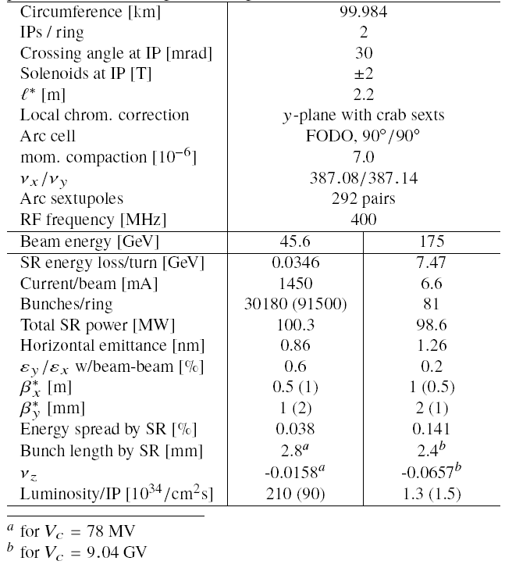
FCC-ee
by Katsunobu Oide*
Table: Parameters of FCC-ee
Figure: Optics of the interaction region for FCC-ee @tt
*K. Oide, IPAC16, THPOR022

Slide 18
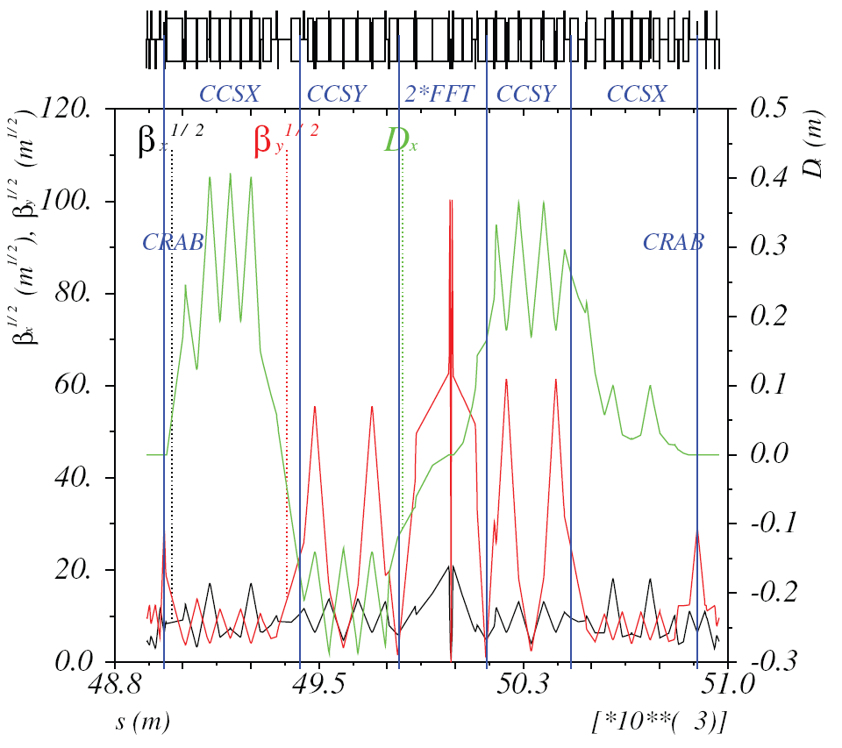
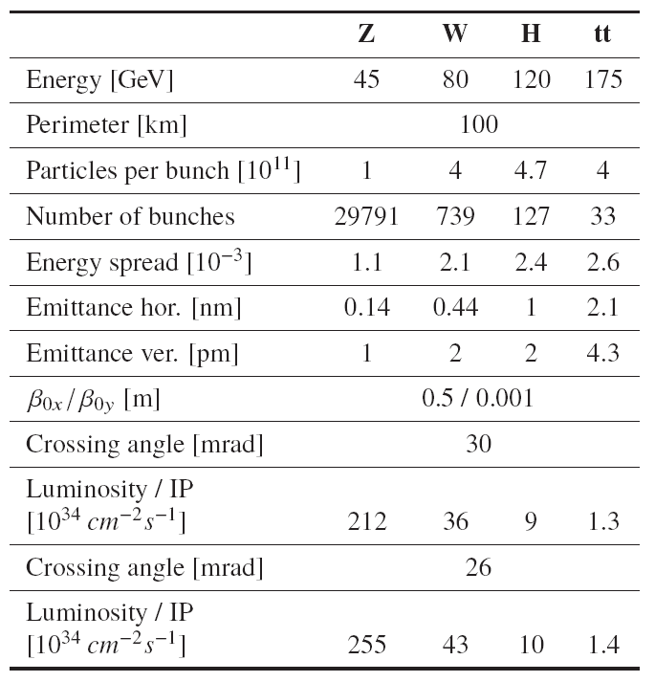
FCC-ee
by Anton Bogomyagkov*
Table: Parameters of FCC-ee
Figure: Optics of the interaction region for FCC-ee @tt
IR lattice should satisfy several requirements:
1. must fit hadron collider tunnel 100 km long,
2. two interaction points (defined by FCC-hh and price),
3. vertical emittance is less or equal than 1 pm at 45 GeV,
4. horizontal emittance is 1-2 nm at 175 GeV,
5. energy acceptance ±2%,
6. SR from the dipoles within 250 m from IP should have
critical energy Eγ,c ≤ 100 keV.
*A. Bogomyagkov et. al., IPAC16, THPOR019

Slide 19
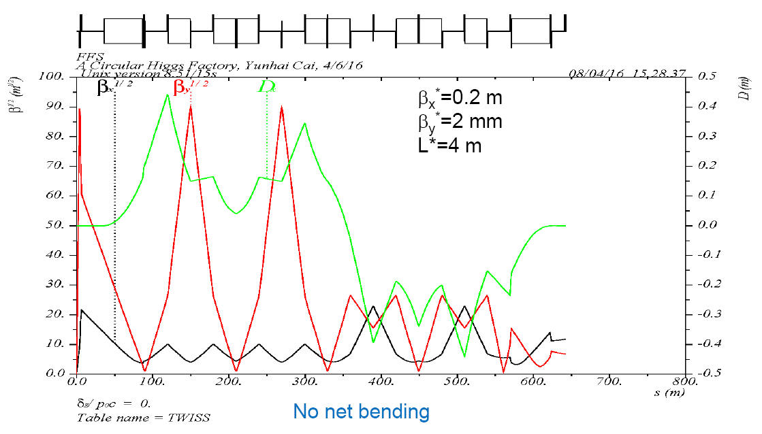
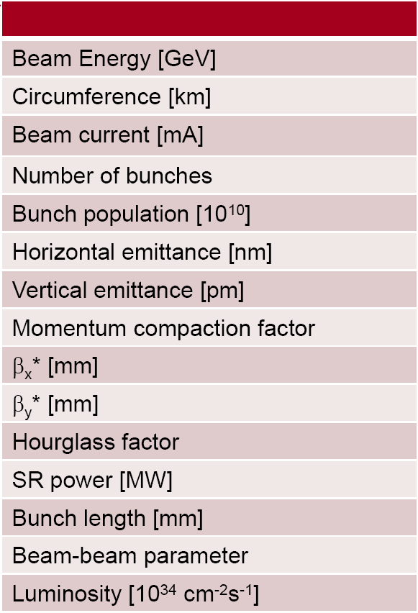
A Higgs factory
by Yunhai Cai*
Table: Parameters for a Higgs factory
Figure: Optics of the interaction region for a Higgs Factory @H
*Lattice for a Higgs Factory, FCC Week 2016

Slide 20
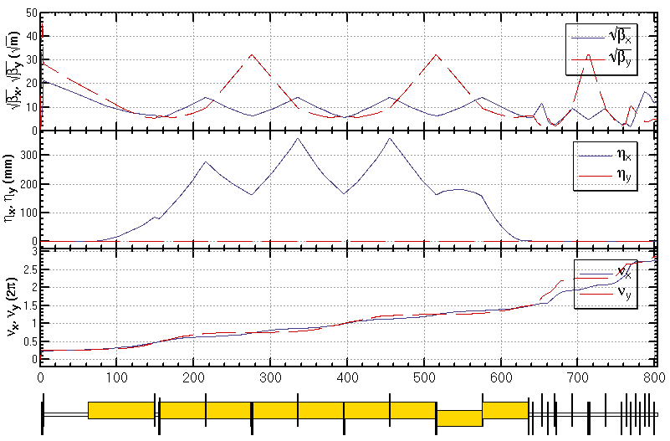
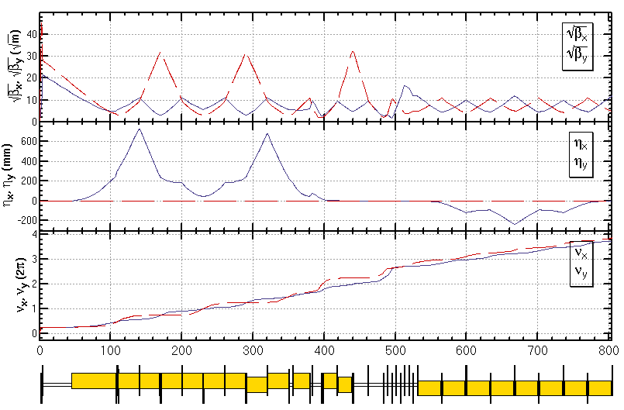
Linear lattice design and lowest order correction (CEPC-DR)
L*= 1.5m
βx*= 0.144mm
βy*= 2mm
GQD0= -200T/m
GQF1= 200T/m
LQD0=1.69m
LQF1=0.90m
IR of IP upstream
Ec < 100 keV within 280m
IR of IP downstream
Ec < 500 keV within 200m
Notes:
New IR bends

