Slide 1
Parameter Potential of 100km CEPC
Dou Wang, Chenghui Yu, Yuan Zhang, Jie Gao, Yiwei Wang, Feng Su, Sha Bai, Cai Meng, Chuang Zhang, Na Wang, Tianjian Bian, Huiping Geng
CEPC AP meeting, 2017.02.17

Slide 2
Parameter difference between CEPC and FCCee
 | CEPC | FCCee
N_{e}/bunch (10¹¹) | 0.97 | 0.8
Momentum compaction (10⁻⁵) | 1.3 | 0.7
β_{IP} x/y (m) | 0.144 /0.002 | 1/0.002
Emittance x/y (nm) | 1.56/0.0047 | 0.61/0.0012
Coupling factor (%) | 0.3 | 0.2
ξ_{x}/ξ_{y}/IP | 0.0126/0.083 | 0.08/0.14
V_{RF} (GV) | 2.22 | 3
f _{RF} (MHz) | 650 | 400
Nature σ_{z} (mm) | 2.72 | 2
Total σ_{z} (mm) | 2.9 | 2.4
Energy acceptance by RF (%) | 2.2 | 7.0
Energy acceptance requirement (%) | 1.5 | 2.0
L_{max}/IP (10³⁴cm⁻²s⁻¹) | 3.1 | 5.1

Slide 3
Constraints for parameter choice
Limit of Beam-beam tune shift
F_{l}: ξy enhancement by crab waist
Beam lifetime due to beamstrahlung
BS life time: 30 min
V.I. Telnov
Beamstrahlung energy spread
A=δ₀/δ_{BS} (A≥3)
HOM power per cavity (coaxial coupler)
*J. Gao, emittance growth and beam lifetime limitations due to beam-beam effects in e+e- storage rings, Nucl. Instr. and methods A533（2004）p. 270-274.

Slide 4
parameters for CEPC double ring （wangdou20161219-100km_1mmβy）
 | Pre-CDR | H-high lumi. | H-low power |  | W | Z
Number of IPs | 2 | 2 | 2 | 2 | 2 | 2 | 2
Energy (GeV) | 120 | 120 | 120 | 120 | 80 | 45.5 | 45.5
Circumference (km) | 54 | 100 | 100 | 100 | 100 | 100 | 100
SR loss/turn (GeV) | 3.1 | 1.67 | 1.67 | 1.67 | 0.33 | 0.034 | 0.034
Half crossing angle (mrad) | 0 | 15 | 15 | 15 | 15 | 15 | 15
Piwinski angle | 0 | 2.5 | 2.5 | 2.5 | 3.57 | 5.69 | 5.69
N_{e}/bunch (10¹¹) | 3.79 | 1.12 | 1.12 | 1.12 | 1.05 | 0.46 | 0.46
Bunch number | 50 | 555 | 333 | 211 | 1000 | 16666 | 65716
Beam current (mA) | 16.6 | 29.97 | 17.98 | 11.4 | 50.6 | 367.7 | 1449.7
SR power /beam (MW) | 51.7 | 50 | 30 | 19 | 16.7 | 12.7 | 50
Bending radius (km) | 6.1 | 11 | 11 | 11 | 11 | 11 | 11
Momentum compaction (10⁻⁵) | 3.4 | 0.96 | 0.96 | 0.96 | 3.1 | 3.3 | 3.3
β_{IP} x/y (m) | 0.8/0.0012 | 0.3/0.001 | 0.3/0.001 | 0.3 /0.001 | 0.1 /0.001 | 0.12/0.001 | 0.12/0.001
Emittance x/y (nm) | 6.12/0.018 | 1.01/0.0031 | 1.01/0.0031 | 1.01/0.0031 | 2.68/0.008 | 0.93/0.0049 | 0.93/0.0049
Transverse σ_{IP} (um) | 69.97/0.15 | 17.4/0.055 | 17.4/0.055 | 17.4/0.055 | 16.4/0.09 | 10.5/0.07 | 10.5/0.07
ξ_{x}/ξ_{y}/IP | 0.118/0.083 | 0.029/0.083 | 0.029/0.083 | 0.029/0.083 | 0.0082/0.055 | 0.0075/0.054 | 0.0075/0.054
RF Phase (degree) | 153.0 | 123.3 | 123.3 | 123.3 | 149 | 160.8 | 160.8
V_{RF} (GV) | 6.87 | 2.0 | 2.0 | 2.0 | 0.63 | 0.11 | 0.11
f _{RF} (MHz) (harmonic) | 650 | 650 | 650 | 650 | 650 (217800) | 650 (217800)
Nature σ_{z} (mm) | 2.14 | 2.72 | 2.72 | 2.72 | 3.8 | 3.93 | 3.93
Total σ_{z} (mm) | 2.65 | 2.9 | 2.9 | 2.9 | 3.9 | 4.0 | 4.0
HOM power/cavity (kw) | 3.6 (5cell) | 0.75(2cell) | 0.45(2cell) | 0.28(2cell) | 1.0 (2cell) | 1.6(1cell) | 6.25(1cell)
Energy spread (%) | 0.13 | 0.098 | 0.098 | 0.098 | 0.065 | 0.037 | 0.037
Energy acceptance (%) | 2 | 1.5 | 1.5 | 1.5
Energy acceptance by RF (%) | 6 | 1.8 | 1.8 | 1.8 | 1.5 | 1.1 | 1.1
n_{γ} | 0.23 | 0.26 | 0.26 | 0.26 | 0.26 | 0.18 | 0.18
Life time due to beamstrahlung_cal (minute) | 47 | 52 | 52 | 52
F (hour glass) | 0.68 | 0.83 | 0.83 | 0.83 | 0.84 | 0.91 | 0.91
L_{max}/IP (10³⁴cm⁻²s⁻¹) | 2.04 | 5.42 | 3.25 | 2.06 | 4.08 | 18.0 | 70.97

Slide 5
parameters for CEPC double ring （wangdou20161202-100km_2mmβy）
 | Pre-CDR | H-high lumi. | H-low power
Number of IPs | 2 | 2 | 2
Energy (GeV) | 120 | 120 | 120
Circumference (km) | 54 | 100 | 100
SR loss/turn (GeV) | 3.1 | 1.67 | 1.67
Half crossing angle (mrad) | 0 | 15 | 15
Piwinski angle | 0 | 2.9 | 2.9
N_{e}/bunch (10¹¹) | 3.79 | 0.97 | 0.97
Bunch number | 50 | 644 | 425
Beam current (mA) | 16.6 | 29.97 | 19.8
SR power /beam (MW) | 51.7 | 50 | 33
Bending radius (km) | 6.1 | 11 | 11
Momentum compaction (10⁻⁵) | 3.4 | 1.3 | 1.3
β_{IP} x/y (m) | 0.8/0.0012 | 0.144 /0.002 | 0.144 /0.002
Emittance x/y (nm) | 6.12/0.018 | 1.56/0.0047 | 1.56/0.0047
Transverse σ_{IP} (um) | 69.97/0.15 | 15/0.097 | 15/0.097
ξ_{x}/ξ_{y}/IP | 0.118/0.083 | 0.0126/0.083 | 0.0126/0.083
RF Phase (degree) | 153.0 | 131.2 | 131.2
V_{RF} (GV) | 6.87 | 2.22 | 2.22
f _{RF} (MHz) (harmonic) | 650 | 650 (217800) | 650 (217800)
Nature σ_{z} (mm) | 2.14 | 2.72 | 2.72
Total σ_{z} (mm) | 2.65 | 2.9 | 2.9
HOM power/cavity (kw) | 3.6 (5cell) | 0.64 (2cell) | 0.42 (2cell)
Energy spread (%) | 0.13 | 0.098 | 0.098
Energy acceptance (%) | 2 | 1.5 | 1.5
Energy acceptance by RF (%) | 6 | 2.2 | 2.2
n_{γ} | 0.23 | 0.26 | 0.26
Life time due to beamstrahlung_cal (minute) | 47 | 52 | 52
F (hour glass) | 0.68 | 0.95 | 0.95
L_{max}/IP (10³⁴cm⁻²s⁻¹) | 2.04 | 3.1 | 2.05

Slide 6
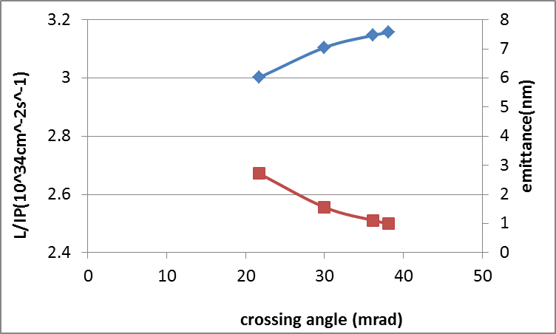
Luminosity vs. crossing angle
Keep beamstrahlung life time constant (52min)

Slide 7
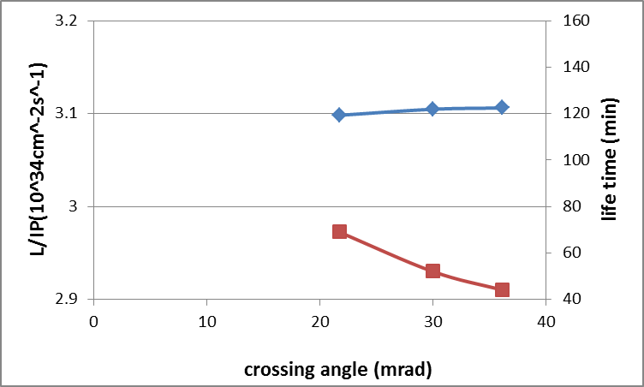
Luminosity vs. crossing angle
Keep emittance constant (1.56nm)

Slide 8
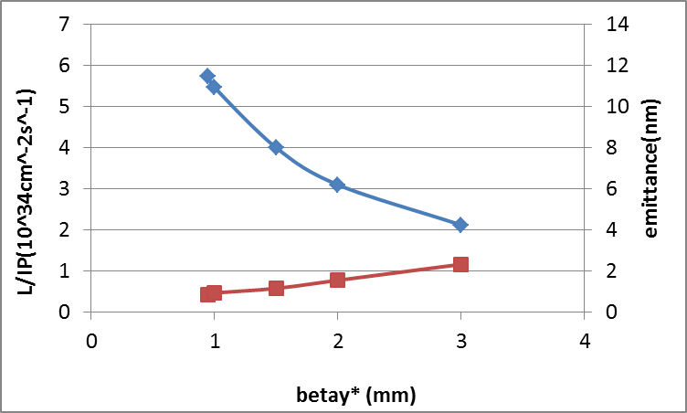
Luminosity vs. βy*
Keep beamstrahlung life time constant (52min)

Slide 9
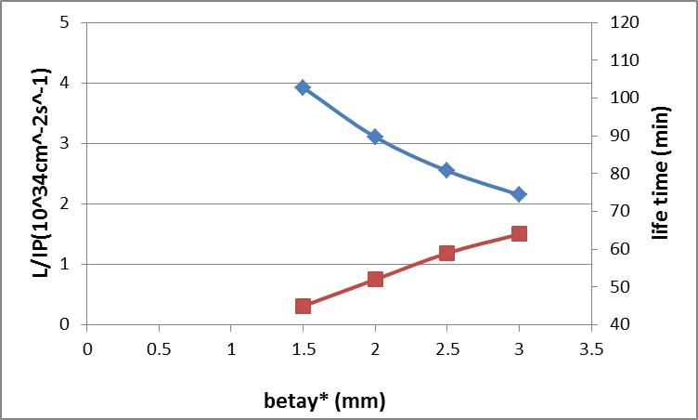
Luminosity vs. βy*
Keep emittance constant (1.56nm)

Slide 10
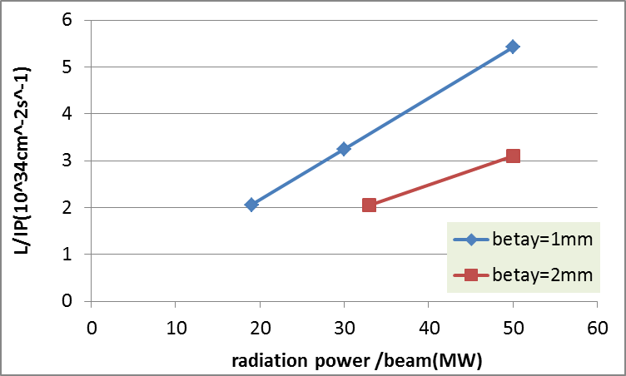
Luminosity vs. SR power
goal

