Slide 1
Question List for MDI

Slide 2
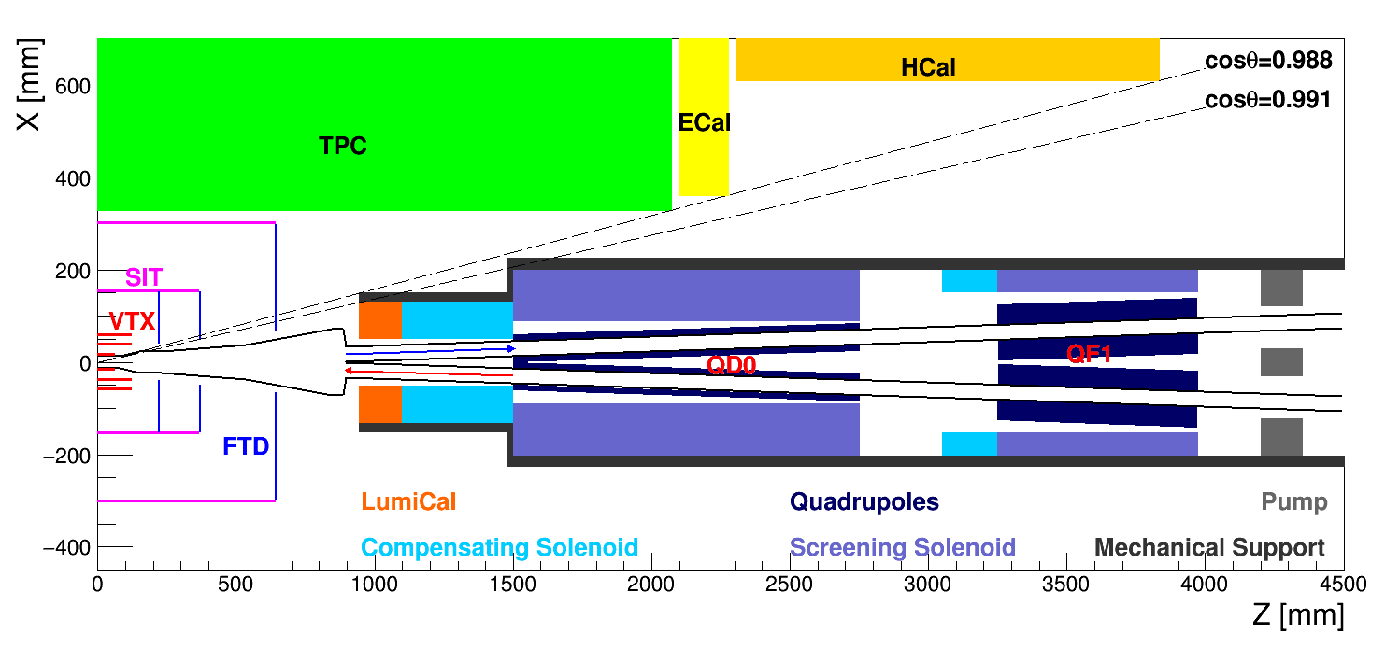
Proposed Layout of IR

Slide 3
Crucial Parameters of MDI
CS: compensating solenoid
SS: screening solenoid
L*
Radius of QD0+SS
Detector solenoid
Crossing angle
Radius of CS
Luminosity measure
Radius of beam pipe
Length of CS
Acceptance of detector
Technology
Acceptance of LumiCal
Support & shielding
What’s the relationship between these parameters?

Slide 4
If Larger L*
Machine
Detector
Lower luminosity
More space for IR
Easier for the design of screening solenoid
Acceptance of the detector could be increased
What’s the length of L*?

Slide 5
If Larger Crossing Angle
Machine
Detector
Higher luminosity
Radius of compensating solenoid and screen solenoid will be increased
Acceptance of the detector will be reduced
What’s the required crossing angle between two beams?
Could we credibly estimate the size and mass of the magnets with a certain technology

Slide 6
If Larger Radius of Beam Pipe
Machine
Detector
Radius of compensating solenoid and screen solenoid will be increased
Acceptance of the detector will be reduced
What’s the required radius and shape of beam pipe?

Slide 7
If Stronger Detector Solenoid
Machine
Detector
Reduce the luminosity by beam coupling
Stronger compensating solenoid to cancel the beam coupling
Fringe field will be more serious
Longer compensating solenoid
Better momentum resolution
Lower efficiency for low energy particles
Acceptance of the detector will be reduced
What’s the optimized strength of the detector solenoid magnetic field?
Could the detector solenoid be weaker at Z pole?
What’s the effects of the fringe field of compensating and screen solenoid?
Is there any other method to cancel the beam coupling?

Slide 8
If Higher Accuracy of the Luminosity Measurement
Machine
Detector
Stronger mechanical support
Larger size of LumiCal
Acceptance of the detector will be reduced
What’s the required accuracy of the luminosity measurement?
Could the luminosity be measured with the CEPC detector?
Bhabha events with large angle

Slide 9
If Larger Detector Acceptance
Machine
Detector
Space for IR is reduced
Higher forward detect efficiency
Might be helpful to discover rare events or new physics
What’s the required minimum acceptance of the detector?
What’s the required minimum space for IR design?

Slide 10
Relationship between the Parameters
Momentum resolution
Detect efficiency
Luminosity
Radius of CS
Length of CS
Detector solenoid
L*
Acceptance of detector
Technology
Radius of beam pipe
Acceptance of LumiCal
Crossing angle
Radius of QD0+SS
Support & shielding
Luminosity measure
How can we find a reasonable resolution?
Could we optimize the resolution?

Slide 11
Questions for Discussion
For the detector
What’s the strength of the detector solenoid at Higgs and Z pole
Could the detector solenoid be weaker at Z pole?
What’s the acceptance of the detector
What’s the required accuracy of the luminosity measurements
Could the luminosity be measured by the CEPC detector
For the accelerator
What’s the L* , crossing angle and radius of beam pipe
How to estimate the size and mass of the magnets with a certain technology
What’s the effects of the fringe field of the compensating and screening solenoid
Is there any other method to cancel the beam coupling
For both
How to find a solution of these parameters
How to optimize the solution

Slide 12
Questions for Future Study
For the mechanical support
What’s the deformation and vibration of the mechanical support
What’s the effects of the force between detector solenoid and anti-solenoid
For beam status
What’s the effects of HOM of the beam pipe
What’s the effects of errors from mechanical support

Slide 13
Thank You

Slide 14
Backup

Slide 15
Effect of the Detector Solenoid
Detector Solenoid $→$ Beam coupling$→ L↓$
Flat beam at CEPC
Coupling between horizontal and vertical betatron motion will increase the transverse beam size
To cancel the coupling: $∫B_{z}ds=0$
Before quadrupoles: $∫B_{z}ds=0$ (Compensating solenoid)
Inside quadrupoles: $B_{z}=0$ (Screening solenoid)
The length of the compensating solenoid is hoped to be as shorter as possible if the beam stability is satisfied
Designing a 13 T compensating solenoid with NbTi technology
By Yingshun Zhu, Weichao Yao
Detector Solenoid: 3.5T
$$∫B_{z}ds=0$$
$$B_{z}=0$$
L = 1m, B=5.25T
L = 0.7m, B=7.5T
Compensating
solenoid
QD0
Screening solenoid

Slide 16
Feedback
In the right plot, the $B_{z}$ inside screening solenoid is not 0.
The fringe field of 13T compensating solenoid will be too strong.
It will cause the emittance blow up at IR
${∆ε}_{y}=3.83×{10}^{−13}\frac{γ^{2}}{J_{y}}\frac{I_{5,IP}}{I_{2}}$
Detector Solenoid: 3.5T
$$∫B_{z}ds=0$$
$$B_{z}=0$$
L = 1m, B=5.25T
L = 0.7m, B=7.5T
Compensating
solenoid
QD0
Screening solenoid

Slide 17
$L$ & $L^{∗}$
$L$: Luminosity (${\sim 2×10}^{34}{cm}^{2}s^{−1}$)
$L=\frac{N_{e}^{2}n_{b}f_{0}}{4πσ_{x}^{∗}σ_{y}^{∗}}FH=\frac{γn_{b}I_{b}}{2er_{e}β_{y}^{∗}}ξ_{y}H$
$β_{y}^{∗}$: Vertical beta function at IP (~1.2mm)
$L^{∗}$: The distance from the IP to QD0
$β_{y}^{∗}=\frac{{L^{∗}}^{2}}{β_{y}}$
$β_{y}$: Vertical beta function at QD0
“To facilitate the design of the final focus, we chose $L^{∗}=1.5m$”
flat beam
Notes:
f0: revolution frequency. F=1: Luminosity reduction factor due to the crossing angle at IP. H: hourglass factor.

Slide 18
Relationship of the Parameters
L*
CS: compensating solenoid
SS: screening solenoid
Radius of QD0+SS
Crossing angle
Support & shielding
Radius of beam pipe
Radius of CS
Technology of magnet
Length of CS
Acceptance of detector
Detector solenoid
Acceptance of LumiCal
Luminosity measure
Increasing the detector solenoid and accuracy of luminosity measurement will decrease the acceptance of the detector

Slide 19
Relationship between the Parameters
CS: compensating solenoid
SS: screening solenoid
Radius of CS
Length of CS
Detector solenoid
L*
Acceptance of detector
Technology
Radius of beam pipe
Acceptance of LumiCal
Crossing angle
Radius of QD0+SS
Support & shielding
Luminosity measure
Increasing the detector solenoid and accuracy of luminosity measurement will decrease the acceptance of the detector

