Slide 1
Research on Charm Physics at Belle Review meeting for Sino-Japan Core-University Cooperative Program Changchun Zhang Institute of High Energy Physics, CAS 8 April 2009
Physics motivation at Belle/KEKB
Search for mixing
Search for exotic states via decays
Search for X(1835) and X(1812) states
Summary

Slide 2
Introduction
• Institutions and Members
• Institute of High Energy Phys. (IHEP)
• Peking University (PU)
• Univ. of Science and Tech. of China (USTC)
Institute | staff | Post-doc | graduate
IHEP | 3 | 1 | 1
PU | 1 |  | 2
USTC | 1 | 1 | 2
total | 5 | 2 | 5
• Funds (General) from NSFC : 220K RMB (2002-2004)
440K RMB (2006-2008)
• Funds (Innovation) from IHEP/CAS : 100K RMB (2001-2004)

Slide 3
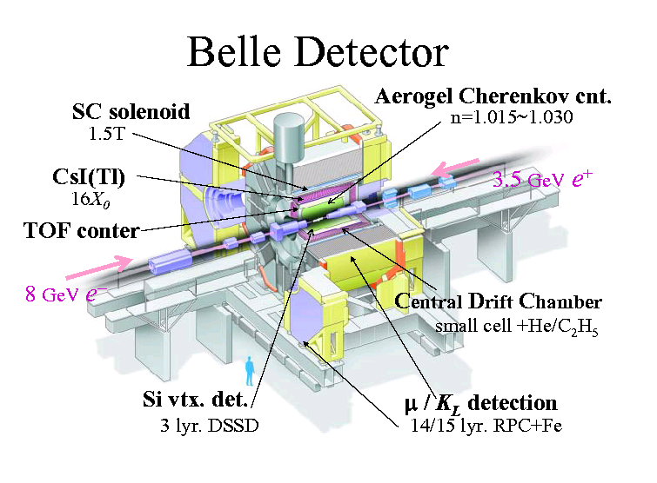
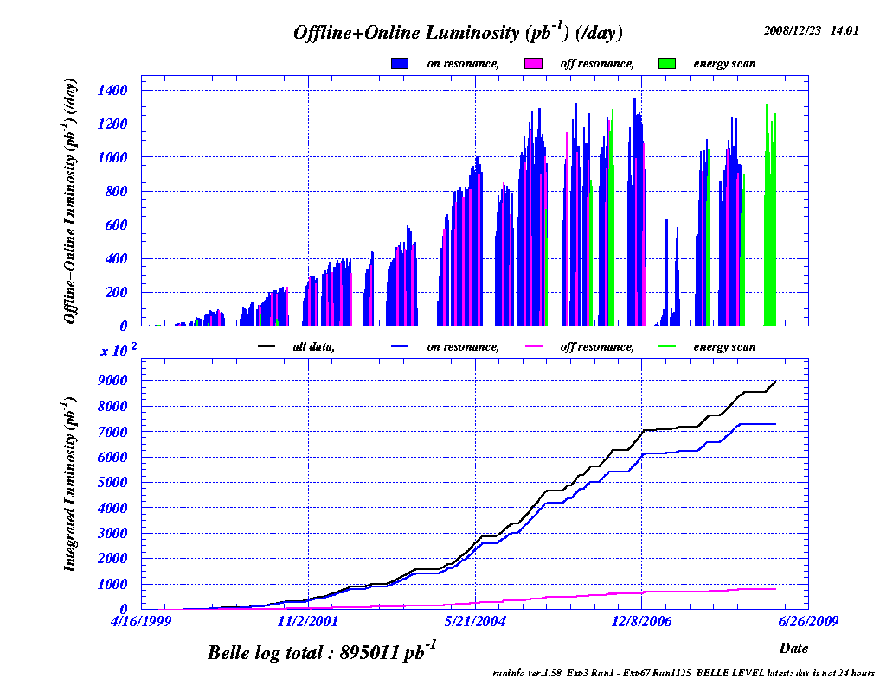
KEKB and Belle detector
Belle collected total integrated luminosity : > 894.8 fb⁻¹ till 2 Dec. 2008

Slide 4
Physics motivation
Search for mixing
Mixing between different flavor quarks had observed
in and ,
but not observed in till 2007.
SM : mixing is at ≤1% level，and
CPV in decay is at ≤0.1% .
New physics, if observed CP is at 1% level.

Slide 5
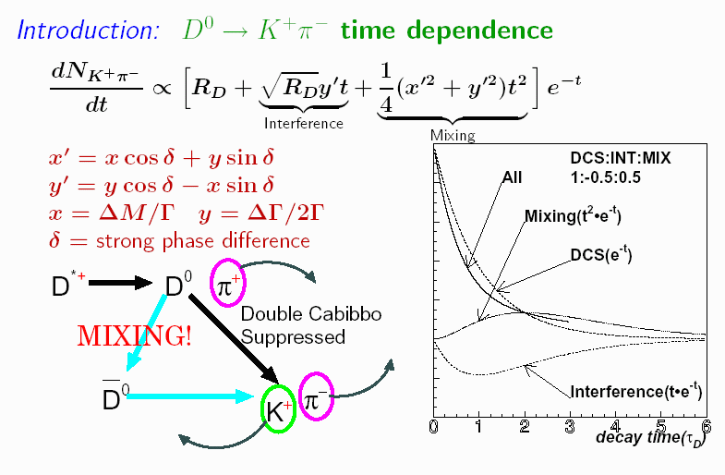
Search for mixing

Slide 6
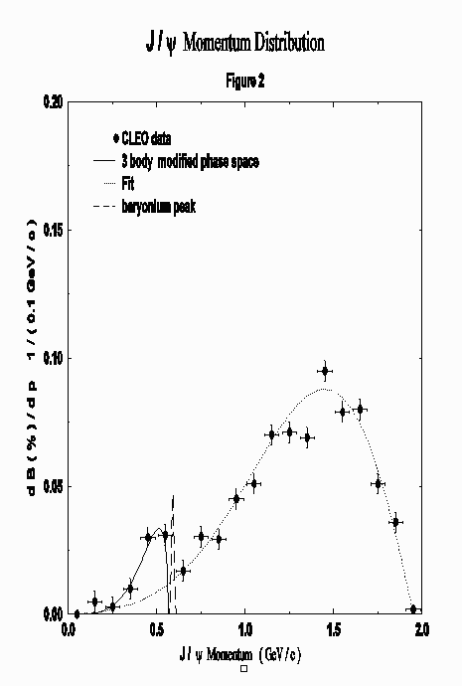
Physics motivation
Slow J/ψ bump observed by CLEO, and
confirmed by BaBar and Belle.
Search for source of the excess
from B decays.
Intrinsic charm inside
of B meson.
Intermediate exotic state in
decay
excited gluonic state in
decay
Search for new resonances X(1835) and X(1810), observed by BES

Slide 7
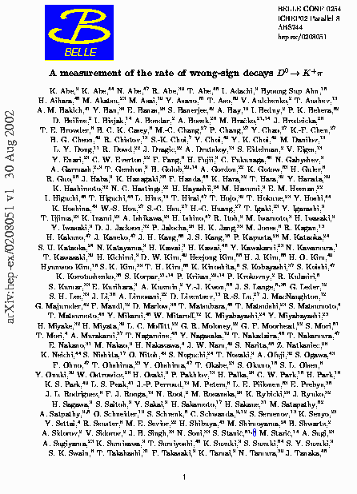
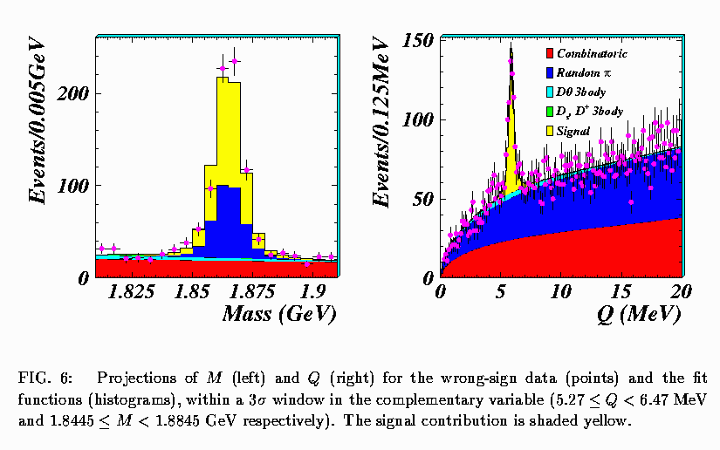
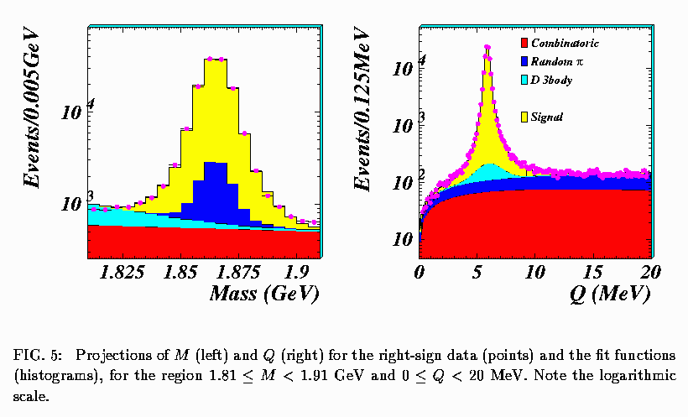
First talk on mixing
WS signal
• Ratio of WS (K⁺π ⁻) over RS (K⁻π⁺) is measured to be
Contribution paper to ICHEP2002
hep-ex/0208051, 30 Aug 2002
RS signal

Slide 8
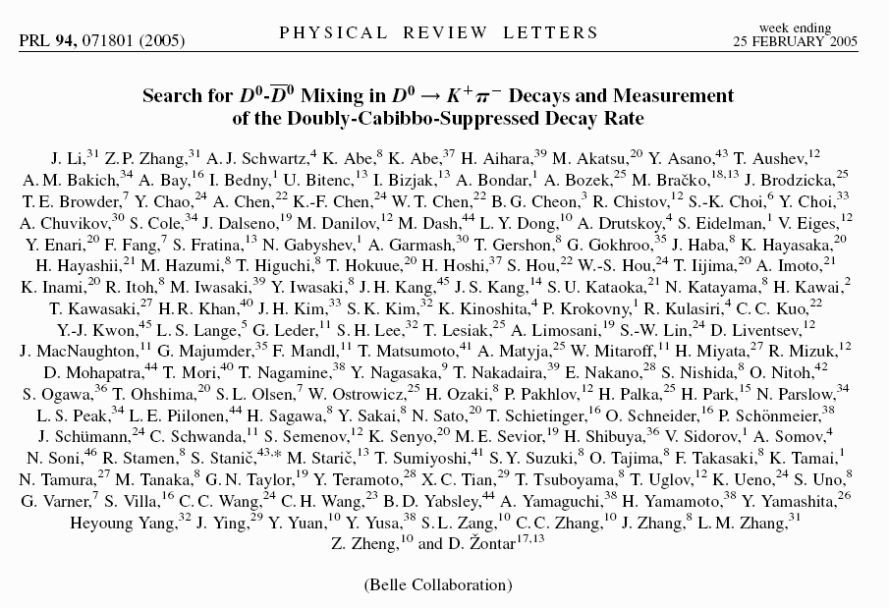
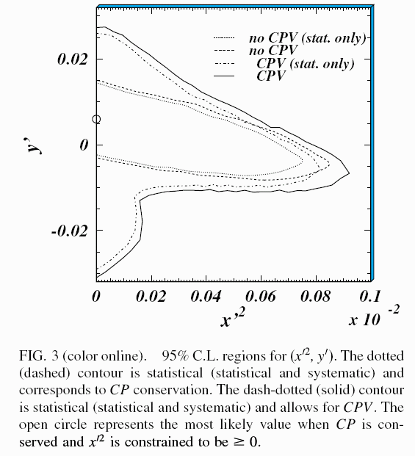
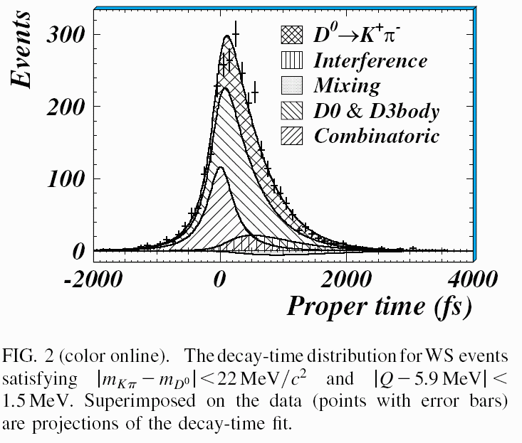
First paper on mixing
Phys Rev Lett 94, 071801 (2005)
Mixing

Slide 9
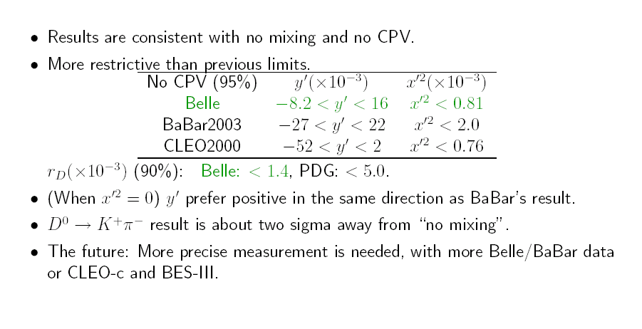
Search for mixing

Slide 10
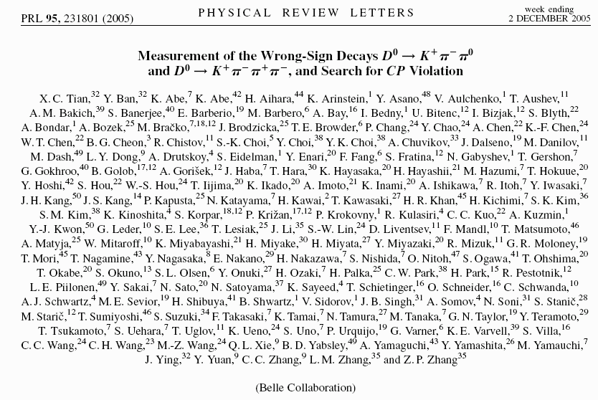
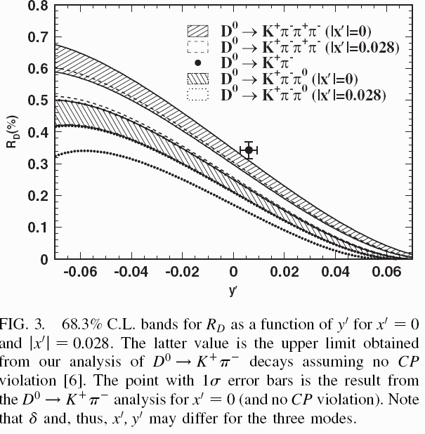
Search for mixing
Phys Rev Lett 95, 231801 (2005)
No CP violation is observed.

Slide 11
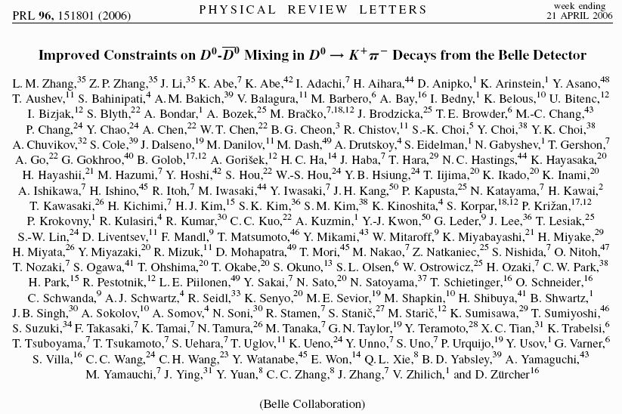
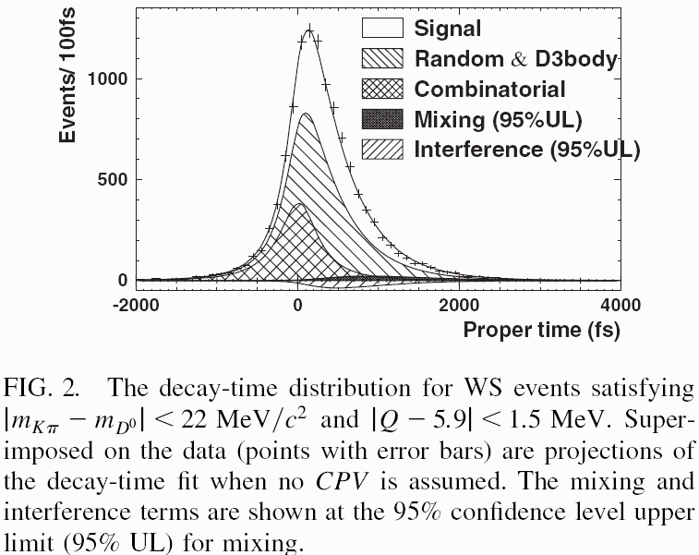
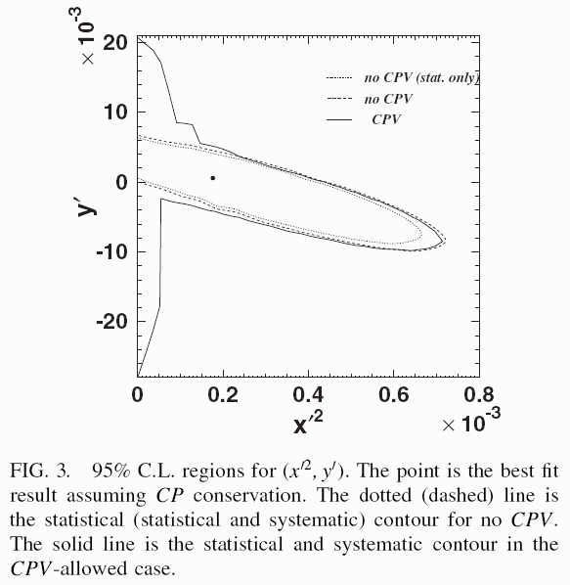
Search for mixing
Phys Rev Lett 96, 151801 (2006)

Slide 12
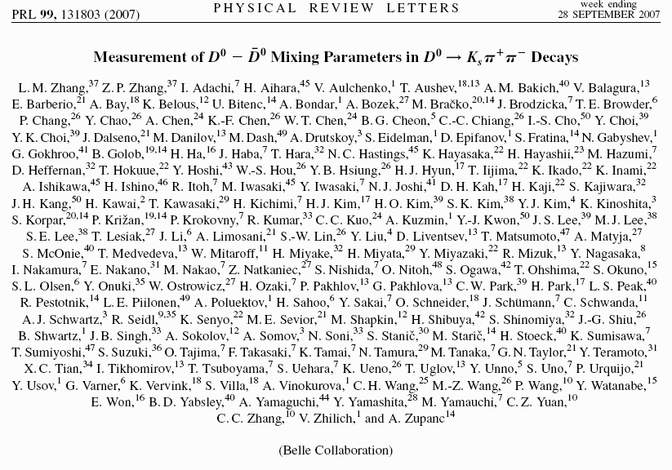
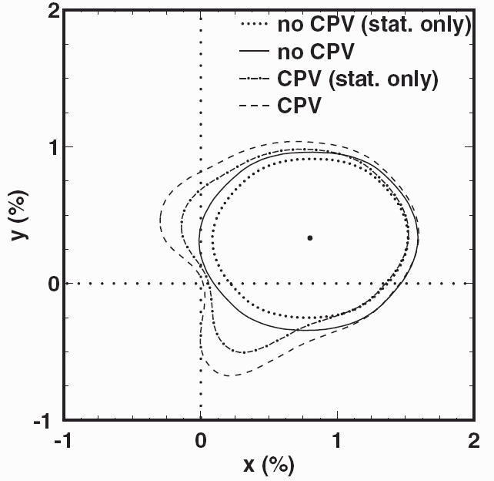
Search for mixing
Phys Rev Lett 99, 131803 (2007)

Slide 13
Search for mixing
Our observations show ：
Precise measurements of Rd agree with other experiments；
Significance for non-zero mixing
Other observations ：
Further study with 10 times more data are still required.

Slide 14
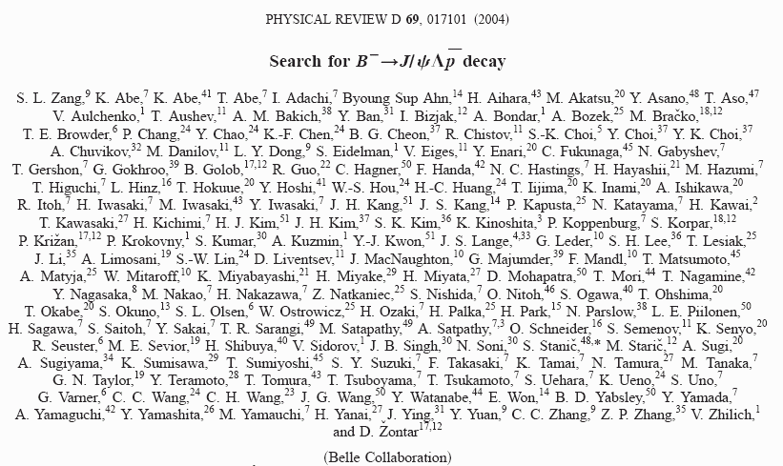
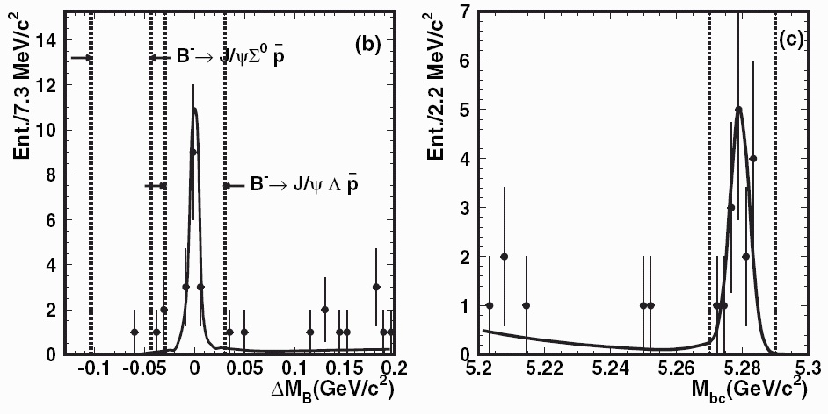
Search for
Phys Rev D 69, 017101 (2004)
No exotic state is found
Phys Rev D 72, 051105 (2005)

Slide 15
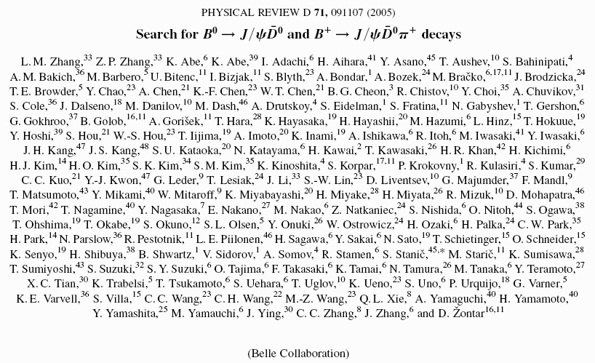
Search for
Phys Rev D 71, 091107 (2005)
Consistent with Babar’s
Rule out possible charm content at 1% level in the B meson

Slide 16
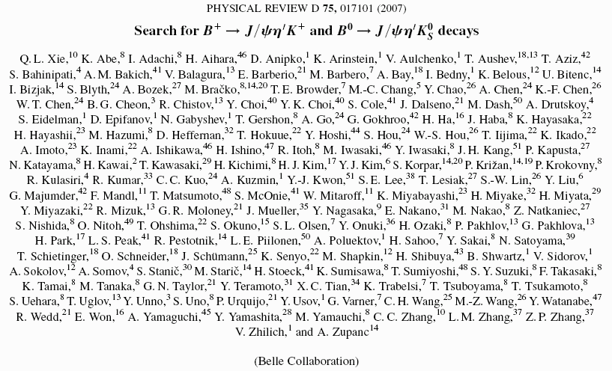
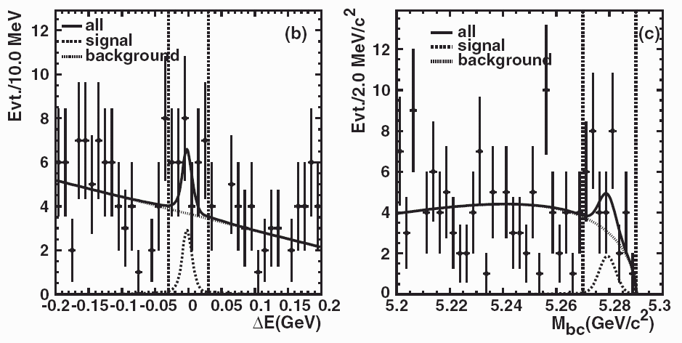
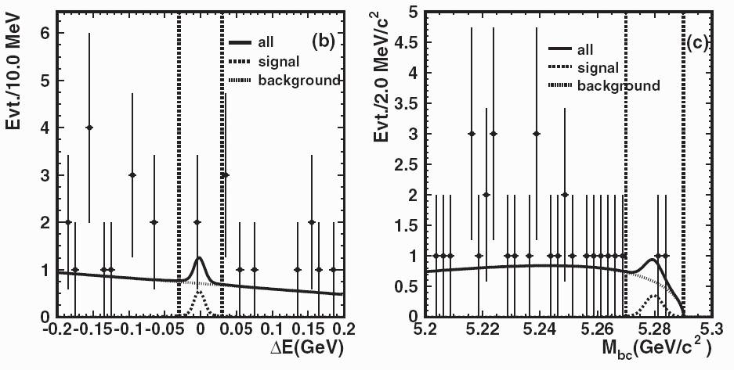
Search for
Phys Rev D 75, 017101 (2007)
No signal hybrid of
is found
Here is excited gluonic
state

Slide 17
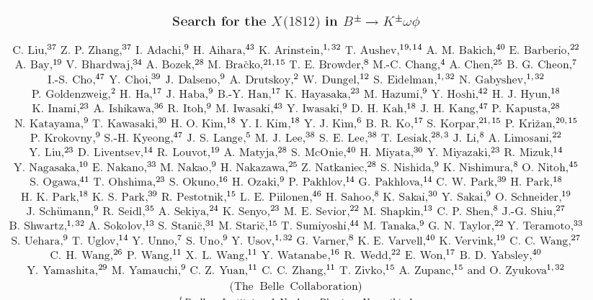
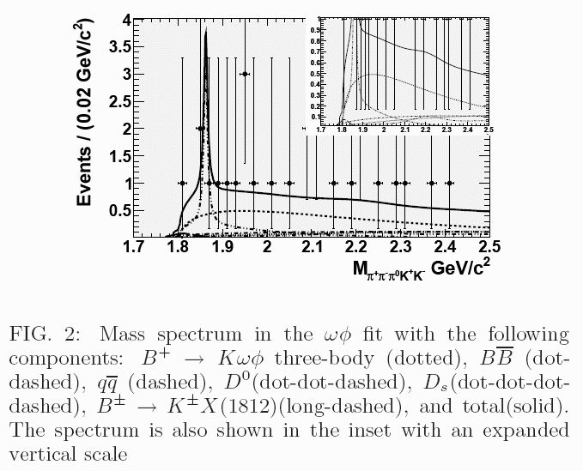
Search for X(1812) in
To be submitted to Phys Rev D (RC)
Search for
as possible tetra-quark state or
hybrid.
No significant signal is found.

Slide 18
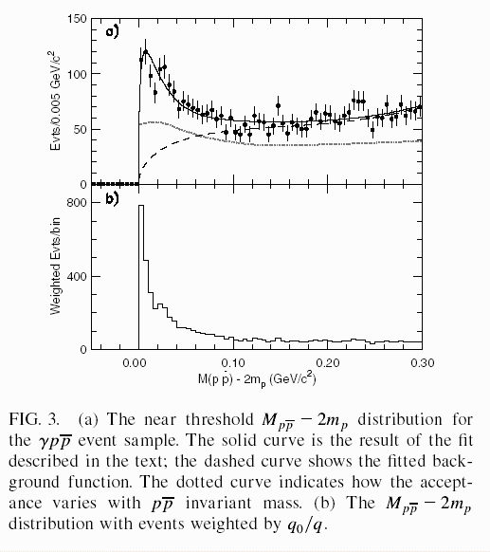
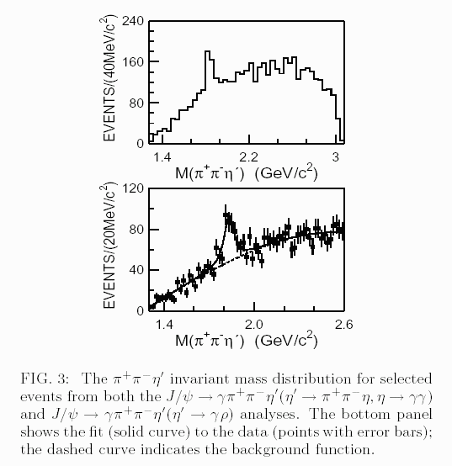
X(1835) observed by BESII
• Observation of X(1835)
See: Phys. Rev. Lett. 95, 262001 (2005)
• Enhancement near threshold
See : Phys. Rev. Lett. 91, 022001 (2003)
S-wave BW fit with FSI & zero isospin
gives:

Slide 19
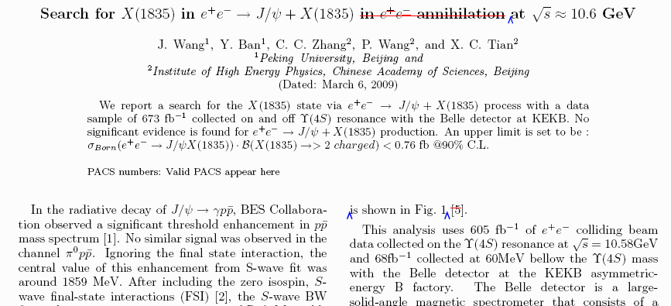
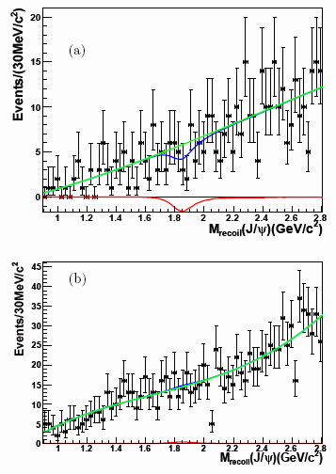
Search for X(1835) in
Under referee process in Belle
Search for
as glueball candidate.
No significant evidence is found.

Slide 20
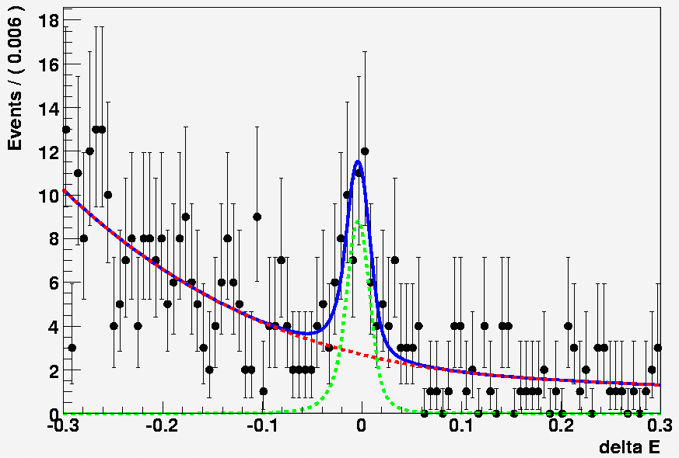
Measurement of and search for X(1835)
X(1835) is observed from J/psi decay by BESII.
It could be produced in B decay and two-photon process, if it is an excited η’ state.
presented at physics group meeting.
Preliminary and unpublished
Internal report only.

Slide 21
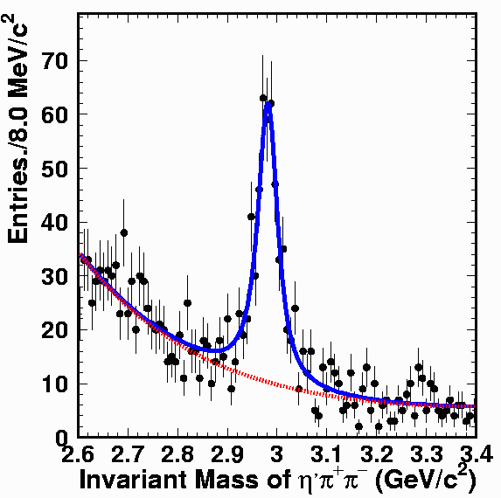
Measurement of and search for X(1835)

Slide 22
PhD thesis on Belle physics
1. Ye Yuan (IHEP) ，2002
“Measurement of decays at Belle/KEKB”
2. Zshilei Zang (IHEP)，2005
“Search for decays at Belle”
3. Jin Li (USTC), 2004
“Search for mixing via ”
4. Qilin Xie (SCU)，2005
“Search for and at Belle”
5. Xinchun Tian (PKU), 2006
“Measurement of the wrong-sign decays and
search for CP violation”
6. Liming Zhang (USTC), 2006
“Search for mixing in and Measurements of ”

Slide 23
Publication
1. “Search for decay”,
Phys. Rev. D69, 017101 (2004)
2. “Observation of and
search for decay”,
Phys. Rev. D72, 051105 (2005)
3. “Search for decay”,
Phys. Rev. D71, 091107 (2005)
4. “Search for mixing in
decays”,
Phys. Rev. Lett. 94, 071801 (2005)
5. “Measurement of WS
decays and Search for CPV”,
Phys. Rev. Lett. 95, 231801 (2005)
6. “Improved Constraints on mixing
in decays”,
Phys. Rev. Lett. 96, 151801 (2006)
7. “Proper-time resolution function in
mixing search”,
Nucl. Instrum. Meth. A553,483 (2005)
8. “Search for decays”,
Phys. Rev. D75, 017101 (2007)
9. “Measurement of mixing parameters in decays”,
Phys. Rev. Lett., 99 131803 (2007)
PRL : 4 papers
PRD : 4 papers
NIM : 1 paper

Slide 24
Summary
Contributions on Charm physics research to Belle experiment
9 papers published（4 for PRL, 4 for PRD, 1 for NIM)
Our results in mixing disfavor the non-mixing point with
significance for .
Continue effort in the search is expected at Super Belle
No evidence for exotic states from decays
is measured, and upper limits for others are obtained.
More papers on X(1812) and X(1835) search will be published.

Slide 25
My appreciations to our colleagues at KEKB and Belle for their dedicate and successful works. JSPS fund NSFC fund Innovation(IHEP,CAS) fund CCAST fund Thanks

Slide 26
Thanks

Slide 27
Research on charm Physics at Belle
Brief status (continue)
• Conf. talk (Yuan Ye/IHEP)
“Branching fractions and Properties on B meson Decays to Charmonium”
presented at the Annual Meeting of Chinese Association of High Energy Physics, Oct. 2002, Xinxiang, China
• Conf. talk (Ban Y/PU, Dong L.Y./IHEP)
“Measurement of R_{WS} using 11 fb⁻¹”
presented at Inter. Conf. of Flavor Physics, 2001,
Hunan, China
• Conf. talk (Yuan.Y./IHEP)
“Selected topics from Belle experiment”
presented at Workshop on B Physics at hadron colliders,
22-23 Nov. 2004, CCAST, Beijing

