Slide 1
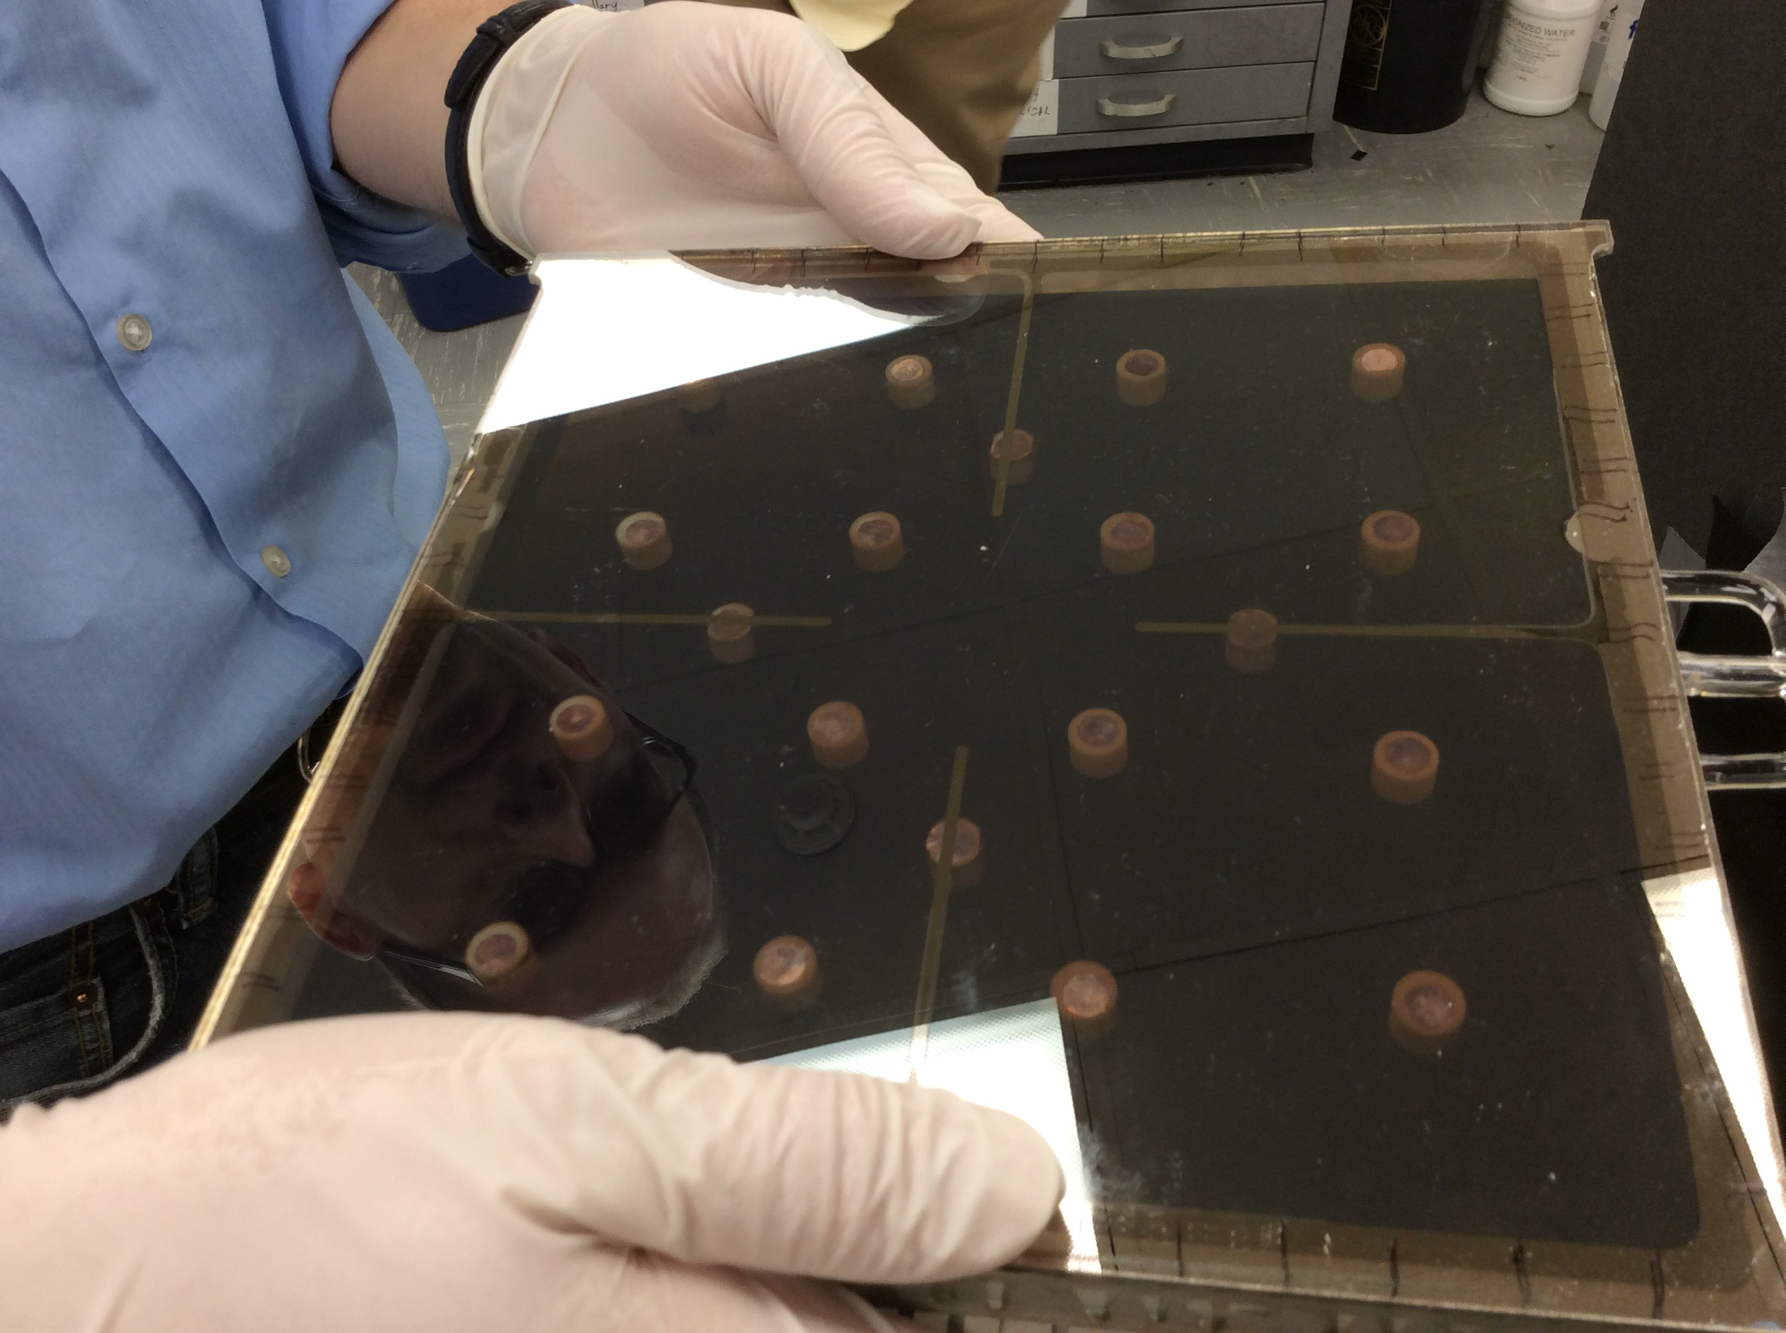
Brief overview of LAPPD technology

Slide 2
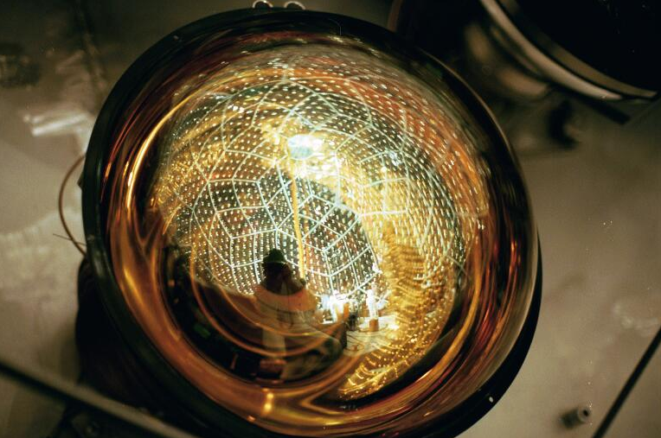
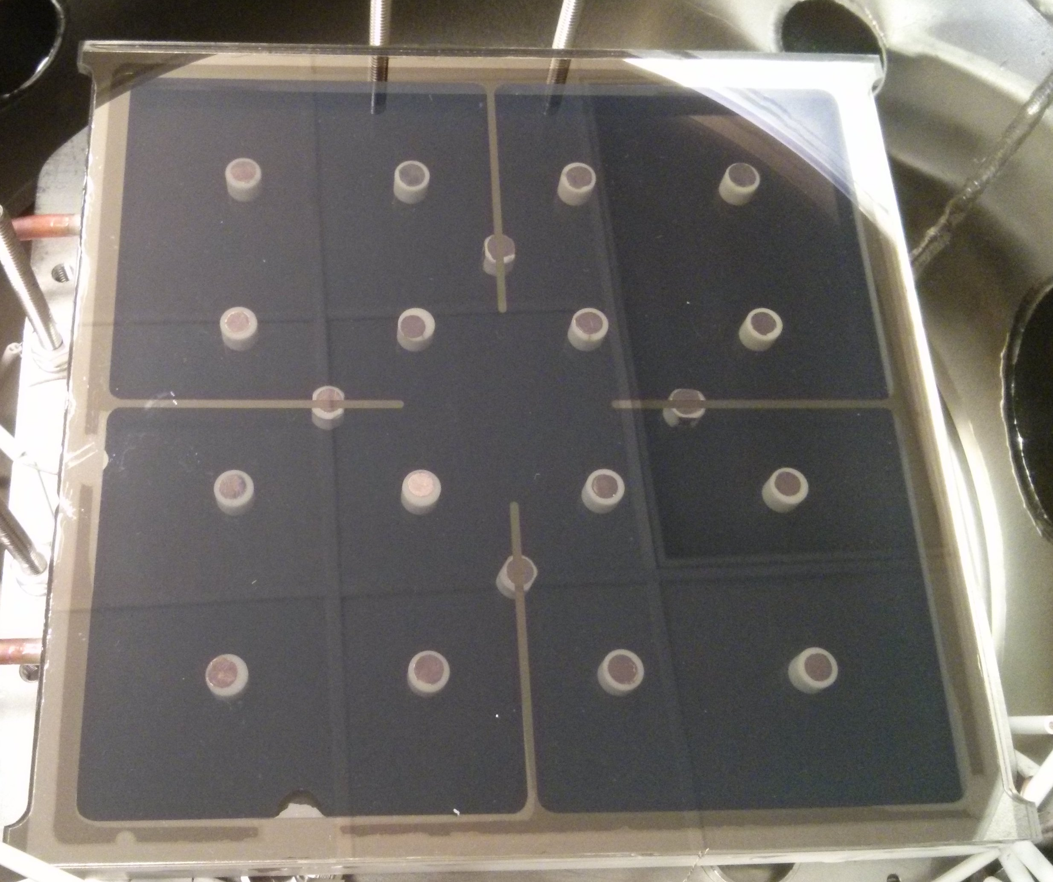
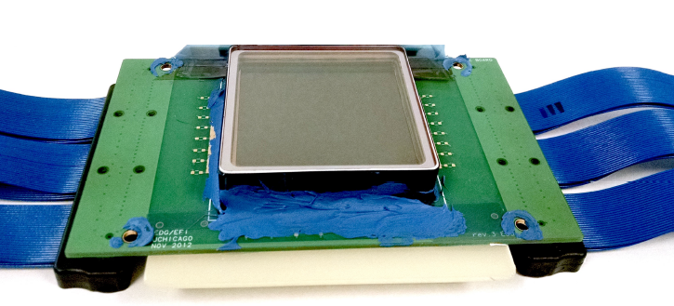
17-20”
tts ~ 3-10ns
dx ~ 20’’
pixel size ~ 20’’
sensitive area ~
photo credit: http://kamland.stanford.edu
tts ~ 50ps
dx ~ 0.7mm
sensitive area ~20cm x 20cm
5 cm
tts ~ 100ps
dx ~ 1mm
pixel size ~ 1.5mm
sensitive area ~5cm x 5cm
photo credit: E.Oberla PhD thesis

Slide 3
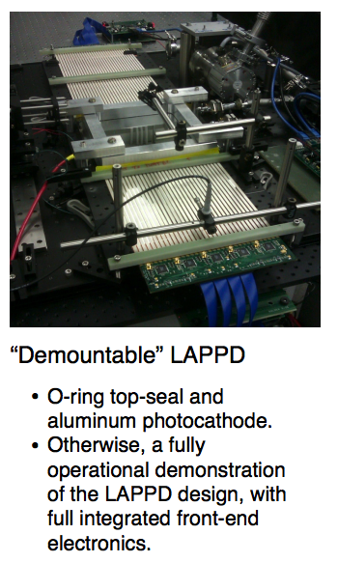
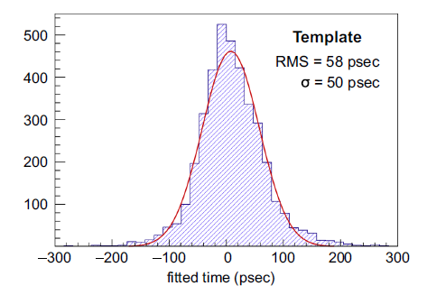
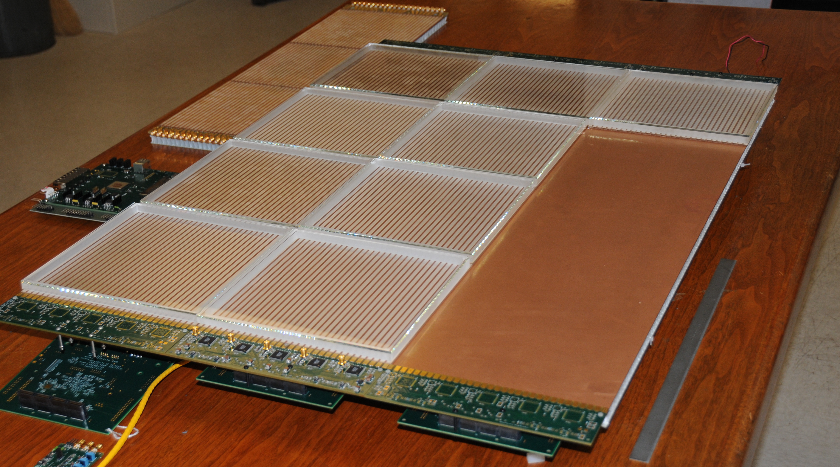
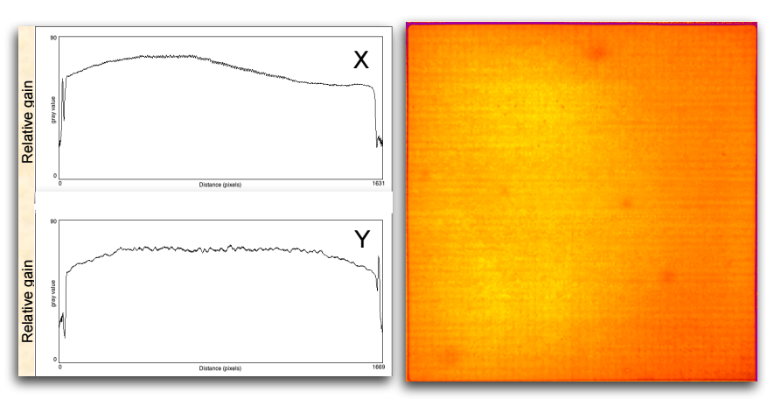
Matt Wetstein, 2014
Demonstrated characteristics:
single PE timing ~50ps
multi PE timing ~35 ps
differential timing ~5 ps
position resolution < 1 mm
gain >10⁷
Gain Uniformity
RSI 84, 061301 (2013),
NIMA 732, (2013) 392
NIMA 795, (2015) 1
See arXiv:1603.01843
for a complete LAPPD bibliography

Slide 4
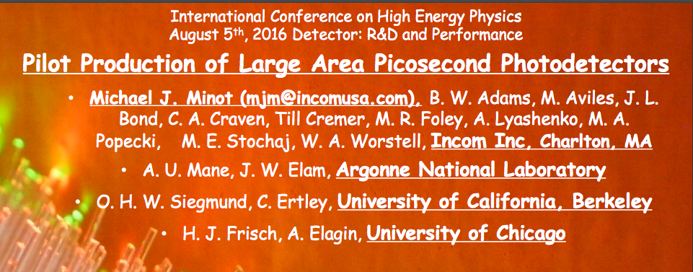

Slide 5
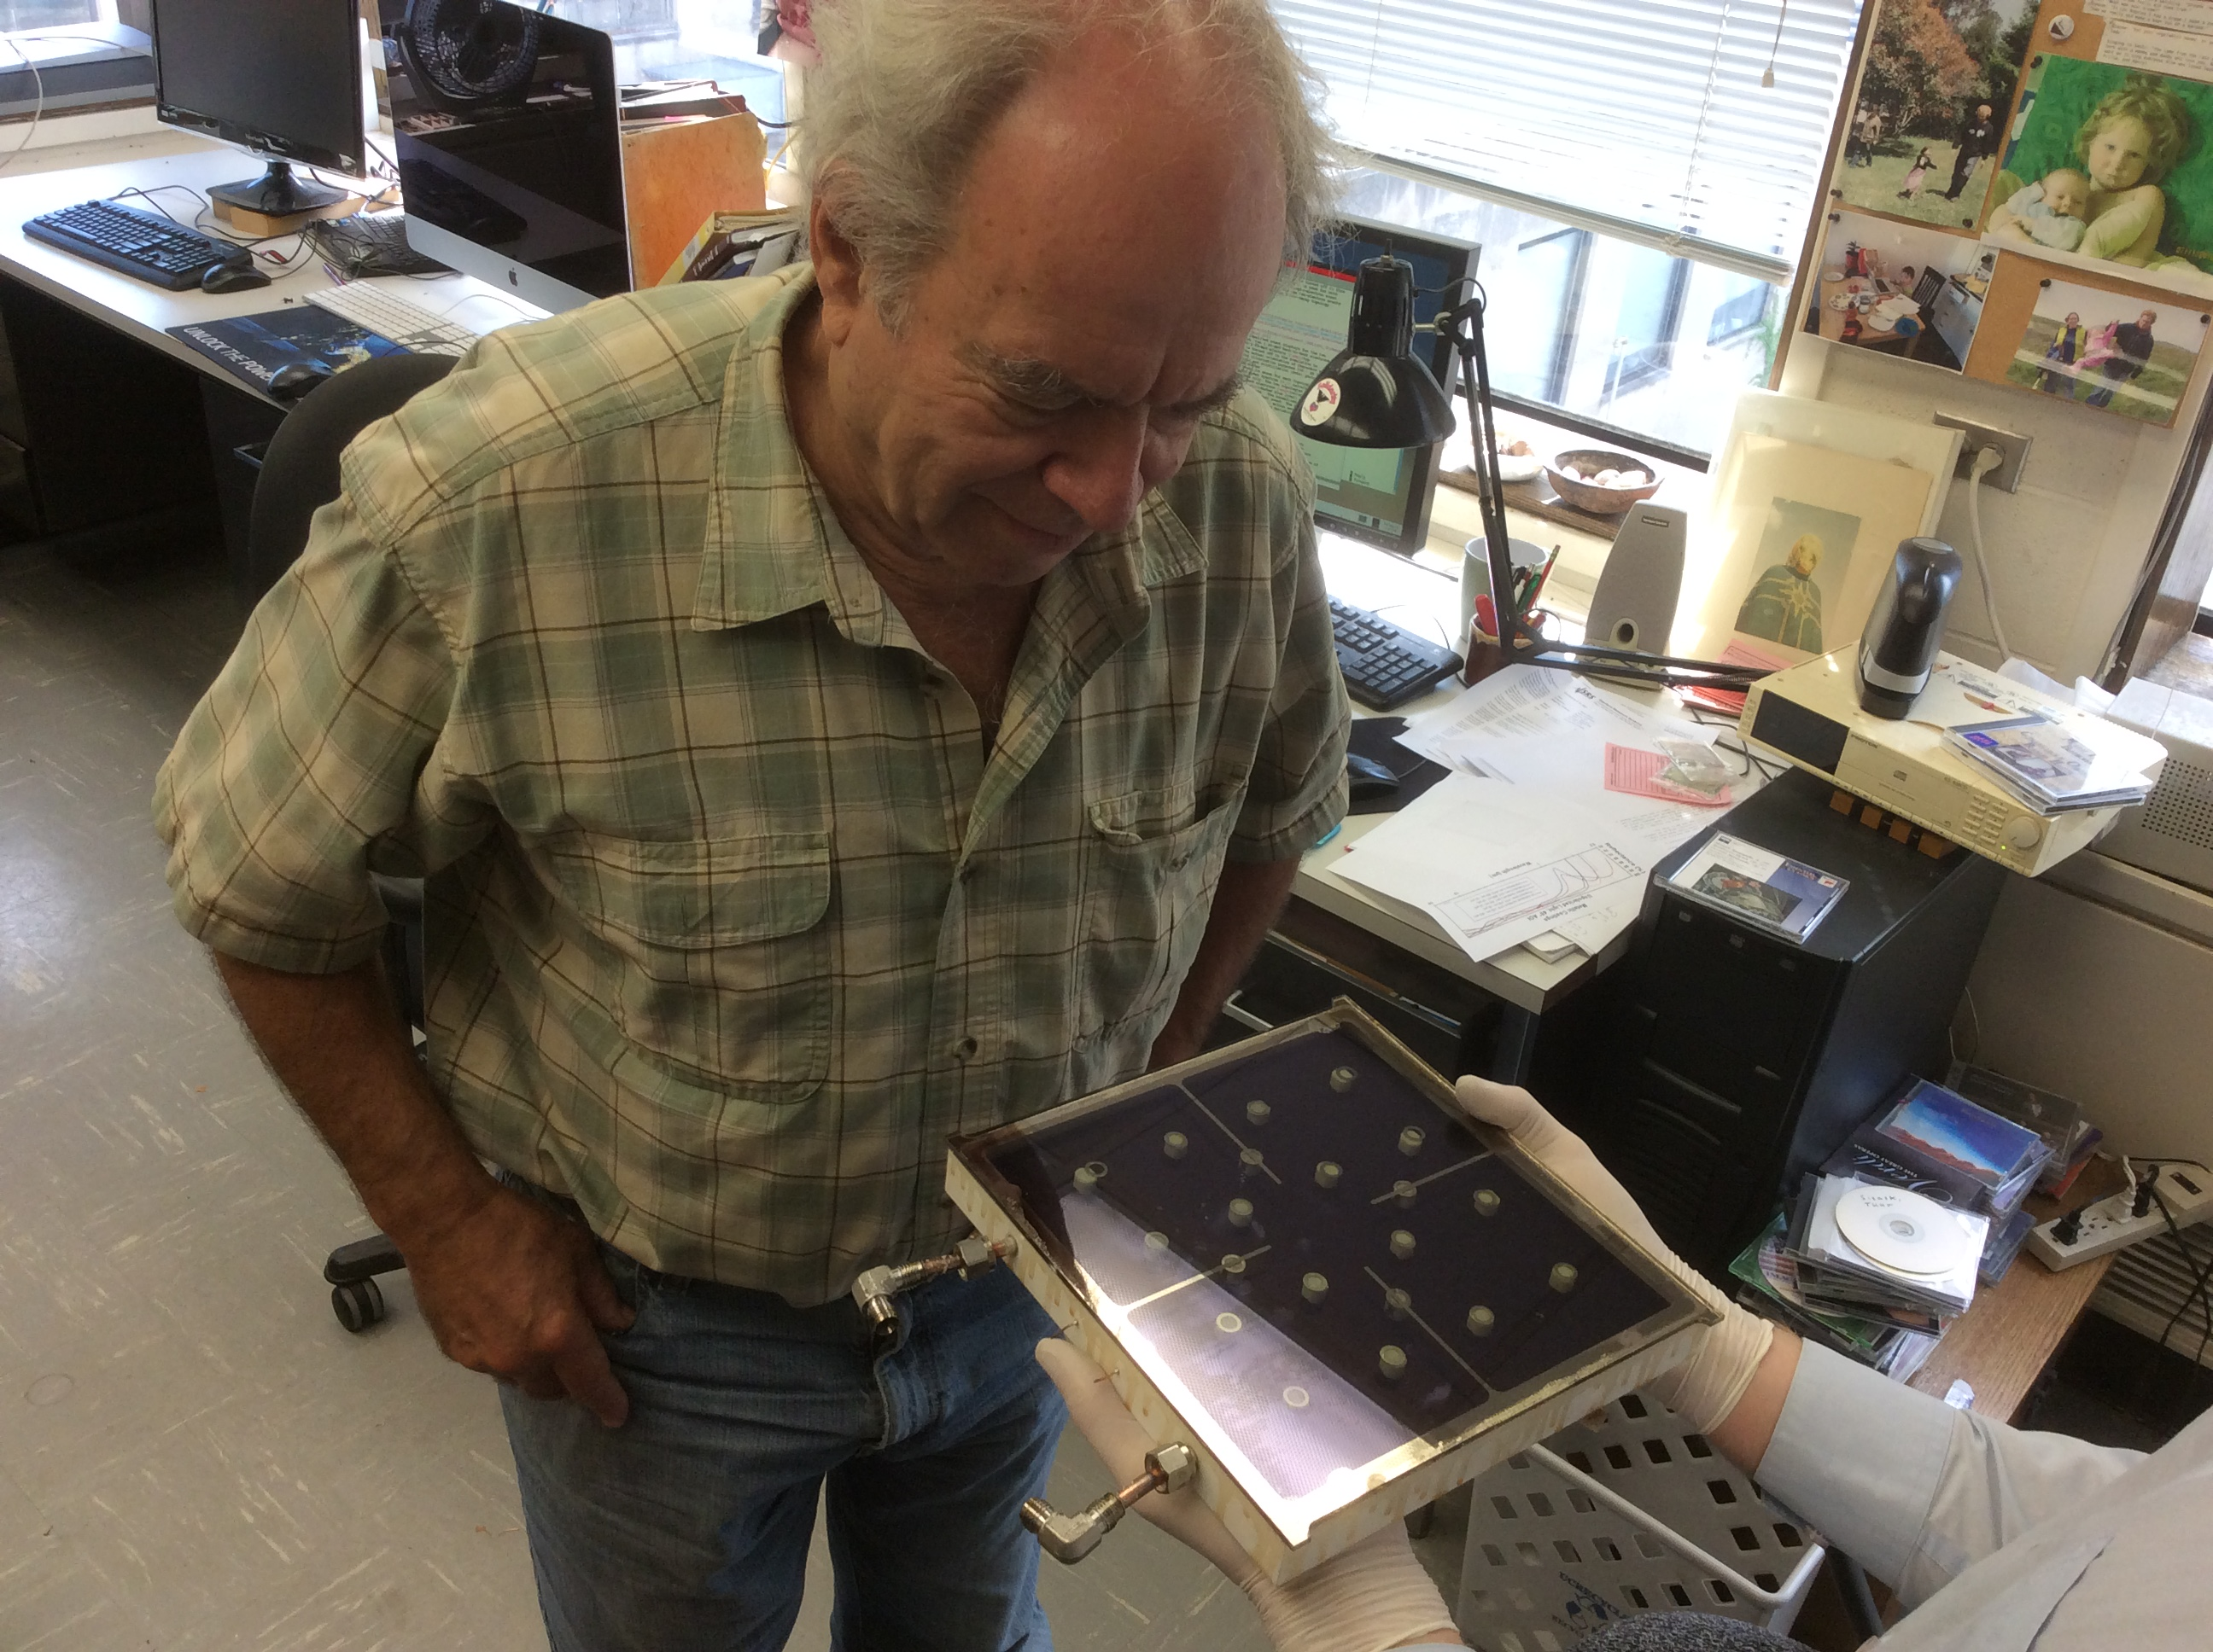
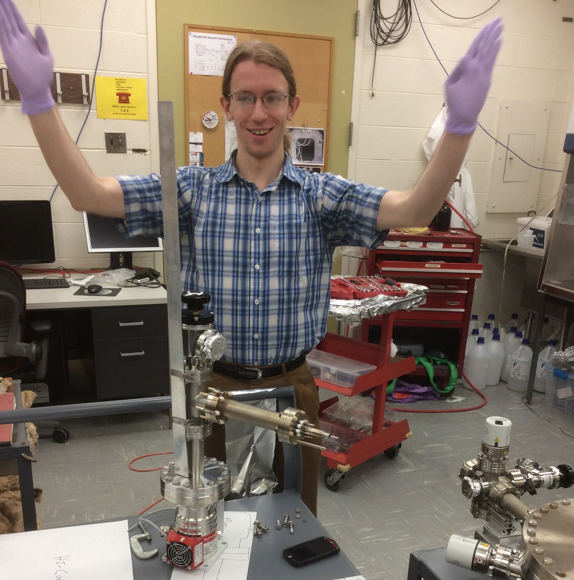
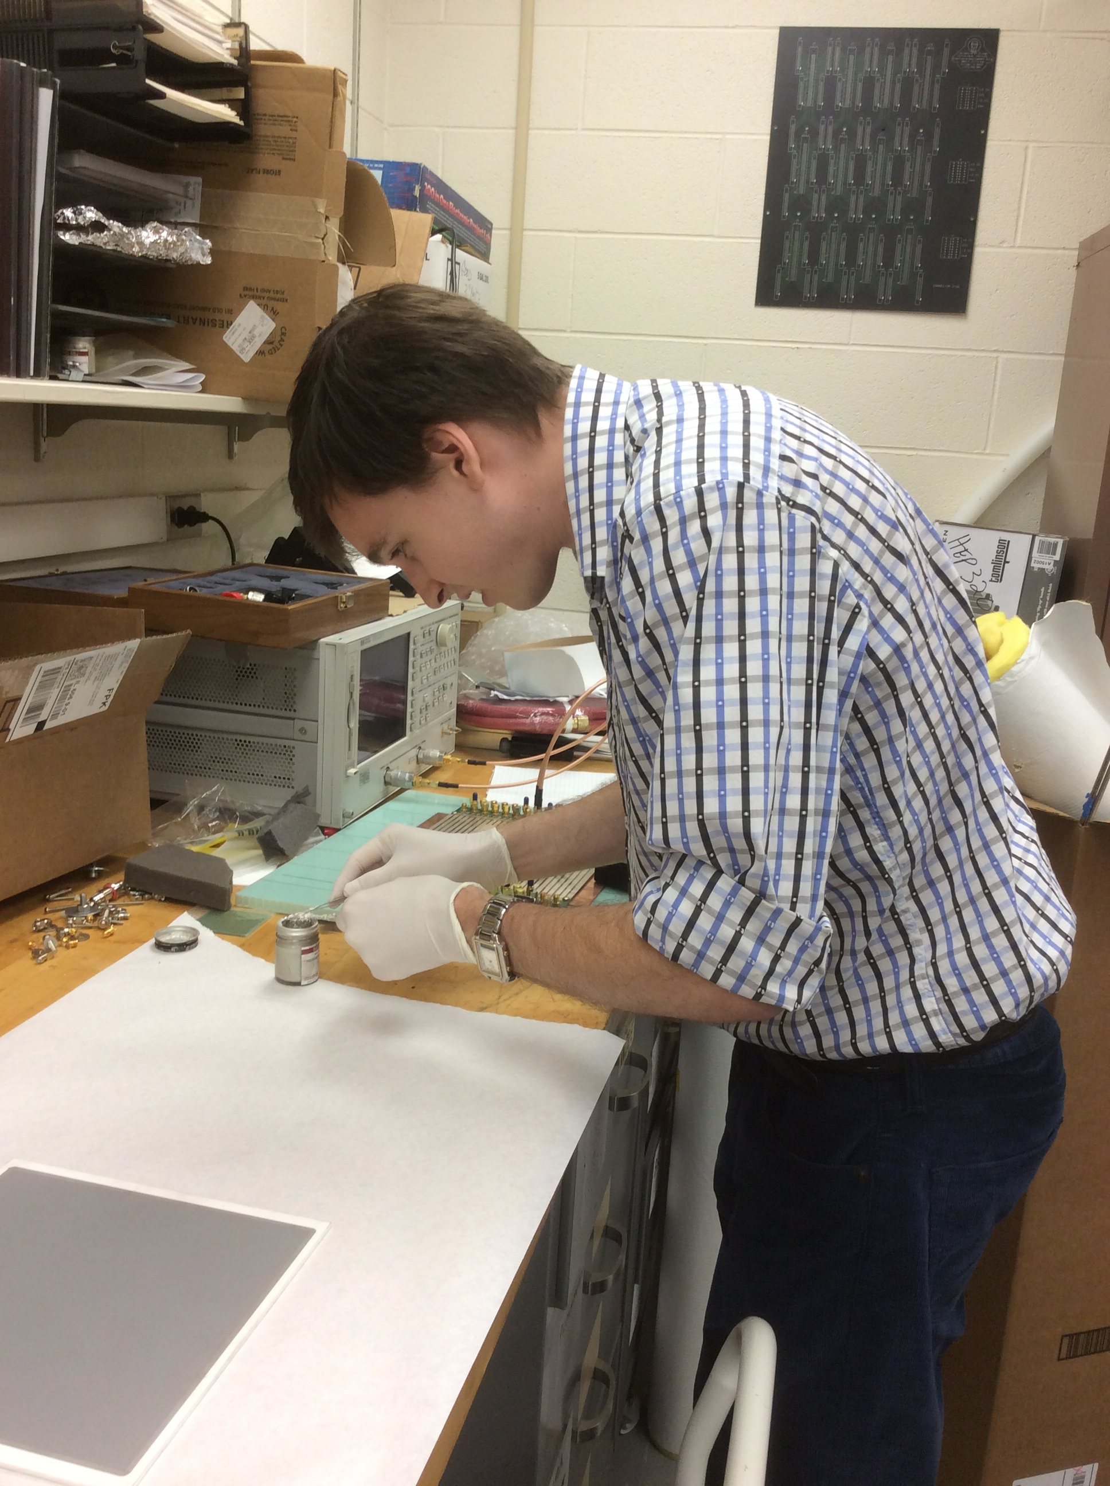
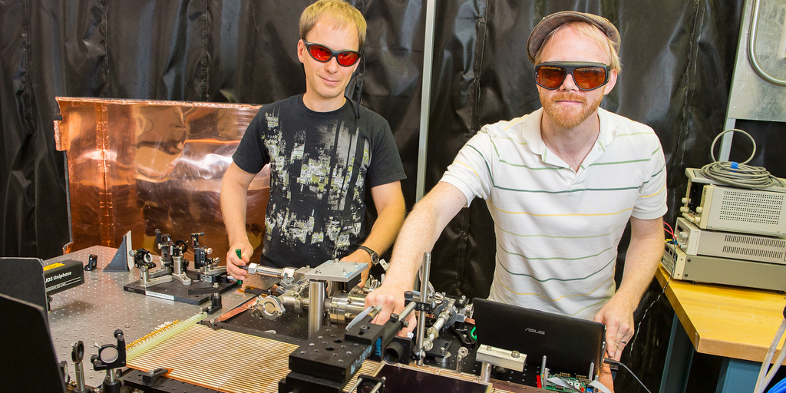
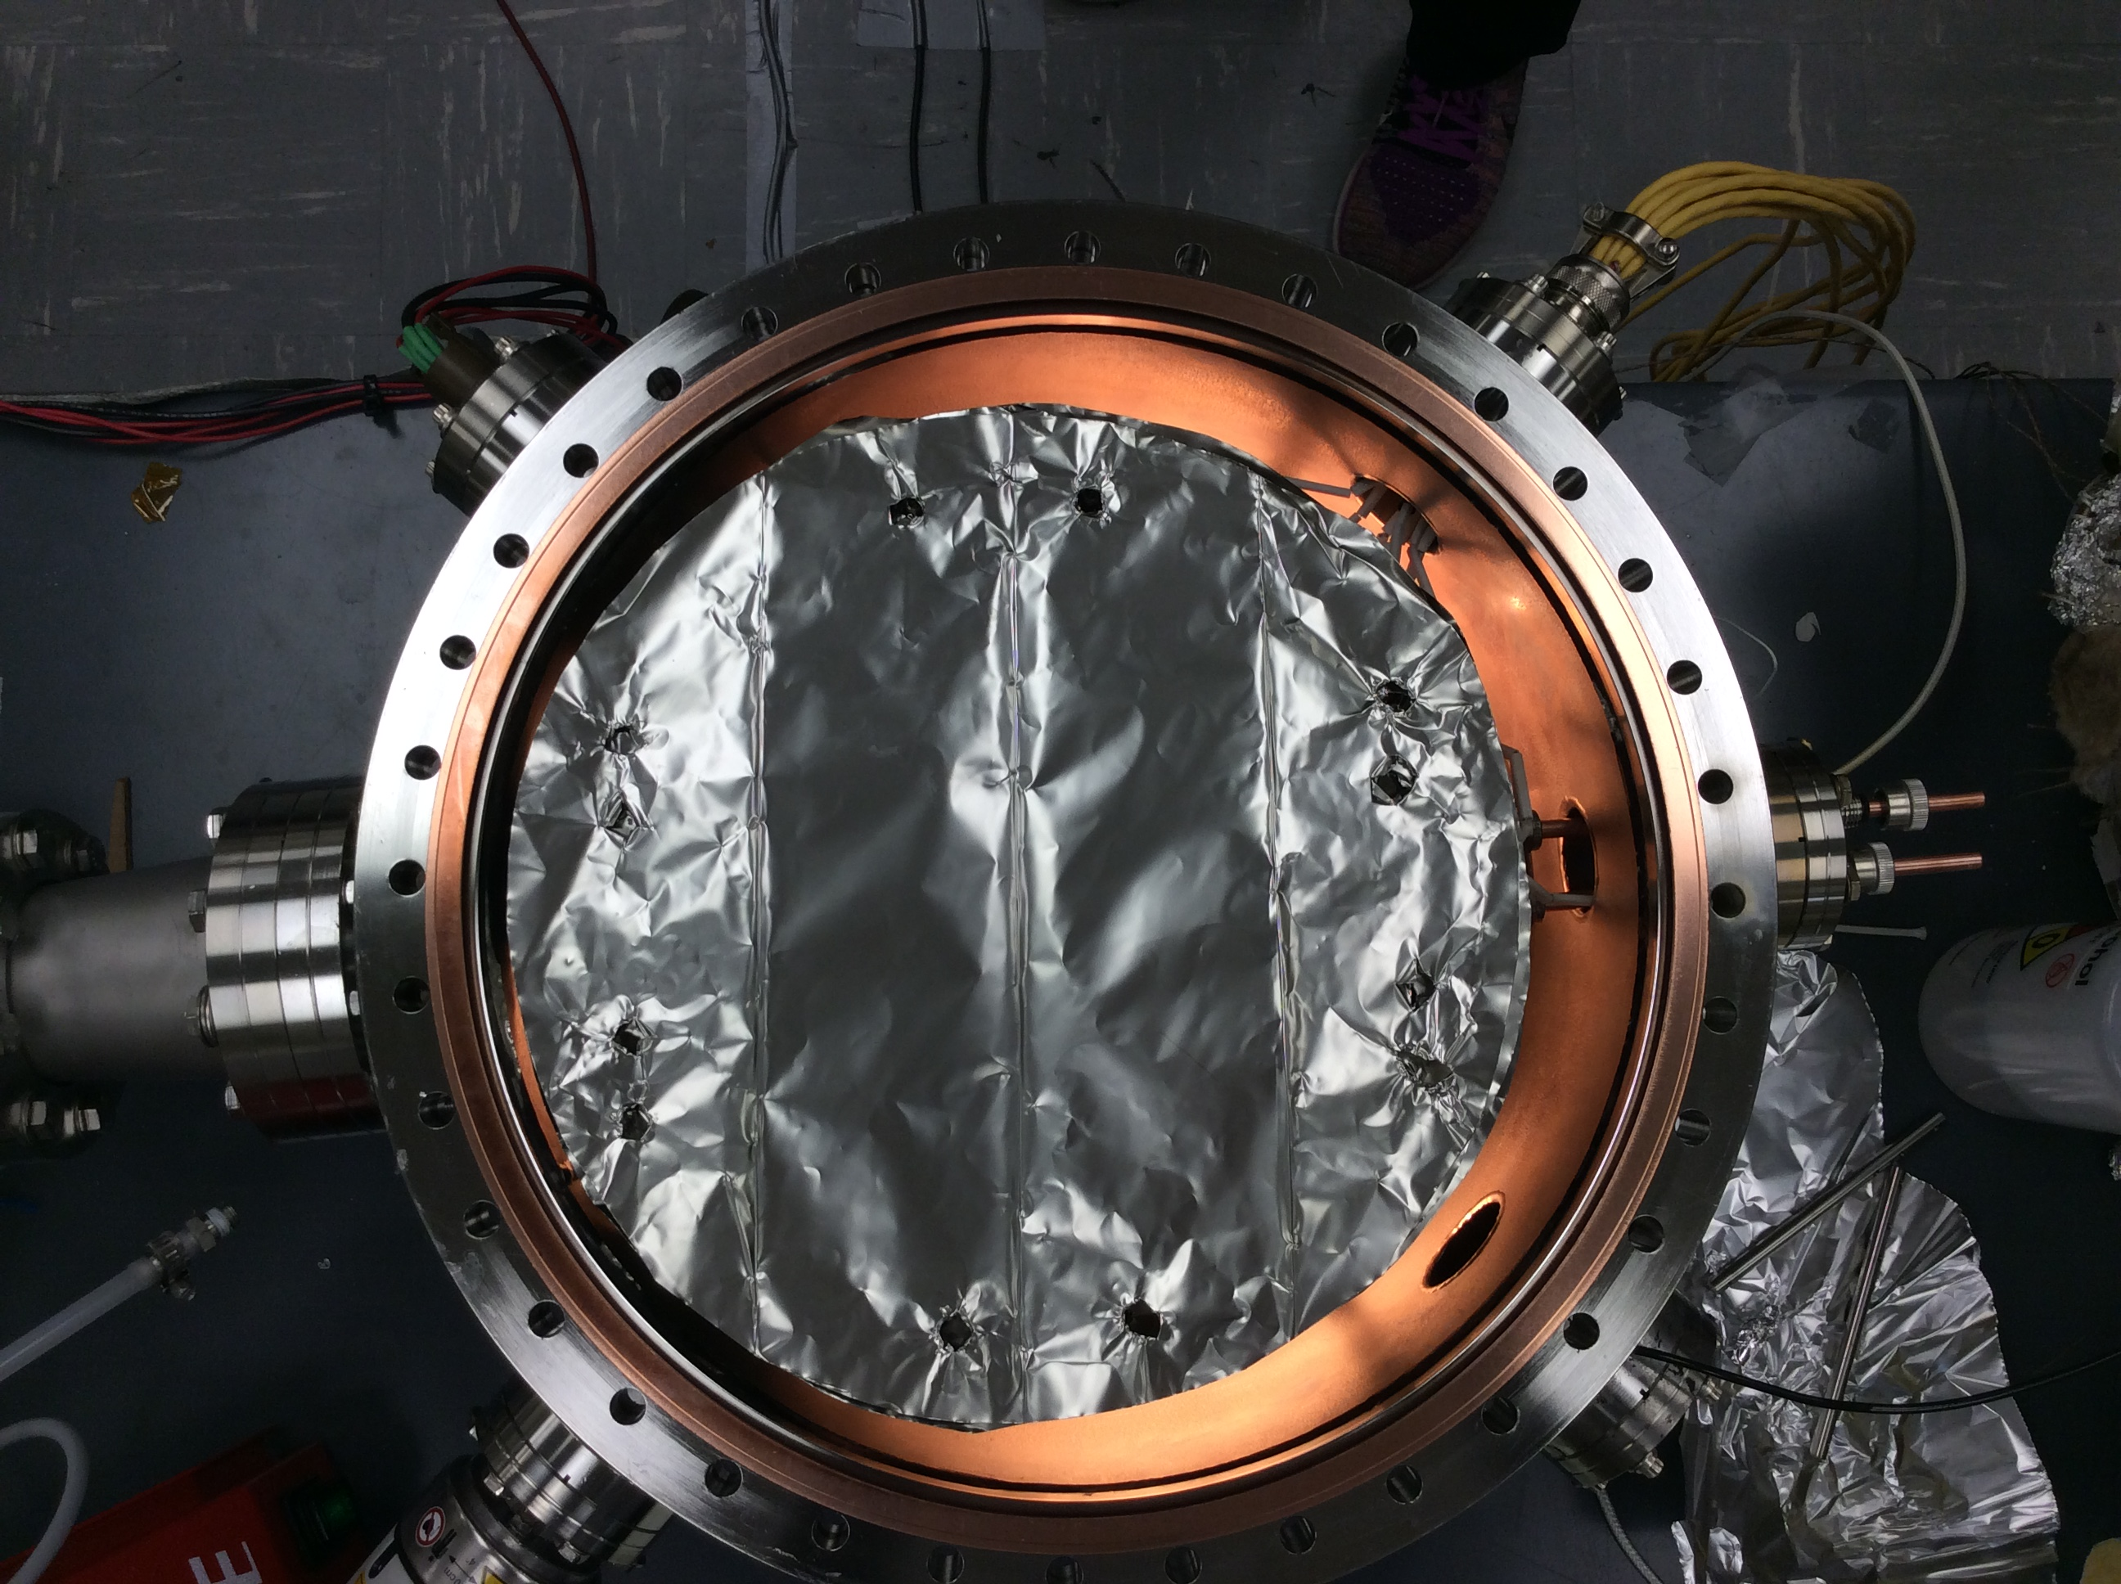

Slide 6
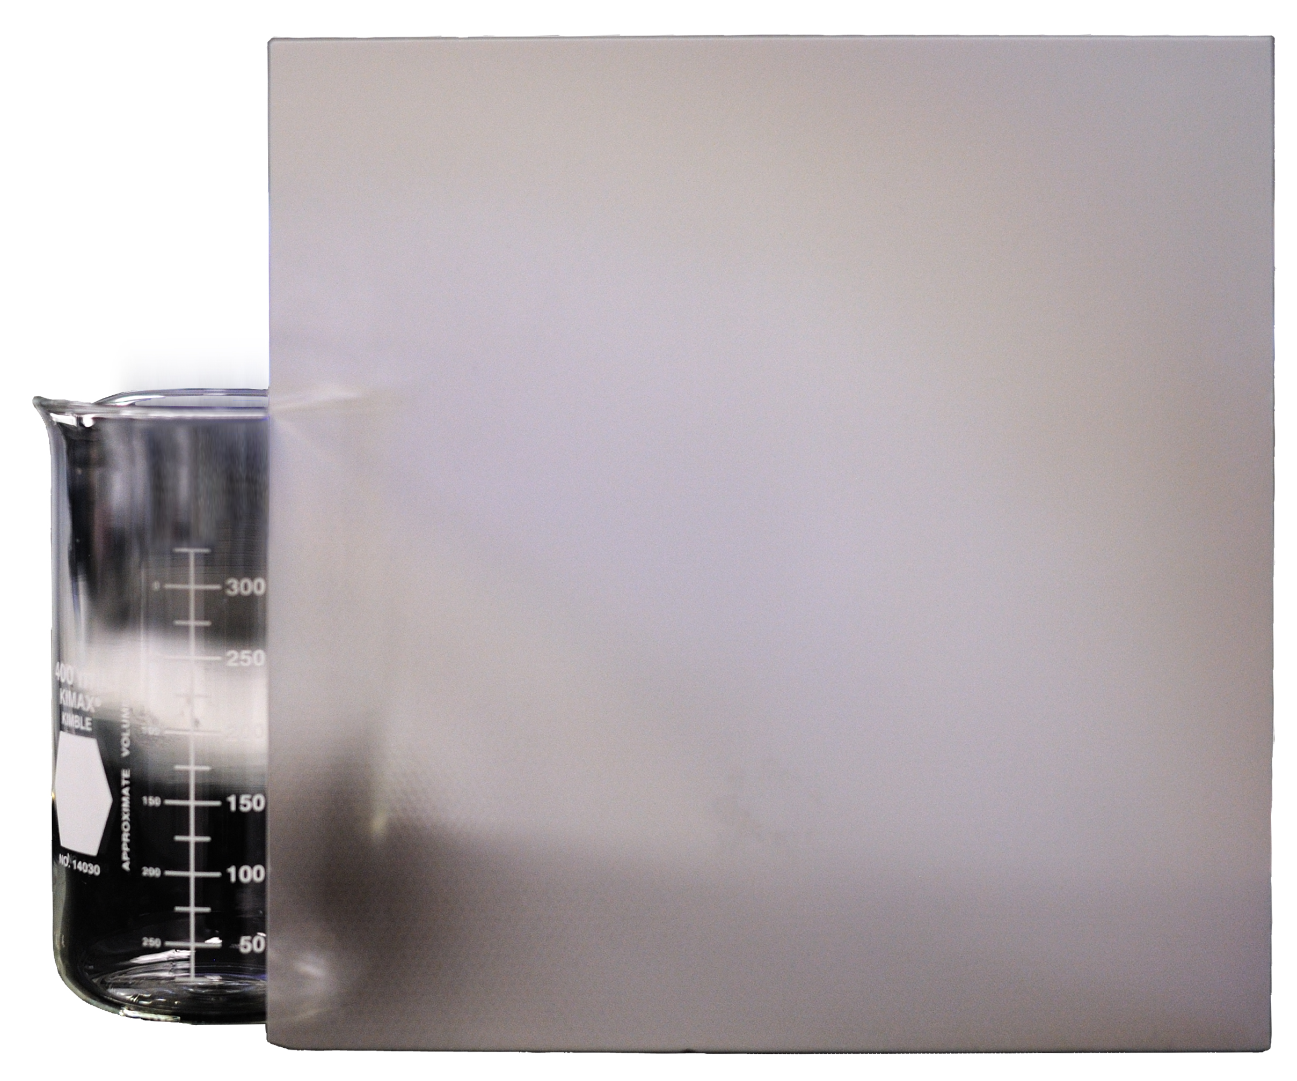
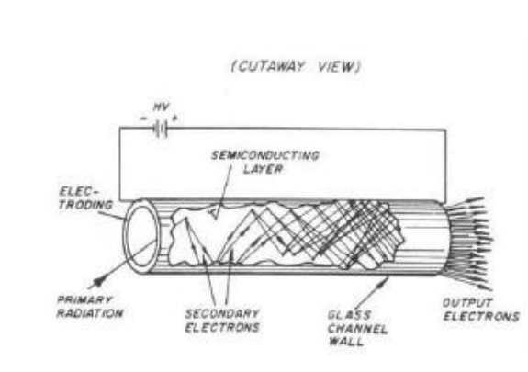
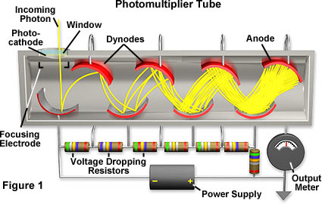
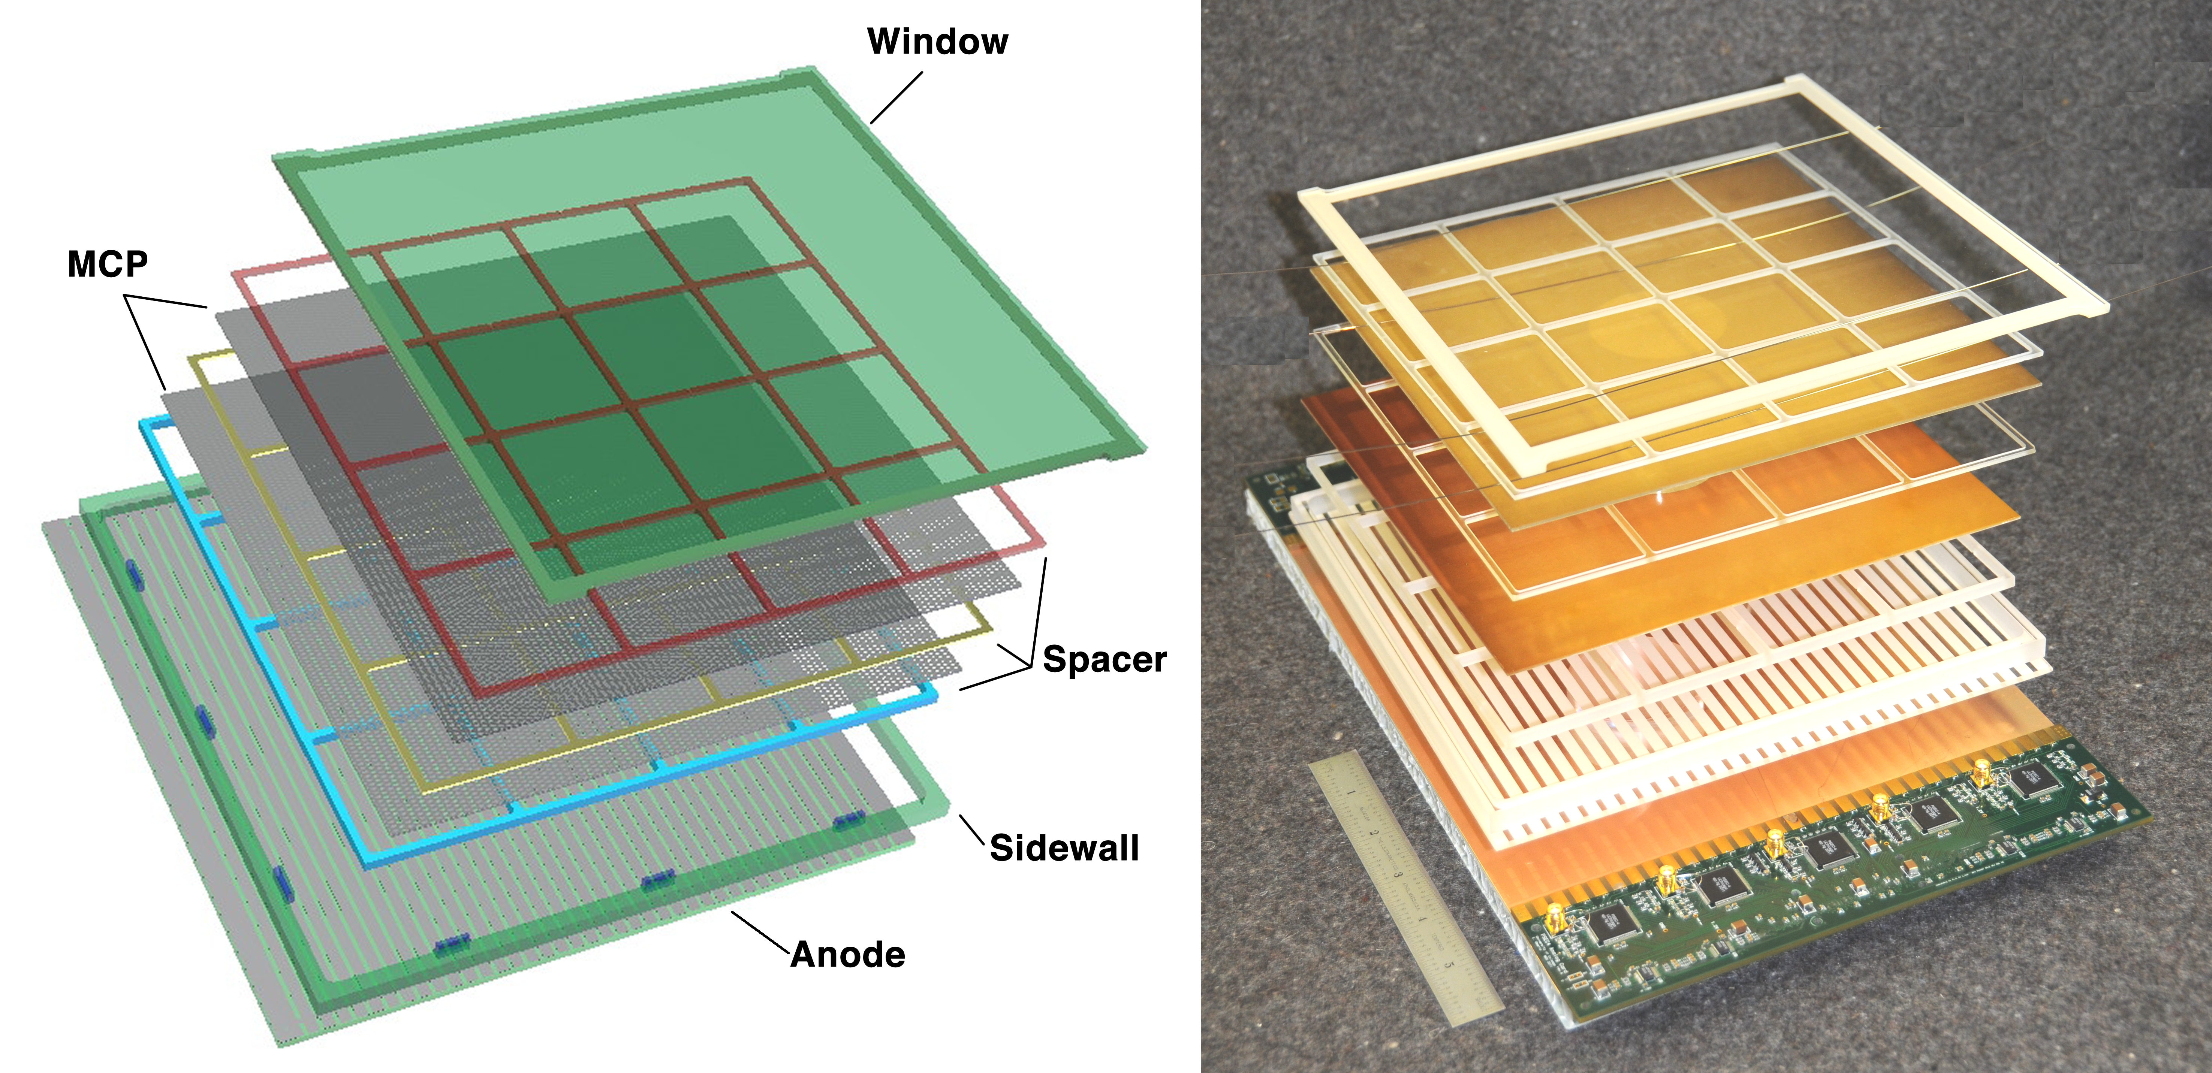

Slide 7
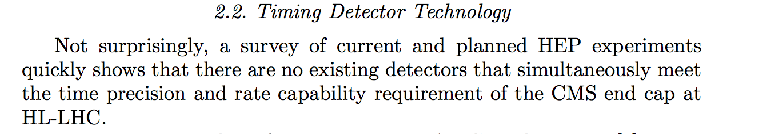
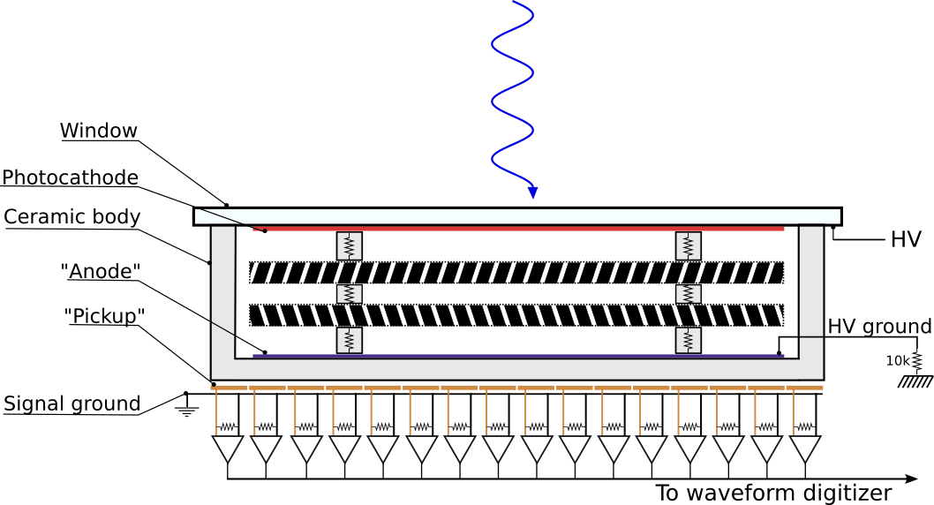


Sebastian White. Arxiv 1409.1165v2
This is a solvable problem, definitely on CEPC timescale
Rate limitations come from “voltage sagging” in the dynode stage (MCPs):
Solutions:
Use external HV divider with zeners and caps
Operate in low gain mode (low current in the shower)
With both of the above points, O.H.W. Siegmund claims as been able to achieve ~100 MHz /cm^2 rates without amplitude degredation

Slide 8
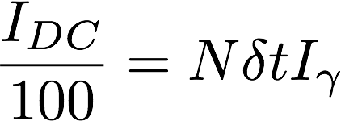

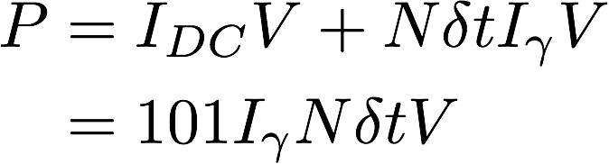
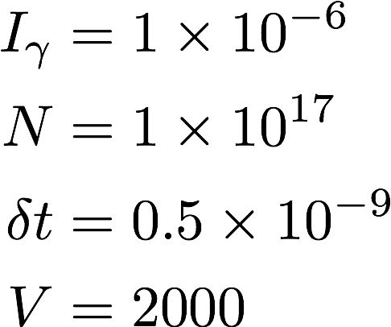
The power issue:
Saturation condition: current of showers are 1% of DC current
= number of photons (or particles) hitting the LAPPD per second
= we should determine this for CEPC?
For atlas, I found a weak source suggesting
that this is about 1e17 per LAPPD per second
https://cds.cern.ch/record/1601801/files/ATL-INDET-SLIDE-2013-630.pdf
Gain of 10⁷
Gain of 10⁵
P ~ 200kW
P ~ 20MW

