Slide 1
And then there were none
Tracing the origin of single spin asymmetry in pA collisions
Yoshitaka Hatta
(Yukawa Inst, Kyoto U.)
Bowen Xiao (Hua-Zhong Normal U.)
Shinsuke Yoshida (Los Alamos)
Feng Yuan (Laurence Berkeley)
Phys. Rev. D94 (2016) 054013 (arXiv:1606.08640) ⬅ PRD Editors’ suggestion
Phys. Rev. D95 (2017) 014008 (arXiv:1611.04746)

Slide 2

Transverse Single Spin Asymmetry (SSA)
unpolarized
transversely polarized proton
Production of hadrons is left-right asymmetric!

Slide 3


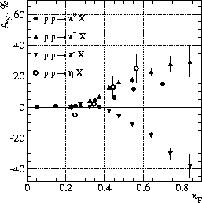

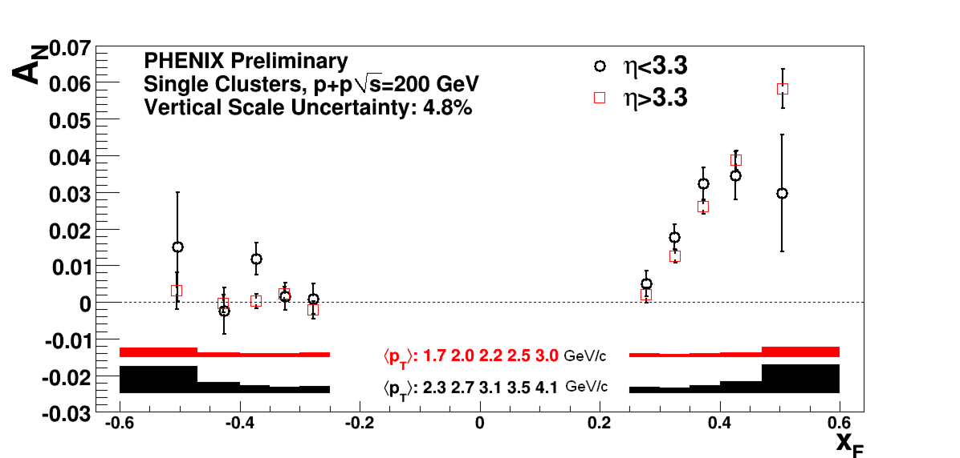

SSA in : experiments
arXiv: 1301.1096
E704 (Fermilab, 1991)
Enhanced in the forward region

Slide 4
SSA in : theory
A twist-three observable, nontrivial to get a nonzero result.
polarized
unpolarized
An extra factor of is needed to make the asymmetry nonvanishing.

Slide 5
The origin of SSA: The suspects
Soft fermionic pole (Efremov-Teryaev)
Soft gluonic pole (Qiu-Sterman)
Twist-three fragmentation functions
Collins-like
genuine twist-three
Others (Odderon, …)

Slide 6
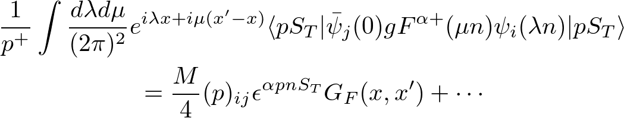




Soft gluonic pole
Twist-three, three-parton correlators (ETQS functions)
Imaginary part from the propagator pole
Qiu, Sterman (1999)
Kouvaris, Qiu, Vogelsang, Yuan (2006)

Slide 7
Soft fermionic pole
Pole condition sets
Koike and Tomita (2009)

Slide 8
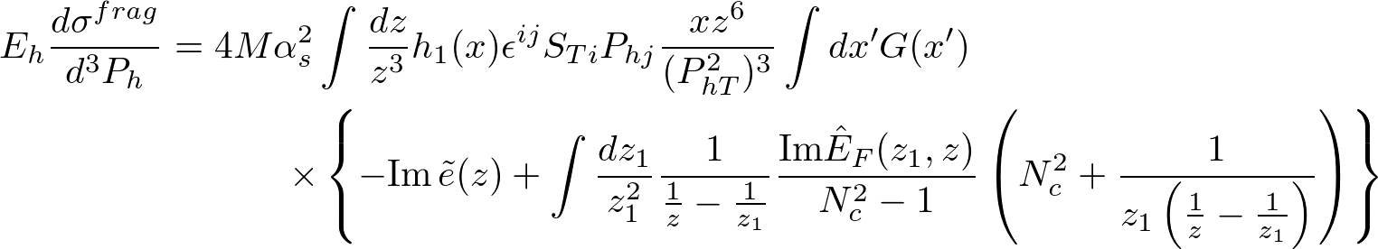
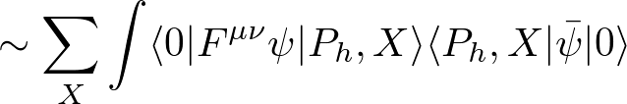
Twist-three fragmentation functions
Kang, Yuan, Zhou (2010)
Metz, Pitonyak (2012)
Kanazawa, Koike (2013)
Imaginary part from the twist-three fragmentation functions
Collins-like
genuine twist-three

Slide 9
A recent fit to the pp data
Kanazawa, Koike, Metz, Pitonyak,
PRD89 (2014) 11501
Good fit obtained if one assumes that the
genuine twist-3 fragmentation is large.
dominant!
Soft gluon pole contribution opposite in sign
to the data. ⬅ sign problem
Collins contribution also small.
Kang,Qiu,Vogelsang,Yuan (2011)

Slide 10
The origin of SSA: The suspects
Soft fermionic pole (Efremov-Teryaev)
Soft gluonic pole (Qiu-Sterman)
Twist-three fragmentation functions
Collins-like
genuine twist-three
Others (Odderon, …)

Slide 11



SSA in pA collisions
In the forward region , small-x effects of the nucleus are important
Study the A-dependence of .
Different contributions have different A-dependences!
$$A_{N}$$

Slide 12

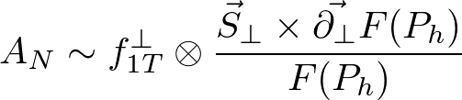



-factorization approach
Boer, Dumitru, Hayashigaki (2006)
Sivers function
Unintegrated gluon distribution
Saturation momentum
Same conclusion from the Collins fragmentation function Kang, Yuan (2011)

Slide 13

The data: STAR@200GeV
Dilks, talk at DIS2016
■ pp
○ pAu
No -dependence!

Slide 14


Compute SSA in pA in the -factorization framework in the forward region
collinear twist-three
Include the saturation effect of the nucleus.
Use the hybrid approach to SSA (Schafer, Zhou (2014)) and apply it to
Proton: collinear (ETQS, transversity)
Nucleus: unintegrated gluon distribution
Fragmentation: collinear
nucleus
proton

Slide 15
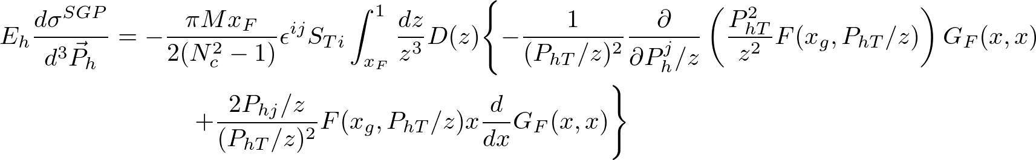

Soft gluon pole
YH, Xiao, Yoshida, Yuan
arXiv:1606.08640
recover kt factorization result
Derivative term, important at
consistent with the STAR data

Slide 16

Fate of the soft fermion pole
Hard coefficient vanishes at the SFP.
Nonvanishing SSA ONLY IF
namely, in the fully collinear calculation.
SFP contribution disappears as soon as of the gluon is included!

Slide 17
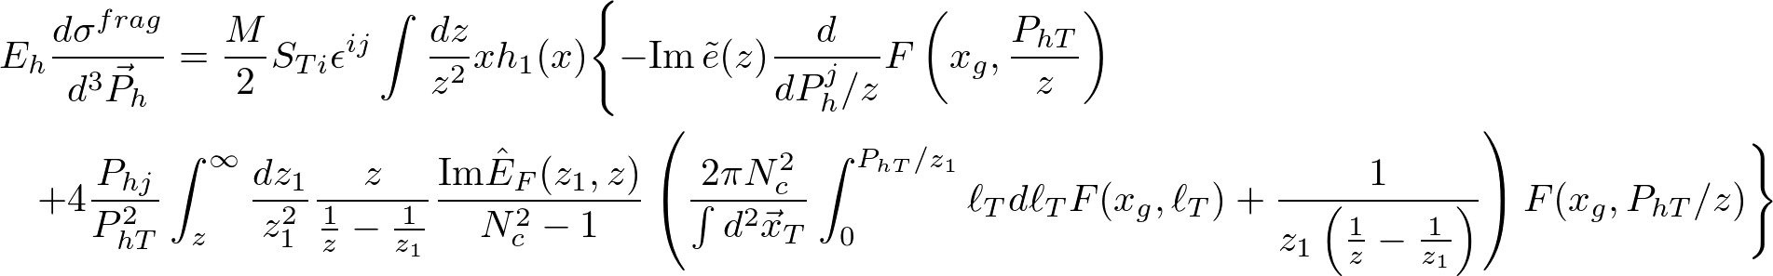
Fragmentation contribution
YH, Xiao, Yoshida, Yuan
arXiv:1611.04746
recover kt factorization result
genuine twist-3
most important term in the fit of Kanazawa et al. (2014)
nonlinear in , most strongly affected by saturation effects!

Slide 18
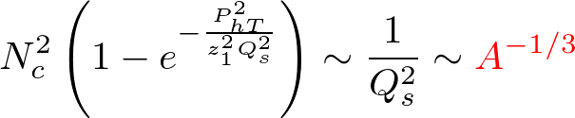
but numerically small according
to Kanazawa et al.
Suppressed!

Slide 19

The origin of SSA: The suspects
Soft fermionic pole (Efremov-Teryaev)
Soft gluonic pole (Qiu-Sterman)
Twist-three fragmentation functions
Collins-like
genuine twist-three
Others (Odderon, …)
Kovchegov, Sievert (2012)

Slide 20

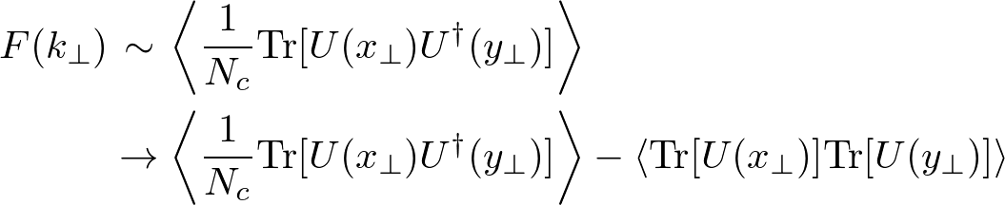
Recent discussions
Gamberg,Kang,Pitonyak,Prokudin,1701.01970
Zhou, 1704.04901
New estimate of the term in the fragmentation contribution
in light of the Lorentz invariant relation (LIR)
→ ``actually moderate in size and certainly not negligible”
Color entanglement effect included in the SGP contribution
not infrared finite

Slide 21
The origin of SSA: The suspects
Soft fermionic pole (Efremov-Teryaev)
Soft gluonic pole (Qiu-Sterman)
Twist-three fragmentation functions
Collins-like
genuine twist-three
Others (Odderon, …)
A-dependence OK.
but the sign problem persists.
← Still alive
← Next talk by Hsiang-nan.

