Slide 1
Performance of MDC during New Data Taking
WU Linghui, WANG Meng
2007-03-15

Slide 2
Outline
Overview of new data
Noise issue

Slide 3
MDC data performance from tracking calibration
Run 47467 – 49830 (2016/12/11 ~ 2017/03/07)
Boss release: 7.0.2.p01
Finish 1st round of calibration
  Calibration of X-T, electronic T0 and Q-T using Bhabha
Use old alignment parameters
Final calibration will be performed after data taking
  Low p_{T} tracks are selected to calibrate X-T relations with large entrance angle

Slide 4
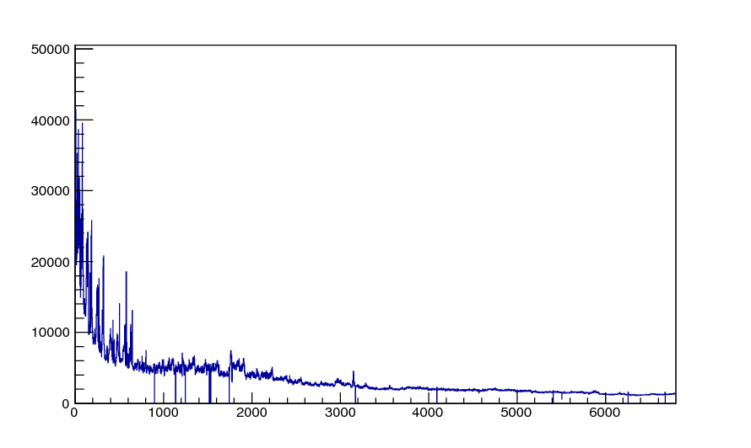
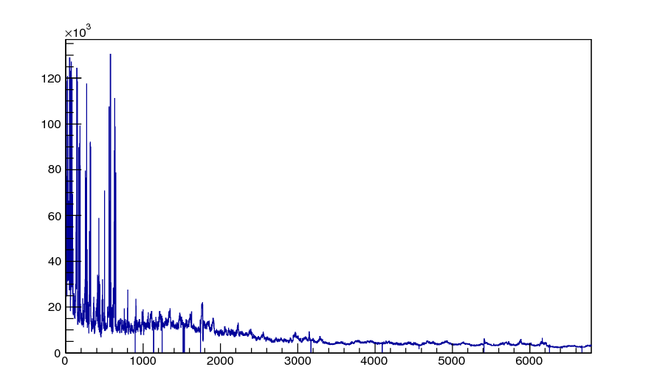
Hitmap & dead channels
Layer | Cell
13 | 88
16 | 14
16 | 81-88
17 | 13
19 | 28
19 | 43
20 | 111
29 | 56
33 | 145
33 | 148
38 | 246
39 | 89
42 | 38
43 | 168
Run 48000
T/Q match
T channel
Wire ID

Slide 5
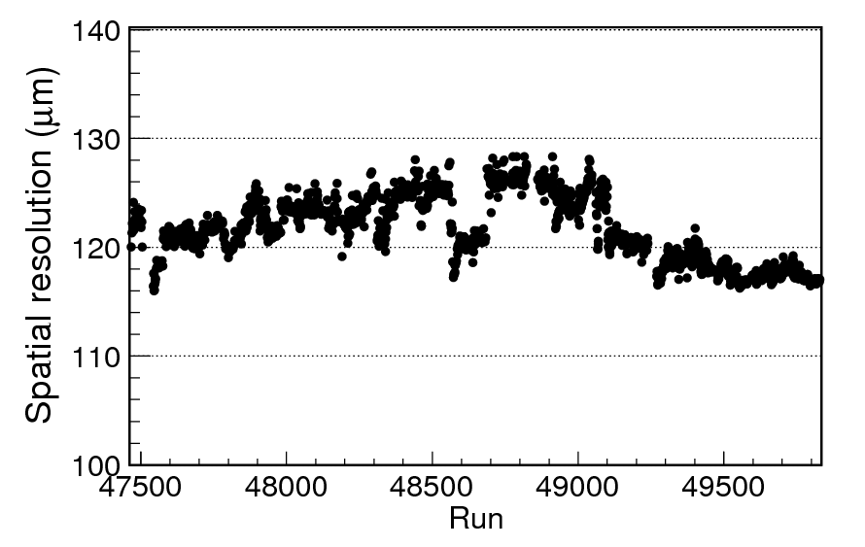
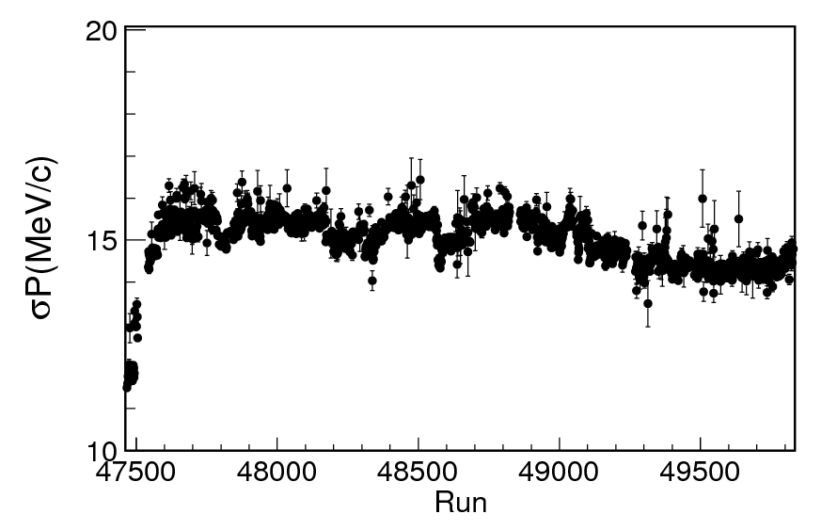
Resolutions vs run
Spatial resolution vs run
σP vs run

Slide 6
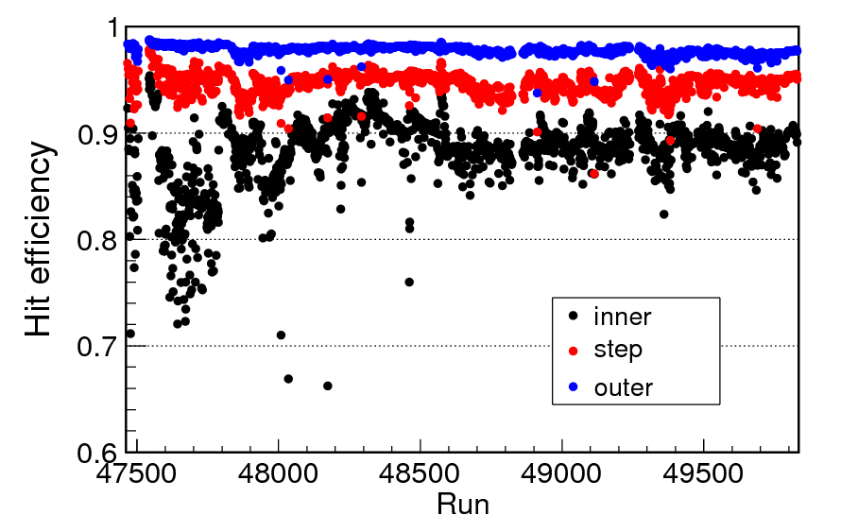
Hit efficiency vs run

Slide 7
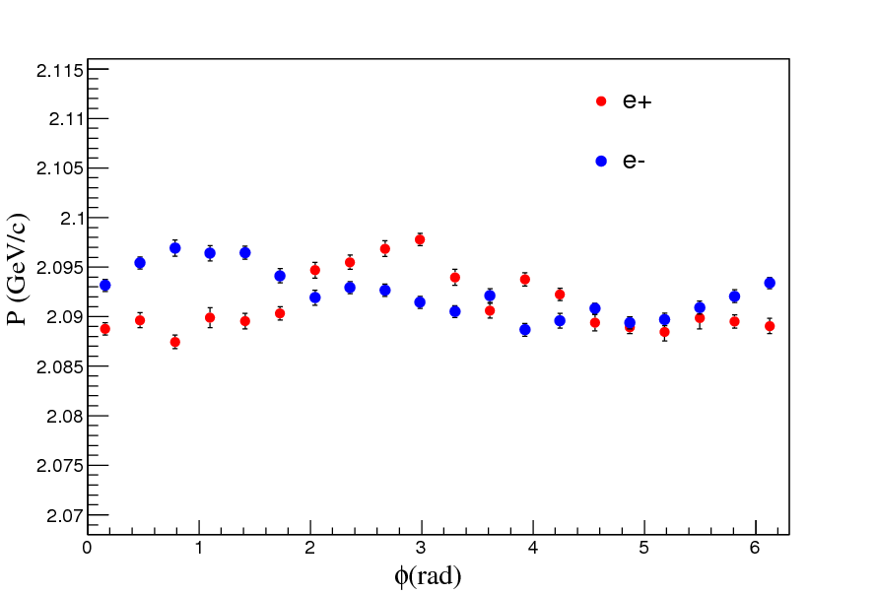
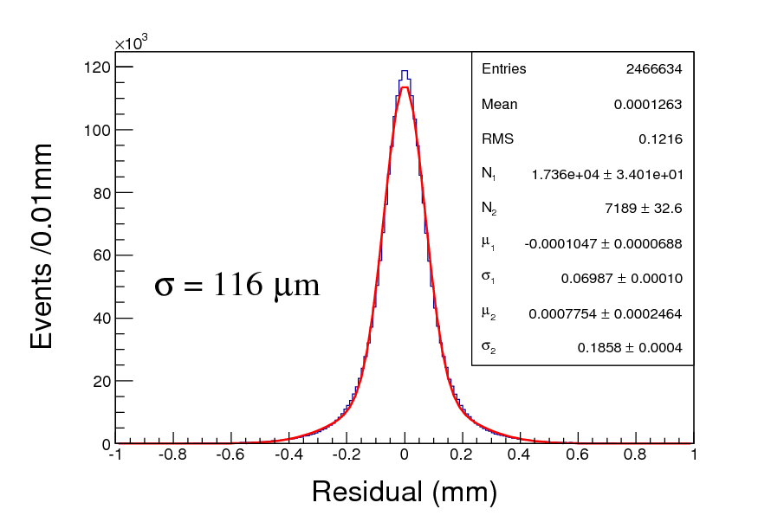
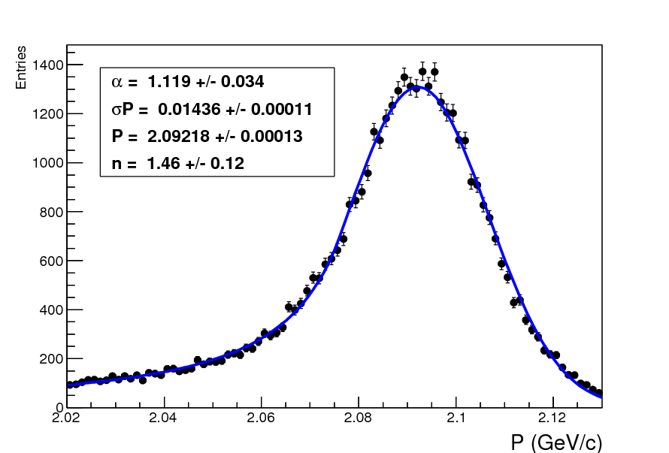
Resolutions
Run47543 (Low noise occupancy)
Resolutions are normal
  Spatial resolution: 116μm
  σP=14.4MeV/c @2.1GeV/c
Alignment: No big displacement

Slide 8
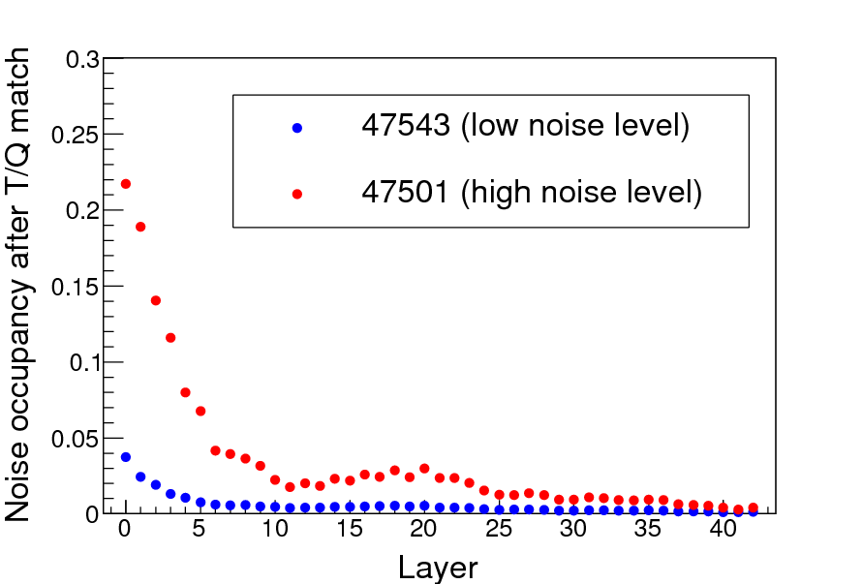
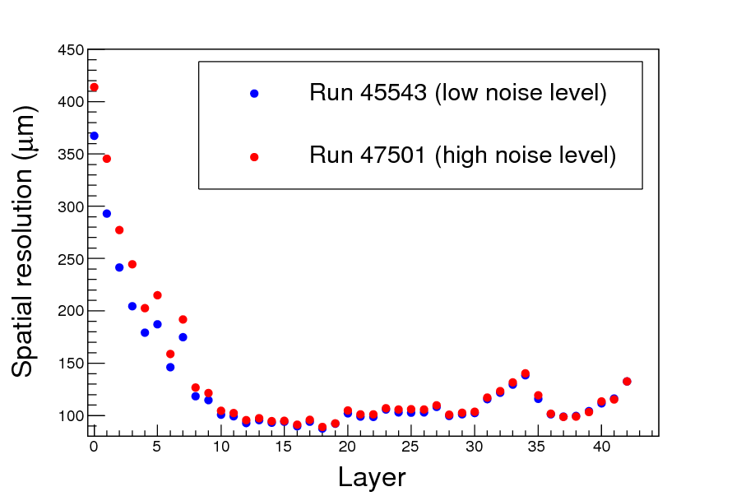
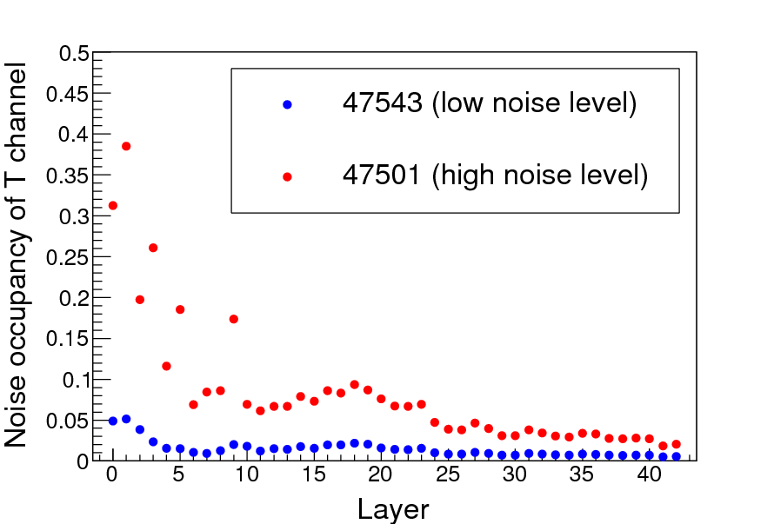
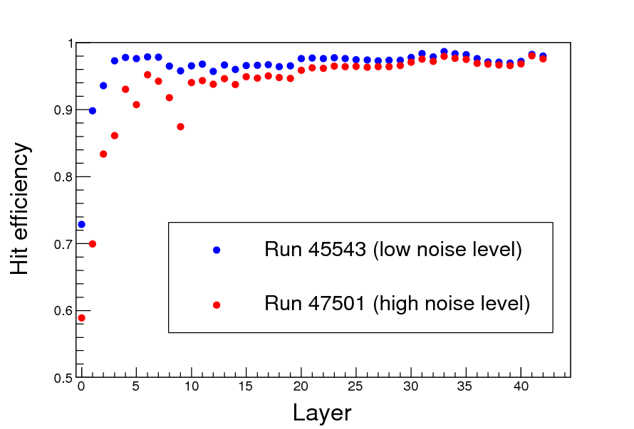
Layer by layer comparison

Slide 9
dE/dx performance is normal
From Jinfa Qiu and Kai Zhu
All fluctuations are within reasonable ranges.
The resolution is fine.

Slide 10
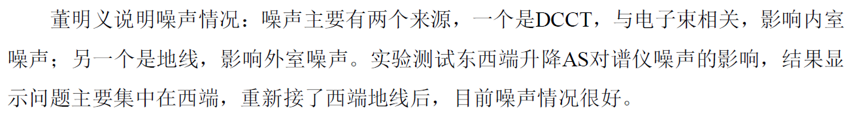
Noise issue
Beam related background
  Reflected from leakage current and has impact on both T and Q channels (BG)
Two types of electronics noises
  Electron beam related noise in T channels of the inner chamber (N I)
  Beam-independent noise in T & Q channels of all layers (N II)

Slide 11
Electron beam related noise (N I)
Provided by Mingyi Dong
Features:
  Only has a relationship with the current of the e⁻ beam, and become more serious with the increase of the current of the single e⁻ bunch.
  Just impact on the time measurement of the inner chamber cells
  The noise in the odd layer (layer 1,3,5…, read out from the east end of the MDC) is more serious than the even layer (layer 0,2,4…, read out from the west end )
Noise source: DCCT (DC current transfer) in the e⁻ storage ring
Solution: Replace the new DCCT shielding box with the old one, and the noise disappears (The new shielding box is bigger than the old one, which benefit the cooling, but the new shielding box have no magnetic layers ) (Feb 14, 2017)

Slide 12
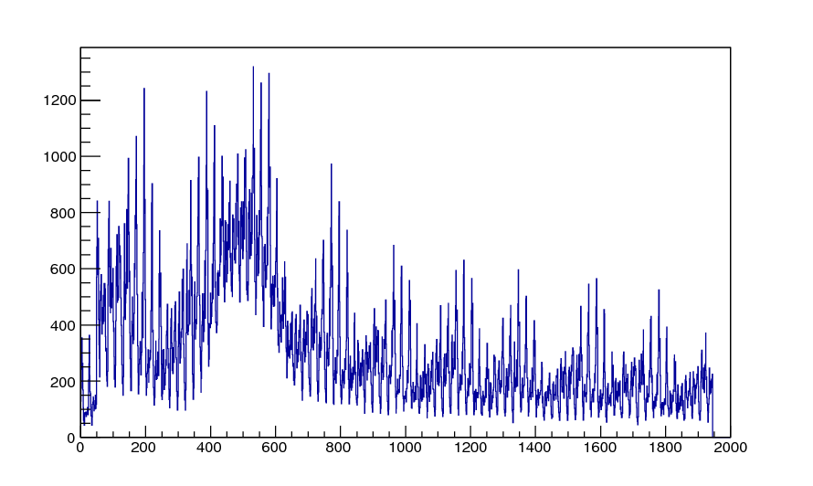
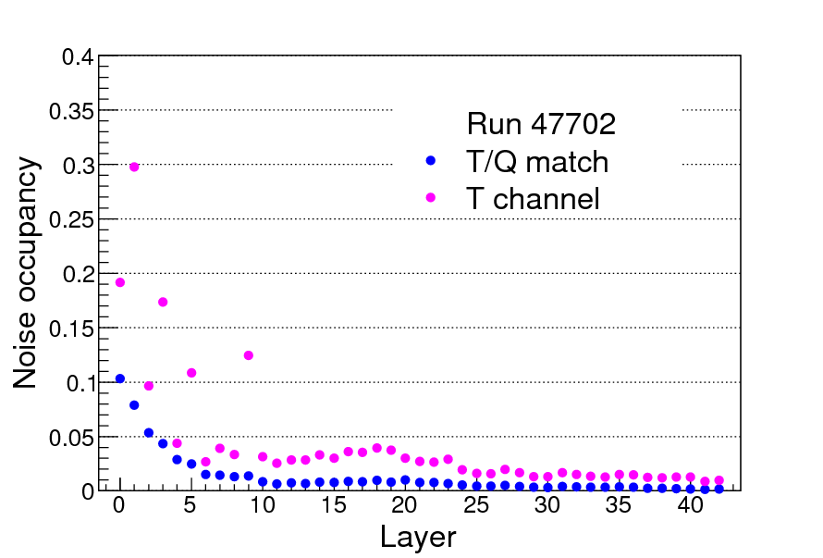
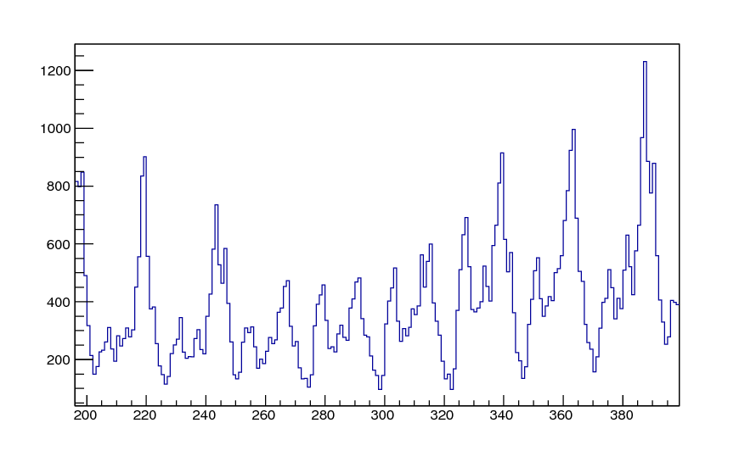
TDC distribution
layer3
TDC (ns)

Slide 13
Beam-independent noise (N II)
Provided by Mingyi Dong
Features:
  This noise has no relationship with the beam
  Has an relationship with the current of AS (reverse solenoid) at the west end
  Has an effect on both the time and the charge measurement of all cells from the inner chamber to the outer chamber
Noise source: the ground from the west end
Solution: reconnect the ground of the accelerator together with the ground of the west door of BESIII and west end cap of EMC, and the noise disappears (Feb 23, 2017)

Slide 14
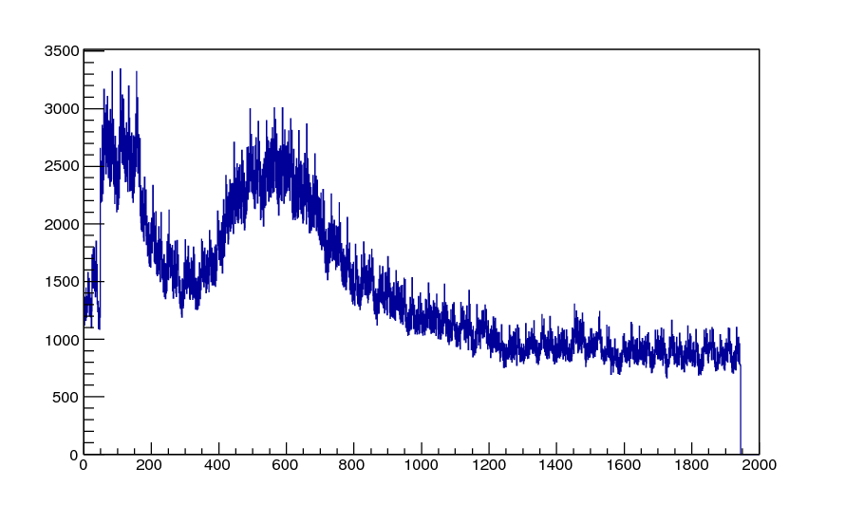
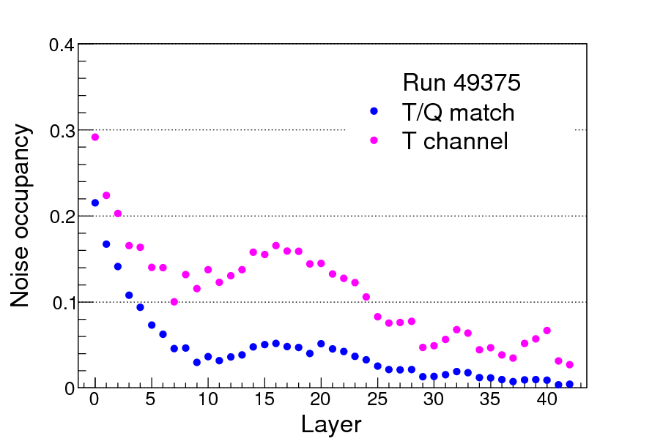
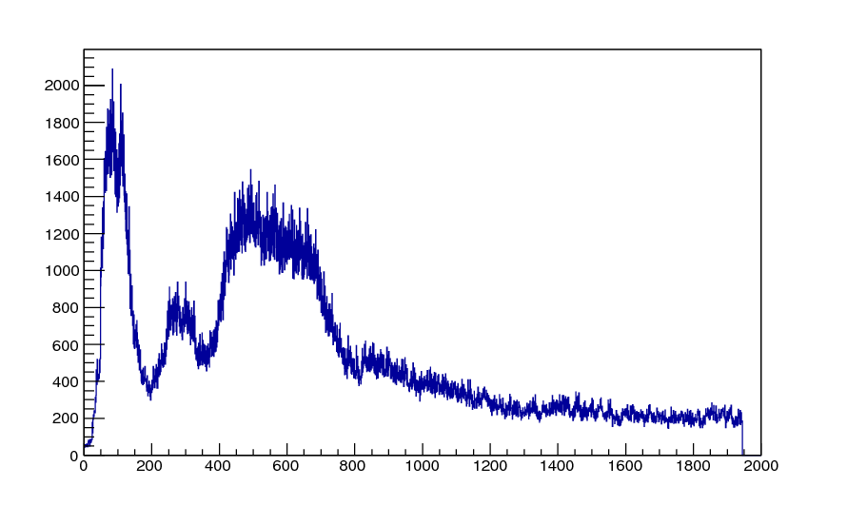
TDC distribution
Layer 16
T channel
T/Q match
TDC (ns)

Slide 15
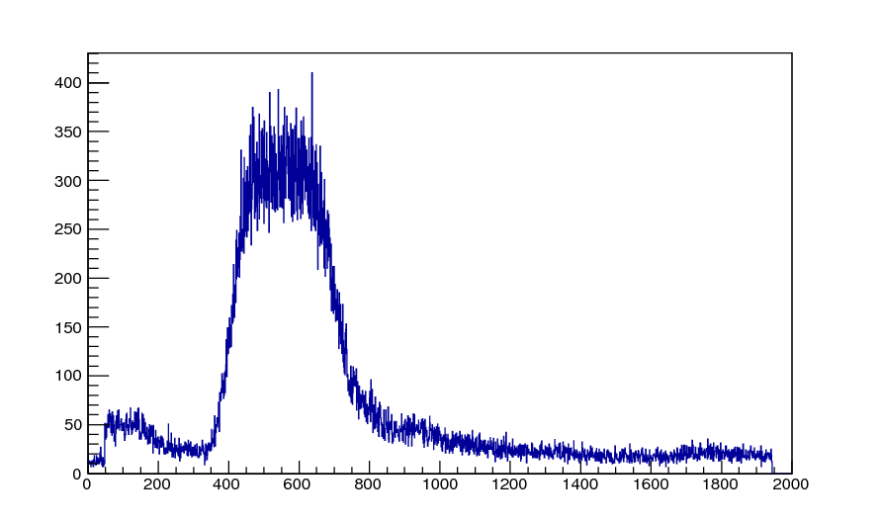
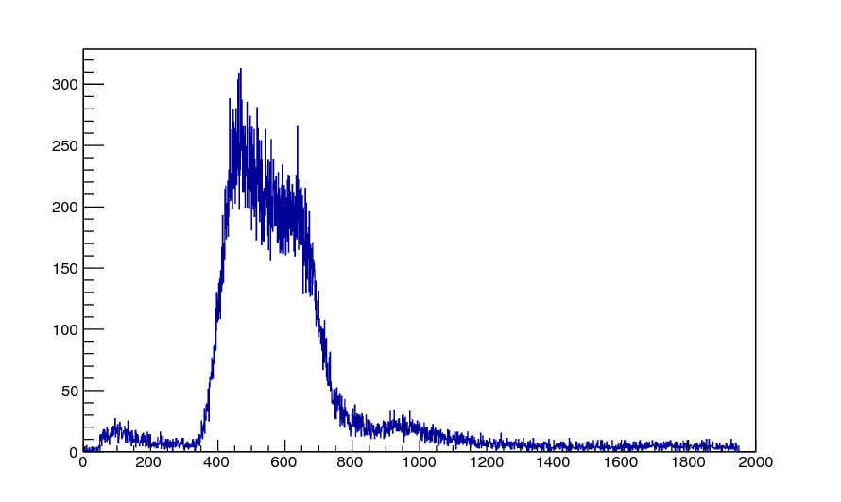
TDC distribution (Layer 16)
Run 47543
Low noise level
Run 49375
T channel
T channel
noise
T/Q match
T/Q match
TDC (ns)
TDC (ns)

Slide 16
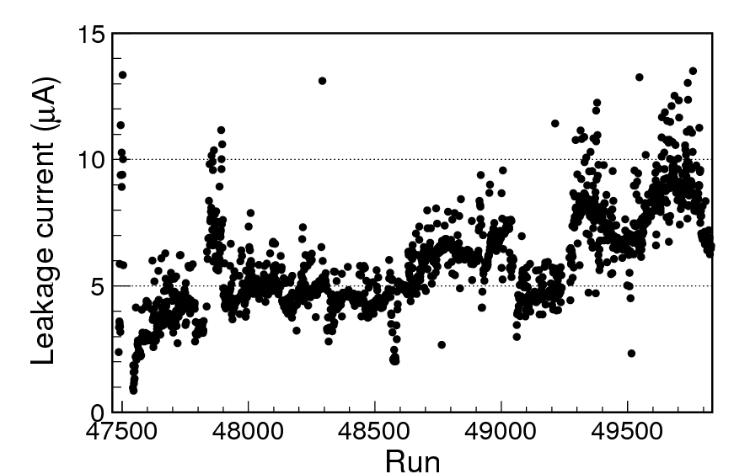
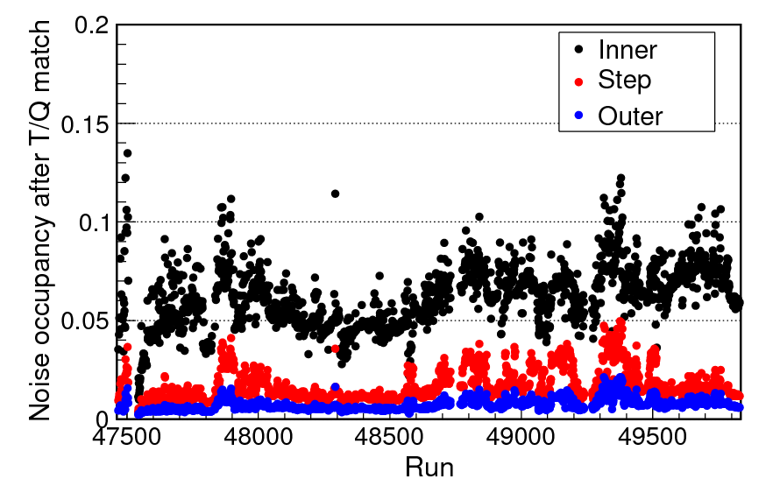
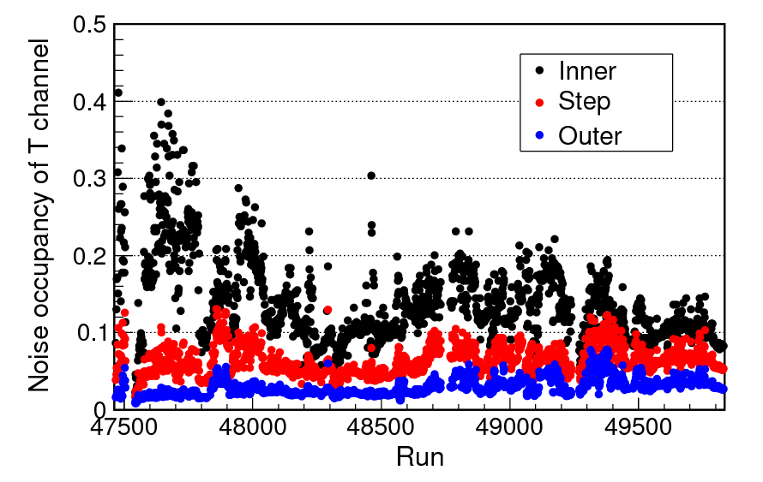
Noise occupancy and leakage current
Layer 1
BG
N I

Slide 17
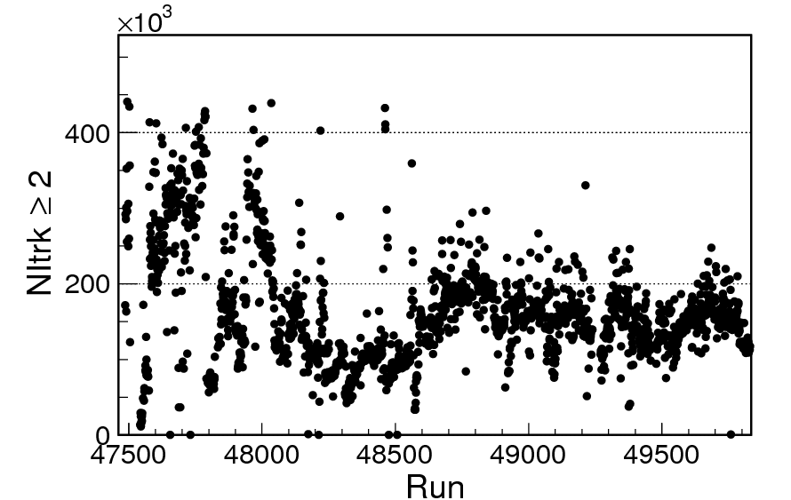
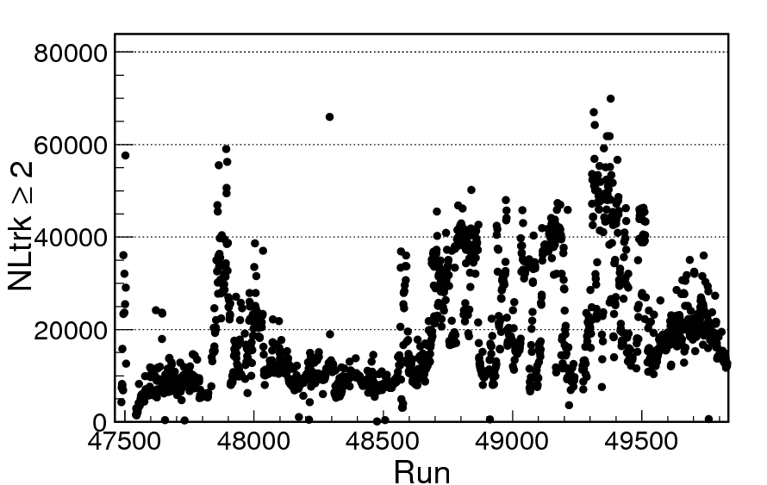
Noise occupancy and trigger rate
N I
N_inner_track ≥2
N_long_track ≥2
N II
Mixture of BG and different kinds of noises in data

Slide 18
Impact on MDC performance
Low noise level→good resolution & hit efficiency
NI causes low hit efficiency by contaminating the drift time

Slide 19
Impact on MDC performance
The impact of NII is not too bad due to the noise can be distinguished with drift time

Slide 20
Impact on MDC performance
Why the resolution is so worse?
Gain? ×
Calibration? ×
Tracking algorithm? ×
Other reasons?

Slide 21
Impact on MDC performance
48503
48605

Slide 22
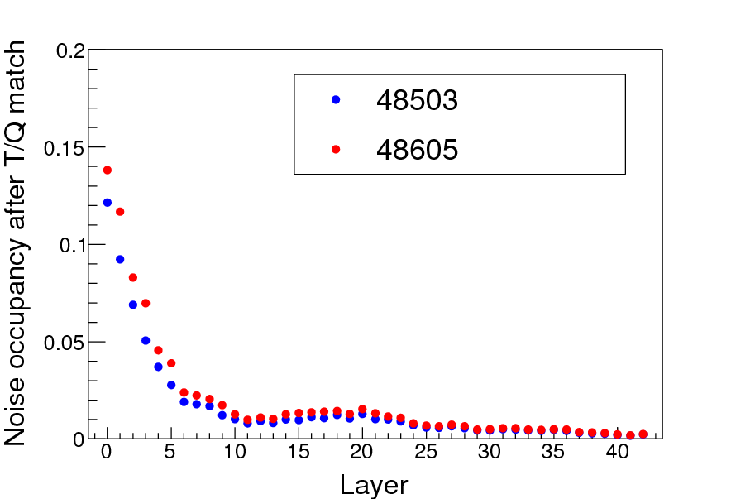
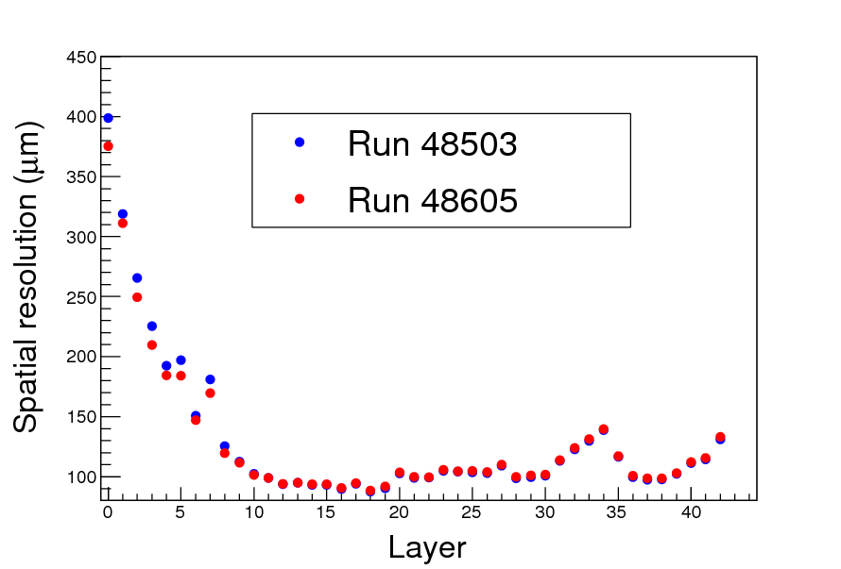
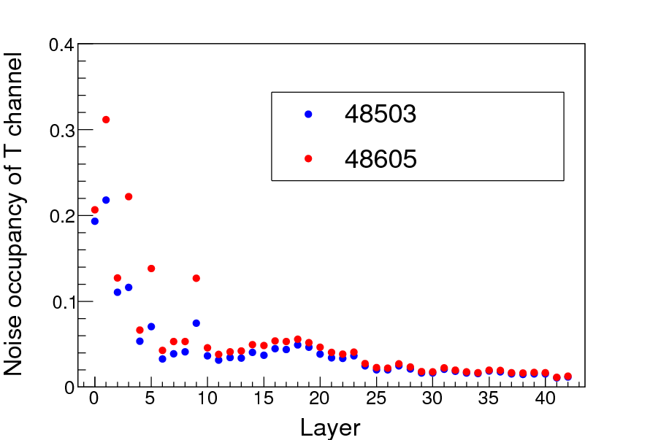
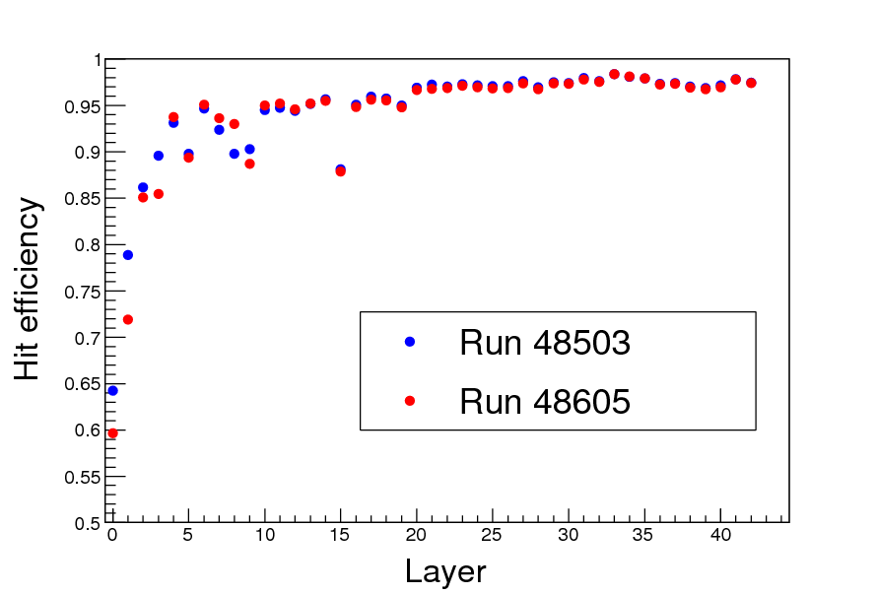

Slide 23
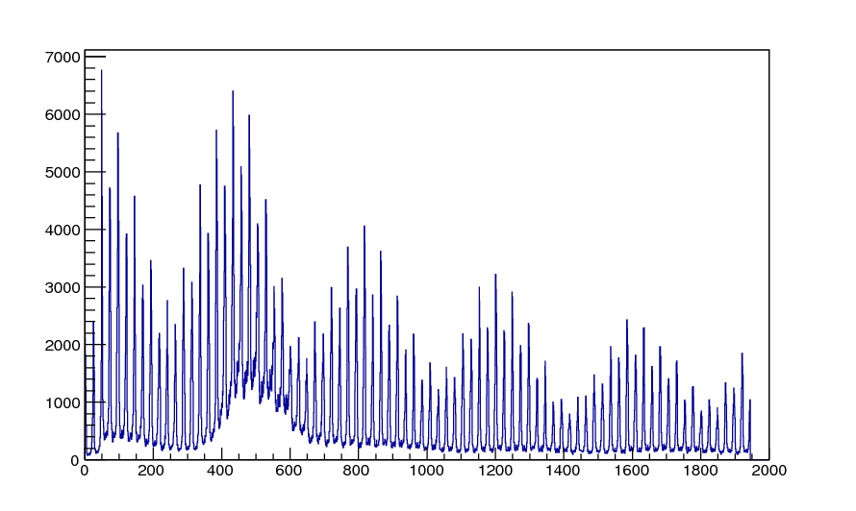
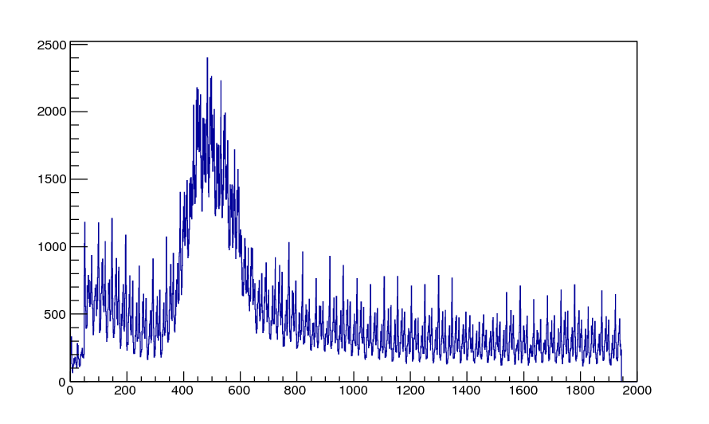
TDC distribution of layer 5
Run 48605
Run 48503
TDC (ns)

Slide 24
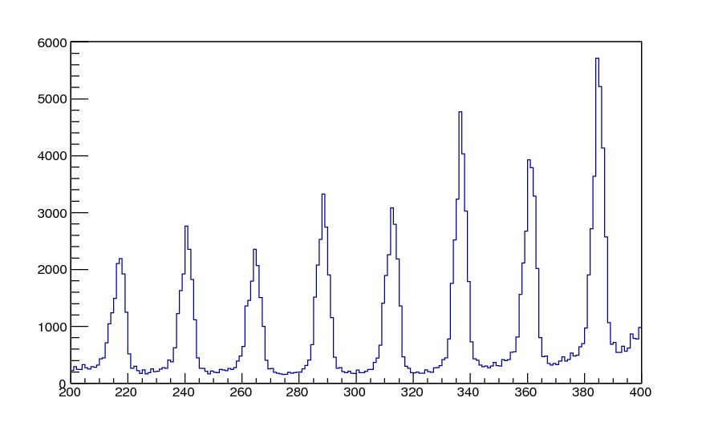
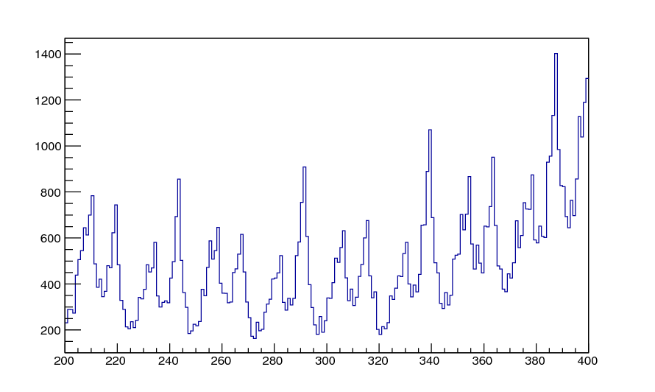
TDC distribution of layer 5
Run 48605
25ns
Run 48503
25ns
TDC (ns)

Slide 25
Summary
Resolutions and hit efficiency are good at low noise level
No big displacement
dE/dx performance is normal
Noise
  Mixture of beam background and different kinds of electronics noises
  Need more study
Thanks for your attention!

Slide 26
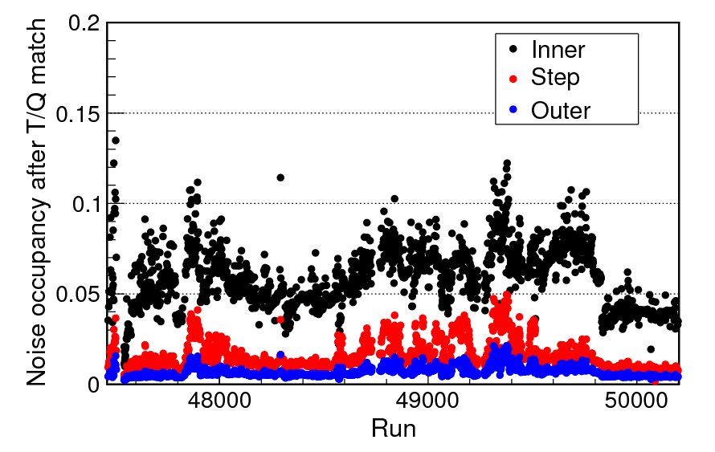
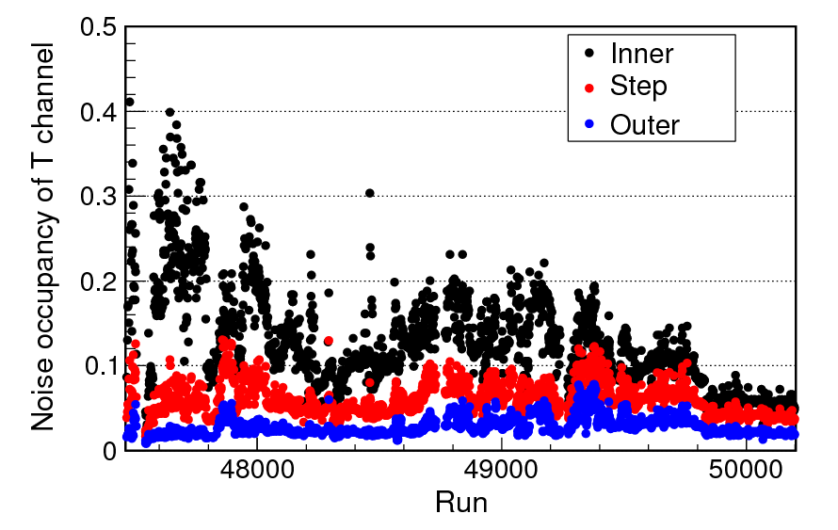
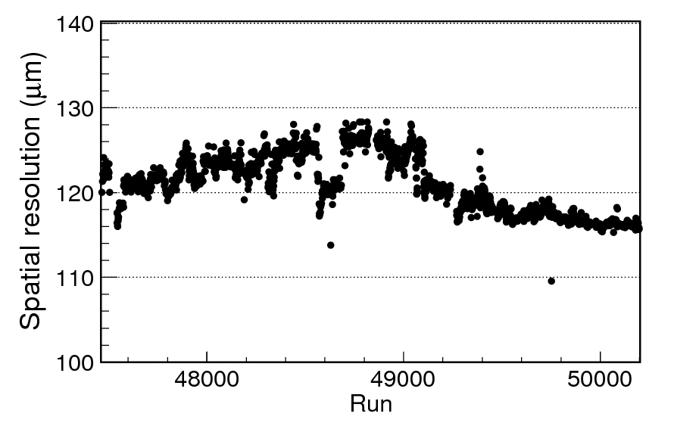
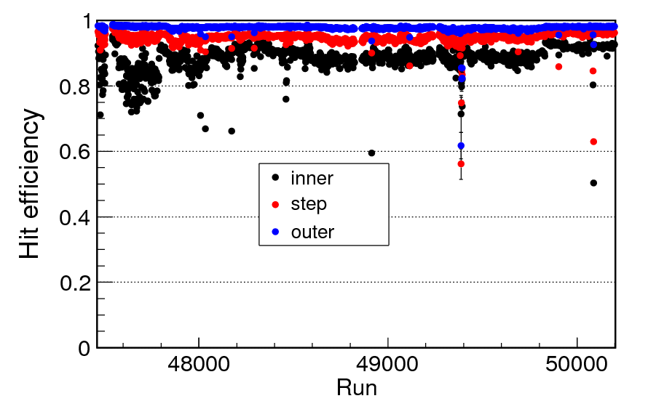
backup

