Slide 1
Evaluation of vertical emittance from solenoid
ZHANG, Yuan YU, Chenghui WANG, Yiwei
CEPC AP Meeting
2017-03-24

Slide 2
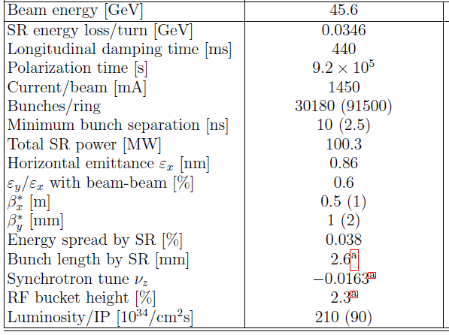
Memo
CEPC V170306
FCC
Emitx/Emity
H: 1.31/0.004 nm
W: 0.57/0.0017 nm
Z: 1.48/0.0078 nm
arXiv:1610.07170 [physics.acc-ph]

Slide 3
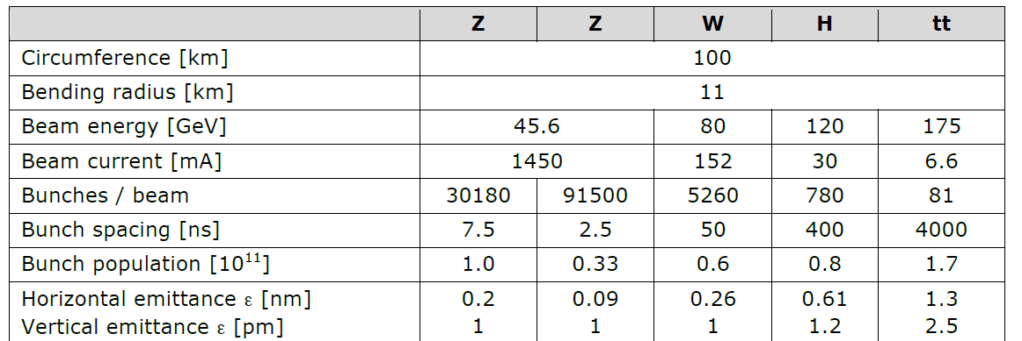
Memo 2
FCC-20160621

Slide 4
Introduction
（-2m，-1m），-3T
（-1m，+1m），3T
（+1m，+2m），-3T

Slide 5
Higgs

Slide 6
W

Slide 7
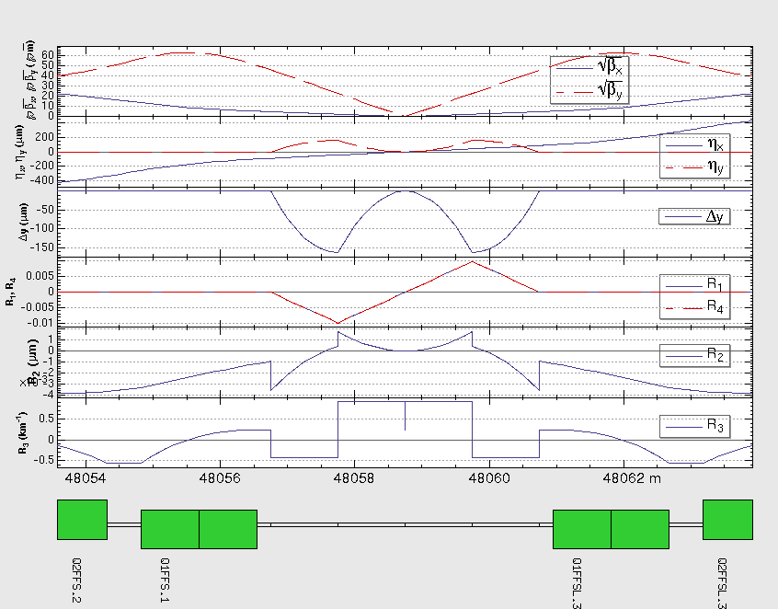
Z
IP1
If the emittance come from coupling in arc?
IP3

Slide 8
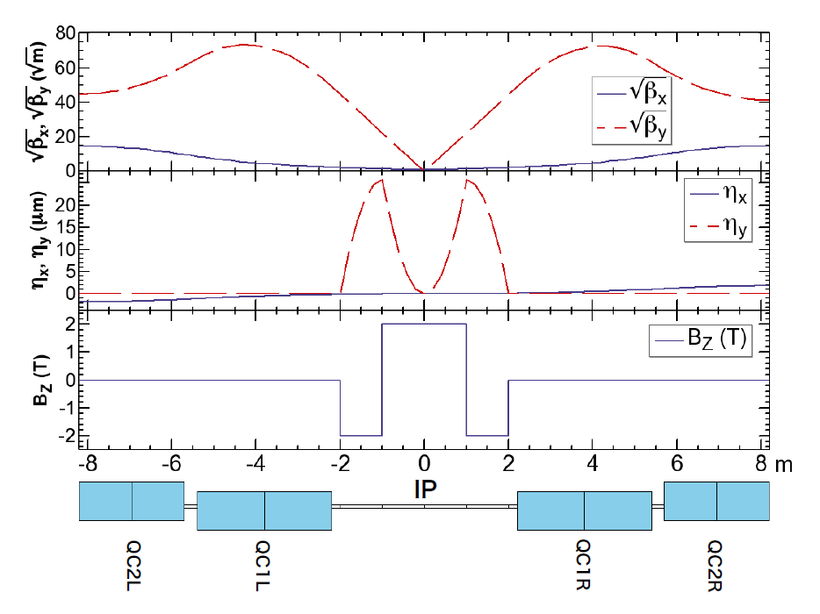
FCC
“The emittance blow-up due to two interaction regions is computed to be 0.11 pm, which is about 10% of our vertical emittance budget.”
“The increase of the
vertical emittance is below 0.2 pm, for 2 IPs, with the step-function prole assuming 10 cm for the length of fringe.”
arXiv:1610.07170 [physics.acc-ph]
arXiv:1607.05446 [physics]

Slide 9
Z: If Amplitude of Bz reduces from 3T to 2T

Slide 10
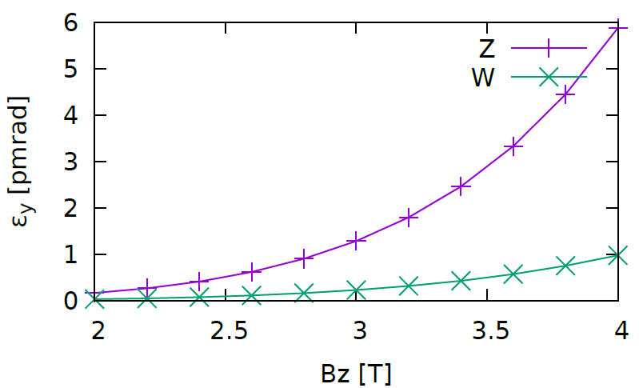
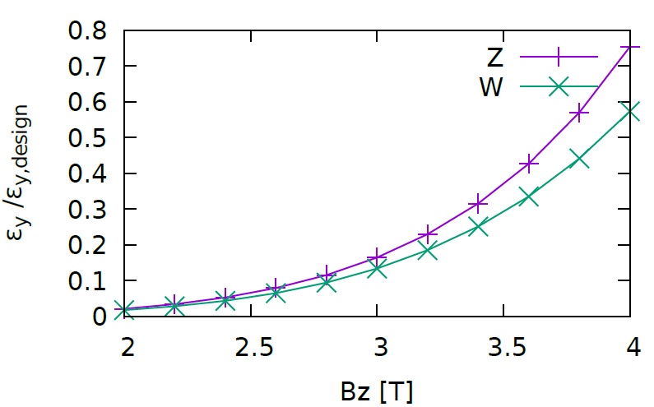
Vertical emittance versus BZ
3T seems good!

Slide 11
CEPC SOL Region
F1 follow Oide now. BAI, Sha?
From K. Oide:
These numbers for F1 are very rough estimation. The length F1 is more or less comparable to the diameter of the solenoid.
SL2/3_F1=0
SL2_F1=0
SL3_F1=0
Vertical emittance coming from
the fringe (3 <-> -3T) is 0.59pm
the fringe (-3 <-> 0T) is 0.76pm
Arc coupling: 7.28e-14/2.28e-10 = 3.2e-4

Slide 12
F1 of SL2 (3 <-> -3T)

Slide 13
F1 of SL3 (0 <-> -3T)

Slide 14
Summary
The vertical emittance could be accepted for the current solenoid configuration
More detailed calculation need more detailed solenoid field data
Need real Z lattice to check

