Slide 1
Parameters of CEPC
Cui Xiaohao

Slide 2
Main parameters of H,W and Z mode
 | Higgs | W | Z
Emittance(nm) | 1.31 | 0.57 | 1.48
Bunch number | 644 | 5534 | 21300
Bunch particle(E11) | 0.968 | 0.365 | 0.455
Bunch Current (mA) | 29.9021 | 96.8886 | 464.8702
5% Bunch charge (nC) | 0.7744 | 0.292 | 0.364

Slide 3
BhaBha lifetime
 | Higgs | W | Z
Bunch Number | 644 | 5534 | 21300
e- per bunch (E11) | 0.968 | 0.365 | 0.455
N0(E13) | 6 | 20 | 97
Luminosity (E34) | 3.13 | 5.15 | 11.9
BhaBha Lifetime (hr) | 1.3 | 2.69 | 5.6

Slide 4
Injection Time
 | Higgs | W | Z
Energy( GeV) | 120 | 80 | 45
Ramping Time (s) | 10 | 7 | 4s
Lifetime ? | 30 min | 2 hr | 4 hr
Time for 5% particle drop | 90 s | 360 s | 740 s
Bunch Number | 644 | 5534 | 21300
Bunch Charge (nC) | 15.49 | 5.84 | 7.28
5% Bunch Charge (nC) | 0.7745 | 0.292 | 0.364
Inject time from Linac | 13 s | 110 s | 426 s

Slide 5
Can We cure this by injecting many times?
Inject into the collider
Inject 1/N bunches into booster
Inject 1/N bunches into booster

Slide 6
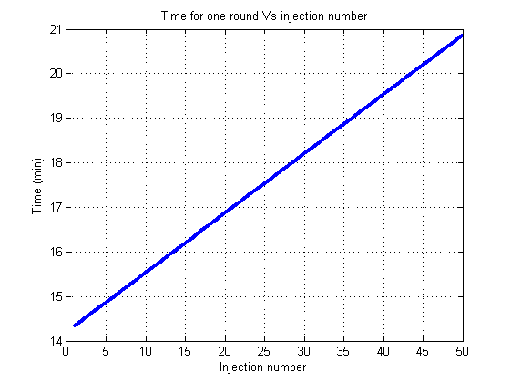
Time Taken to inject into every bunch

Slide 7
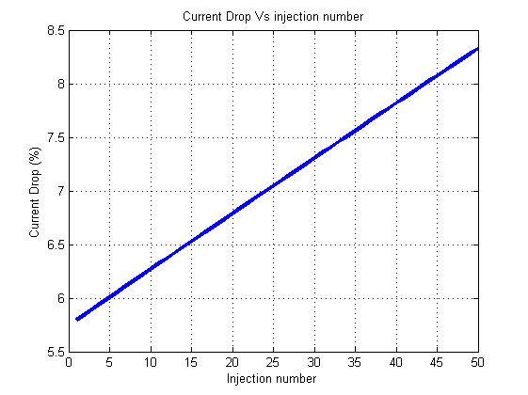
Beam current drop

Slide 8
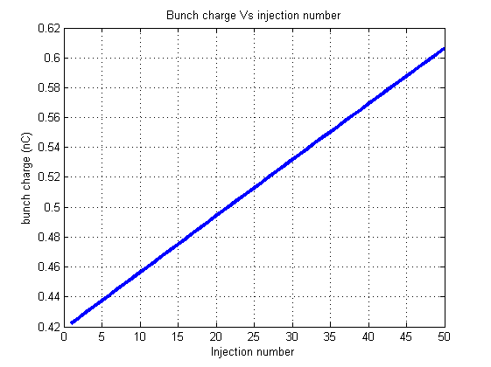
Bunch charge in the booster

Slide 9
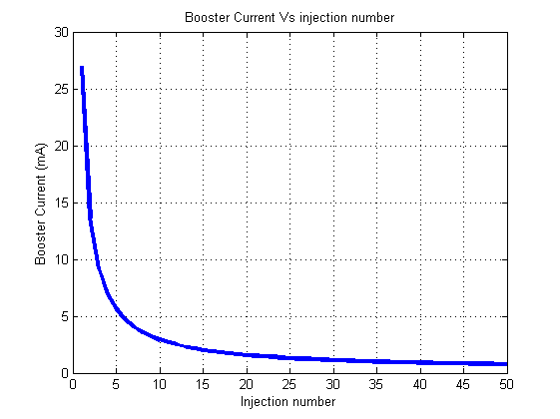
Booster Current

Slide 10
Backup Slides

Slide 11
Injection from Linac to booster
Linac frequency: 50 Hz
Time between Linac bunches: 20 ms
Recirculation time of the ring: 3.3356e-004 s
RF frequency of the main collider: 650 MHz, 1.5385e-009 s
Bunch separation: 5.1795e-007s/ 6.0275e-008s/ 1.5660e-008s

