Slide 1
Hough Transform with drift distance
2017-3-30

Slide 2
Outline
Conformal transform
Fill Hough Map
Use slant of sino line on Hough Map
The maximum bin on Hough Map - > track
Hits select method : in Real space
deltaD
Multi turn tracks

Slide 3
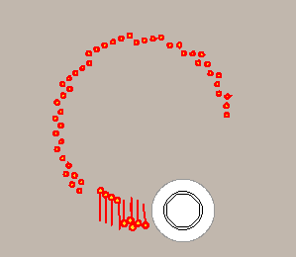
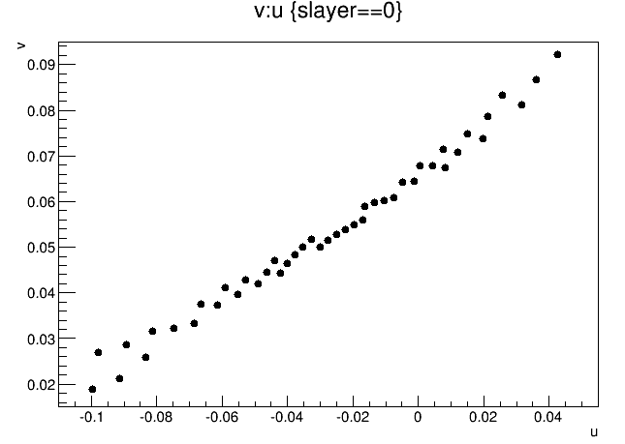
1.Conformal transform
Conformal transform:
Circle -> straight line
Like to stretching a “bend rope” to staight
Previous conformal transform
u=x/(x*x+y*y)
v=y/(x*x+y*y)
(x,y) midpoint of hits in real space
(u,v) points in CF space
use only mid point of axial hits
every points have big error due to neglect drift distance
2nd half
Circle corner
First half

Slide 4
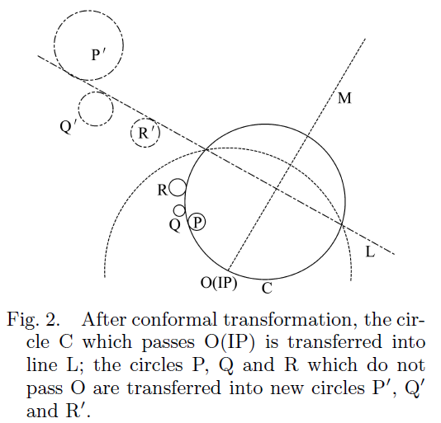
Modified CFT and HT method
Circle not passed (0,0) will still be circle by modified CFT
For circle (xc,yc,rc) in real space :
Xc=2*x /( xc*xc + yc*yc - rc*rc)
Yc=2*y / ( xc*xc + yc*yc - rc*rc)
Rc=2*rc /( xc*xc + yc*yc - rc*rc)
Circle (xc,yc,rc) turned to (Xc,Yc,R) in CF space
Proved by legendre transform , circle tangent to the same circle will tagent to the straight line in CF space

Slide 5
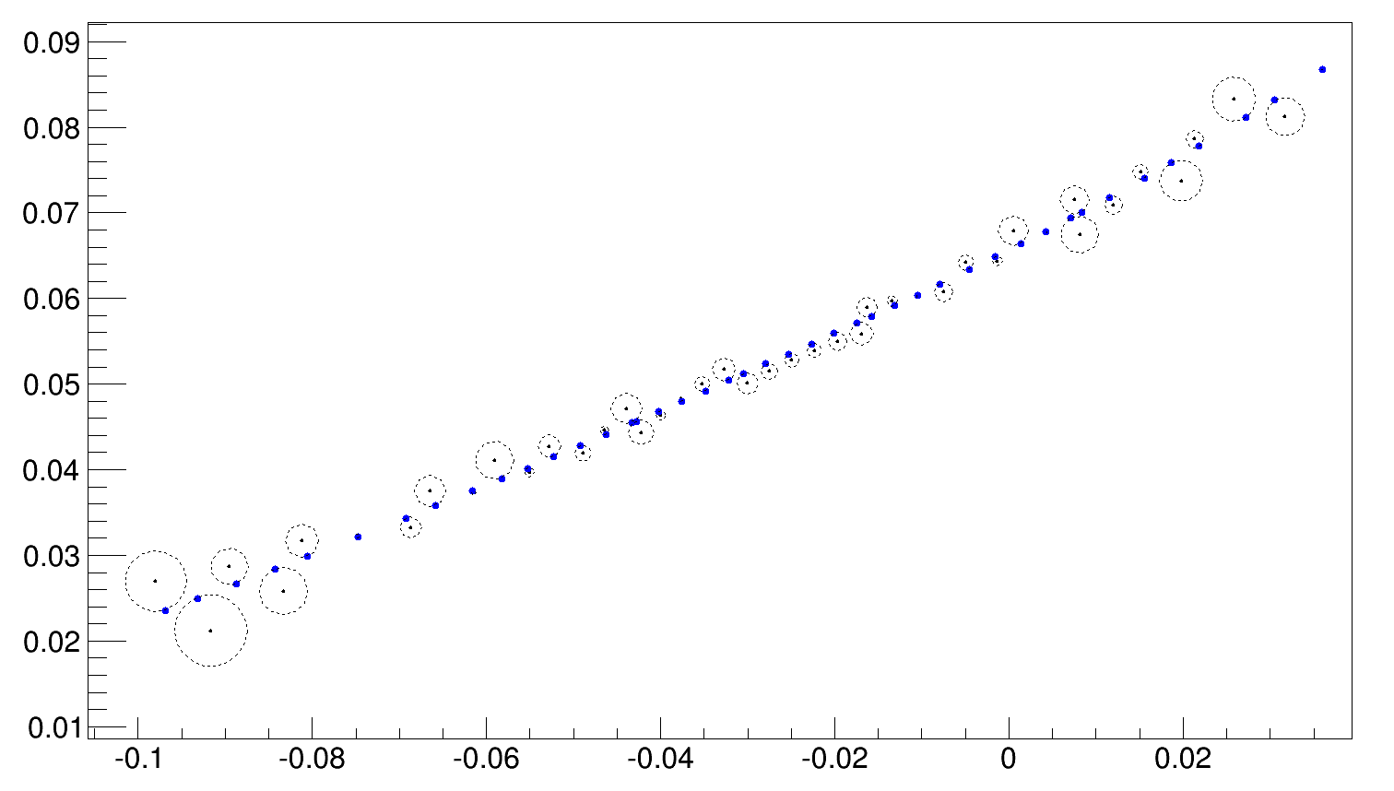
Perform on Conformal Space
Every drift circle is transformed by CFT to CF space
Xc = x/(x*x + y*y - drift*drift )
Yc = y/(x*x + y*y - drift*drift )
CFdrift = drift/( x*x + y*y - drift*drift )
Blue points : truth position of hits in MC
Circle : each drift circle by CFT
A fix pt 60MeV event
Real Space
Old CFT
new CFT

Slide 6
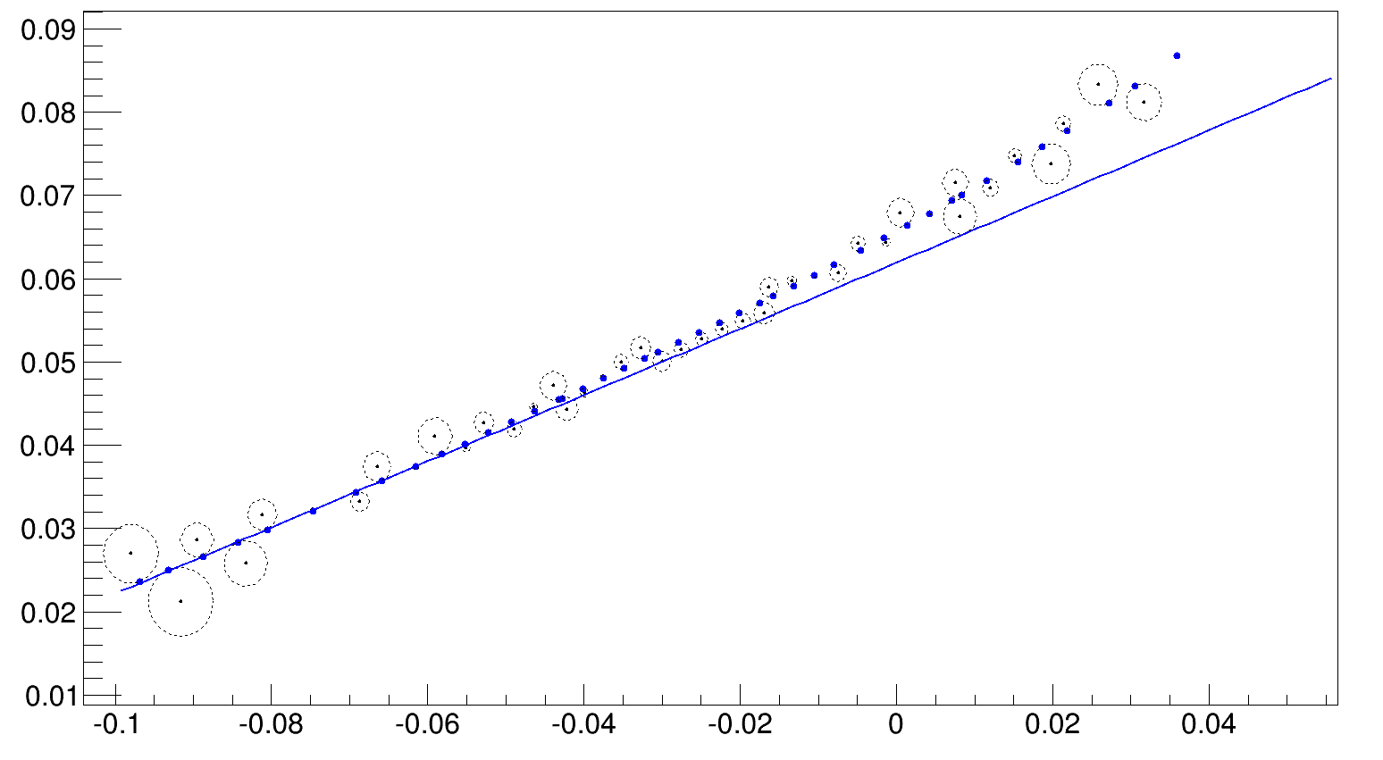
2.Hough Transform based on Conformal Transform
Blue points : truth position of hits in MC
Blue line : by line fit of hit truth information
Of first 10 axial hits
Circle : each drift circle by CFT
Far ,mainly due to energy loss
Hough transform aim to find a line as close to the above line

Slide 7
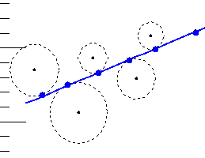
Fill Hough Map CF Space -> Hough Space
The straight line is tangent to each drift circle on CFS
Split the drift circle along alpha , for example (0~360) to 60 parts
For each part there is a tangent line to the drift circle
More parts - > more accurate of the track

Slide 8
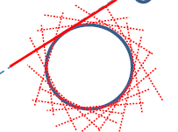
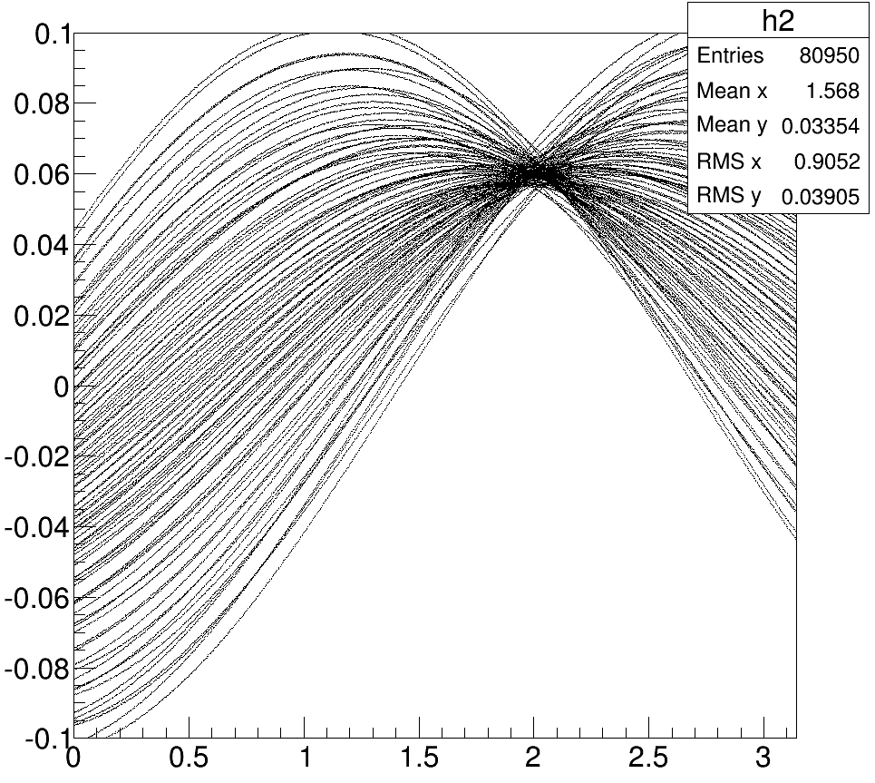
CF Space -> Hough Space
Calculate tangent line of each points on the drift circle
Convert parameters to (rho,theta) , and fill Hough Space
all drift circles on Hough Space

Slide 9
3.Use slope of sin line on Hough Map
Slope of line means the position of that hit on track

Slide 10
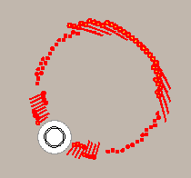
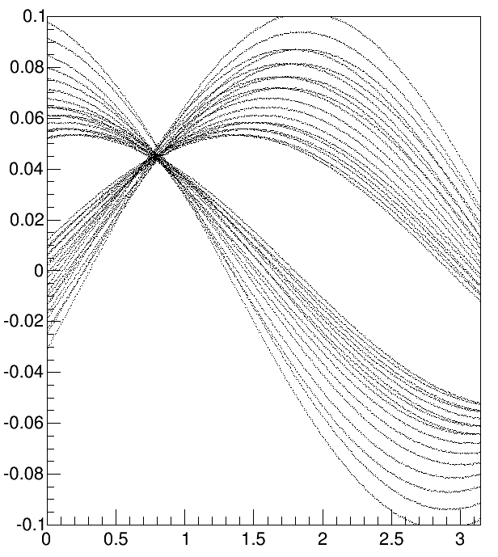
(1) Slope to diff 1st and 2nd circle
Same with the previous method
Determine by sign of slant & sign of rho
(sign of slant) *(sign of ρ)
Hits on 1st half and 2nd half have different sign of slope when there appears a track

Slide 11
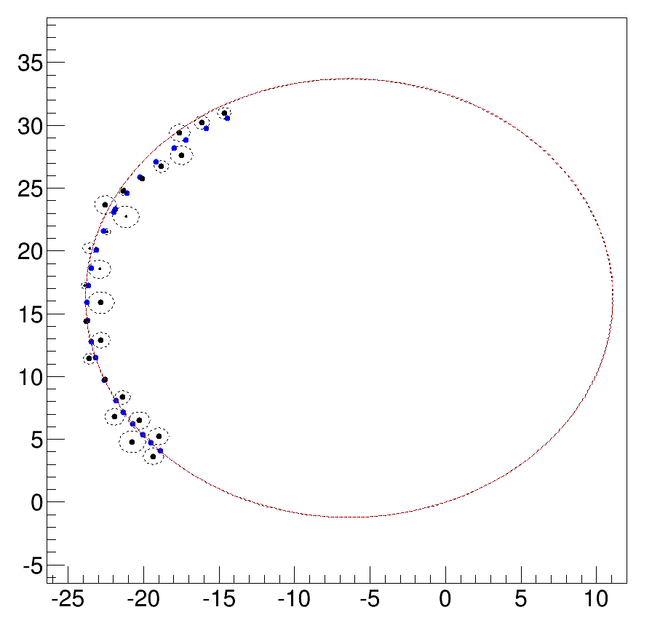
(2) Slope to differ hits on the track corner
Hits on the corner
1 . big energy loss due to long flight length
2. Perhaps bad x-t calibration

Slide 12
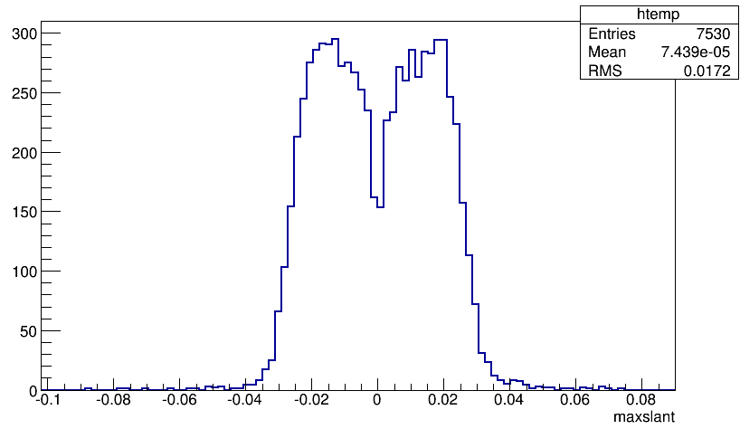
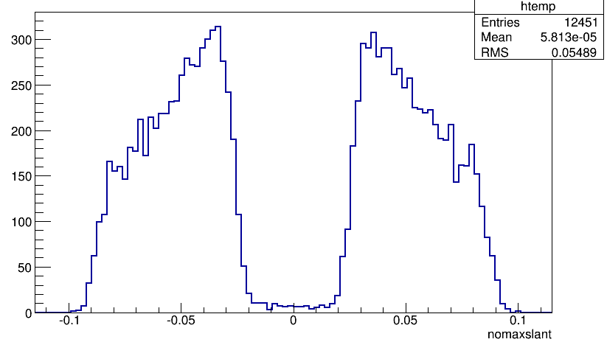
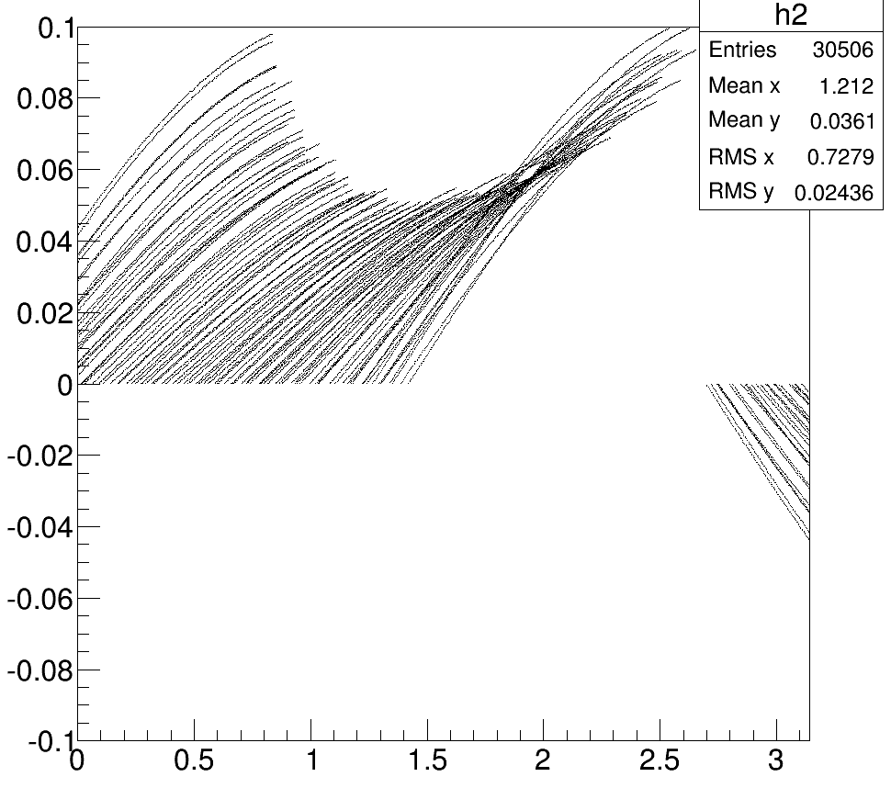
(2) Slope to differ hits on the track corner
Calculate the slope of each sin line where the track appears
Slope of hits ( outer 2 layers)
Slope of hits ( except outer 2 layers)
By slope cut , 1st half hits are reserve on Hough Map & remove outer hits

Slide 13
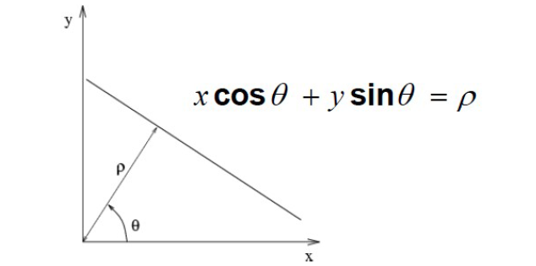
4.Track detecting on Hough Map
Theta : line in CFS 0~pi
Alpha : angel around the drift circle
alpha -> theta two to one match ( 0,2*pi) -> (0,pi)
How to split the drift circle determine the theta bin on Hough map
By this method :
Each bin along theta axis of HS represent one possible position of the straight line in CFS

Slide 14
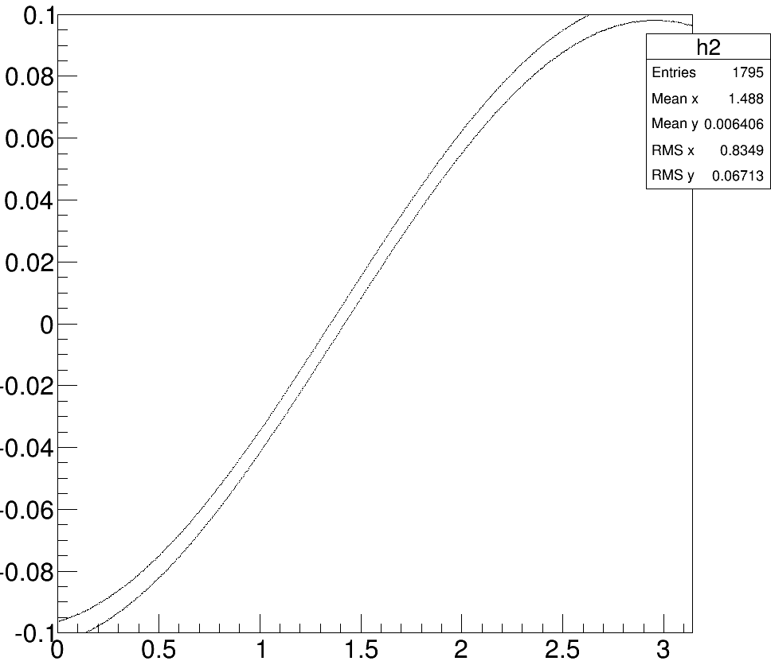
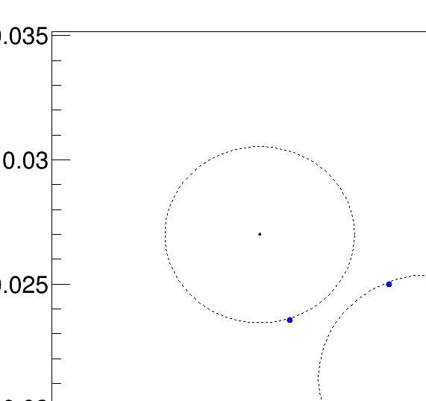
Track detecting on Hough Map

Slide 15
How to split Hough Map
The number of bin of θ axis in Hough Map correspond to
How many parts we split the drift circle
Each point on sino curve in Hough Map correspond to a tangent line in Conformal Space
The number of bin of ρ axis in Hough Map influence the accurate of the straight line in Conformal Space
So , the principle
cut the bin in Hough Map as more as possible
The number of θ correspond to number of parts of drift circle
1000*1000 , time need to improve

Slide 16
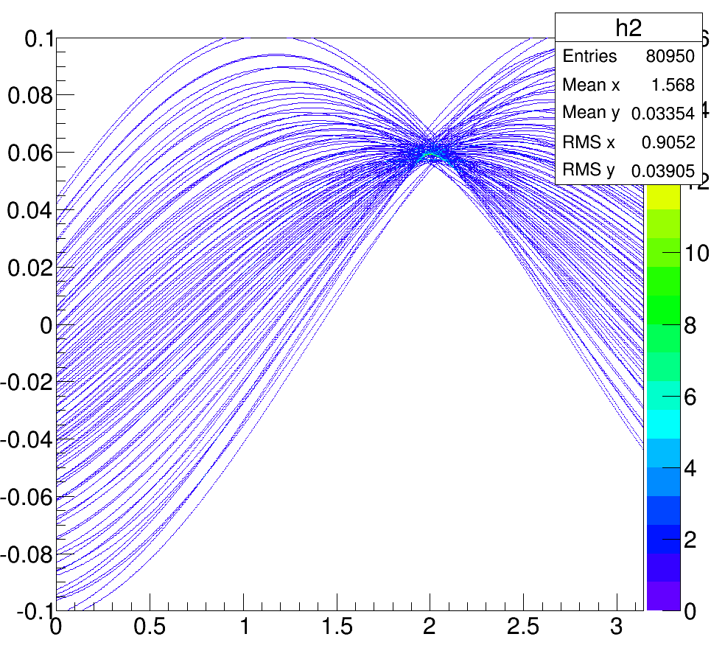
5.Peak detecting
As the old method , look for the maximum bin in local area
For the single track events , we use the maximum bin as the found track in Hough Map

Slide 17
Peak in HoughMap - > track in real space
Rho -> 1/radius_track
Theta -> theta in real space
Circle track in real space :
Rc = (1/rho)
Xc = (1/rho)*cos(theta)
Yc = (1/rho)*sin(theta)

Slide 18
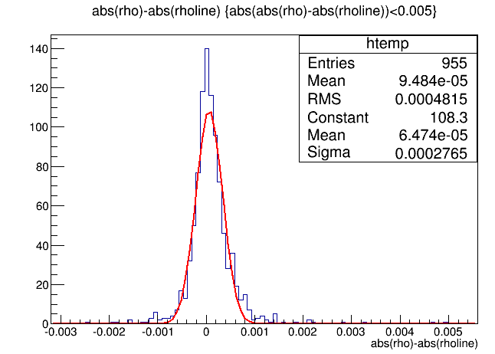
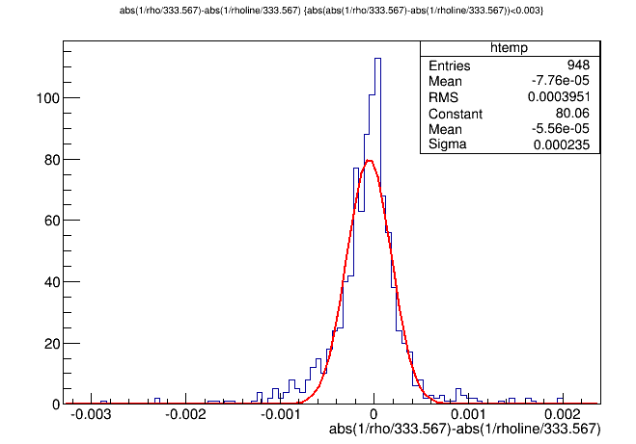
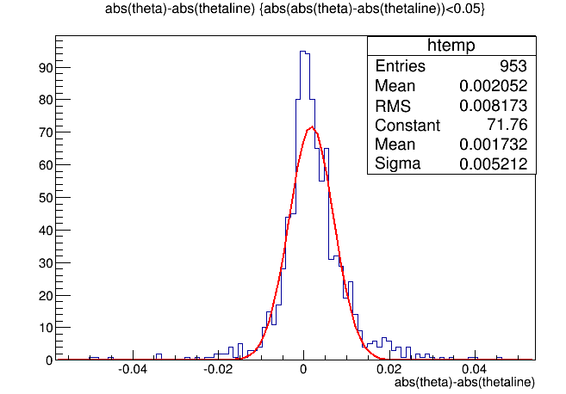
Resolution of track parameter
Fixpt 60 MeV 1000 events , with background
Pt resolution: pt_peak-pt_truth
Pt_truth : by line fit of truth information of first 10 axial hits
Rho
Pt
By find the maximum peak
The pt resolution~0.2MeV
Theta resolution ~0.0052 rad ( 0.3 )
theta

Slide 19
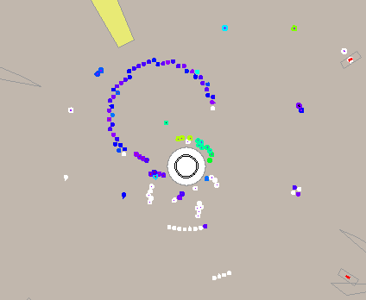
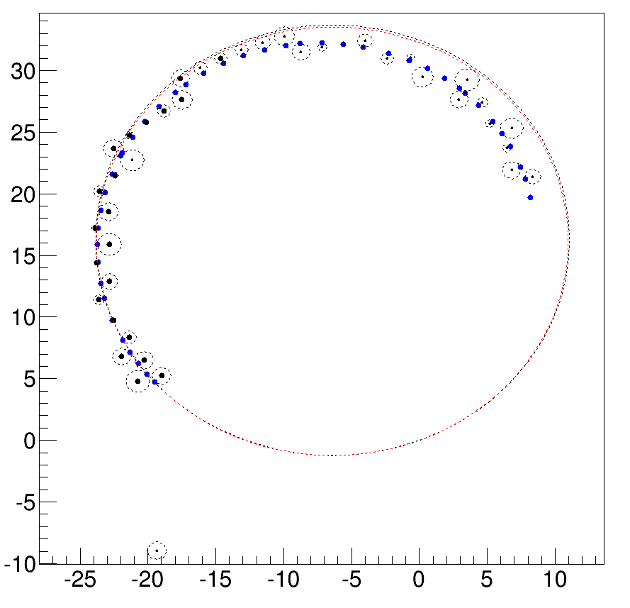
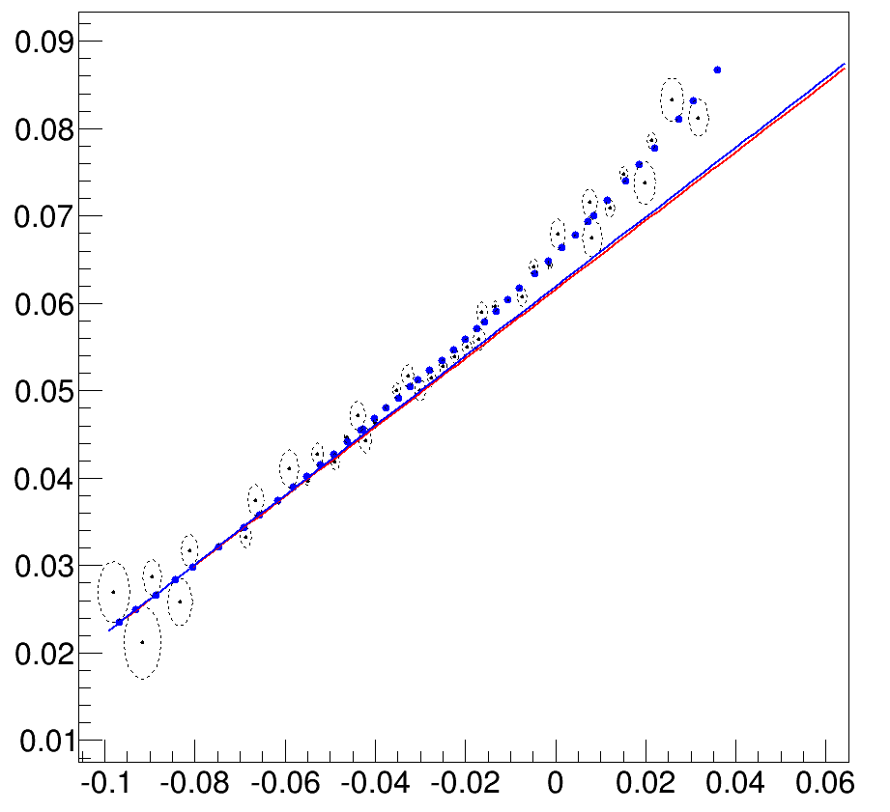
Event : 0

Slide 20
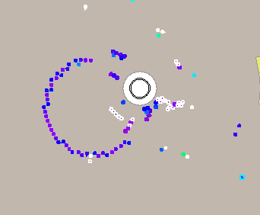
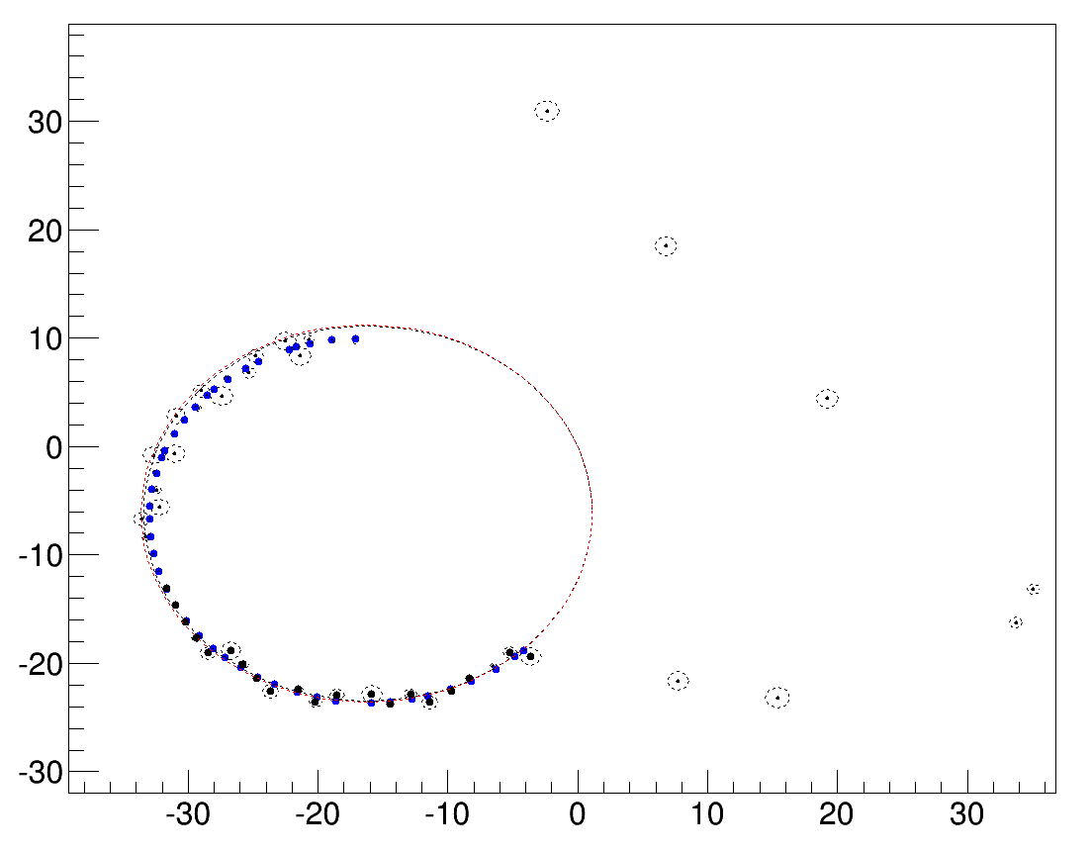
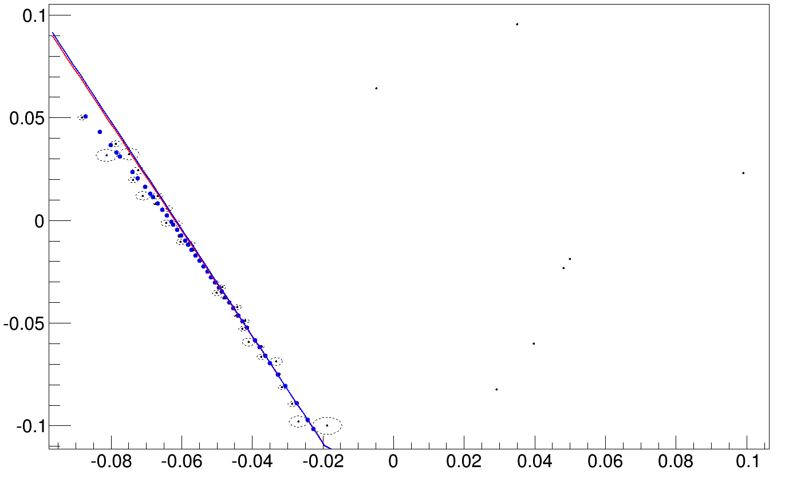
Event : 1

Slide 21
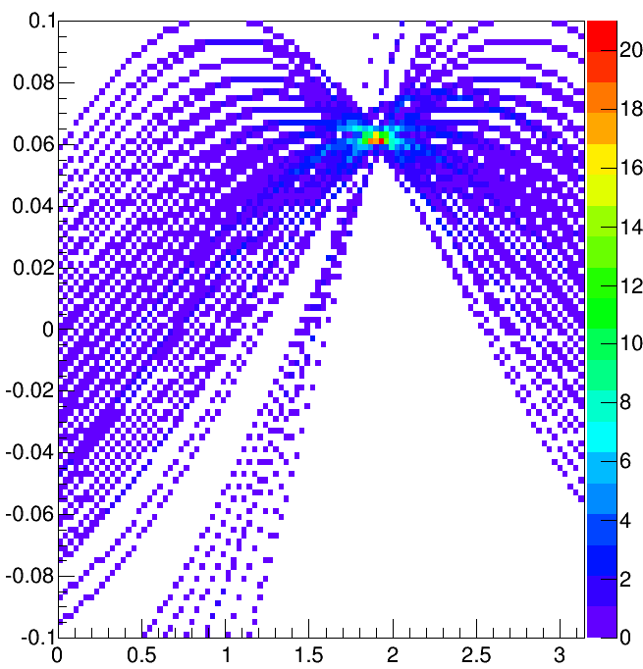
6.Hits select method : in Real space
Use information on real space instead a rectangle in Hough Space to collect hits
Old method

Slide 22
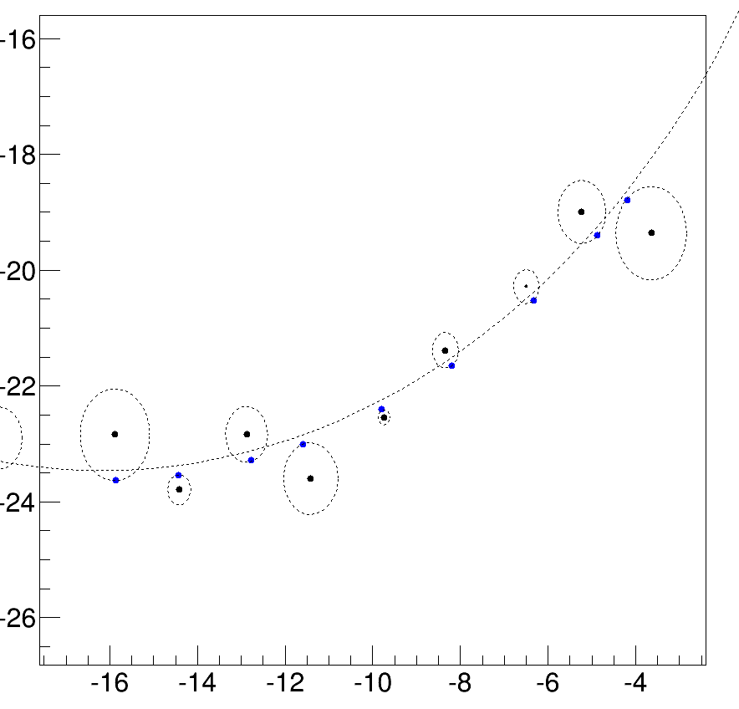
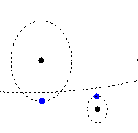
Hits select method : in Real space
deltaD : distance of “fit track” and detect position
We could select hits in a deltaD window

Slide 23
deltaD
O1
O1O2>circle_track :
deltaD = O1O2-circle_track-drift
O1O2<circle_track :
deltaD = O1O2-circle_track+drift
O2
deltaD<0 : circle radius of track is large
deltaD>0 : circle radius of track is small

Slide 24
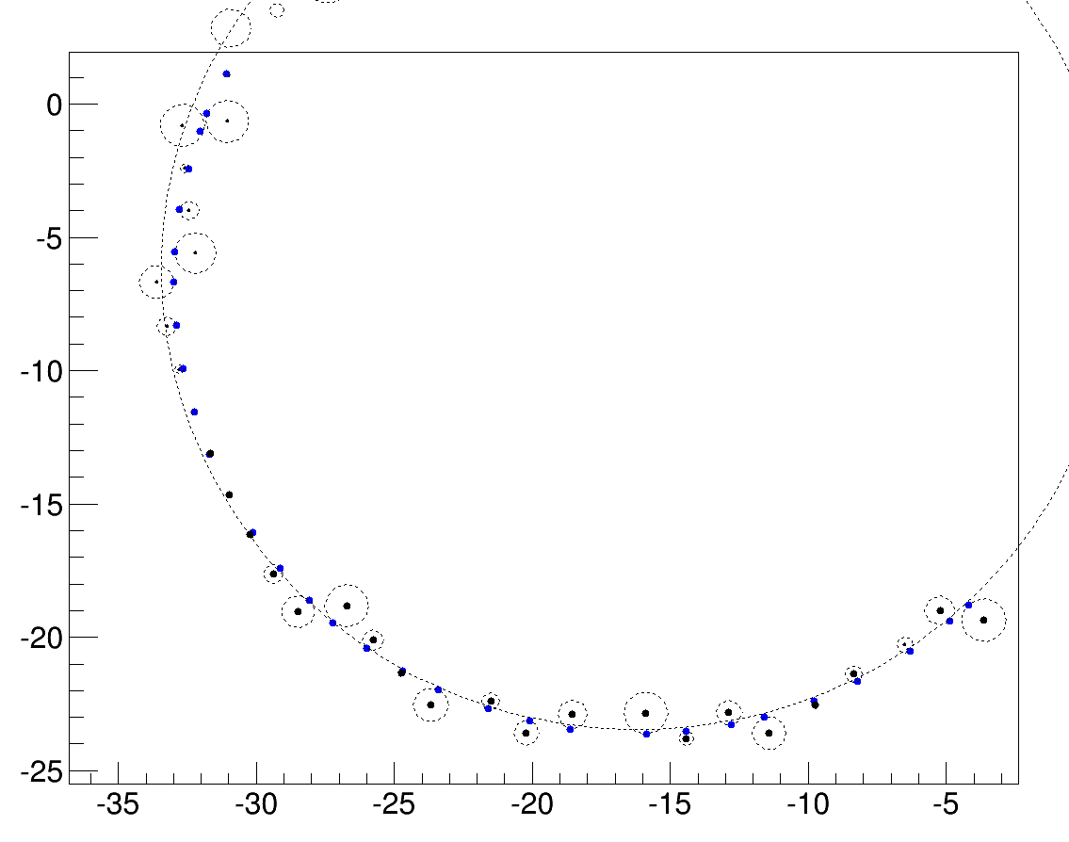
Flight length: r * theta

Slide 25
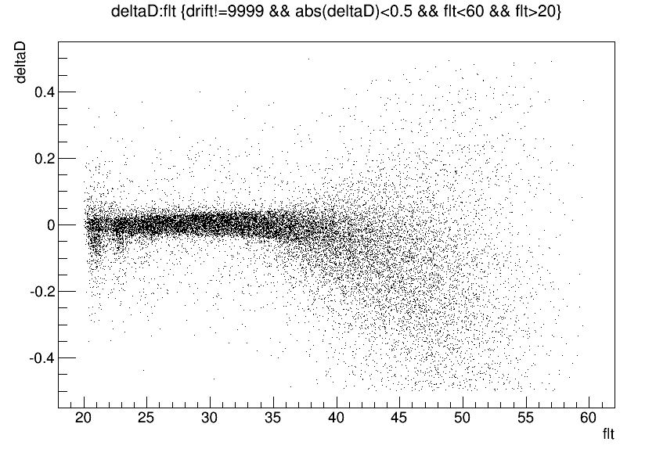
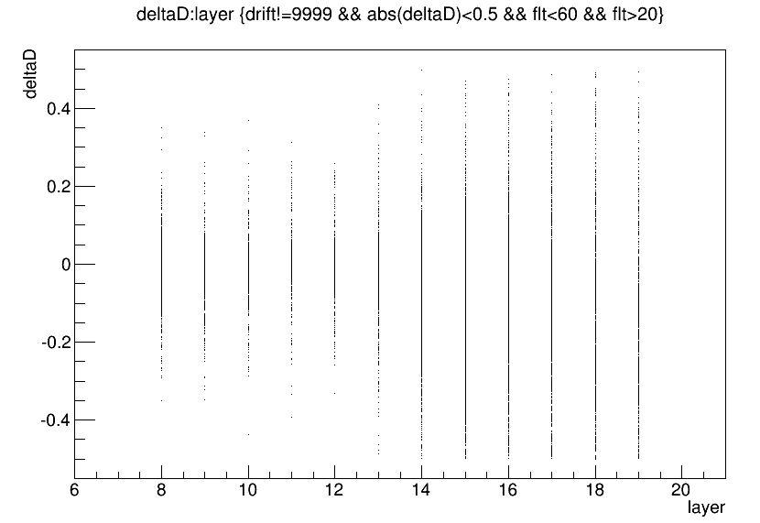
Relation between flight length , layer ,deltaD
Fix pt 60 MeV 1000 events no back ground
Most are inside 0.05 cm ( flt<40) 4 times of spatial resolution(0.13 mm)

Slide 26
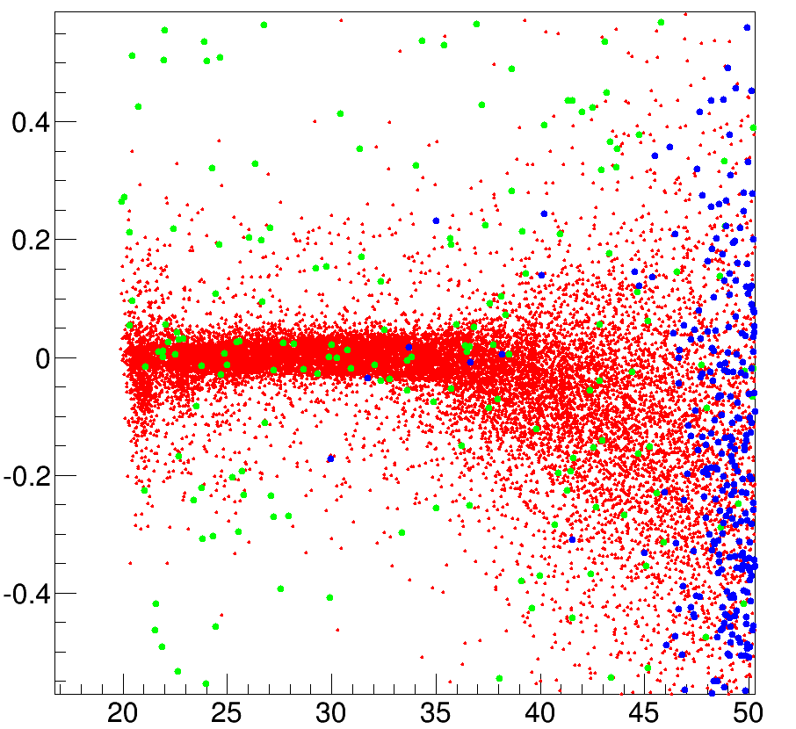
deltaD window
Fix pt 60 MeV 1000 events mix back ground
Red : 1st half circle hits
Green : noise
Blue: 2nd half circle hits
Large scale
By deltaD window we can collect most hits and resist noise

Slide 27
Conclusion of hit select method
Why not do on HoughMap
The distribution of TH2D hard tell how to keep a hit select efficiency
After peak detecting , we actually get a relatively accurate
2D track and know its information (pt , position …)
Hit –on-track information is clear ( flight length , deltaD..)
Distance of a hit position to track(“deltaD”) can
be related to the detect error in real space
A curve about signal efficiency vs background efficiency
is on doing to collect hits in a “deltaD” window

Slide 28
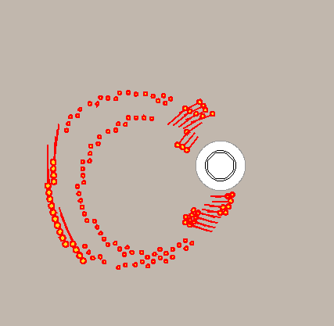
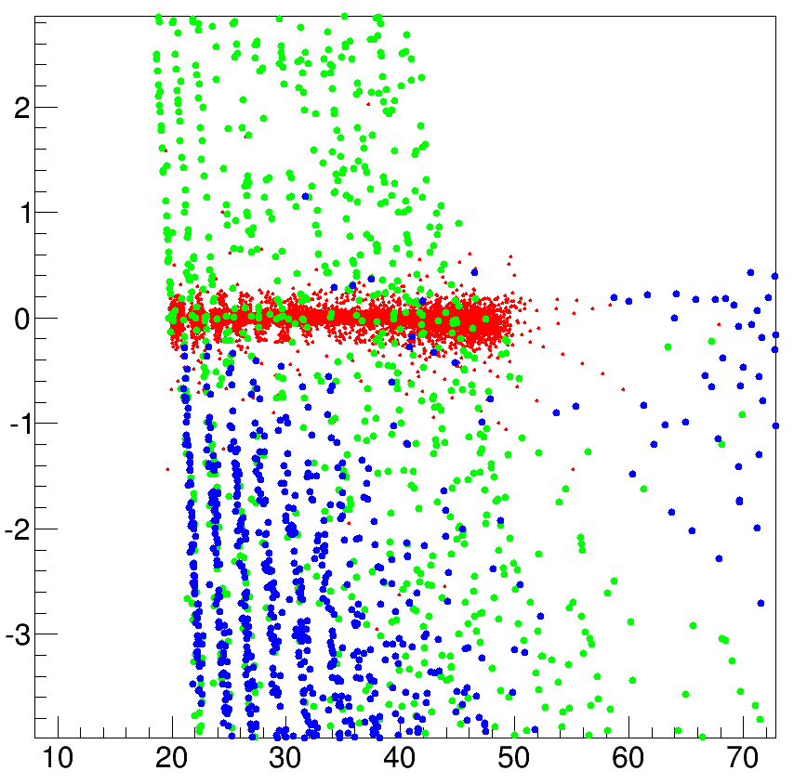
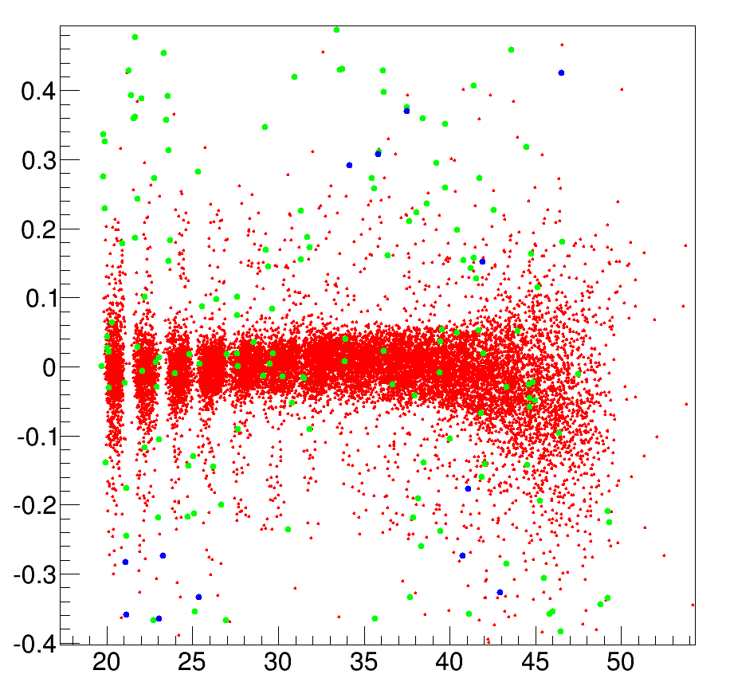
A focused question : multi turn tracks
70MeV : begin to make multi turn tracks
Large scale
Hits can be tell from different turns in 70MeV

Slide 29
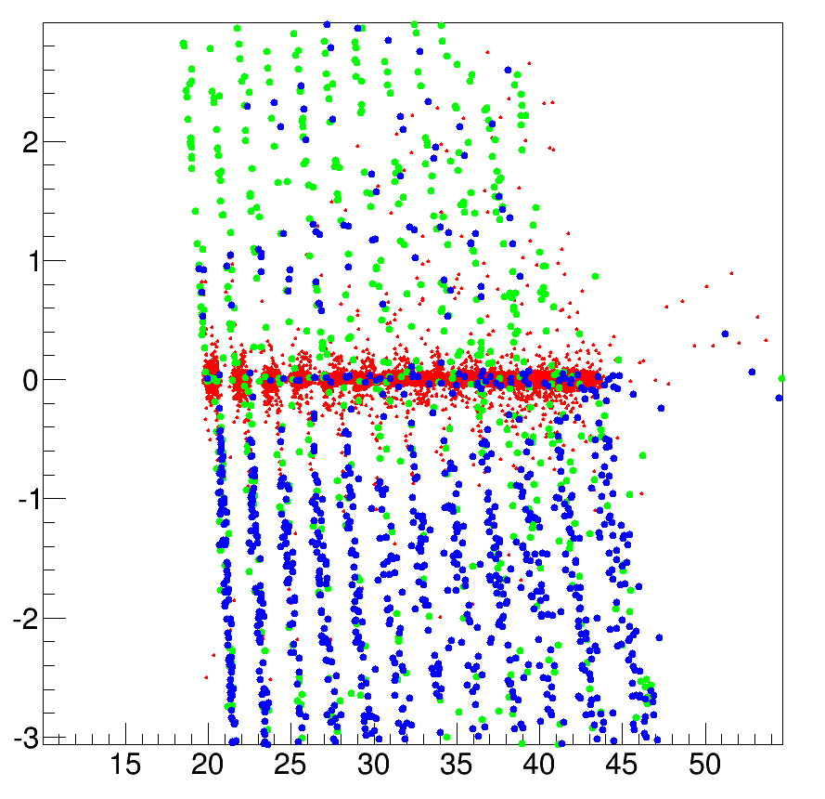
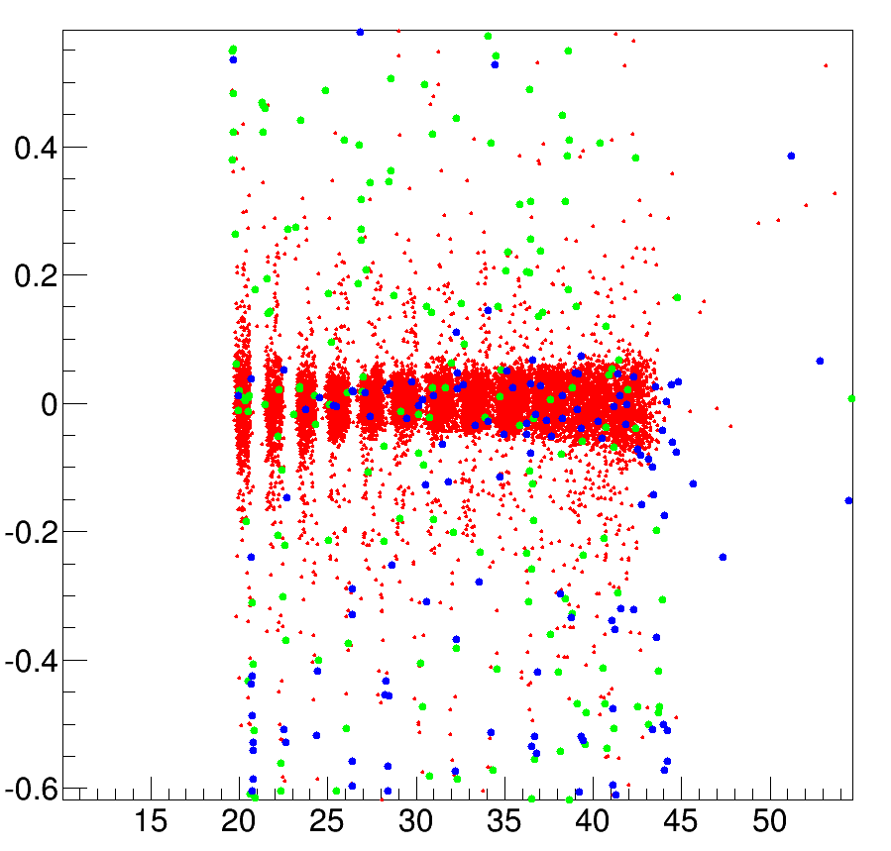
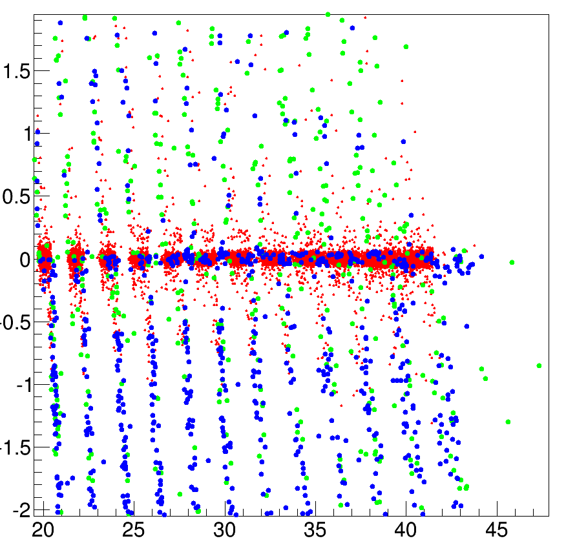
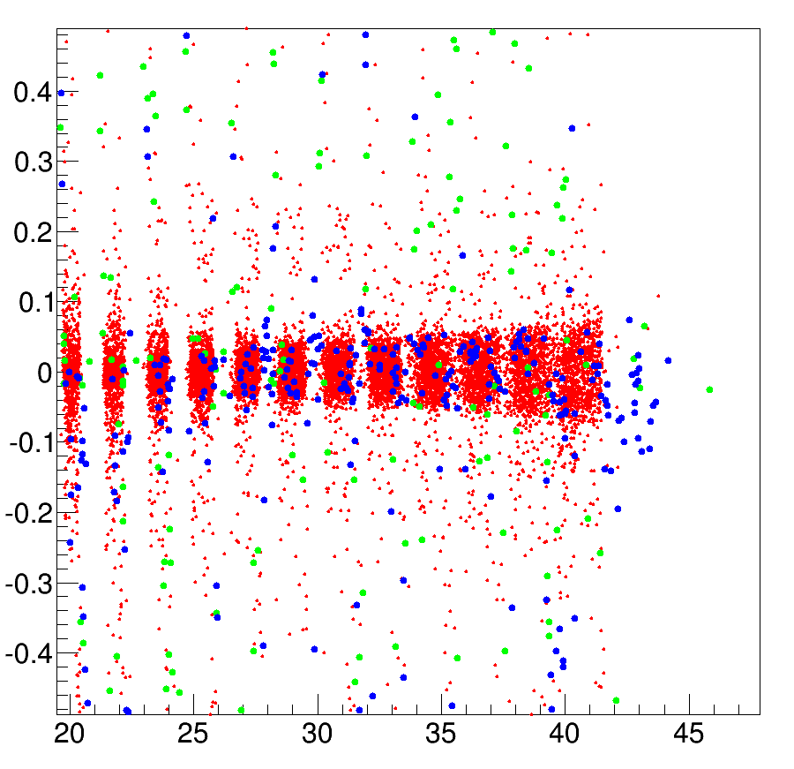
80MeV 90MeV

Slide 30
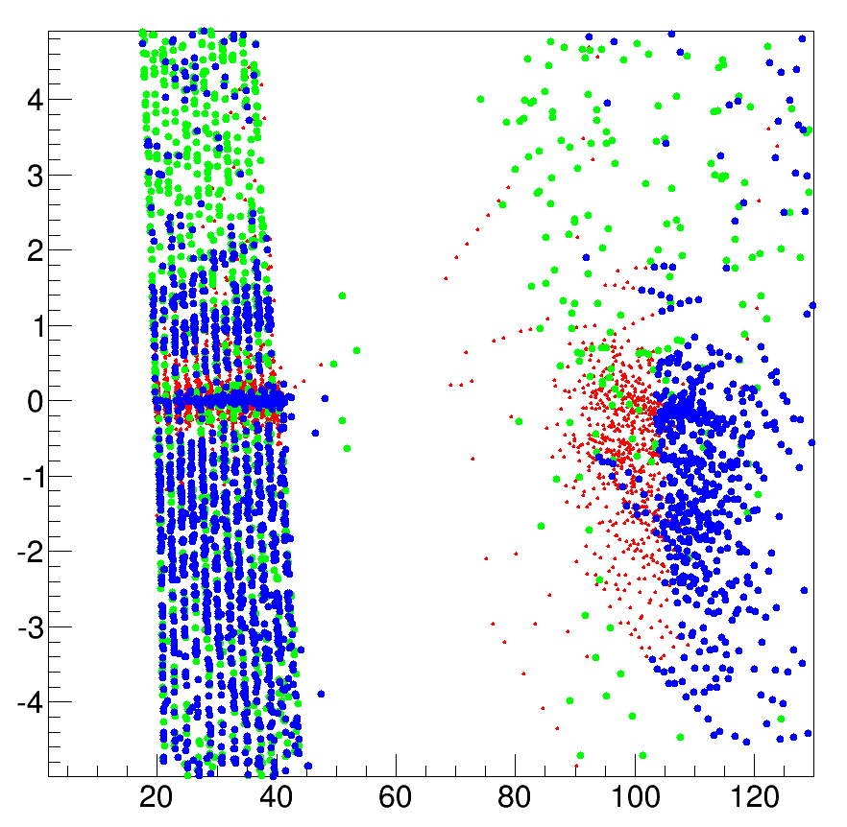
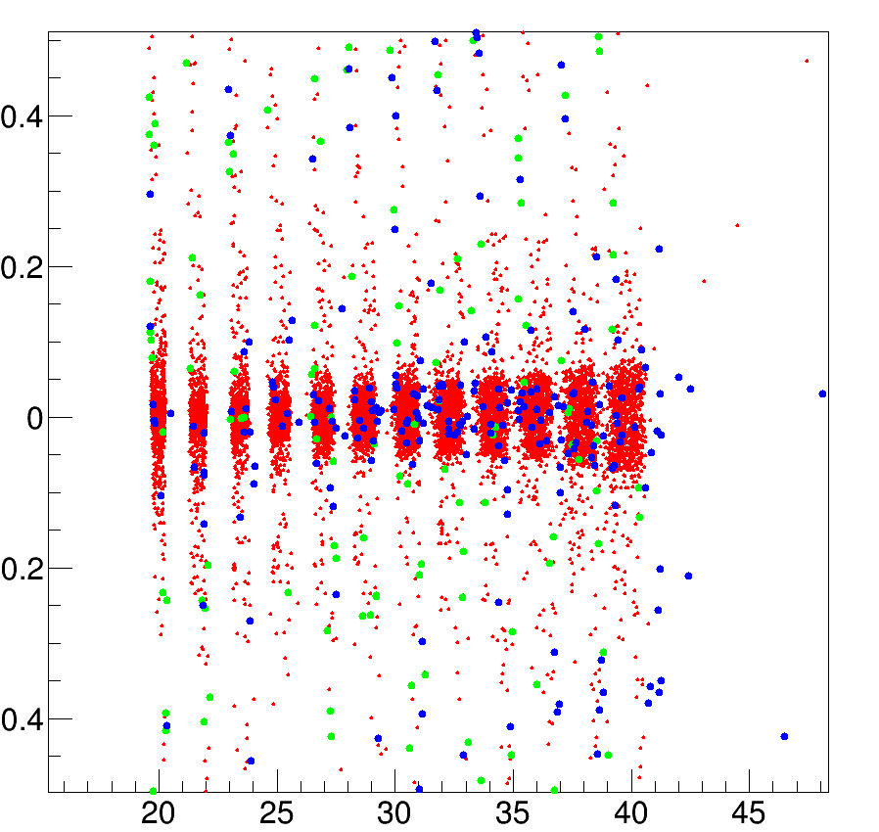
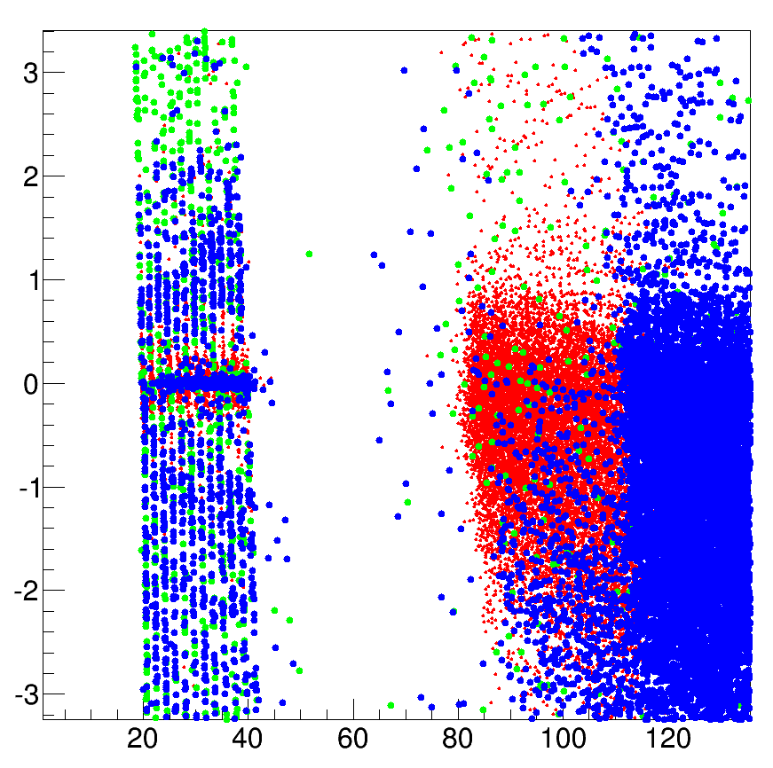
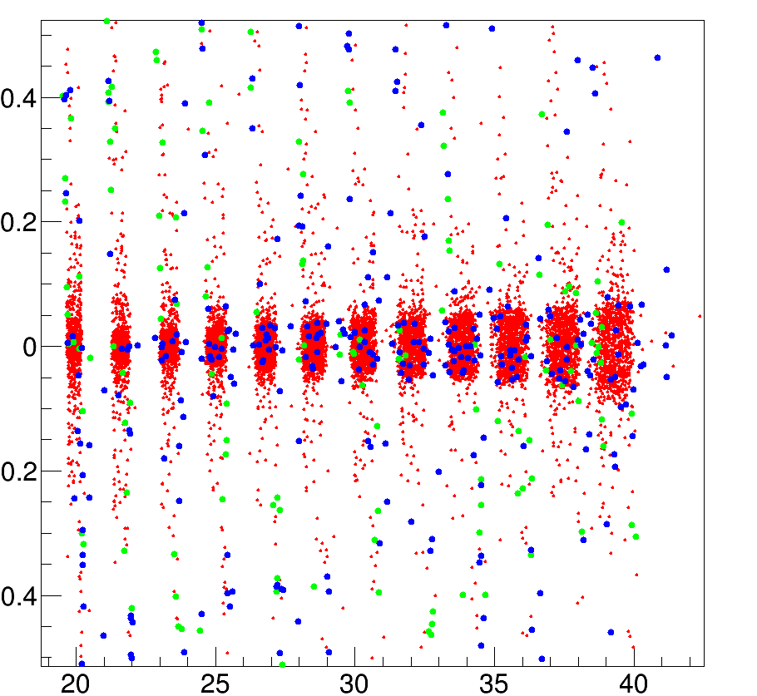
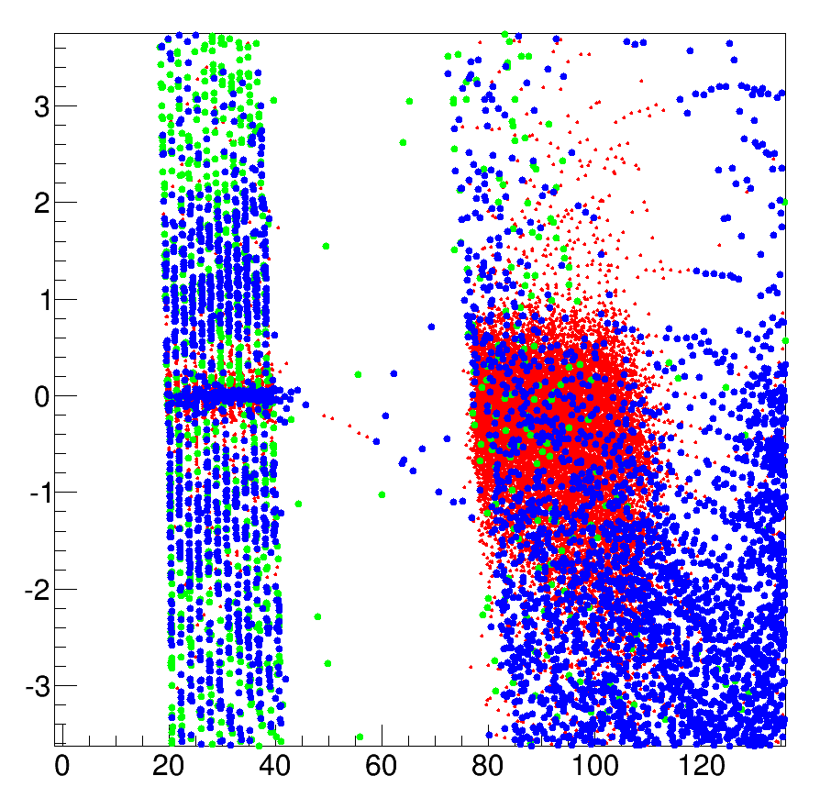
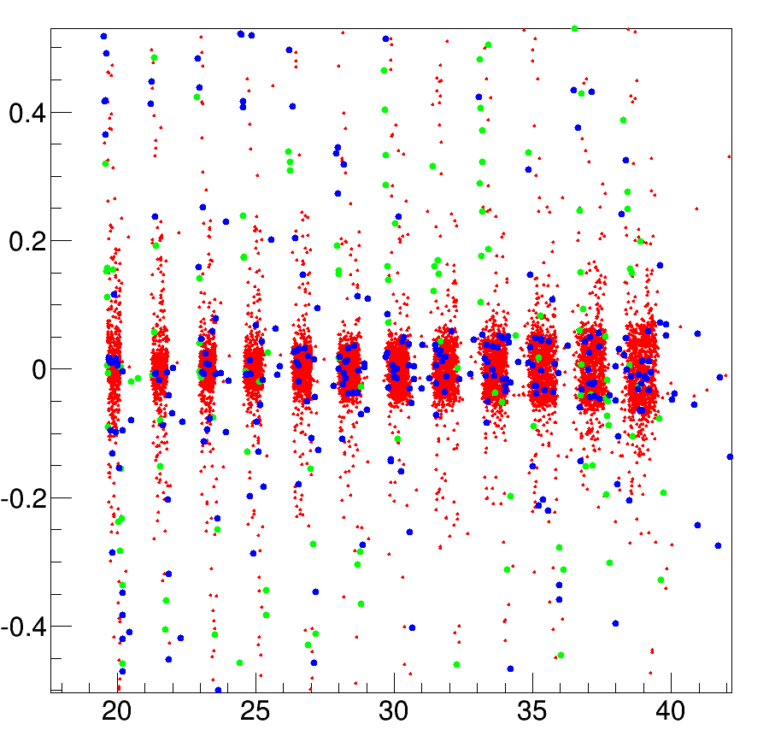
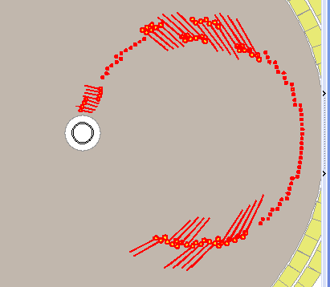
100~120MeV
100MeV
110MeV
120MeV
Energy loss is a reason but need to confirm

Slide 31
Summary & on doing
Method of is confirm
Conformal transfrom
Fill Hough Map
Split bin in Hough Map
Find peaks
Select hits
A hit selecting cut curve is on doing for high signal-noise ratio
Multi turn tracks are hopeful to solve
Could be solve good at 70MeV
Could reject most hits from at the inner axial hits layers
Program time need to be optimized

Slide 32
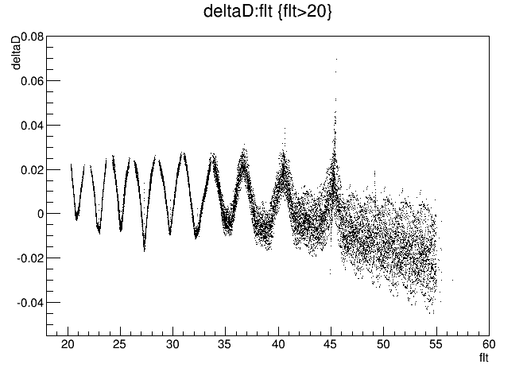
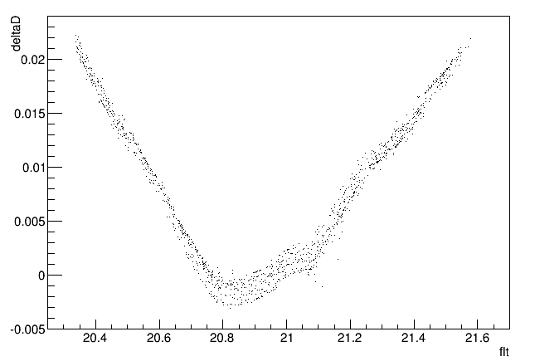
Bakup geantino 60MeV
Layer == 8

Slide 33
Bakup tail in layer 8,9
rec drift , peak inf
Truth drift , peak inf
Truth drift , truth inf

