Slide 1
Study of dE/dx Performance in TPC at CEPC
Fenfen An
2017.04.19

Slide 2
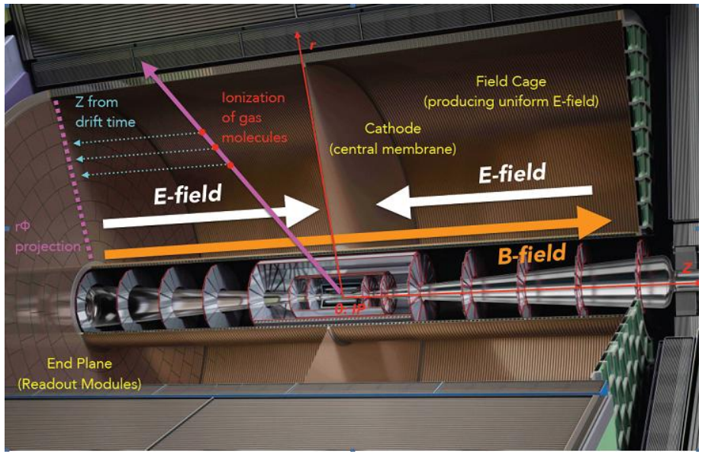
Sketch of ILD TPC Structure

Slide 3
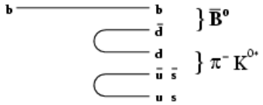
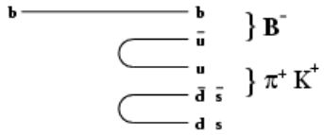
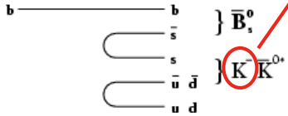
What can dE/dx do at CEPC
PID of pion and kaon would be useful for tagging the jet induced by b-quark
Same Side Tagging algorithms determine the B meson flavor at production time by exploting the correlation between b-flavor and the charge of the particles produced in the hadronisation of the quark

Slide 4
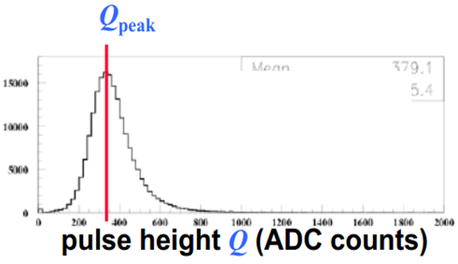
$〈$dE/dx$〉$ of One Track
N independent energy loss measurements in one track
Large tail caused by $δ$ electrons
Truncated mean is calculated as $〈$dE/dx$〉$: The mean value after rejecting several percentages of the highest and lowest of the N measured dE/dx values

Slide 5
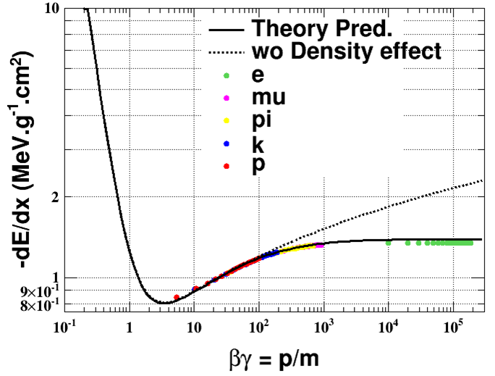
Beth-Bloch Equation
The energy deposit due to ionization of the projectile, independent of its particle type, is a function of $βγ=p/m$

Slide 6
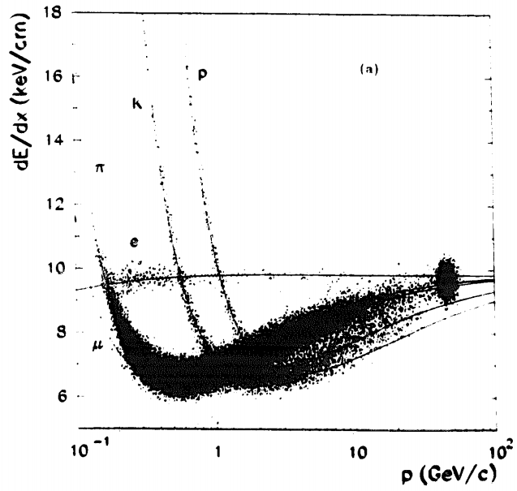
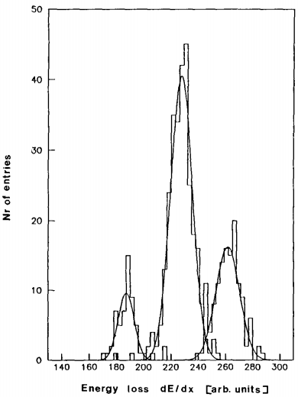
Particle Identification Using dE/dx
$$p=6 GeV/c$$
OPAL
$$π$$
OPAL
$$e$$
$$p$$
Interesting momentum range at CEPC: [1,100] GeV/c
How apart can the peaks be separated at CEPC?

Slide 7
What determines dE/dx resolution
Dependence on the projectile.
$p:$ momentum
$θ$: polar angle relative to the beam
s
$$h$$
θ
The number of primary ionizations in one dE/dx hit.
h: cell size
$ρ$: gas density
n: The number of dE/dx hits in one track

Slide 8
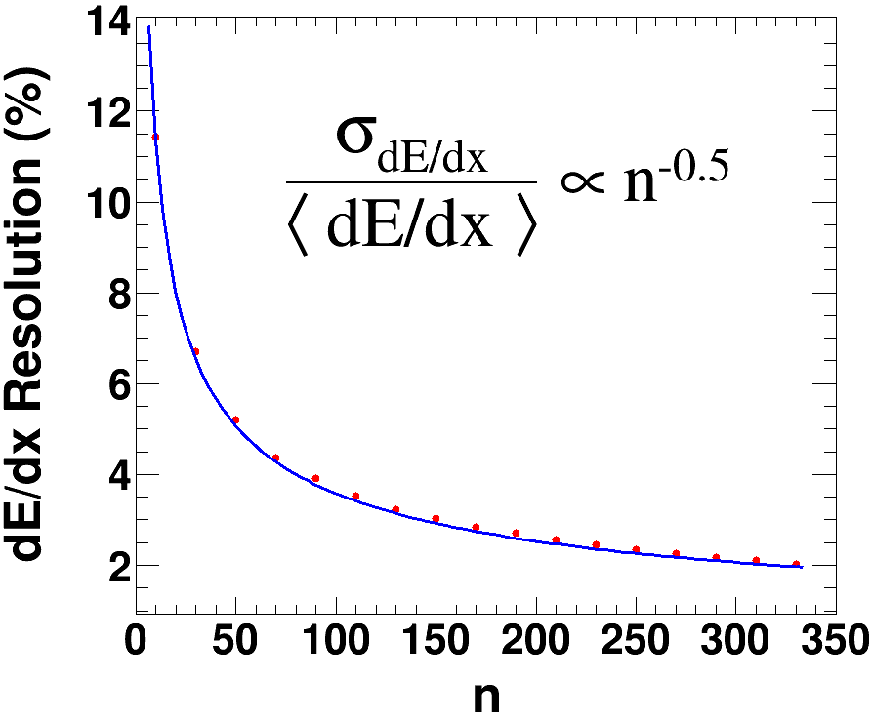
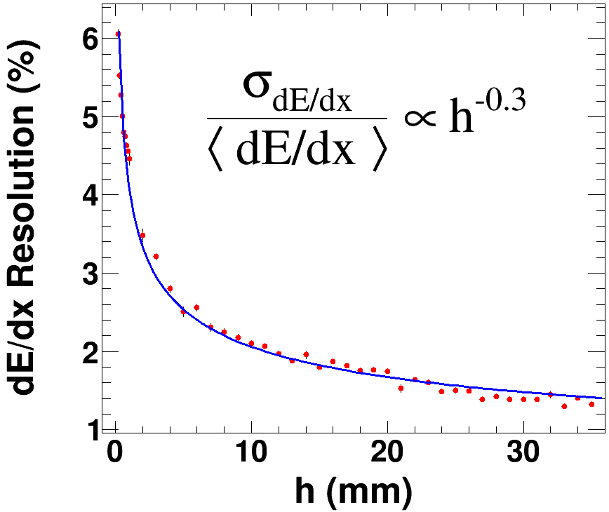
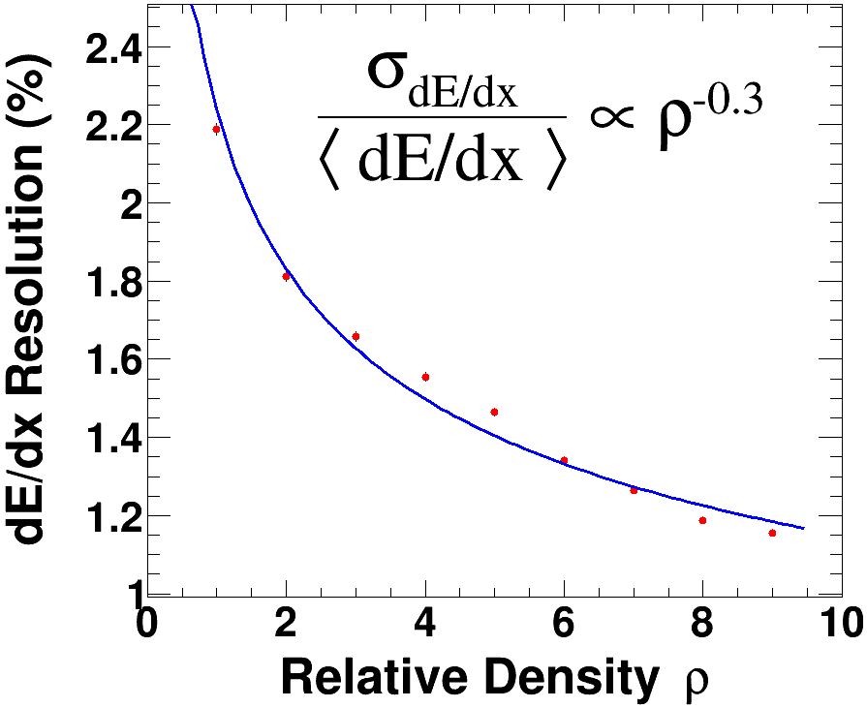
Parameterization of dE/dx Resolution
The powers $p_{j}$ are determined by MC:
Single pion with $θ={45}^{o}$
Default geometry as the start point:
(n=222, h=6mm, $ρ=1$)

Slide 9
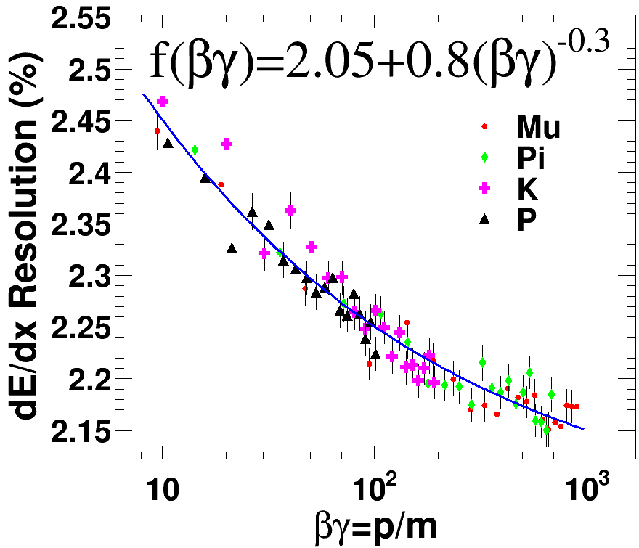
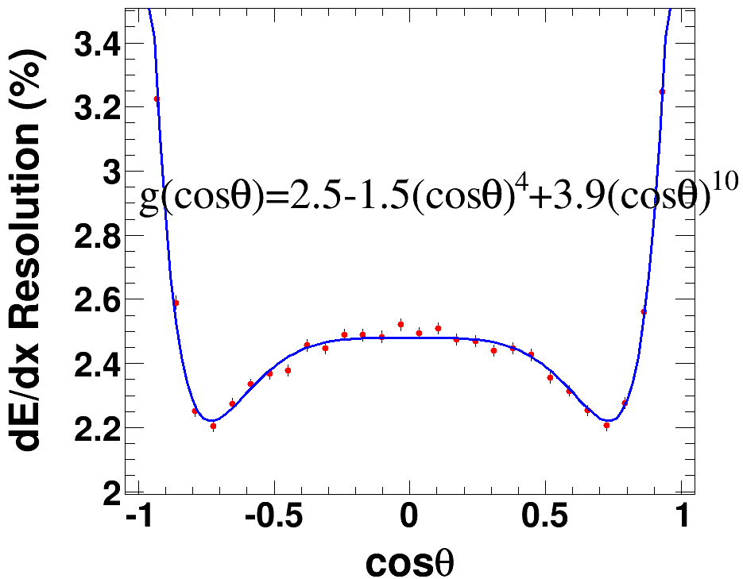
Parameterization of dE/dx Resolution
f$\left(βγ\right):$ validation range [6, 1000], corresponding to the logarithm rise region
g$(cosθ)$: single pion of 20 GeV/c，reflecting combined influence of change of step
length and number of dE/dx hits

Slide 10
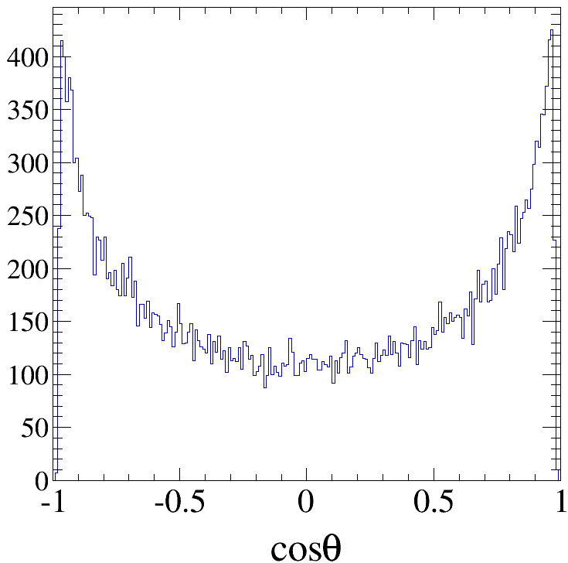
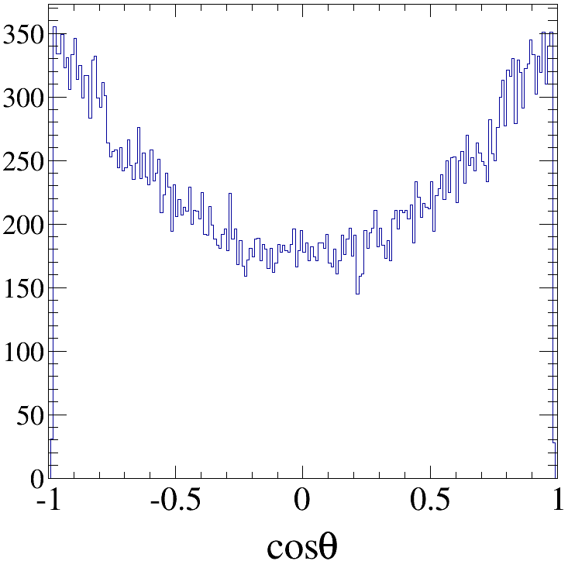
dE/dx Resolution in Physics Events
$\frac{σ_{dE/dx}}{〈dE/dx〉}$ are consistent between physics events and single track MC in ($p, cosθ$) space.
Define r= $\frac{{\frac{σ_{dE/dx}}{〈dE/dx〉}}_{θ={45}^{o}}}{{\frac{σ_{dE/dx}}{〈dE/dx〉}}_{phys}}$, where the numerator and denominator are determined by single track and specific physics event MC, respectively.
Bhabha@Z pole
dimu@Z pole
r=1.32
r=1.265

Slide 11
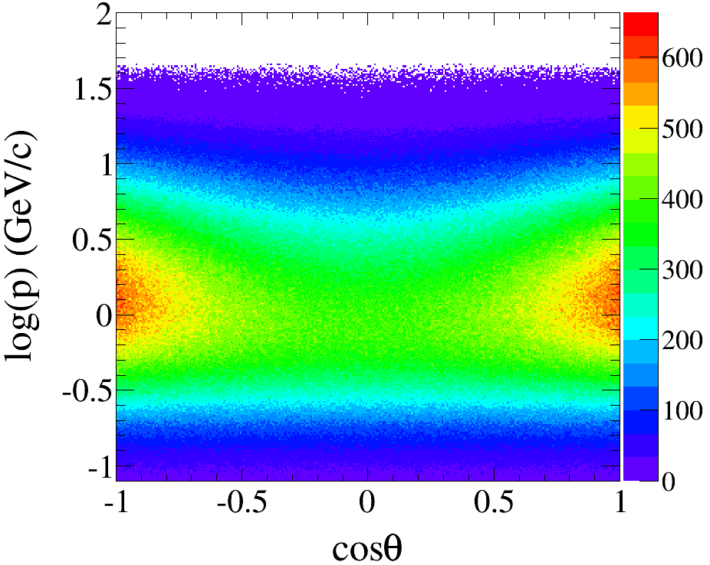
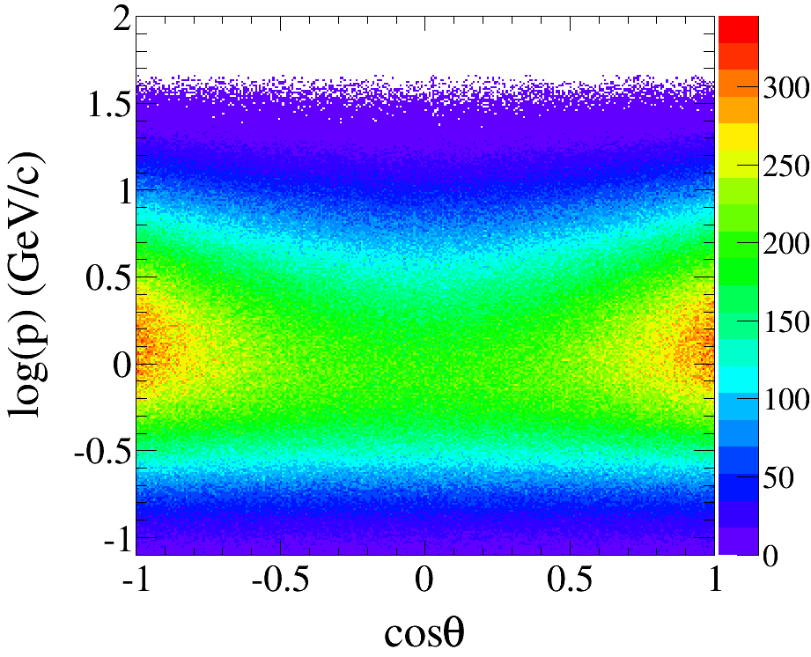
dE/dx Resolution in Physics Events
Pion, $e^{+}e^{−}→Z→q\overline{q}$
Pion, $e^{+}e^{−}→HZ, Z→q\overline{q}$
r=1.243

Slide 12
Comparison With Previous Experiments
${\frac{σ_{dE/dx}}{〈dE/dx〉}}_{θ={45}^{o}}$ is obtained by single track MC, with the same geometry, gas and control sample as the experiment in contrast
Correct about $N_{used}$, the number of the hits used for dE/dx calculation
Multiply the ratio r based on the $cosθ$ distribution of the control sample
The remaining difference between MC prediction and experimental measurement, is due to imperfect DAQ and calibration

Slide 13
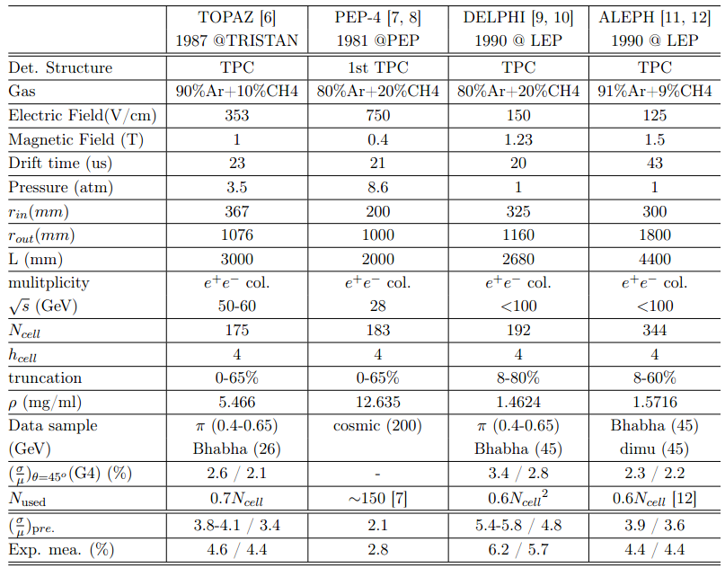
Comparison With Previous Experiments

Slide 14
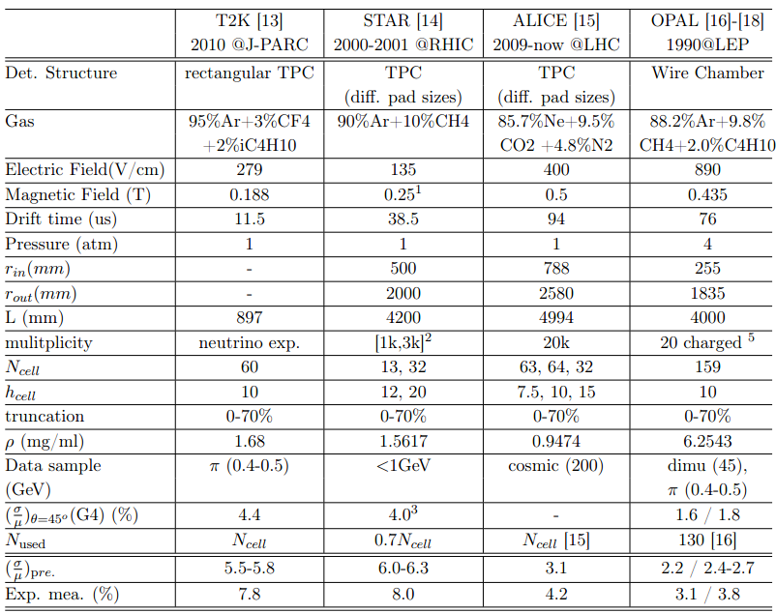
Comparison With Previous Experiments

Slide 15
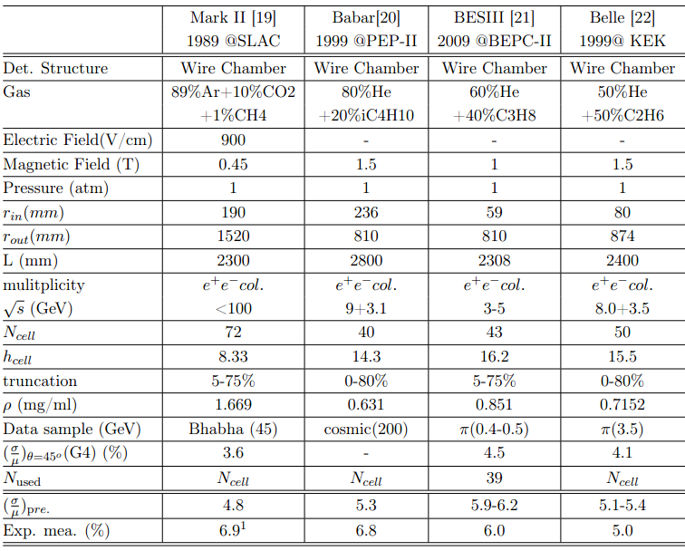
Comparison With Previous Experiments

Slide 16
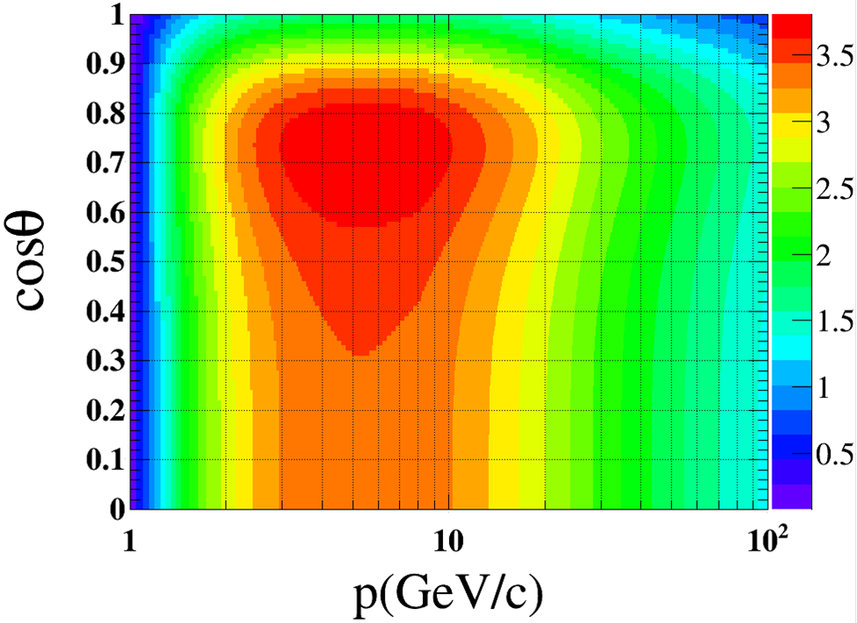
Separation Power
Assuming 70% of the hits can be used for dE/dx calculation, the best separation power between pion and kaon under the default TPC configuration in ($p,cosθ$) space is as right.
2.4$σ$ and 3.9$σ$ corresponds to a mid-id probability of 4.5% and 0.3%, respectively.

Slide 17
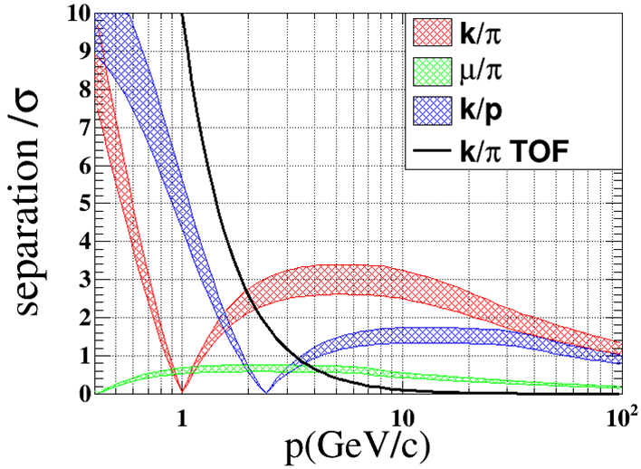
Separation Power
In multihadronic events, separation power between particles under the default TPC configuration versus $p$ is as right.
The bands delimit the best case and when dE/dx resolution is 30% worse due to imperfect DAQ and calibration.
A TOF counter of 50ps is added to cover the hole, which can effectively separate kaon and pion of up to 2 GeV/c after a flight of 2m.

Slide 18
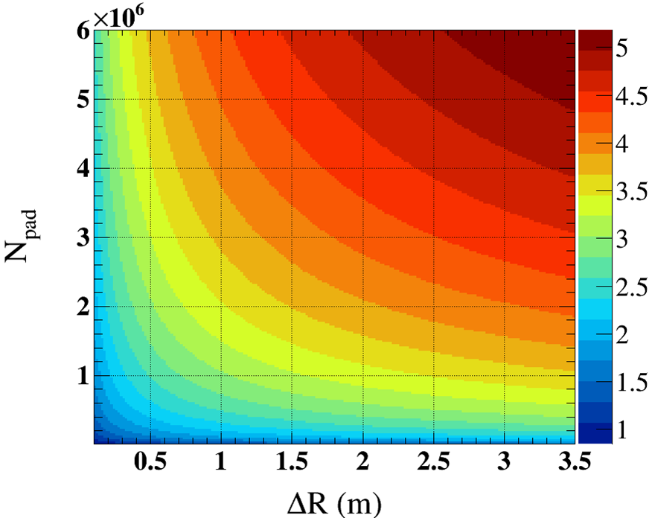
Proposal for TPC Optimization
Optimization would be a balance of cost, influence on the outer subdetectors and dE/dx performance.
Working gas and pressure are not appropriate for optimization.
The upper limit of separation power between pion and kaon versus the total number of pads and the effective radius $ΔR$ is as right.

Slide 19
Summary
Particle identification using dE/dx at TPC may provide useful information for physics analysis at CEPC
Comparison with previous experiments shows that the separation power between kaon and pion would be around 3$σ$ between 2-15 GeV/c
Optimization of the number of pads and the effective radius can be considered for dE/dx improvement

Slide 20
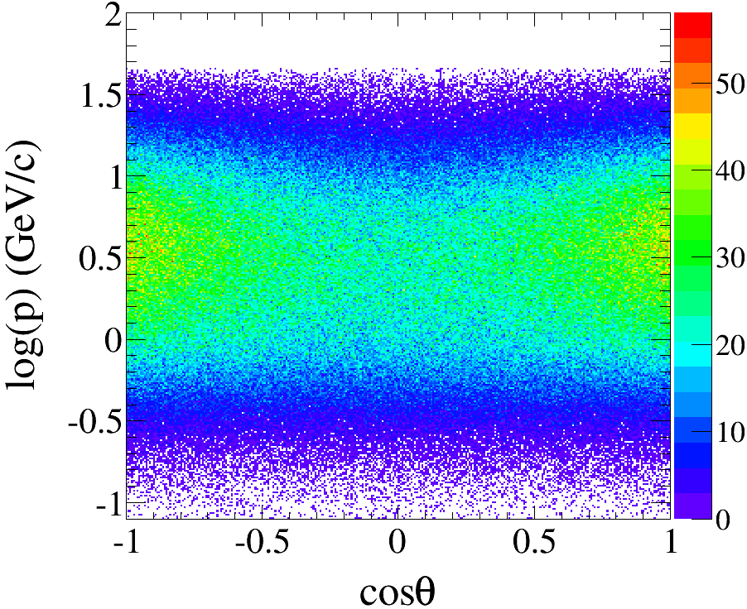
Backup

