Slide 1
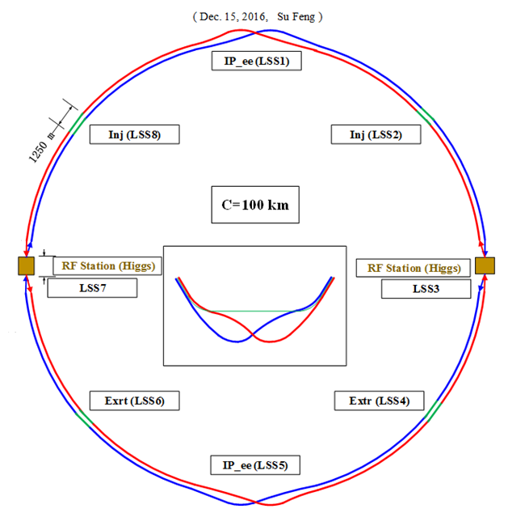
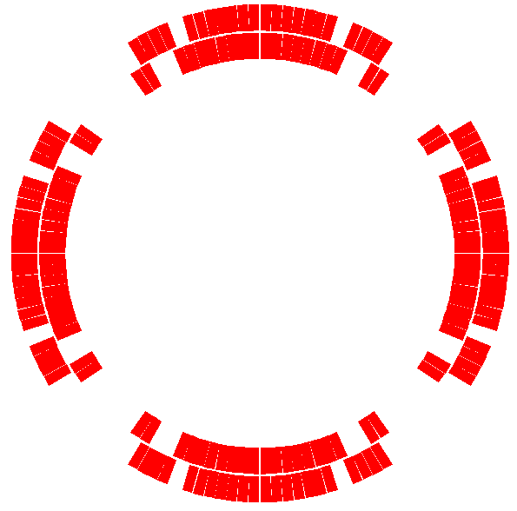
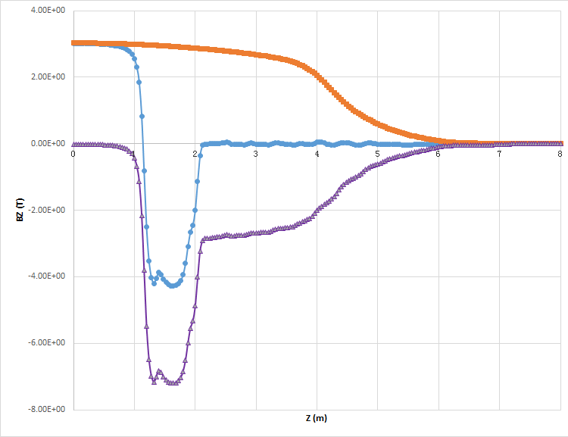
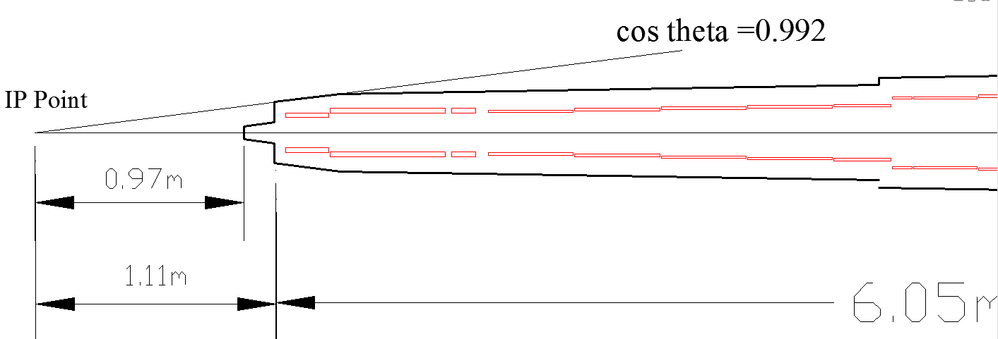
Full Partial Double Ring
Magnet | Field Strength | Length | Inner Radius
QD0 | 150 T/m | 1.7489 m | 19 mm
QF1 | 106 T/m | 1.4636 m | 26 mm
Detector solenoid
Total
QD0 coil layout
Compensating solenoid
Updated baseline parameters:
Head-on collision changed to crossing angle of 33 mrad
Focal length (L*) increased from 1.5m to 2.2 m
Solenoid field reduced from 3.5T to 3T
Magnets with cryogenics
NEXT: iterative studies to decide the positions and designs of the magnets and LumiCal

Slide 2
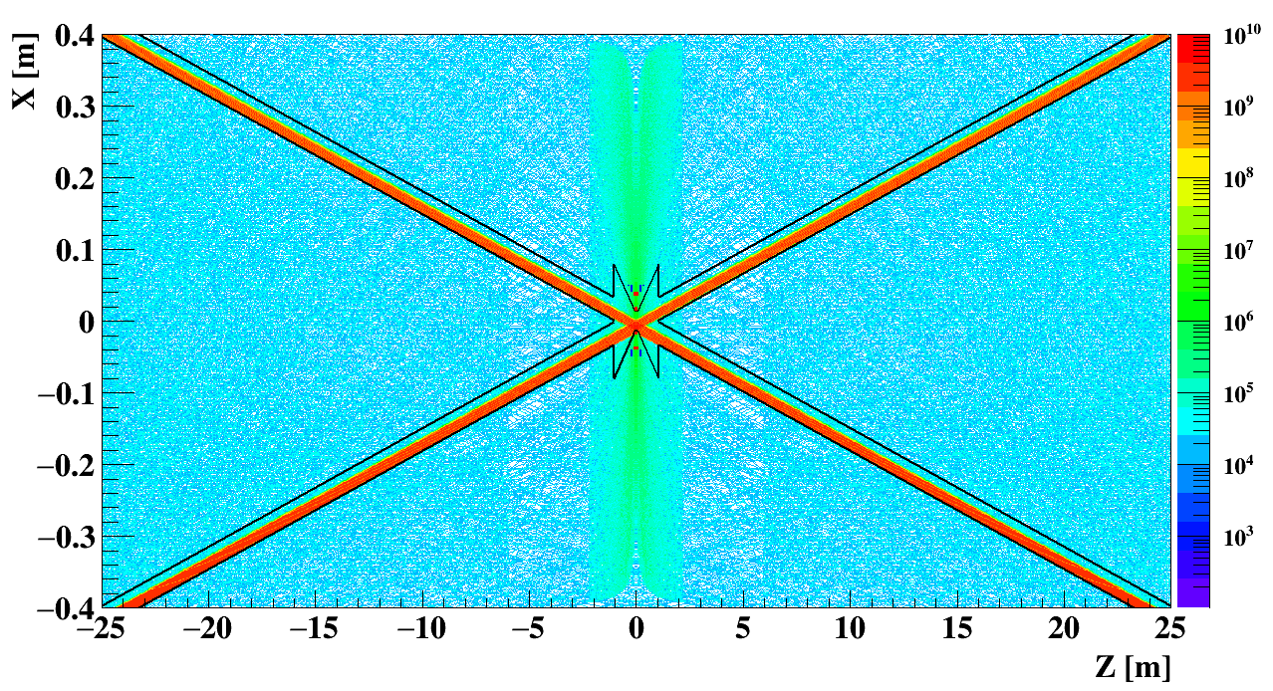
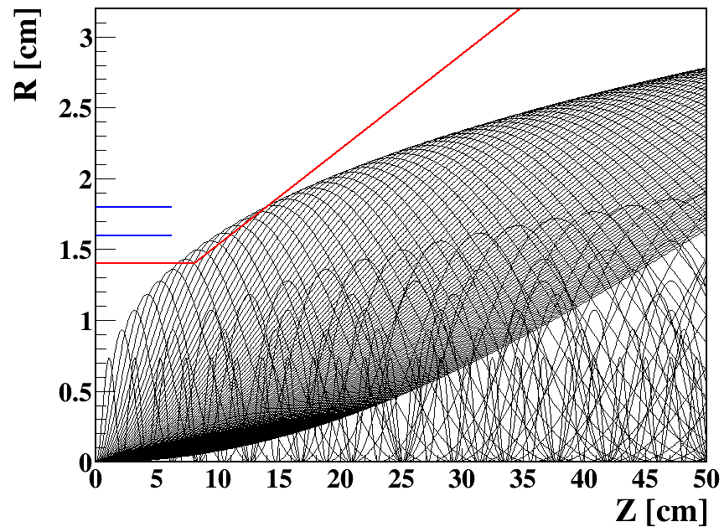
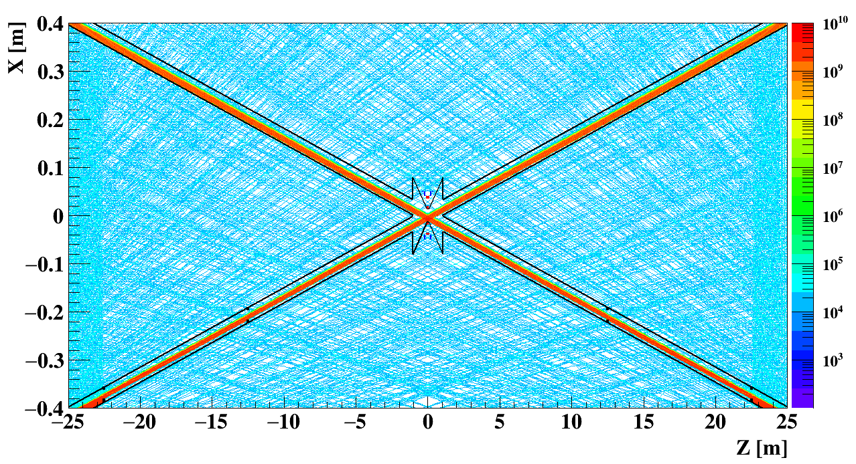
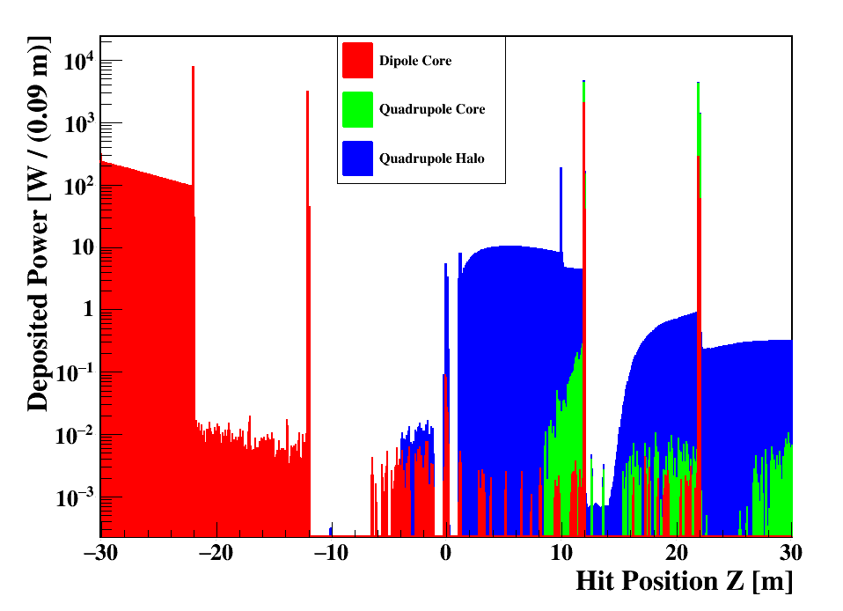
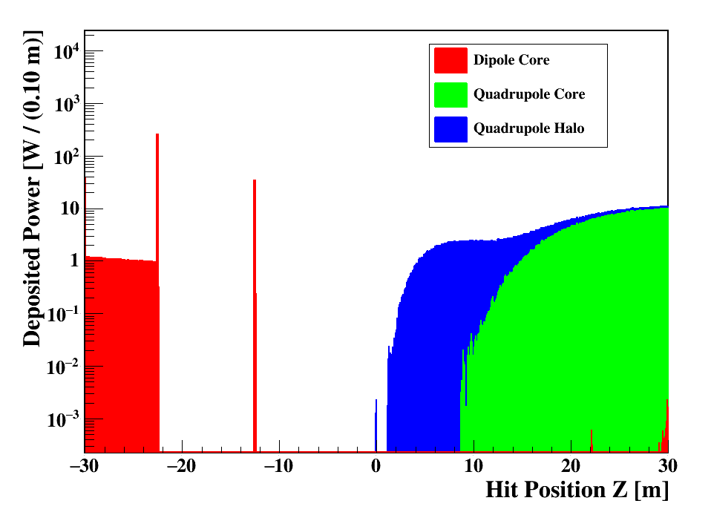
Radiation Backgrounds
SR photon flux with & without collimators
Pair production from beamstrahlung: reduced solenoid requires adjusting the beam pipe and/or 1st vertex detector layer
Reduced power deposition after changing to the double ring design
NEXT: Detector backgrounds, e.g. hit density and radiation levels, to be updated; collimation and shielding design; full estimation of SR backgrounds
Updated Interaction Region Layout

Slide 3
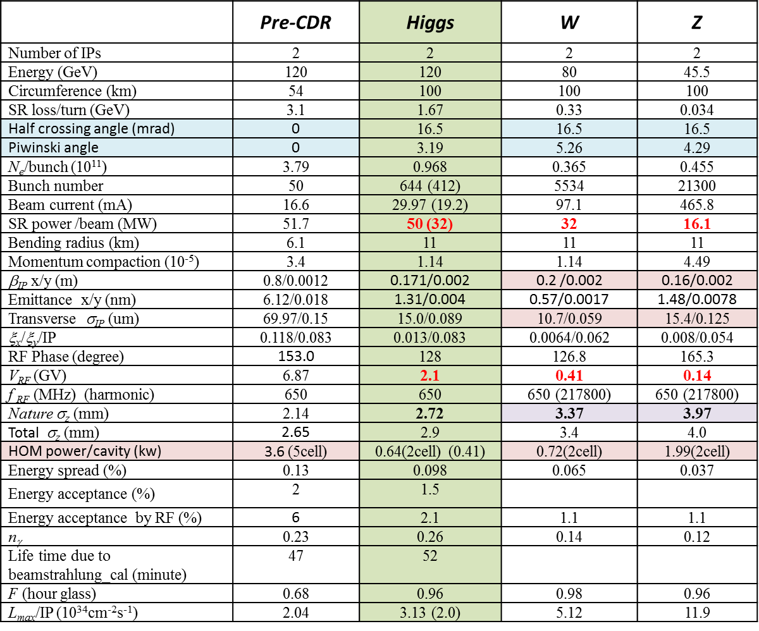
Updated Machine Parameters

