Slide 1
Tracking efficiency and multi turn tracks

Slide 2
Tracking condition
Event sample
1000 events
Fixpt from 60 ~ 120 MeV
No decay
No delta e-
Mix background
Track quality cut
pt: |Δpt|<10MeV
P: |Δp |<15MeV
Vr: |Δvr|<1cm
Vz: |Δvz|<10cm
Efficiency definition:
at least one track in the event pass quality cut

Slide 3
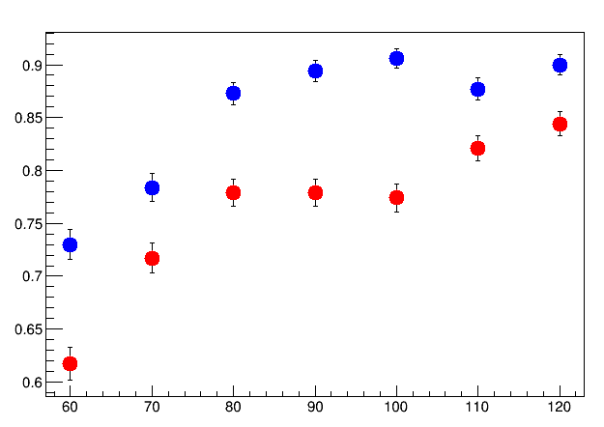
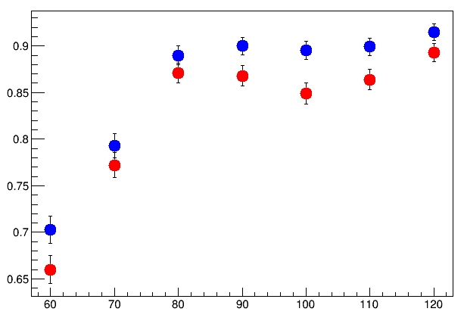
Tracking efficiency compared with the old Hough Finder
Old
New
Hough method alone
PatTsf + Hough
110 120 MeV different due to outer axial chamber

Slide 4
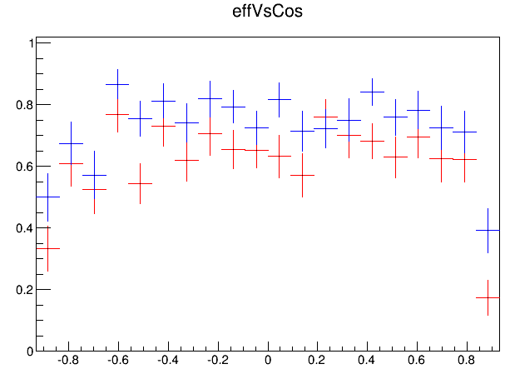
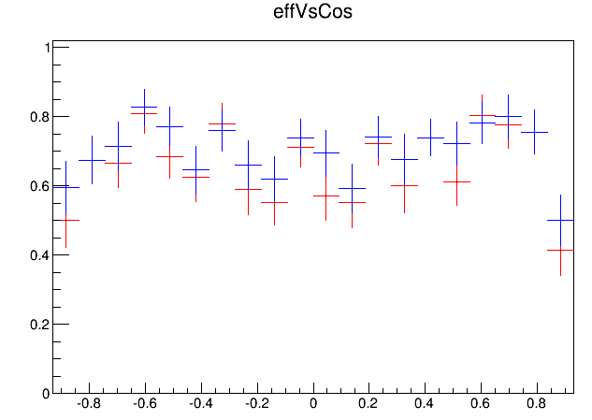
60MeV
61.7%
73.0%
66.0%
70.3%

Slide 5
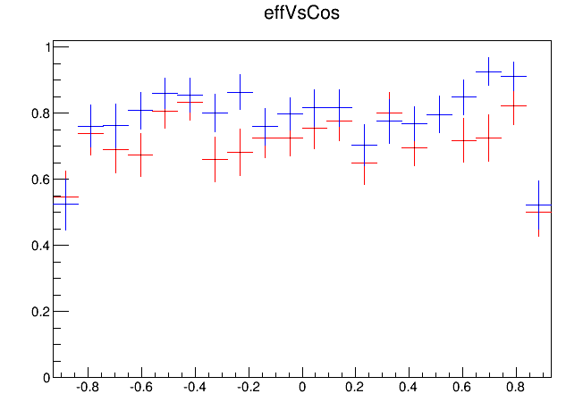
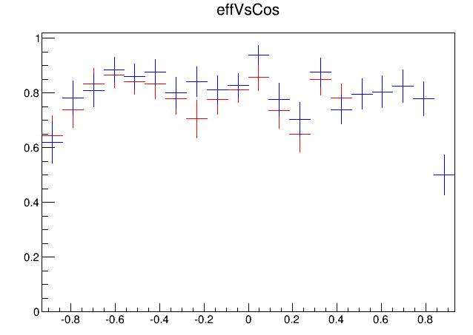
70MeV
71.7%
78.4%
77.2%
79.3%

Slide 6
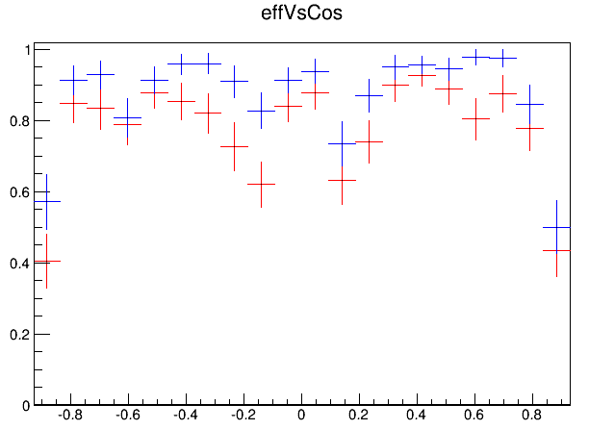
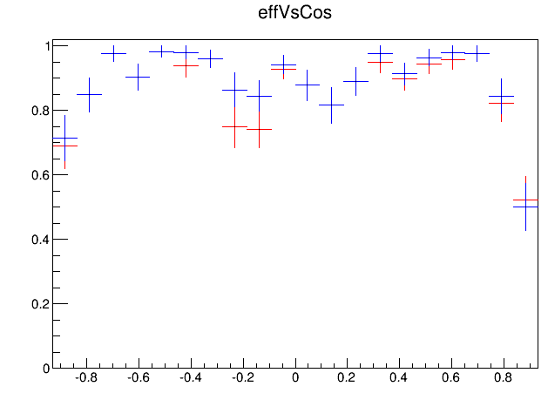
80MeV
77.9%
87.3%
87.1%
89.0%

Slide 7
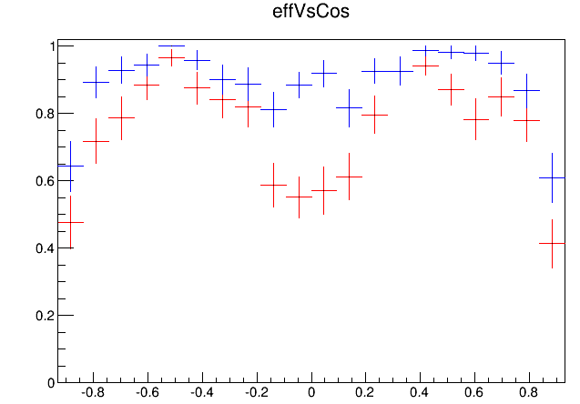
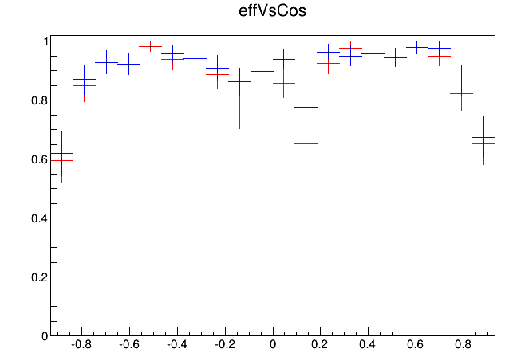
90MeV
75.3%
89.4%
86.8%
90.0%

Slide 8
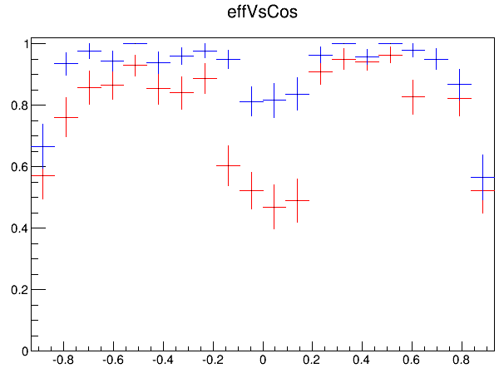
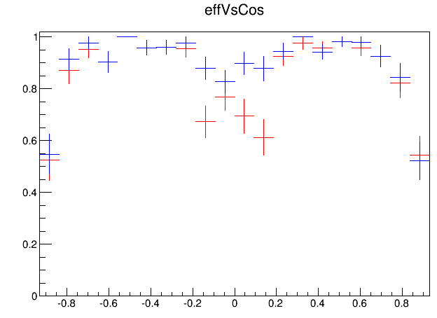
100MeV
77.4%
90.6%
84.9%
89.5%

Slide 9
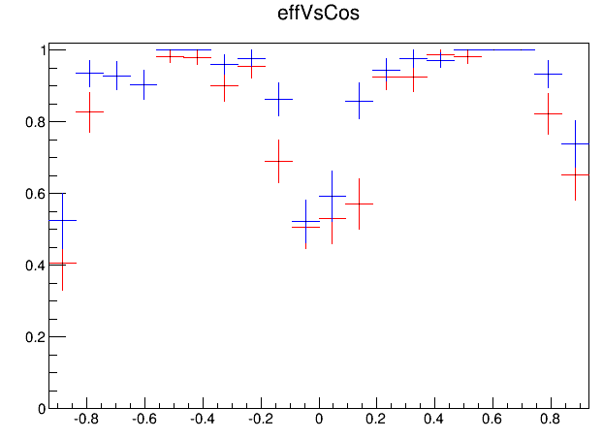
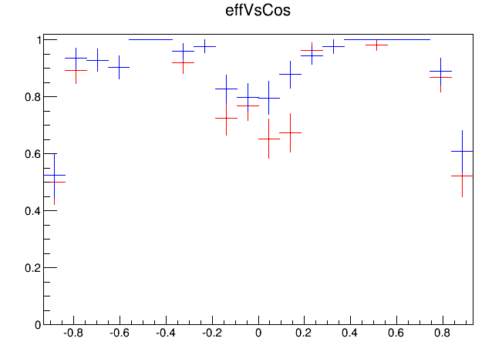
110MeV
82.1%
87.7%
86.4%
89.9%

Slide 10
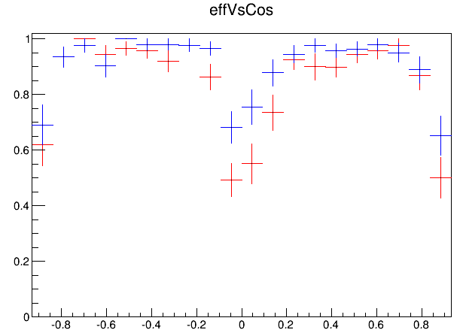
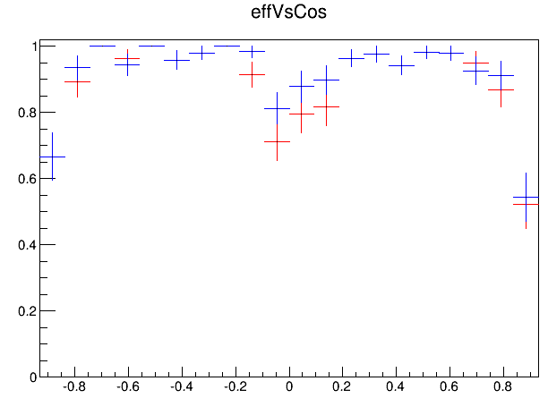
120MeV
84.4%
90.0%
89.3%
91.5%

Slide 11
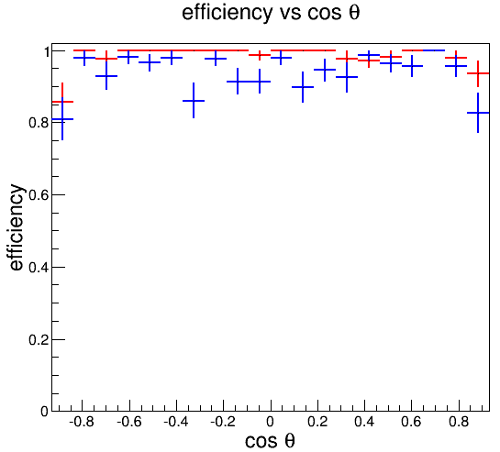
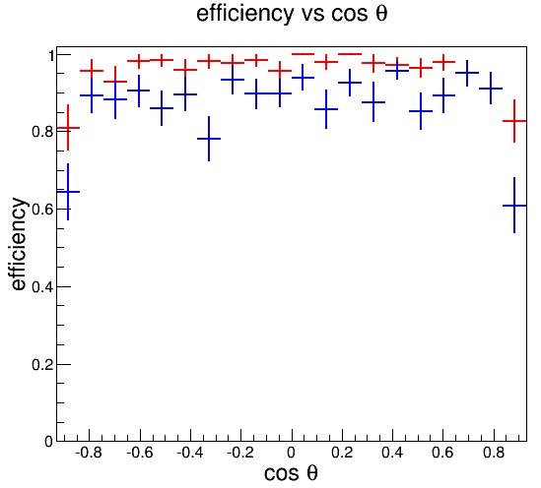
Efficiency improve when tracking
60MeV
Efficiency : track with at least 1 track inside (pt-ptTruth)<100MeV
After global 2D
After global 3D
New 98.4%
Old 93.8%
New 95.6%
Old 87.1%

Slide 12
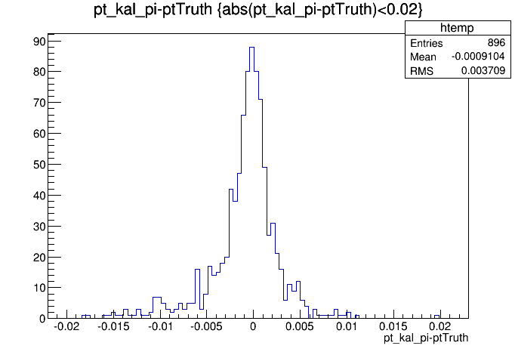
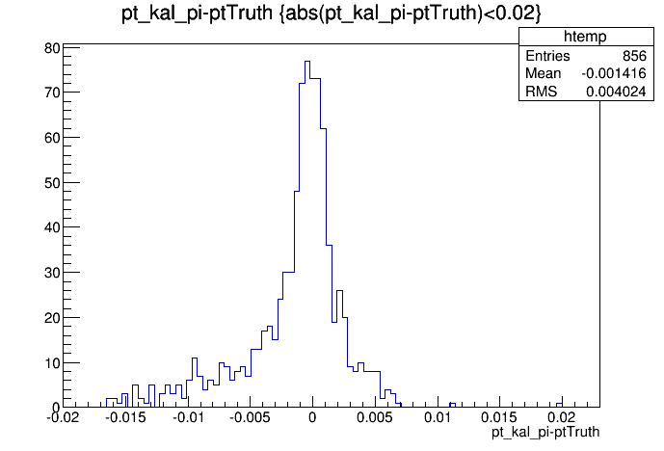
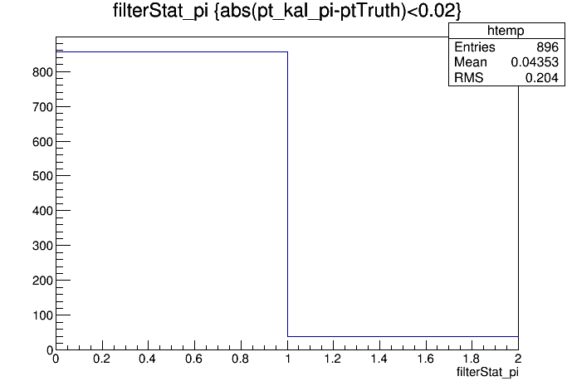
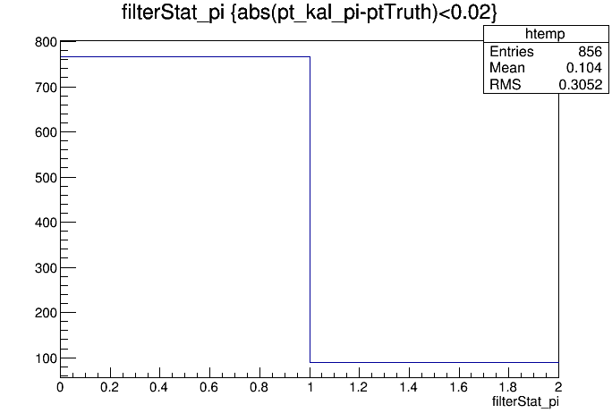
Pt resolution & kalman fit efficiency
60MeV
New Hough alone
old Hough alone
Kalman success
95.6%
Kalman success
89.6%

Slide 13
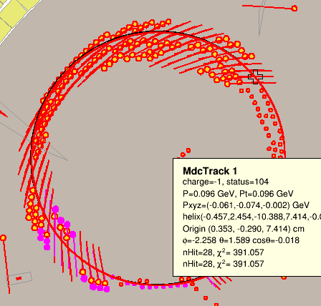
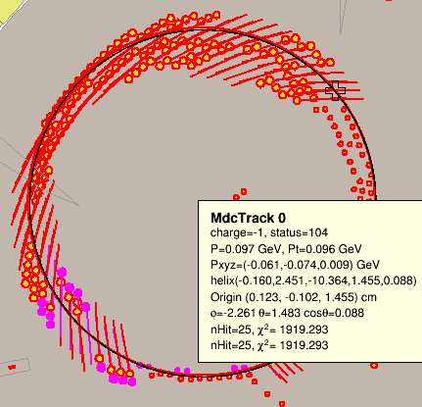
Multi turn tracks
Multi turn axial hits could be tell
100MeV

Slide 14
Conclusion
Efficiency improve
find more tracks in tracking
Kalman efficiency
Multi turn tracks could be tell
Next : combine multi turn tracks

Slide 15
Cut condition
Hit : drift<1000
HoughMap :
1000*1000
Cut in split circle : 1000
Slant : <0.03
Map minimum bin cut : ?(aver +10*sigma ) :5
HoughPeak
least hit cut : 5
Hits select : abs(deltaD)<0.2 && flightlength <=45 ;
(60MeV: abs(deltaD)<0.1 when flightlength>30 )

