Slide 1
Evaluation of vertical emittance from solenoid
ZHANG, Yuan YU, Chenghui WANG, Yiwei Zhu, Yingshun
CEPC AP Meeting
2017-04-07

Slide 2
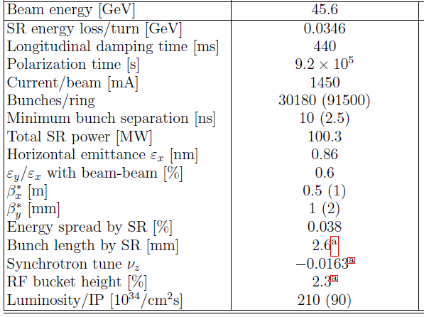
Memo
CEPC V170306
FCC
Emitx/Emity
H: 1.31/0.004 nm
W: 0.57/0.0017 nm
Z: 1.48/0.0078 nm
arXiv:1610.07170 [physics.acc-ph]

Slide 3
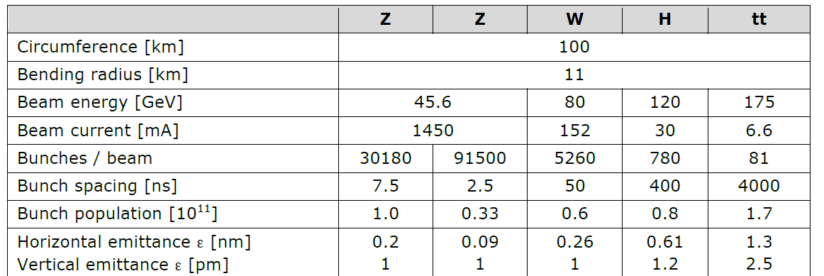
Memo 2
FCC-20160621

Slide 4
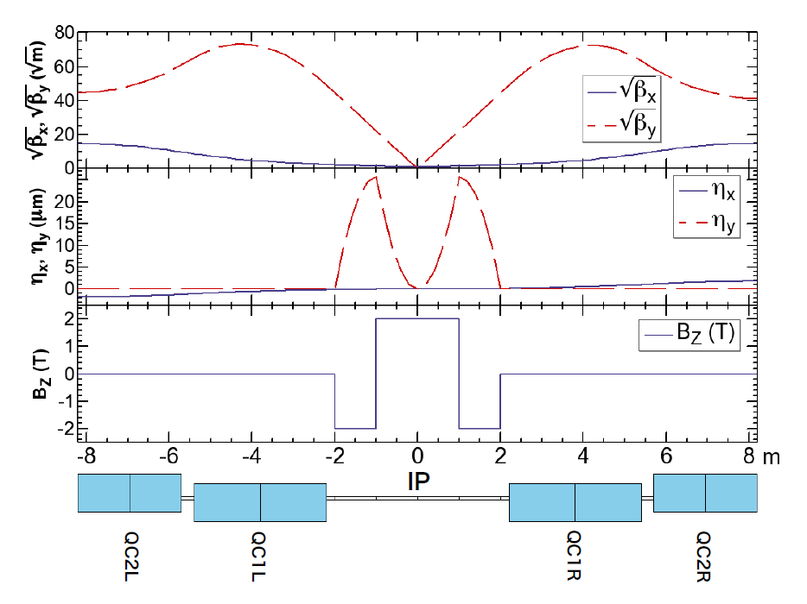
FCC
“The emittance blow-up due to two interaction regions is computed to be 0.11 pm, which is about 10% of our vertical emittance budget.”
“The increase of the
vertical emittance is below 0.2 pm, for 2 IPs, with the step-function prole assuming 10 cm for the length of fringe.”
arXiv:1610.07170 [physics.acc-ph]
arXiv:1607.05446 [physics]

Slide 5
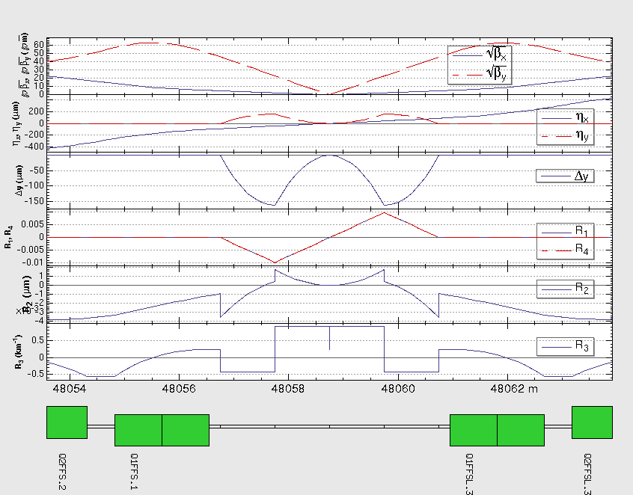
Z
Hard Edge
（-2m，-1m），-3T
（-1m，+1m），3T
（+1m，+2m），-3T
IP1
If the emittance come from coupling in arc?
IP3

Slide 6
Z: If Amplitude of Bz reduces from 3T to 2T

Slide 7
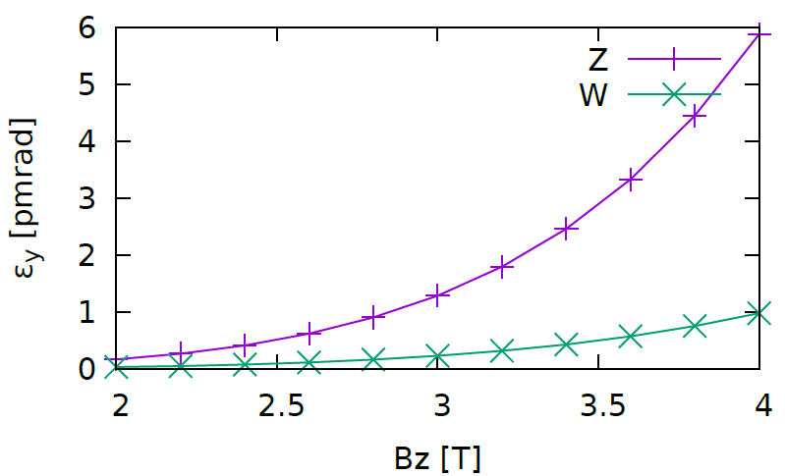
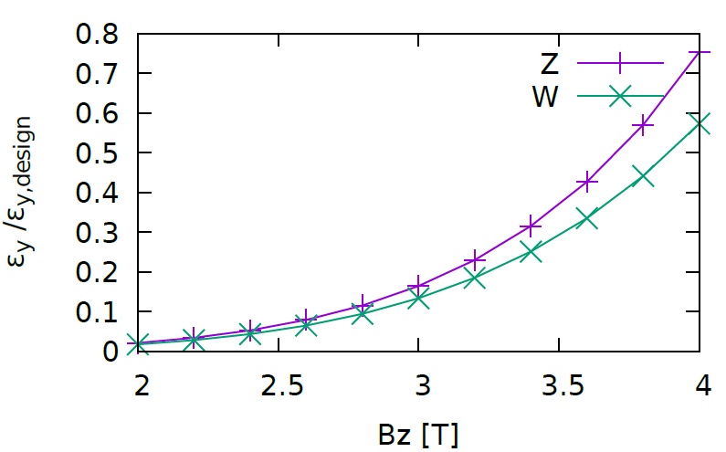
Vertical emittance versus BZ
3T seems good!

Slide 8
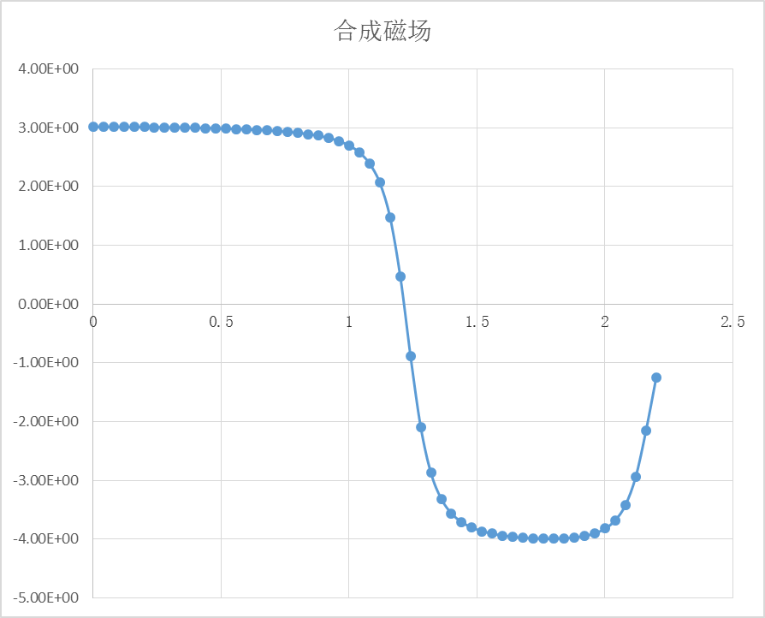
Bz (including all magnet), v170327 (ZHU Yingshun)
Only consider Bz ( 0<s< 2.2m ) in the following estimation
3T
$$\int_{0}^{2.2}{B_{z}ds=3.72×{10}^{−2}}$$
$$Bρ=151.77 Tm for Z$$
$$θ_{R}=\frac{\int{B_{z}ds}}{2Bρ}=0.25mrad$$
-4T

Slide 9
Z: Sol On (Zhu,Yingshun v170327)
Design Parameter
Z: 1.48/0.0078 nm
Hard Edge
Model
（-2m，-1m），-3T
（-1m，+1m），3T
（+1m，+2m），-3T

Slide 10
Vertical Emittance versus scale of Bz (Z, v170327)

Slide 11
W/H: Sol On (Zhu,Yingshun v170327)
W
Design: 0.57nm /1.7 pm
H
Design: 1.31nm /4 pm

Slide 12
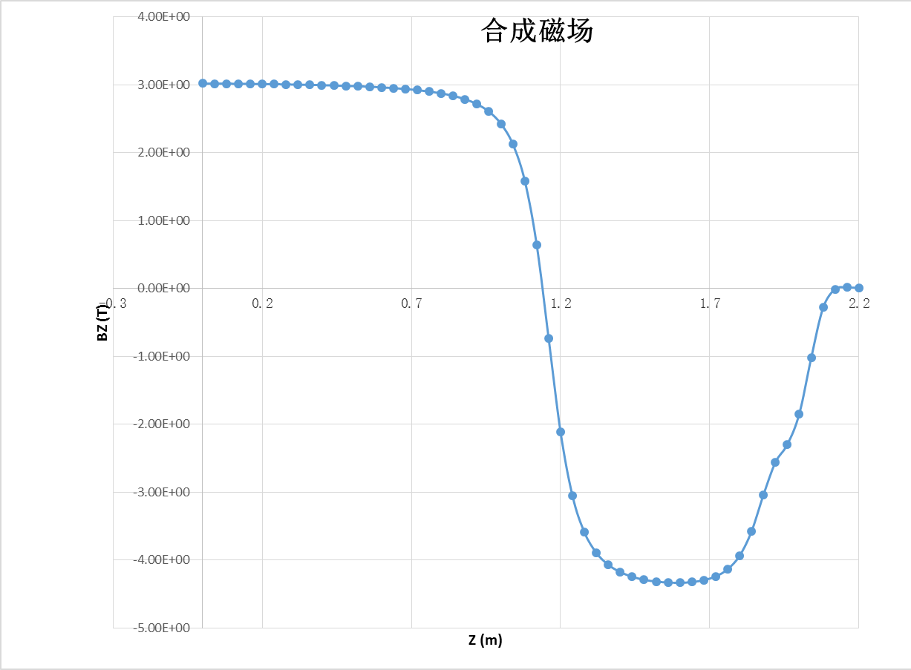
Bz (including all magnet), v170405 (ZHU Yingshun)

Slide 13
Z/W/H: Sol On (Zhu,Yingshun v170405)
Z: 1.48/0.0078 nm
W: 0.57/0.0017 nm
H: design 1.31/0.004 nm

Slide 14
Comparison of Bz
What helps to suppress vertical emittance:
Compensating solenoid is more closer to IP
The change of BZ along s is more smooth

Slide 15
Summary
New version of Bz distribution (170405) is much better for vertical emittance suppression
The coupling correction for W is more critical than Z

