Slide 1
Parameters and DA of 100km CEPC
Dou Wang, Chenghui Yu, Yuan Zhang, Yiwei Wang, Sha Bai, Feng Su, Cai Meng, Chuang Zhang, Na Wang, Tianjian Bian, Huiping Geng, Jie Gao
CEPC AP meeting, 2017.04.07

Slide 2
Parameter difference between CEPC and FCCee
 | CEPC | FCCee
N_{e}/bunch (10¹¹) | 0.97 | 0.8
Momentum compaction (10⁻⁵) | 1.3 | 0.7
β_{IP} x/y (m) | 0.144 /0.002 | 1/0.002
Emittance x/y (nm) | 1.56/0.0047 | 0.61/0.0012
Coupling factor (%) | 0.3 | 0.2
ξ_{x}/ξ_{y}/IP | 0.0126/0.083 | 0.08/0.14
V_{RF} (GV) | 2.22 | 3
f _{RF} (MHz) | 650 | 400
Nature σ_{z} (mm) | 2.72 | 2
Total σ_{z} (mm) | 2.9 | 2.4
Energy acceptance by RF (%) | 2.2 | 7.0
Energy acceptance requirement (%) | 1.5 | 2.0
L_{max}/IP (10³⁴cm⁻²s⁻¹) | 3.1 | 5.1

Slide 3
Constraints for parameter choice
Limit of Beam-beam tune shift
F_{l}: ξy enhancement by crab waist
Beam lifetime due to beamstrahlung
BS life time: 30 min
V.I. Telnov
Beamstrahlung energy spread
A=δ₀/δ_{BS} (A≥3)
HOM power per cavity (coaxial coupler)
*J. Gao, emittance growth and beam lifetime limitations due to beam-beam effects in e+e- storage rings, Nucl. Instr. and methods A533（2004）p. 270-274.

Slide 4
parameters for CEPC double ring
（wangdou20161219-100km_1mmβy）
 | Pre-CDR | H-high lumi. | H-low power |  | W | Z
Number of IPs | 2 | 2 | 2 | 2 | 2 | 2 | 2
Energy (GeV) | 120 | 120 | 120 | 120 | 80 | 45.5 | 45.5
Circumference (km) | 54 | 100 | 100 | 100 | 100 | 100 | 100
SR loss/turn (GeV) | 3.1 | 1.67 | 1.67 | 1.67 | 0.33 | 0.034 | 0.034
Half crossing angle (mrad) | 0 | 15 | 15 | 15 | 15 | 15 | 15
Piwinski angle | 0 | 2.5 | 2.5 | 2.5 | 3.57 | 5.69 | 5.69
N_{e}/bunch (10¹¹) | 3.79 | 1.12 | 1.12 | 1.12 | 1.05 | 0.46 | 0.46
Bunch number | 50 | 555 | 333 | 211 | 1000 | 16666 | 65716
Beam current (mA) | 16.6 | 29.97 | 17.98 | 11.4 | 50.6 | 367.7 | 1449.7
SR power /beam (MW) | 51.7 | 50 | 30 | 19 | 16.7 | 12.7 | 50
Bending radius (km) | 6.1 | 11 | 11 | 11 | 11 | 11 | 11
Momentum compaction (10⁻⁵) | 3.4 | 0.96 | 0.96 | 0.96 | 3.1 | 3.3 | 3.3
β_{IP} x/y (m) | 0.8/0.0012 | 0.3/0.001 | 0.3/0.001 | 0.3 /0.001 | 0.1 /0.001 | 0.12/0.001 | 0.12/0.001
Emittance x/y (nm) | 6.12/0.018 | 1.01/0.0031 | 1.01/0.0031 | 1.01/0.0031 | 2.68/0.008 | 0.93/0.0049 | 0.93/0.0049
Transverse σ_{IP} (um) | 69.97/0.15 | 17.4/0.055 | 17.4/0.055 | 17.4/0.055 | 16.4/0.09 | 10.5/0.07 | 10.5/0.07
ξ_{x}/ξ_{y}/IP | 0.118/0.083 | 0.029/0.083 | 0.029/0.083 | 0.029/0.083 | 0.0082/0.055 | 0.0075/0.054 | 0.0075/0.054
RF Phase (degree) | 153.0 | 123.3 | 123.3 | 123.3 | 149 | 160.8 | 160.8
V_{RF} (GV) | 6.87 | 2.0 | 2.0 | 2.0 | 0.63 | 0.11 | 0.11
f _{RF} (MHz) (harmonic) | 650 | 650 | 650 | 650 | 650 (217800) | 650 (217800)
Nature σ_{z} (mm) | 2.14 | 2.72 | 2.72 | 2.72 | 3.8 | 3.93 | 3.93
Total σ_{z} (mm) | 2.65 | 2.9 | 2.9 | 2.9 | 3.9 | 4.0 | 4.0
HOM power/cavity (kw) | 3.6 (5cell) | 0.75(2cell) | 0.45(2cell) | 0.28(2cell) | 1.0 (2cell) | 1.6(1cell) | 6.25(1cell)
Energy spread (%) | 0.13 | 0.098 | 0.098 | 0.098 | 0.065 | 0.037 | 0.037
Energy acceptance (%) | 2 | 1.5 | 1.5 | 1.5
Energy acceptance by RF (%) | 6 | 1.8 | 1.8 | 1.8 | 1.5 | 1.1 | 1.1
n_{γ} | 0.23 | 0.26 | 0.26 | 0.26 | 0.26 | 0.18 | 0.18
Life time due to beamstrahlung_cal (minute) | 47 | 52 | 52 | 52
F (hour glass) | 0.68 | 0.83 | 0.83 | 0.83 | 0.84 | 0.91 | 0.91
L_{max}/IP (10³⁴cm⁻²s⁻¹) | 2.04 | 5.42 | 3.25 | 2.06 | 4.08 | 18.0 | 70.97

Slide 5
parameters for CEPC double ring
（wangdou20161202-100km_2mmβy）
 | Pre-CDR | H-high lumi. | H-low power
Number of IPs | 2 | 2 | 2
Energy (GeV) | 120 | 120 | 120
Circumference (km) | 54 | 100 | 100
SR loss/turn (GeV) | 3.1 | 1.67 | 1.67
Half crossing angle (mrad) | 0 | 15 | 15
Piwinski angle | 0 | 2.9 | 2.9
N_{e}/bunch (10¹¹) | 3.79 | 0.97 | 0.97
Bunch number | 50 | 644 | 425
Beam current (mA) | 16.6 | 29.97 | 19.8
SR power /beam (MW) | 51.7 | 50 | 33
Bending radius (km) | 6.1 | 11 | 11
Momentum compaction (10⁻⁵) | 3.4 | 1.3 | 1.3
β_{IP} x/y (m) | 0.8/0.0012 | 0.144 /0.002 | 0.144 /0.002
Emittance x/y (nm) | 6.12/0.018 | 1.56/0.0047 | 1.56/0.0047
Transverse σ_{IP} (um) | 69.97/0.15 | 15/0.097 | 15/0.097
ξ_{x}/ξ_{y}/IP | 0.118/0.083 | 0.0126/0.083 | 0.0126/0.083
RF Phase (degree) | 153.0 | 131.2 | 131.2
V_{RF} (GV) | 6.87 | 2.22 | 2.22
f _{RF} (MHz) (harmonic) | 650 | 650 (217800) | 650 (217800)
Nature σ_{z} (mm) | 2.14 | 2.72 | 2.72
Total σ_{z} (mm) | 2.65 | 2.9 | 2.9
HOM power/cavity (kw) | 3.6 (5cell) | 0.64 (2cell) | 0.42 (2cell)
Energy spread (%) | 0.13 | 0.098 | 0.098
Energy acceptance (%) | 2 | 1.5 | 1.5
Energy acceptance by RF (%) | 6 | 2.2 | 2.2
n_{γ} | 0.23 | 0.26 | 0.26
Life time due to beamstrahlung_cal (minute) | 47 | 52 | 52
F (hour glass) | 0.68 | 0.95 | 0.95
L_{max}/IP (10³⁴cm⁻²s⁻¹) | 2.04 | 3.1 | 2.05

Slide 6
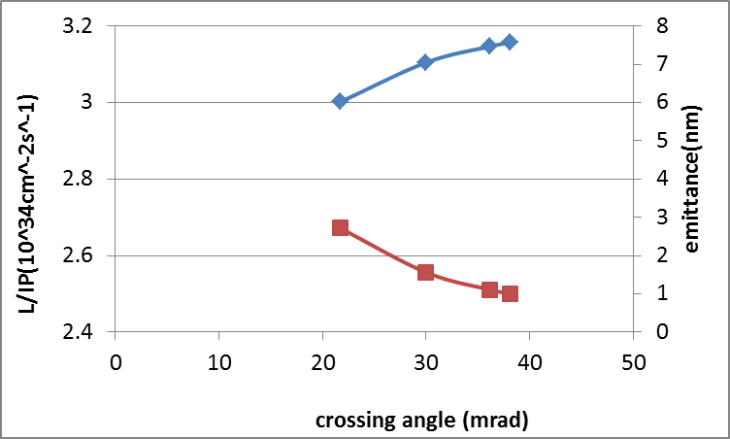
Luminosity vs. crossing angle
Keep beamstrahlung life time constant (52min)

Slide 7
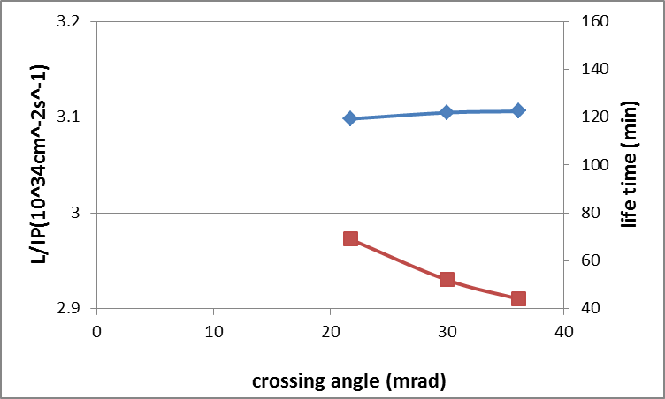
Luminosity vs. crossing angle
Keep emittance constant (1.56nm)

Slide 8
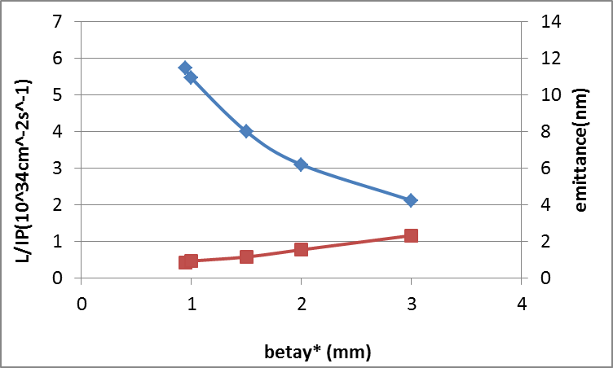
Luminosity vs. βy*
Keep beamstrahlung life time constant (52min)

Slide 9
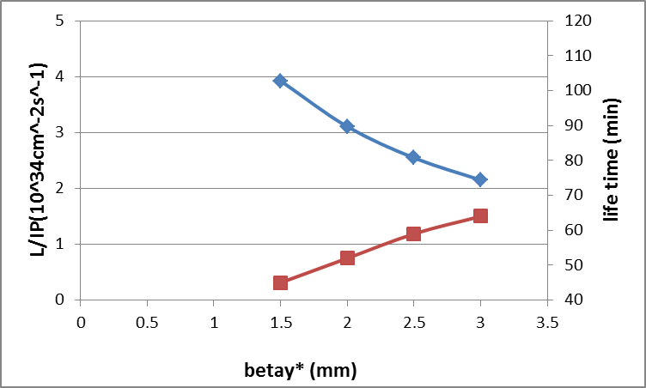
Luminosity vs. βy*
Keep emittance constant (1.56nm)

Slide 10
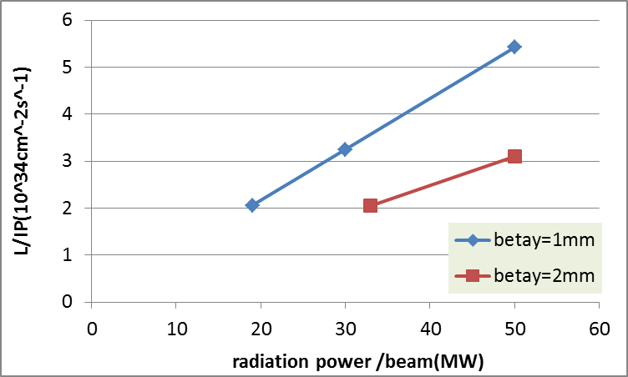
Luminosity vs. SR power
goal

Slide 11
parameters for CEPC double ring
（wangdou20170306-100km_2mmβy）
 | Pre-CDR | tt | Higgs | W | Z
Number of IPs | 2 | 2 | 2 | 2 | 2
Energy (GeV) | 120 | 175 | 120 | 80 | 45.5
Circumference (km) | 54 | 100 | 100 | 100 | 100
SR loss/turn (GeV) | 3.1 | 7.55 | 1.67 | 0.33 | 0.034
Half crossing angle (mrad) | 0 | 16.5 | 16.5 | 16.5 | 16.5
Piwinski angle | 0 | 1.6 | 3.19 | 5.69 | 4.29
N_{e}/bunch (10¹¹) | 3.79 | 1.41 | 0.968 | 0.365 | 0.455
Bunch number | 50 | 98 | 412 | 5534 | 21300
Beam current (mA) | 16.6 | 6.64 | 19.2 | 97.1 | 465.8
SR power /beam (MW) | 51.7 | 50 | 32 | 32 | 16.1
Bending radius (km) | 6.1 | 11 | 11 | 11 | 11
Momentum compaction (10⁻⁵) | 3.4 | 1.3 | 1.14 | 1.14 | 4.49
β_{IP} x/y (m) | 0.8/0.0012 | 0.2/0.002 | 0.171/0.002 | 0.171 /0.002 | 0.16/0.002
Emittance x/y (nm) | 6.12/0.018 | 3.19/0.0097 | 1.31/0.004 | 0.57/0.0017 | 1.48/0.0078
Transverse σ_{IP} (um) | 69.97/0.15 | 25.3/0.14 | 15.0/0.089 | 9.9/0.059 | 15.4/0.125
ξ_{x}/ξ_{y}/IP | 0.118/0.083 | 0.016/0.055 | 0.013/0.083 | 0.0055/0.062 | 0.008/0.054
RF Phase (degree) | 153.0 | 122.2 | 128 | 126.9 | 165.3
V_{RF} (GV) | 6.87 | 8.92 | 2.1 | 0.41 | 0.14
f _{RF} (MHz) (harmonic) | 650 | 650 | 650 | 650 (217800) | 650 (217800)
Nature σ_{z} (mm) | 2.14 | 2.62 | 2.72 | 3.37 | 3.97
Total σ_{z} (mm) | 2.65 | 2.7 | 2.9 | 3.4 | 4.0
HOM power/cavity (kw) | 3.6 (5cell) | 0.53(5cell) | 0.41(2cell) | 0.36(2cell) | 1.99(2cell)
Energy spread (%) | 0.13 | 0.14 | 0.098 | 0.065 | 0.037
Energy acceptance (%) | 2 | 2 | 1.5
Energy acceptance by RF (%) | 6 | 2.6 | 2.1 | 1.1 | 1.1
n_{γ} | 0.23 | 0.23 | 0.26 | 0.15 | 0.12
Life time due to beamstrahlung_cal (minute) | 47 | 50 | 52
F (hour glass) | 0.68 | 0.89 | 0.96 | 0.98 | 0.96
L_{max}/IP (10³⁴cm⁻²s⁻¹) | 2.04 | 0.62 | 2.0 | 5.15 | 11.9

Slide 12
For Z pole, if we use the same RF system as Higgs and feedback system, the luminosity is 1.2×10³⁵cm⁻²s⁻¹.
Considering the constraint of 10 ns bunch separation from detector, the maximum bunch number is 30870 and the according beam power is 23MW.

Slide 13
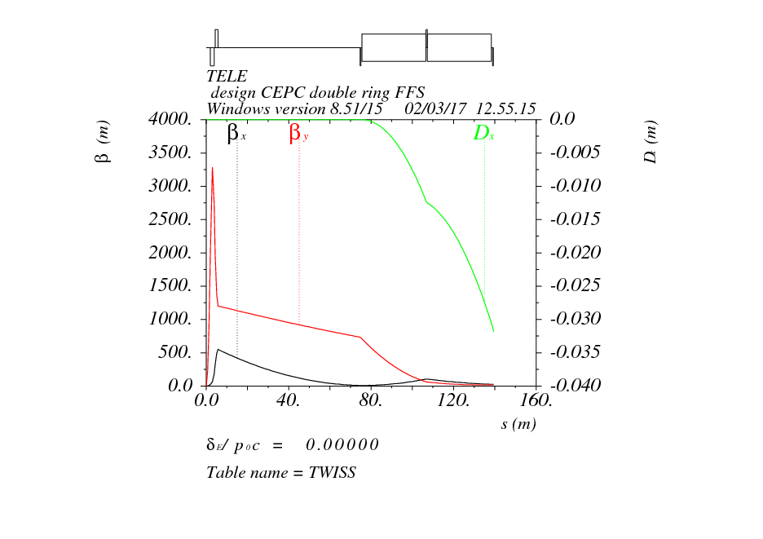

Slide 14
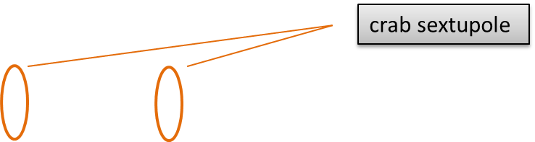
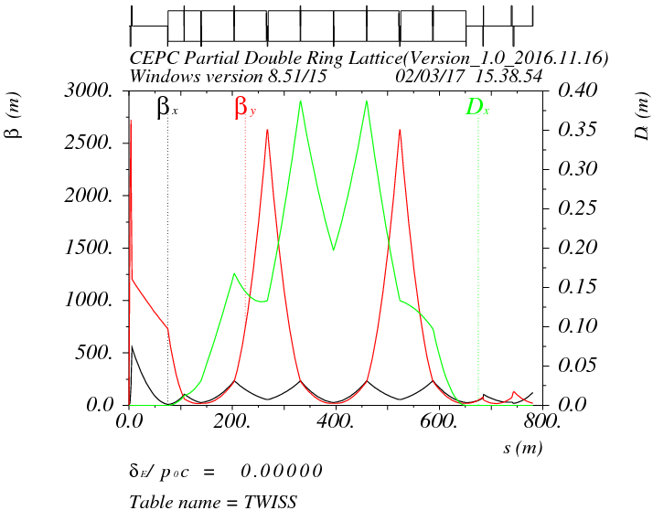
μx=1.5, μy=1.25
μx=1.0, μy=0.75

Slide 15
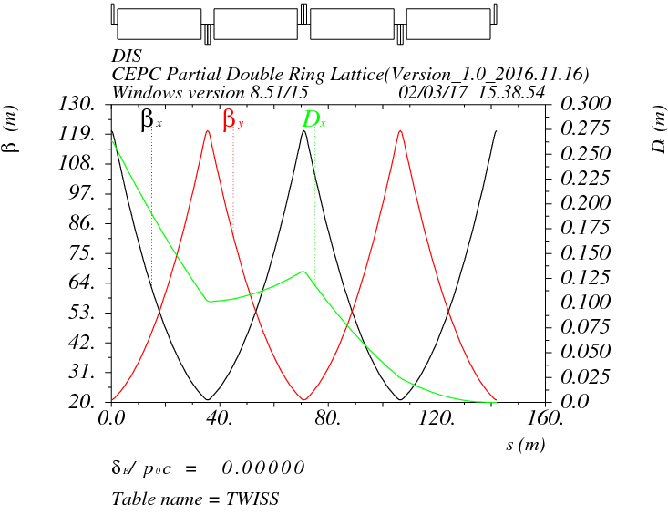
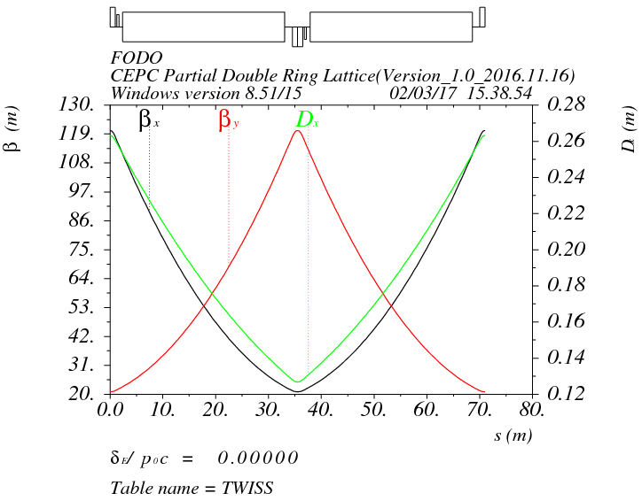
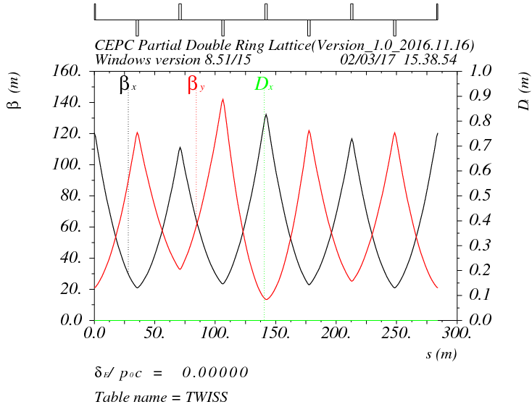
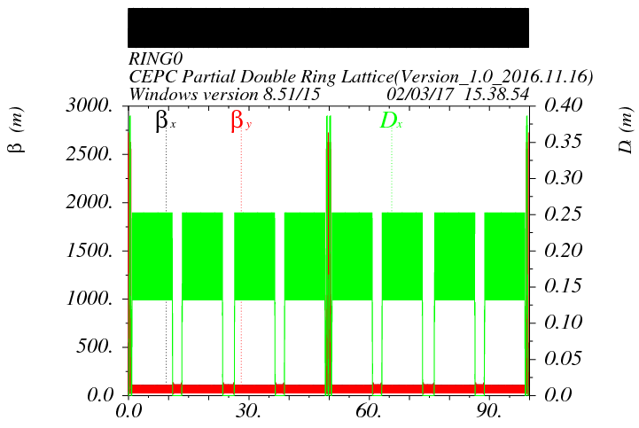
arc

Slide 16
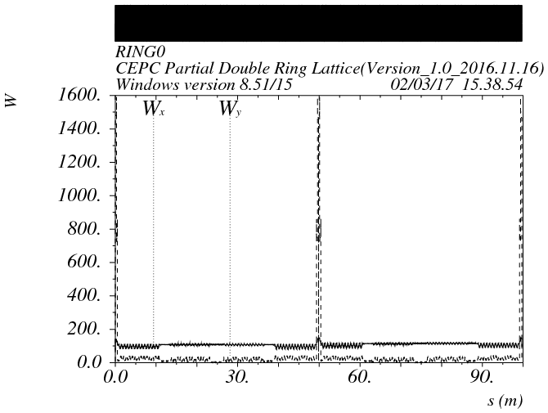

Slide 18
DA without crab

Slide 19
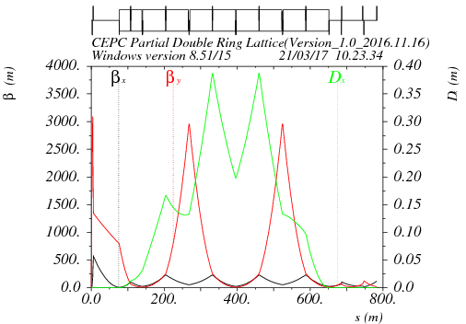

FFS optics
（L*=2.2m,Betax=0.171m,Betay=0.002m）
Tune: 348.338/348.22

Slide 20
L*=2.2m
Betax=0.171m
Betay=0.002m

Slide 21
DA optimization （112fam）
Damping close
Damping open

Slide 22
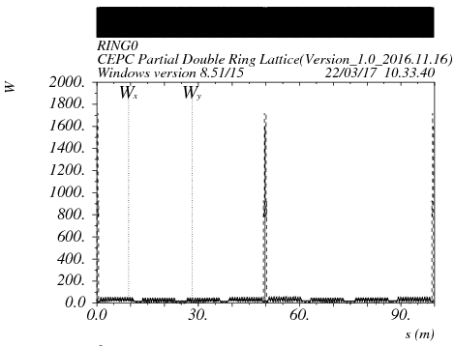
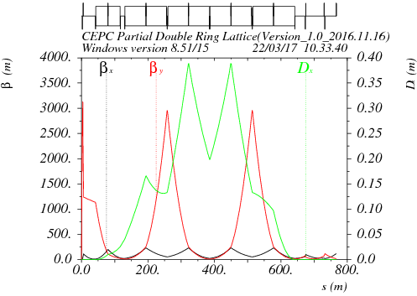
FFS optics
（L*=2.2m,Betax=1.0m,Betay=0.002m）
Tune: 348.338/348.22

Slide 23
L*=2.2m
Betax=1.0m
Betay=0.002m

Slide 24
DA optimization （112fam）
Damping close
Damping open

Slide 25
Z parameters with different coupling
 | Z-0.303% | Z-0.527% | Z-0.714% | Z-1% | Z-1%
Number of IPs | 2
Energy (GeV) | 45.5
Circumference (km) | 100
SR loss/turn (GeV) | 0.034
Half crossing angle (mrad) | 16.5
Piwinski angle | 4.29
N_{e}/bunch (10¹¹) | 0.346 | 0.455 | 0.532 | 0.63 | 0.455
Bunch number | 30870 | 21300 | 15580 | 11120 | 21300
Beam current (mA) | 513.3 | 465.8 | 398.3 | 336.7 | 465.8
SR power /beam (MW) | 17.7 | 16.1 | 13.7 | 11.6 | 16.1
Bending radius (km) | 11
Momentum compaction (10⁻⁵) | 4.49
β_{IP} x/y (m) | 0.16/0.002 | 0.16/0.002 | 0.16/0.002 | 0.16/0.002 | 0.16/0.002
Emittance x/y (nm) | 1.48/0.0045 | 1.48/0.0078 | 1.48/0.0106 | 1.48/0.015 | 1.48/0.015
Transverse σ_{IP} (um) | 15.4/0.095 | 15.4/0.125 | 15.4/0.145 | 15.4/0.172 | 15.4/0.17
ξ_{x}/ξ_{y}/IP | 0.006/0.054 | 0.008/0.054 | 0.009/0.054 | 0.011/0.054 | 0.008/0.039
RF Phase (degree) | 165.2 | 165.3 | 165.4 | 165.6 | 165.3
V_{RF} (GV) | 0.13 | 0.14 | 0.14 | 0.14 | 0.14
f _{RF} (MHz) (harmonic) | 650 (217800)
Nature σ_{z} (mm) | 3.99 | 3.97 | 3.96 | 3.93 | 3.96
Total σ_{z} (mm) | 4.0
HOM power/cavity (kw) | 1.67(2cell) | 1.99(2cell) | 1.99(2cell) | 1.99 | 1.99
Energy spread (%) | 0.037
Energy acceptance by RF (%) | 1.1 | 1.1 | 1.1 | 1.1 | 1.1
n_{γ} | 0.09 | 0.12 | 0.14 | 0.17 | 0.12
F (hour glass) | 0.96 | 0.96 | 0.96 | 0.96 | 0.96
L_{max}/IP (10³⁴cm⁻²s⁻¹) | 13.1 | 11.9 | 10.2 | 8.62 | 8.61

Slide 26
Z parameters with different coupling-2cell
 | Z-0.303% | Z-0.527% | Z-0.714% | Z-1% | Z-1.5% | Z-2%
Number of IPs | 2
Energy (GeV) | 45.5
Circumference (km) | 100
SR loss/turn (GeV) | 0.034
Half crossing angle (mrad) | 16.5
Piwinski angle | 4.29
N_{e}/bunch (10¹¹) | 0.346 | 0.455 | 0.532 | 0.63 | 0.77 | 0.89
Bunch number | 27018 | 21300 | 15580 | 11120 | 7410 | 5550
Beam current (mA) | 449.3 | 465.8 | 398.3 | 336.7 | 274.9 | 237.9
SR power /beam (MW) | 15.5 | 16.1 | 13.7 | 11.6 | 9.5 | 8.2
Bending radius (km) | 11
Momentum compaction (10⁻⁵) | 4.49
β_{IP} x/y (m) | 0.16/0.002 | 0.16/0.002 | 0.16/0.002 | 0.16/0.002 | 0.16/0.002 | 0.16/0.002
Emittance x/y (nm) | 1.48/0.0045 | 1.48/0.0078 | 1.48/0.0106 | 1.48/0.015 | 1.48/0.022 | 1.48/0.029
Transverse σ_{IP} (um) | 15.4/0.095 | 15.4/0.125 | 15.4/0.145 | 15.4/0.172 | 15.4/0.21 | 15.4/0.243
ξ_{x}/ξ_{y}/IP | 0.006/0.054 | 0.008/0.054 | 0.009/0.054 | 0.011/0.054 | 0.014/0.054 | 0.016/0.54
RF Phase (degree) | 165.2 | 165.3 | 165.4 | 165.6 | 166.0 | 166.4
V_{RF} (GV) | 0.13 | 0.14 | 0.14 | 0.14 | 0.14 | 0.15
f _{RF} (MHz) (harmonic) | 650 (217800)
Nature σ_{z} (mm) | 3.99 | 3.97 | 3.96 | 3.93 | 3.88 | 3.81
Total σ_{z} (mm) | 4.0
HOM power/cavity (kw) | 1.46(2cell) | 1.99(2cell) | 1.99(2cell) | 1.99(2cell) | 1.99(2cell) | 1.99(2cell)
Energy spread (%) | 0.037
Energy acceptance by RF (%) | 1.1 | 1.1 | 1.1 | 1.1 | 1.1 | 1.1
n_{γ} | 0.09 | 0.12 | 0.14 | 0.17 | 0.2 | 0.23
F (hour glass) | 0.96 | 0.96 | 0.96 | 0.96 | 0.96 | 0.96
L_{max}/IP (10³⁴cm⁻²s⁻¹) | 11.5 | 11.9 | 10.2 | 8.62 | 7.04 | 6.1

Slide 27
Z parameters with different coupling-1cell
 | Z-0.303% | Z-0.527% | Z-1% | Z-1.5% | Z-2%
Number of IPs | 2
Energy (GeV) | 45.5
Circumference (km) | 100
SR loss/turn (GeV) | 0.034
Half crossing angle (mrad) | 16.5
Piwinski angle | 4.29
N_{e}/bunch (10¹¹) | 0.346 | 0.455 | 0.63 | 0.77 | 0.89
Bunch number | 27018 | 27018 | 22250 | 14810 | 11090
Beam current (mA) | 449.3 | 590.8 | 673.7 | 549.5 | 475.4
SR power /beam (MW) | 15.5 | 20.4 | 23.2 | 18.95 | 16.4
Bending radius (km) | 11
Momentum compaction (10⁻⁵) | 4.49
β_{IP} x/y (m) | 0.16/0.002 | 0.16/0.002 | 0.16/0.002 | 0.16/0.002 | 0.16/0.002
Emittance x/y (nm) | 1.48/0.0045 | 1.48/0.0078 | 1.48/0.015 | 1.48/0.022 | 1.48/0.029
Transverse σ_{IP} (um) | 15.4/0.095 | 15.4/0.125 | 15.4/0.172 | 15.4/0.21 | 15.4/0.243
ξ_{x}/ξ_{y}/IP | 0.006/0.054 | 0.008/0.054 | 0.011/0.054 | 0.014/0.054 | 0.016/0.54
RF Phase (degree) | 165.2 | 165.3 | 165.6 | 166.0 | 166.4
V_{RF} (GV) | 0.13 | 0.14 | 0.14 | 0.14 | 0.15
f _{RF} (MHz) (harmonic) | 650 (217800)
Nature σ_{z} (mm) | 3.99 | 3.97 | 3.93 | 3.88 | 3.81
Total σ_{z} (mm) | 4.0
HOM power/cavity (kw) | 0.73(1cell) | 1.26(1cell) | 1.99(1cell) | 1.99(1cell) | 1.99(1cell)
Energy spread (%) | 0.037
Energy acceptance by RF (%) | 1.1 | 1.1 | 1.1 | 1.1 | 1.1
n_{γ} | 0.09 | 0.12 | 0.17 | 0.2 | 0.23
F (hour glass) | 0.96 | 0.96 | 0.96 | 0.96 | 0.96
L_{max}/IP (10³⁴cm⁻²s⁻¹) | 11.5 | 15.1 | 17.25 | 14.1 | 12.2

Slide 28
Z parameters with different coupling-1cell
（without 10ns constraint of detector）
 | Z-0.303% | Z-0.527% | Z-1% | Z-1.5% | Z-2%
Number of IPs | 2
Energy (GeV) | 45.5
Circumference (km) | 100
SR loss/turn (GeV) | 0.034
Half crossing angle (mrad) | 16.5
Piwinski angle | 4.29
N_{e}/bunch (10¹¹) | 0.346 | 0.455 | 0.63 | 0.77 | 0.89
Bunch number | 73770 | 42700 | 22250 | 14810 | 11090
Beam current (mA) | 1226.7 | 933.7 | 673.7 | 549.5 | 475.4
SR power /beam (MW) | 42.3 | 32.2 | 23.2 | 18.95 | 16.4
Bending radius (km) | 11
Momentum compaction (10⁻⁵) | 4.49
β_{IP} x/y (m) | 0.16/0.002 | 0.16/0.002 | 0.16/0.002 | 0.16/0.002 | 0.16/0.002
Emittance x/y (nm) | 1.48/0.0045 | 1.48/0.0078 | 1.48/0.015 | 1.48/0.022 | 1.48/0.029
Transverse σ_{IP} (um) | 15.4/0.095 | 15.4/0.125 | 15.4/0.172 | 15.4/0.21 | 15.4/0.243
ξ_{x}/ξ_{y}/IP | 0.006/0.054 | 0.008/0.054 | 0.011/0.054 | 0.014/0.054 | 0.016/0.54
RF Phase (degree) | 165.2 | 165.3 | 165.6 | 166.0 | 166.4
V_{RF} (GV) | 0.13 | 0.14 | 0.14 | 0.14 | 0.15
f _{RF} (MHz) (harmonic) | 650 (217800)
Nature σ_{z} (mm) | 3.99 | 3.97 | 3.93 | 3.88 | 3.81
Total σ_{z} (mm) | 4.0
HOM power/cavity (kw) | 1.99(1cell) | 1.99(1cell) | 1.99(1cell) | 1.99(1cell) | 1.99(1cell)
Energy spread (%) | 0.037
Energy acceptance by RF (%) | 1.1 | 1.1 | 1.1 | 1.1 | 1.1
n_{γ} | 0.09 | 0.12 | 0.17 | 0.2 | 0.23
F (hour glass) | 0.96 | 0.96 | 0.96 | 0.96 | 0.96
L_{max}/IP (10³⁴cm⁻²s⁻¹) | 31.4 | 23.8 | 17.25 | 14.1 | 12.2

Slide 29
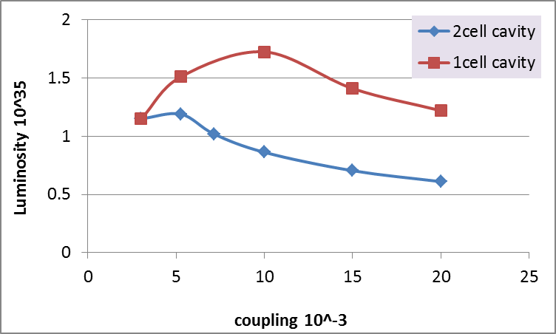
Z luminosity vs. coupling

Slide 30
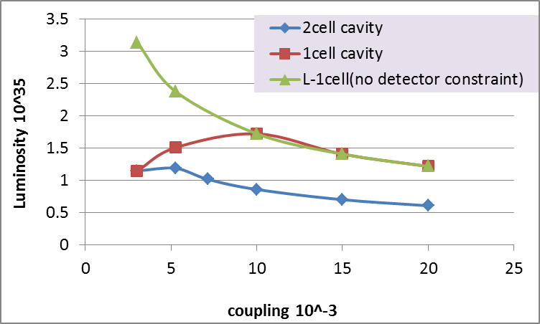
Z luminosity vs. coupling
3ns
6ns
12ns
21ns
30ns

