Slide 1
Status Report
Fenfen An
2017.04.17

Slide 2
Outline
dE/dx performance study in TPC at CEPC
Get familiar with CEPC software and some physics.
dE/dx performance is predicted. Report will be given in the workshop.
Note is written. Paper is in preparation.
Work plan & Discussion

Slide 3
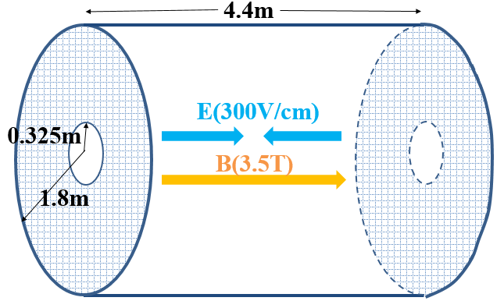
TPC @CEPC
222 rows of pads to detect signals
Low material
Precise 3-d track points
Particle ID by dE/dx
Long drift time (~25us)
Gas volume
(95% Ar+3%CF4+2%iso-C4H10)

Slide 4
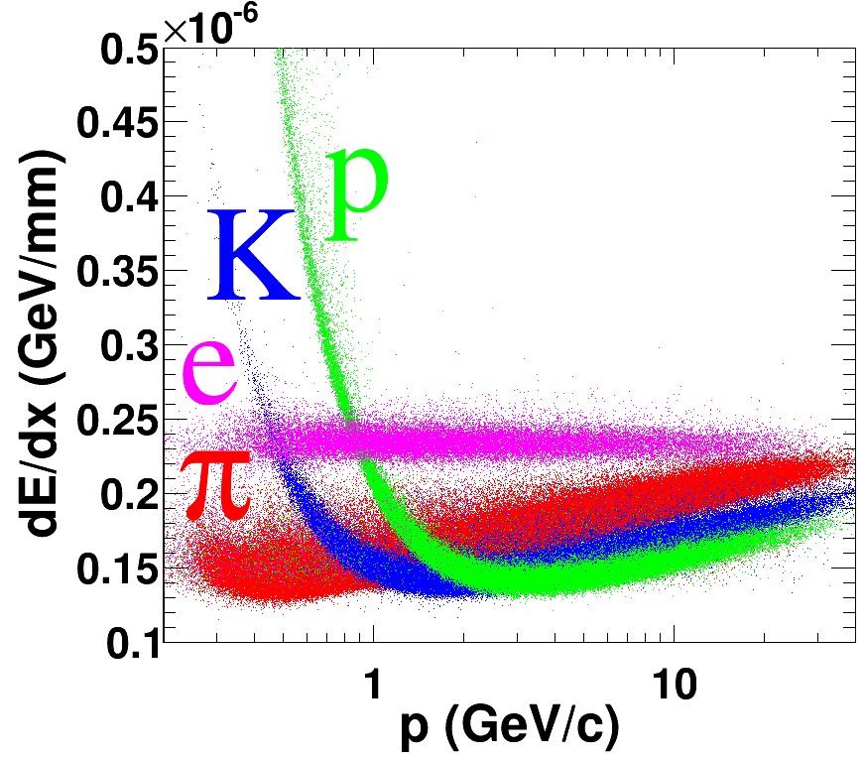
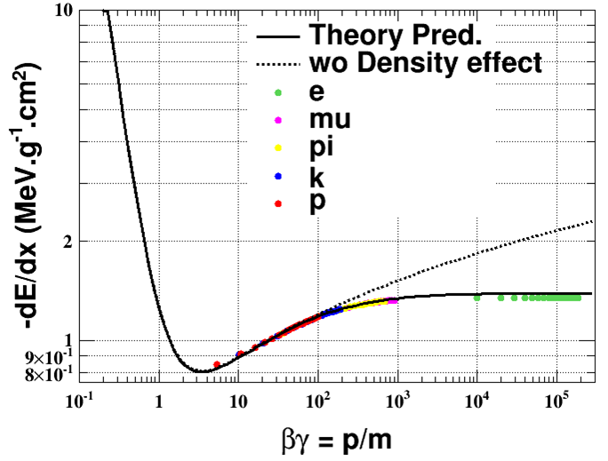
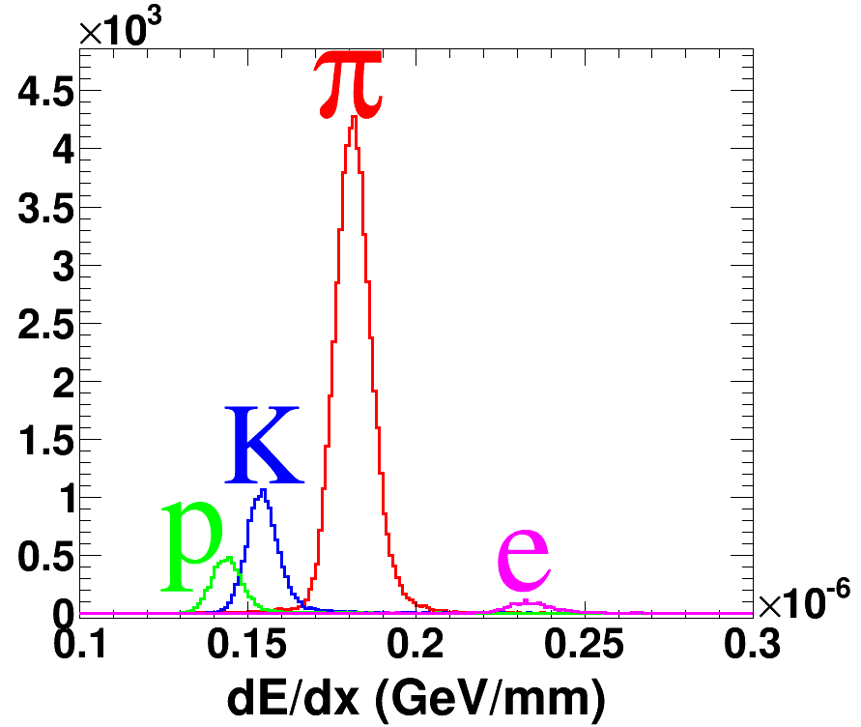
dE/dx Simulation @CEPC
Motivation: Explore the particle identification ability in the relativistic region
$$p=5 GeV/c$$

Slide 5
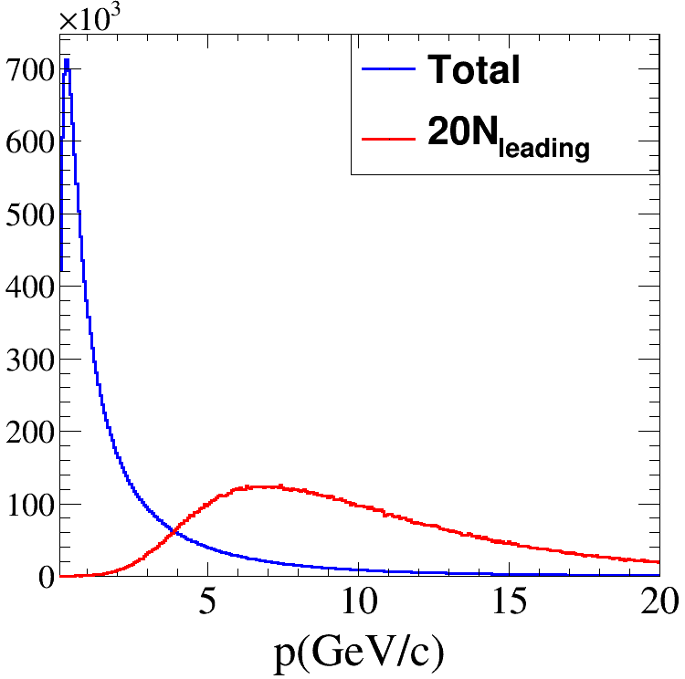
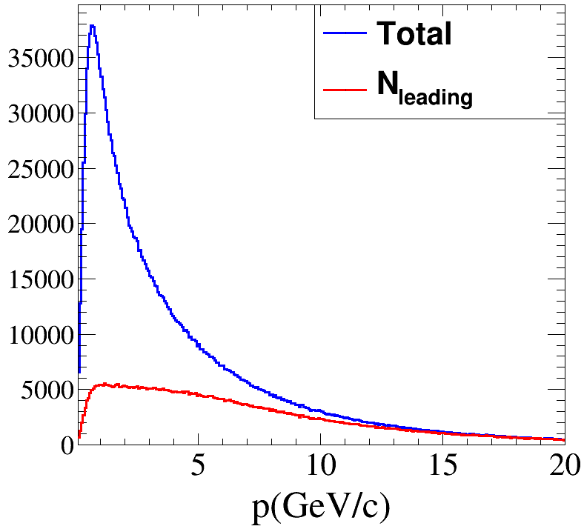
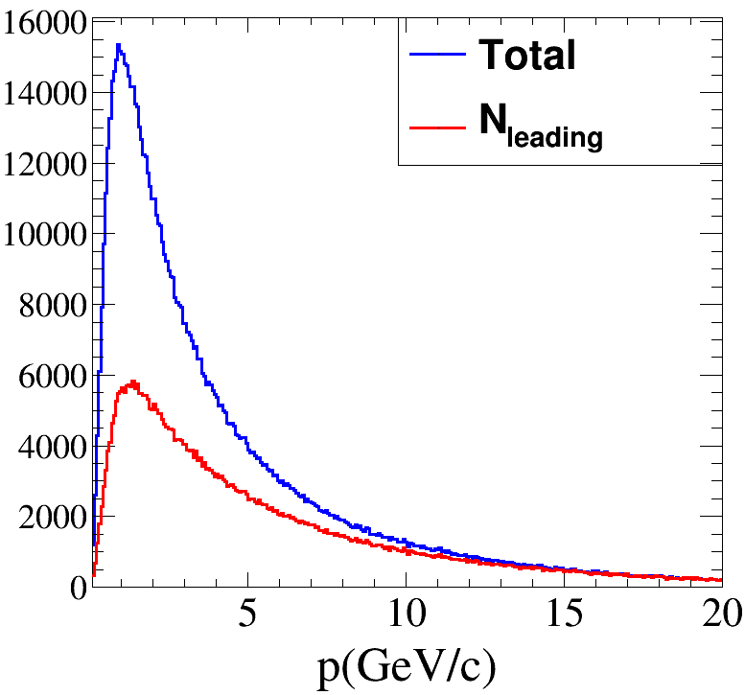
Typical Momentum Range @CEPC
$$e^{+}e^{−}→Z→q\overline{q}$$
$$π$$
$$K$$
$$p$$
Much more secondary pions compared to kaons and protons.
dE/dx would hopefully be an effective tool to identify the hadrons, especially for leading particles.

Slide 6
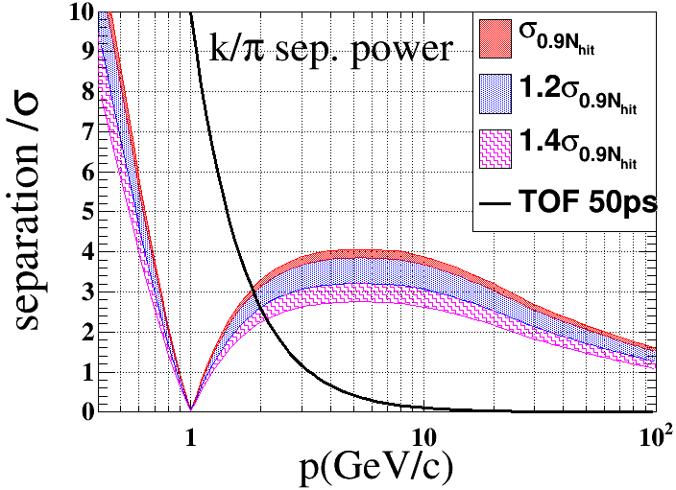
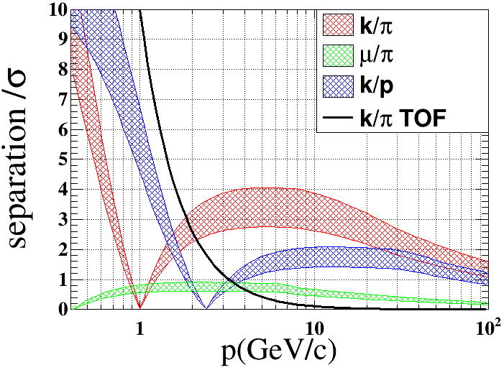
Separation Power in MultiHadronic Events
2.4$σ$ and 3.9$σ$ corresponds to a mid-id probability of 4.5% and 0.3%.
A TOF counter of 50ps is added to cover the hole, which can effectively separate kaon and pion of up to 2 GeV/c after a flight of 2m.

Slide 7
Main Problems
Understand the difference between G4 prediction and experimental measurements. $→$ Can we achieve the G4 prediction?
Research Method:
Simulate the previous experiments and obtain the dE/dx resolution predicted by G4;
Compare with the experimental measurements.
Difficulty:
Limited by the information of the various experiments provided in the paper.
Hard to extract obvious support to estimate our future reach of PID ability. Recent and similar experiments are rare.

Slide 8
What determines dE/dx resolution
Dependence on the projectile.
$p:$ momentum
$θ$: polar angle relative to the beam
s
$$h$$
θ
The number of primary ionizations in one dE/dx hit.
h: cell size
$ρ$: gas density
n: The number of dE/dx hits in one track

Slide 9
Comparison Between G4 & Exp. Meas.
 | PEP-4 | TOPAZ | DELPHI | ALEPH | STAR | ALICE | T2K
Year | 1981 | 1987 | 1990 | 1990 | 2000 | 2009 | 2010
Gas | 80%Ar+ 20%CH4 | 90%Ar+ 10CH4 | 80%Ar+ 20%CH4 | 91%Ar+ 9%CH4 | 90%Ar+ 10CH4 | 85.7Ne+ 9.5%CO2+4.8%N2 | 95%Ar+3%CF4+2%iC4H10
$ρ$(mg/ml) | 12.4 | 5.5 | 1.5 | 1.6 | 1.6 | 0.95 | 1.7
N | 183 | 175 | 192 | 344 | 13,32 | 63,64,32 | 60
h(mm) | 4 | 4 | 4 | 4 | 12,20 | 7.2,10,15 | 10
Control Sample | e (14) | $π$ (0.5) | $π$ (0.5) | e (45.6) | Hadron, (<1) | Cosmic | $π$ (0.5)
$$N_{eff}$$ | N | 0.7N | 0.6N | 338 | 0.7N | N | N
$σ/μ$ (G4) | 2.6 | 3.8 | 5.4 | 3.0 | 6.0 | 3.1 | 5.5
$σ/μ$(Exp) | 3.5 | 4.6 | 6.2 | 4.4 | 8.0 | 4.2 | 7.8
Exp/G4-1 | 35% | 21% | 15% | 47% | 33% | 35% | 42%

Slide 10
Comparison Between G4 & Exp. Meas.
 | MarkII | OPAL | Babar | Belle | BESIII
Year | 1989 | 1990 | 1999 | 1999 | 2009
Gas | 89%Ar+ 10%CO2+ 1%CH4 | 88.2%Ar+ 9.8%CH4+ 2%iC4H10 | 80%He+ 20%iC4H10 | 50%He+ 50%C2H6 | 60%He+ 40%C3H8
$ρ$(mg/ml) | 1.7 | 6.3 | 0.63 | 0.72 | 0.85
N | 72 | 159 | 40 | 50 | 43
h(mm) | 8.33 | 10 | 14.3 | 15.5 | 16.2
Control Sample | e(45) | $$μ(45)$$ | Cosmic | $π$ (3.5) | $π$ (0.5)
$$N_{eff}$$ | N | 130 | N | N | 39
$σ/μ$ (G4) | 4.8 | 2.2 | 5.3 | 5.1 | 5.9
$σ/μ$(Exp) | 6.9 | 3.1 | 6.8 | 5 | 6
Exp/G4-1 | 44% | 41% | 28% | 0 | 0

Slide 11
Work Plan & Discussion
CEPC work not done yet:
Diagnosis package development, whole ILC Software establishment
Reconstruction work content not decided
The conferences that I expect to attend & the reports expected to give
CEPC collaboration meeting at the end of 2017
ATLAS conferences & reports?
Any time limits on the $Z→eμ$ analysis @ATLAS?

Slide 12
Backup

Slide 13
Considerations in Real Case
Factors that may influence dE/dx resolution:
TPC geometry (radius, pads …) and gas (type, pressure …)
Perfectly estimated by Geant4
Hit loss due to multi hits overlapping in jets
~30% in previous experiments (STAR, OPAL, DELPHI …)
Hope it could lower to 10% at CEPC (Two hits >2mm separable)
Calibration (track length, saturation, …) and readout electronics
0-40% in previous experiments (see the next page)
20% is expected for the current

Slide 14
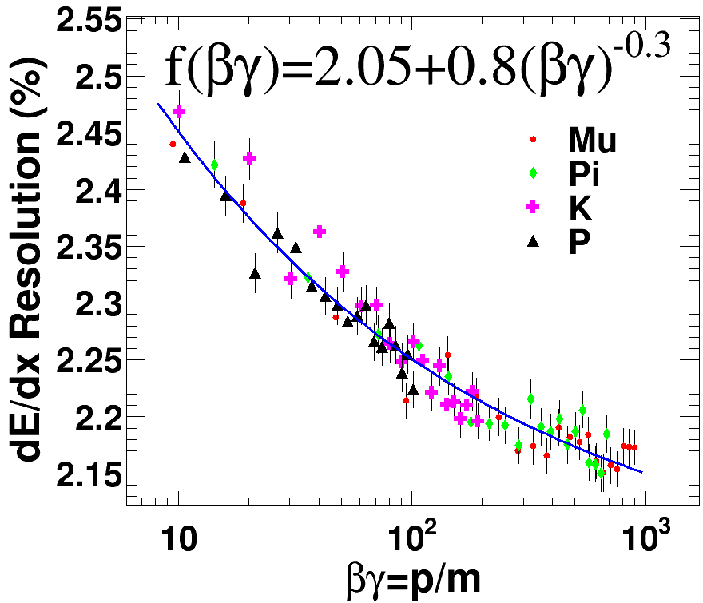
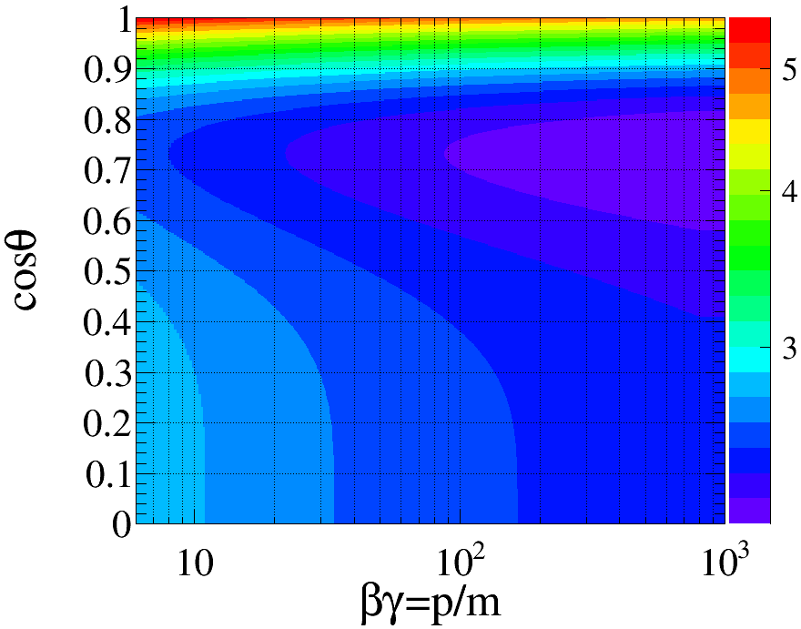
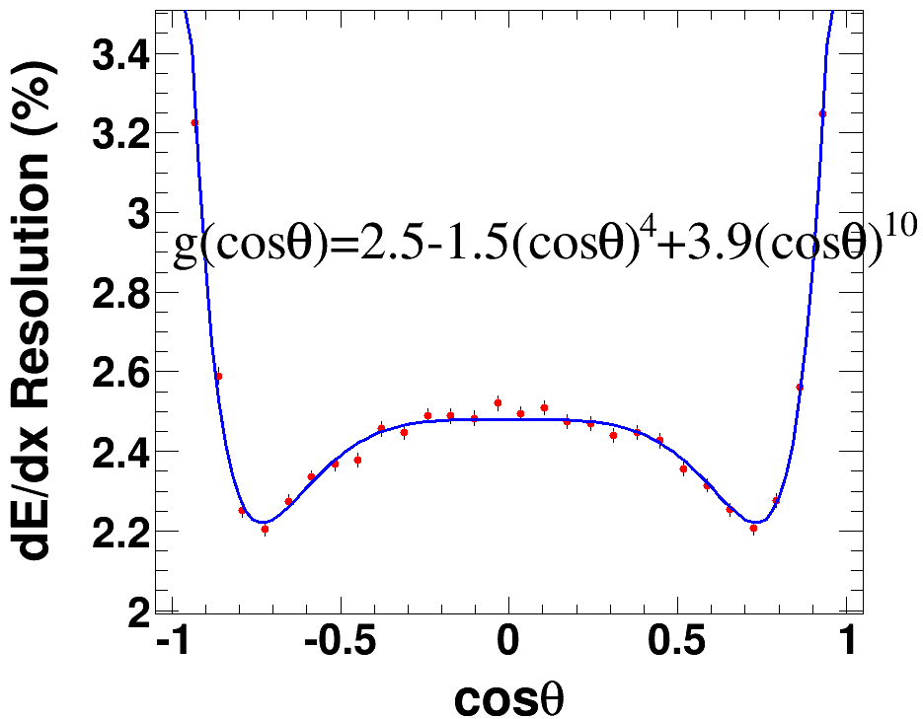
$\frac{σ_{dE/dx}}{〈dE/dx〉}$ in $\left(p,cosθ\right)$ Space
Single track MC results.

Slide 15
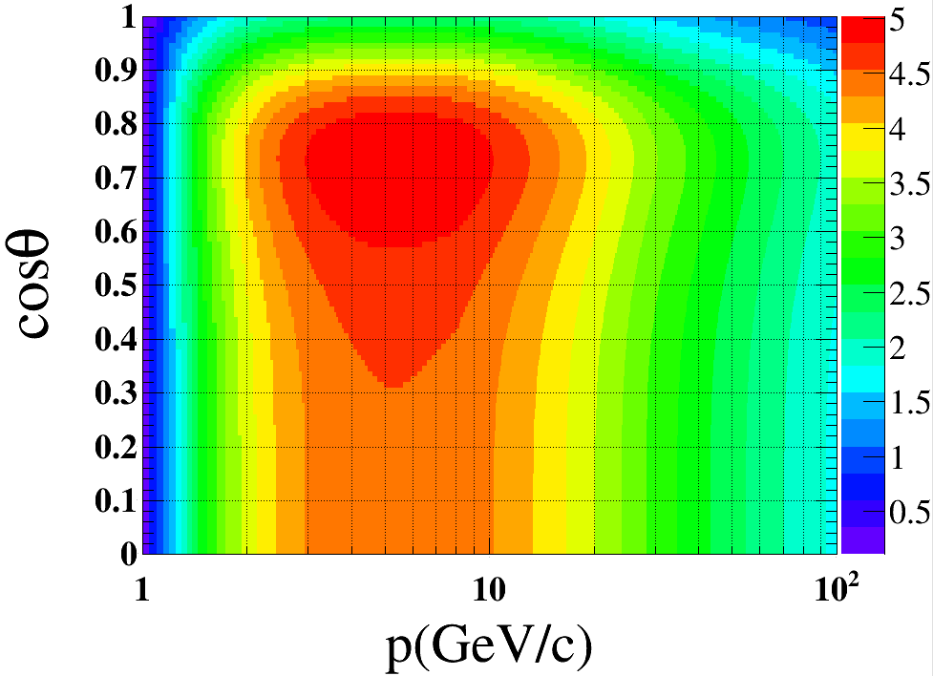
Separation Power in $\left(p,cosθ\right)$ Space
2.4$σ$ and 3.9$σ$ corresponds to a mid-id probability of 4.5% and 0.3%, respectively.

Slide 16
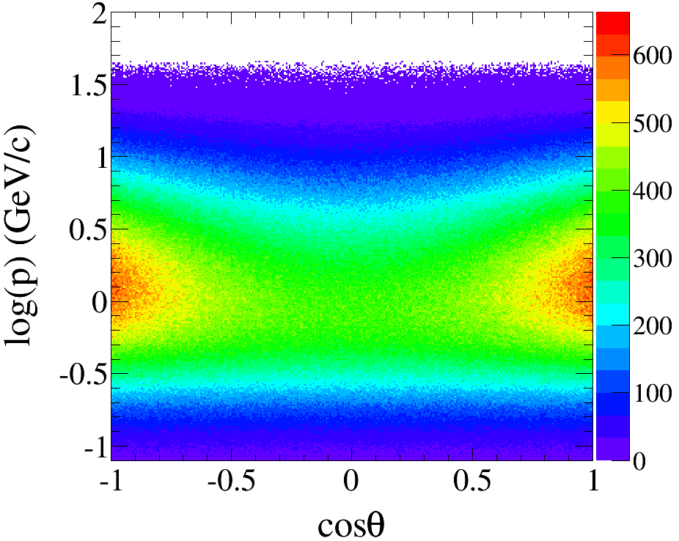
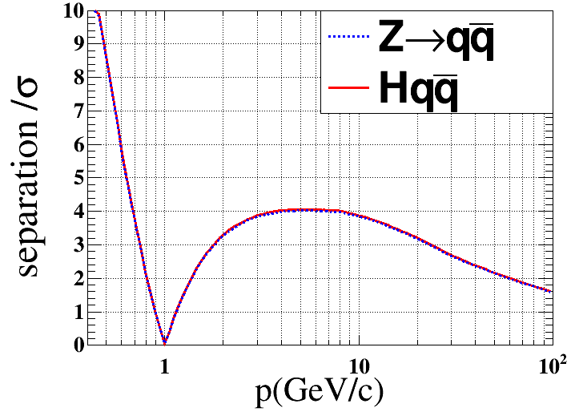
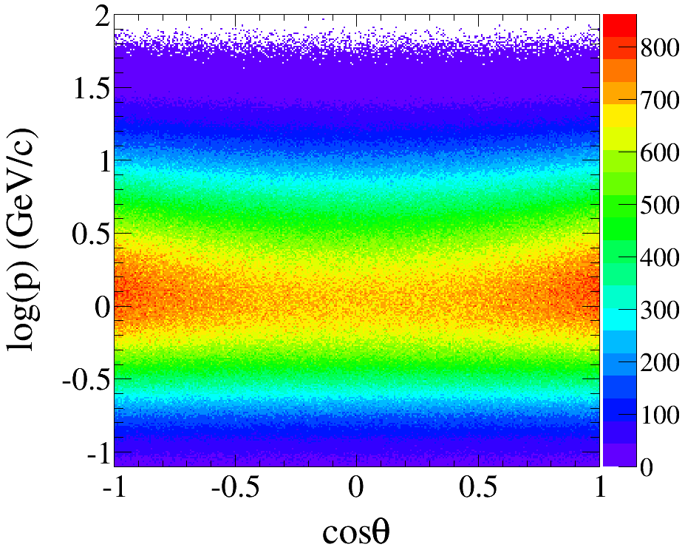
Separation Power in Physics Events
S~p by weighting $cosθ$ in different physics events
$$e^{+}e^{−}→Z→q\overline{q}$$
$$e^{+}e^{−}→Hq\overline{q}$$

Slide 17
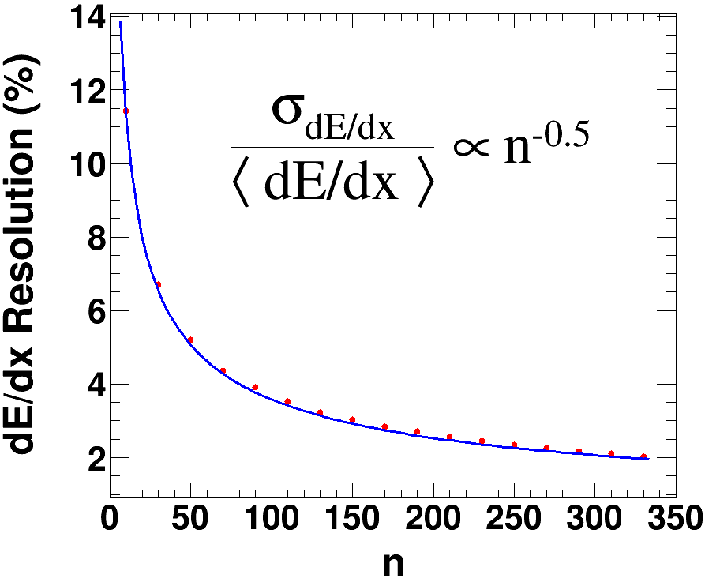
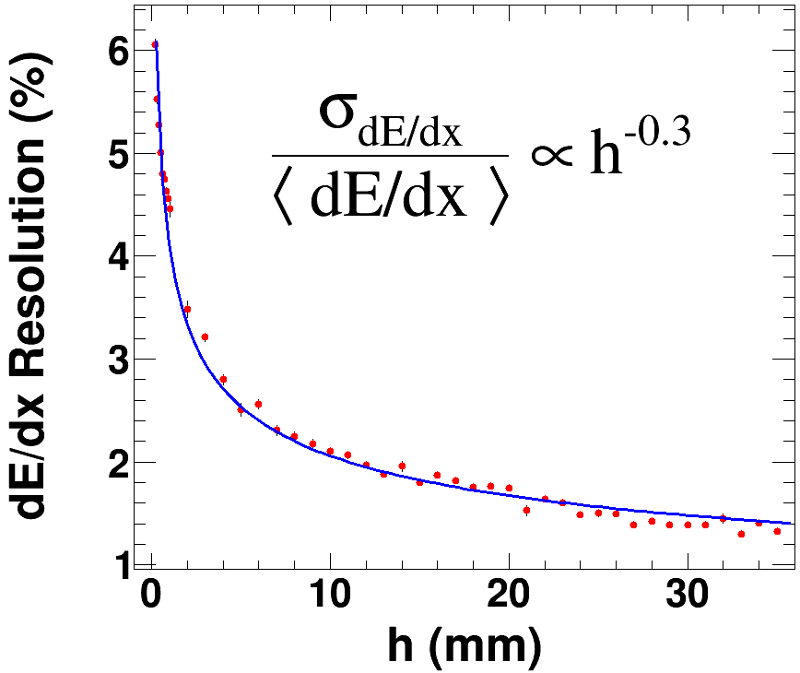
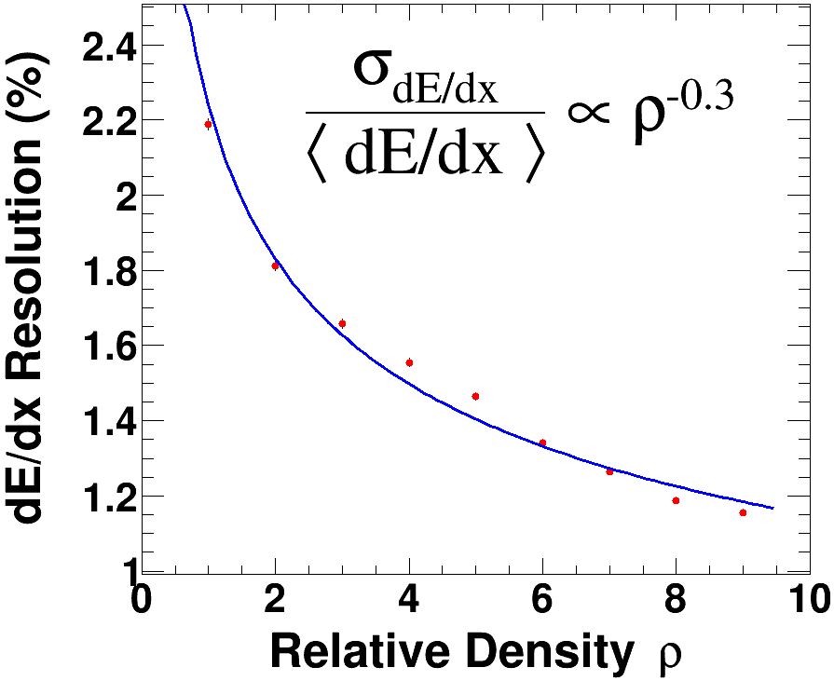
$\frac{σ_{dE/dx}}{〈dE/dx〉}$ ~ Geometry & Gas
The powers $p_{j}$ are determined by MC:
Single pion with $θ={45}^{o}$
Default geometry as the start point:
(n=222, h=6mm, $ρ=1$)

Slide 18
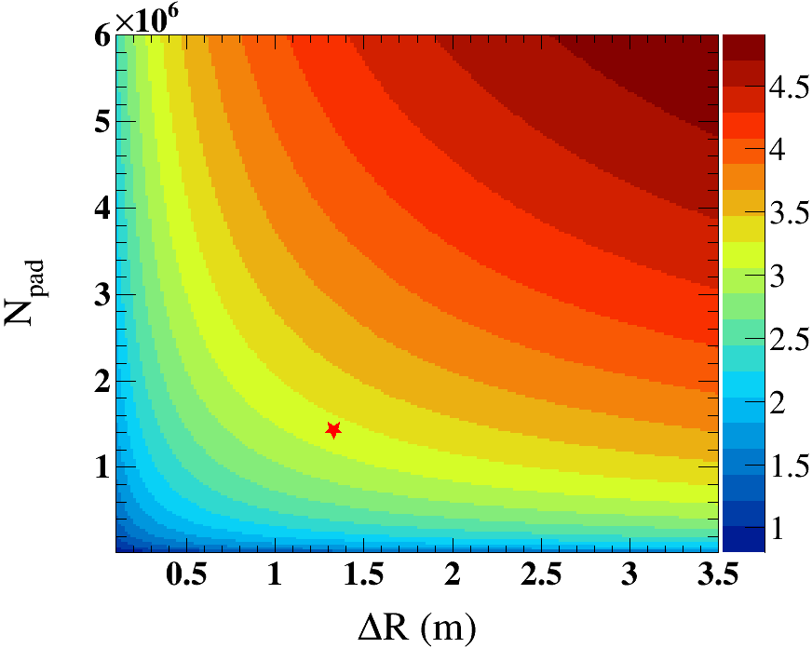
Proposal for TPC Geo. Optimization
Suppose:
90% of the total pads can be used for dE/dx calibration;
20% degradation caused by calibration and DAQ;
TPC Geometry can be optimized on the total number of pads ($N_{pad}$) and the effective radius ($ΔR$)
Single track MC,
$p=5GeV/c$, $θ={45}^{o}$

Slide 19
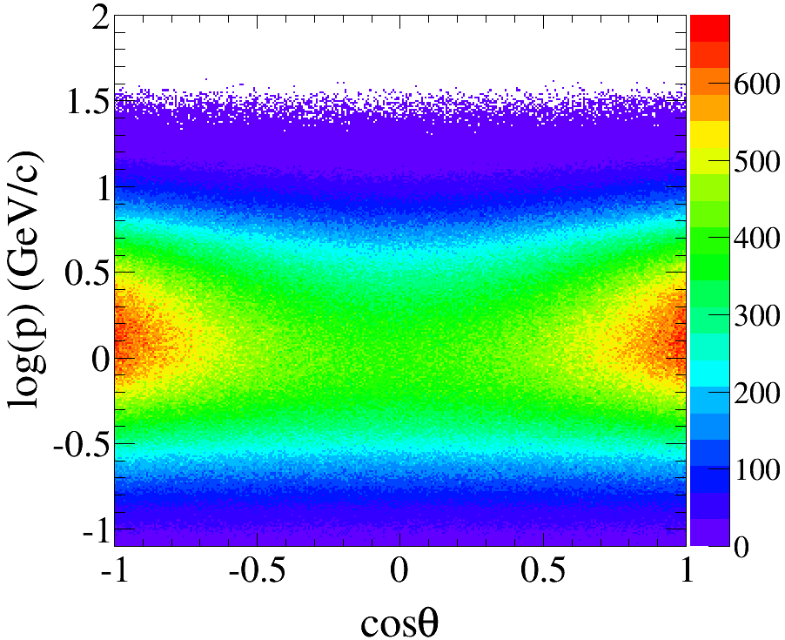
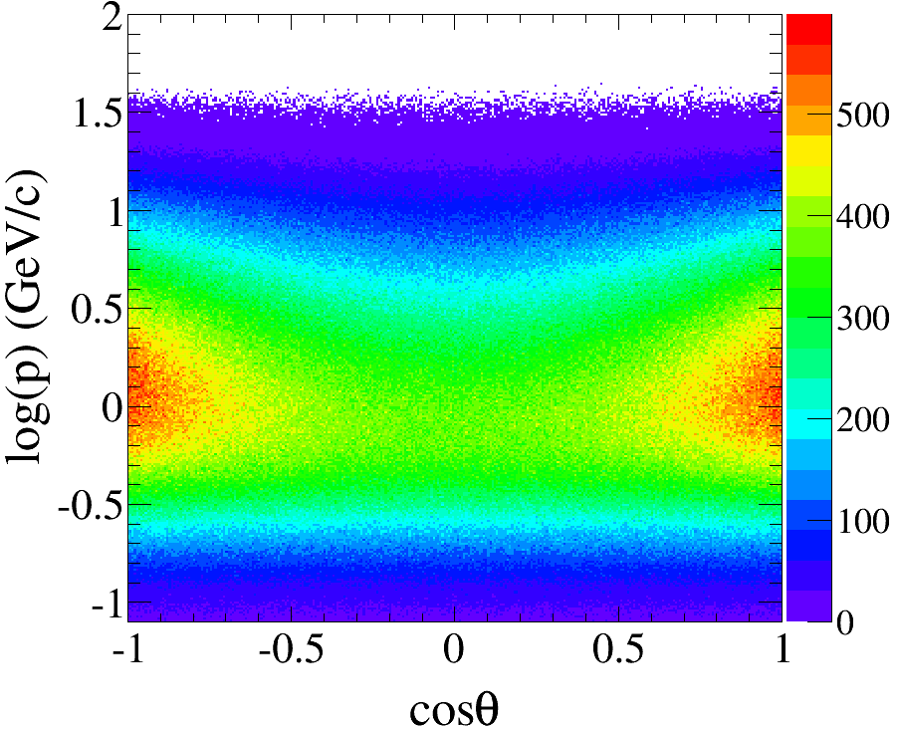
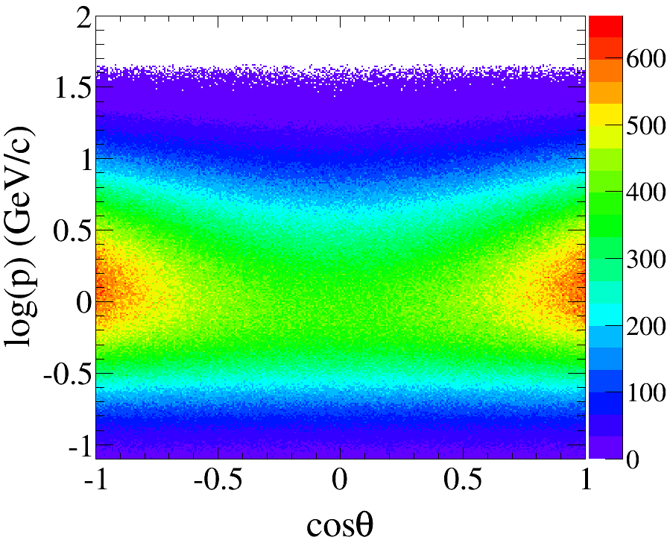
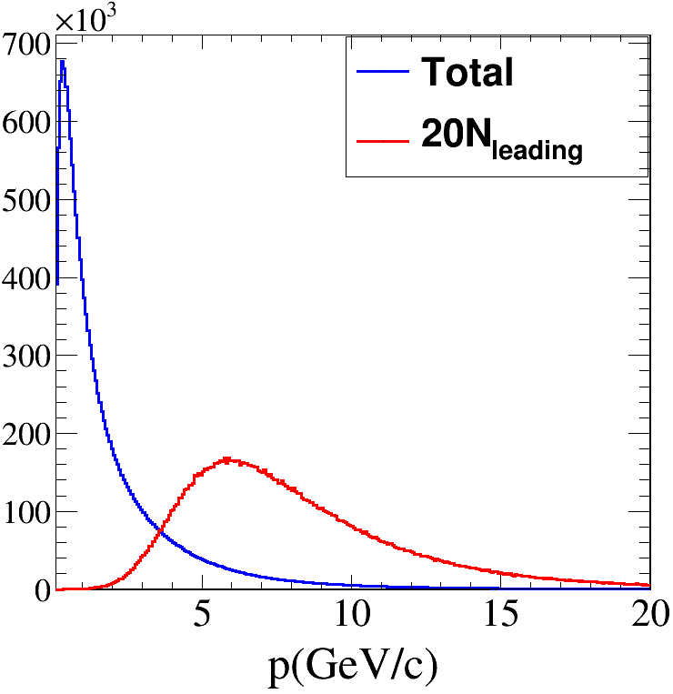
Pion Distribution @91GeV
$$Z→bb$$
$$Z→ss$$
$$Z→qq$$

Slide 20
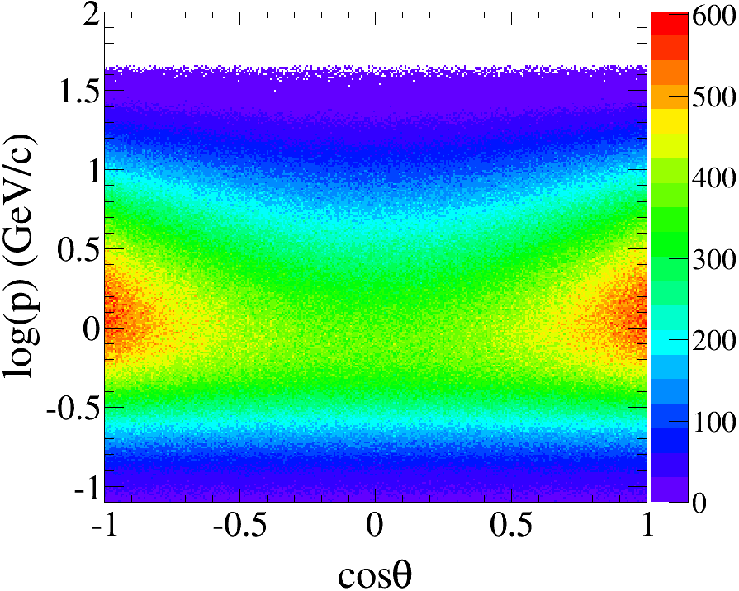
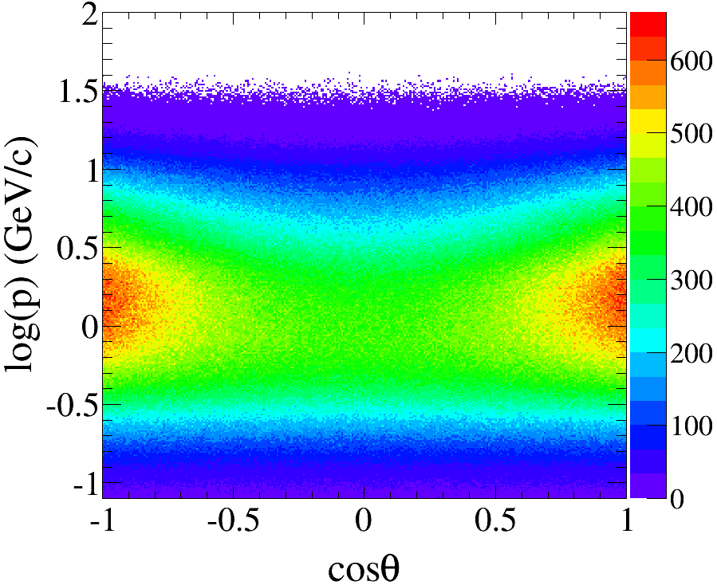
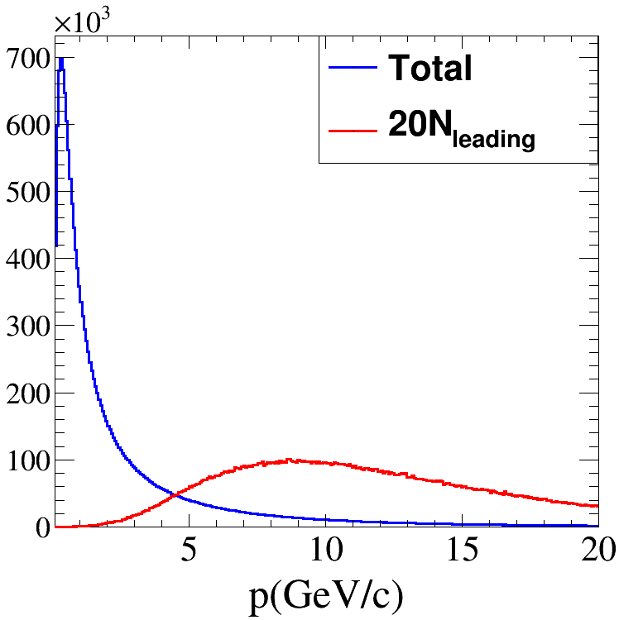
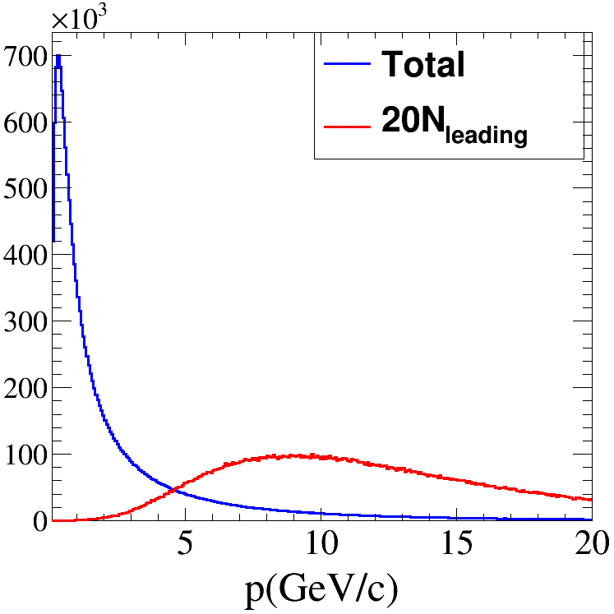
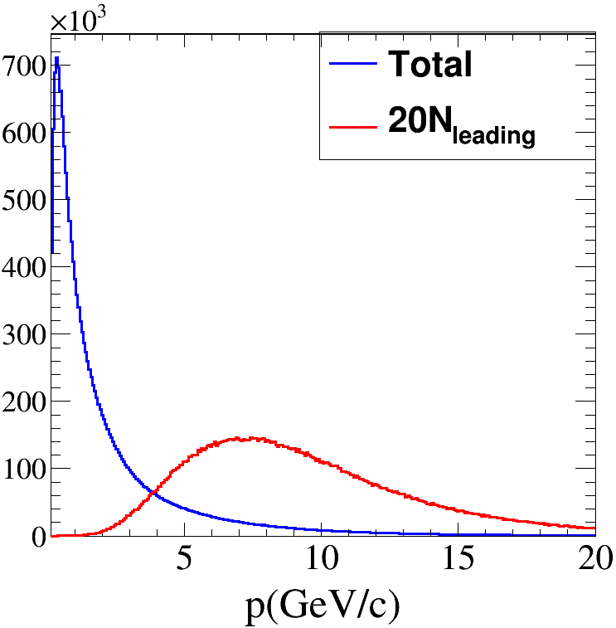
Pion Distribution @91GeV
$$Z→uu$$
$$Z→dd$$
$$Z→cc$$

Slide 21
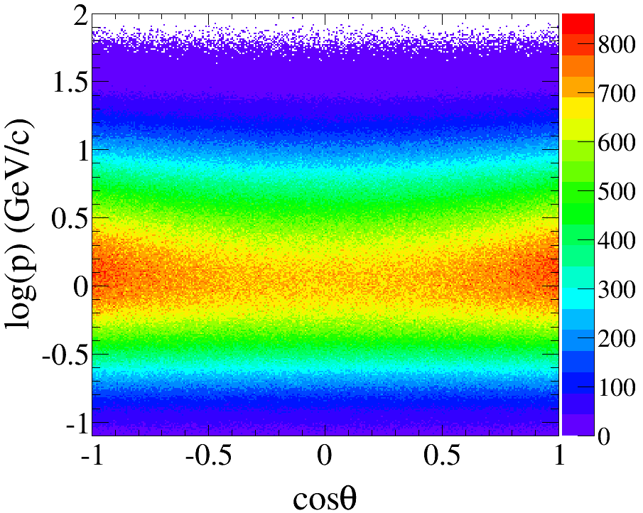
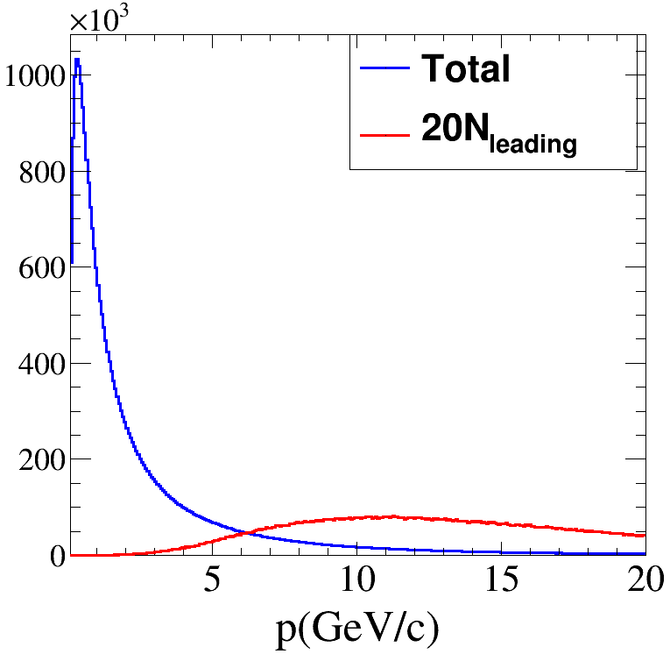
What To Identify (Pion)
$e^{+}e^{−}→ZH,$ $Z→qq$
$$Z→qq$$

Slide 22
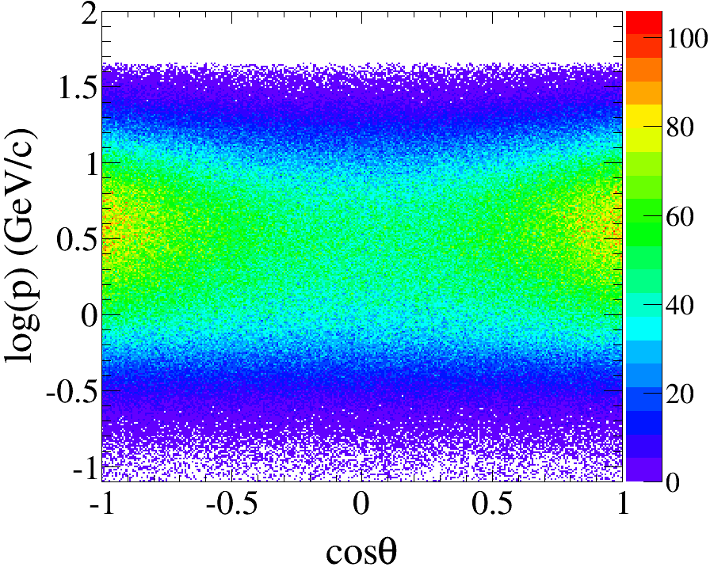
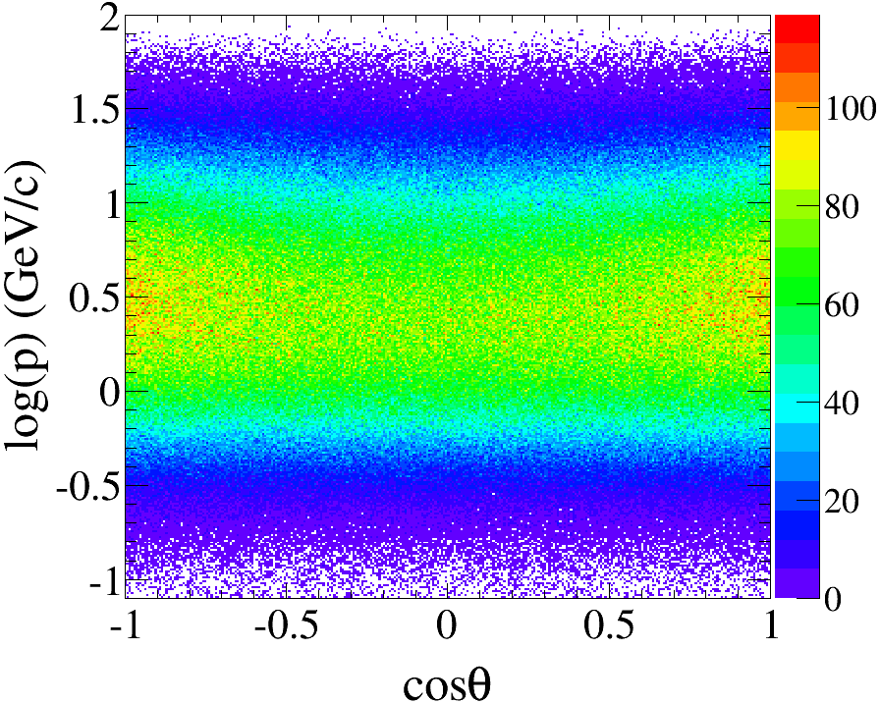
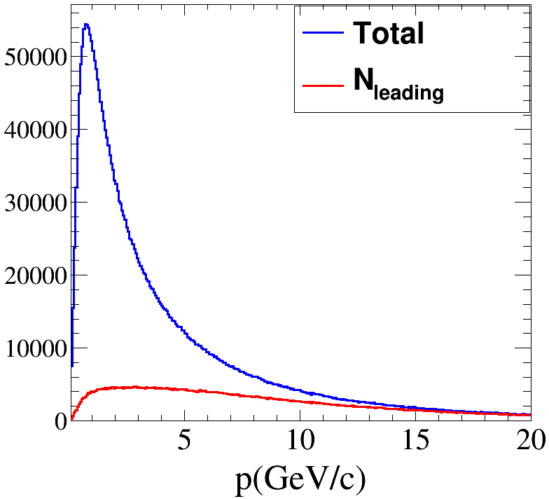
What To Identify (Kaon)
$$Z→qq$$
$e^{+}e^{−}→ZH,$ $Z→qq$

Slide 23
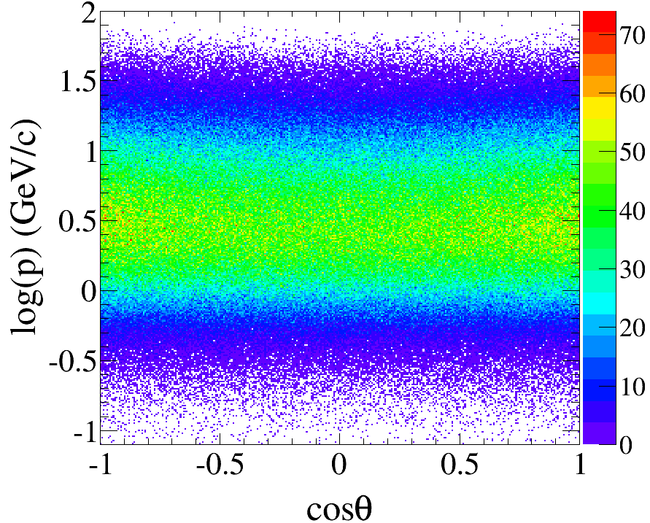
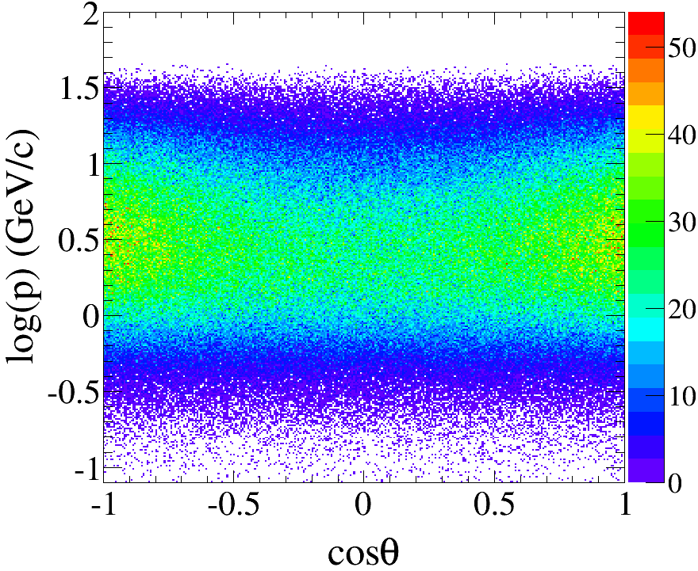
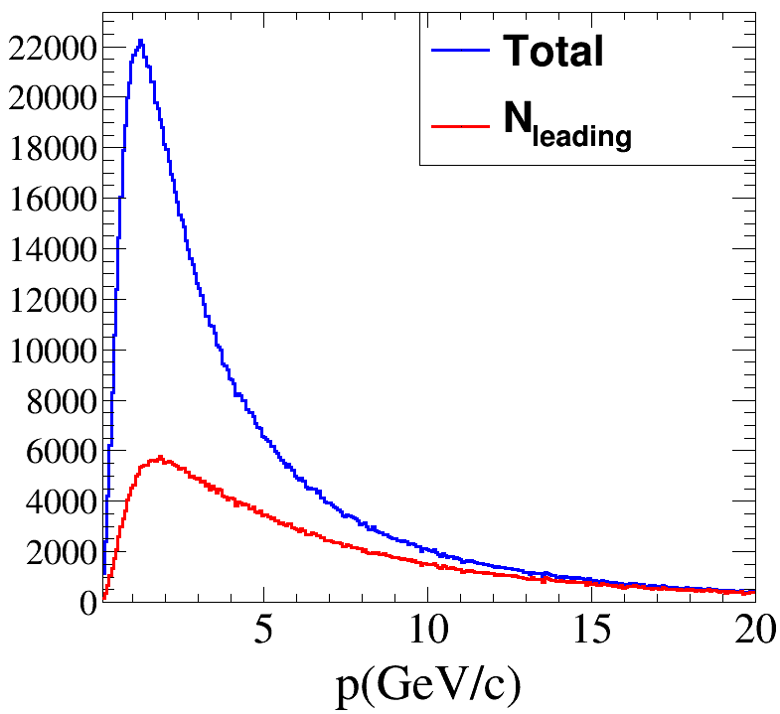
What To Identify (Proton)
$e^{+}e^{−}→ZH,$ $Z→qq$
$$Z→qq$$

Slide 24
TPC at CEPC
4.4m
E(300V/cm)
0.325m
B(3.5T)
1.8m

Slide 25
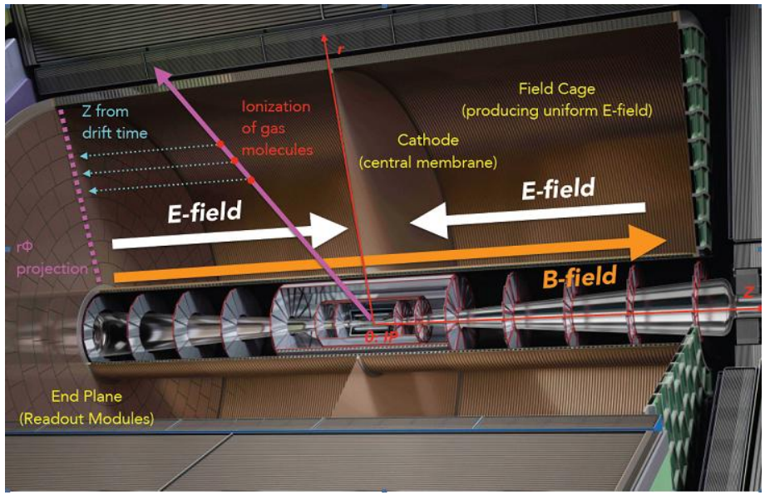
Sketch of ILD TPC Structure

