Slide 1
Introduction
Yaquan Fang (IHEP)
Physics toward CDR

Slide 2
Slides from Joao at CEPC Spring workshop
Link of the workshop: http://indico.ihep.ac.cn/event/6433/other-view?view=standard

Slide 3
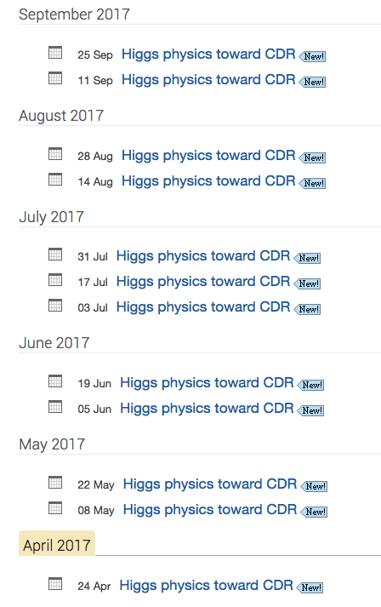
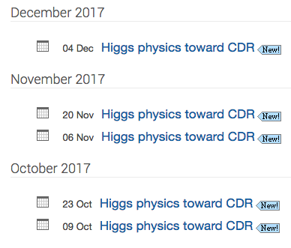
Scheduled meetings in 2017
Could add one before Christmas (Dec 18th)
If needed….

Slide 4
Reviewing the individual notes
Hww and Hgamgam notes have been uploaded to Git:
https://github.com/ijinwang/CEPCHiggsPaper
Establish editorial board to review/edit the notes.
More notes will be reviewed and volunteers are welcome.
bb/gg/cc, mumu,zz, combination and interpretation, …
Will start to write the paper in July.

