Slide 1
Introduction
Yaquan Fang (IHEP)
Physics toward CDR

Slide 2
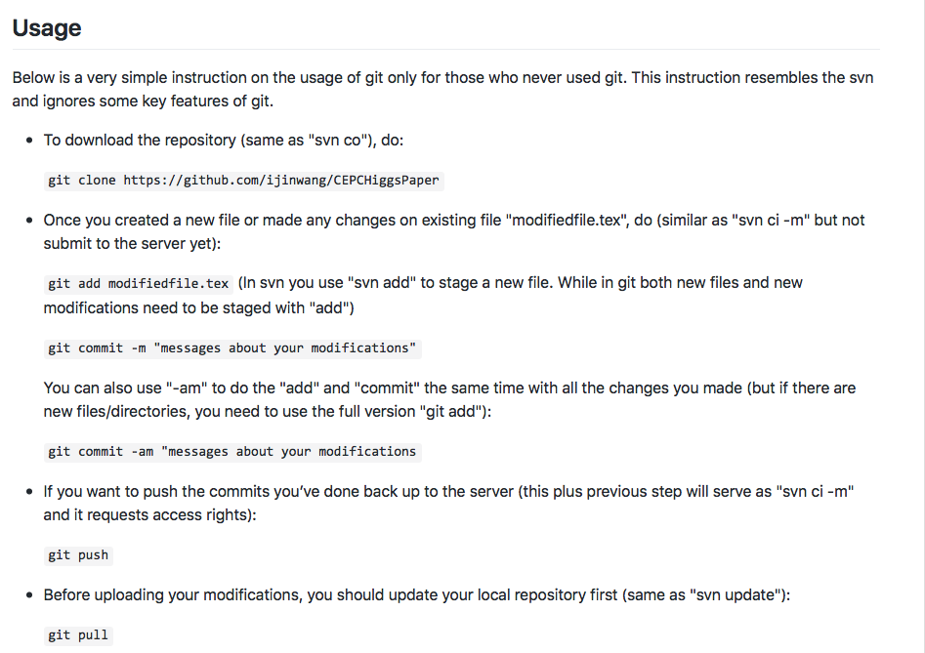
How to use Git
Apply a Git account
https://github.com/ijinwang/CEPCHiggsPaper

Slide 3
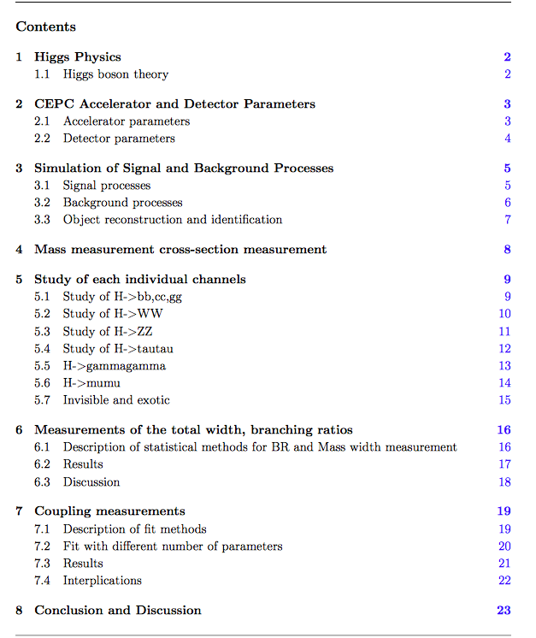
Skeleton of the paper
Need to share the tasks.

