Slide 1
Electroweak Physics Towards the CDR
Zhijun Liang (IHEP)

Slide 2
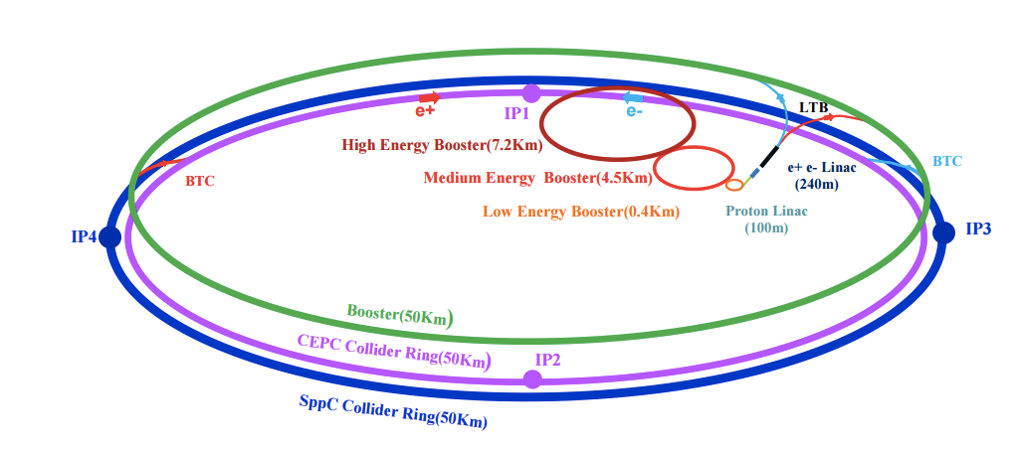
CEPC electroweak
Electron-positron circular collider
Higgs Factory（E_{cms}=250GeV , 10⁶ Higgs)
Precision study of Higgs coupling in ZH runs
complementary to ILC
See Manqi and Gang’s talk this morning in Higgs section for more details
Z factory（E_{cms}=91 GeV, 10¹⁰ Z Boson）:
Precision Electroweak measurement in Z pole running
Major focus of this talk
Preliminary Conceptual Design Report( Pre-CDR) available :
http://cepc.ihep.ac.cn/preCDR/volume.html
Aiming to finalize Conceptual Design Report (CDR)

Slide 3
Motivation
CEPC have very good potential in electroweak physics.
Precision measurement is important
It constrain new physics beyond the standard model.
Eg: Radiative corrections of the W or Z boson is sensitive to new physics

Slide 4
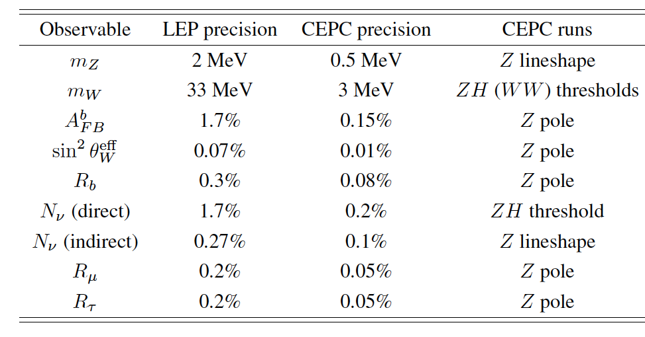
The prospect of CEPC electroweak physics in pre-CDR study
Expected precision on some key measurements in CEPC Pre-CDR study based on projections from LEP and ILC.
http://cepc.ihep.ac.cn/preCDR/volume.html
From now to next year, plan to update the study for Conceptual Design Report (CDR) with full detector simulation

Slide 5
Toward CDR
Some key experimental systematics study in full-sim MC samples.
Get jet energy resolution , lepton acceptance, b tagging efficiency …
Expected precision for electroweak measurements can be done
In generator level with key detector performance input from fullsim
Generator based Truth level study
Expected precision in CEPC detector
Jet calibrations
Lepton(jet) efficiency , energy resolution
Detector Acceptance
Detector performance study with full-sim

Slide 6
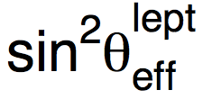
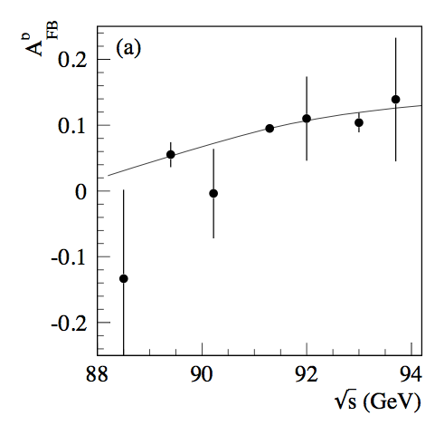
Weak mixing angle
LEP/SLD: 0.23153 ± 0.00016
0.1% precision.
Stat error is one of limiting factor.
CEPC
systematics error : 0.01%
Input From Backward-forward asymmetry measurement in Z pole Z->μμ events
Lepton efficiency and acceptance is one of the major systematics
LEP

Slide 7
m_{μμ} distribution in Z pole runs
df

Slide 8
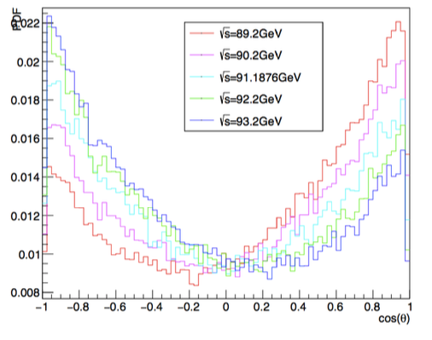
Cos (𝛉) of μ+ in Z-> μ⁺ μ⁻ events
Backward-forward asymmetry in Z pole runs

Slide 9
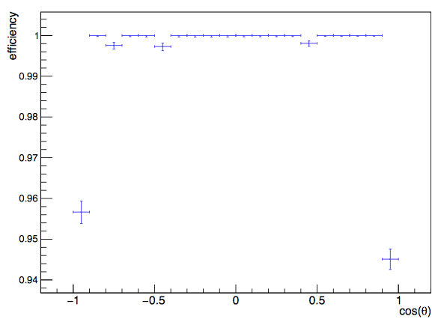
Muon reconstruction efficiency in CEPC Z-> μ⁺ μ⁻ full simulation
In-efficiency in forward regions is the key of Afb measurement.

Slide 10
df

Slide 11
Weak mixing angle analysis toward CDR
Key detector performance inputs are almost ready
Lepton acceptance and efficiency map obtained
Towards CDR
Estimate the expected precision using Gfitter framework with lepton performance inputs.

Slide 12
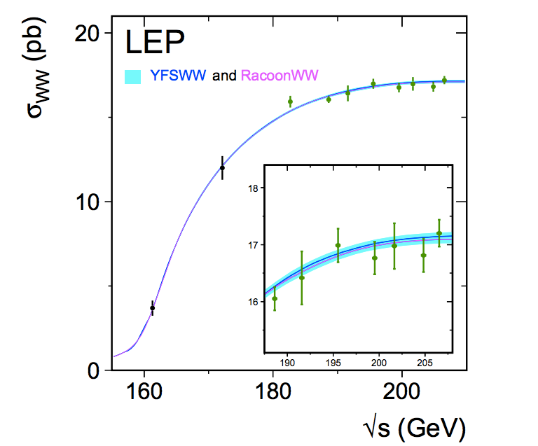
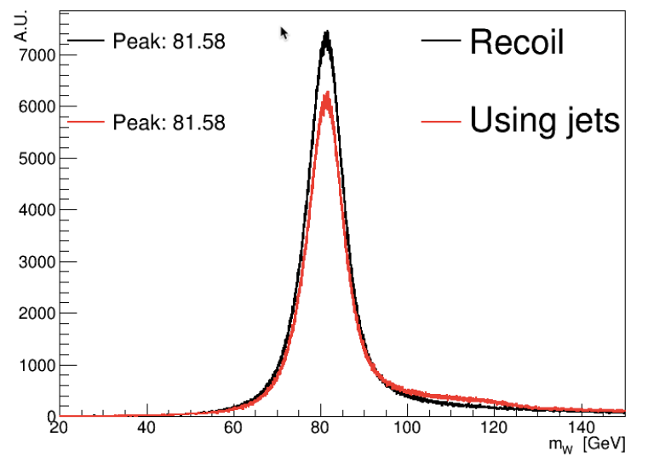
Update in W mass measurement
From Bo and Lesya
Threshold scan method
Optimize off-peak runs statistics
Check selection efficiency in different off-peak runs
Direct measurement of the hadronic mass (method for pre-CDR)
Optimize W mass direct reconstruction method in ZH runs
Jet energy calibration
Threshold scan
Direct reconstruction
Fullsim
WW->lvjj in ZH run

Slide 13
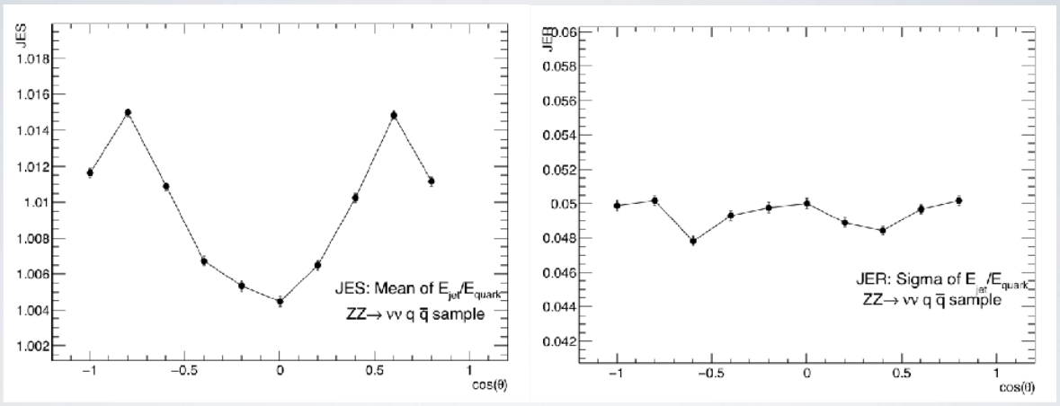
Jet energy scale and resolution
From Bo and Lesya
Precision of Direct measurement depends strongly on
Jet energy calibration
CEPC can collect 10¹¹ Z->qq events
can obtain a good jet energy calibration

Slide 14
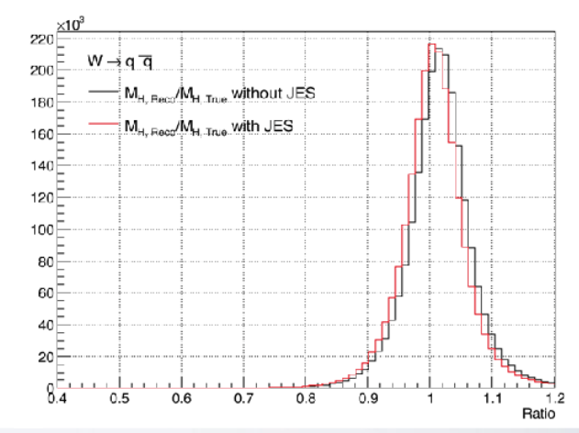
W boson mass
From Bo and Lesya
Reconstructed the W boson mass from dijet can be improved a few percent after calibrations

Slide 15
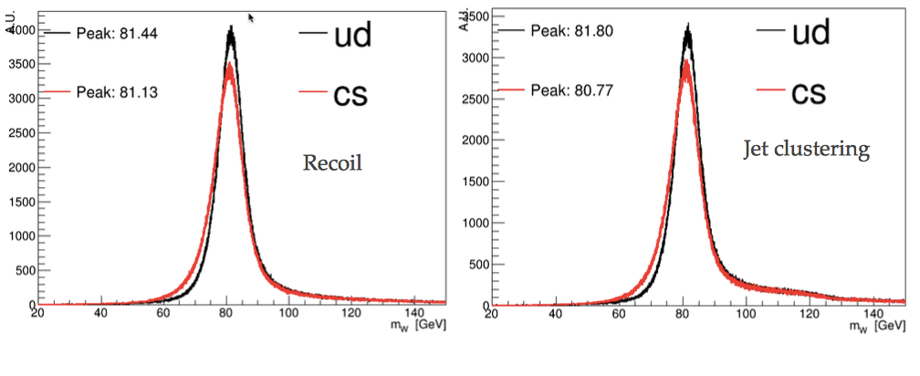
W mass and flavor dependence of jet energy scale
From Bo and Lesya
Found flavor dependence on jet energy scale.
Need to refine jet calibration, considering this dependence.

Slide 16
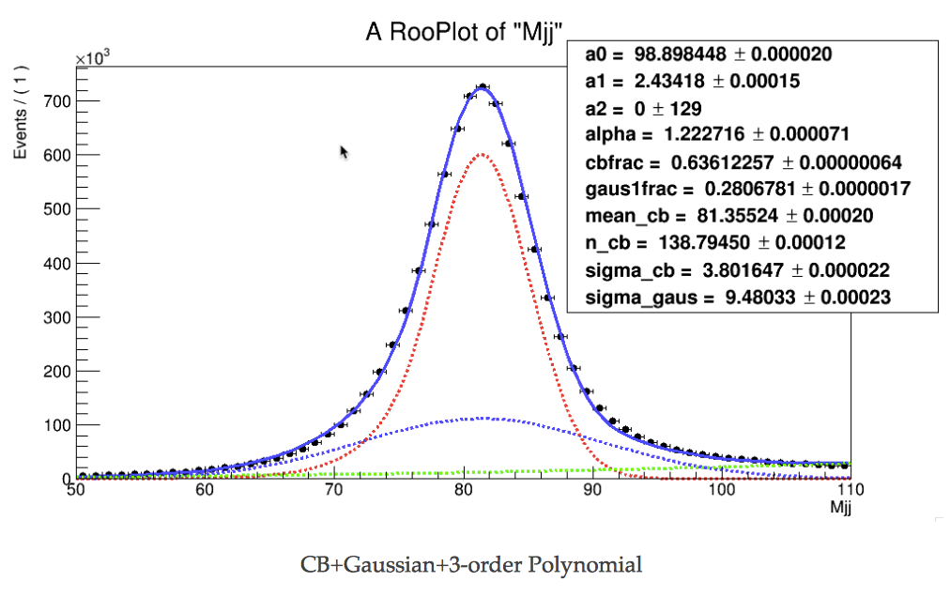
W mass reconstructed from dijet mass in semi leptonic decay
From Bo and Lesya
df

Slide 17
W mass analysis toward CDR
Finalize Z->qq jet calibrations.
Quantify the jet energy resolution and jet angular resolution
Apply jet energy calibration on WW->lvjj events
Quantify the uncertainty due to jet resolution

Slide 18
Major systematics in EWK measurement
 | Major systematics | Other systematics
m_{Z} | Beam energy (10^{-5 ~}10⁻⁶ ) | Luminosity measurement (10⁻⁴)
A_{FB}(lepton) | Beam energy (10^{-5 ~}10⁻⁶ ) | Track Alignment in forward region Track angular resolution (<0.05%)
R_b | flavor tagging (light jet Bkg). | Gluon splitting modeling
A_{FB}(b) | flavor tagging (light jet and c jet background). | Jet charge
m_{W} (direct measurement) | Jet energy scale and resolution (<3% JER)
m_{W} (threshold can) | Beam energy | Luminosity measurement
α_{QCD} | To be study
α_{QED} | To be study
_{TGC} | Lepton angular resolution

Slide 19
Summary
Expected precision for electroweak measurements can be done
In generator level with key detector performance input from full simulation
Updates in understanding key detector performance in precision electroweak measurements .
Jet energy calibration
Lepton accetance in CEPC detector
Similar study can be done for other EWK topics.
Eg: triple-gauge coupling (TGC) from WW events
Lepton performance and jet energy resolutions in place.
Welcome to join this effort

Slide 20
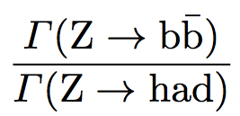
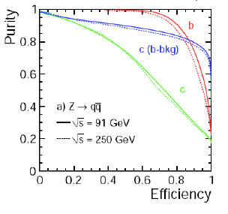
B tagging performance in Branching ratio ( R^{b})
Major systematics is from light jet and c jet background
can be reduced by improving the b tagging performance
Need fullsim to validate its performance
Uncertainty | LEP | CEPC | CEPC improvement
hemisphere tag correlations for b events | 0.2% | 0.1% | Higher b tagging efficiency

Slide 21
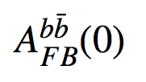
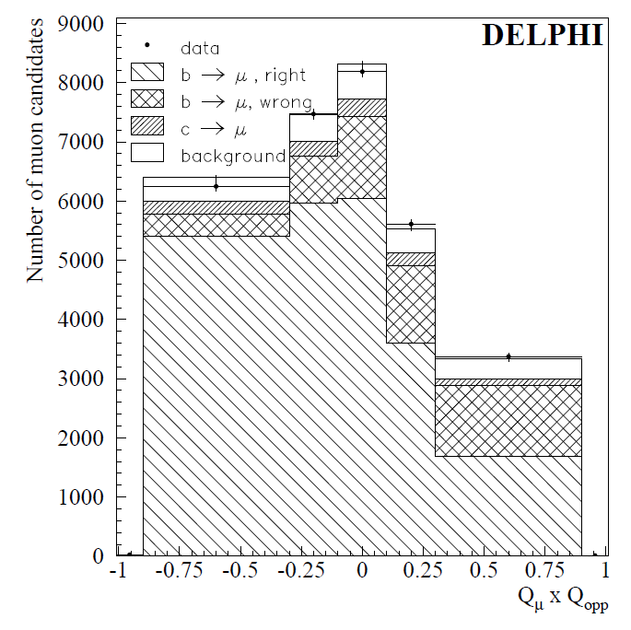
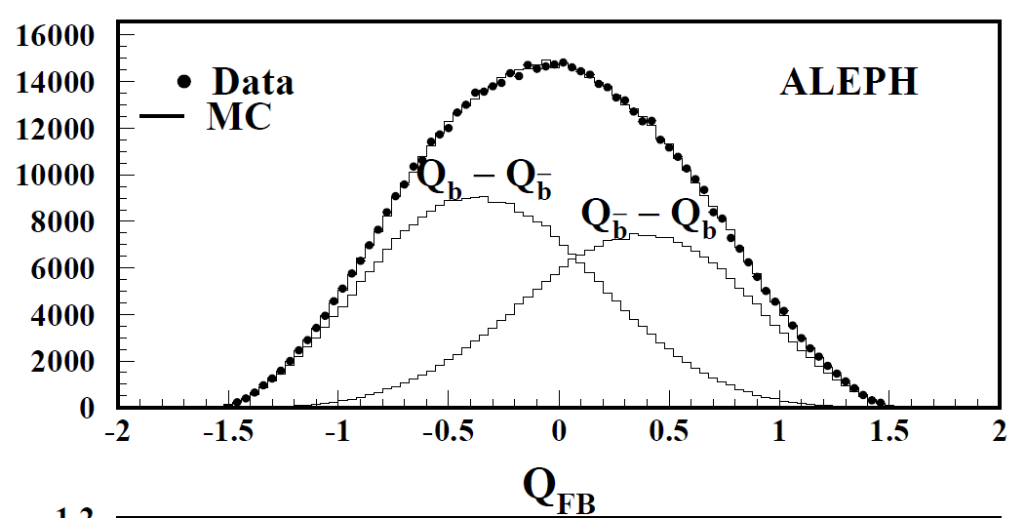
Backward-forward asymmetry measured from b jet
LEP measurement : 0.1000+-0.0017 (Z peak)
Method 1: Soft lepton from b/c decay (~2%)
Select one lepton from b/c decay, and one b jets
Select lepton charge (Q_lepton) and jet charge (Q_jet)
Method 2: jet charge method using Inclusive b jet (~1.2%)
Select two b jets
use event Thrust to define the forward and background
Use jet charge difference (Q_F - Q_B)
Q_lepton - Q_jet in method 1
Arxiv:
Hep-ex/0107033
Q_F - Q_B in method 2
Arxiv:
Hep-ex/0403041

Slide 22
Weak mixing angle
LEP/SLD: 0.23153 ± 0.00016
0.1% precision.
Stat error is one of limiting factor.
CEPC
systematics error : 0.01%
Input From Backward-forward asymmetry measurement
The precision mZ is another limiting factor ( uncertainty on P_{beam} )
If mZ is not well measured in CEPC ,
We need a large statistics of off-Z peak runs for weak mixing angle
CEPC off-peak runs stat
LEP

Slide 23
Branching ratio ( R^{b})
LEP measurement 0.21594 ±0.00066
Stat error : 0.44%
Syst error : 0.35%
Typically using 65% working points
CEPC pre-CDR
Expected Stat error ( 0.04%)
Expected Syst error (0.07%)
Expect to use 80% working points
15% higher efficiency than SLD
20-30% higher in purity than SLD
Uncertainty | LEP | CEPC | CEPC improvement
charm physics modeling | 0.2% | 0.05% | tighter b tagging working point
hemisphere tag correlations for b events | 0.2% | 0.1% | Higher b tagging efficiency
gluon splitting | 0.15% | 0.08% | Better granularity in Calo

Slide 24
Backward-forward asymmetry measured from b jet
LEP measurement : 0.1000+-0.0017 (Z peak)
Method 1: Soft lepton from b/c decay (~2%)
Method 2: jet charge method using Inclusive b jet (~1.2%)
Method 3: D meson method (>8%, less important method)
CEPC pre-CDR
Focus more on method 2 (inclusive b jet measurement)
Expected Systematics (0.15%) :
Uncertainty | LEP | CEPC | CEPC improvement
charm physics modeling | 0.2% | 0.05% | tighter b tagging working point
tracking resolution | 0.8% | 0.05% | better tracking resolution
hemisphere tag correlations for b events | 1.2% | 0.1% | Higher b tagging efficiency
QCD and thrust axis correction | 0.7% | 0.1% | Better granularity in Calo

Slide 25
Summary
CEPC electroweak physics in Preliminary Conceptual Design Report.
Expected precision based on projections from LEP and ILC.
Aim for more realistic study with full simulation for CDR next year.
Mainly focus on a few key measurements.
m_{W}
Weak mixing angle
mZ
Welcome to join this effort

Slide 26
Urgent open task
1. W mass measurement
Try to understand the precision with direct measurement approach
Design dedicated runs for WW threshold scan approach
2. Detector optimization using Z->bb R(b) measurement as benchmark model.
Pixel size optimization:
Baseline 16x16μm
Whether we need high resolution both direcction
Is 16x32 μm OK ?
Momentum resolution requirement
Impact parameter requirement

Slide 27
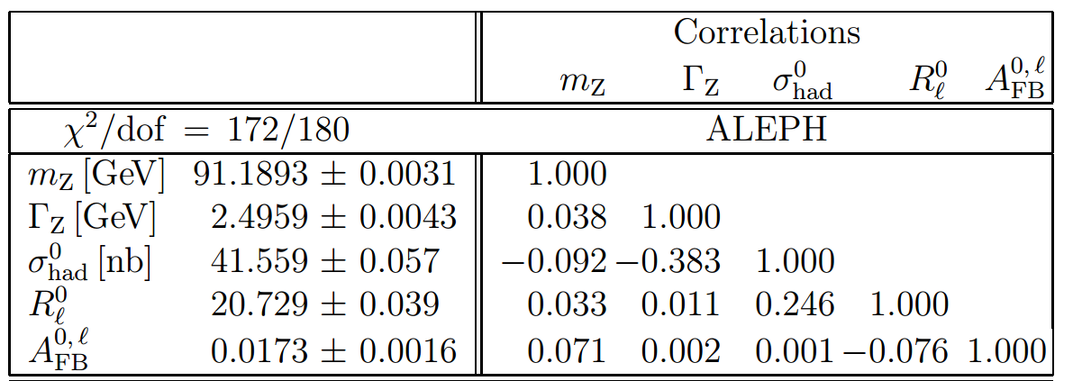
From Pre-CDR to CDR
Propagate beam momentum scale uncertainty to all EW measurement.
Give a clear physics requirement to accelerator

Slide 28
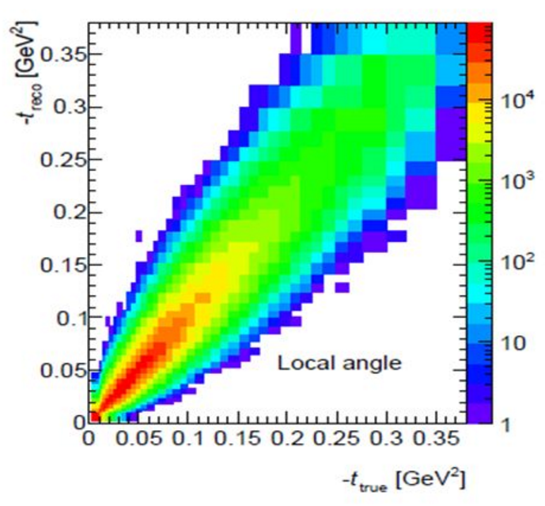
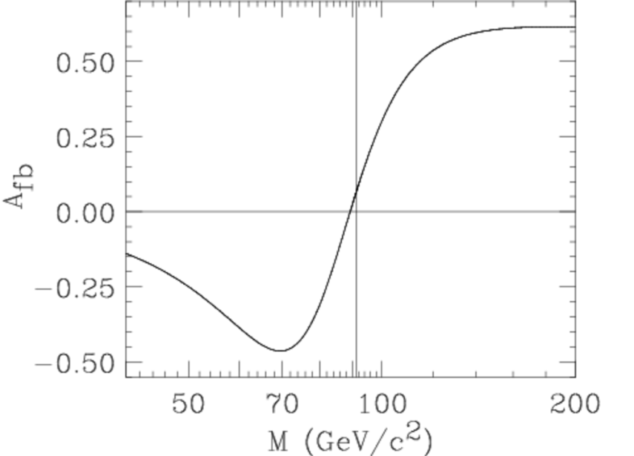
Plan for Weak mixing angle
More details in Mengran’s talk
Truth distribution
From Z fitter
unFolding matrix
Reco level distribution

Slide 29
CEPC accelerator
Electron-positron circular collider
Higgs Factory（E_{cms}=250GeV , 10⁶ Higgs)
Precision study of Higgs coupling in ZH runs
complementary to ILC
See Manqi and Gang’s talk this morning in Higgs section for more details
Z factory（E_{cms}=91 GeV, 10¹⁰ Z Boson）:
Precision Electroweak measurement in Z pole running
Major focus of this talk
Preliminary Conceptual Design Report( Pre-CDR) available :
http://cepc.ihep.ac.cn/preCDR/volume.html
Aiming to finalize Conceptual Design Report (CDR) next year

Slide 30
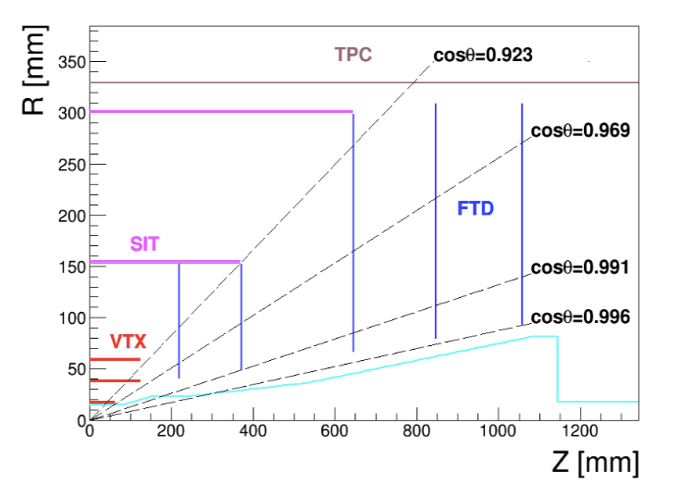
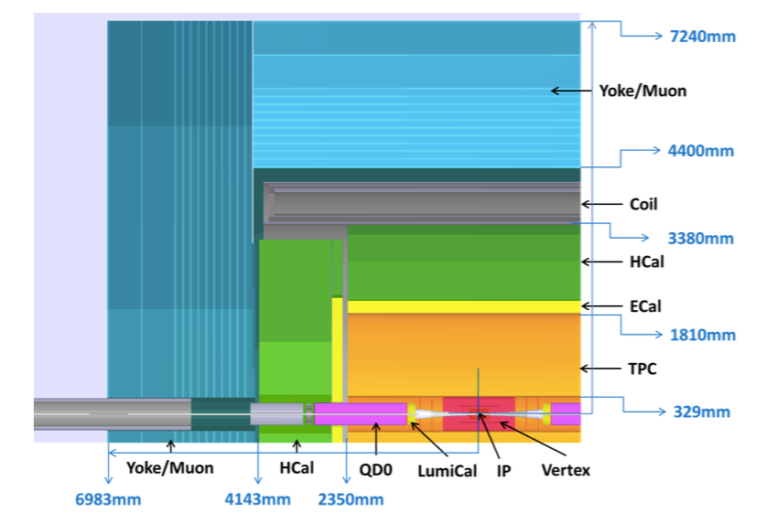
CEPC detector (1)
ILD-like design with some modification for circular collider
No Power-pulsing
Tracking system (Vertex detector, TPC detector , 3.5T magnet)
Expected Pixel size in vertex detector : less than 16x 16μm
Expected Impact parameter resolution: less than 5μm
Expected Tracking resolution : δ(1/Pt) ~ 2*10⁻⁵(GeV⁻¹)

Slide 31
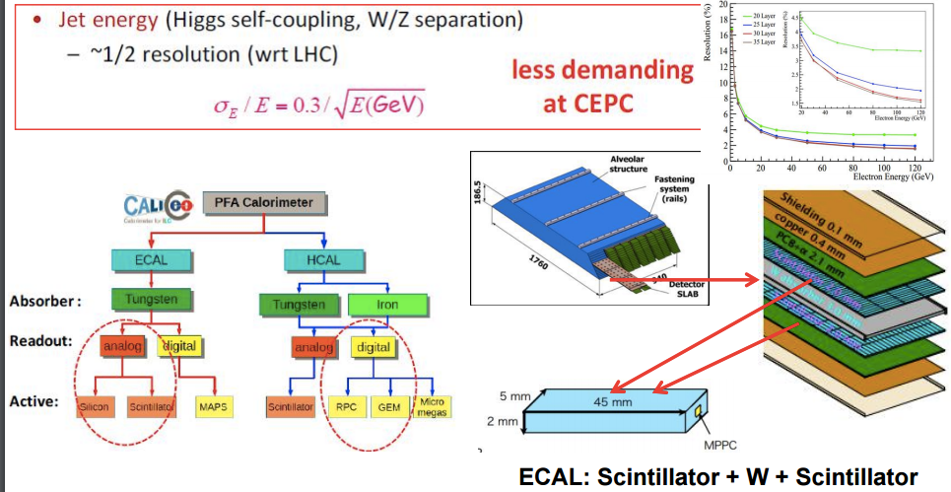
CEPC detector (2)
Calorimeters:
Concept of Particle Flow Algorithm (PFA) based
EM calorimeter energy resolution: σ_{E}/E ~ 0.16/√E
Had calorimeter energy resolution: σ_{E}/E ~ 0.5/√E
Expected jet energy resolution : σ_{E}/E ~ 0.3/√E

Slide 32
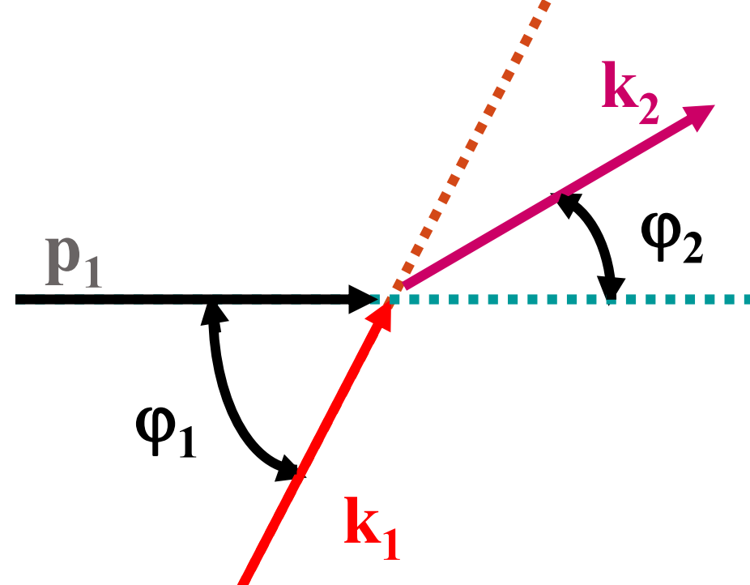
Task 1 : Beam energy measurement
Resonant depolarization method. (LEP approach)
Urgently need Beam polarization design in CEPC
Whether CEPC can have bunch with polarization and how long it lasts
Polarization fraction in Z and WW threshold
compton scattering approach
Whether it can reach 1MeV precision from this approach
preliminary study in G-Y. Tang’s talk http://indico.ihep.ac.cn/event/6495/session/4/contribution/29/material/slides/0.pdf

Slide 33
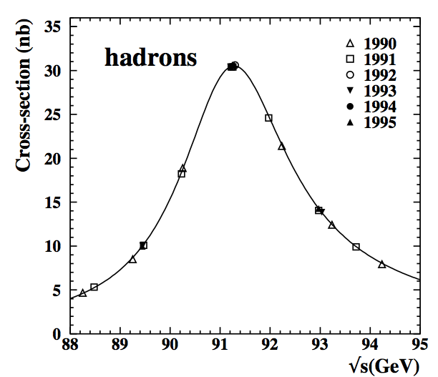
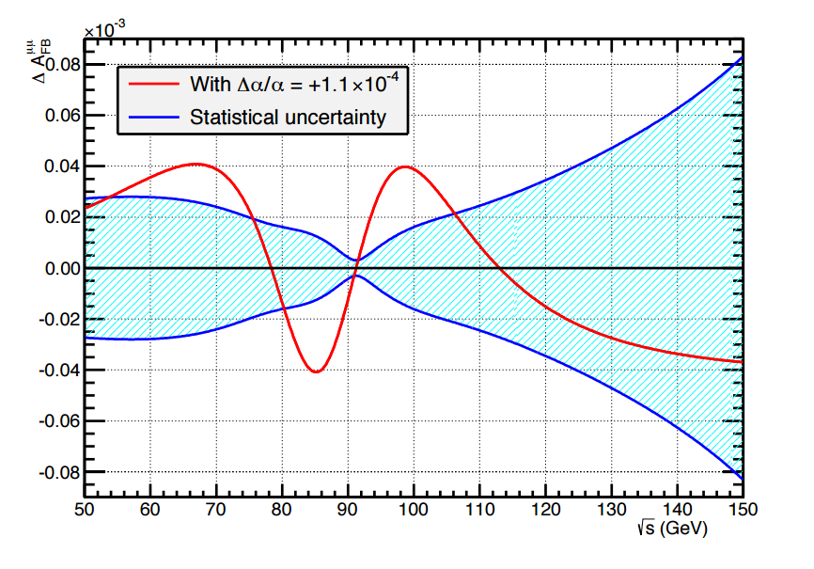
Task 2: optimizing Z threshold scan
Optimize off-peak runs statistics for Z line shape and α_{QED} shape
Check event selection efficiency as a function of beam energy
Fcc-ee colleague proposed to take more data around 87 and 94 GeV
off-peak runs for α_{QED} shape
Need fastsim study to check α_{QED} measurement

Slide 34
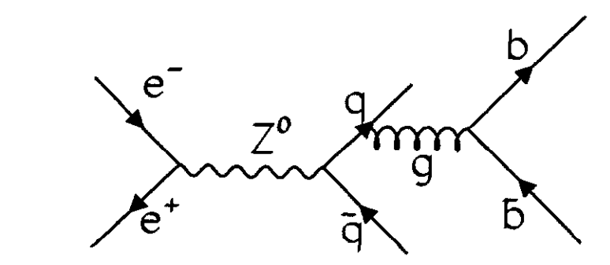
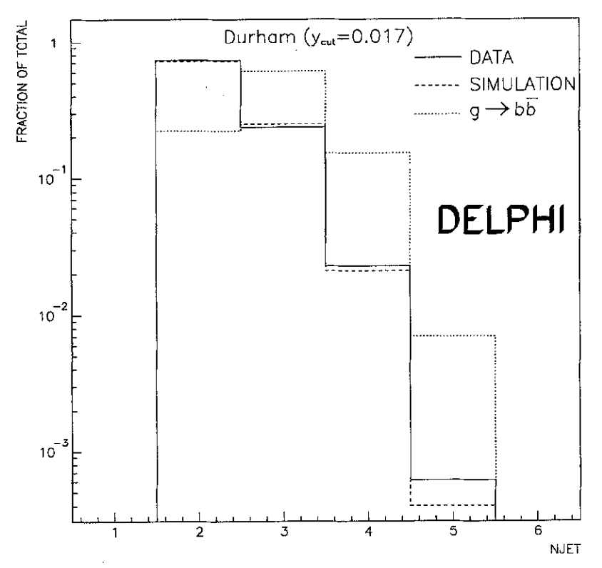
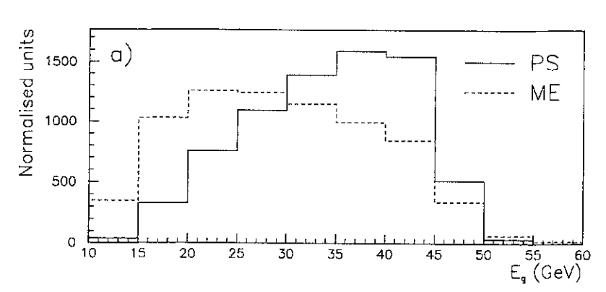
Branching ratio ( R^{b}): task : gluon splitting measurements
To reduce the R_b systematics
One of the task is to measure gluon splitting
Phys Lett B 405 (1997) 202

