Slide 1
Petrogenesis of extensive intermediate-felsic magmatism and related subduction processes in coastal region of South China
Kong-Yang Zhu, Qun-Ke Xia, Han-Lin Chen, Zhong-Yue Shen
Zhejiang University
Zheng-Xiang Li, Simon A. Wilde
Curtin University
Xi-Sheng Xu
Nanjing University
IHEP, Beijing
23-July-2017,
Notes:
Good afternoon, everyone. It is a great honor for me to give a presentation here on the magmatism of South China, with contributions from three universities (Zhejiang, Curtin and Nanjing University). I am grateful to the invitation of Prof. Shijie Zhong and the organization of Prof. McDonough and Prof. Xi.

Slide 2
Three Orogenic Cycles in South China
Sibao Orogeny:
Amalgamation between Yangtze and Cathaysia Block
Syn-Orogenic Magmatism: 1200-880 Ma
Post-Orogenic Magmatism: 850-750 Ma
Wuyi-Yunkai Orogeny:
An intraplate Orogeny:
460-420 Ma
Indosinian Orogeny:
An Andean-type Orogeny?
Syn-Orogenic Magmatism: 280-200 Ma
Post-Orogenic Magmatism: 190-90 Ma
Lee, J.S. (李四光) (1918）,The Geology of China, University of Birmingham
Li et al. (2014), Tectonics of the South China Block: interpreting the rock record
Notes:
As other speakers reported, the South China underwent three orogenys from the Proterozoic time. They are Meso- to Neo-proterozoic Sibao or Jiangnan Orogeny amalgamated the Yangtze and Cathaysia Block. (2) a Paleozoic Wuyi-Yunkai Orogeny (we also call it Caledonian Orogeny in China), which is believed as an intraplate orogeny. (3) a Mesozoic orogeny, often considered by many as an Andean-type orogeny, which there are also many controversies is the main topic of this presentation.
From the thesis of Si-Guang Li, you can see the two hiatus caused by the latter two orogens. Prof. Li is very famous for Chinese people and perhaps the only geologist many Chinese know.

Slide 3
Indosinian Orogeny: magmatic records
“Phanerozoic (<570 Ma) magmatism, peaked in the Mesozoic (70-200 Ma), forming the largest granite province in the world with rich metallic ore-deposits.”
Li and Li (2007); Zhou et al. (2006)
“The cause of such large-scale magmatism remains uncertain.”
~1300 km orogen
Magmatism is more developed in the southeast.
Volcanic rocks are most developed in the coastal region.
Episodic and diachronous.
Notes:
As Prof. Liu has showed us, “Phanerozoic magmatism, peaked in the Mesozoic (70-200 Ma), forming the largest granite province in the world with rich metallic ore-deposits.” However, “The cause of such large-scale magmatism remains uncertain.”
The orogen is around 1300 kilometer wide, with magmatism most developed in the southeast and volcanics most developed in the coast of Zhejiang and Fujian Province. Studies show the magmatism is episodic and diachrous.

Slide 4
Models on the Mesozoic Tectonics of the South China Block
Notes:
There are many models for the Mesozoic tectonics of South China. I believe the most influential ones are the changing subduction angle model (Zhou and Li, 2000) and the flat-slab subduction model of Li and Li (2007), as I will show you later. Personally, I think the latter model is build on the former one. However, there are also many differences in terms of time and details.

Slide 5
Flat-slab subduction in the Andes.
Ramos (2009)
USGS et al., This Dynamic Planet
Notes:
From this poster from USGS, you may note Nazca Plate subducted towards South America. There are earthquakes along this subduction zone; however, there are magmatic gaps in two regions. Subduction angle is very small or we call them flat-slab subduction. In such conditions, normal arc magmatism does not occur although the deformation can go far away from the trench.

Slide 6
Andean Orogenic Cycle
Ramos (2009)
Notes:
Many authors give the Andean-type orogenic cycle like this to interpret the tectonic and magmatic evolution involved flat-slab subduction, such as North America and South China. First, you have normal arc; Then, flat-slab subduction occurs, often caused by a hot or low-density oceanic slab, such as Ontong Java plateau; The flat-slab caused very wide orogen. However, the largest volume of magmatism are generated during collapse of the orogen, accompanied by the delamination of the heavy orogenic root.

Slide 7
Laramide Orogen,
North America
“Initial dynamic subsidence above the slab hinge,
followed by uplift and volcanism triggered by influx of asthenosphere beneath the overriding plate.”
(Smith et al., 2014, Geology)
Notes:
Let’s also have a look at western North America. In recent paper, Smith argued that during the foundering of the flat-slab of the Laramide Orogeny, Initial dynamic subsidence above the slab hinge, followed by uplift and volcanism triggered by influx of asthenosphere beneath the overriding plate.”

Slide 8
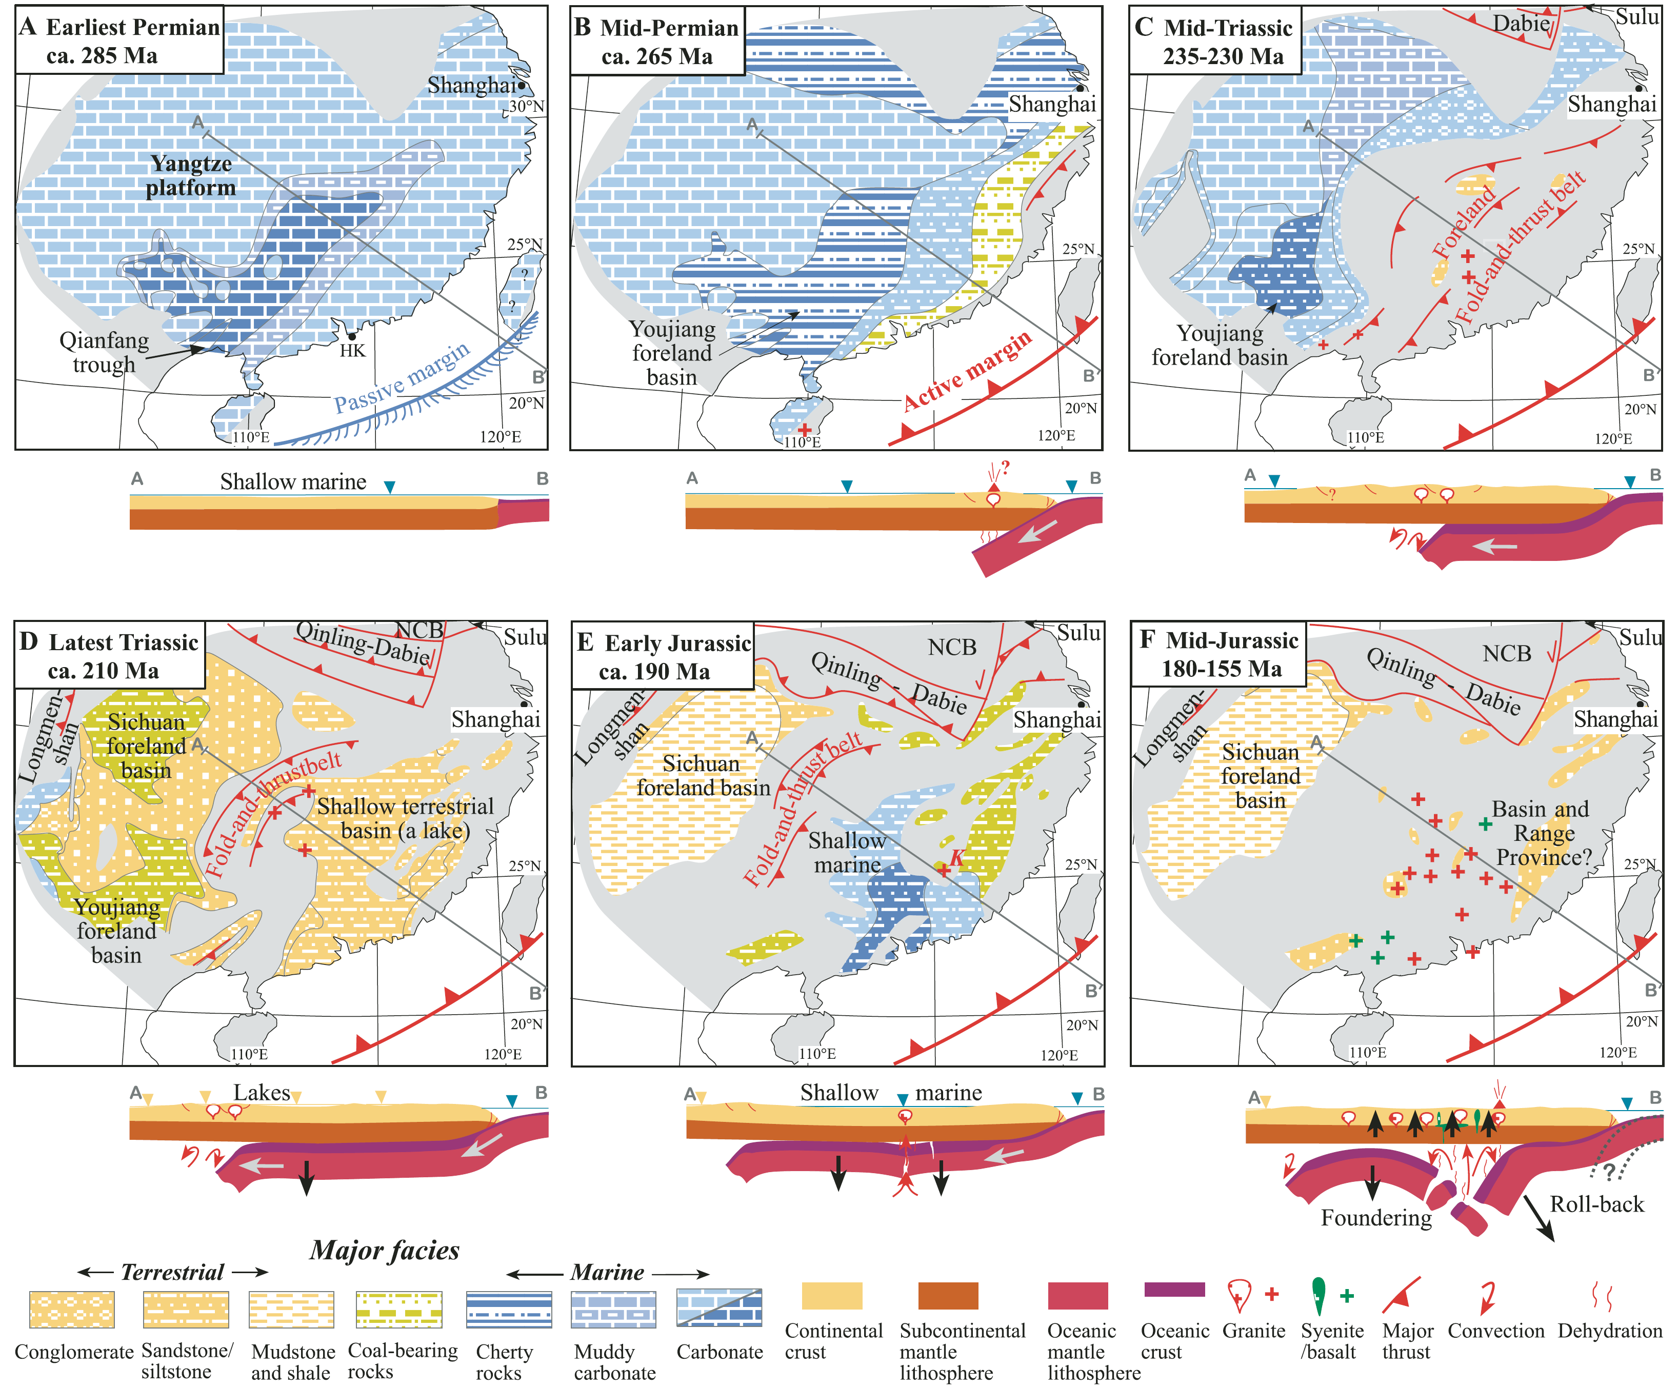
Flat-slab subduction of the South China Block
Li and Li (2007)
Notes:
The Early Permian, South China is carbonate platform and have passive margin. At mid-Permian, the margin became active, deformation and propagate towards the hinterland and terrestrial facies replaced the carbonate. Since Early Jurassic, foundering of the flat-slab first caused the subsidence and marine facies again came back.
After this, the upper plate rebound, with influx of asthenosphere, extensive crustal melting occurred. The coastal region underwent stronger thickening and foundering of mountain root caused even more extensive magmatism.

Slide 9
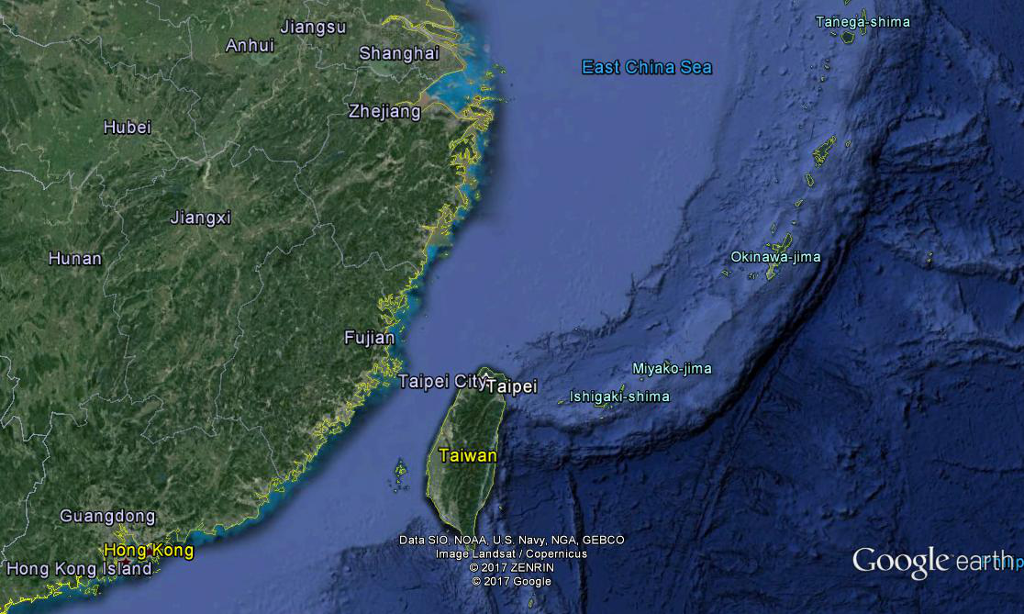
K contents of Mesozoic magmatism
A（High-K)
Paleoproterozoic gneiss
(Yang et al., 2010)
D(High-K)
B（High-K)
C（Medium-/High-K)
D
Yuan et al. (2017)
Notes:
Where is the paleo-trench? Coast or continental shelf margin. First, Paleoproterozoic gneiss like the Badu gneiss of the Cathaysia Block has been reported from the continental shelf. Second, the Mesozoic granitoids from the continental shelf are comparable to those in the adjacent continent in terms of age, elemental and isotopic compositions. Third, Prof. Tatsumi shows that there commonly exists a K-h or Dickinson relationship for subduction magmatism. From trench to hinterland, the potassium and other incompatible element contents increase. Let’s have a look at the granitoids from the four localities. If the coast is the paleo-trench, why A and C have different potassium contents, and why A and D are both high-K.

Slide 10
The age the subduction (Andean-type orogeny) initiated?
Early Triassic or Early Jurassic?
Sedimentation & Deformation
The latest marine sedimentation: Lower Triassic
The earliest molasse: Upper Triassic
The synorogenic character of the Upper Triassic deposits.
The folds and thrusts are unconformably overlain by Upper Triassic molasse sediments.
Xiao et al. (2005, GSA Bulletin)
Triassic terrain collision model
Notes:
I will show you some detailed evidence support Early Mesozoic orogeny in South China. You can find the information of Triassic sedimentation and the age constraints on deformations from the paper of Prof. Wen-Jiao Xiao, although he argues for a Triassic terrain collision model.

Slide 11
The age the subduction (Andean-type orogeny) initiated?
Early Triassic or Early Jurassic?
Regional Metamorphism (up to granulite-facies), regional metamorphism with Jurassic is unknown.
Yu et al. and Xia et al. (2009, 2012, Precambrian Research)
Notes:
It was found that the Triassic regional metamorphism upper to granulite facies are preserved in the Badu Complex, which is believed as the basement of Cathaysia Block. However, the Jurassic regional metamorphism is unknown in the region.

Slide 12
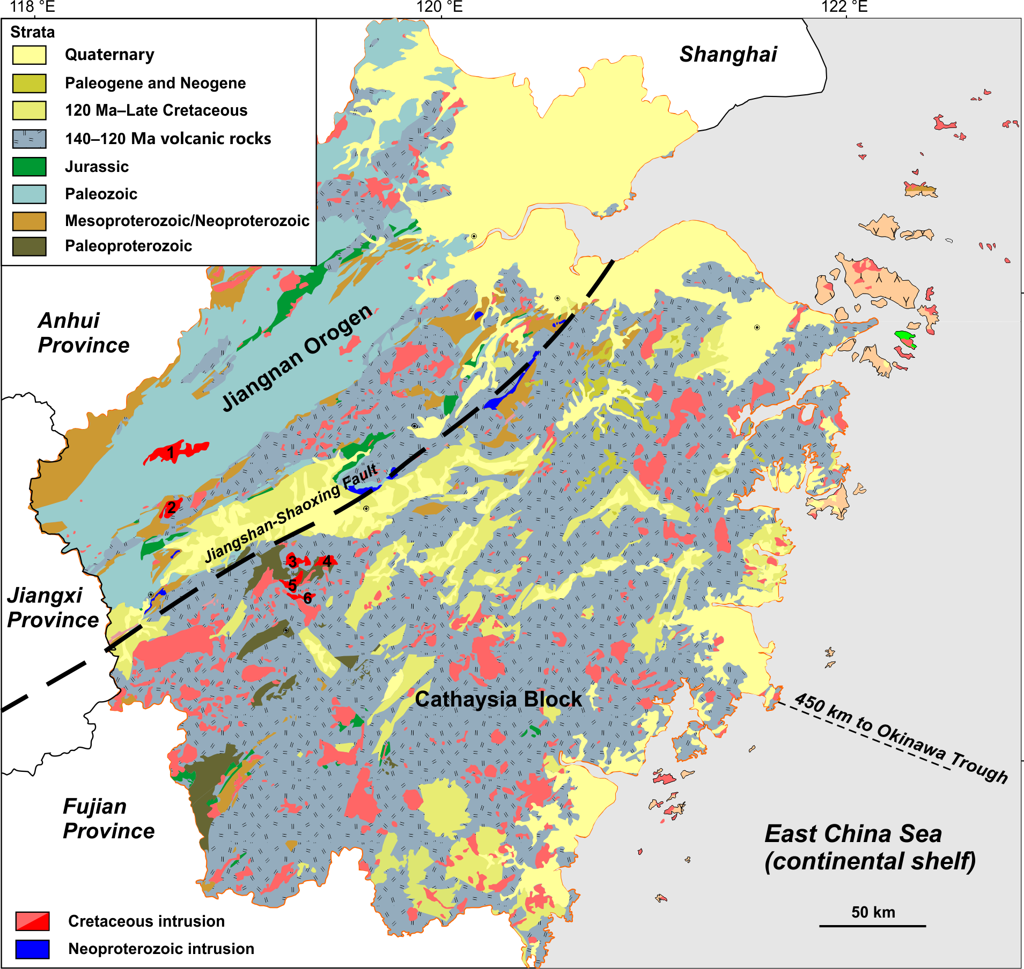
REE differentiation with crustal thickening in the Central Andes
(Mooney et al., 1998, JGR; Ramos, 2002; Mamani et al., 2010, GSA Bulletin)
Notes:
Before come to the Triassic magmatism in our study region. Let’s return to the Andes. As Prof. Mooney has shown us, the Central Andes has a very thick continental crust. During making this thick crust, we see stronger and stronger HREE differentiation, mostly likely caused by increasing stability of garnet in deep crust as Prof. Gill and Pitcher have also argue this. This figure shows the model of Prof. Ramos for the tectonic processes. For our studied Mesozoic granitoids in Zhejiang Province, we see a similar but reserve trend, we interpret it as a crustal attenuation process.

Slide 13
The age the subduction (Andean-type orogeny) initiated?
Early Triassic or Early Jurassic?
Triassic Magmatism: “aluminous A-type” （high Ga/Al） + I-type
High Gd/Yb ->Garnet in deep crust
(low Gd/Yb for younger rocks)
Deep-level intrusions (Hbl: 2.0-4.5 kbar)
1.0-2.5 kbar for Cretaceous I-type granitoids
High-silica granitoids are rare
Extensive Cretaceous high-silica granites and volcanic rocks
Notes:
Triassic granitoids comprise both I-type and so-called aluminous A-type. They are deep-level intrusions with very strong HREE differentiation. High-silica granitoids are rare. Except for A-type, other features are consistent with high-pressure melting in the orogeny.

Slide 14
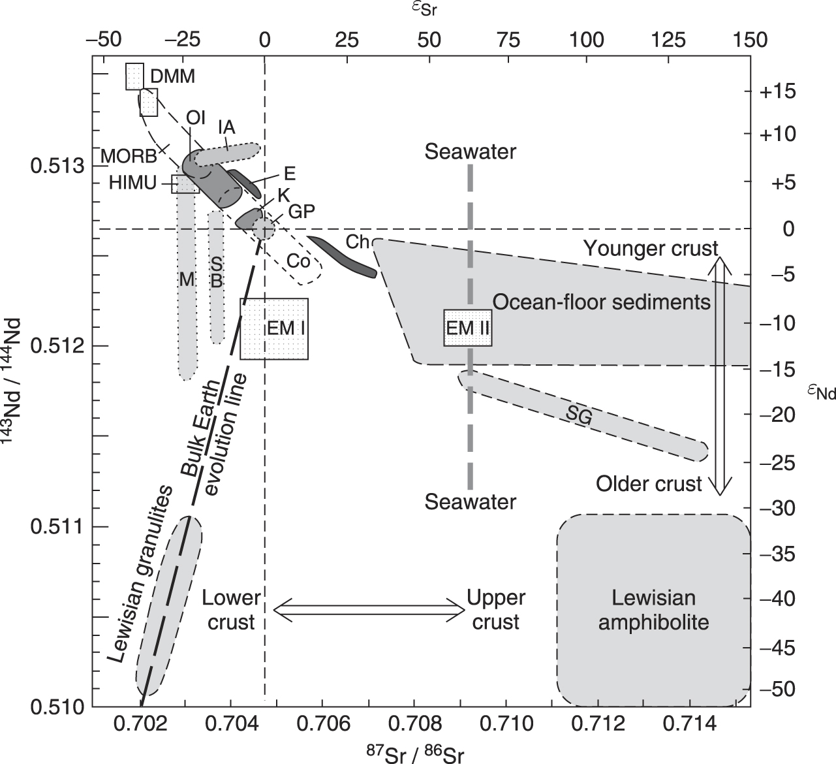
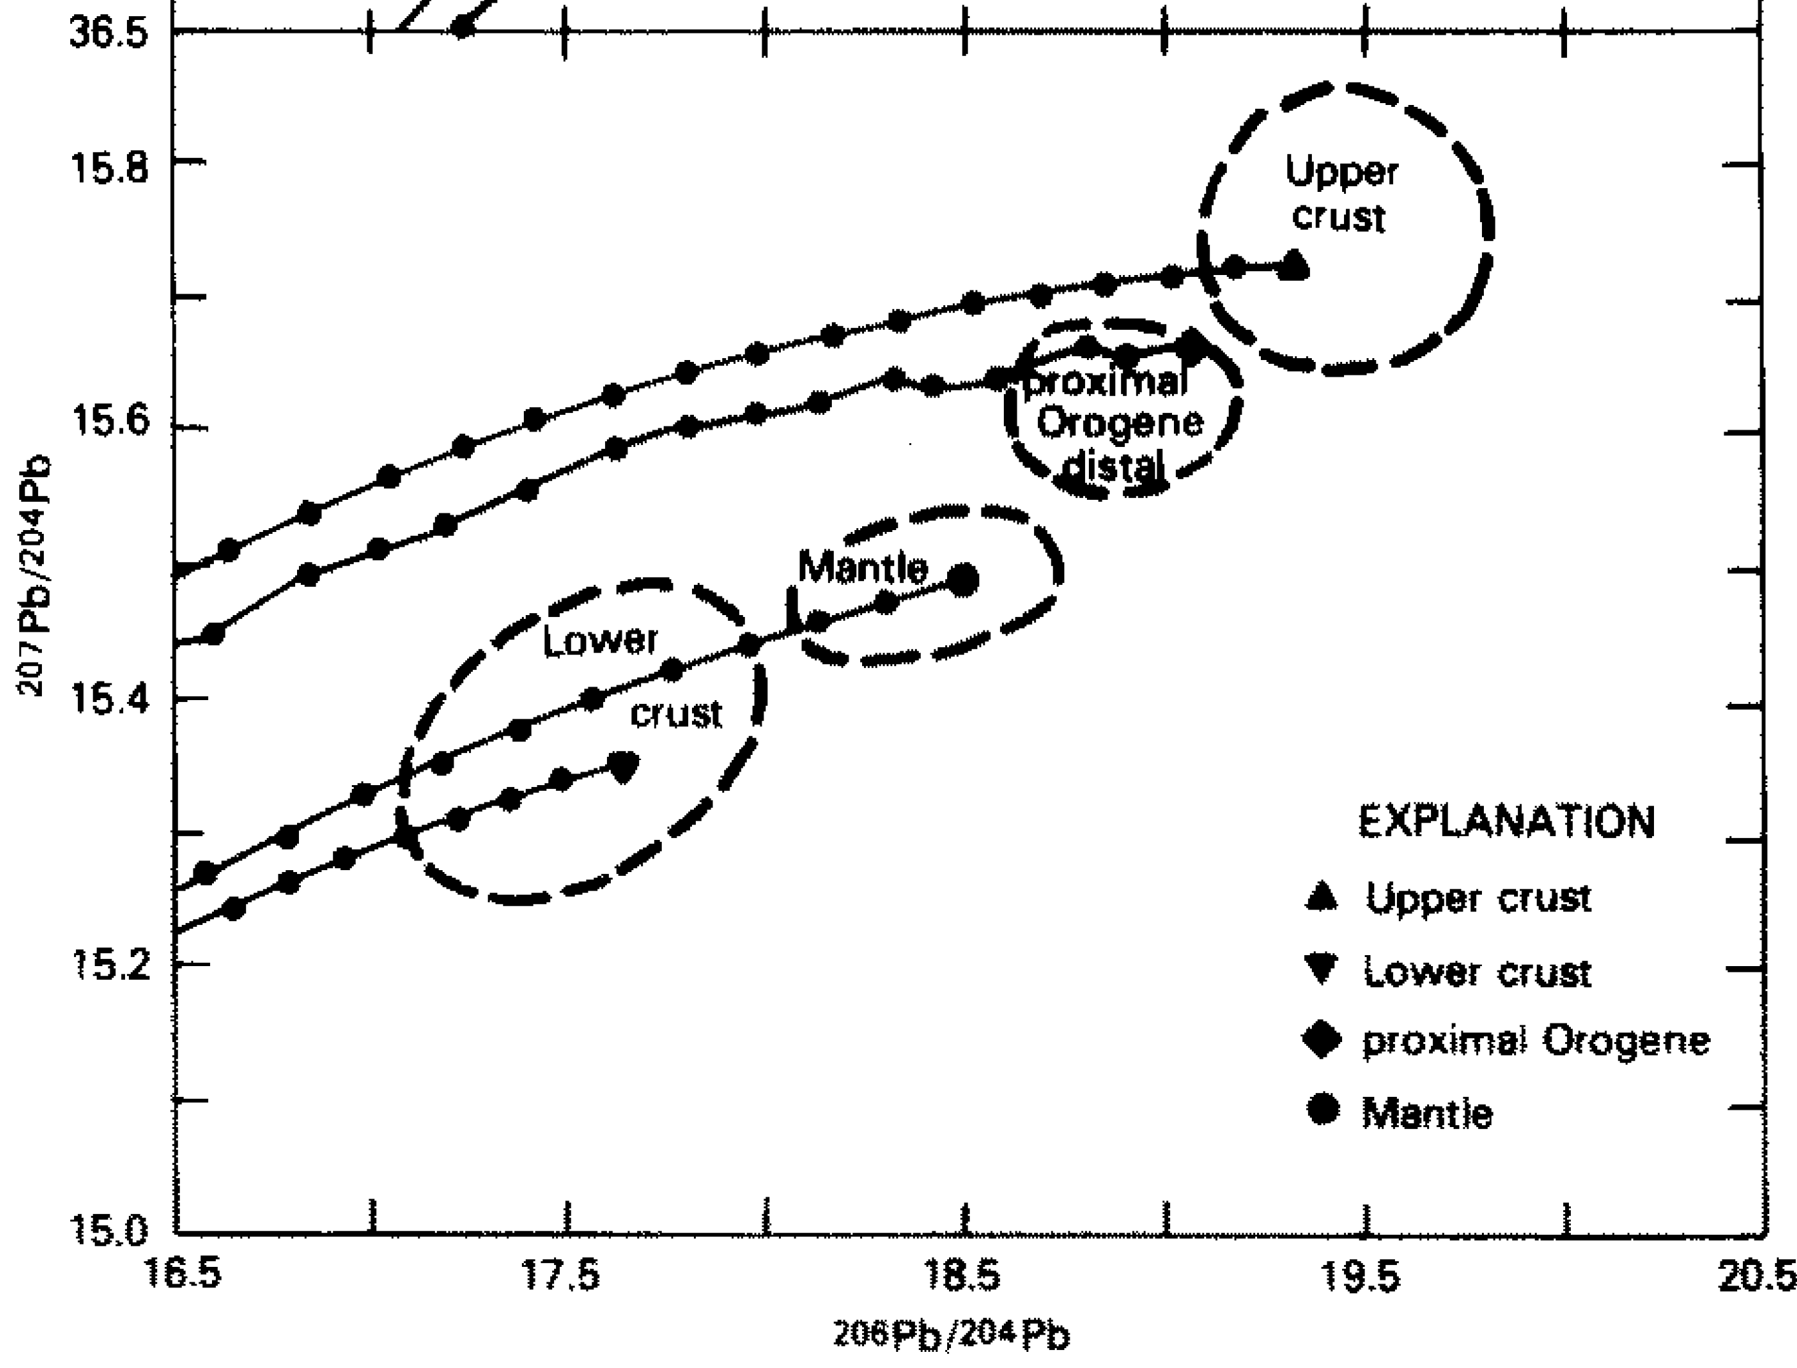
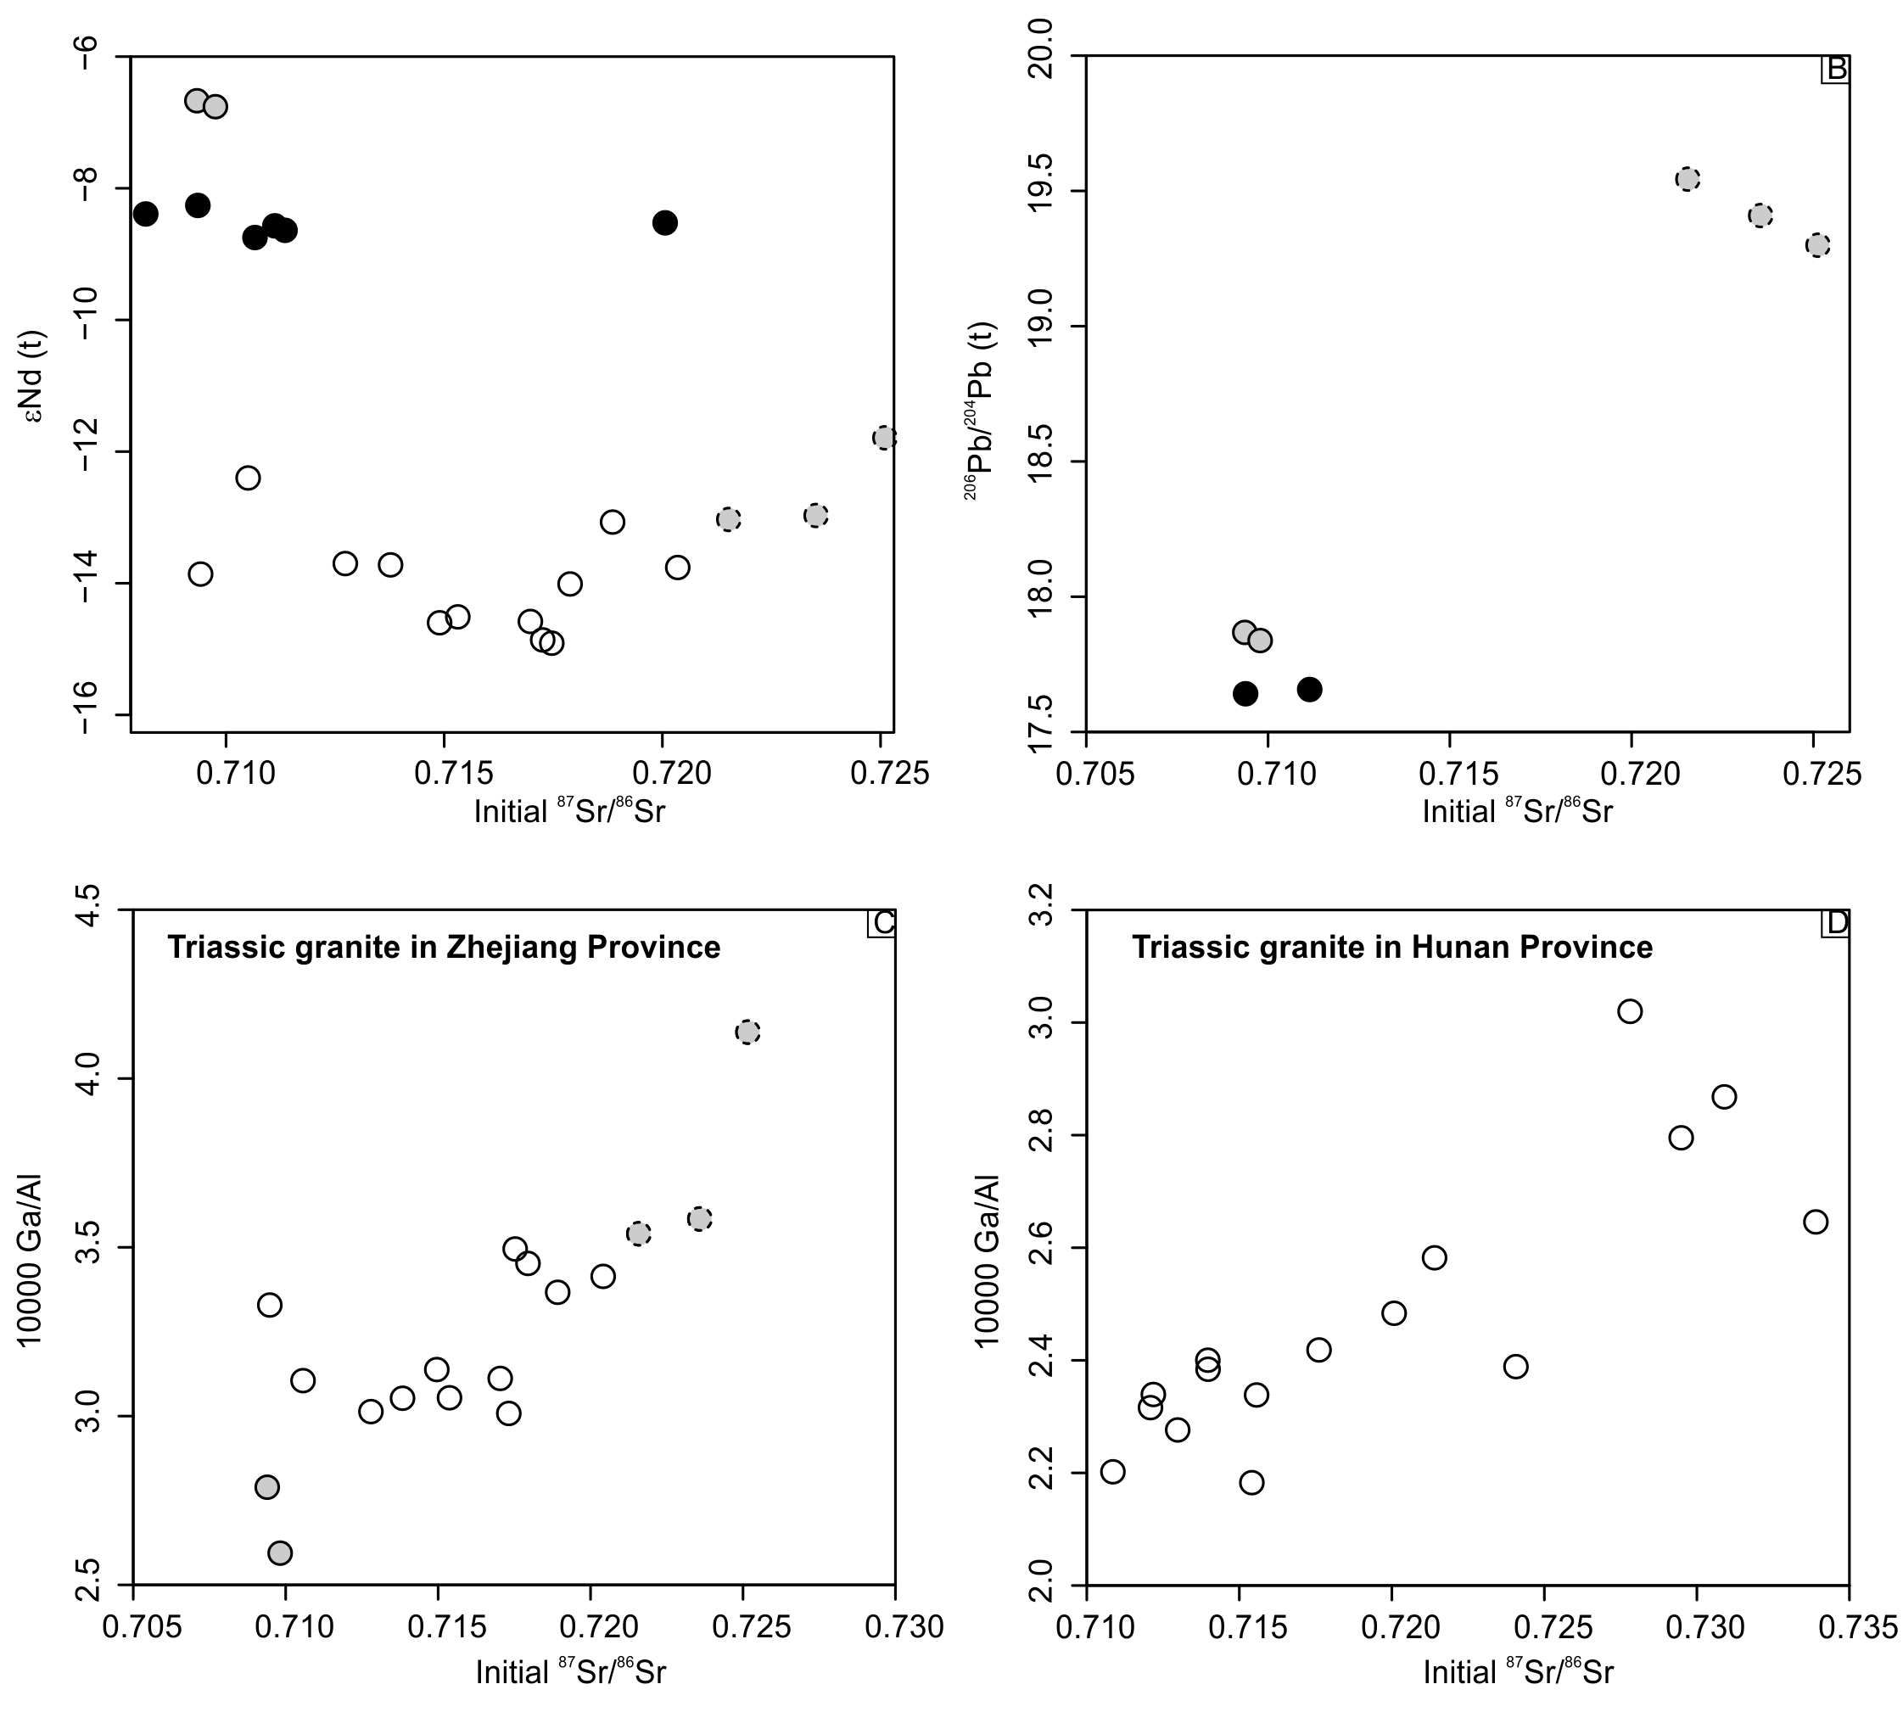
Late Triassic A-type granitoids in South China:
tectonics or sources?
Notes:
Let’s have a look at high Ga/Al ratio, the diagnostic feature of A-type, with new data of Sr-Nd-Pb isotopic data. Nd isotopes do not strongly fractionate during crustal differentiation. But this is not the case for Sr and Pb isotopes, which may show large differences between upper and lower crust. The Triassic granitoids from the Cathaysia Block show that there is Sr and Pb isotopes have a large range. The Ga/Al is positively related to initital 87Sr/86Sr.

Slide 15
Late Triassic A-type granitoids in South China:
tectonics or sources?
Willbold and Stracke (2010)
Notes:
The source has an affinity to the continental upper crust in isotopic compositions. Such a source is a high Ga/Al reservoir. Extension causes higher geothermal gradients and probably basaltic underplating. Crustal melting may therefore involve higher proportions of upper crustal material and form granites with high Ga/Al. But, of course, this is by no means the only way to involve a high Ga/Al and enriched isotopic source in the melting processes. Subduction, relamination and thrusting can all do this.

Slide 16
J₂₋₃ rocks with arc signatures:
The geochemical features were attributed to:
  A juvenile (Meso- or Neo-proterozoic) subduction-related rocks of Jiangnan Orogeny (Wang, 2012; Hou, 2013)
  Oceanic slab melting (Zhang, 2013)
  Shallow subduction (Zhou and Li, 2010; Li et al., 2013)
  Foundering and dehydration of the flat slab (Li and Li, 2007)
Notes:
Now we come to the Middle-Late Jurassic granitoids with arc signatures. For these rocks, there are four petrogenetic models: The geochemical features were attributed to:
A juvenile (Meso- or Neo-proterozoic) subduction-related rocks of Jiangnan Orogeny (Wang, 2012; Hou, 2013)
Oceanic slab melting (Zhang, 2013)
Shallow subduction (Zhou and Li, 2010; Li et al., 2013)
Foundering and dehydration of the flat slab (Li and Li, 2007)

Slide 17
J₂₋₃ I-type granitoids
Tongcun porphyry,
Jiangnan Orogeny
Isr (170 Ma) = 0.706–0.714
εNd (170 Ma) = –5.8 to –3.9
Jingju quartz porphyry
Cathaysia Block
Isr (160 Ma) = 0.723456
εNd (160 Ma) = –9.0
Granodiorite, MYF-1 borehole
E China Sea Basin
εHf (~170 Ma) = –27 to – 21
Zr = ~200 ppm
Y = 6–23 ppm
Yb = 0.55–2.23 ppm
Zr = 148 ppm
Y = 14 ppm
Yb = 1.23 ppm
Y = 6–22 ppm
Zr = 122–207 ppm
Yb = 0.25–1.13 ppm
εHf (170 Ma) = –4.5 to 2
Notes:
The samples of this age, no matter from Jiangnan Orogen, Cathaysia Block or the continental shelf, have similar petrology and elemental compositions. Note that what I say is elemental.

Slide 18
J₂₋₃ rocks with arc signatures:
Tongcun porphyry
Jiangnan Orogeny
Jingju porphyry
Cathaysia Block
MYF-1 granodiorite
E China Sea Basin
Bachmann and Bergantz et al. (2008, Journal of Petrology)
Notes:
With different water contents, felsic magmas show two distinct features in many elements, especially Srand REE. Under wet conditions, hornblende and titantie is stable but the crystallization of plagioclase is postdated, we commonly have a low and flat REE and no strong Sr depletion. With dry condition, we commonly see a REE pattern with seagull shape and strong Sr depletion.

Slide 19
J₂₋₃ rocks with arc signatures:
J₂₋₃ rocks with similar arc signatures are found in both Jiangnan Orogeny, Cathaysia Block (including E South China Sea). The arc signatures are probably controlled by external water (Richards, 2011)
In our model, water is from the foundering flat-slab(probably transported to the crust by hydrous basalt)
Their isotopes show very large variations and appear related to the basement.

Slide 20
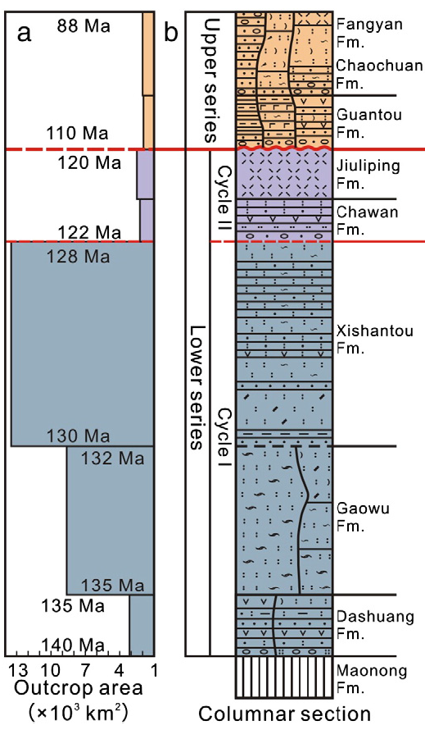
~130 Ma felsic flare-up magmatism in Zhejiang Province
Rhyolite/Tuff
(Liu et al., 2012)
Notes:
Now let’s come to the Early Cretaceous flare-up, the large volume of magmas in a short time. On the map, the deep blue patterns are felsic volcanic rocks, deposited in the grabens and the red ones are granitoids.

Slide 21
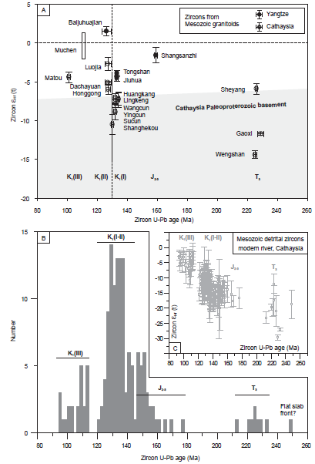
~130 Ma felsic flare-up magmatism in Zhejiang Province
Granitoids &
detrital zircon
(Zhu et al., 2014)
(Xu et al., 2007)
Most batholiths were generated in the period.
--Delamination of the thickened orogenic root?
The Archaean and Proterozoic mantle in Palaeozoic times has been largely or completely removed, probably during Late Mesozoic to Cenozoic time, based on studies on mantle-derived xenoliths. (Xu et al., 2000, Journal of Petrology)
Notes:
From thickness of volcanic rocks, the number of the granitoids and detrital zircon in modern river, you may know how extensive the magmatism is.
The reason for such extensive magmatism. Our model is delamination of the mountain root together with the subcontinental lithosphere, this is a result of the Early Mesozoic orogeny, which had caused stronger thickening in the coastal region.
Based on studies on mantle-derived xenoliths, Prof. Xu shows that in coastal region of South China, the Archaean and Proterozoic mantle in Palaeozoic times has been largely or completely removed, probably during Late Mesozoic to Cenozoic time

Slide 22
REE differentiation with crustal attenuation in coastal region of South China
Notes:
As Prof. Niu has shown, there is no migration of granitic magmatism with age in South China. Actually, in our study region and others, we may find all episodes of magmatism in an orogenic cycle and they are diachronous. As we have shown, these shallow intrusions with weak HREE differentiation, do not involve a thick crust and consistent with extensional setting this period.

Slide 23
~130 Ma felsic flare-up magmatism:
Shallow-level dry melting with shallow-level crystallizaiton fractionation
(Bachmann and Bergantz., 2008)

Slide 24
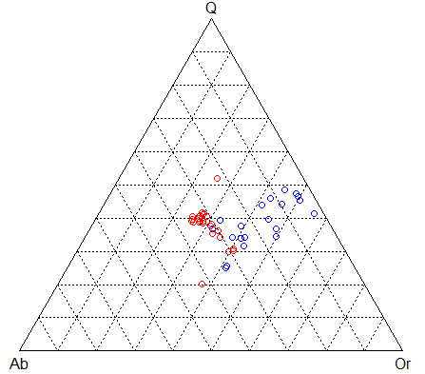
~130 Ma felsic magmatism: minimum melts at shallow levels
Red: norm An < 4%
Blue: norm An > 4%
(James and Hamilton, 1968)

Slide 25
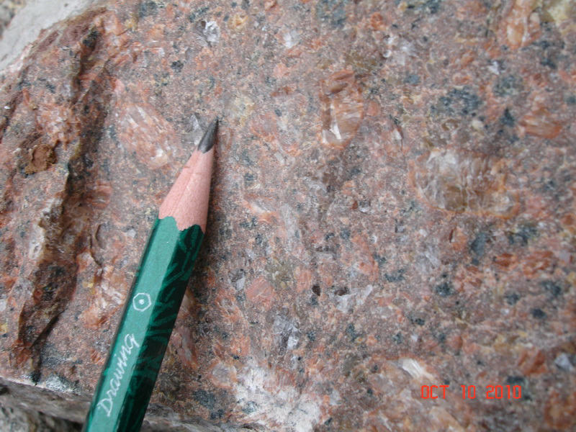
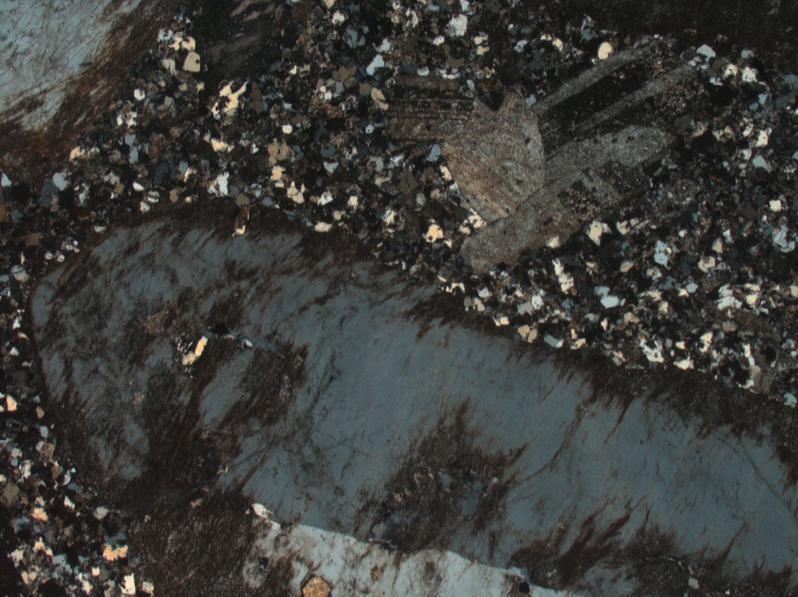
~130 Ma felsic magmatism : shallow-level crystallization fractionation
Field width: 5.57 mm
Melt H₂O content
2-8 wt% based on Kfs FTIR
(large uncertainties form partition coefficient
Whole-rock | BaO (wt%) | SrO (wt%)
 | 0.0001-0.2 | 0.0125-0.0158
K-feldspar | Median | BaO (wt%) | SrO (wt%)
Phenocryst Core | Or₇₀Ab₃₀ | 0.034 | 0
Phenocryst Rim | Or₉₆Ab₄ | 0.394 | 0.001
Groundmass | Or₉₇Ab₃ | 0.102 | 0.005
 | _{Median}
Plagioclase | Median | BaO (wt%) | SrO (wt%)
Phenocryst | Or_{0.5}Ab₉₈An_{1.5} | 0.024 | 0.021
Groundmass | Or₁Ab₉₇An₂ | 0 | 0.005

Slide 26
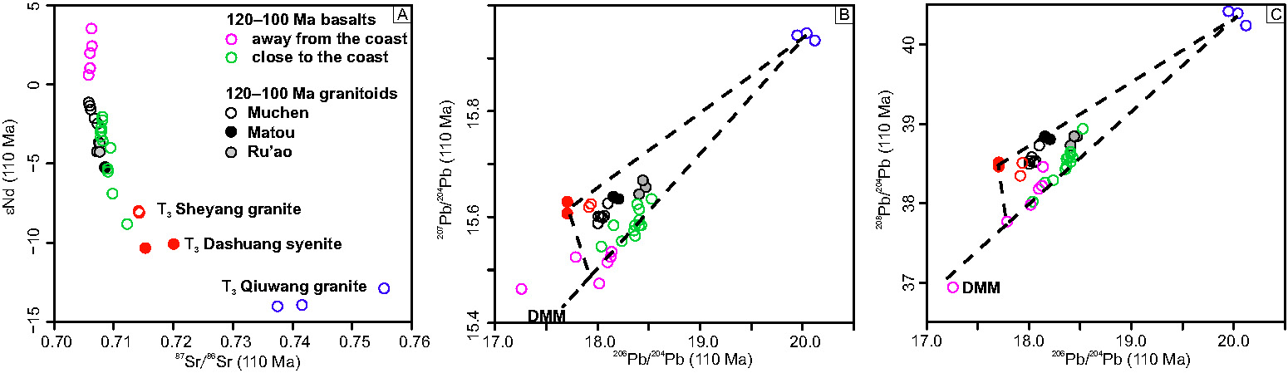
Three-component Mixing Model for K₁(III) granitoids
Bulk Sr-Nd and zircon Hf isotopes are similar for mafic (basalts and MMEs) and granitoids and do not imply a magma mixing model but extensive crystallization fractionation.
The Sr-Nd-Hf isotopes of the most felsic granitoids are also close to the coeval basaltic rocks, but not the older Mesozoic granitoids
Some authors argue that Mafic Microgranular Enclaves(MMEs) imply the magma mixing processes are not efficient.
Notes:
The last part of this presentation is formation of 120-100 Ma granitoids by mixing. Published isotopic data are mainly Sr, Nd and zircon Hf. You can see from the plots that these isotopes are overlapped for mafic, intermediate and felsic rocks. So crystallization fractionation or mixing cannot be distinguished.

Slide 27
Three-component Mixing Model for
K₁(III) granitoids
Relative to Sr-Nd-Hf data, Pb isotopic data are rare for the granitoids in the region.
Pb isotopes identify three components for the K₁(III) granitoids.
  Enriched mantle (basalts)
  Upper continental crust
  Lower continental crust
How did recycle upper continental materials enter the subduction zone magmas?
Near-trench samples have more radiogenic Pb isotopic compositions, which is also inherited by the granitoids generated from mixing processes
--Likely mantle wedge
processes rather than crustal contamination.
Notes:
Our recent Pb isotope show that

Slide 28
Mixing or No Mixing two types of MME swarms
 | Pingtan Island | Muchen
MME/host rock ratio | High | Low
Size of MMEs | Large | Small
Shape of MMEs | Angular | Rounded
Kfs megacrysts in MMEs | Rare | Common
Host rocks | Granite or Granodiorite | Quartz monzonite

Slide 29
Magma mixing in South China during K₁(III): two types of MME swarms
Muchen
(Griffin et al., 2002, Lithos)
(Liu et al., 2013, Lithos)

Slide 30
Magma mixing in South China: two types of MME swarms
Also note K₂O content
Pingtan: bimodal
Muchen: continuous

Slide 31
Bimodal or
Andesitic?
“However, intermediate plutonic rocks, like their volcanic counterparts, appear to be products of mingling and mixing.”
Pingtan
Muchen
(Reubi and Blundy, 2009, Nature)
(Huang et al., 2015, Science)

Slide 32
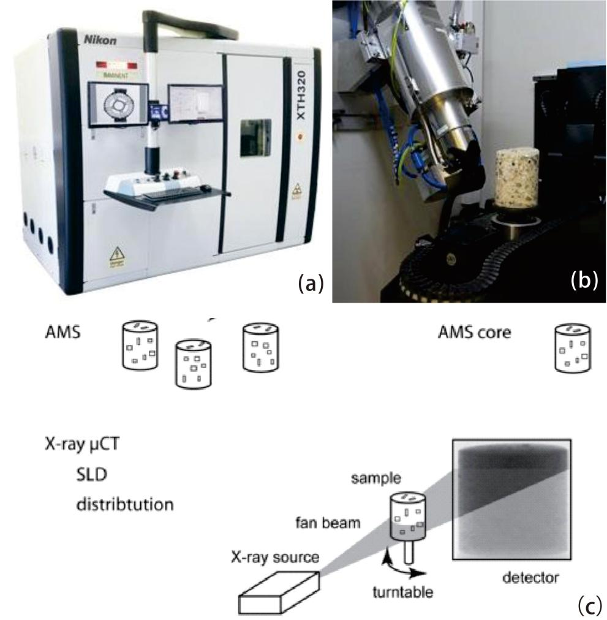
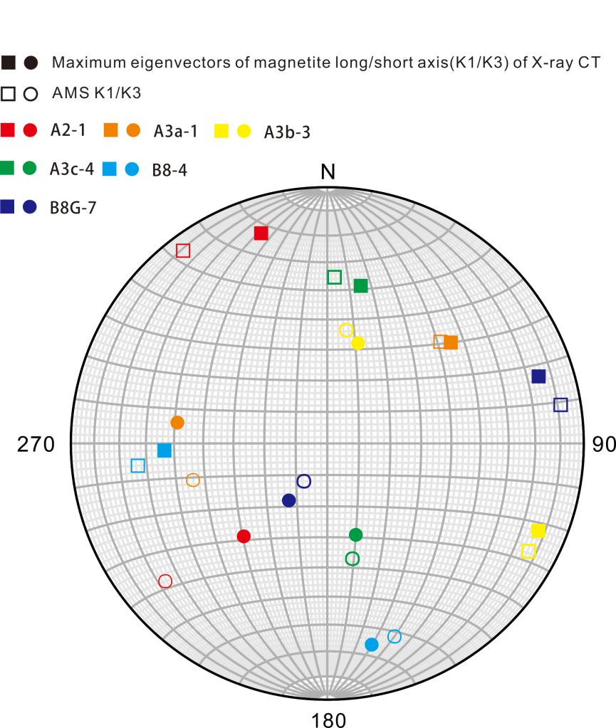
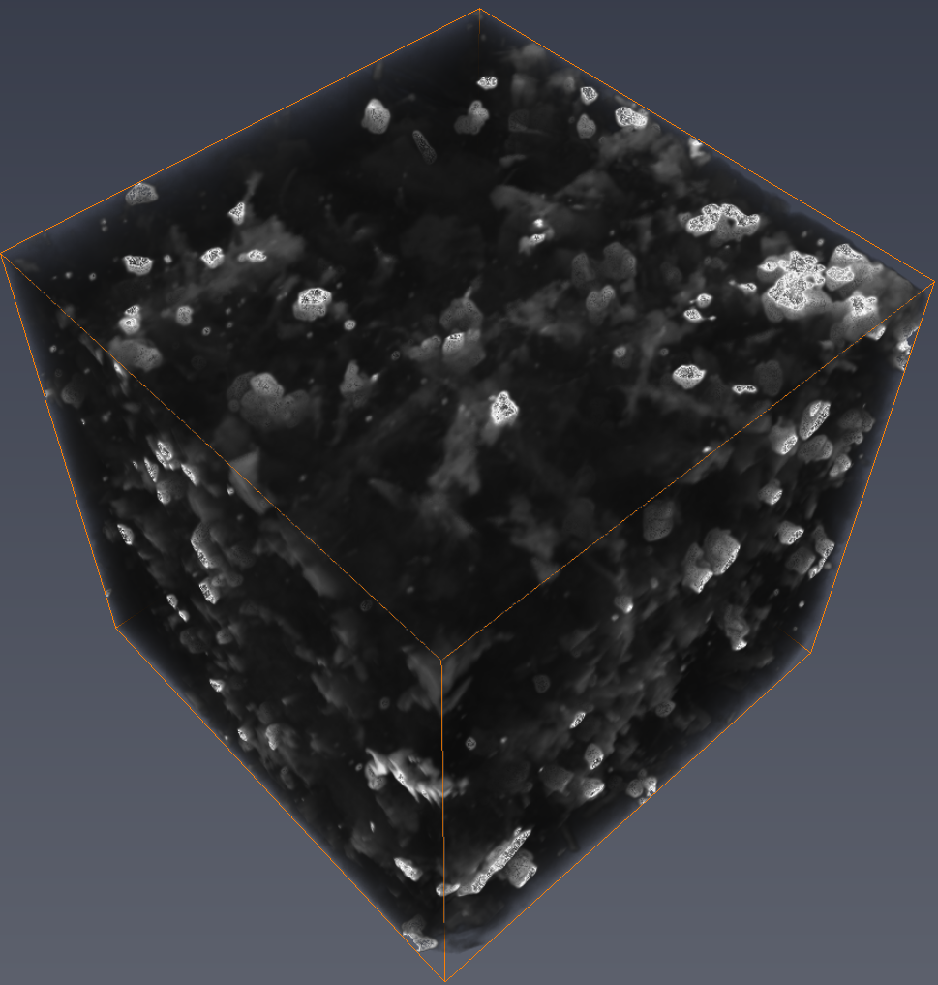
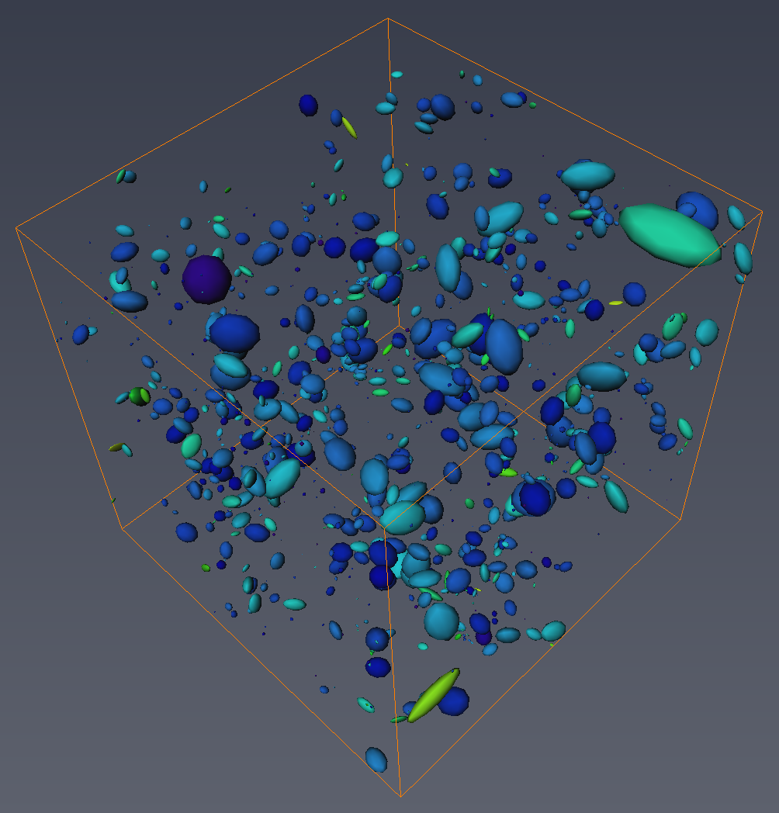
Magma mixing in South China:
Petrofabrics
Anisotropy of Magnetic Susceptibility (AMS)
  9 mm cores applied to MMEs
  15-20 mm cubes applied to granite
X-ray micron-CT (with ~8 μm resolution, also resolving inverse/abnormal magnetic fabrics)
Smaller cores (9 mm in this study) provide better sampling/CT resolutions and resolve some short-range phenomena.

Slide 33
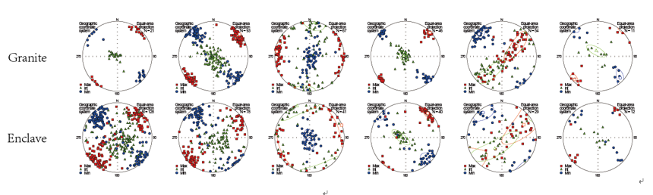
Magma mixing in South China: Pingtan
In contrast, MME swarms from Pingtan Complex show uniform magnetic foliations and lineations for both MMEs and host granites, at outcrop scale
ZD ZD2 YD XX XFD BC

Slide 34
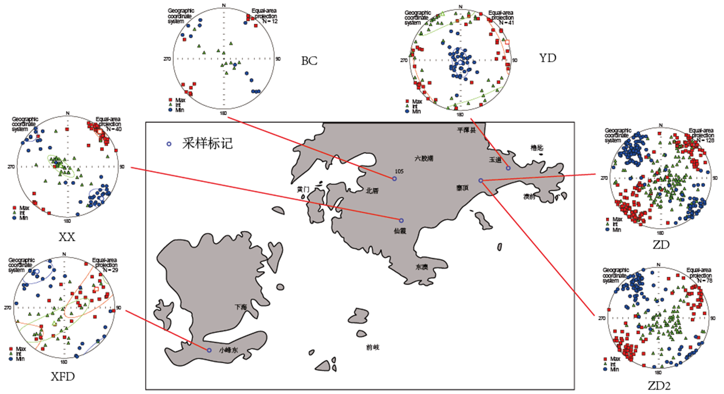
Magma mixing in South China: Pingtan
And also at intrusion scale
Pingtan MME swarms

Slide 35
Magma mixing in South China: Muchen
Magma mixing in Muchen Complex likely had a more active fluid dynamic regime, with stronger stirring processes.
granite
MME
swarm

Slide 36
Magma mixing in South China
"The mixing of magmas is a process commonly observed in both plutonic and volcanic rocks and, depending on the fluid dynamic regime, is controlled by stirring, stretching and diffusion.”
Maurizio Petrelli
Implications from petrology, magnetic susceptibility, AMS and X-ray CT studies (Zhu et al., 2017)
  Magma mixing regions can have significantly higher magnetite contents than both granitoids and MMEs (calc-alkaline trend, magnetite-series granitoids)
  Magnetite crystallization and magma mixing are strongly related to magma flow/deformation (as shown by petrofabrics)
  Real-time CT scan of magma mixing/crystallization processes by neutrino?

Slide 37
Diachronous magmatism: an example from Hong Kong close to JUNO
data provided by Sewell

Slide 38
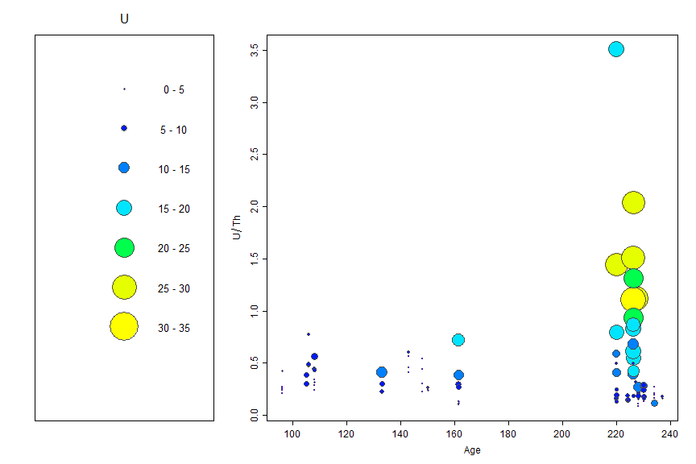
Western Fujian

Slide 39
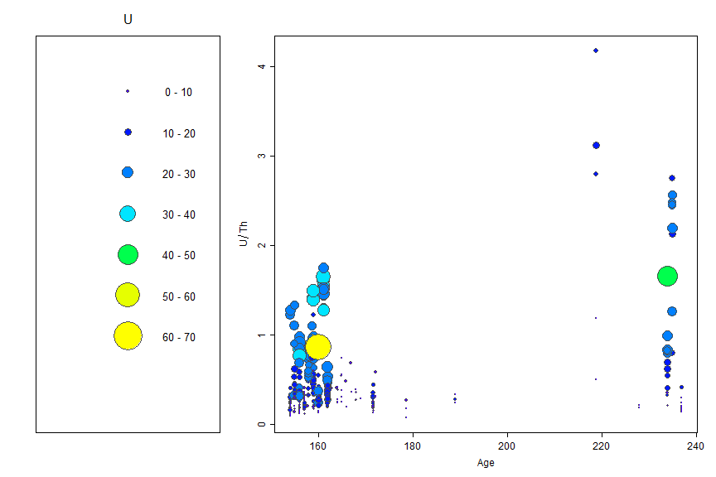
Nanling Range

