Slide 1
Geological evolution of the South China Block
Mian Liu (刘勉）
University of Missouri
中科院计算地球动力学重点实验室

Slide 2
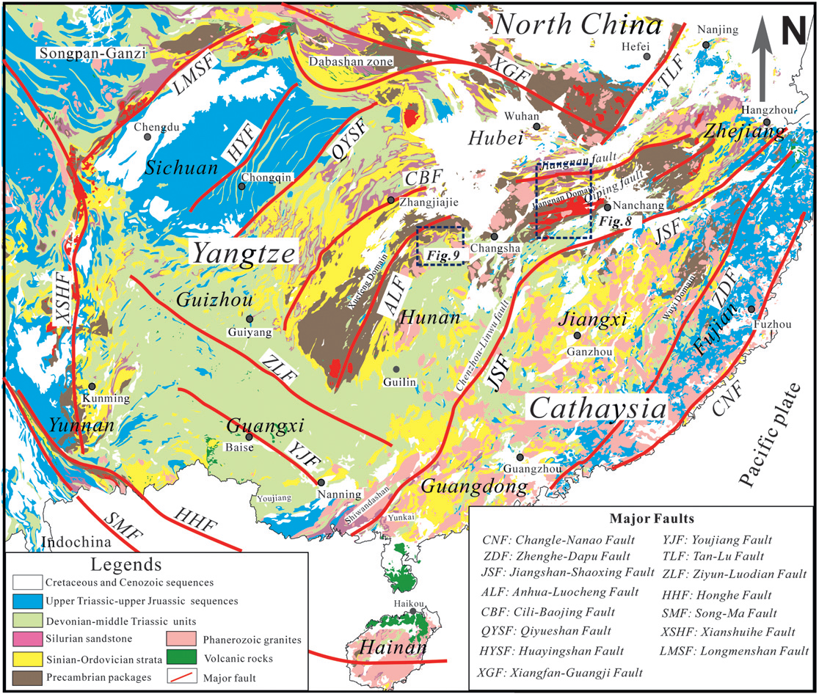
Geological Map of South China
Y.Wang et al., 2013

Slide 3
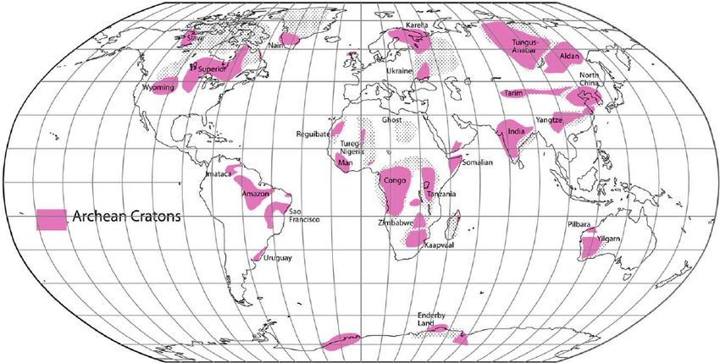
Cratons (克拉通）– The old (>1.0 Ga), stable core of continents
South China is a craton!

Slide 4
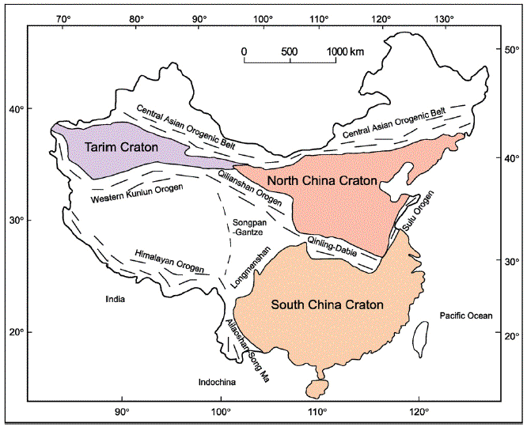
Cratons in China
Zhao and Cawood（2012）

Slide 5
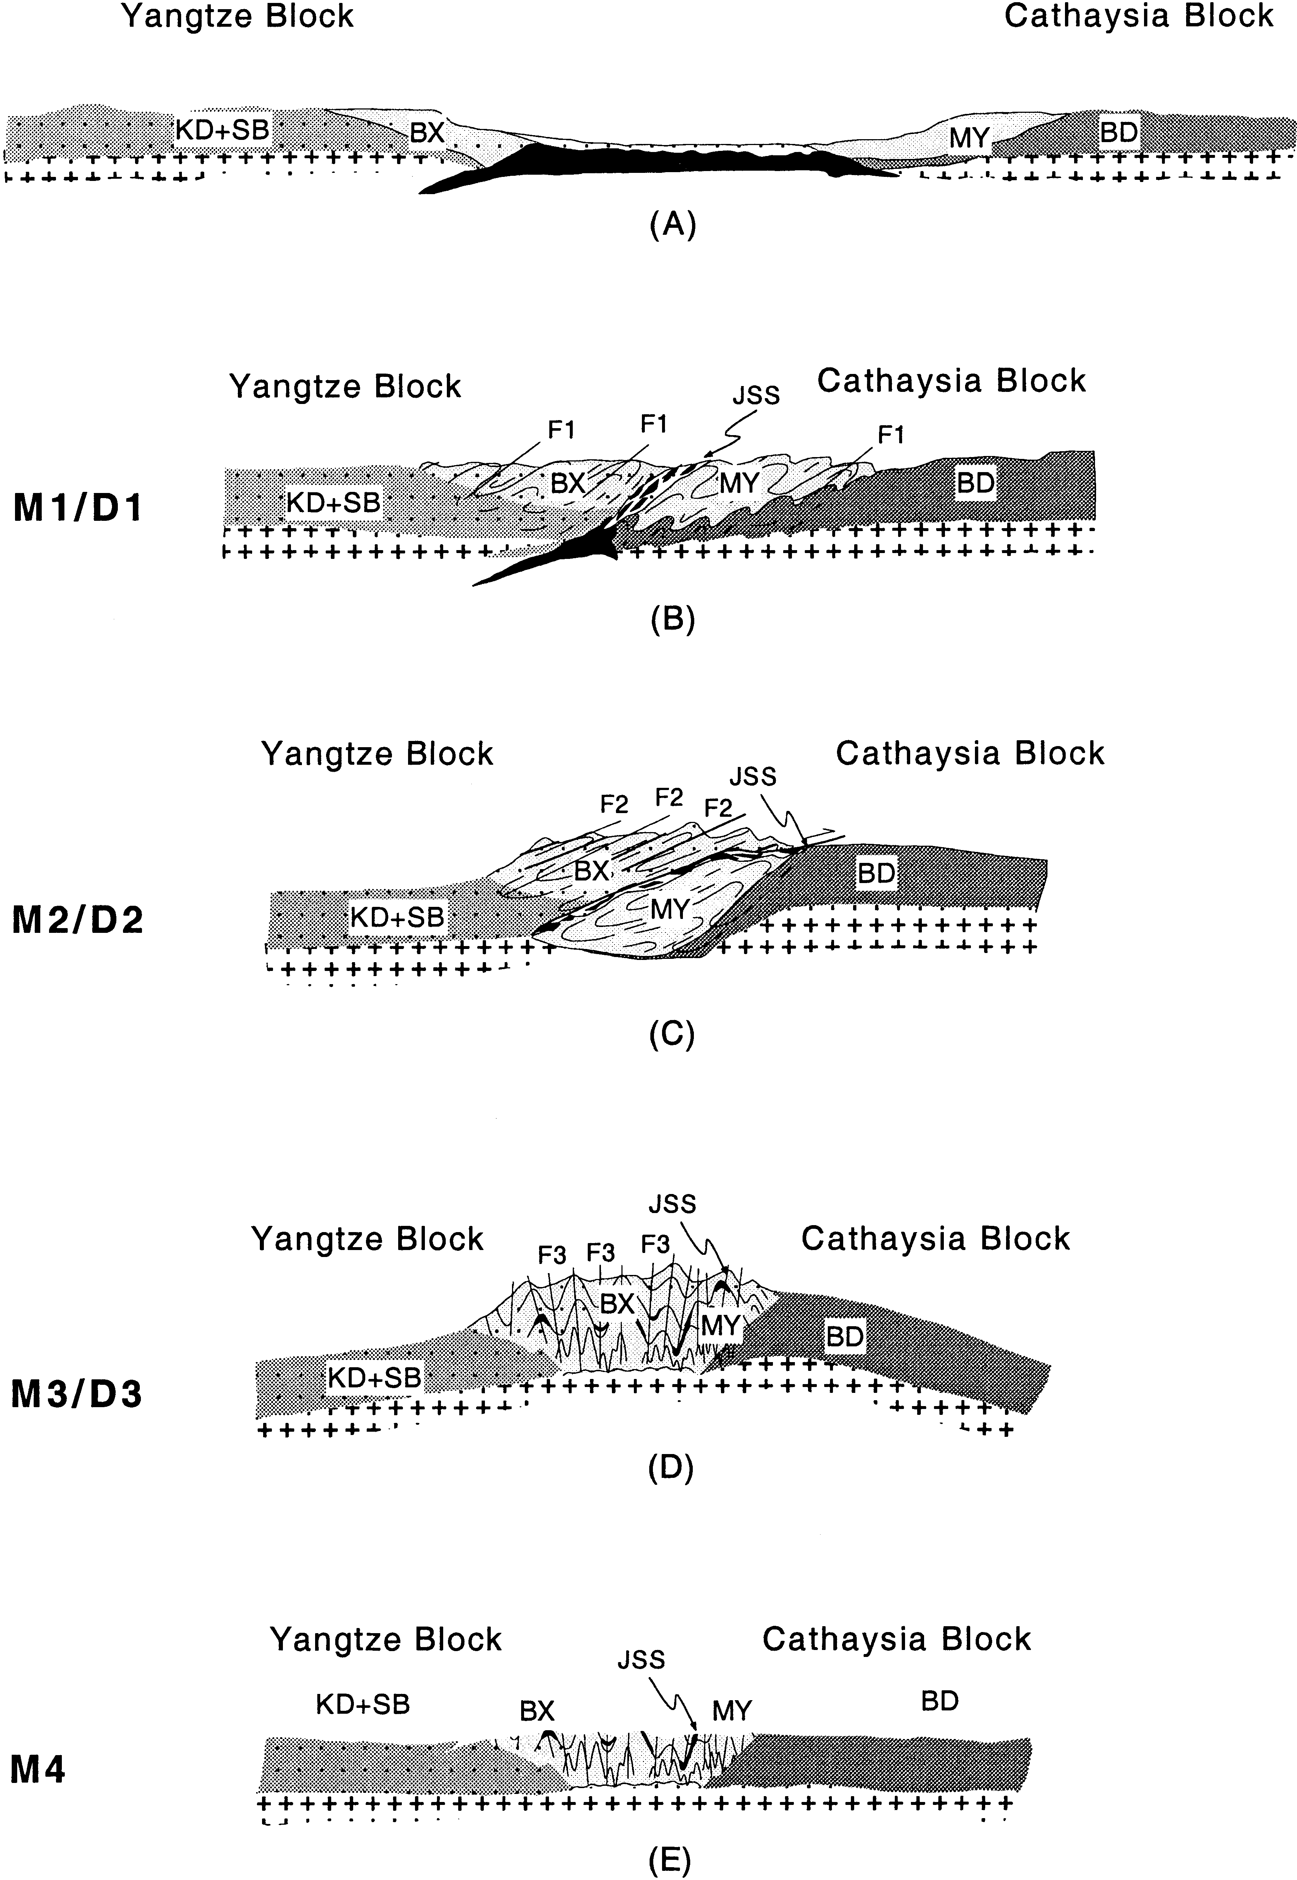
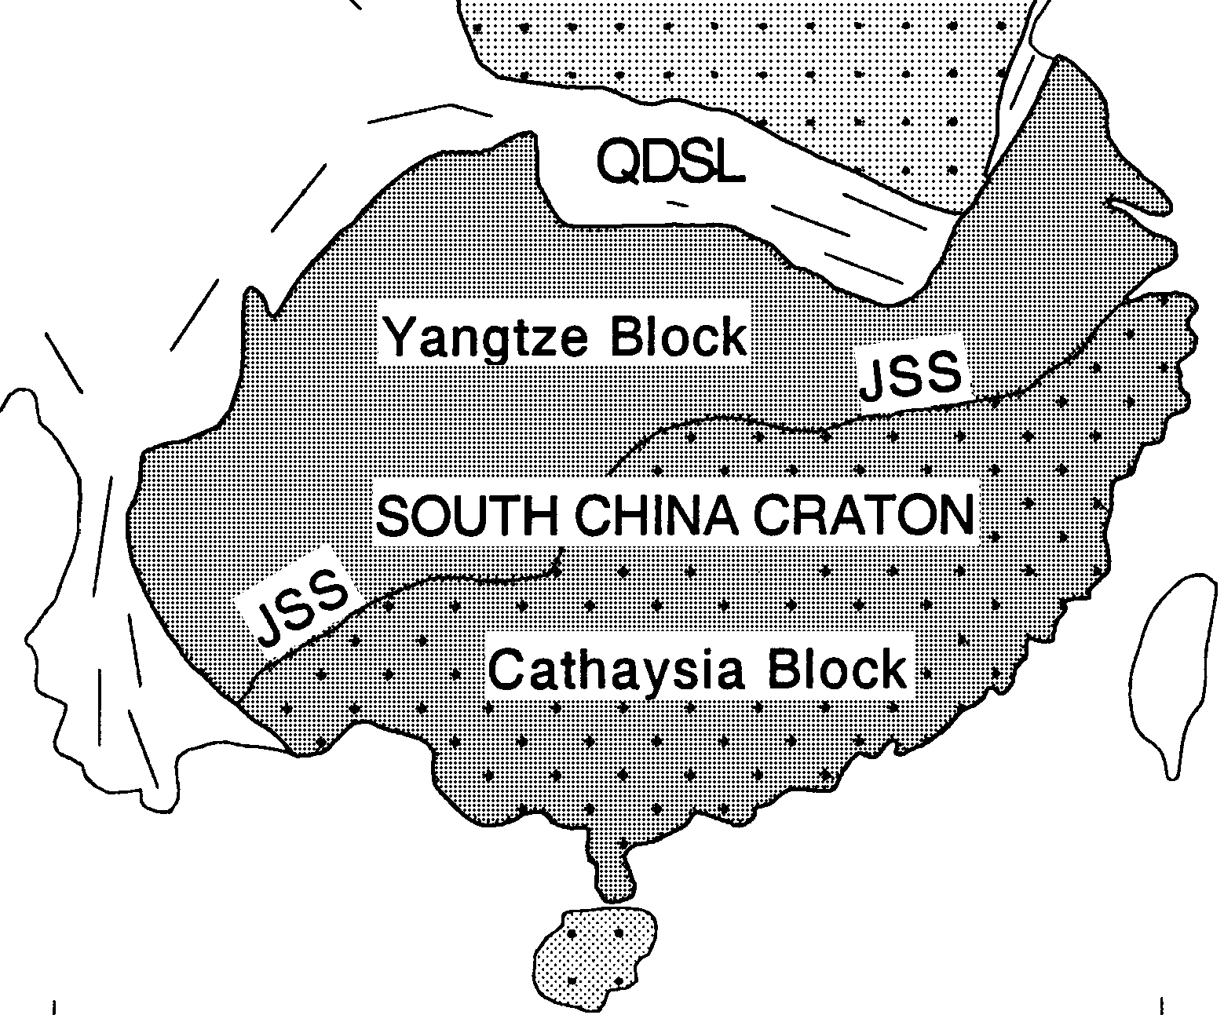
The South China craton formed by collision and amalgamation of two pieces of ancient continents: The Yangtze (扬子）block and the Cathaysia （华夏）block, in the Neoprotorozoic (~1.0 Ga) or earlier.

Slide 6
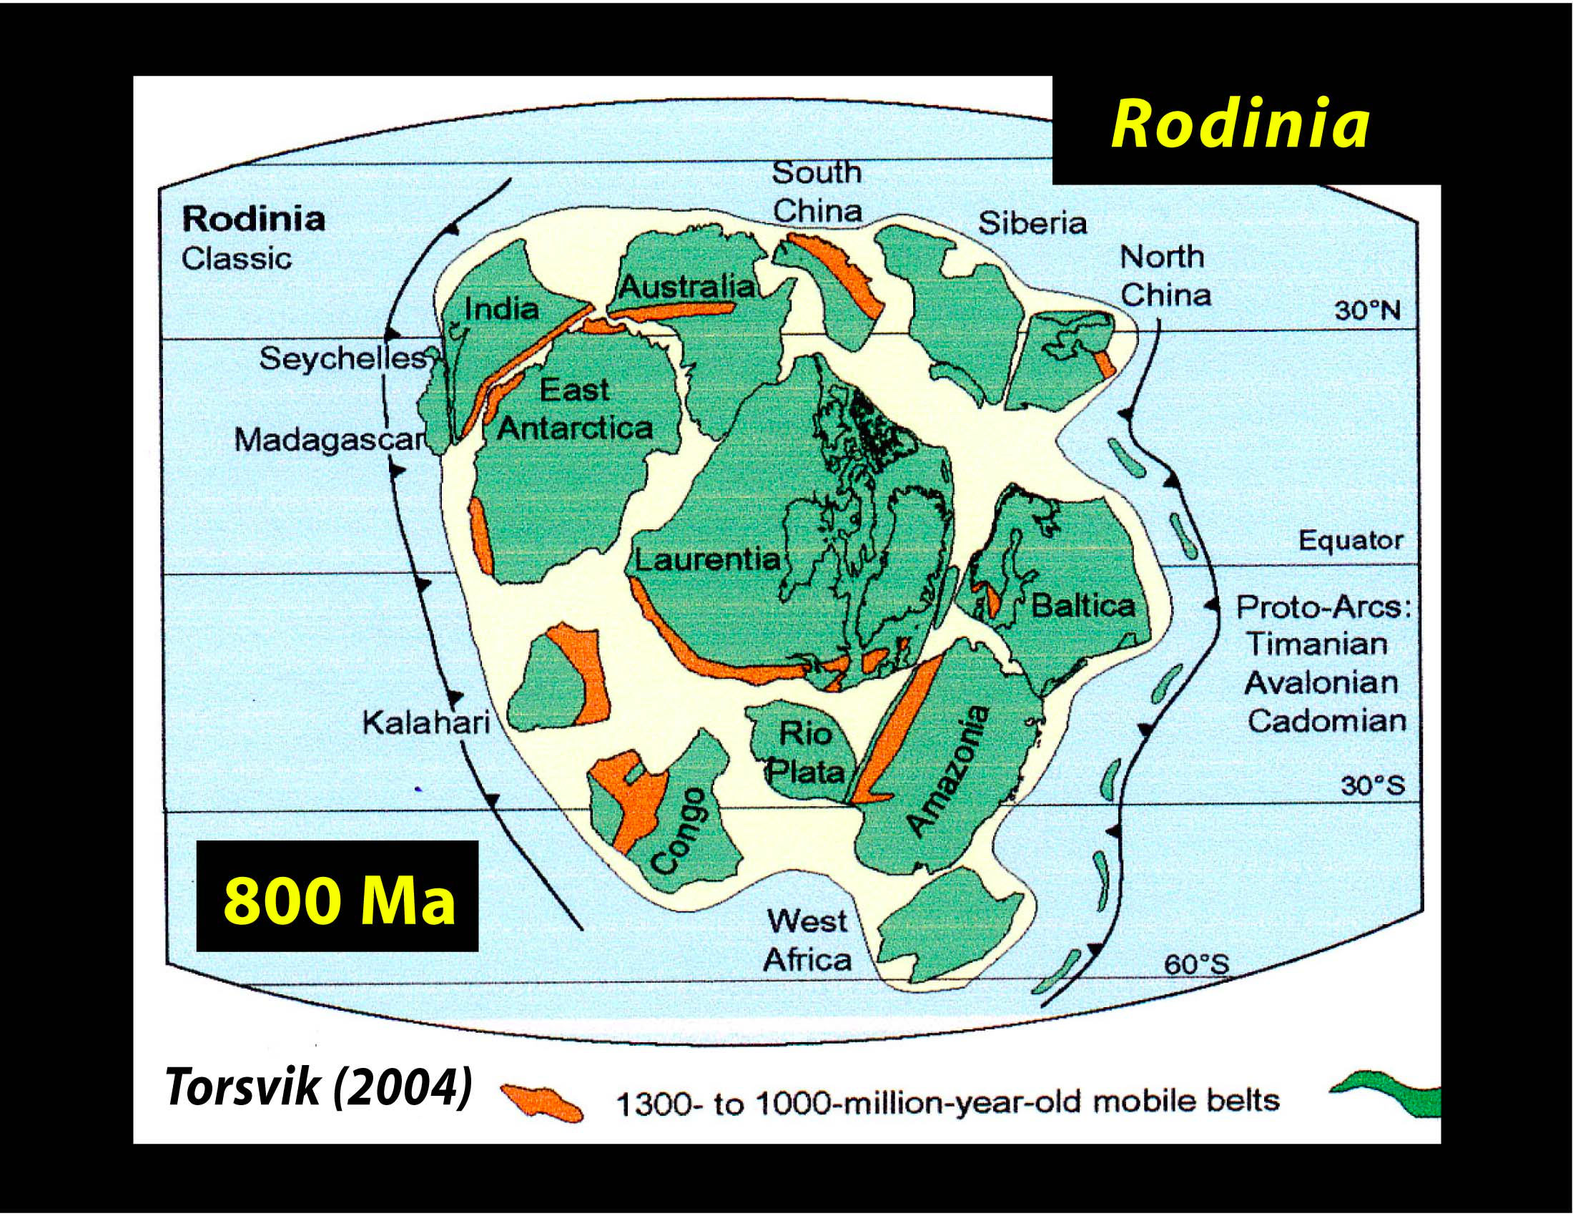
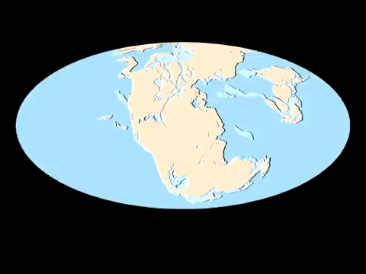
Continental Drift and Supercontinents
Disintegration of the last supercontinent
-Pangaea
天下大陆，分久必合，合久必分。
~200 Ma => present

Slide 7
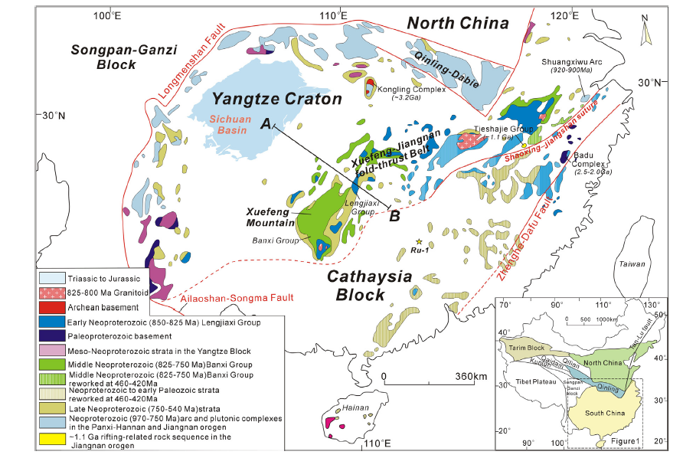
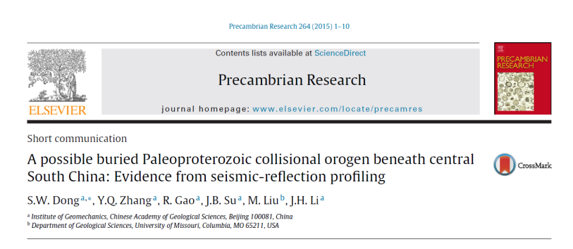

Slide 8
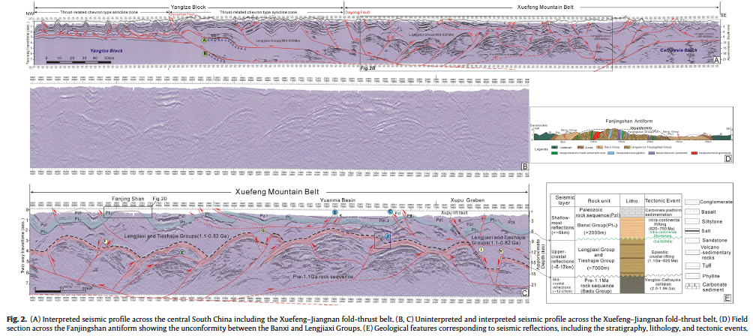
Deep Seismic Reflection across the Yangtze – Cathaysia collision zone:
A paleoproterozoic age for the South China craton?
Dong et al., 2015

Slide 9
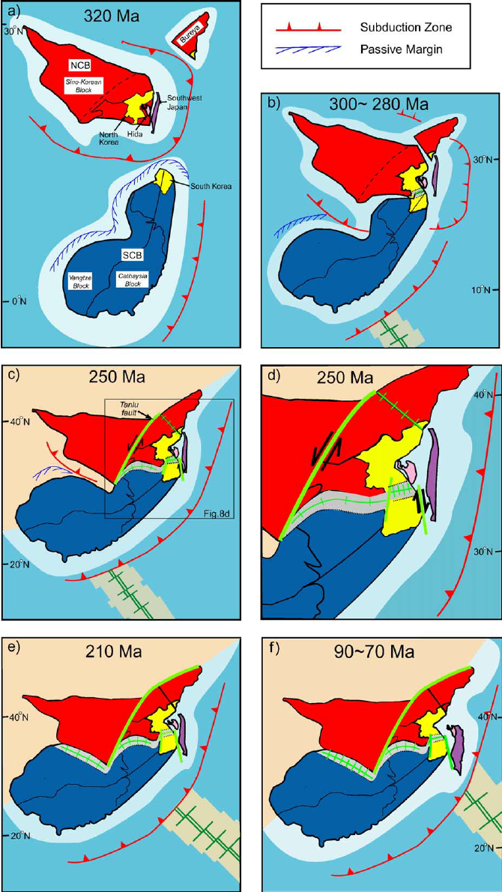
Mesozoic collision with the North China Block
Chang (2006) JGR

Slide 10
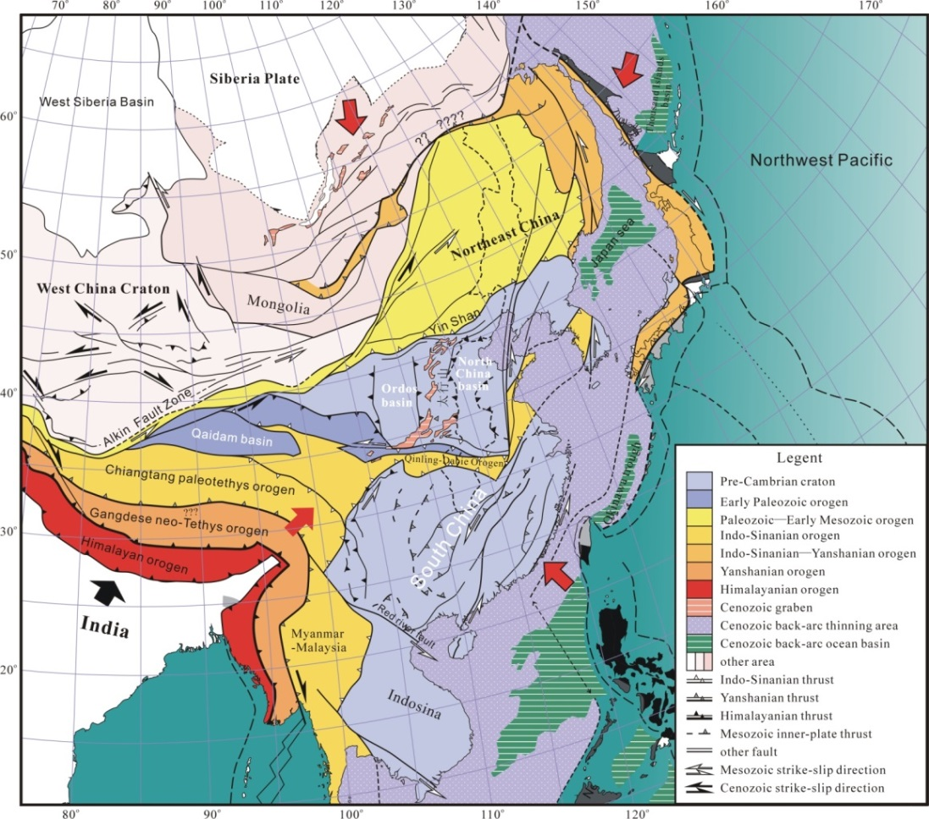
Late Jurassic compressive tectonics in east Asia
晚侏罗纪东亚汇聚与岩石圈增厚
据沙金庚，1999
董树文等，2000，2007；张岳桥等，2007
After www.scotese.com

Slide 11
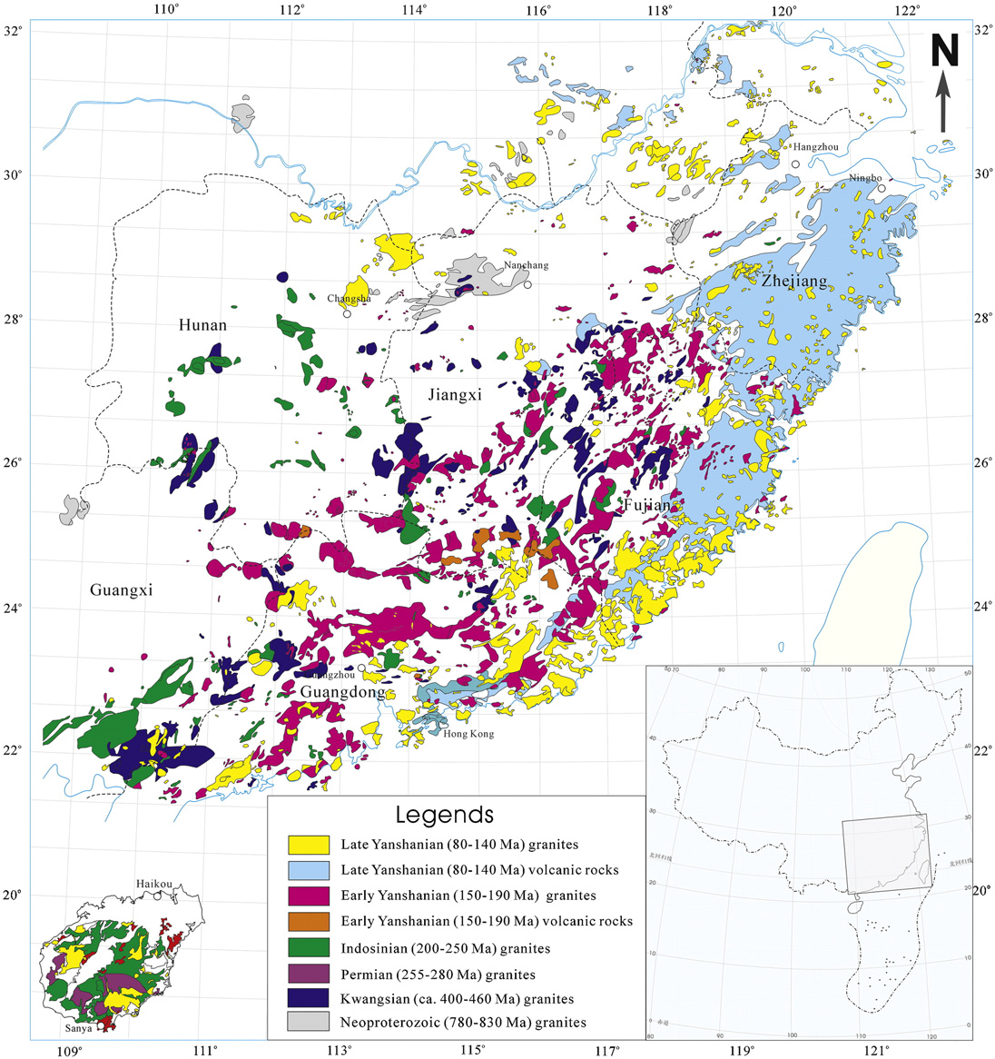
Phanerozoic granites in South China
The largest granitic province in the world
Y.Wang et al. 2013

Slide 12
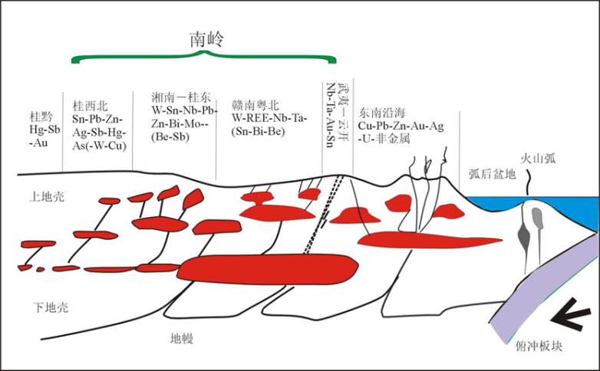
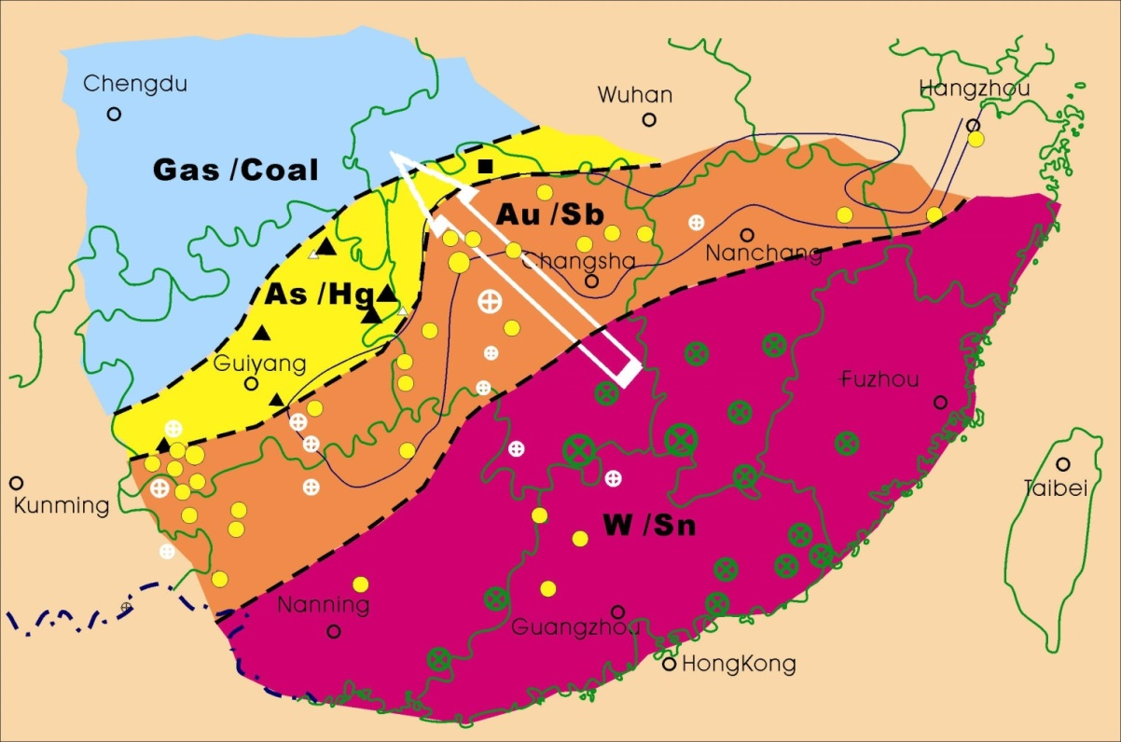
Metal ore-deposits zones in South China
华南区域成矿分带
Low T
据沙金庚，1999
High T
1、华南东部高温W/Sn;
2、华南中部中温Au/Sb;
3、华南西部中低温Pb/Zn;
4、华南西南部低温Hg/As;
5、华南中西部天然气
Courtesy of S.W. Dong
After www.scotese.com

Slide 13
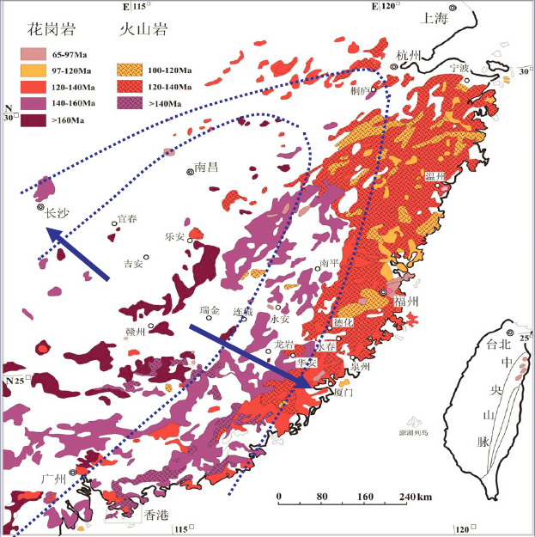
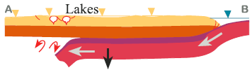
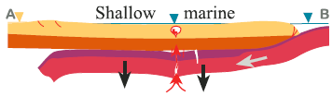
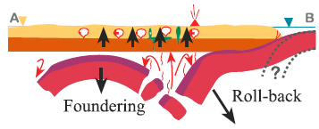
Mesozoic Magmatism: Younging towards NW and SE
中生代火成岩省时空分布：中心老两侧新
水平俯冲与板片拆沉模式
210 Ma
据沙金庚，1999
190 Ma
180-155 Ma
中国东南部晚中生代火成岩分布
李正祥，2015
(Li ZX & Li XH, 2007)

Slide 14
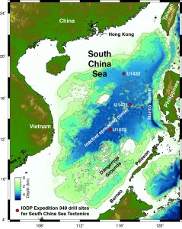
Cenozoic opening of the South China Sea

Slide 15
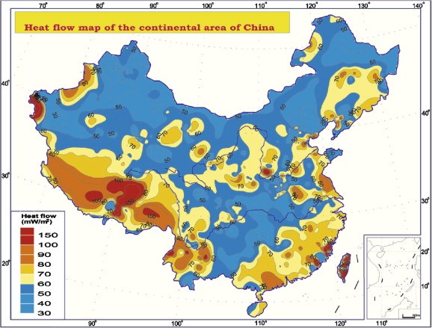
Surface Heat Flux in China
Hu et al., 2000

Slide 16
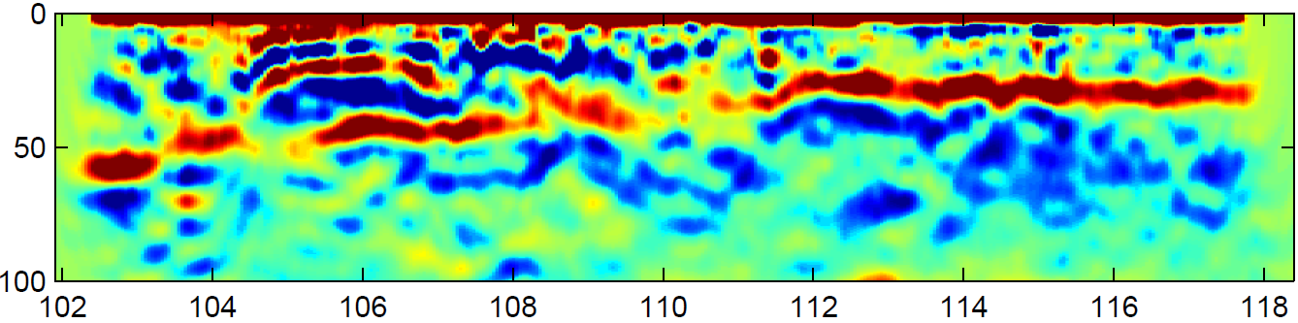

Contrasting Crustal Structure across South China
龙门山
四川盆地
雪
峰
山
武夷山
湘鄂西-川东构造带
Yangtze Block
MXT
Cathaysia Block
Moho
Moho
Courtesy of S.W.Dong

Slide 17
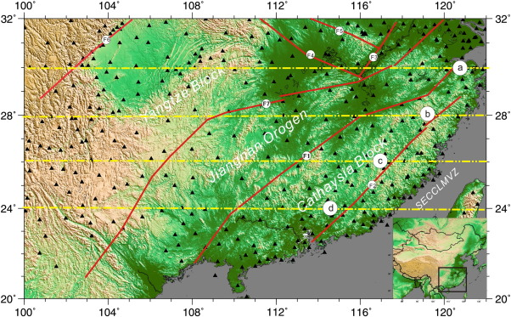
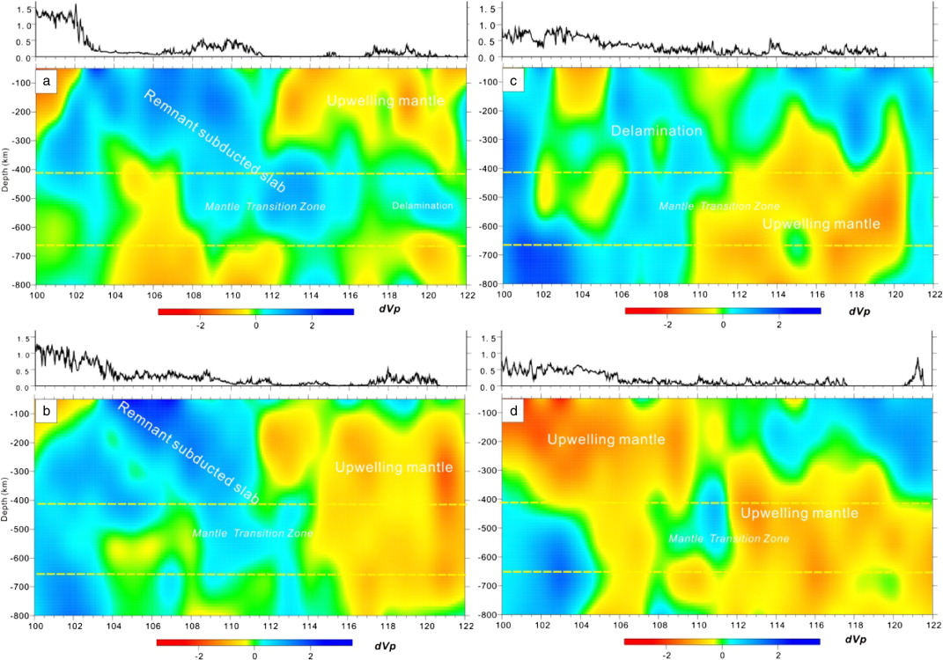
Upper mantle structure under South China
HV
LV
High velocity under Yangtze block vs. low velocity under Cathaysia block
He and Santosh, 2016

Slide 18
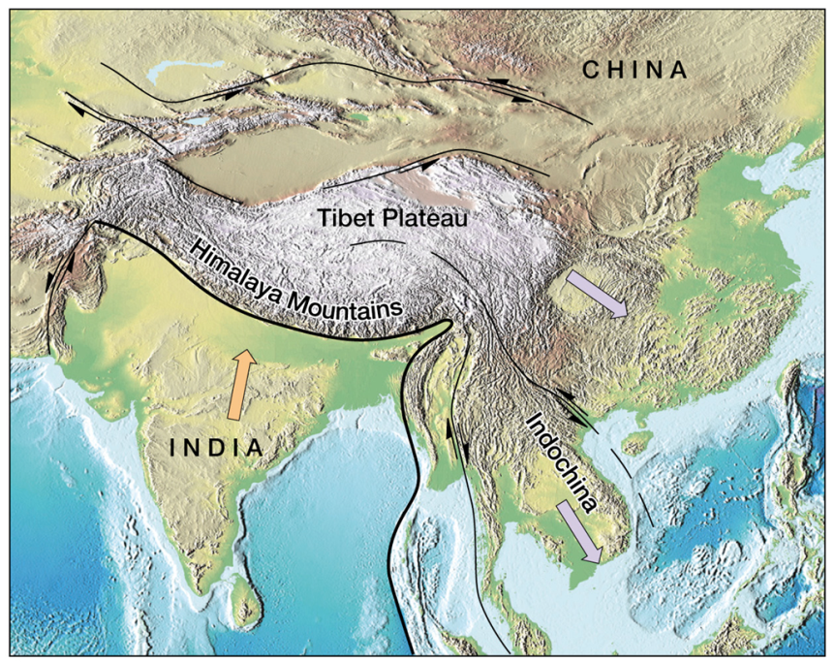
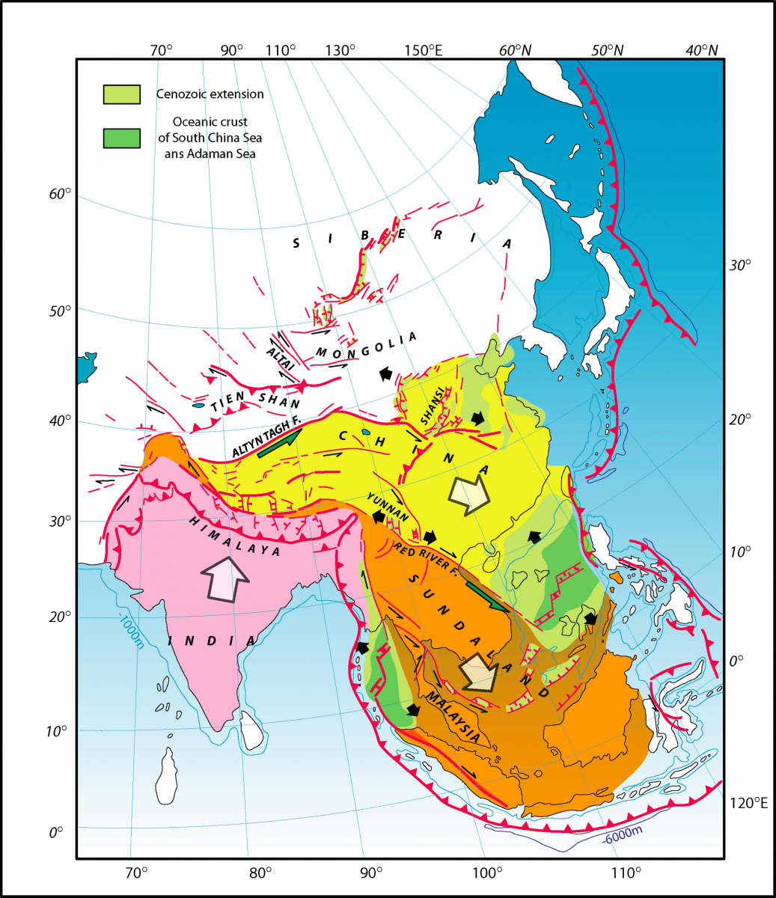
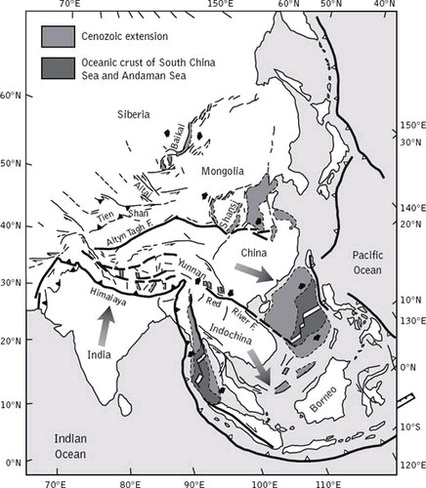
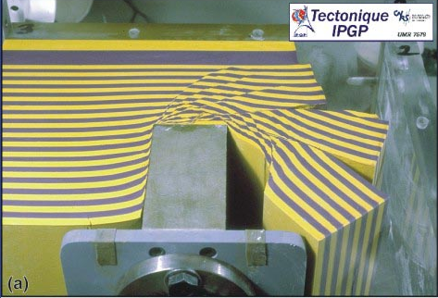
Cenozoic Asian tectonics:
Indo-Asian collision and tectonic extrusion
Tapponnier et al., 1982
Notes:
It has been established that, in the past 50 Ma or so, the collision and continued convergence between the India and Eurasian plate has caused crustal thickening and uplifting of the TP. The Indo-Asian collision may have also squeezed out blocks of Asian lithosphere along numerous large strike-slip faults, as illustrated by the model of tectonic extrusion.
The tectonic extrusion model implies that Cenozoic tectonics of much of Asia is directly associated and strongly controlled by the Indo-Asian collision. However, the relative roles of tectonic extrusion and crustal thickening, and to what extend has extrusion tectonics controlled Asian tectonics, have been uncertain.

Slide 19
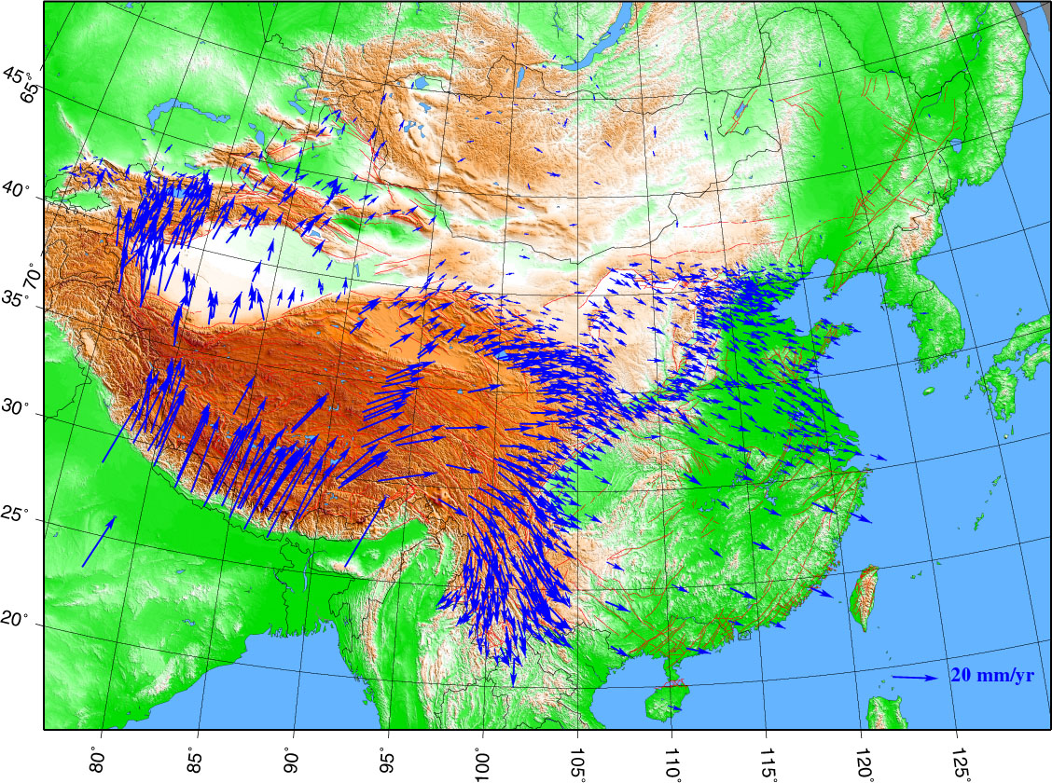
GPS site velocities relative to stable Eurasia
Tibetan Plateau
South China
India
Wang et al., 2003
Notes:
If so, today’s crustal motion should give us a clear idea of the scope of tectonic extrusion. This is the GPS v. relative to stable Eurasia. Most extrusion is seen in the NE TP and around the SE corner, into Indochina.

Slide 20
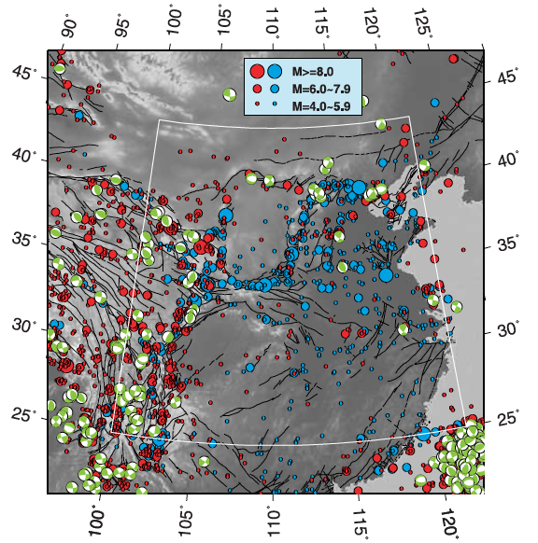
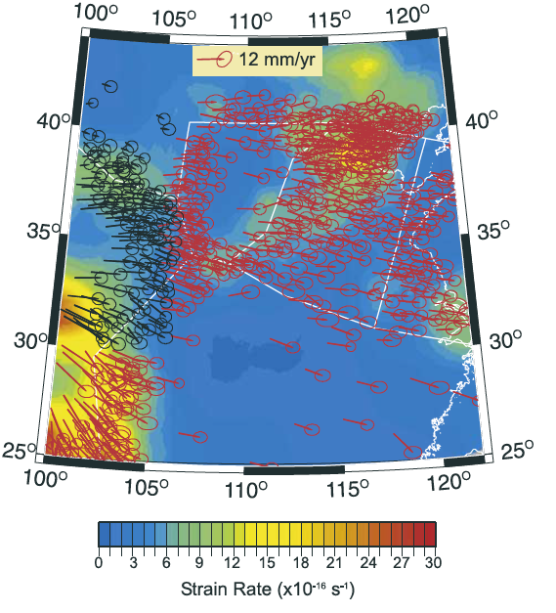
South China is tectonically stable today
Seismicity
Strain Rates
South China
South China
Liu and Yang, 2005

Slide 21
Thank you!
谢谢！

Slide 22
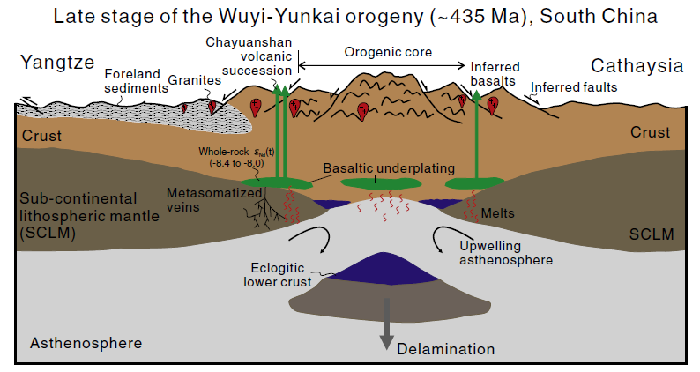
陆内造山背景：地壳增厚与深熔,增厚岩石圈拆沉与软流圈上涌
据沙金庚，1999
造山带核部
榴辉质下地壳
软流圈上隆
玄武岩浆底侵
软流圈
晚侏罗纪东亚汇聚与岩石圈增厚
董树文等，2000，2007；张岳桥等，2007
拆沉
舒良树，2012；Wang YJ 2013；李三忠等，2011；张国伟等，2013
After www.scotese.com

Slide 23
Geodetic and geophysical evidence is consistent with geological reconstruction, which shows limited extrusion in the past 5 Ma. Large-scale extrusion of Indochina during 15-30 Ma was based on Leloupe et al.’s (1995) estimate of >700 km sinistral displacement on the Ailong Shan-Red River Fault.
0-5 Ma
15-30 Ma
Replumaz et al., 2003

Slide 24
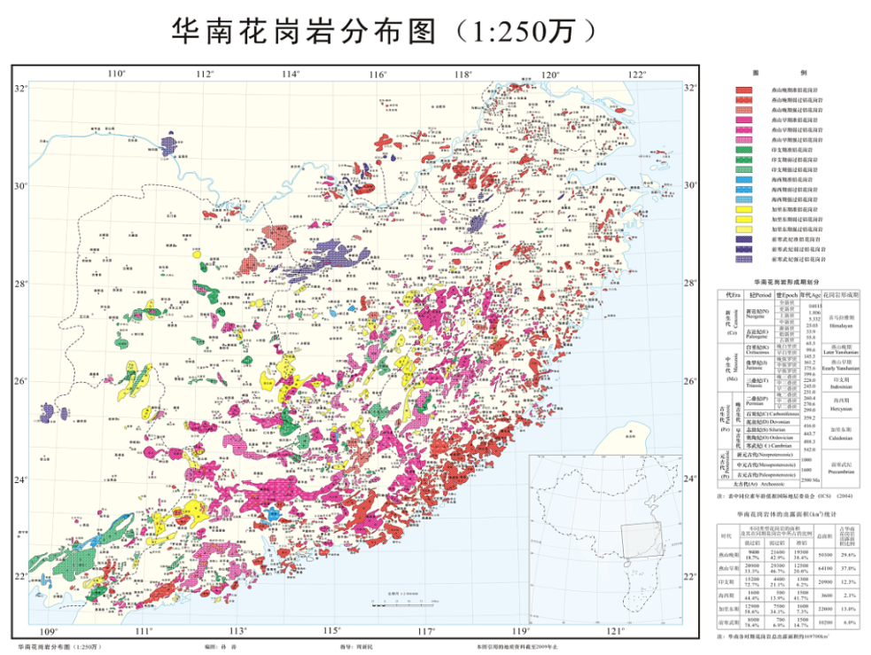
(孙涛，2006)

Slide 25
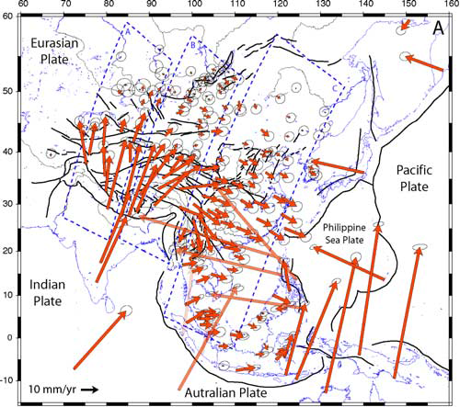
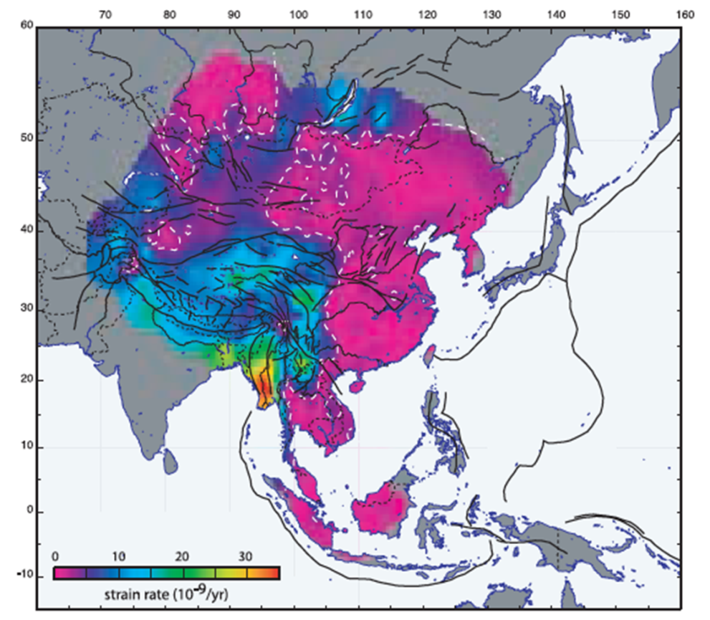
GPS velocities and strain rates in Asia
Crustal extrusion from Indo-Asian collision ends in N. Indochina, so is the intra-block crustal deformation
Calais et al., 2006

Slide 26
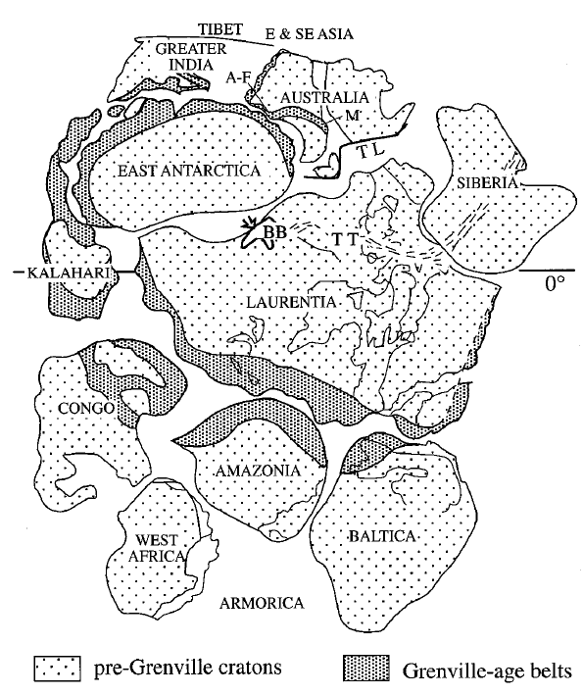

Slide 27
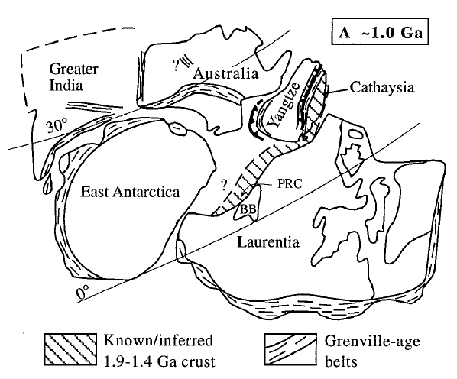
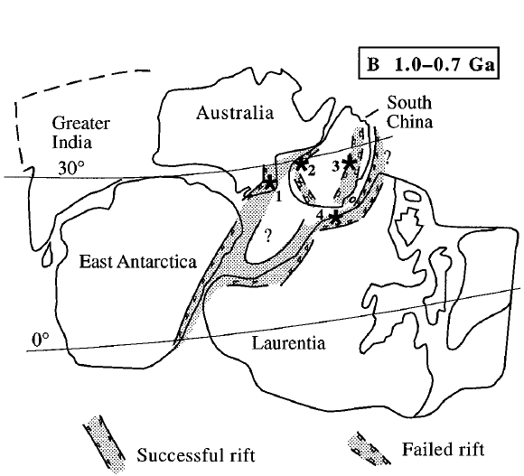

Slide 28
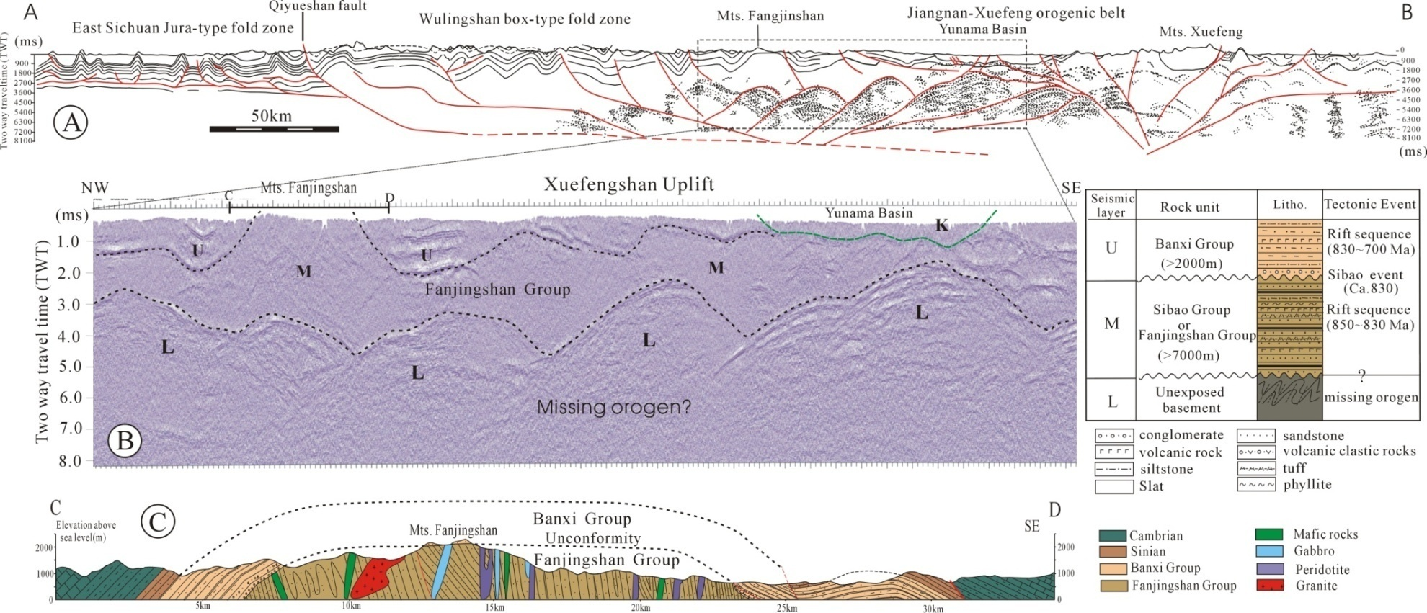
a possible Paleoproterozoic collisional orogen beneath Xuefenshan orogen
Fig. Interpretation of the reflection seismic profile A-B (location in Fig. 1). B: details of the reflection seismic image showing three layers delineated by seismic reflectors, indicated by letter U (upper layer), M (middle layer), and L (lower layer). The corresponding stratigraphy, lithology and tectonic events are shown in the right panel. C: Box fold section across the Mts FJS (Fangjingshan) to show folded outcrop of Sibao sequence corresponding to the middle layer of seismic reflectors.

Slide 29
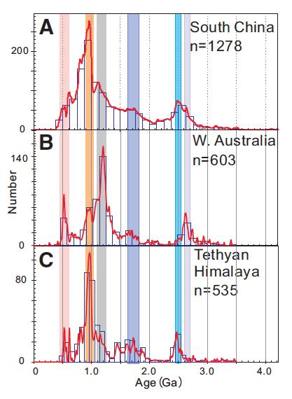
Carwood et al., 2013

Slide 30
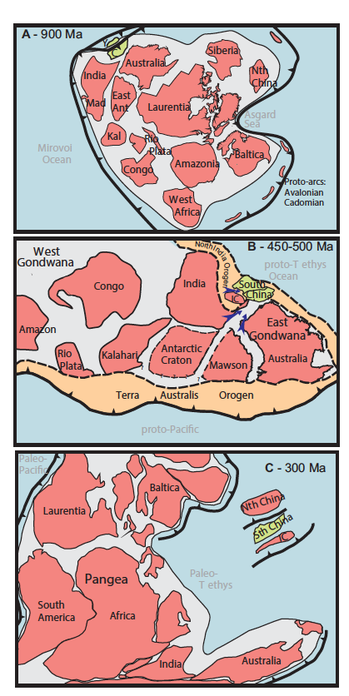
Carwood et al., 2013

Slide 31
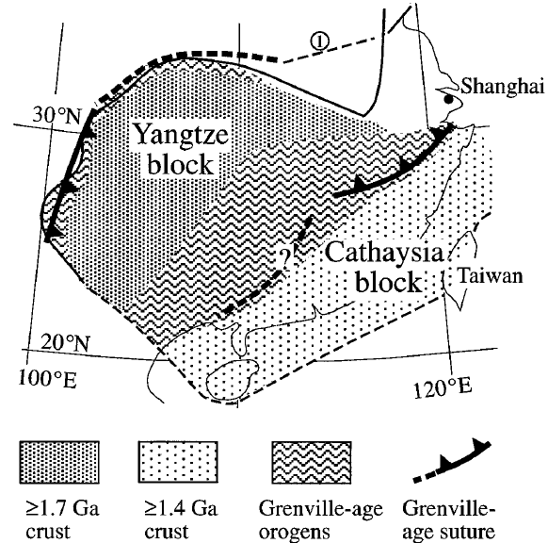

Slide 32
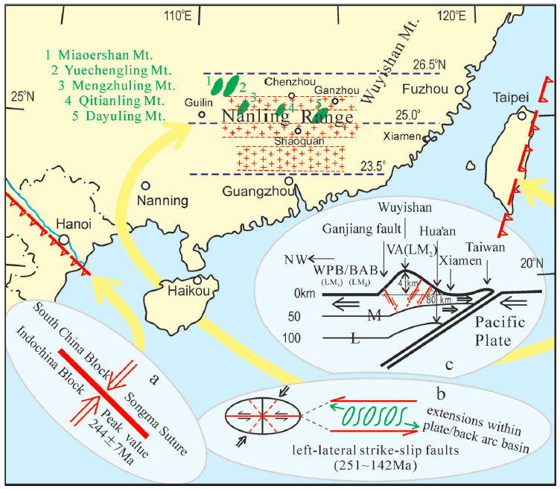
动力学研究：俯冲造山背景，古太平洋板块俯冲
陆-陆碰撞阶段和洋-陆俯冲阶段
水平俯冲与板片拆沉模式
210 Ma：
据沙金庚，1999
190 Ma
180-155 Ma
(Zhou XM et al., 2006)
(Li ZX & Li XH, 2007)

Slide 33
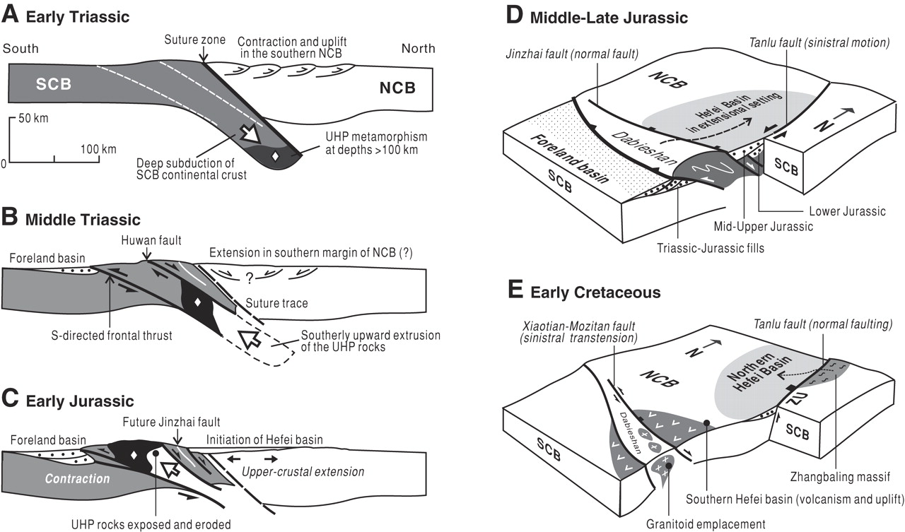
Mesozoic collision with the North China Block
Qing-Ren Meng et al. (2007)

