Slide 1
DA with MODE
ZHANG, Yuan WANG, Yiwei
2017-04-28

Slide 2
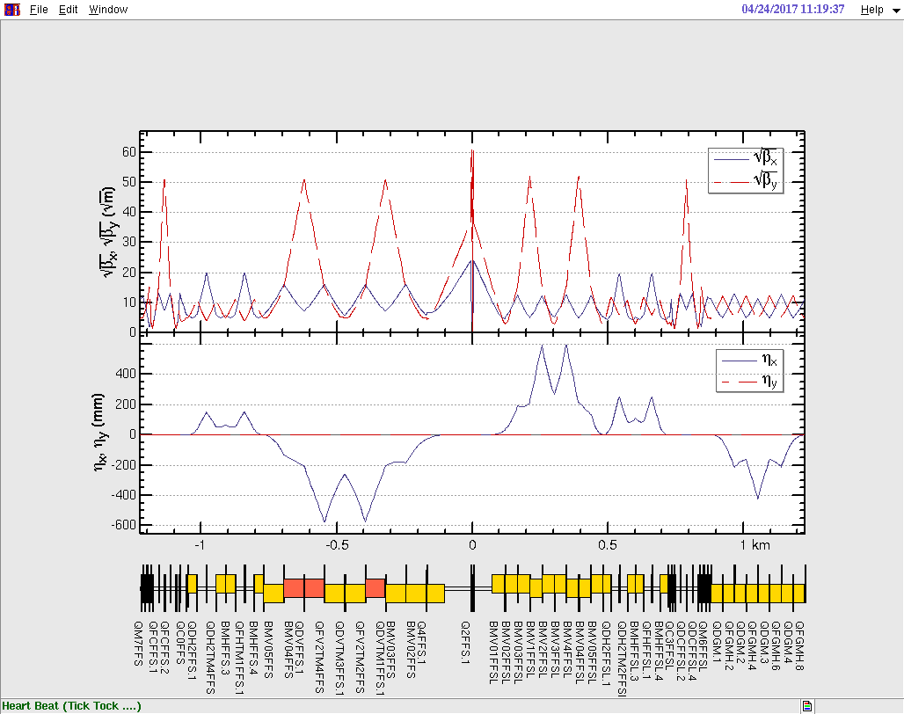
IR

Slide 3
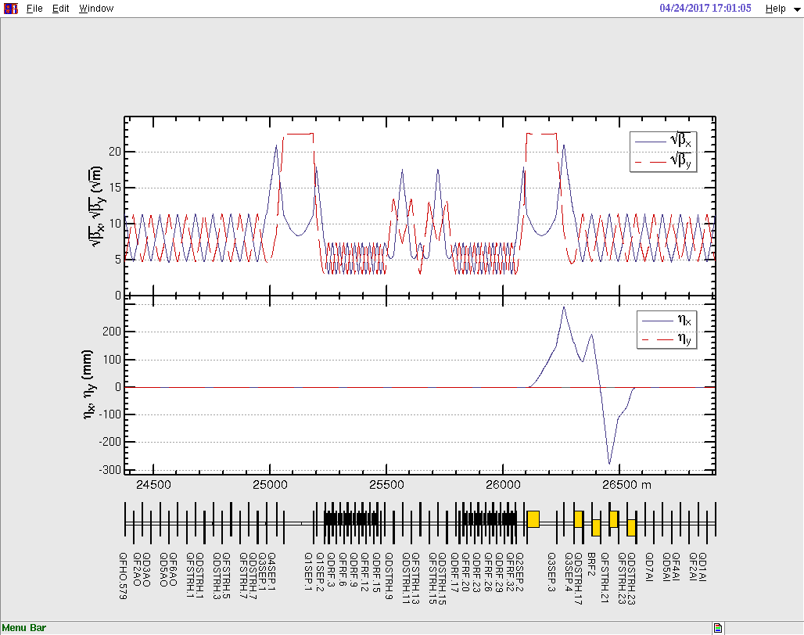
RF

Slide 4
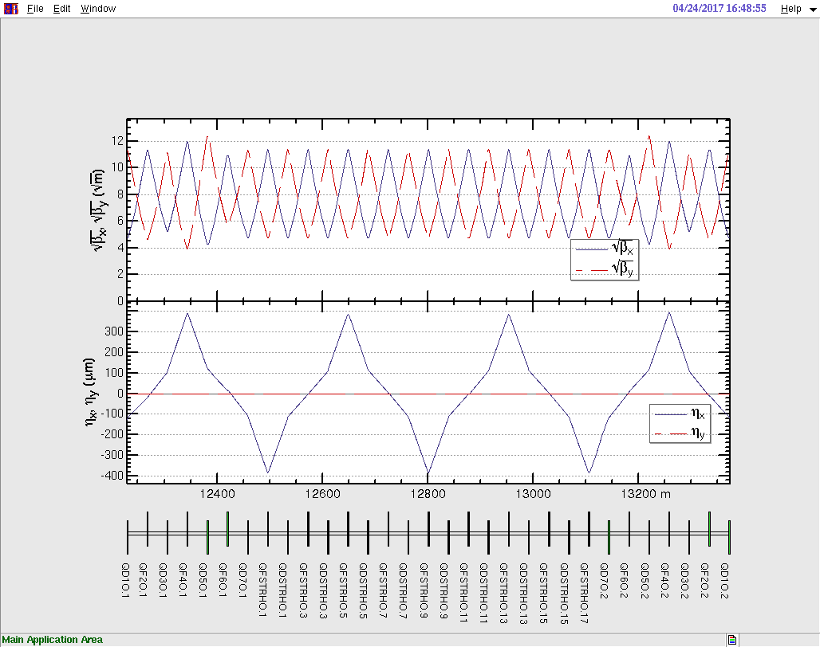
STR1

Slide 5
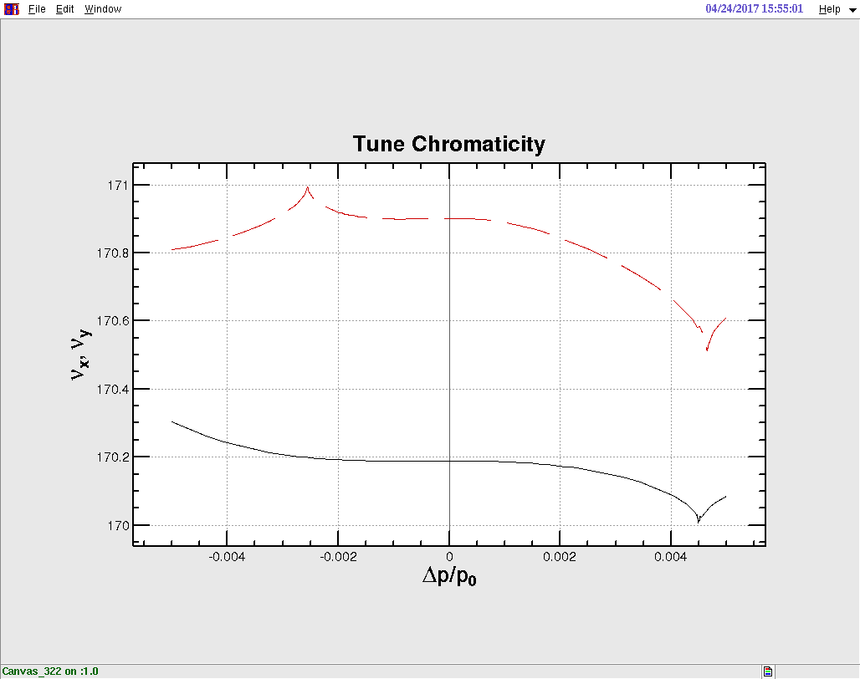
Chromaticity
Step1: Arc Sext , Chromaticity = 0 without IR
Step2: IR main sext,
Chromaticity = 0, ring

Slide 6
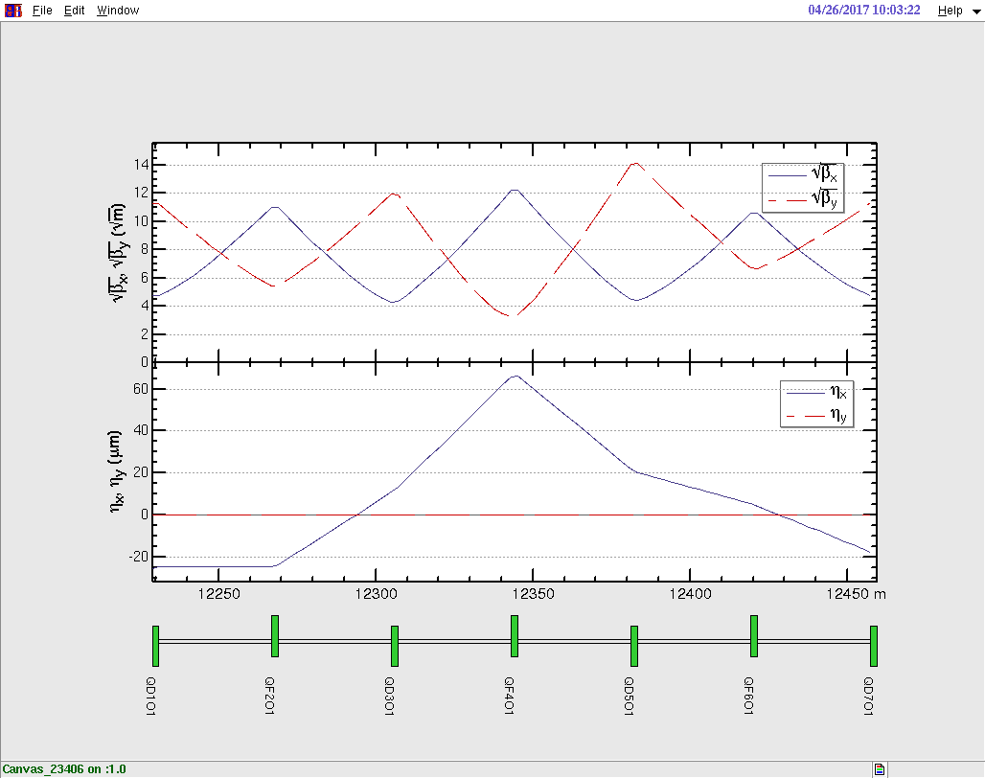
Tune -> 170.55/170.61

Slide 7
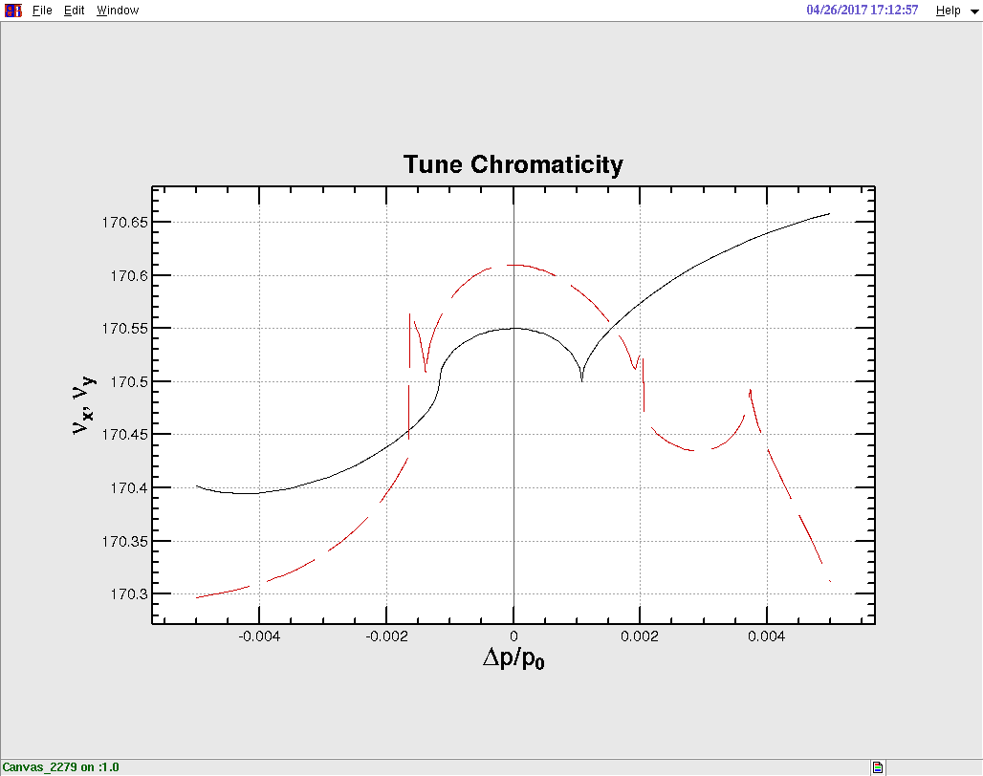
Chromaticity @ (0.55, 0.61)

Slide 8
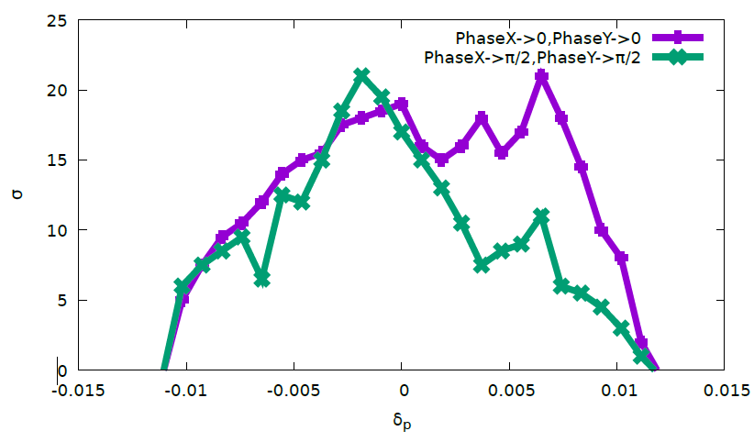
Optimize DA with IR sext and SFO/SDO/SFI/SDI

Slide 9
