Slide 1
Primary estimation of CEPC beam dilution and beam halo
Dou Wang
April. 28th, 2017

Slide 2
parameters for CEPC double ring
（wangdou20170426-100km_2mmβy）
 | Pre-CDR | Higgs | W | Z
Number of IPs | 2 | 2 | 2 | 2
Energy (GeV) | 120 | 120 | 80 | 45.5
Circumference (km) | 54 | 100 | 100 | 100
SR loss/turn (GeV) | 3.1 | 1.67 | 0.33 | 0.034
Half crossing angle (mrad) | 0 | 16.5 | 16.5 | 16.5
Piwinski angle | 0 | 3.19 | 5.69 | 4.29 | 11.77
N_{e}/bunch (10¹¹) | 3.79 | 0.968 | 0.365 | 0.455 | 0.307
Bunch number | 50 | 412 | 5534 | 21300 | 2770
Beam current (mA) | 16.6 | 19.2 | 97.1 | 465.8 | 408.7
SR power /beam (MW) | 51.7 | 32 | 32 | 16.1 | 1.4
Bending radius (km) | 6.1 | 11 | 11 | 11 | 11
Momentum compaction (10⁻⁵) | 3.4 | 1.14 | 1.14 | 4.49 | 1.14
β_{IP} x/y (m) | 0.8/0.0012 | 0.171/0.002 | 0.171 /0.002 | 0.16/0.002 | 0.171 /0.002
Emittance x/y (nm) | 6.12/0.018 | 1.31/0.004 | 0.57/0.0017 | 1.48/0.0078 | 0.18/0.0037
Transverse σ_{IP} (um) | 69.97/0.15 | 15.0/0.089 | 9.9/0.059 | 15.4/0.125 | 5.6/0.086
ξ_{x}/ξ_{y}/IP | 0.118/0.083 | 0.013/0.083 | 0.0055/0.062 | 0.008/0.054 | 0.006/0.054
RF Phase (degree) | 153.0 | 128 | 126.9 | 165.3 | 136.2
V_{RF} (GV) | 6.87 | 2.1 | 0.41 | 0.14 | 0.05
f _{RF} (MHz) (harmonic) | 650 | 650 | 650 (217800) | 650 (217800)
Nature σ_{z} (mm) | 2.14 | 2.72 | 3.37 | 3.97 | 3.83
Total σ_{z} (mm) | 2.65 | 2.9 | 3.4 | 4.0 | 4.0
HOM power/cavity (kw) | 3.6 (5cell) | 0.41(2cell) | 0.36(2cell) | 1.99(2cell) | 0.12(2cell)
Energy spread (%) | 0.13 | 0.098 | 0.065 | 0.037
Energy acceptance (%) | 2 | 1.5
Energy acceptance by RF (%) | 6 | 2.1 | 1.1 | 1.1 | 0.68
n_{γ} | 0.23 | 0.26 | 0.15 | 0.12 | 0.22
Life time due to beamstrahlung_cal (minute) | 47 | 52
F (hour glass) | 0.68 | 0.96 | 0.98 | 0.96 | 0.99
L_{max}/IP (10³⁴cm⁻²s⁻¹) | 2.04 | 2.0 | 5.15 | 11.9 | 1.1

Slide 3
Main sources of beam dilution and beam halo generation in CEPC
Beam-gas scattering → transverse distribution
Beam-gas bremsstrahlung → longitudinal distribution
Intrabeam scattering → transverse distribution + longitudinal distribution
Table1. CEPC Higgs parameters
Energy E0 (GeV) | 120
Circumference (km) | 100
Nature energy spread δ₀ | 9.8×10-4
Energy acceptance | 0.021
Average βx/βy (m) | 70/70
Horizontal emittance (nm) | 1.31
Vertical emittance (pm) | 4
Transverse damping time (ms) | 48
Longitudinal damping time (ms) | 24

Slide 4
Cross section of beam-gas scattering
The differential cross-section of the electron scattering with an gas atom is
where Z is the atomic number, r_{e} is the classical electron radius, γ is the relativistic Lorentz factor and θ_{min} is determined by the uncertainty principle as
Total cross-section:
Assuming , make an integration over one direction, one gets the differential cross-section for the other direction
Probability density

Slide 5
Distribution calculation
Assuming the CO gas is dominate for beam-gas scattering in CEPC, Z=50^{1/2} and n=2.
(Q—Residual gas density , n−the number of atoms in each gas molecule, P−the pressure of the gas)
Collision probability during one damping time
The distribution is decided only by two parameters!
—Scattering frequency
—Minimum scattering angle normalized by angular beam size

Slide 6
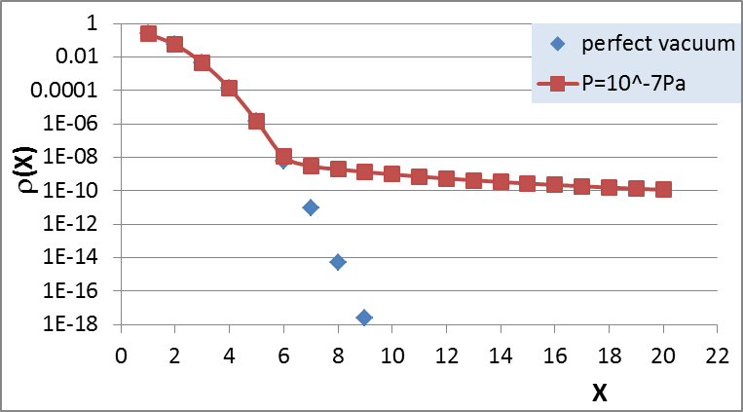
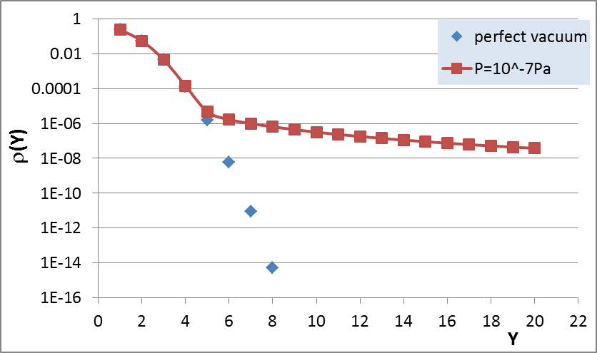
CEPC beam distribution due to beam-gas scattering
Average beta function was used.
Here and hereafter, the effect of local low beta insertion (FFS) was not included.
Coordinates were normalized by RMS beam size under zero current.
Horizontal emittance growth: 7E-6
Vertical emittance growth: 0.14%

Slide 7
Cross section and tail distribution due to beam-gas bremsstrahlung
The differential cross-section of beam-gas bremsstrahlung is
where ε is the energy loss due to bremsstrahlung.
(εmax is equal to the ring energy acceptance, εmin is a assumed value.)
Probability density
Energy distribution:

Slide 8
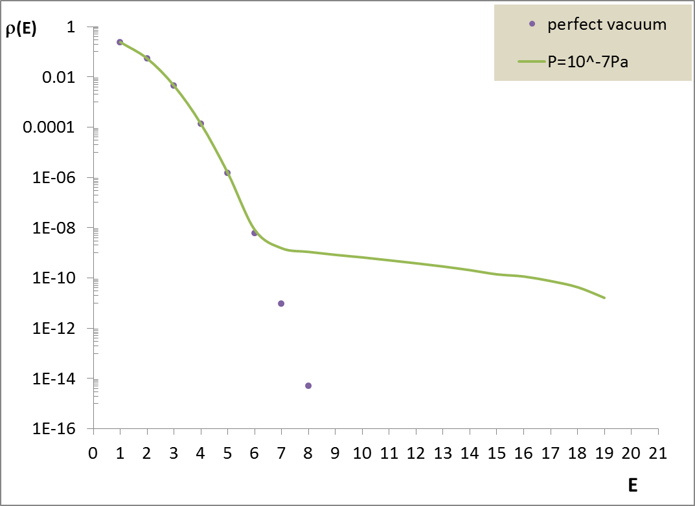
Energy distribution due to beam-gas bremsstrahlung
Almost no longitudinal emittance growth due to beam-gas bremsstrahlung.

Slide 9
IBS cross section for longitudinal direction
differential cross section of Coulomb scattering in the center-of-mass system
(Small angle scattering)
The angular change of the momentum gives a momentum component perpendicular to the horizontal axis
Where is the c.m. velocity of the electrons in units of c ( ) and is the momenta exchange from horizontal direction to the perpendicular directions in the center-of-mass frame.
✦ probability is same for transfers occurring in the vertical and longitudinal directions.
Total events of momenta exchange from horizontal direction to longitudinal direction per second:
Probability density function:

Slide 10
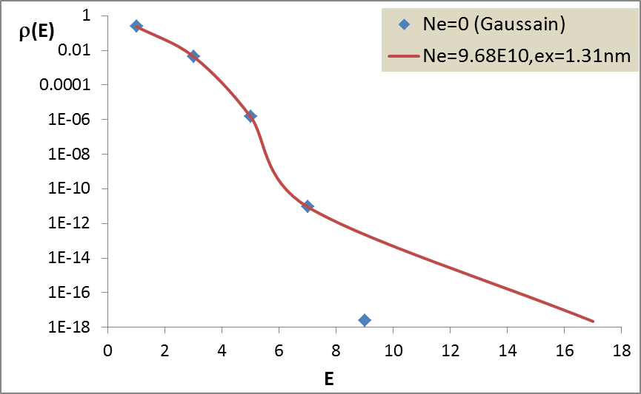
Energy distribution due to IBS
For CEPC, IBS has no contribution to longitudinal distribution.
Longitudinal distribution is dominated by beam-gas bremsstrahlung effect.

Slide 11
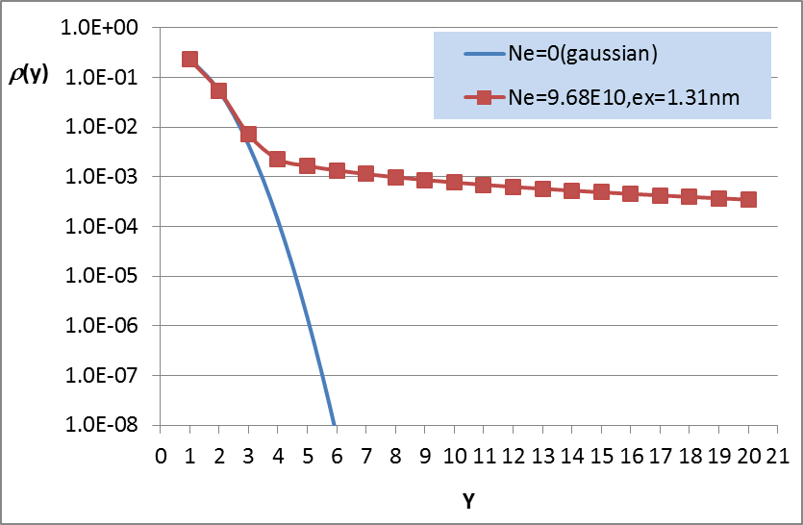
vertical distribution due to IBS
Vertical emittance growth: 102% !

Slide 12

Comparison with beam-gas scattering effect
IBS
Beam-gas scattering
For Higgs, vertical distribution is dominated by IBS.

