Slide 1

Outline of CEPC Calorimeters CDR
CEPC-Calo Group

Slide 2
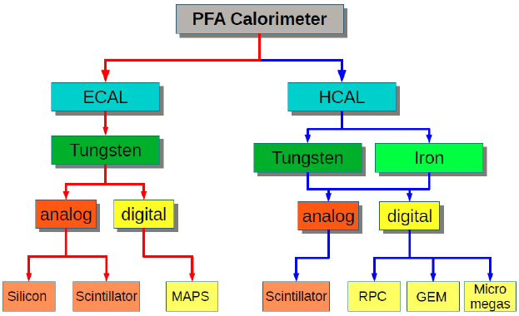

Calorimeters Options
ECAL with Silicon and Tungsten (LLR, France)
ECAL with Scintillator+SiPM and Tungsten (IHEP + USTC)
SDHCAL with RPC and Stainless Steel (SJTU + IPNL, France)
HCAL with ThGEM/GEM and Stainless Steel (IHEP + UCAS + USTC)
HCAL with Scintillator+SiPM and Stainless Steel (IHEP)
Dual readout calorimeters (INFN, Italy + Iowa, USA)
https://twiki.cern.ch/twiki/bin/view/CALICE/CalicePapers

Slide 3
Outline of Calorimeter CDR
General introduction of Calorimetry system
Electromagnetic calorimeters for PFA (Tao Hu, Jianbei Liu, Haijun Yang)
  General design, common geometry
  Optimization ( with Silicon ?) ( Manqi )
  Active sensor study
    Silicon tungsten sandwich calorimeter (Vincent Boudry)
    Scintillator tungsten sandwich calorimeter (Zhigang Wang, Yunlong Zhang)
  Performance of ECAL with TB data (Vincent Boudry)
Hadronic calorimeters for PFA (Tao Hu, Jianbei Liu, Haijun Yang)
  General design, common geometry
  Optimization ( with RPC ?) ( Manqi )
  Active sensor study
    DHCAL based on RPC (Imad Laktineh, Haijun Yang)
    DHCAL based on GEM (Jianbei Liu)
    Aanlog HCAL based on scintillator (Boxiang Yu)
  Performance of HCAL with TB data (Imad + Haijun)
Dual Readout calorimeter ( ? )
  General design and performance (Roberto Ferrari)
Summary

Slide 4
Backup Slides

Slide 5
Preparation for CEPC-Calo CDR
ECAL with Silicon and Tungsten
Editor: Vincent Boudry (LLR, France)
ECAL with Scintillator+SiPM and Tungsten
Editors: Tao Hu, Zhigang Wang (IHEP) + Yunlong Zhang (USTC)
SDHCAL with RPC and Stainless Steel
Editors: Haijun Yang (SJTU) + Imad Laktineh (IPNL, France)
HCAL with ThGEM/GEM and Stainless Steel
Editors: Jianbei Liu (USTC) + Boxiang Yu (IHEP)
HCAL with Scintillator+SiPM and Stainless Steel
Editor: Boxiang Yu (IHEP)
Dual readout calorimeters
Editor: Roberto Ferrari (INFN, Italy)

Slide 6
Calorimeters R&D Plan
Supported by MOST, NSFC and IHEP seed funds, about $ 1M
1. CEPC ScW ECAL simulation and optimization
- Optimization of ECAL: layers, Cell size, Scintillator thick etc.
- SiPM test and performance of scintillator strip
- Design of readout electronics
- Preparing for ScW ECAL module construction and beam test
2. CEPC DHCAL performance study and optimization
- Optimization of HCAL: layers, cell size
- Comparison of different technologies: RPC, GEM, Scintillator
- SDHCAL (RPC) TB data analysis for performance study
- Design of readout electronics
3. Need international collab. for CEPC Calo studies.

Slide 7
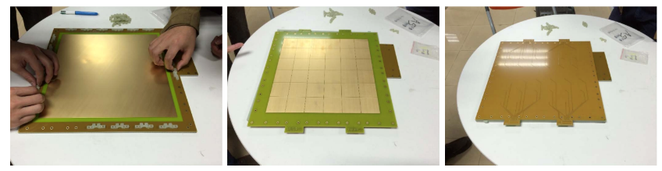
Recent Progress about Calorimeters
IHEP: studies of SiPM response curve, optimization of scintillator light outputs
USTC: design & test of readout electronics (PCB & FPGA firmware), construction of 30cm×30cm double-layer GEM, study of GEM displacement using mechanical simulation
SJTU: SDHCAL TB analysis and optimization of # of layers

