Slide 1
Stereo hit in Hough Tracking

Slide 2
Method
By 2D global fit , get a 2D circle track
With the 2D circle track , get calculate position of (z,s) of each stereo
Wire with 2 assumption(left,right)
By zs-fit , we can fit a straight line in zs space
Multi-turn track is far from the straight line

Slide 3
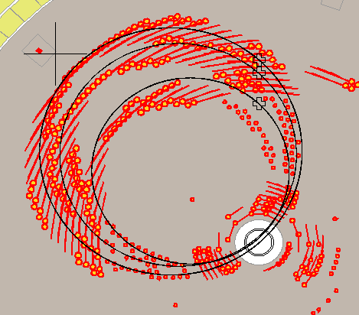
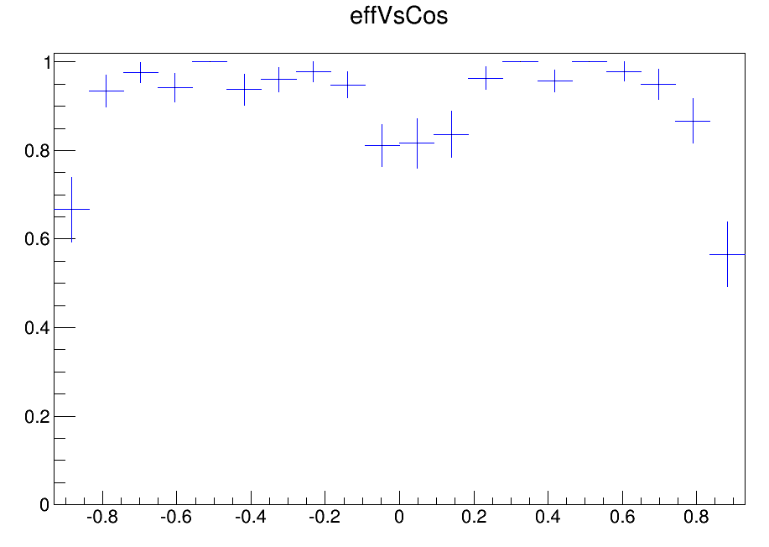
learn 100MeV fixpt
Event sample
1000 events
Fixpt from 100
No decay
No delta e-
Mix background
|cos|<0.2 : most are multi-turn tracks

Slide 4
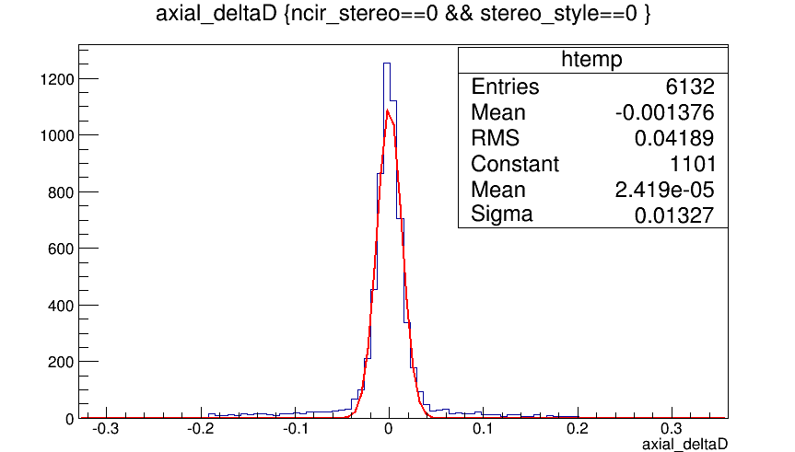
Axial wire spacial resolution after global2D
Spacial resolution ~ 0.13mm
2D information is accurate for 3D hit select

Slide 5
Stereo hit position calculation
Method is finished before
Amend the method ( little effect)
Drift circle
Stereo wire in xy plane
track

Slide 6
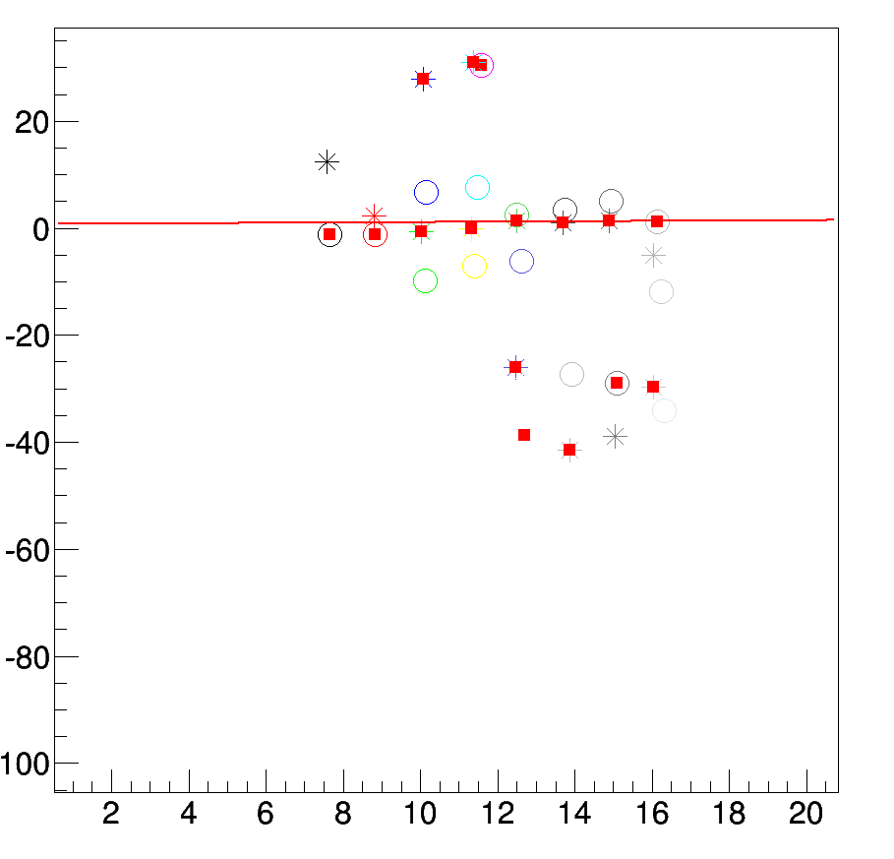
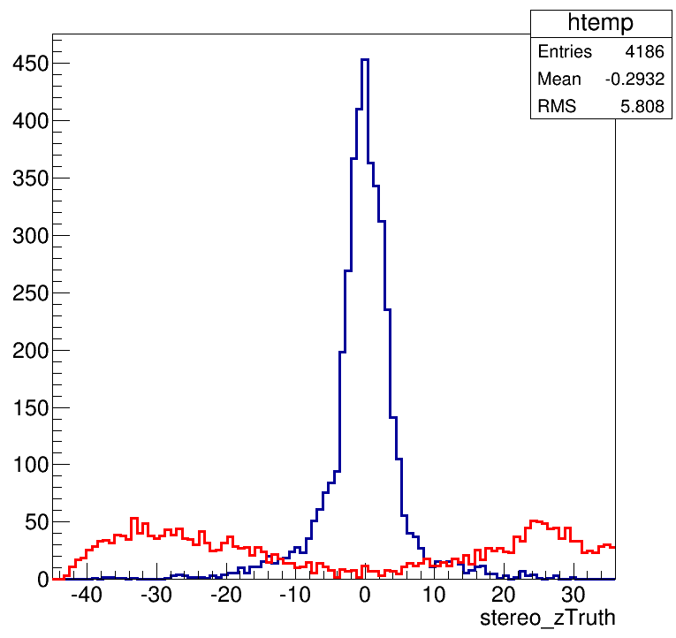
ZS place
Z : hit z position of stereo wire
S: hit s position of stereo wire
The z position of the 1st turn track are close
to z =0 , the 2nd turn track hit far from z =0
Position of (s,z) of the (0~8) layer
Z(cm)
Ztruth( use right ambig) distribution
1st hit & 2nd hit
S(cm)

Slide 7
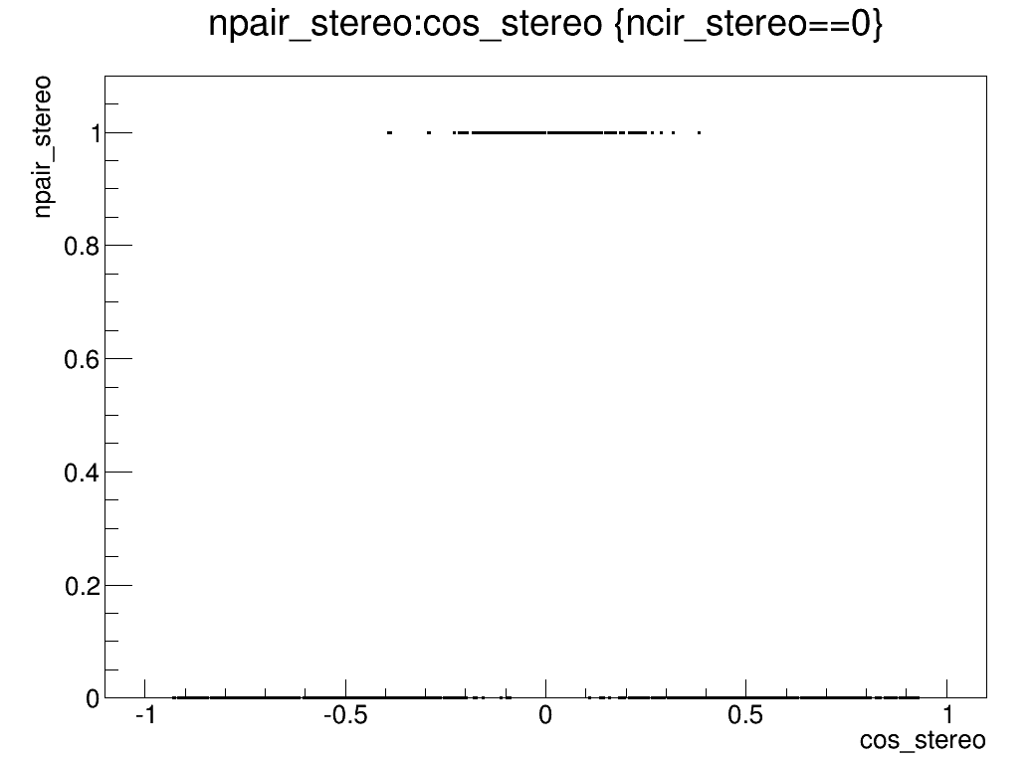
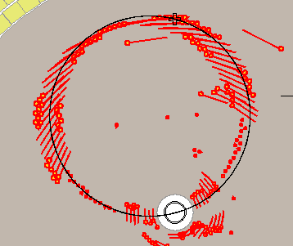
Judge track if make turns in MDC
Find if there is some hits in the other side
Each super layer collect 2 hits in the other side : track makes turns
Npaire_stereo==1 : judge as a turn track

Slide 8
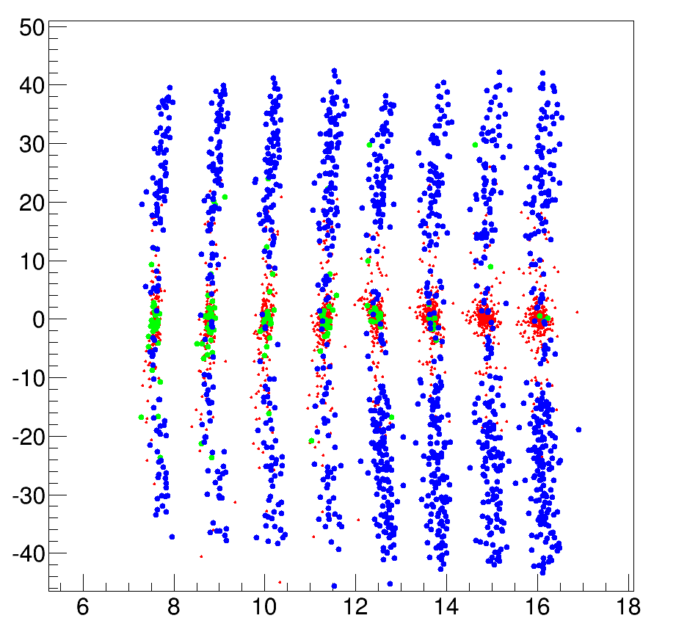
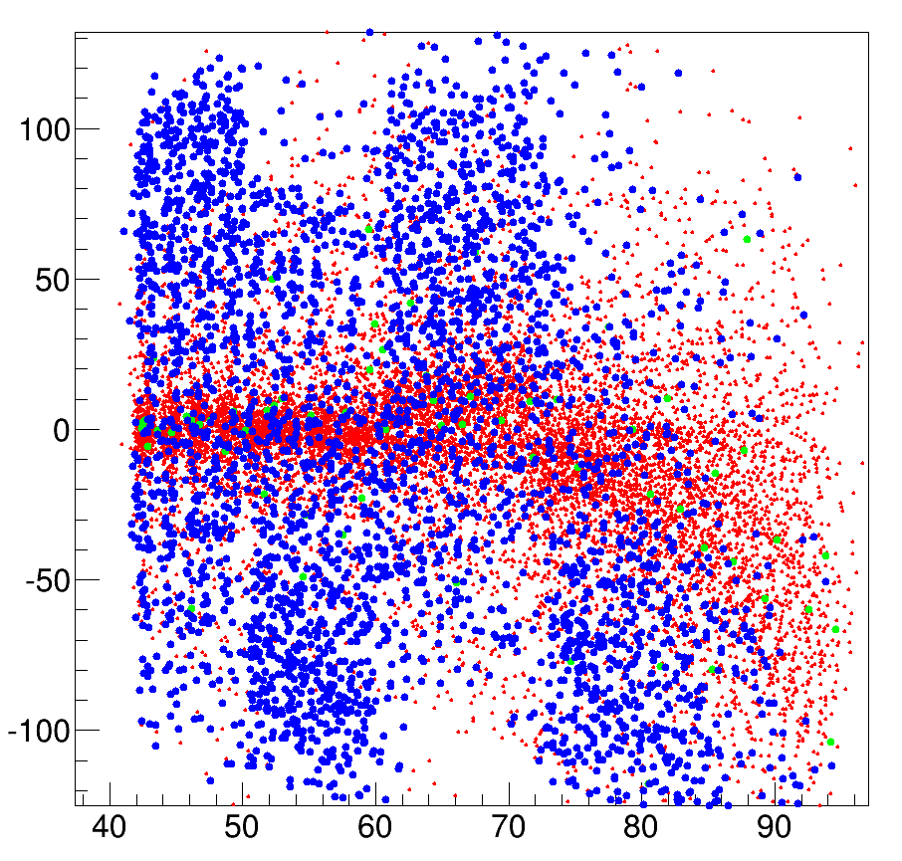
Zs fit && hit select
Drop stereo hit when both (zleft,zright) > 10cm
Zs fit method as the old method
deltaZ : distance of z position to the fit line
Red : 1st half circle hits
Green : noise hit
Blue: 2nd half circle hits
deltaZ vs flight length
deltaZ vs flight length

Slide 9
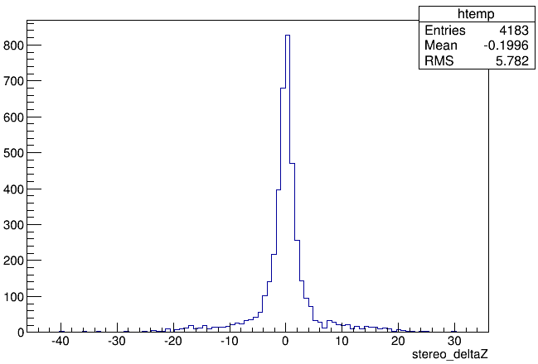
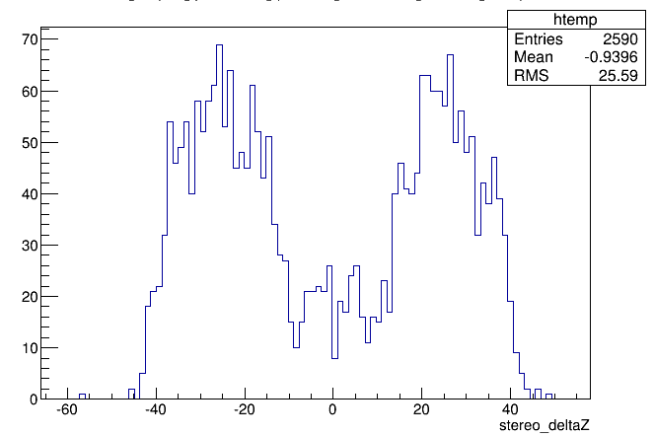
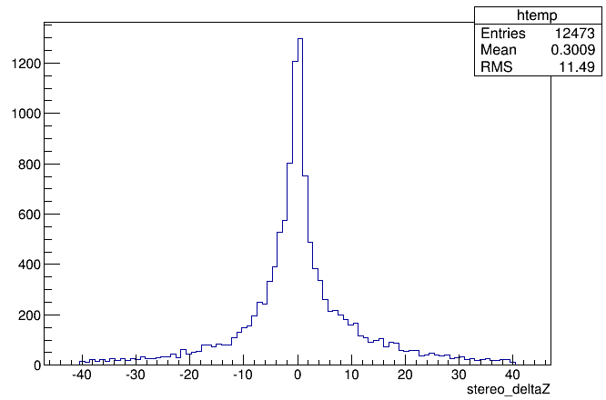
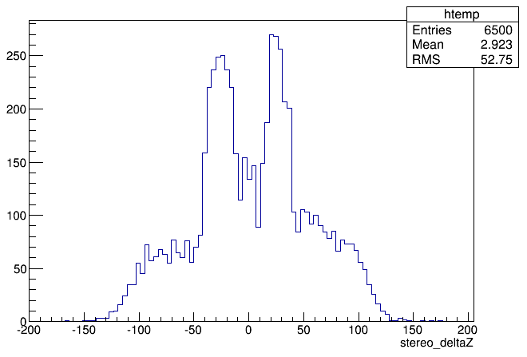
DeltaZ cut to tell 1st from 2nd
1st
Layer<8
2nd
Layer<8
Layer<30
Layer<30

Slide 10
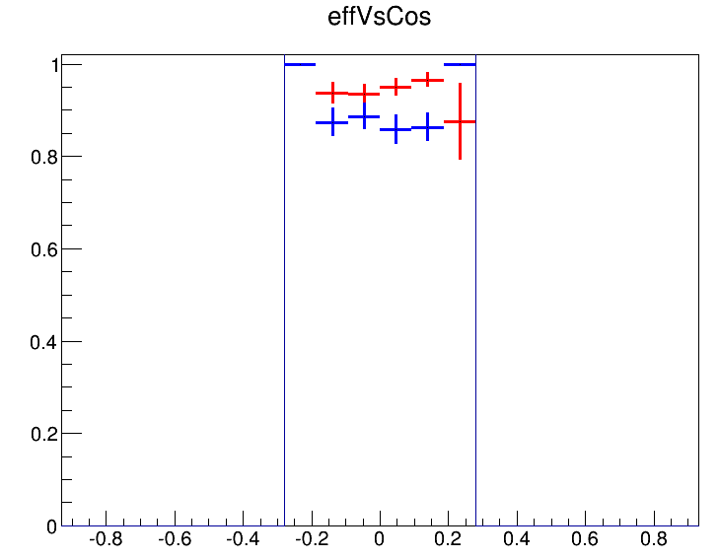
Tracking condition(only Hough method)
Event sample
500 events
Fixpt from 100 MeV
No decay
No delta e-
Mix background
|cos|<0.2
Track quality cut
pt: |Δpt|<10MeV
P: |Δp |<15MeV
Vr: |Δvr|<1cm
Vz: |Δvz|<10cm
Efficiency definition:
at least one track in the event pass quality cut
94.6%
87.8%

Slide 11
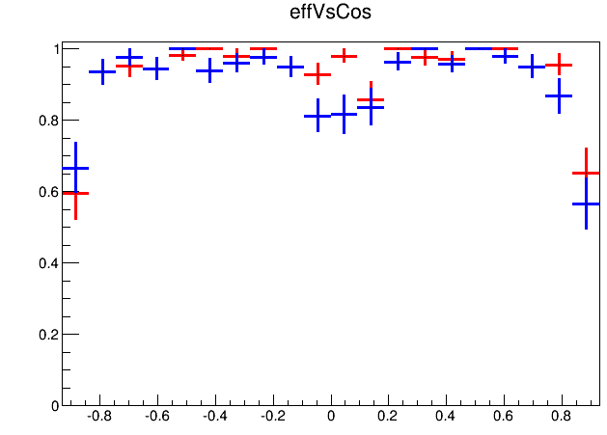
Tracking condition
Event sample
1000 events
Fixpt 100 MeV
No decay
No delta e-
Mix background
Track quality cut
pt: |Δpt|<10MeV
P: |Δp |<15MeV
Vr: |Δvr|<1cm
Vz: |Δvz|<10cm
Efficiency definition:
at least one track in the event pass quality cut
93.4%
90.6%

Slide 12
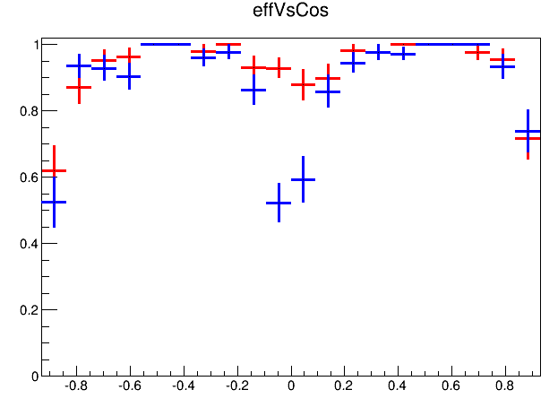
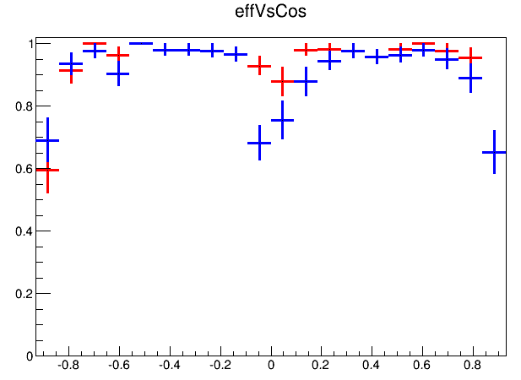
Other pt
110MeV
120MeV
87.7%
93.5%
90.0%
93.5%

