Slide 1
Rb measurement at CEPC MC Level
Bo Li

Slide 2
Outline
Basic information
Btag performance
Method

Slide 3
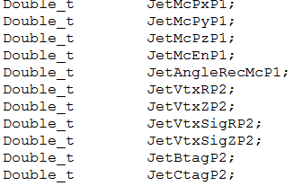
Basic information
简介
MC samples:Zbb,Zcc,Zll
Produced from FSClasser with command : ” Marlin *.xml”
The Z boson hadronic events root file:
Including the final particle information:
Such as the lepton Pt, jet Pt, jet tag prob ..
~140,000 events are produced

Slide 4
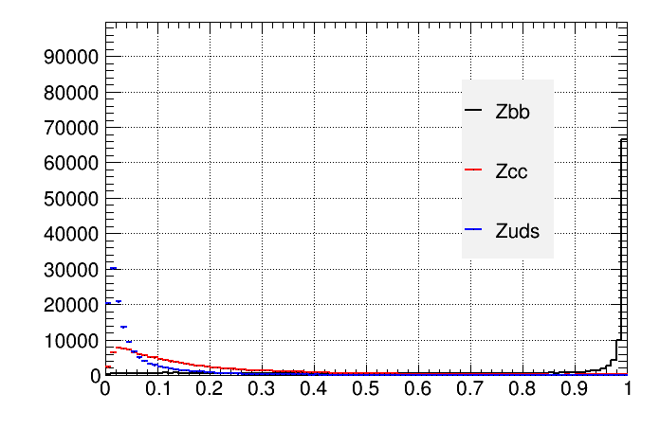
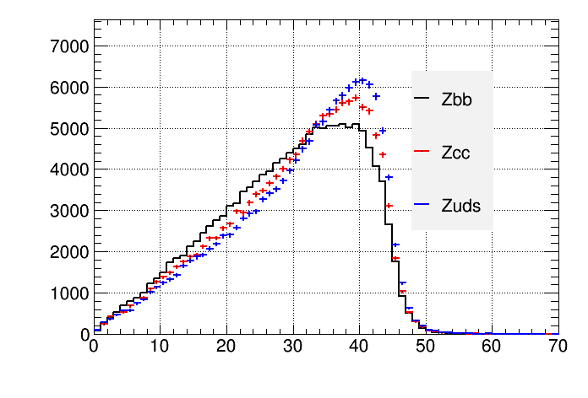
Btagging performance
Variable in Zbb,Zcc,Zll
JetBtag Prob
JetPt
all the 2jets
The BtagProb are different for Zbb, Zcc and Zll
Four BtagProb Work Point are used :
The BtagProb>0.6 , BtagProb>0.7, BtagProb>0.8, BtagProb>0.9

Slide 5
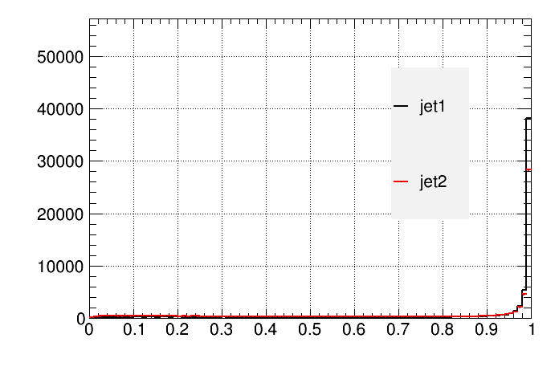
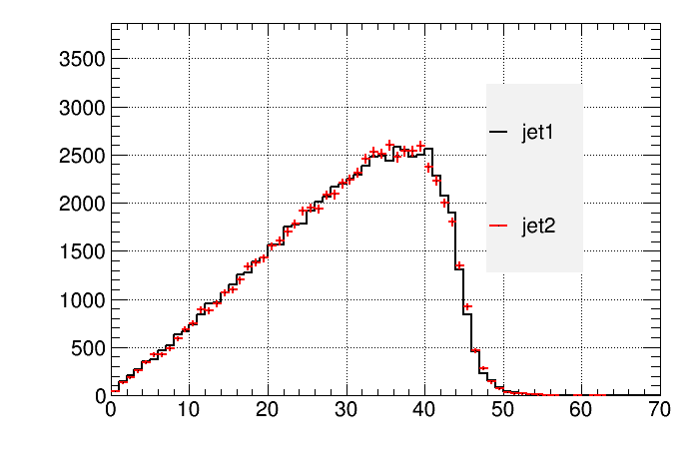
Btagging performance
Variable of jet1, jet2 in Zbb
JetBtag Prob
JetPt
Jet1 vs jet2

Slide 6
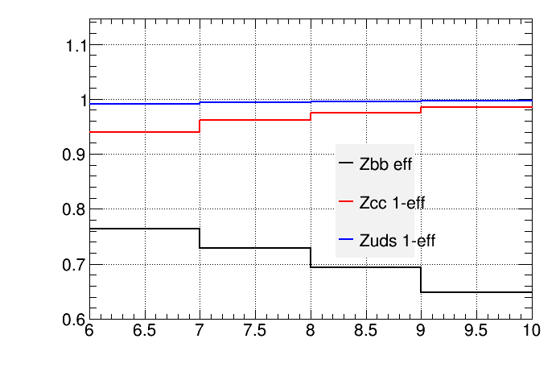
Btagging performance
Effency and rejection for Zbb,Zcc,Zll
The Zll rejction at four work point are ~100%
 | Prob>0.6 | Prob>0.7 | Prob>0.8 | Prob>0.9
Zbb_eff | 0.7640 | 0.7294 | 0.6931 | 0.6488
Zcc_Rej: | 0.9402 | 0.9610 | 0.9755 | 0.9858
Zll_Rej | 0.9911 | 0.9941 | 0.9959 | 0.9973

Slide 7
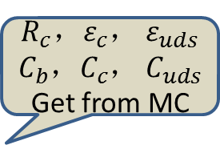
Rb method
简介
Get From Mixed MC Sample
$R_{c}，ε_{c}$， $ε_{uds}$ $C_{b}$，$C_{c}$， $C_{uds}$
Get from MC
$$\frac{N_{t}}{2N_{had}}=R_{b}ε_{b}+R_{c}ε_{c}+\left(1−R_{b}−R_{c}\right)ε_{uds}$$
$$\frac{N_{tt}}{N_{had}}=C_{b}R_{b}ε_{b}^{2}+{C_{c}R}_{c}ε_{c}^{2}+C_{uds}\left(1−R_{b}−R_{c}\right)ε_{uds}^{2}$$
$$C_{b}=\frac{ε_{2jet−tagged}}{{(ε_{1jet−tagged})}^{2}}$$
1.015 1.021 1.026 1.033
Following this procedure, we can measured the $R_{b}{ , ε}_{b}$
The Z hadronic ‘DATA’ is mixed by MC samples: Zbb sample1, Zcc sample1, Zll sample1
We set Rb=0.3, Rb=0.5, Rb=0.7 as the Input Rb to mix the ‘DATA’
The $R_{c}，ε_{c}$ ${, C}_{b}$，$C_{c}$， $C_{uds}$ is gotten by MC samples: Zbb sample2, Zcc sample2, Zllsample2
So if sample1≠ sample2，which means the MC $R_{c}，ε_{c}$ ${, C}_{b}$，$C_{c}$， $C_{uds}$ are different from the Truth in ‘DATA’

Slide 8
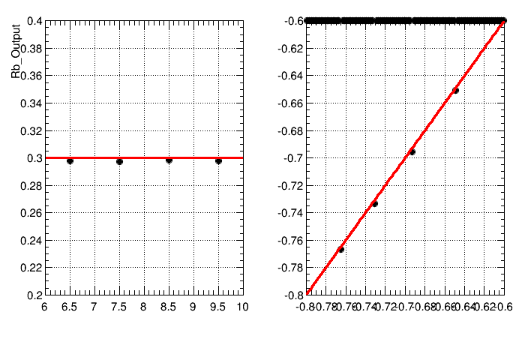
Btagging performance
IO test
Input Rb=0.3, Four BtagProb work point: Prob>0.6, >0.7, >0.8, >0.9
Input Rb: 0.3000
Output Rb: 0.2981 0.2975 0.2984 0.2980
Input eff: 0.7643 0.7300 0.6936 0.6480
Output eff: 0.7668 0.7333 0.6956 0.6508

Slide 9
Btagging performance
IO test
Input Rb=0.5, Four BtagProb work point: Prob>0.6, >0.7, >0.8, >0.9
Input Rb: 0.5000
Output Rb: 0.4985 0.4981 0.4988 0.4980
Input eff: 0.7643 0.7300 0.6936 0.6480
Output eff: 0.7657 0.7316 0.6946 0.6501

Slide 10
Btagging performance
IO test
Input Rb=0.7, Four BtagProb work point: Prob>0.6, >0.7, >0.8, >0.9
Input Rb: 0.7000
Output Rb: 0.6988 0.6988 0.6991 0.6979
Input eff: 0.7643 0.7300 0.6936 0.6480
Output eff: 0.7652 0.7308 0.6942 0.6498

Slide 11
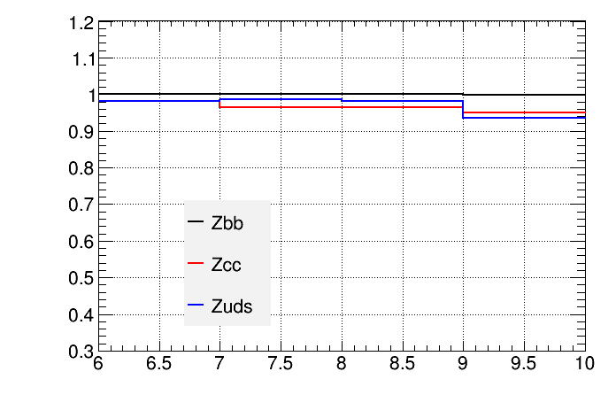
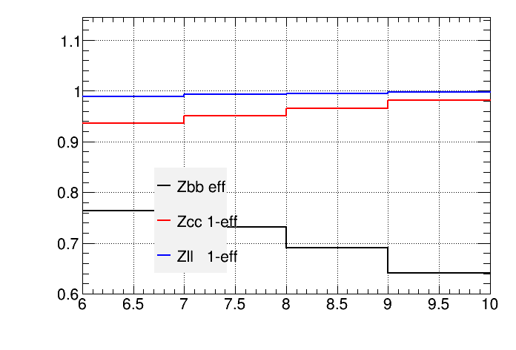
Result
the measured Rb and effb in DATA are different from the Input Truth Rb and effb at Prob>0.9
The $R_{c}，ε_{c}$ ${, C}_{b}$，$C_{c}$， $C_{uds}$ is got by MC samples: Zbb sample2, Zcc sample2, Zllsample2
So if DATA sample1≠ sample2，which means the MC $R_{c}，ε_{c}$ ${, C}_{b}$，$C_{c}$， $C_{uds}$ is different from the ‘DATA’
The difference as a Ratio: Eff in ‘DATA’/ Eff in MC
${ ε}_{b}$ difference between DATA and MC are very small
$ε_{c}$ and $ε_{uds}$ differences are big at Prob>0.9 :
which may come from the very low statistics after Btagging
which will lead to the difference in the IO test
$ε_{uds}$ effect is very small, as The Zll rejction at four work point are ~100%

Slide 12
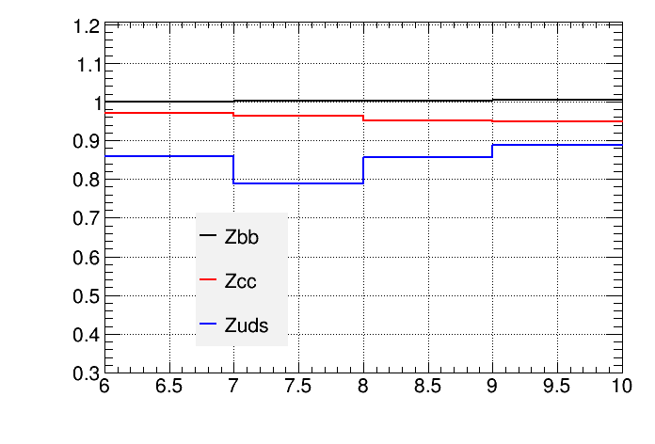
Result
We can see the measured Rb and effb in DATA are different from the Input Truth Rb and effb
The $R_{c}，ε_{c}$ ${, C}_{b}$，$C_{c}$， $C_{uds}$ is got by MC samples: Zbb sample2, Zcc sample2, Zllsample2
So if sample1≠ sample2，which means the MC $R_{c}，ε_{c}$ ${, C}_{b}$，$C_{c}$， $C_{uds}$ is different from the ‘DATA’
10k events in the past
The difference as a Ratio: Eff in ‘DATA’/ Eff in MC
${ ε}_{b}$ difference between DATA and MC are very small
$ε_{c}$ and $ε_{uds}$ difference are very big:
which may come from the very low statistics after Btagging
which will lead to the difference in the IO test
$ε_{uds}$ effect is very small, as The Zll rejction at four work point are ~100%

Slide 13
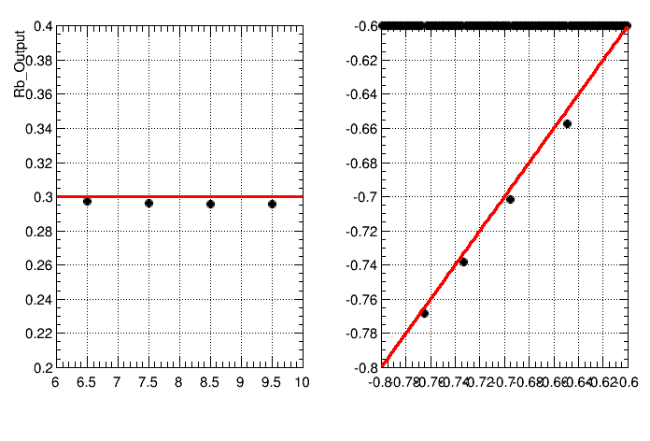
Check
Input Rb=0.3
We redo the IO test by ‘DATA’ and MC with same Zcc sample
Zcc DATA Sample≠ Zcc MC Sample
Zcc DATA Sample= Zcc MC Sample
We can see the differences of measured Rb and effb between DATA and MC are smaller

Slide 14
Check
Input Rb=0.5
Zcc DATA Sample= Zcc MC Sample

Slide 15
Check
Input Rb=0.7
Zcc DATA Sample= Zcc MC Sample

Slide 16
Summary
The IO test shows Analysis code worked as expected.
Increase the statistics of ‘DATA’ and MC.
Study the FSClasser: know well about the procedure at event reconstruction level.

Slide 17
backup

Slide 18
backup
‘DATA’ and MC all are used the same sample

