Slide 1
Progress on DA Optimization with MODE
ZHANG, Yuan WANG, Yiwei
2017-05-05

Slide 2
1. Optimize DA with IR sext and SFO/SDO/SFI/SDI (2017-04-28)
12 Knob: 8 IR sextupoles + 4 Arc sextupoles

Slide 3
2. Optimize DA with 4*(SFO/SDO)+4*(SFI/SDI)
16 Knob: 16 Arc sextupoles

Slide 4
3. Optimize DA with IR sext and IR multipole
30 Knob: 8 IR sextupoles + 22 IR multipoles(k2)

Slide 5
4. Optimize DA with Arc sext 8*(SFO/SDO)+8*(SFI/SDI)
32 Knob: 32 arc sextupoles

Slide 6
5. Optimize DA with all the used knobs
62 Knob: 30 IR + 32 arc sextupoles

Slide 7
II. DA optimization with chromaticity constraint

Slide 8
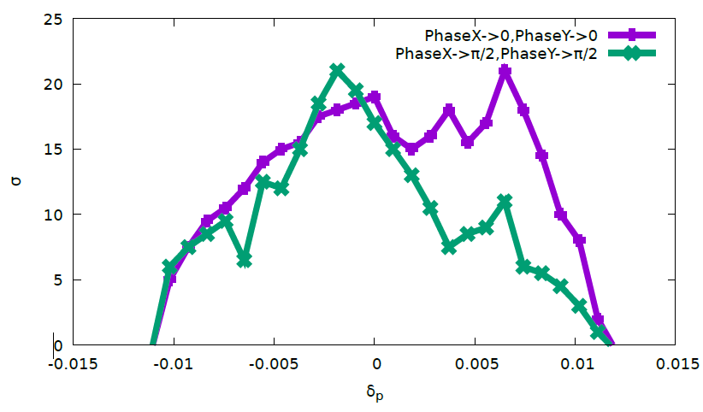
II.1 Optimize DA with IR sext and SFO/SDO/SFI/SDI
12 Knob: 8 IR + 4 arc sextupoles

Slide 9
II.2 Optimize DA with IR sext and 4*(SFO/SDO)+4*(SFI/SDI)
24 Knob: 8 IR + 16 arc sextupoles

Slide 10
II.3 Optimize DA with IR sext/mult and 4*(SFO/SDO)+4*(SFI/SDI)
46 Knob: 8 IR sext + 22 IR Mult(k2) + 16 arc sextupoles

Slide 11
MEMO
RFSW
RAD
DAMPONLY
DAPWIDTH=7
Turns=100 (halfring)

