Slide 1
Progress on DA Optimization with MODE
ZHANG, Yuan WANG, Yiwei WANG, Dou GENG, Huiping
2017-05-12

Slide 2
II.3 Optimize DA with IR sext/mult and 4*(SFO/SDO)+4*(SFI/SDI)
2017-05-05
控制色品，优化孔径
46 Knob: 8 IR sext + 22 IR Mult(k2) + 16 arc sextupoles

Slide 3
II.4 Optimize DA with IR sext/mult and 8*(SFO/SDO)+8*(SFI/SDI)
46 Knob: 8 IR sext + 22 IR Mult(k2) + 32 arc sextupoles

Slide 4
III.1 Optimize DA with IR sext and SFO/SDO/SFI/SDI + IR knobs(Cai)
24 Knob: 8 IR sext + 4 arc sextupoles + 4 IR multipoles(K1/K2/K3)

Slide 5
III.2 Optimize DA with IR sext + 4*(SFO/SDO)+4*(SFI/SDI) + IR knobs(Cai)
36 Knob: 8 IR sext + 16 arc sextupoles + 4 IR multipoles(K1/K2/K3)

Slide 6
III.3 Optimize DA with IR sext/mult and 4*(SFO/SDO)+4*(SFI/SDI)+IR knobs(Cai)
58 Knob: 8 IR sext + + 4 IR multipoles(K1/K2/K3) + 22 IR Mult(k2) + 16 arc sextupoles

Slide 7
III.4 Optimize DA with IR sext/mult and 8*(SFO/SDO)+8*(SFI/SDI)+IR knobs(Cai)
70 Knob: 8 IR sext + 4 IR multipoles(K1/K2/K3) + 18 IR Mult(k2) + 32 arc sextupoles

Slide 8
Cai Chromaticity Knobs: k1/k2/k3 of multipole

Slide 9
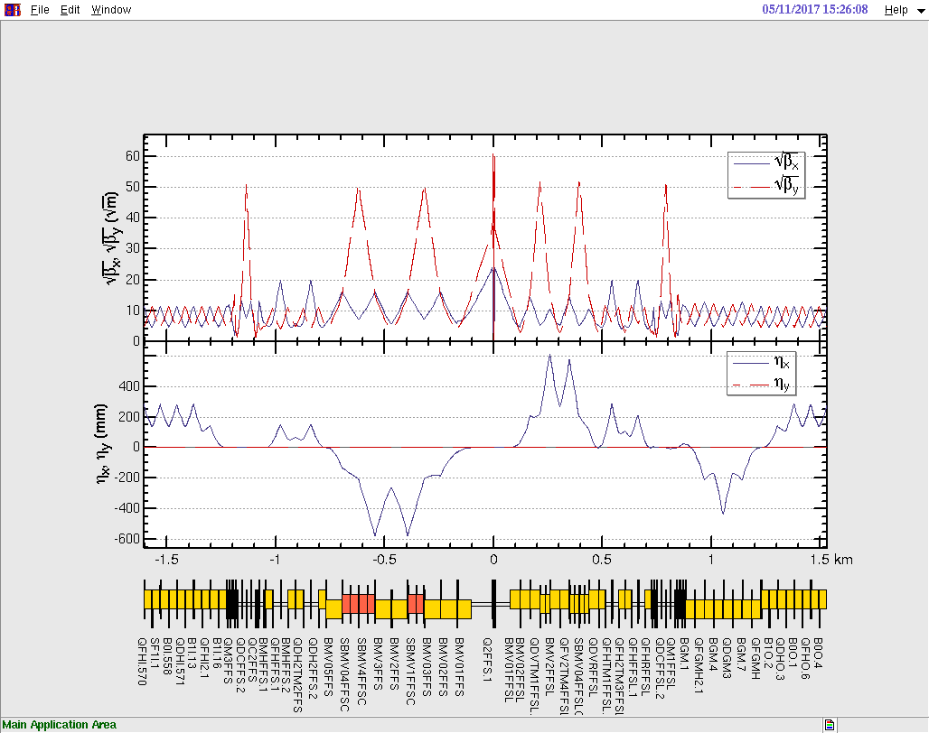
Optics Distortion in IR

Slide 10
MEMO
RFSW
RAD
DAMPONLY
DAPWIDTH=7
Turns=100 (halfring)

