Slide 1
CEPC DA optimization
Dou Wang, Yuan Zhang, Yiwei Wang, Huiping Geng,Chenghui Yu
2017.05.05

Slide 2
DA before optimization (lattice 1)
No damping
240 turns
With damping

Slide 4
DA after optimization (lattice 1)
No damping
240 turns
With damping

Slide 5
DA before optimization (lattice 2)
No damping
240 turns
With damping

Slide 6
DA after optimization (lattice 2)
No damping
240 turns
With damping

Slide 7
DA before optimization (lattice 3)
With damping
50 turns

Slide 8
DA after optimization (lattice 3)
With damping
50 turns

Slide 9
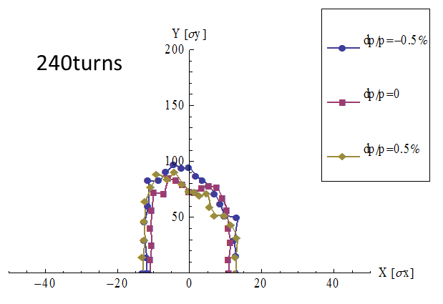

Slide 10
320turns

Slide 11
480turns

