Slide 1
Work report
Miao NanNan
2017.05.18

Slide 2
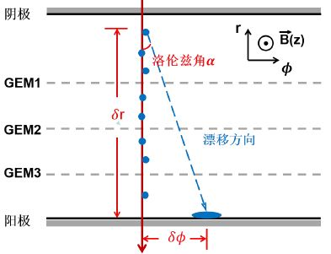
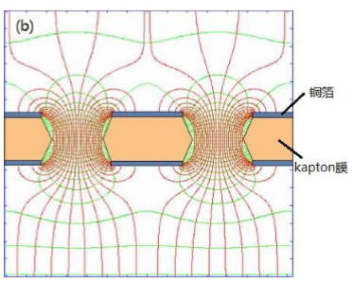
Distribution of electrons (end point)in r direction
Cathode
track
Simulation：
Magnetic field is 1Tesla
Avalanche simulation：AvalancheMicroscopic
Gas mixture：
Argon 90%+iC4H10 10%
Drift
5mm
Copper
Transfer1
2mm
x
Kapton
Transfer2
2mm
Induction
2mm
Anode
Lia’ geometry
Simulate 2000 electrons of each Gem separately.

Slide 3
Gain
Gem1
Lia’ geometry
Only produce one electron and it do not get through the Gem hole. Percentage is about 4.4%
Percentage is about 12.2%

Slide 4
Gain
Gem2
Lia’ geometry
Percentage is about 17.0%
Percentage is about 30.1%

Slide 5
Gain
Gem3
Lia’ geometry
Percentage is about 16.3%
Percentage is about 29.4%

Slide 6
Avalanche shift(mean) and size(RMS)
Simulate 2000 electrons from 150um before Gem1 to 150um after Gem1
Avalanche shift in 𝜙 direction
Avalanche size in 𝜙 direction
Avalanche shift in Z direction
Avalanche size in Z direction

Slide 7
Avalanche shift(mean) and size(RMS) --lia’s geometry
Simulate 2000 electrons from 150um before Gem1 to 150um after Gem1
Avalanche shift in 𝜙 direction
Avalanche size in 𝜙 direction
Avalanche shift in Z direction
Avalanche size in Z direction

Slide 8
Avalanche shift(mean) and size(RMS)
Simulate 2000 electrons from 150um before Gem2 to 150um after Gem2
Avalanche shift in 𝜙 direction
Avalanche size in 𝜙 direction
Avalanche shift in Z direction
Avalanche size in Z direction

Slide 9
Avalanche shift(mean) and size(RMS) --lia’s geometry
Simulate 2000 electrons from 150um before Gem2 to 150um after Gem2
Avalanche shift in 𝜙 direction
Avalanche size in 𝜙 direction
Avalanche shift in Z direction
Avalanche size in Z direction

Slide 10
Avalanche shift(mean) and size(RMS)
Simulate 2000 electrons from 150um before Gem3 to 150um after Gem3
Avalanche shift in 𝜙 direction
Avalanche size in 𝜙 direction
Avalanche shift in Z direction
Avalanche size in Z direction

Slide 11
Avalanche shift(mean) and size(RMS) --lia’s geometry
Simulate 2000 electrons from 150um before Gem3 to 150um after Gem3
Avalanche shift in 𝜙 direction
Avalanche size in 𝜙 direction
Avalanche shift in Z direction
Avalanche size in Z direction

Slide 12
Question??
Distribution of electrons (end point)in r direction with different gas mixture.
AvalancheMicroscopic
Argon 90%+CO2 30%
AvalancheMicroscopic
Argon 90%+CO2 10%

