Slide 1
CEPC DA optimization
Dou Wang, Yuan Zhang, Yiwei Wang, Huiping Geng,Chenghui Yu
2017.05.19

Slide 2
DA before optimization (lattice 1)
No damping
240 turns
With damping

Slide 4
DA after optimization (lattice 1)
No damping
240 turns
With damping

Slide 5
DA before optimization (lattice 2)
No damping
240 turns
With damping

Slide 6
DA after optimization (lattice 2)
No damping
240 turns
With damping

Slide 7
DA before optimization (lattice 3)
46 Knob: 8 IR sext + 22 IR Mult(k2) + 16 arc sextupoles
With damping
50 turns

Slide 8
DA after optimization (lattice 3)
With damping
50 turns

Slide 9
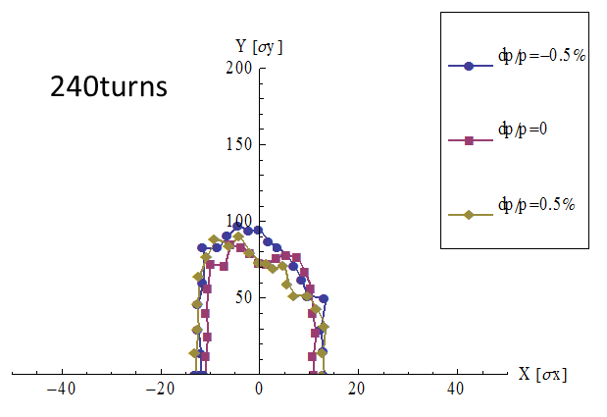

Slide 10
320turns

Slide 11
480turns

Slide 12
DA before optimization (lattice 4)
70 Knob: 8 IR sext + 4 IR multipoles(K1/K2/K3) + 18 IR Mult(k2) + 32 arc sextupoles
With damping
50 turns
200 turns

Slide 13
DA before optimization (lattice 4)
70 Knob: 8 IR sext + 4 IR multipoles(K1/K2/K3) + 18 IR Mult(k2) + 32 arc sextupoles
50 turns
Close K1
Close K2
K1 is the key of DA!

Slide 14
DA before optimization (lattice 4)
70 Knob: 8 IR sext + 4 IR multipoles(K1/K2/K3) + 18 IR Mult(k2) + 32 arc sextupoles
50 turns
Close K3
Close K2&K3

Slide 15
DA before optimization (lattice 4)
70 Knob: 8 IR sext + 4 IR multipoles(K1/K2/K3) + 18 IR Mult(k2) + 32 arc sextupoles
Close 22 multipoles except for K1

Slide 16
DA after optimization (lattice 4)
With damping
50 turns

Slide 17
DA before optimization (lattice 5)
70 Knob: 8 IR sext + 4 IR multipoles(K1/K2/K3) + 18 IR Mult(k2) + 32 arc sextupoles
With damping
200 turns

Slide 18
DA after optimization (lattice 5)
With damping
200 turns

Slide 19
Add multipole k1 to real quadrupole (lattice 5)
200 turns
Optics Distortion in IP : beata=0.1740689/ 0.0019829
working point=341.09925/341.22003

Slide 20
Add multipole k1 to real quadrupole (lattice 5)
200 turns
Optics Distortion in IP : beata=.17268262886877295/ .0019902450192472373
working point=341.099617/341.219991

