Slide 1
Progress on DA Optimization with MODE
ZHANG, Yuan WANG, Yiwei WANG, Dou GENG, Huiping
2017-05-19

Slide 2
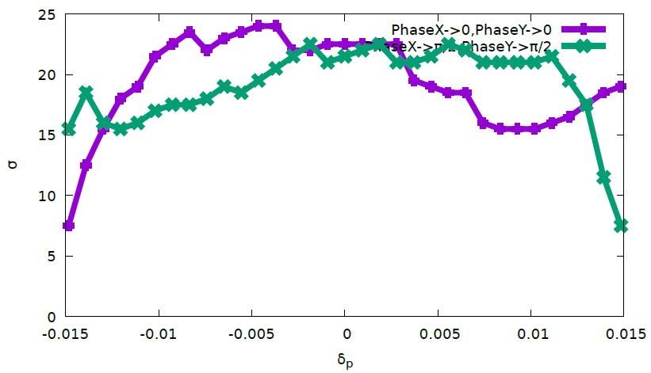
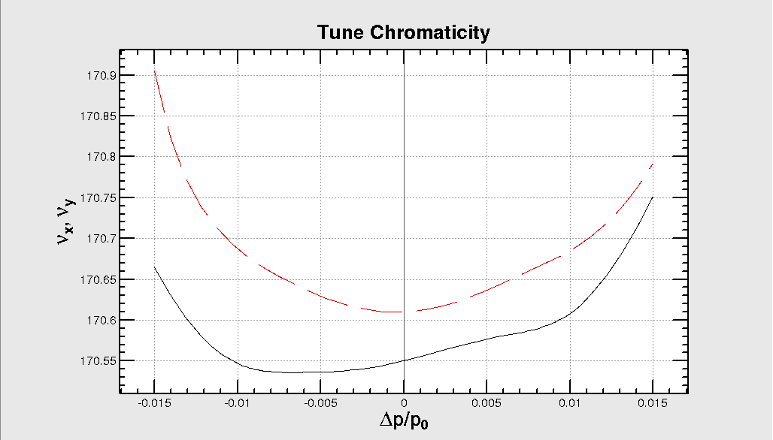
III.4 Optimize DA with IR sext/mult and 8*(SFO/SDO)+8*(SFI/SDI)+IR knobs(Cai)
50 turns
70 Knob: 8 IR sext + 4 IR multipoles(K1/K2/K3) + 18 IR Mult(k2) + 32 arc sextupoles
2017-05-12

Slide 3
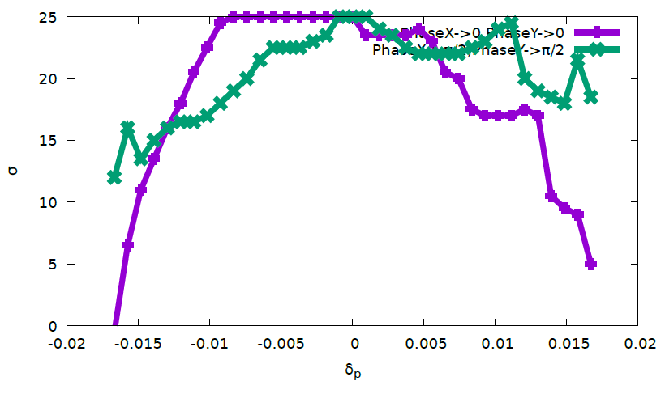
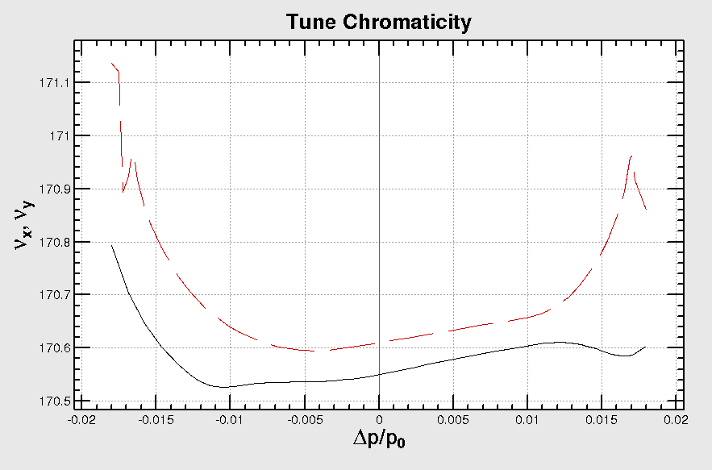
III.5 Optimize DA with IR sext/mult and 56*(SFO/SDO)+56*(SFI/SDI)+IR knobs(Cai)
50 turns
262 Knob: 8 IR sext + 4 IR multipoles(K1/K2/K3) + 18 IR Mult(k2) + 224 arc sextupoles

Slide 4
blank

Slide 5
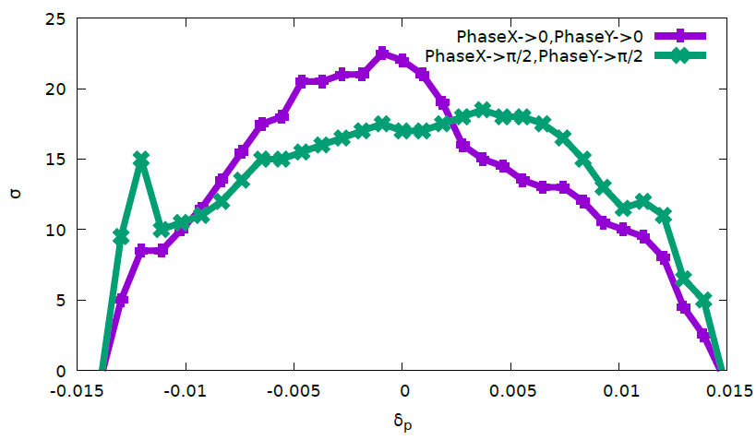
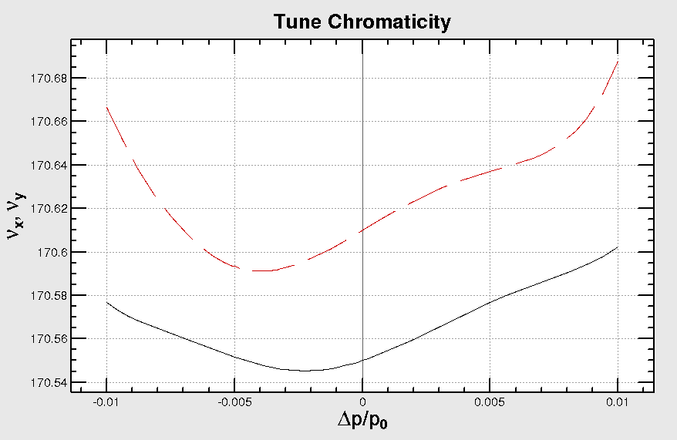
IV.1 Optimize DA with IR sext and SFO/SDO/SFI/SDI + IR knobs(Cai)
200 turns
Keep IP Optics
24 Knob: 8 IR sext + 4 arc sextupoles + 4 IR multipoles(K1/K2/K3)

Slide 6
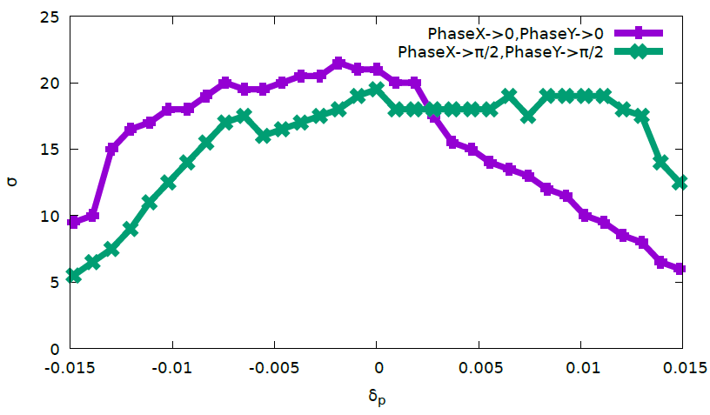
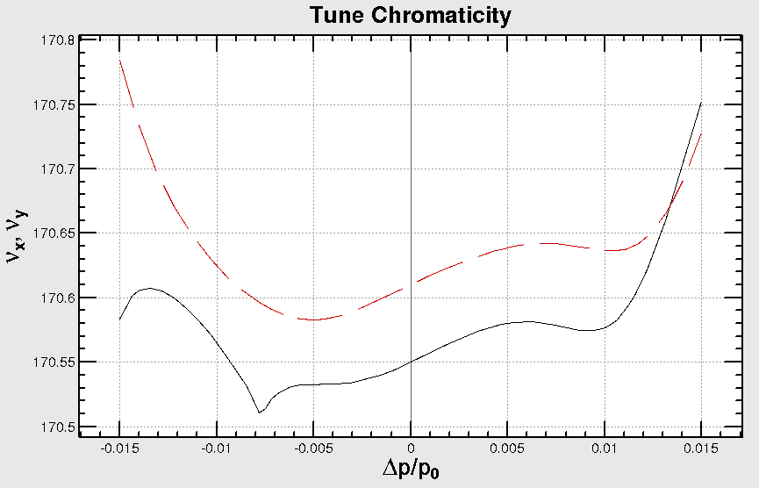
IV.2 Optimize DA with IR sext + 4*(SFO/SDO)+4*(SFI/SDI) + IR knobs(Cai)
200 turns
Keep IP Optics
36 Knob: 8 IR sext + 16 arc sextupoles + 4 IR multipoles(K1/K2/K3)

Slide 7
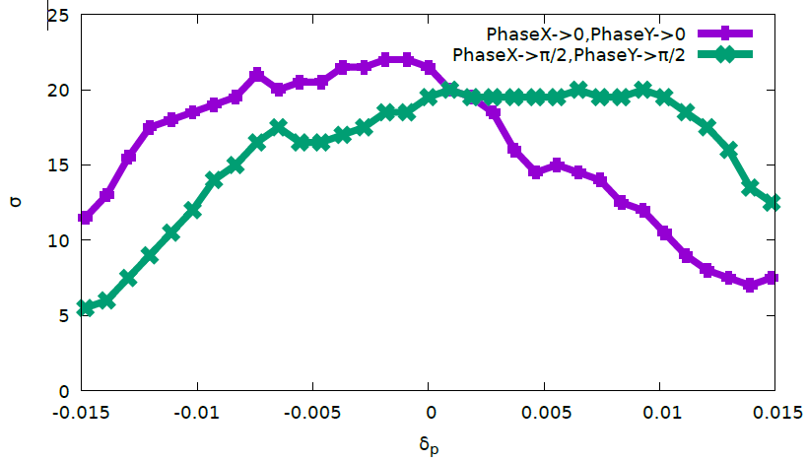
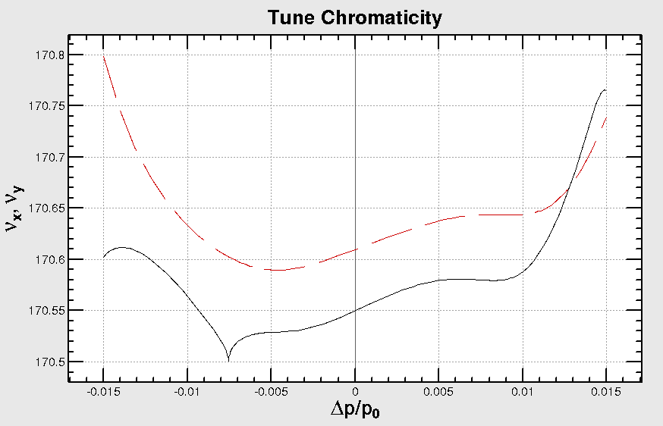
IV.3 Optimize DA with IR sext/mult and 4*(SFO/SDO)+4*(SFI/SDI)+IR knobs(Cai)
200 turns
Keep IP Optics
58 Knob: 8 IR sext + + 4 IR multipoles(K1/K2/K3) + 22 IR Mult(k2) + 16 arc sextupoles

Slide 8
blank

Slide 9
MEMO
RFSW
RAD
DAMPONLY
DAPWIDTH=7
Turns=50

Slide 10
DA with SAWTOOTH+TAPER
FFS["CELL"];
FFS["RING"];
FFS["RAD"];
FFS["CODPLOT"];
FFS["RADCOD"];
FFS["RADTAPER"];
FFS["RFSW"];
FFS["DAMPONLY"];
Element["PHI","RFC",Saved->True]=-ArcSin[EnergyLossU0/RfVoltageVc]/.Emittance[];
FFS[“emit”];

