Slide 1
Update of lattice design for CEPC main ring
Yiwei Wang, Feng Su, Sha Bai, Yuan Zhang, Dou Wang,
Huiping Geng, Chenghui Yu, Jie Gao
IHEP, CAS
CEPC AP meeting, 19 May 2017

Slide 2
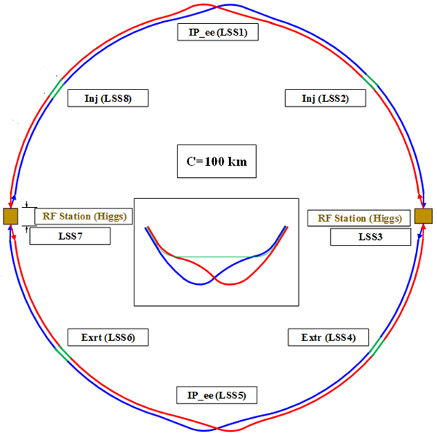
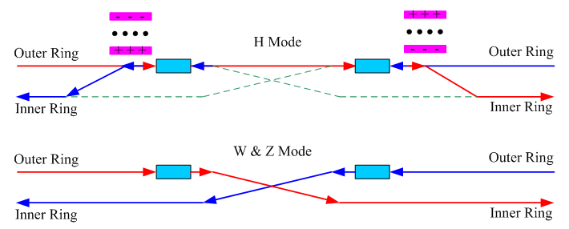
Introduction
With new parameter list (20170306-100km_2mmβy)
With new IR parameters L*=2.2m, θc=33mrad, GQD0=150T/m
to lower the requirements of anti-solenoid and QD0 field
Bsol=6.6T, BQD0=3.3T which are realizable
Compatible lattices for H, W and Z modes
geometry, β*, emittance
common cavities for H, W and Z modes, bunches filled in full ring for
W&Z modes
The geometry of CEPC is compatible for the SPPC.

Slide 3
Parameters for CEPC double ring
(20170306-100km_2mmβy, D. Wang)
 | Pre-CDR | tt | Higgs | W | Z
Number of IPs | 2 | 2 | 2 | 2 | 2
Energy (GeV) | 120 | 175 | 120 | 80 | 45.5
Circumference (km) | 54 | 100 | 100 | 100 | 100
SR loss/turn (GeV) | 3.1 | 7.55 | 1.67 | 0.33 | 0.034
Half crossing angle (mrad) | 0 | 16.5 | 16.5 | 16.5 | 16.5
Piwinski angle | 0 | 1.6 | 3.19 | 5.69 | 4.29
N_{e}/bunch (10¹¹) | 3.79 | 1.41 | 0.968 | 0.365 | 0.455
Bunch number | 50 | 98 | 644 (412) | 5534 | 21300
Beam current (mA) | 16.6 | 6.64 | 29.97 (19.2) | 97.1 | 465.8
SR power /beam (MW) | 51.7 | 50 | 50 (32) | 32 | 16.1
Bending radius (km) | 6.1 | 11 | 11 | 11 | 11
Momentum compaction (10⁻⁵) | 3.4 | 1.3 | 1.14 | 1.14 | 4.49
β_{IP} x/y (m) | 0.8/0.0012 | 0.2/0.002 | 0.171/0.002 | 0.171 /0.002 | 0.16/0.002
Emittance x/y (nm) | 6.12/0.018 | 3.19/0.0097 | 1.31/0.004 | 0.57/0.0017 | 1.48/0.0078
Transverse σ_{IP} (um) | 69.97/0.15 | 25.3/0.14 | 15.0/0.089 | 9.9/0.059 | 15.4/0.125
ξ_{x}/ξ_{y}/IP | 0.118/0.083 | 0.016/0.055 | 0.013/0.083 | 0.0055/0.062 | 0.008/0.054
RF Phase (degree) | 153.0 | 122.2 | 128 | 126.9 | 165.3
V_{RF} (GV) | 6.87 | 8.92 | 2.1 | 0.41 | 0.14
f _{RF} (MHz) (harmonic) | 650 | 650 | 650 | 650 (217800) | 650 (217800)
Nature σ_{z} (mm) | 2.14 | 2.62 | 2.72 | 3.37 | 3.97
Total σ_{z} (mm) | 2.65 | 2.7 | 2.9 | 3.4 | 4.0
HOM power/cavity (kw) | 3.6 (5cell) | 0.53(5cell) | 0.64(2cell) (0.41) | 0.36(2cell) | 1.99(2cell)
Energy spread (%) | 0.13 | 0.14 | 0.098 | 0.065 | 0.037
Energy acceptance (%) | 2 | 2 | 1.5
Energy acceptance by RF (%) | 6 | 2.6 | 2.1 | 1.1 | 1.1
n_{γ} | 0.23 | 0.23 | 0.26 | 0.15 | 0.12
Life time due to beamstrahlung_cal (minute) | 47 | 50 | 52
F (hour glass) | 0.68 | 0.89 | 0.96 | 0.98 | 0.96
L_{max}/IP (10³⁴cm⁻²s⁻¹) | 2.04 | 0.62 | 3.13 (2.0) | 5.15 | 11.9

Slide 4
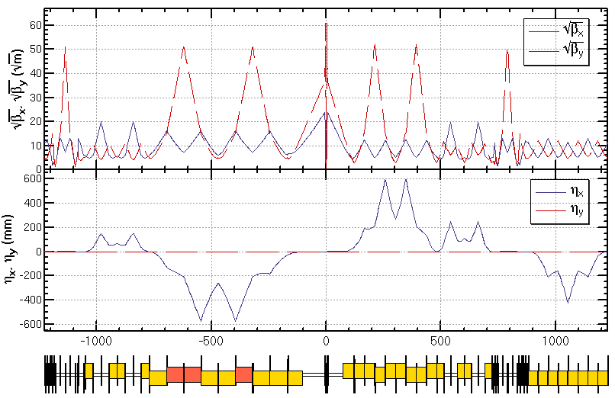
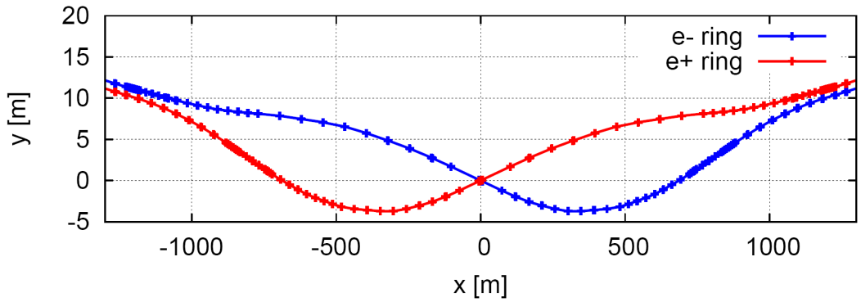
Lattice design for interaction region
Provide local chromaticity correction
L*=2.2m, θc=33mrad, GQD0=150T/m
Reverse bending direction of last bends to avoid synchrotron radiation hitting IP
IR of IP upstream: Ec < 100 keV within 400m, last bend Ec < 60 keV
IR of IP downstream: Ec < 300 keV within 250m, last bend Ec < 120 keV
L*= 2.2m
βx*= 0.171mm
βy*= 2mm
GQD0≅-150T/m
GQF1≅100T/m
LQD0=1.73m
LQF1=1.48m
Notes:
New IR bends

Slide 5
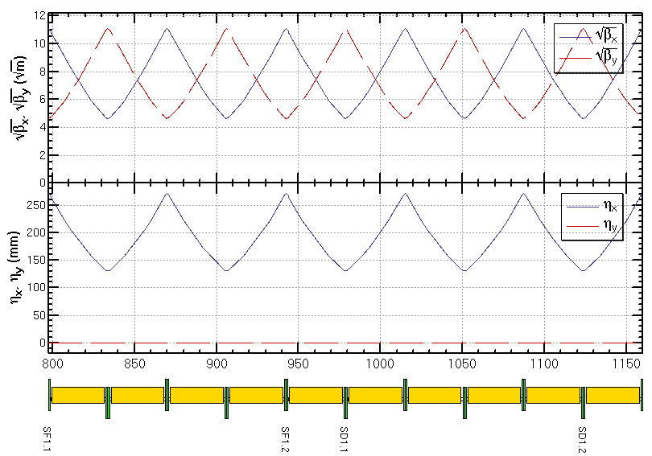
Lattice design for ARC region
FODO cell, 90°/90°, non-interleaved sextupole scheme
period N=5cells
all 3rd and 4th resonance driving terms (RDT) due to sextupoles cancelled, except small 4Qx, 2Qx+2Qy, 4Qy, 2Qx-2Qy
tune shift dQ(Jx, Jy) is very small
DA on momentum: large
Chromaticity dQ(δ) need to be corrected with many families
DA off momentum: with many families to correct dQ(δ) and –I break down
-I
-I
ρ_{Bin}=12320 m
ρ_{Bout}=12321 m
Notes:
Should be 5 cells

Slide 6
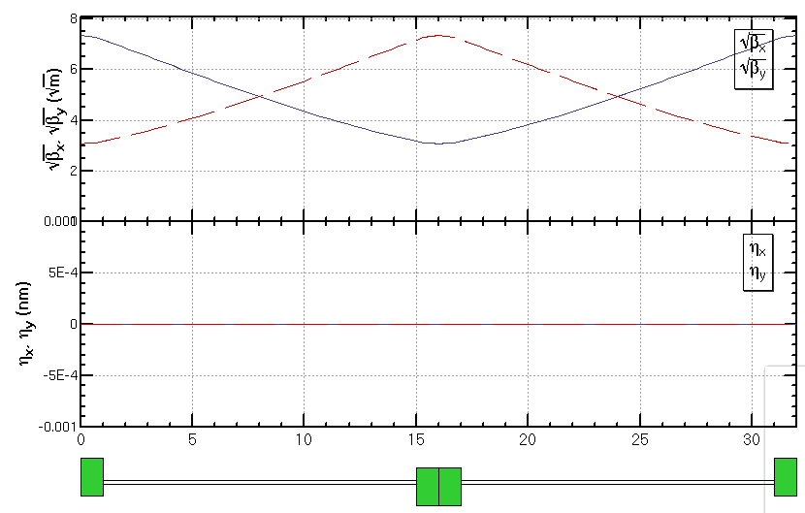
FODO cell for cryo-module
336 / 6 / 2RF stations / 2 sections / 2= 7 cells in each section
get a smallest average beta function to reduce the multi-bunch instability caused by RF cavities
90/90 degree phase advance
as short as possible distance between quadrupoles, but should be larger than a module length (12m)
90/90 deg
Half cell: 14m+2m
βmax: 53.8 m
βmin: 9.5 m
cryo-module
quadrupole

Slide 7
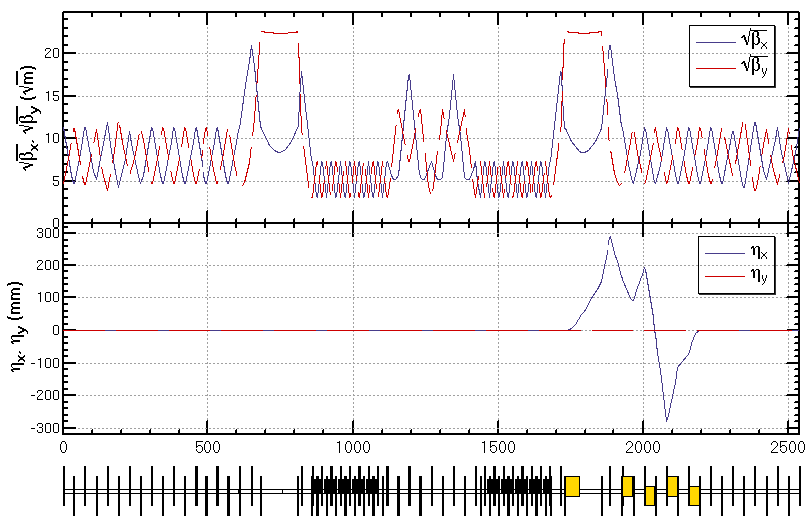
Lattice design of RF region
Common RF cavities for e- and e+ ring (Higgs)
An electrostatic separator combined with a dipole magnet to avoid bending of incoming beam (ref: Oide, ICHEP16)
RF region divided into two sections for bypassing half numbers of cavities in Z mode
Deviation of outgoing beam is Δx=1.0 m for bypassing the cryo-modules
common RF cavities
combined magnet
Esep=1.8 MV/m
Lsep=50m
Ldrift=75m
Δx=10cm at entrance of quad

Slide 8
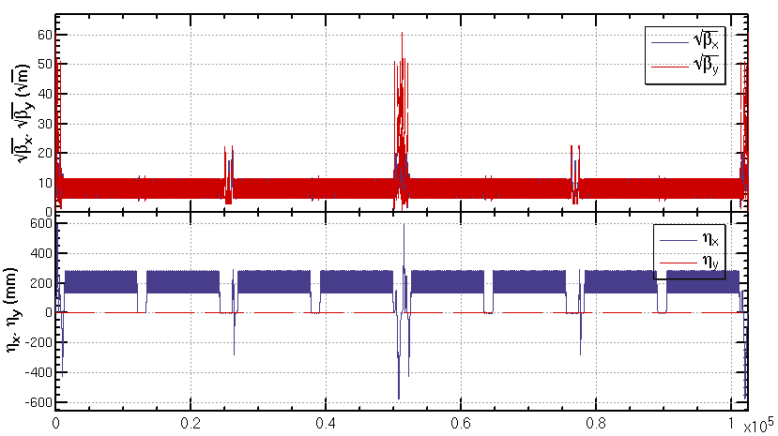
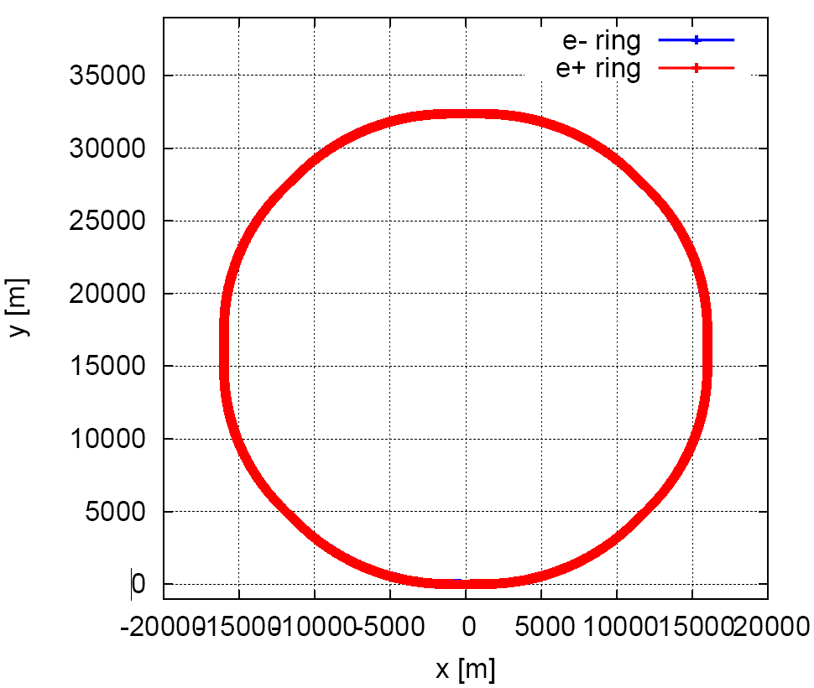
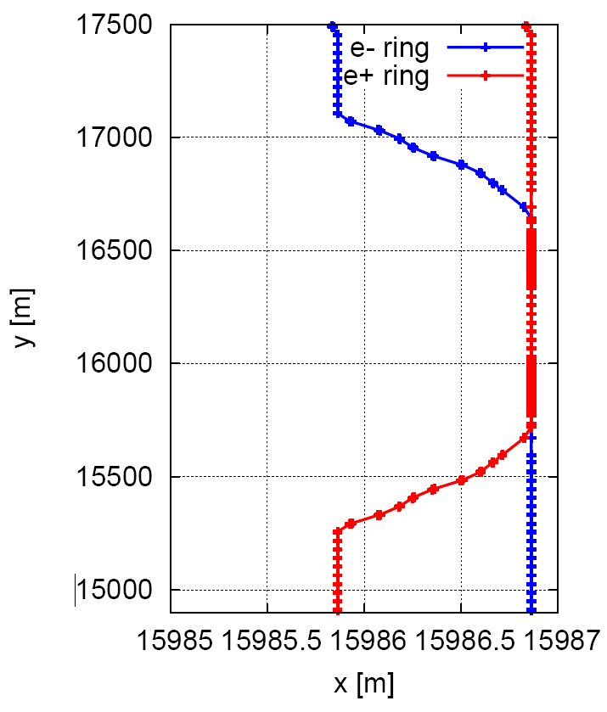
Lattice design for whole ring
A lattice fulfilling requirements of the parameters list, geometry, photon background and key hardware

Slide 9
Magnets
ARC
Sextupole: 56*4*4=896, 0.4 m
Quadrupole: 56*4*5*2+2*8*2=2272, 2 m
Dipole: 56*4*5*2+2*8*2=2272, 34 m in half of cell
IR
Sextupole : (6 to 12) *4=24 to 48, 0.3 m

Slide 10
Re-design of the ARC region
Fit the circumference of ring C=100 km
Lringr
= (Ncell+6+2)*Lcell*8 + Nstr1*Lcell*4 + Lstr2*4+Pi*1m
= 99996.8 + 3.14 m
Fix the problem of residual dispersion due to half bend scheme of dispersion suppressor

Slide 11
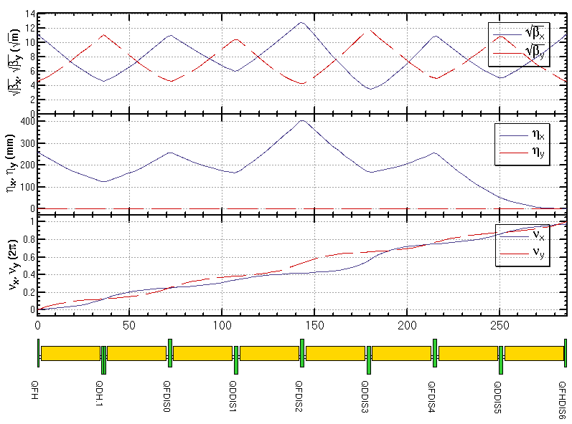
Dispersion suppressor
Half bend scheme
Simple but destroy the geometry (2ρ, 2Δ ρ)
Full bend scheme
Keep geometry
2 cells w/ bend, 3 cells w/ bend+1 cell, 4 cells w/ bend, 3 cells w/ bend
3 cells w/ bend for β matching in Z mode

Slide 12
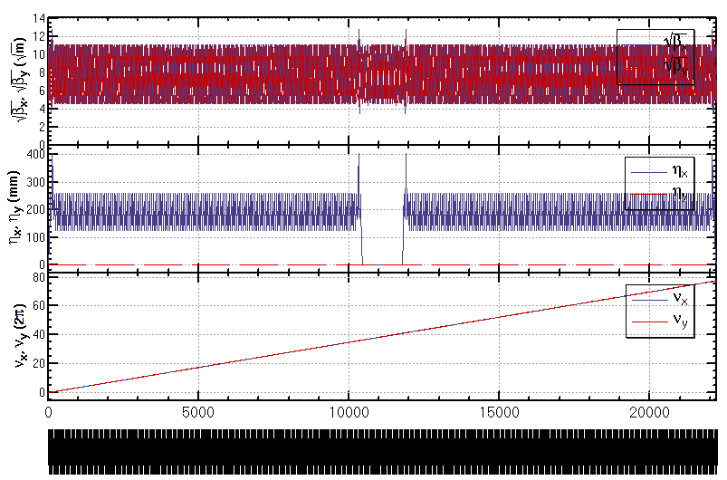
RINGQI

Slide 13
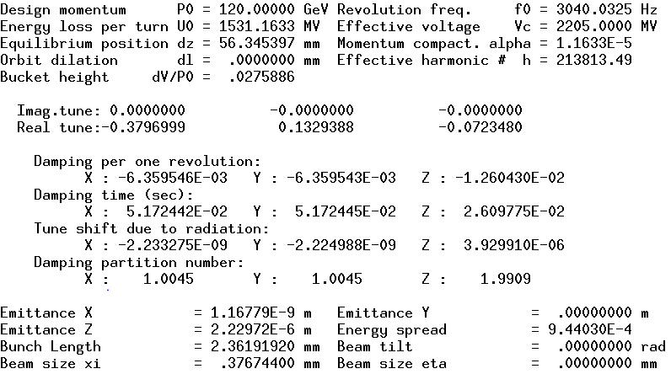
Parameters of ARC region (rough)

