Slide 1

Pion-nucleon sigma term from
the latest LQCD simulations
Speaker: Xizhe Ling(凌悉哲)
School of Physics and Nuclear Energy Engineering,
Beihang University, Beijing, China
Supervisor: Lisheng Geng(耿立升)
Cooperator: Xiulei Ren(任修磊)
Oct.17,2017

Slide 2
OUTLINE
Introduction-why sigma terms
Theoretical Framework
Results and Discussion
Summary

Slide 3
Introduction-why sigma terms
Weakly Interacting Massive Particles (WIMPS)
e.g., Neutralino in MSSM.

Slide 5
Indirect dark matter detection in China

Slide 7

Collider searches
Large Hadron Collider(LHC) in n Europe;

Slide 9
Direct dark matter detection in China

Slide 11
Spin-independent neutralino-nucleon scattering
ELLIS, OLIVE, SANTOSO, AND SPANOS. PHYSICAL REVIEW D 71, 095007 (2005)

Slide 12
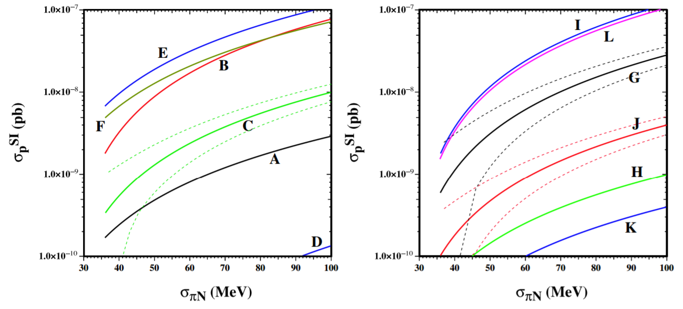
Spin-independent neutralino-nucleon scattering
ELLIS, OLIVE, SANTOSO, AND SPANOS. PHYSICAL REVIEW D 71, 095007 (2005)

Slide 13
Theoretical Framework
How to determine sigma terms
Experimentally, the pion-nucleon sigma term can be inferred from pion-nucleon scattering data at Cheng-Dashen point

Slide 14
How to determine sigma terms
LQCD determination of sigma terms
Direct method —calculates the 3-point connected and disconnect diagrams
Spectrum method-calculates the baryon masses, and relates the sigma terms to their quark mass dependence via the Feynman-Hellmann theorem
– JLQCD, PRD83,114506 (2011)
– R. Babich et al., PRD85,054510 (2012)
– QCDSF, PRD85, 054502 (2012)
– ETMC, JHEP 1208,037(2012)
– M. Engelhardt et al., PRD86, 114510 (2012)
– JLQCD, PRD87, 034509 (2013)
– ETMC, PRL 116, 252001 (2016)
– RQCD, PRD 93, 094504 (2016)
– χ QCD, PRD94, 054503 (2016)

Slide 15
How to determine sigma terms
LQCD determination of sigma terms
Spectrum method-calculates the baryon masses, and relates the sigma terms to their quark mass dependence via the Feynman-Hellmann theorem
– JLQCD, PRD83,114506 (2011)
– R. Babich et al., PRD85,054510 (2012)
– QCDSF, PRD85, 054502 (2012)
– ETMC, JHEP 1208,037(2012)
– M. Engelhardt et al., PRD86, 114510 (2012)
– JLQCD, PRD87, 034509 (2013)
– BMW, PRL 116, 172001 (2016).
R. P. Feynman, Forces in molecules, Phys. Rev. 56, 340 (1939).

Slide 16
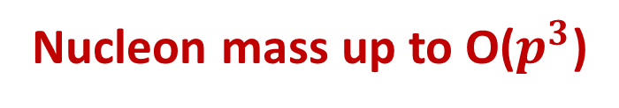
BChPT
Nucleon mass up to O($p^{3}$)
Naively
(no PCB)

Slide 17
BChPT
Power-counting-restoration methods
Heavy baryon ChPT: baryons treated “semi-relativistically” ( Jenkins et al., 1991, Bernard et al., 1992)
Relativistic baryon ChPT: removing power counting breaking terms but retaining higher order corrections, thus keeping relativity
- Infrared baryon ChPT: Becher & Leutwyler 1999
- Extended on mass shell (EOMS) scheme: Gegelia
1999, Fuchs 2003

Slide 18
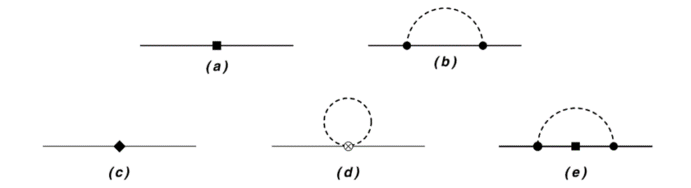
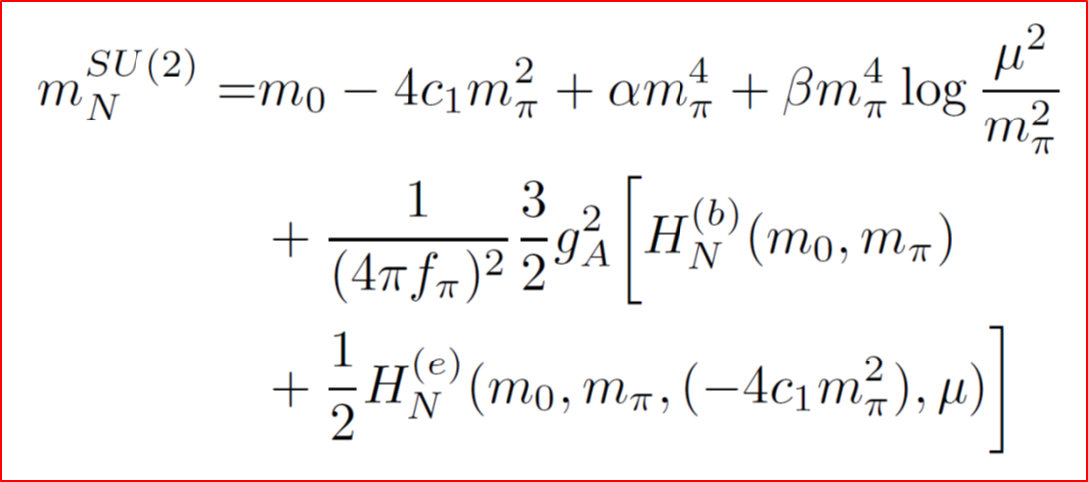
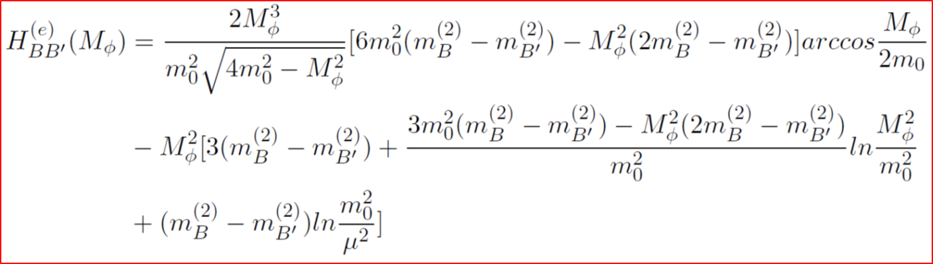
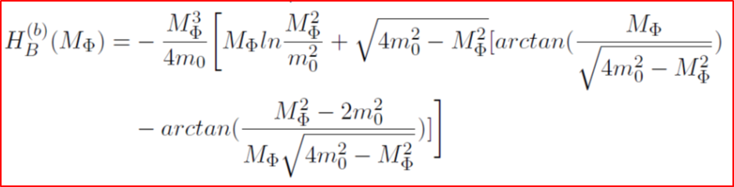

EOMS BChPT
Up to $N^{3}$LO in SU(2) EOMS BChPT
X. L. Ren, L. Alvarez-Ruso, L. S. Geng, T. Ledwig, J. Meng and M. J. Vicente Vacas, Phys. Lett. B 766, 325 (2017).

Slide 19
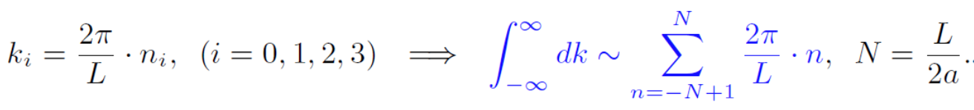
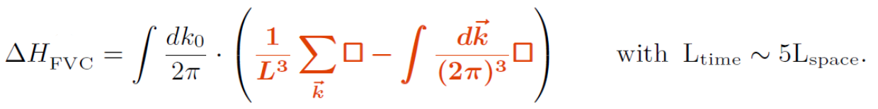
Finite volume correction
Momentum of virtual particle discretized
Definition of FVCs

Slide 20
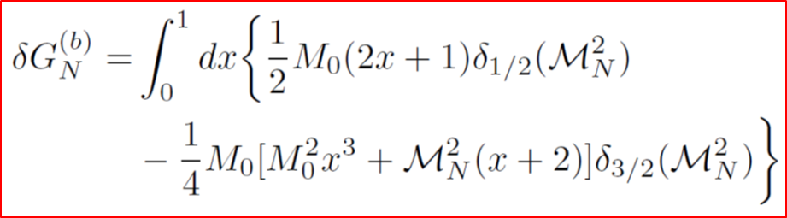
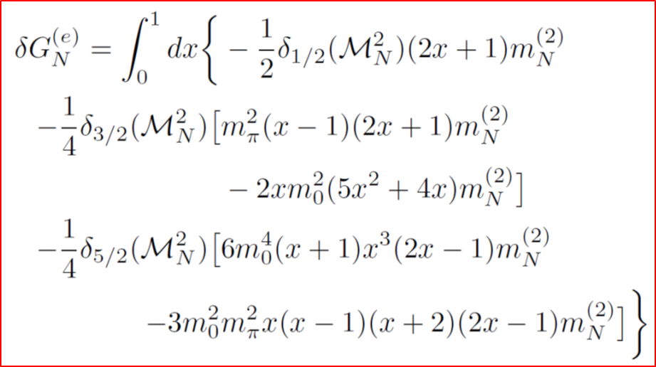
Finite volume correction
L. S. Geng, X. l. Ren, J. Martin-Camalich and W. Weise, Phys. Rev. D 84, 074024 (2011).
X. -L. Ren, L. S. Geng, J. Martin Camalich, J. Meng and H. Toki, JHEP 1212, 073 (2012).

Slide 21
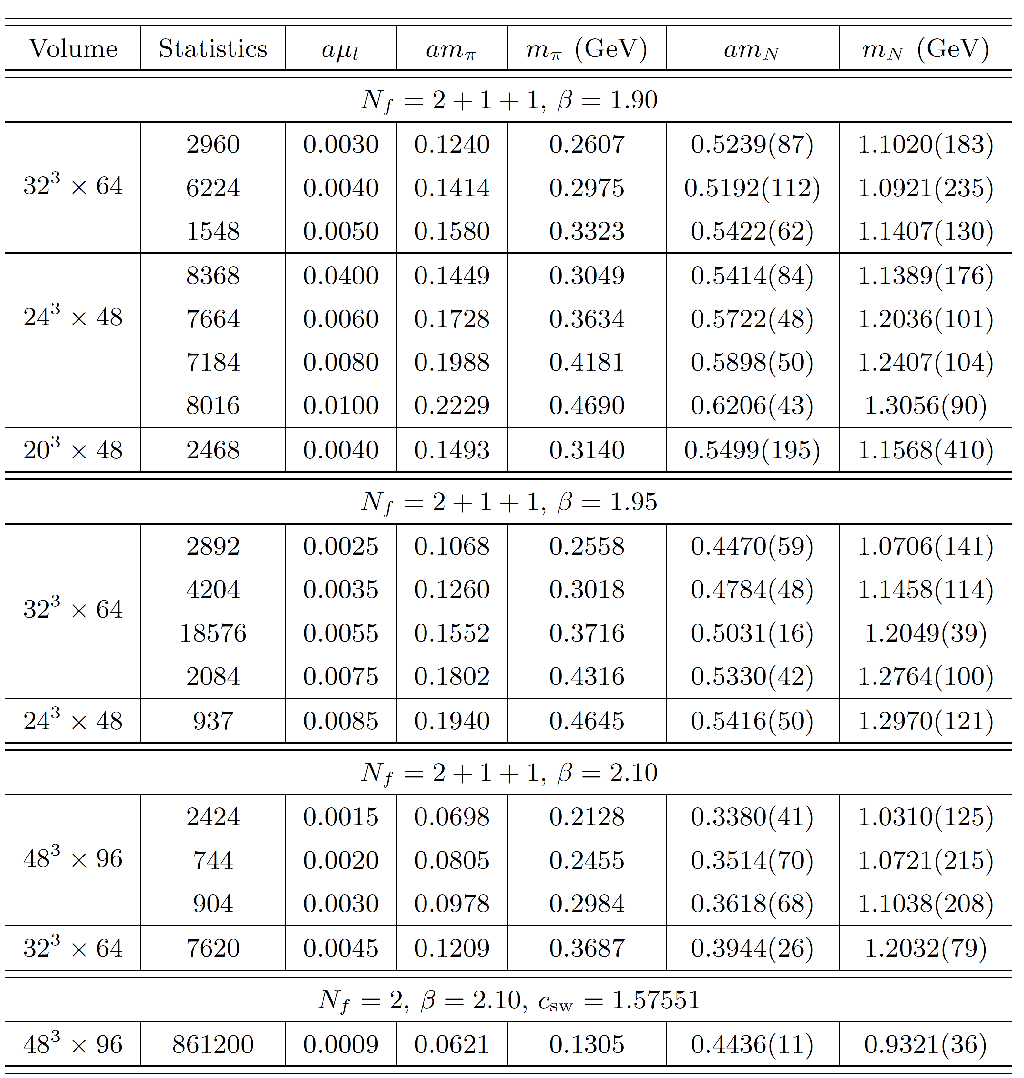
Latest LQCD data from ETMC
C. Alexandrou and C. Kallidonis, Phys. Rev. D 96, 034511 (2017).

Slide 22
Latest LQCD data from ETMC
HB BChPT
C. Alexandrou and C. Kallidonis, Phys. Rev. D 96, 034511 (2017).

Slide 23
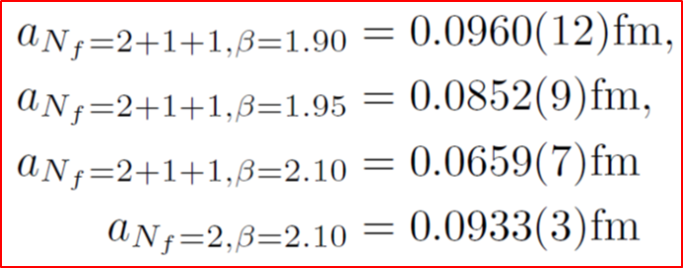
Results and Discussion

Slide 24
EOMS BChPT
“Drop” the PCB terms
Equivalent to redefinition of the LECs

Slide 25
Results and Discussion
ETMC data with finite volume corrections subtracted in comparison with the best fits in the $N^{2}$LO and $N^{3}$LO BChPT

Slide 26
EOMS BChPT
HB BChPT
C. Alexandrou and C. Kallidonis, Phys. Rev. D 96, 034511 (2017).

Slide 27
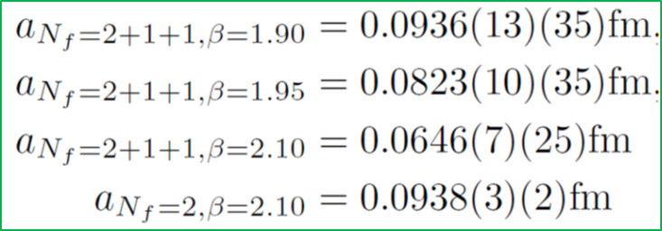
EOMS BChPT
HB BChPT
C. Alexandrou and C. Kallidonis, Phys. Rev. D 96, 034511 (2017).

Slide 28
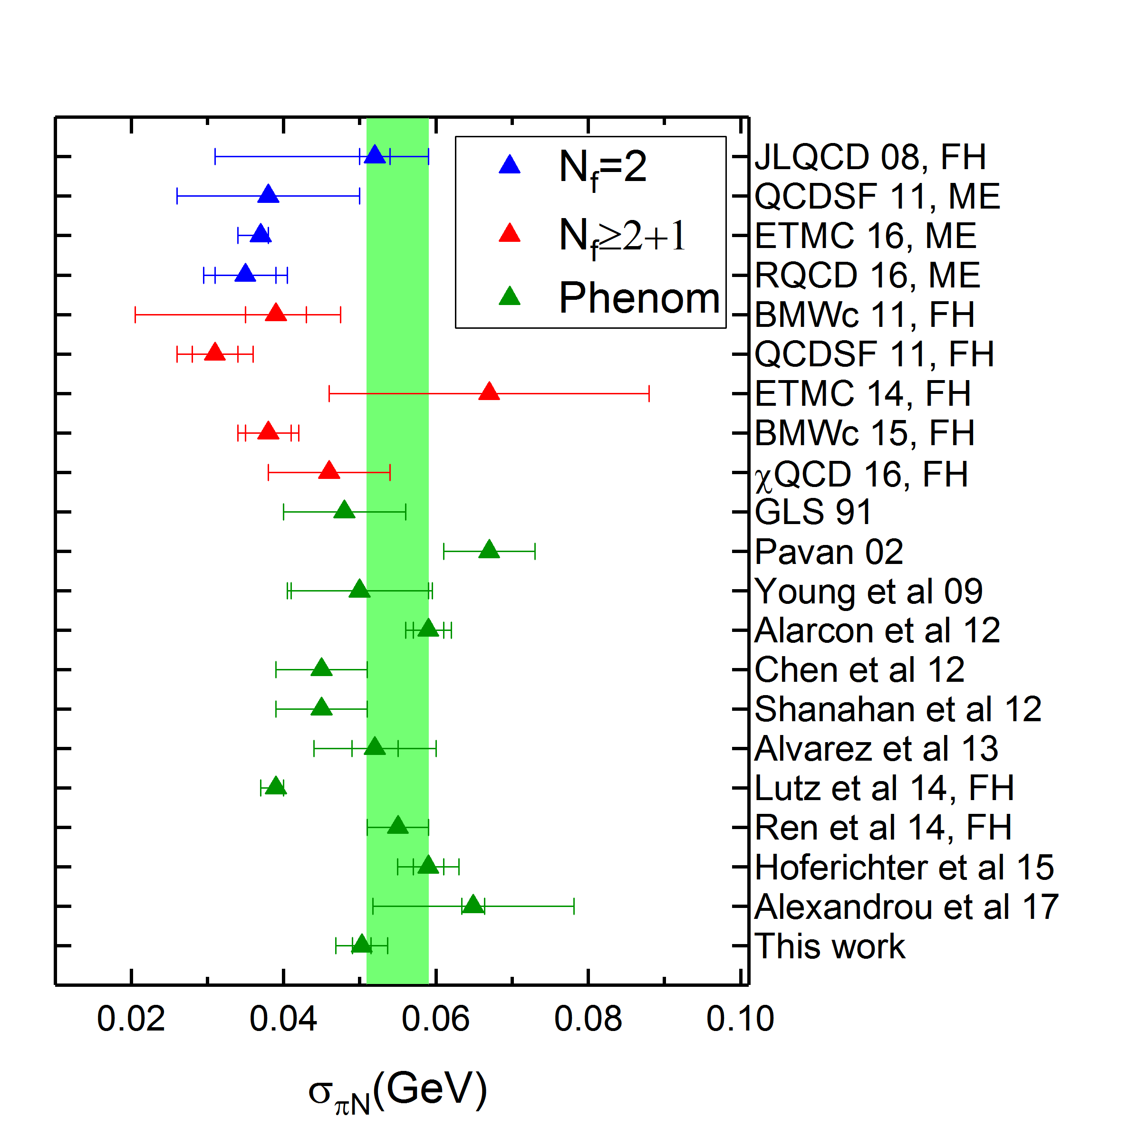
Comparison with other studies
X. L. Ren, L. Alvarez-Ruso, L. S. Geng, T. Ledwig, J. Meng and M. J. Vicente Vacas, Phys. Lett. B 766, 325 (2017)

Slide 29
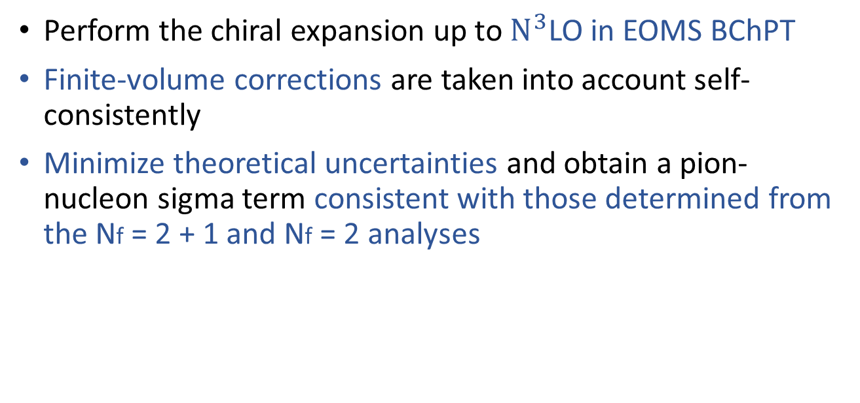
Summary
We have reanalyzed the latest ETMC simulations of the nucleon mass and extracted the pion-nucleon sigma term.
Perform the chiral expansion up to $N^{3}$LO in EOMS BChPT
Finite-volume corrections are taken into account self-consistently
Minimize theoretical uncertainties and obtain a pion-nucleon sigma term consistent with those determined from the Nf = 2 + 1 and Nf = 2 analyses

Slide 30
Thank you very much for your attention!

Slide 31
Our aim
To apply the Feynman-Hellmann theorem to predict the baryon sigma terms using the covariant (EOMS) baryon chiral perturbation theory
To fix the unknown low-energy constants of BChPT, we rely on the LQCD simulations of baryon masses

