Slide 1
Recent highlights at BESIII
王至勇
(for the BESIII Collaboration)
第四届手征有效场论研讨会，西安
Notes:
Good morning everyone, this meson spectroscopy review is supposed to be given by Changzheng, but unfortunately he can not be here due to the visa problem, so I will give this talk for him. The meson spectroscopy is a large topic, the talk today will focus on the new charmonium or charmonium-like states observed most recently.

Slide 2
Outline
Light hadron decay
X states
Y states
Z states
Summary

Slide 3
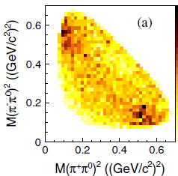
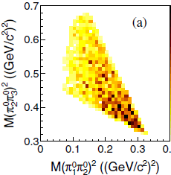
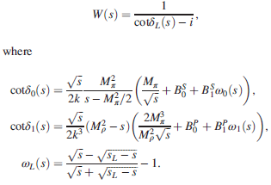
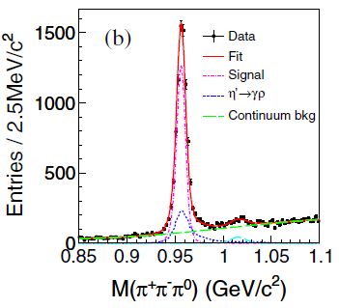
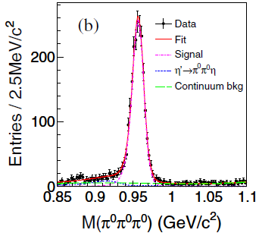
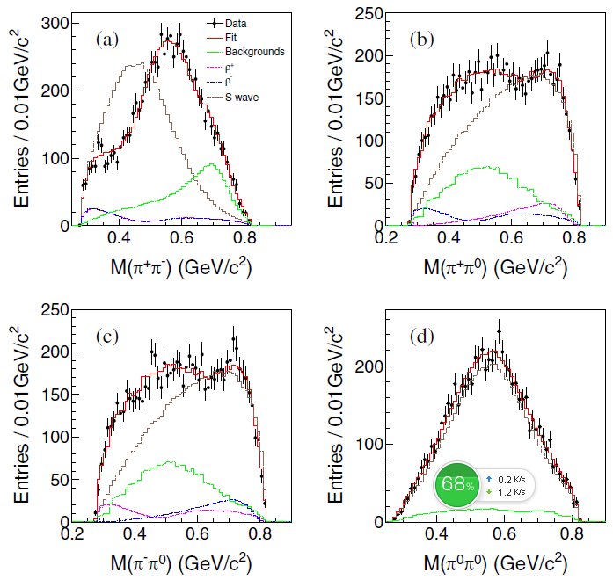
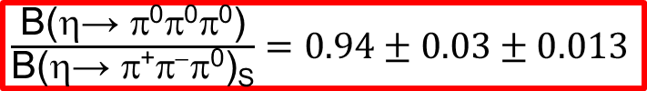
Dalitz analysis：η′→ π⁺π⁻π⁰ and η′→π⁰π⁰π⁰
ππ-S-wave and ππ-P-wave.
B(η′→ π⁺π⁻π⁰)_{S}=(37.63±0.77±0.22±4.48)×10⁻⁴
B(η′→ π⁰π⁰π⁰)=(35.22±0.82±2.54)×10⁻⁴
Phys. Rev. Lett. 118,012001 (2017)
电荷对称性：
$$\frac{B\left(η^{′}→ρ^{+}π^{−}\right)−B\left(η^{′}→ρ^{−}π^{+}\right)}{B\left(η^{′}→ρ^{+}π^{−}\right)+B\left(η^{′}→ρ^{−}π^{+}\right)}=0.053±0.060\left(stat\right)±0.010(sys)$$
分支比测量：
S波同位旋对称性：
$\frac{\text{B}\text{(η→ 000)}}{\text{B}\text{(η→ +−0)}\text{S}}=0.94±0.03±0.013$

Slide 4


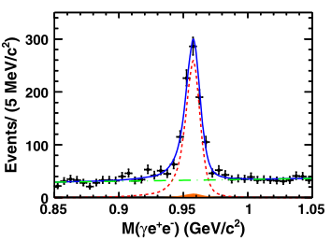

Dalitz analysis: η′→ γe⁺e⁻
Reveal the inner structure of the meson
Study the transition form factor → providing information for the muon anomalous magnetic moment.
|QED(q²)| represents the calculable QED part for a point-like meson
Phys. Rev. D92,012001 (2015)

Slide 5
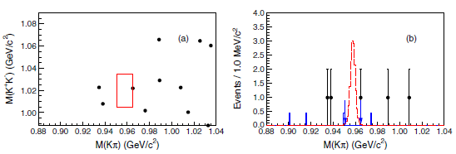

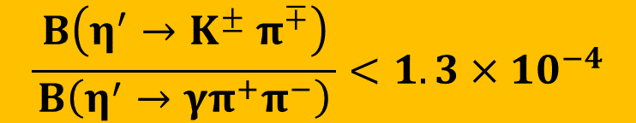
Search the weak decay η′→$K^{±} π^{∓}$
Motivation: test CKM mechanism and search for new physics beyond the SM.
Strategy: J/→φη′,η′→Kπ
No obvious signal is found. The upper limit for branching fraction relative to η′→γπ+π− mode is determined to be
$$\frac{{ B\left(η^{′}→K^{±} π^{∓}\right)}_{ }}{B\left(η^{′}→{γπ}^{+}π^{−}\right)}<1.3{×10}^{−4}$$

Slide 6
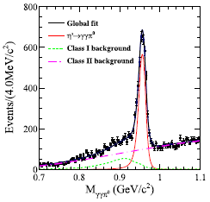
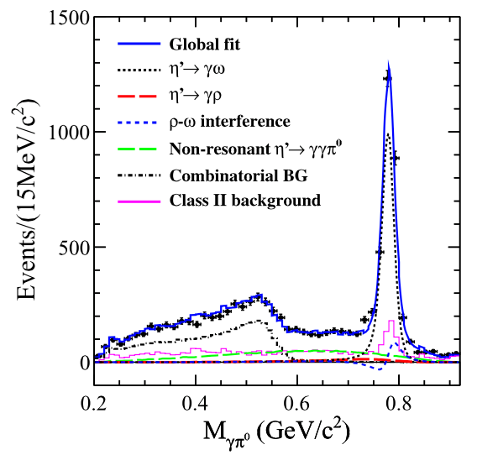
Doubly radiative decay η′→γγπ⁰
Study the linear σ model (LσM) && vector meson dominance (VMD).
Only a upper limit is available before.
We measure the inclusive mode. i.e. including all possible intermediate states. For example, ρ, ω, non-resonance……
Numerical result:
B(η′→ γγπ⁰)_{incl}=(3.20±0.07(stat)±0.23(sys))×10⁻³
B(η′→ γγπ⁰)_{NR}=(6.16±0.64(stat)±0.67(sys))×10⁻⁴

Slide 7
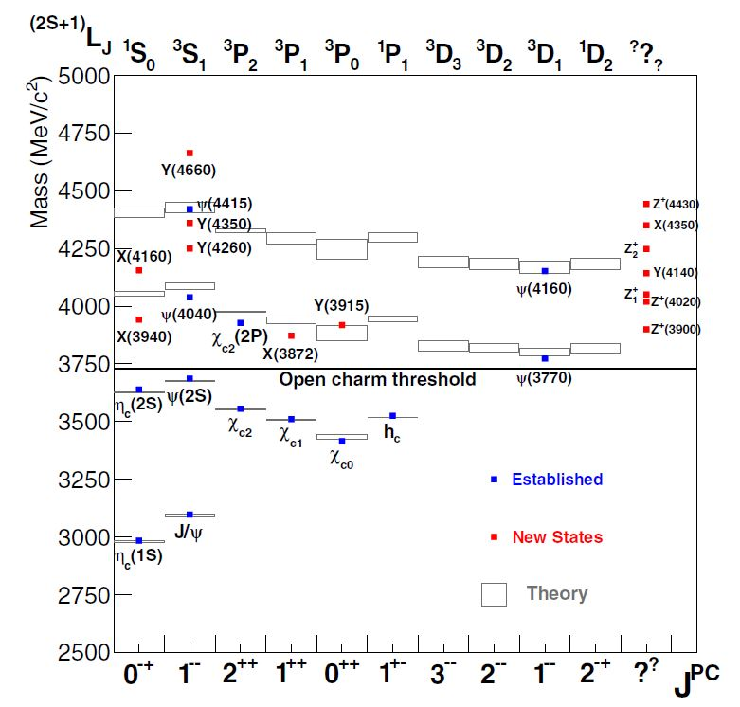
Charmonium Spectrum (1)
S=0,1
c
‾c
L
J=L+S
New charmonium-like states, i.e. “XYZ” states, are observed in experiment

Slide 8
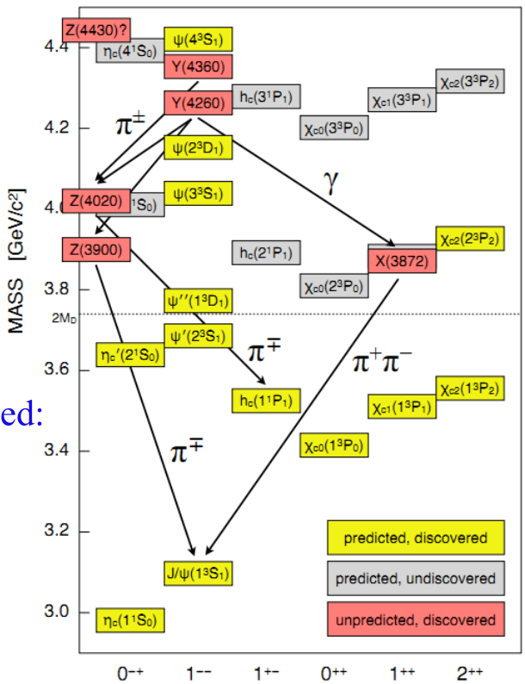
Charmnonium spectrum (2)
Below the open charm threshold the spectrums well understood
  very good agreement between predicted and discovered states
Above the threshold the situation in more complex
  only few of the predicted states have been found
  in the last decades many new states have been observed with properties that are not consistent with expectations for charmonium: X, Y, Z
  X states:
charmonium-like states with J^{PC} ≠ 1⁻⁻
Observed in B decays, pp and pp collisions
  Y states:
charmonium-like states with J^{PC} = 1⁻⁻
Observed in direct e⁺e⁻ annihilation or in ISR
  Z states:
Must contain at least a cc and a light qq pair

Slide 9
X states

Slide 10
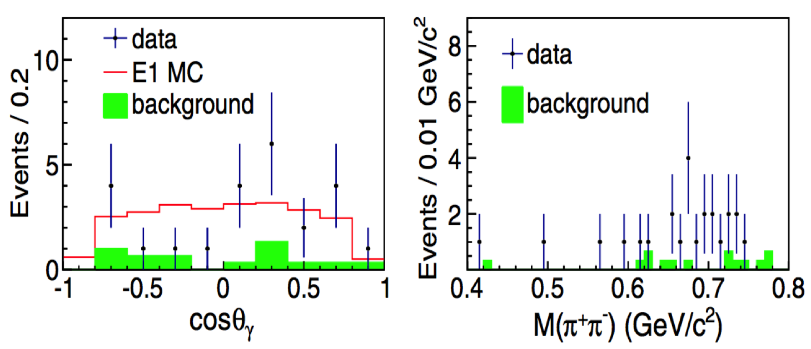
e⁺e⁻ →γX(3872)→γπ⁺π⁻J/ψ
PRL 112 092001 (2014)
M = (3871.9±0.7±0.2) MeV, Γ<2.4 MeV, Significance:6.3σ
production in Y(4260) decay suggestive, but not conclusive

Slide 11

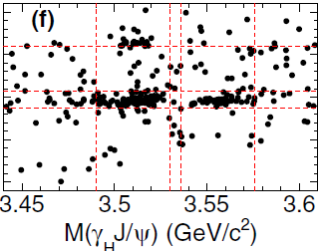
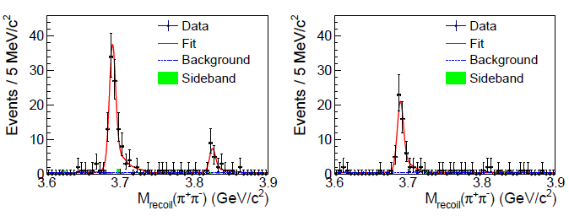
e⁺e⁻→π⁺π⁻X(3823)→π⁺π⁻γχ_{c1}
γχ_{c1}
γχ_{c2}
Fit: M=3821.7±1.3±0.7 MeV;
Significance: 6.7σ, observation
Phys. Rev. Lett. 91, 112015 (2015)
X(3823) as the ψ(1³D₂)
Mass argees with ψ(1³D₂)
Narrow width (<16 MeV @90% C.L.)
R=B[X(3823)→γχ_{c2}]/B[X(3823)→γχ_{c1}]<0.43 @ 90% C.L.
Agree with predicted ~0.2
1¹D₂→γχ_{c1} forbidden; 1³D₃→γχ_{c1} amplitude=0.

Slide 12
Y states

Slide 13
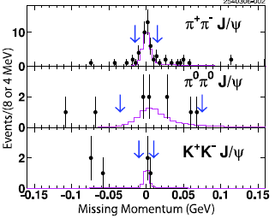


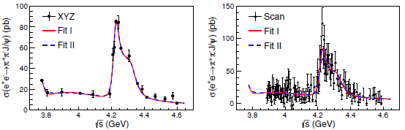
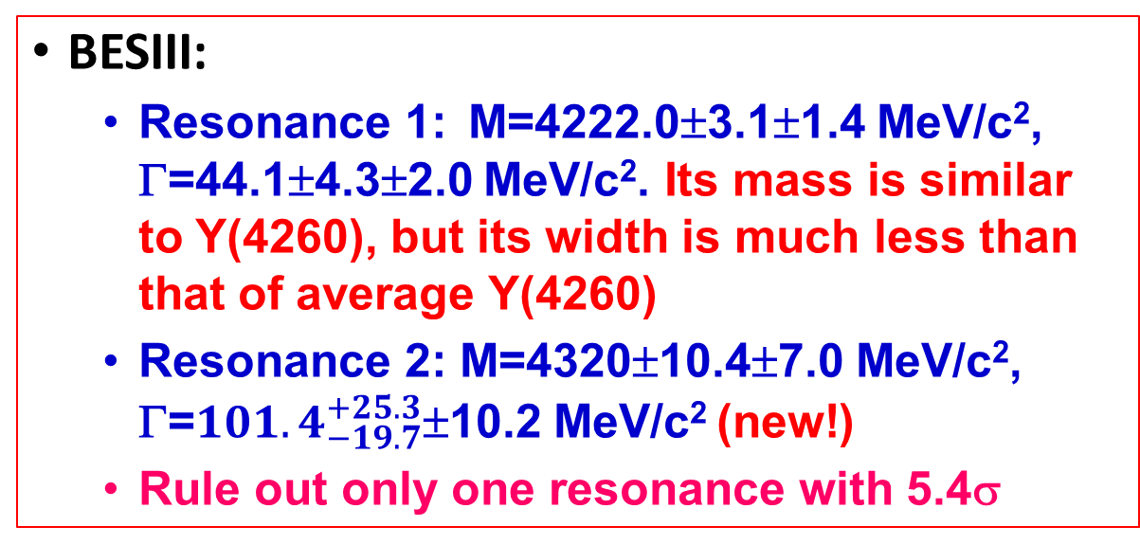
e⁺e⁻→π⁺π⁻J/ψ (Y(4260), or Y(4220)&Y(4320)?)
CLEO:
  Confirm Y(4260) via the missing momentum (√s=4.26 GeV)
CLEO:PRL96, 162003(2006)
BESIII:
  Resonance 1: M=4222.0±3.1±1.4 MeV/c², Γ=44.1±4.3±2.0 MeV/c². Its mass is similar to Y(4260), but its width is much less than that of average Y(4260)
  Resonance 2: M=4320±10.4±7.0 MeV/c², Γ=${101.4}_{−19.7}^{+25.3}$±10.2 MeV/c² (new!)
  Rule out only one resonance with 5.4σ
BESIII:PRL118,092001 (2017)

Slide 14

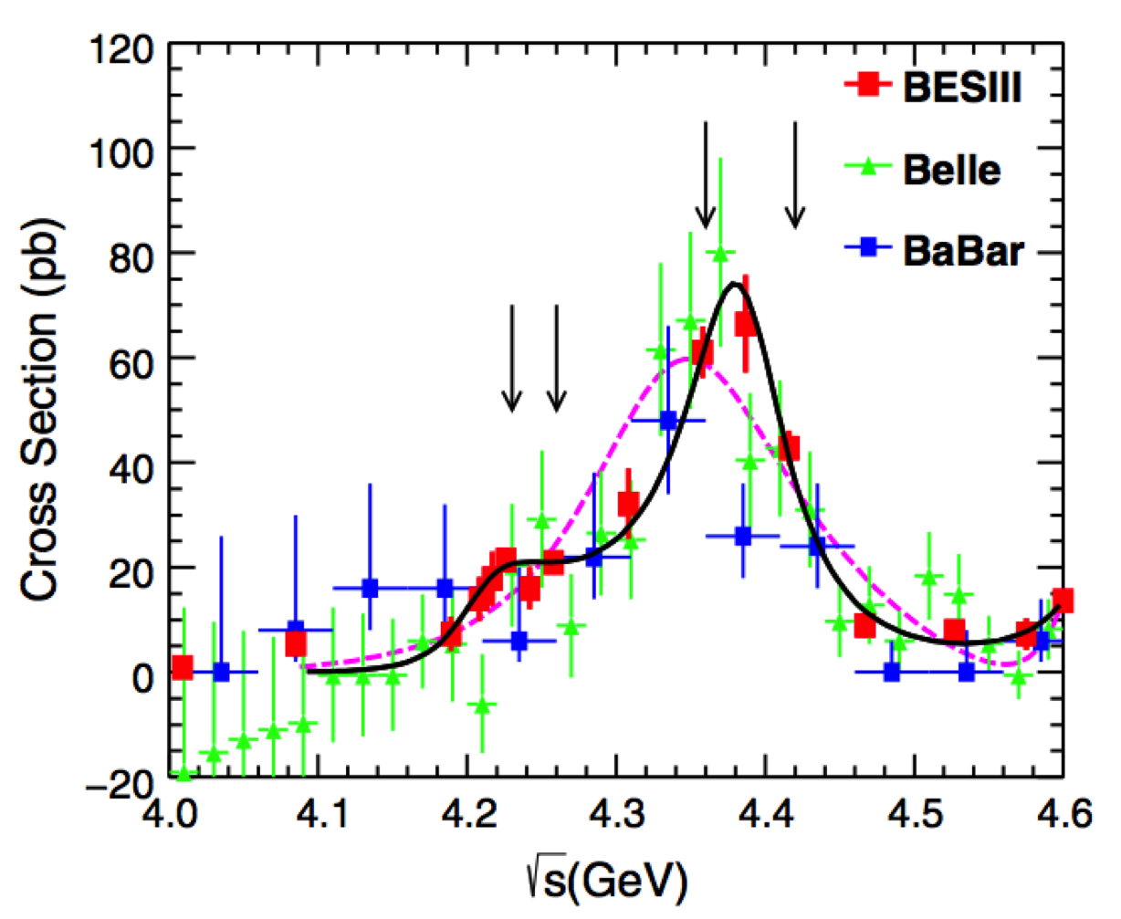
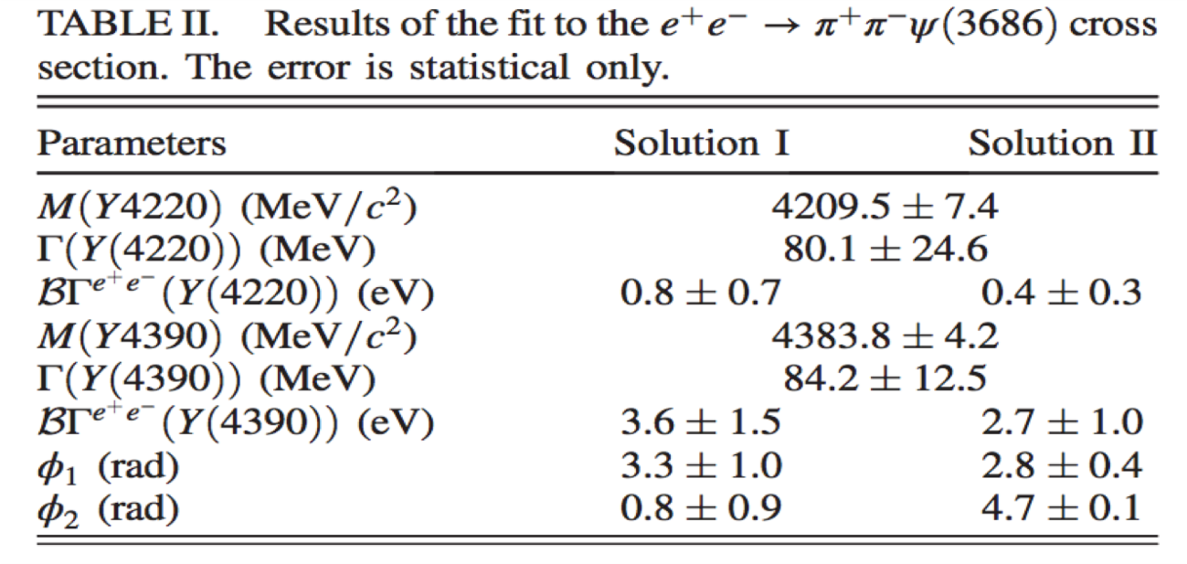
e⁺e⁻→π⁺π⁻，π⁰π⁰ψ(2S) (Y(4220)&&Y(4390)?)
BESIII measured the Born cross section of e⁺e⁻→π⁰π⁰ψ(2S) at 16 energies. Our results agree with the previous experiments
There is a bump near 4.36 GeV. Is it Y(4360)?
PRD 96,032004(2017)

Slide 15
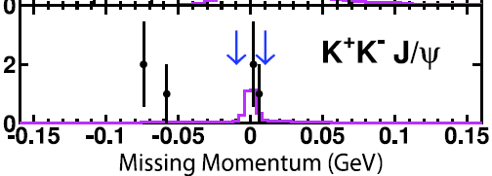
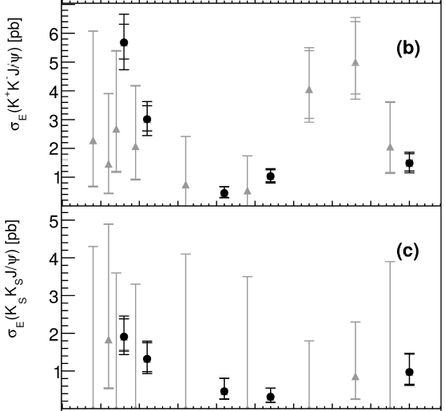

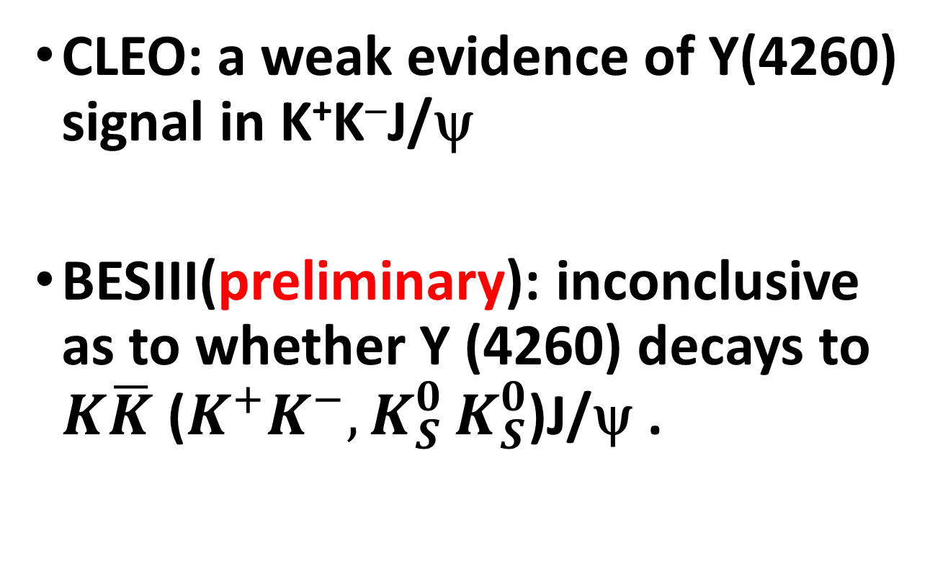
e⁺e⁻→KKJ/ψ (Y(4260)?)
CLEO
CLEO: a weak evidence of Y(4260) signal in K⁺K⁻J/ψ
BESIII(preliminary): inconclusive as to whether Y (4260) decays to $K\overline{K}$ ($K^{+}K^{−}{,K}_{S}^{0}K_{S}^{0}$)J/ψ .
Black: high stat.
Grey: low stat.
BESIII

Slide 16

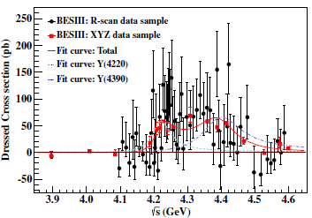
e⁺e⁻→π⁺π⁻h_{c} (two Y states?)
PRL118,092002 (2017)
: constant width BW function
P(m) : 3-body phase space factor
φ : relative phase between two resonances
Significance of two resonant structures over that of one structure is 10σ
The parameters of these two structures are different from those of Y(4260) and Y(4360), and ψ(4415)
 | M (MeV) | Γ_{tot} (MeV) | Γ_{ee}•Br (eV) | φ (rad)
Y(4220) | ±0.9 | ±0.4 | ±0.8 | --
Y(4390) | ±1.0 | ±0.6 | ±1.9 | ±0.2

Slide 17
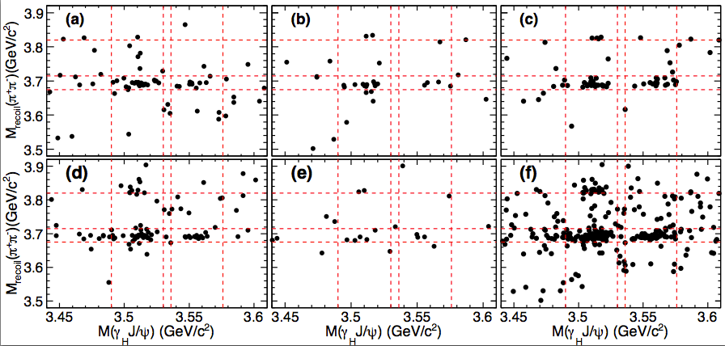
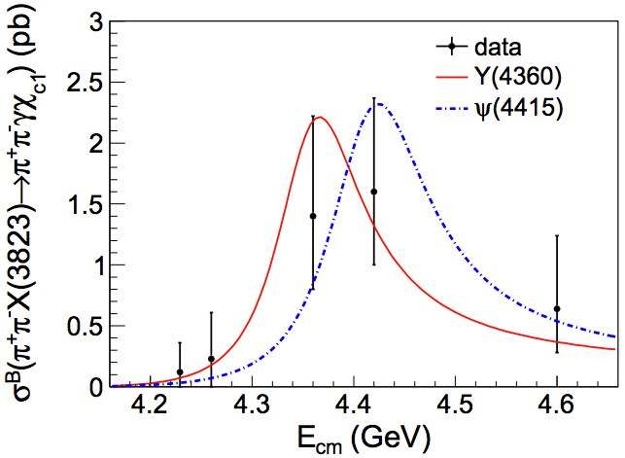
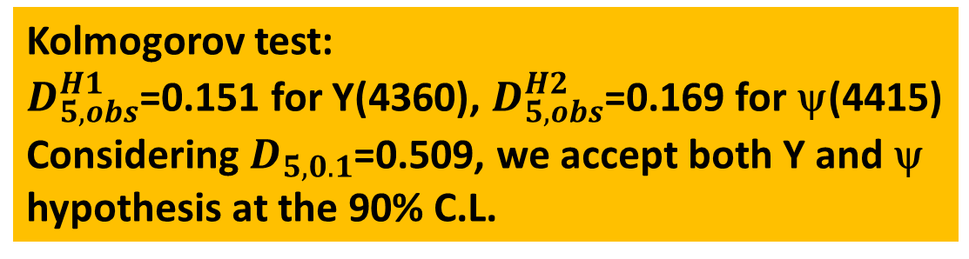
e⁺e⁻→ π⁺π⁻X(3823) (Y or ψ?)
Clear X(3823) is seen in χ_{c1} mass region
Line-shape of π⁺π⁻X(3823)
  Y(4360)?
  ψ(4415)?
  Both?
  More?
4.23 GeV
4.26 GeV
4.36 GeV
4.42 GeV
4.60 GeV
Sum
Kolmogorov test:
$D_{5,obs}^{H1}$=0.151 for Y(4360), $D_{5,obs}^{H2}$=0.169 for ψ(4415)
Considering $D_{5,0.1}$=0.509, we accept both Y and ψ hypothesis at the 90% C.L.
PRL115,011803 (2015)

Slide 18
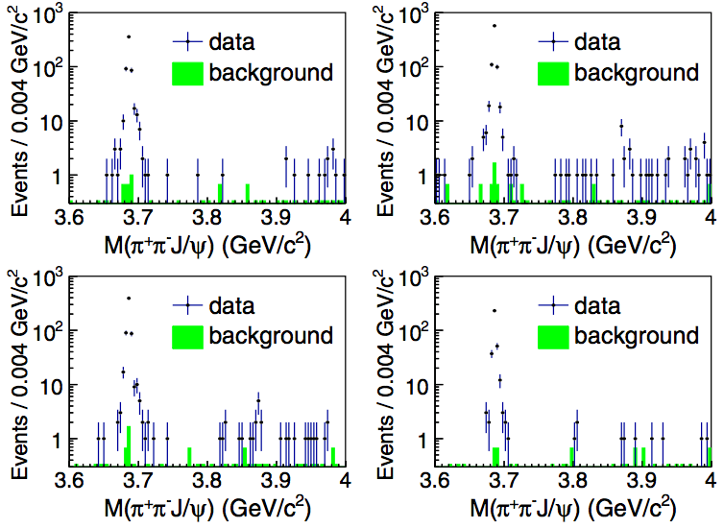
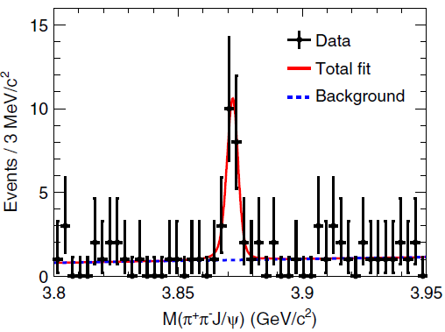
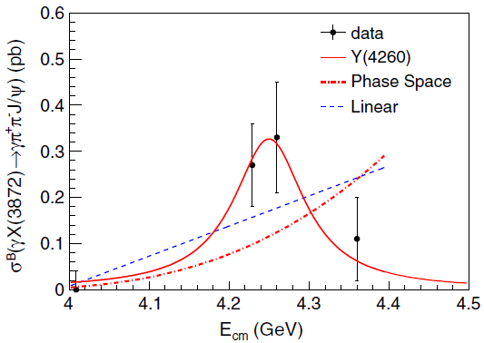
e⁺e⁻→ γX(3872) (Y(4260)?)
Try to fit σ^{B}(γX(3872) →γπ⁺π⁻J/ψ) with Y(4260) , linear and phase-space shape
Y(4260) → γX(3872)? Need to be confirmed

Slide 19
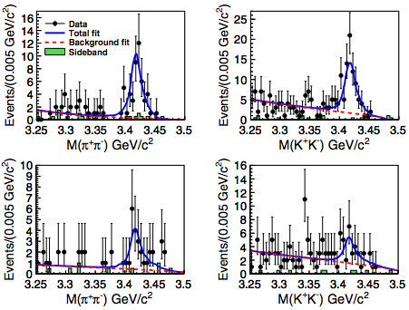
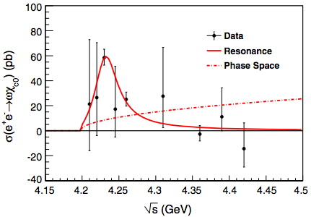
e⁺e⁻→ωχ_{c0} (Y(4220)?)
PRL114, 092003 (2015)
Using scan data over 4.23 and 4.6 GeV, e⁺e⁻→ωχ_{c0} are significant.
Cross section peak near 4.23 GeV, fit with BW yields Mass=(4230±8±6) MeV, Width=(38±12±2) MeV.
  A new structure?
  Tetraquark [PRD 91, 117501 (2015)]?
  Threshold effect?
  Similar to the first structure Y(4220) in e⁺e⁻→π⁺π⁻h_{c} line-shape
4.23 GeV
4.26 GeV
Same?

Slide 20
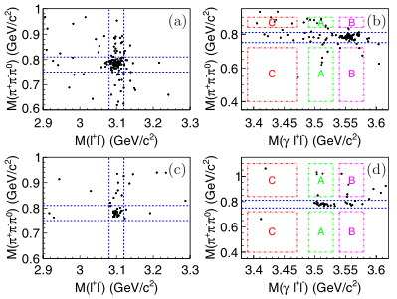
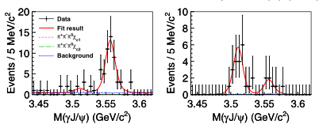
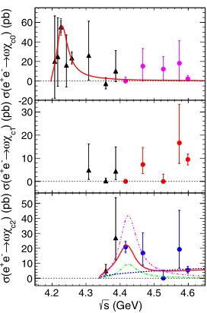
e⁺e⁻ →ωχ_{c1,2} (Y or ψ?)
ωχ_{c0}
4.42 GeV
ωχ_{c1}
4.6 GeV
ωχ_{c2}
Phys. Rev. D 93, 011102 (2016)
Clear χ_{c2},χ_{c1} are observed at √s=4.42, 4.6 GeV, respectively
The Born cross section have been measured for e⁺e⁻ →ωχ_{c1,2}
σ(e⁺e⁻ →ωχ_{c2}) is fitted with the coherent sum of the ψ(4415) BW function and a phase-space term. Two solutions are obtained: constructive, destructive

Slide 21
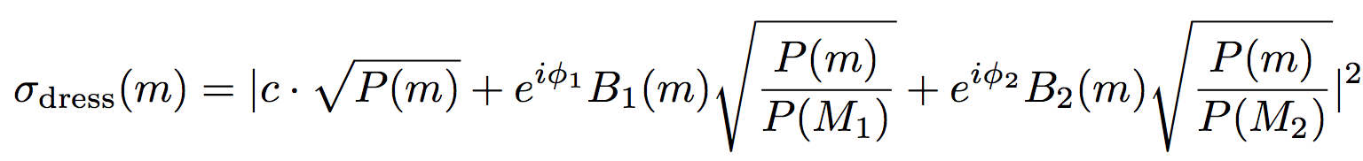
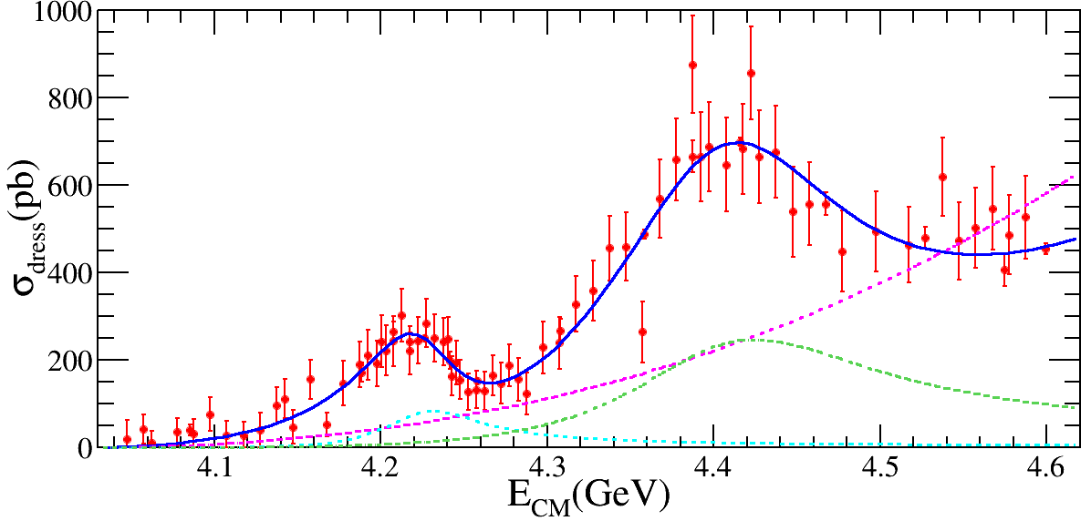
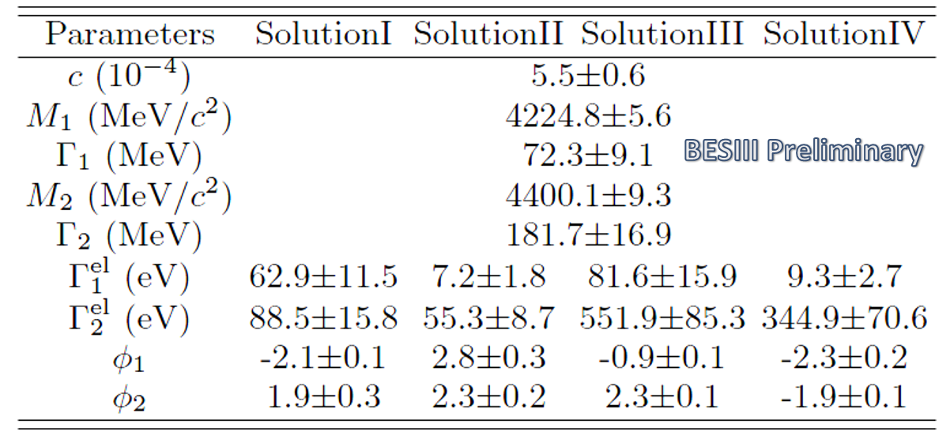
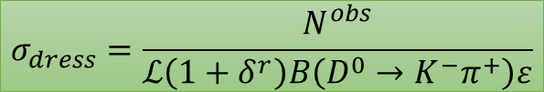
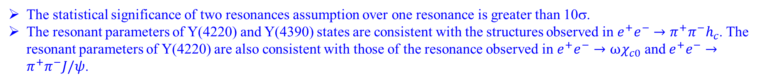
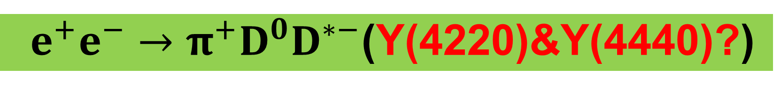
$e^{+}e^{−}→π^{+}D^{0}D^{∗−}$(Y(4220)&Y(4440)?)
$$σ_{dress}=\frac{N^{obs}}{ℒ\left(1+δ^{r}\right)B\left(D^{0}→K^{−}π^{+}\right)ε}$$
The statistical significance of two resonances assumption over one resonance is greater than 10σ.
The resonant parameters of Y(4220) and Y(4390) states are consistent with the structures observed in $e^{+}e^{−}→π^{+}π^{−}h_{c}$. The resonant parameters of Y(4220) are also consistent with those of the resonance observed in $e^{+}e^{−}→ωχ_{c0}$ and $e^{+}e^{−}→π^{+}π^{−}J/ψ$.

Slide 22
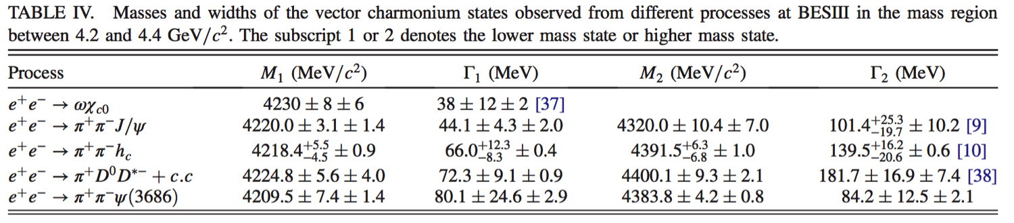
Summary Y(4220) & Y(4390) at BESIII

Slide 23
Z states

Slide 24
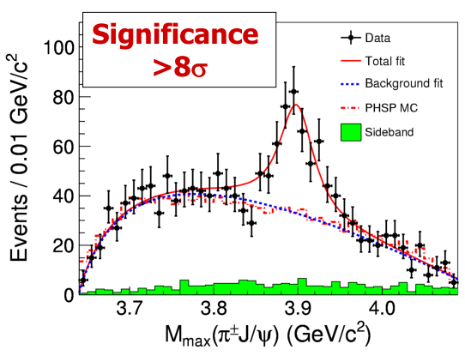

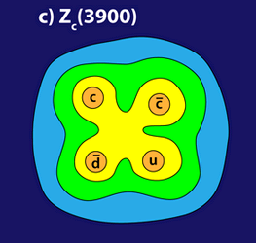
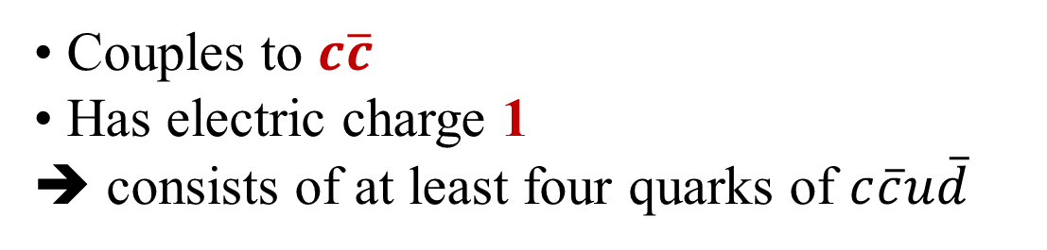
Z_{c}(3900)⁺ discovery
PRL110, 252001 (2013)
Mass = (3899.0±3.6±4.9) MeV
Width = (46±10±20) MeV
307±48events
from APS/Alan Stonebraker

Slide 25
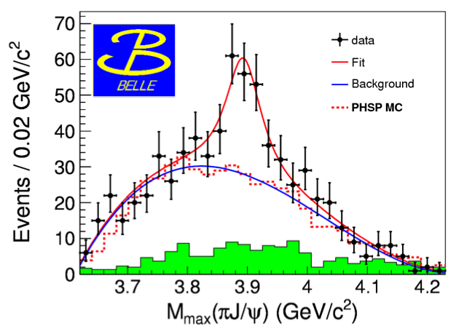
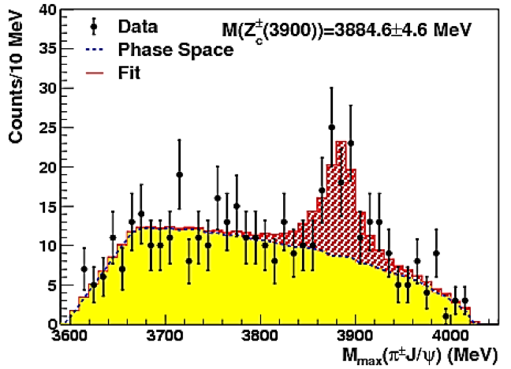
Confirmations from other experiments
Belle with ISR-return from Y(nS) data set
PRL110, 252002 (2013)
CLEOc data at 4.17 GeV:
PLB 727, 366 (2013)
81±20events
6.1σ
>5.2σ
159±49events
Mass = (3894.5±6.6±4.5) MeV
Width = (63±24±26) MeV
Mass = (3885±5±1) MeV
Width = (34±12±4) MeV

Slide 26
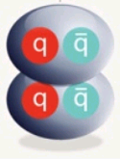

Nature of the exotic Z_{c}(3900)⁺
Its mass lies close to the threshold of m(D)+m(D*)
DD* molecule?
tetraquark?
and other scenarios:
Cusp?
Threshold effect?
...
Other decay mode of the Zc(3900)?
Partner(s) of the Zc?

Slide 27









e⁺e⁻ →π⁻Z⁺_{c}(3885)→π⁻(DD*)⁺ at 4.26GeV
similar for the iso-spin partner mode
PRL110, 252001 (2013)
If Z_{c}(3885) is Z_{c}(3900):
$$R=\frac{Γ(Z_{c}\left(3885\right)→{\left(\overline{D}D^{∗}\right)}^{+})}{Γ({Z_{c}\left(3900\right)→π}^{+}J/ψ)}=6.2±1.1±2.7$$
Angular distribution favors 1⁺ and disfavors 1⁻ or 0⁻

Slide 28




Structures in e⁺e⁻ →π⁺π⁻h_{c}(1P)
PRL111, 242001 (2013)
Reflection and possible Z_{c}(3900) signal

Slide 29





Observation of the Z_{c}(4025)⁺ via e⁺e⁻→π⁻(D*D*)⁺
assume it as a particle, Zc(4025), and fit to the π⁻ recoil mass distribution
>10σ
401±47 Z_{c}(4025) events
Z_{c}(4020)=Z_{c}(4025)?
Coupling to D*D* is much larger than to π⁻h_{c} if they are the same state

Slide 30




Discoveries of the charged Z_{c}±’s by 2014
Zc(3900)⁺
Zc(3885)⁺
PRL110, 252001
PRL110, 252001
Zc(4020)⁺
Zc(4025)⁺
PRL111, 242001
PRL113, 132001
Searching for isospin partners of these states are important to identify the nature
Measurement of their quantum numbers

Slide 31





Search for Z_{c}(3900)⁰ in $e^{+}e^{−}→π^{0}π^{0}$J/𝜓
Search for Z_{c}(4020)⁰ in $e^{+}e^{−}→π^{0}π^{0}\text{h}\text{c}$
PRL 115, 112003 (2015)
PRL113, 212002 (2014)
M = 3894.8±2.3±3.2 MeV/c²
= 29.6±8.2±8.2 MeV
M = (4023.6$±2.2±3.9$) MeV/c²
Width fixed to the Z_{c}(4020)⁺
Isospin triplet is established: &
    Evidence for neutral isospin partner!
    [T. Xiao et al., PLB 727, 366 (2013)]
Z_{c}(3900)^{±/0}
Z_{c}(4020)^{±/0}

Slide 32









Search for Z_{c}(3885)⁰ in $e^{+}e^{−}→π^{0}{(D{\overline{D}}^{∗})}^{0}$
Search for Z_{c}(4025)⁰ in $e^{+}e^{−}→π^{0}{(D^{∗}{\overline{D}}^{∗})}^{0}$
PRL 115, 222002 (2015)
PRL115, 182002 (2015)
D⁺→K⁻π⁺π⁺, K⁻π⁺π⁺π⁰, Ksπ⁺,
Ksπ⁺π⁰, Ksπ⁺π⁺π⁻
D⁰→K⁻π⁺, K⁻π⁺π⁰, K⁻π⁻π⁺π⁺
D⁺→K⁻π⁺π⁺
D⁰→K⁻π⁺, K⁻π⁺π⁰, K⁻π⁻π⁺π⁺
$e^{+}e^{−}→D^{+}D^{∗−}π^{0}$ $→D^{+}{\overline{D}}^{0}π^{−}π^{0}$
7.4σ
m_{pole} = ($\text{3885.7}{}_{−5.7}^{+4.3}{\text{±}}$8.4) MeV/c²
Γ_{pole} = (35${}_{−12}^{+11}{\text{±}}$15) MeV
m_{pole} = (4025.5${}_{−4.7}^{+2,0}{\text{±}}$3.1) MeV/c²
Γ_{pole} = (23.0±6.0±1.0) MeV
Isospin triplet is established: &
Z_{c}(3885)^{±/0}
Z_{c}(4025)^{±/0}

Slide 33




e⁺e⁻→(DD*)⁺π⁻+c.c. ( DT method )
PRD92,092006 (2015)
Double tag @ 4.23 GeV
Double tag @ 4.26 GeV
PRL 112, 022001 (2014)
PRD92,092006 (2015)
Single tag
M=3883.9±1.5±4.2 MeV
Γ=24.8±3.3±11.0 MeV
J^{P}=1⁺
Double tag
M=3881.7±1.6±2.1 MeV
Γ=26.6±2.0±2.3 MeV
J^{P}=1⁺
$Z_{c}\left(4020\right)→\overline{D}D^{∗}$ is not observed
➔ $\frac{{Γ(Z}_{c}\left(4020\right)→\overline{D}D^{∗})}{Γ(Z_{c}(3885)→\overline{D}D^{∗})}<0.13$
Good agreement between ST & DT method

Slide 34


The Zc Family at BESIII

Slide 35





The Zc Family at BESIII
Zc(3900)⁺?
Zc(3900)⁰?
Zc(4020)⁺?
Zc(4020)⁰?
PRL 110, 252001 (2013)
PRL 115, 112003 (2015)
PRL 111, 242001(2013)
PRL113,212002 (2014)
Zc(3885)⁺?
Zc(3885)⁰?
Zc(4025)⁺?
Zc(4025)⁰?
ST: PRL 112, 022001(2014)
DT: PRD92, 092006 (2015)
PRL 115, 222002 (2015)
PRL 112, 132001 (2014)
PRL115, 182002 (2015)
$$e^{+}e^{−}→π^{0}{(D^{∗}{\overline{D}}^{})}^{0}$$
$$e^{+}e^{−}→π^{0}{(D^{∗}{\overline{D}}^{∗})}^{0}$$
Which is the nature of these states?
Different decay channels of the same observed states? Other decay modes?

Slide 36

Amplitude analysis of e⁺e⁻ →π⁺π⁻J/𝜓
PRL 119.072001 (2017)

Slide 37





Spin-parity determination of the Z_{c}(3900)⁺
PRL 119.072001 (2017)
Zc line shape parameterized with Flatte-like formula
4.23GeV
J^{P}=1⁺
4.26GeV
J^{P} is measured to be 1⁺ with significance larger than 7.6𝞼

Slide 38
Determiend properties of the Z_{c}(3900)⁺
PRL 119.072001 (2017)

Slide 39









Z_{c} candidate in π±𝜓(3686) at 4.416 GeV (Z_{c}(4030)±)
PRD96，032004，(2017)
4.416GeV
However, the fitting quality is not good.

Slide 40













Study of e⁺e⁻→π⁰π⁰ψ(2S) (Z_{c}(4030)⁰?)
(a) 4.226 GeV, (b) 4.258 GeV, (c) 4.358 GeV, (d) 4.416 GeV
$𝓛$= 1091.74 pb ⁻¹
825.67 pb⁻¹
539.84 pb⁻¹
1073.56 pb ⁻¹
BESIII preliminary
4038.7±6.5 MeV
Consistent with charged mode!
40

Slide 41
Summary
Some new decay modes for light meson are observed.
Many candidates of charmonium-like vector states are observed above open charm threshold. They enrich the charmonium family.
The Y states are difficult to distinguish from the traditional charmonium states.
Some potential new structures need to be further confirmed.
谢谢！

