Slide 1
Phase shift formulas for baryon-baryon scattering in elongated boxes
荔宁
西安工业大学
2017手征有效场论研讨会（西安）
2017.10

Slide 2
Physics motivation
Elastic scattering phaseshift
Partial-wave expansion of scattering amplitude:
Phaseshift
Physics significance:
Attractive interaction (δ<0); repulsive interaction (δ>0);
formation of resonances;
scattering length from effective range expansion, etc

Slide 3
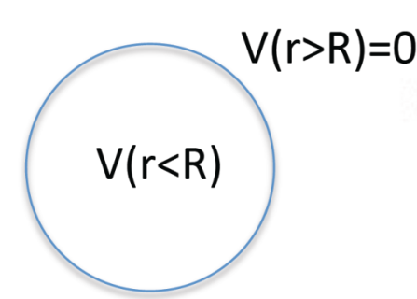
Physics motivation
The phaseshift can be determined in the region where the interaction is vanishing so the solution to the Schrodinger equation,
can be expressed in terms of ordinary spherical bessel functions
The phaseshift can be determined by
Lüscher method:
Lüscher established a relation between the discrete energy spectrum in a box of size L*L*L and elastic scattering phaseshift in the infinite volume:

Slide 4
Physics motivation
Once the interaction energy is determined, the phaseshift can be extracted from the Lüscher formula.
Two comments:
In a box, the matching of wave functions on the interaction boundary (to obtain the coefficients α_{l} and β_{l}) is replaced by the matrix function M(k,L); The nature of the interaction is encoded in the energies of the two-body states, which is measured through the quark-gluon dynamics of QCD.
Even though the energies are obtained in Euclidean time in a finite box, the phaseshift has the same definition and meaning as in infinite volume and Minkowski time. Once the pion mass is brought to the physical point, the phase shift computed in the box can be directly compared with experiment.

Slide 5
Physics motivation
Why we use finite box??
The box is simply a device that serves two purposes at once:
to allow the interaction energy to be computed in lattice QCD by making the problem finite thus amenable to a numerical approach;
to facilitate the access to the physical phase shift via the Lüscher method;
Successfully used

Slide 6
Physics motivation
Our goal: perform such an reduction for baryon-baryon scattering in the elongated box.(Ning Li arXiv:1708.01879)
Meson-meson scattering
Phaseshift in the elongated box is derived by Frank X. Lee. (arXiv:1706.00262)
Meson-baryon scattering
Why we use elongated box??
In a cubic box, the three momenta of a single particle are quantized according to
However, in the cubic lattice, many low momentum modes are energy degenerate such as modes (1,0, 0), (0, 1, 0) and (0, 0, 1) since they are related to each another by the cubic symmetry.

Slide 7
Phaseshift reduction
Start with phase shift formulas for baryon-baryon scattering in COM frame in elongated boxes
Ning Li arXiv:1708.01879
Brief review of the basic Lüscher 's formula
The asymptotic form of the wave function is written as:

Slide 8
Phaseshift reduction
For baryon-baryon scattering, we enclose the two-particle system in a cubic box of size L with periodic boundary condition. In the outer region where the potential vanishes, the wave function becomes
Then, we can expand the wave function into a linear superposition of the singular periodic solutions, i.e., G_{JMls}(r; k²), of the Helmholtz equation in the outer region. Thus, one can get

Slide 9
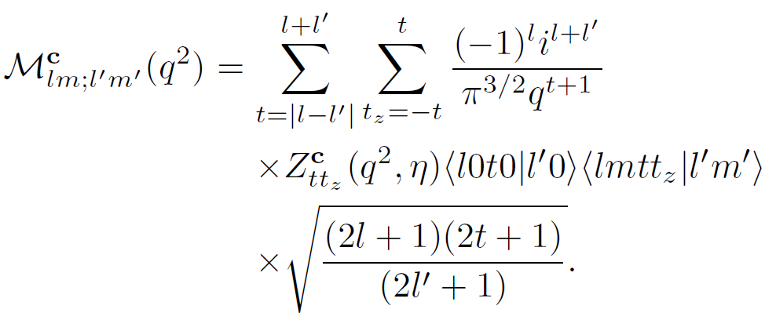
Phaseshift reduction
The phaseshift is determined from the quantization condition:

Slide 10
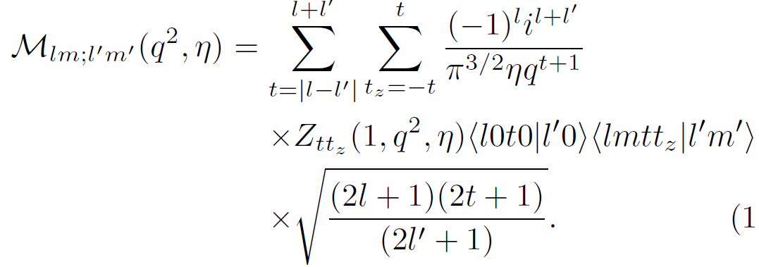
Phaseshift reduction continued
Extension in elongated boxes in COM frame:
Two comments:
1) One can expand the wave function of the system in the outer region as series of the modified matrix, whose element is

Slide 11
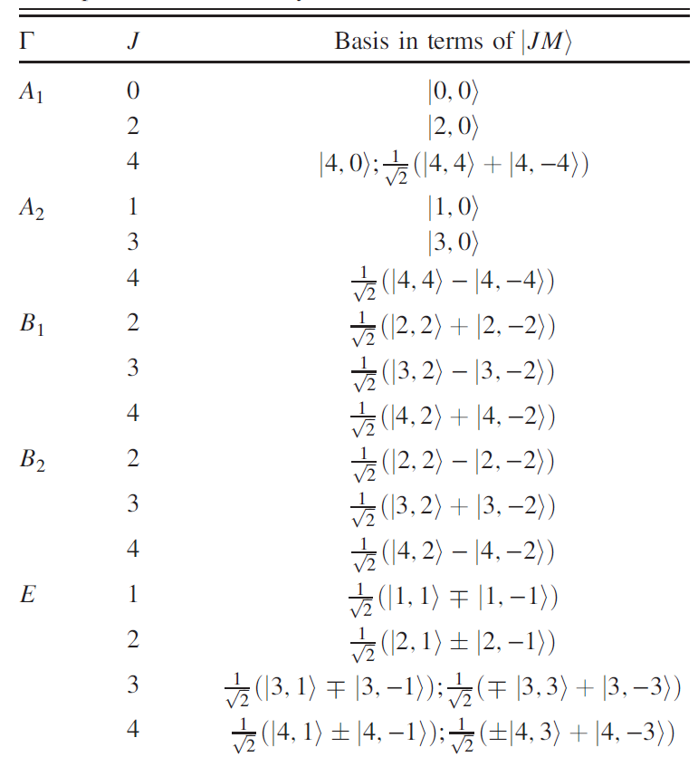
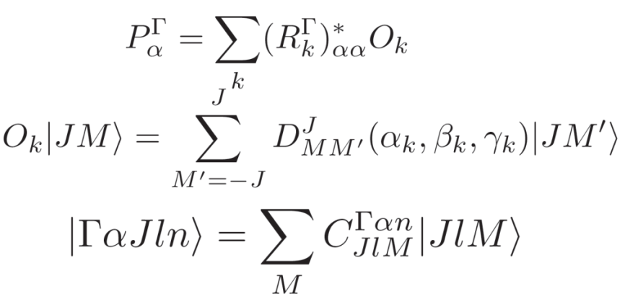
Phaseshift reduction
2) The symmetry of two-particle system is no longer O_{h} but reduces to D_{4h} group.
In infinite volume, we can rotate the
spherical harmonics |JM> in any way we like. In a box, only certain discrete rotations are permitted, generating unique linear combinations of |JM> in each irrep, called basis vectors:
Leads to block-diagonal form by irreps:

Slide 12
Symmetry reduction:
Since physics is extracted from a finite box, we must adapt to the symmetry of the box.
Internal symmetries such as color, flavor, isospin are not affected; but angular momentum, which is a measure of rotational symmetry, is greatly affected.
Specifically,
– How is angular momentum resolved in a finite box?
– How are Lüscher phaseshift formulas reduced?

Slide 13
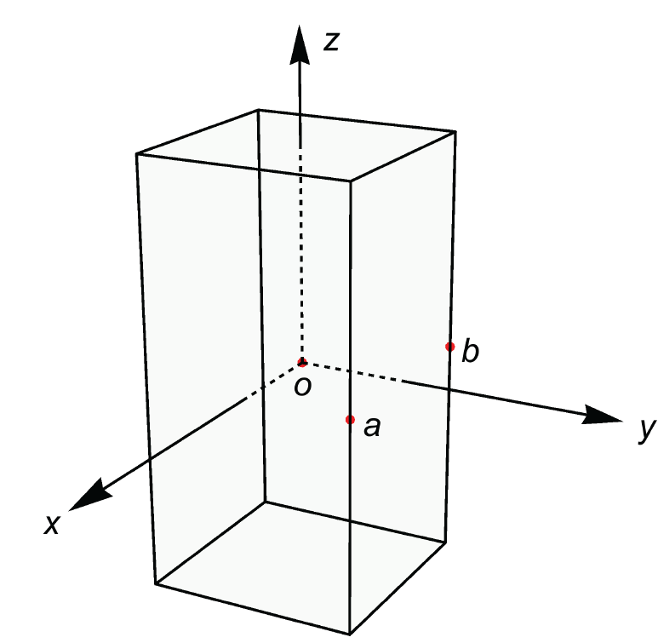
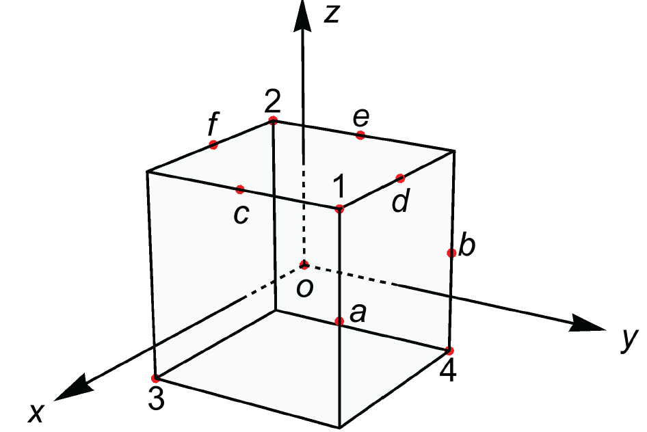
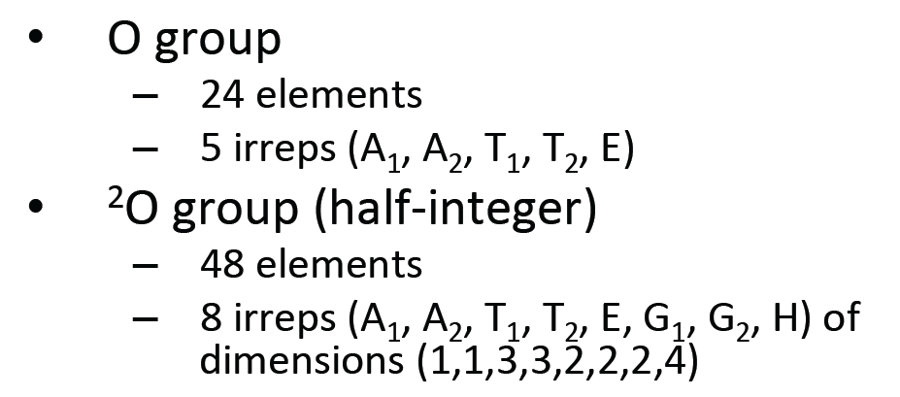
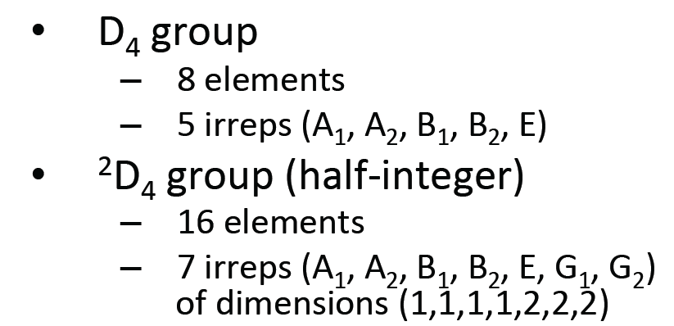
Group theory: Cubic vs. Elongated

Slide 14
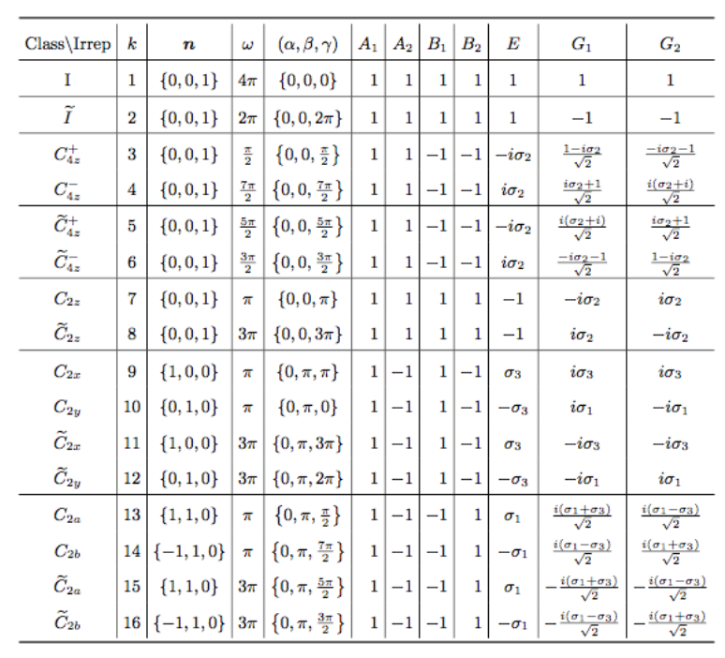
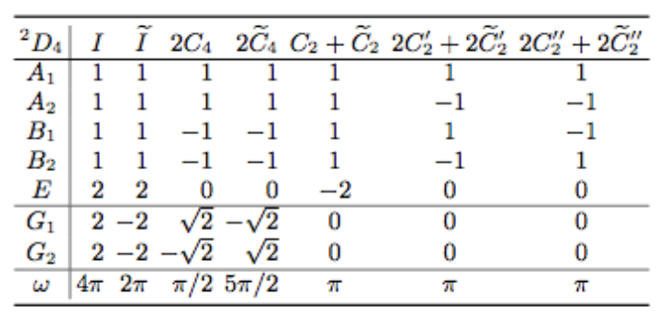
Group symmetry in elongated box
Elements and irreps
character table

Slide 15
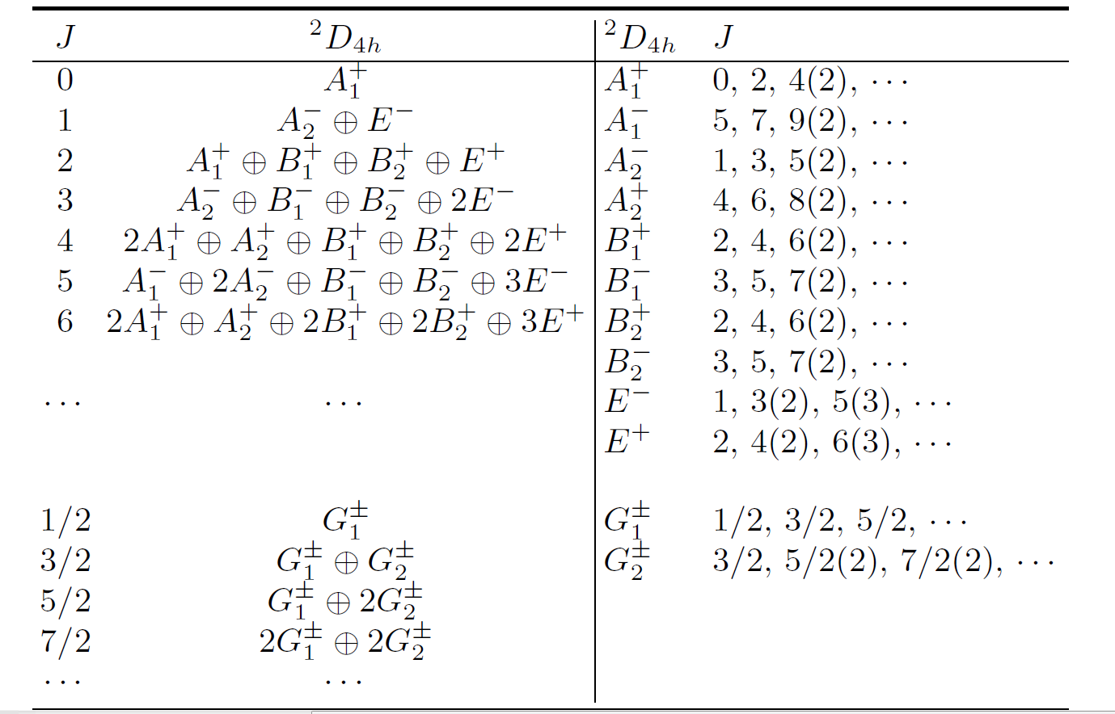
Group symmetry in elongated box
Frank X. Lee arXiv:1706.00262
PHYSICAL REVIEW D 96, 054508 (2017)

Slide 16
Phaseshift reduction
Elongated box and integer J
Key feature of box quantization: mixing of different partial waves in each irrep in the finite box.
Before writing out the explicit form of the phase shift formula, one should exploit the symmetry properties to simplify the M matrix and the parity of the two-particle system.
1) The matrix is hermitian which constrains half of the off-diagonal elements.
2) A lot of short-hand functions vanish to satisfy certain constraints, which can be traced back to how the zeta function behaves under the symmetry operations in the elongated box.

Slide 17
Phaseshift reduction
For the baryon-baryon scattering considered in this paper, the total spin s can take 0 (singlet state) or 1 (triplet states).
In the case with s = 0 we have l = J which is conserved, and the parity is simply
When s = 1 for a given J, l takes three different values, i.e., l = J+1; J-1; J.
The first two have the same parity , ,and the parity for third one
is .
The total parity of the two-particle state is equal to
For simplicity we assume that the intrinsic parity is positive, then the total parity is
For parity-conserving theories like QCD, there is no scattering between states
with opposite parity. Then we divide Lüscher’s formulas into the case A and case B corresponding to the states with parity and parity respectively.

Slide 18
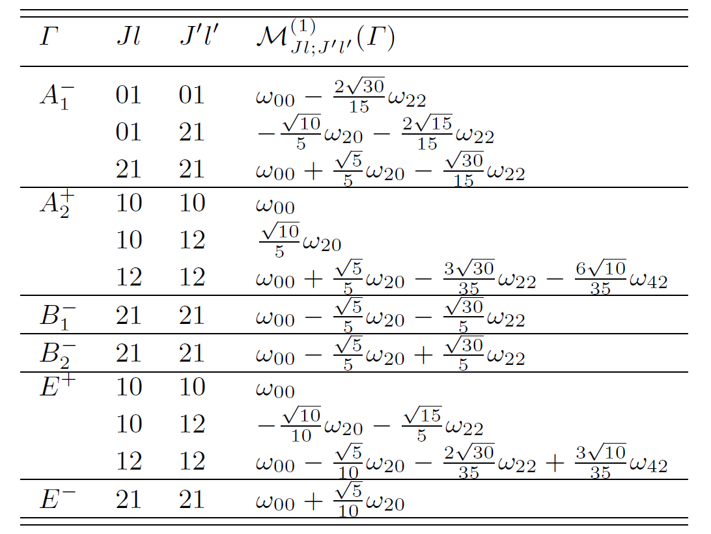
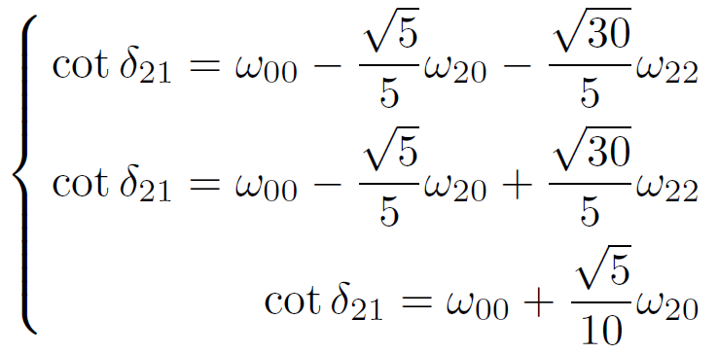
Phaseshift reduction
Application to case A
if mixing with higher partial waves can be ignored

Slide 19
Phaseshift reduction
sector:
The total angular momentum J is fixed for 1. There is a mixing with l = J-1 = 0 (S-wave) and l = J + 1 = 2(D-wave).
representation
is similar with
sector

Slide 20
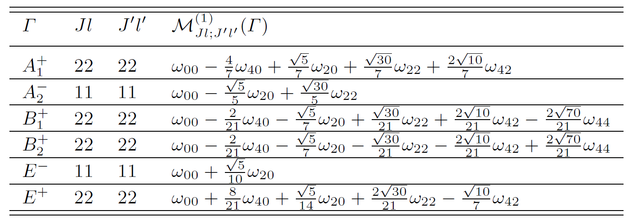
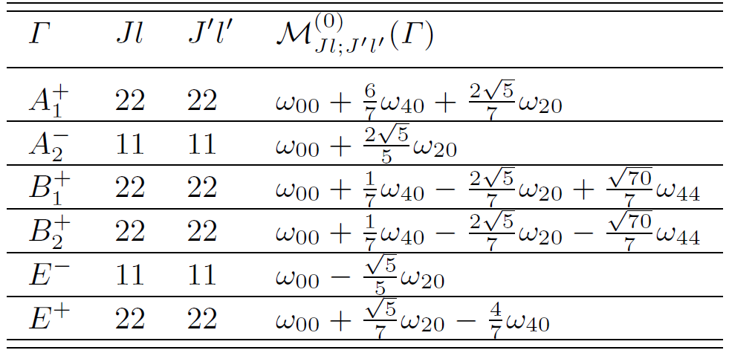
Phaseshift reduction
Application to case B

Slide 21
Phaseshift reduction
Comment:
For the two identical particles, the singlet-triplet transition is forbidden since the singlet state has an antisymmetric spin wave function which then requires a symmetric spatial one that necessarily has positive parity while the triplet state has the opposite parity.

Slide 22
Phaseshift reduction
This is similar with meson-meson scattering.
representation

Slide 23
Some generalizations in elongated boxes
Boosting in the elongated boxes: kinematics
The COM frame is then moving relative to the lab frame with a velocity
Then, we denote the momenta of the two particles with and for the two scattering particles. Thus, is related to k by conventional Lorentz boost:

Slide 24
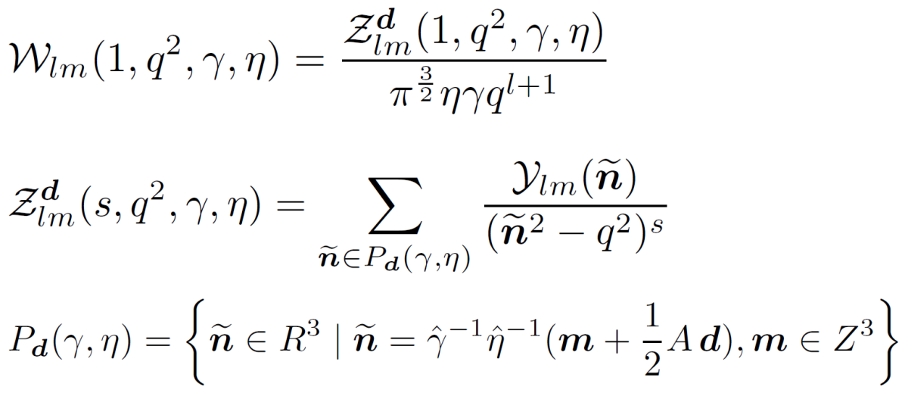
Some generalizations in elongated boxes
Boosting in the elongated boxes: zeta functions

Slide 25
Some generalizations in elongated boxes
Boost in z-direction: from D_{4h} to C_{4v}
Same formulas as in the COM frame;
the only difference is in the modified zeta functions

Slide 26
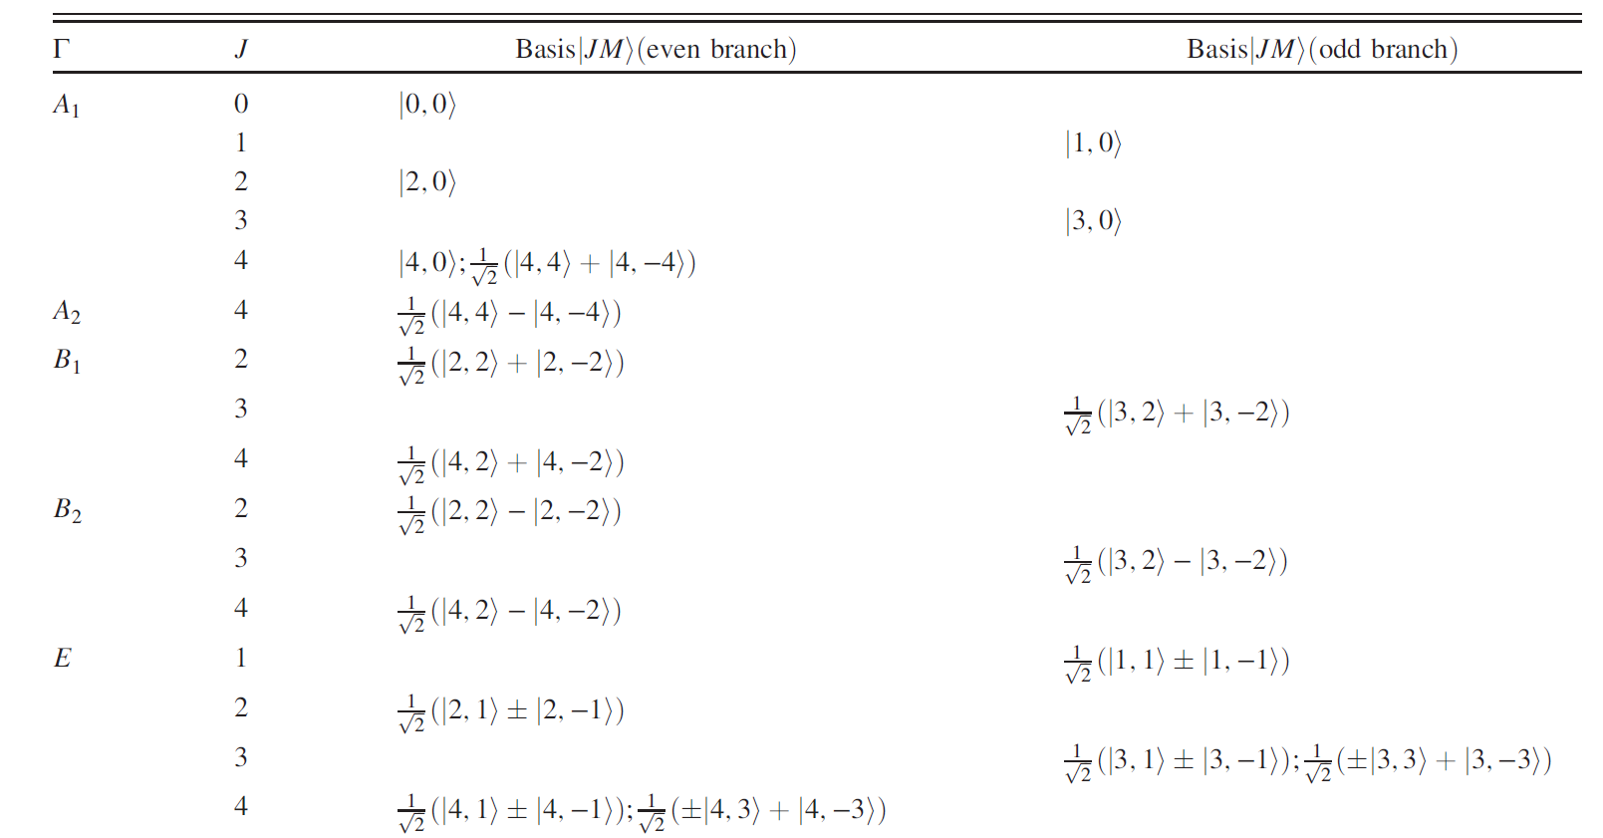
Some generalizations in elongated boxes
Boosting in the elongated boxes : basis vectors
Loss of parity leads to mixing of even and odd states

Slide 27
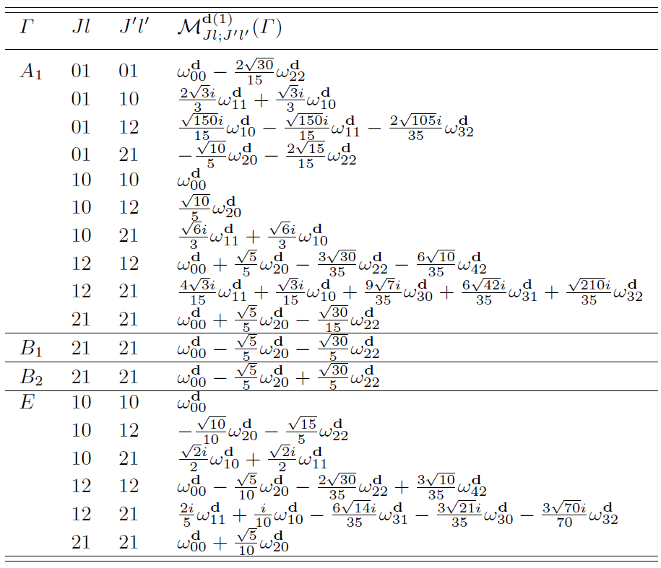
Some generalizations in elongated boxes
Boosting in the elongated boxes and integer J
Appearance of odd-l zeta functions.
Mixing between even and odd partial waves.
Here, we take phase shift formula in
Case A as an example.
we ignore the mixing with l = 2

Slide 28
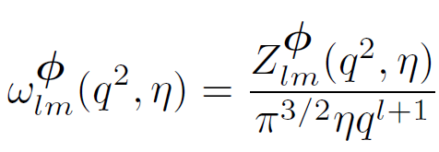
Some generalizations in elongated boxes
Twisted boundary condition in COM frame:
Twist in z-direction:
the corresponding little group is C_{4v}, same formulas as in the Moving frame; the only difference is in the modified zeta functions
the the corresponding little group is D_{4h}, same formulas as in the COM frame; the only difference is in the modified zeta functions

Slide 29
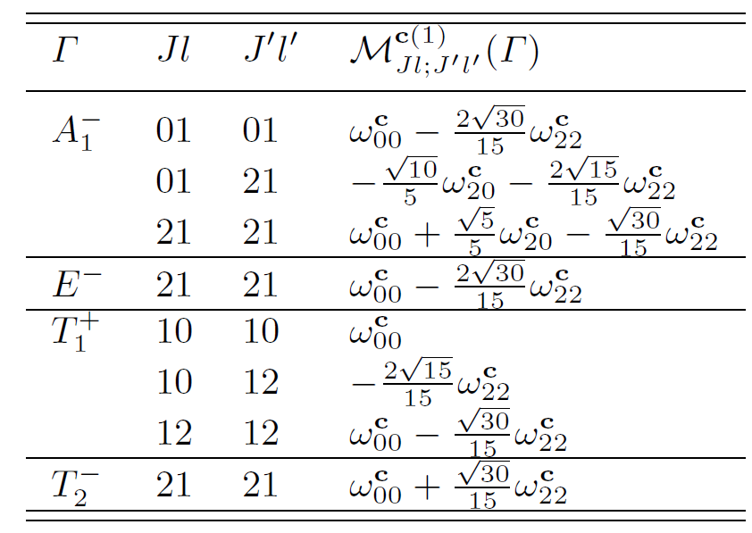
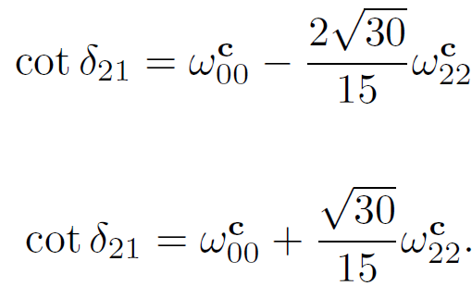
Cubic vs. Elongated
Cubic box and integer J
Case A

Slide 30
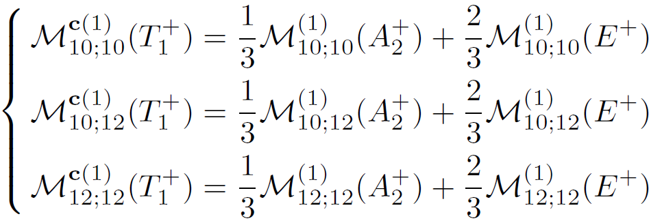
Cubic vs. Elongated
Subduction rules
( ), the has one-to-one correspondence:

Slide 31
Cubic vs. Elongated
We take representation in cubic boxes as an example.
From the elongated box to the cubic symmetry, the matrix elements
will individually approach
in the limit
One can see how to follow this limit by subduction rule in this particular channel. The relationship translates directly into one for the phase shift as follows:

Slide 32
Conclusion
We derived Lüscher phaseshift formulas in elongated boxes for elastic baryon-baryon scattering of
1) COM frame with periodic boundary condition
2) COM frame with twisted boundary condition
3) Moving frame with periodic boundary condition
along the elongated direction
Results checked against those in the cubic box
Relationship between the two follows subduction rules
possible applications
H dibaryon state
Hyperonic matters inside the neutron stars
Details can be found in arXiv:1708.01879

