Slide 1

Coupling schemes of heavy quarkonia with heavy-light mesons
2017手征有效场论
武敬
指导老师：刘言锐, 司宗国, 李世渊
山东大学
2017.10.17（西安）

Slide 2
Content
Introduction
Basic method
Discussion
Summary

Slide 3
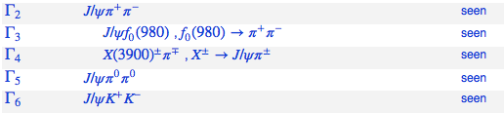
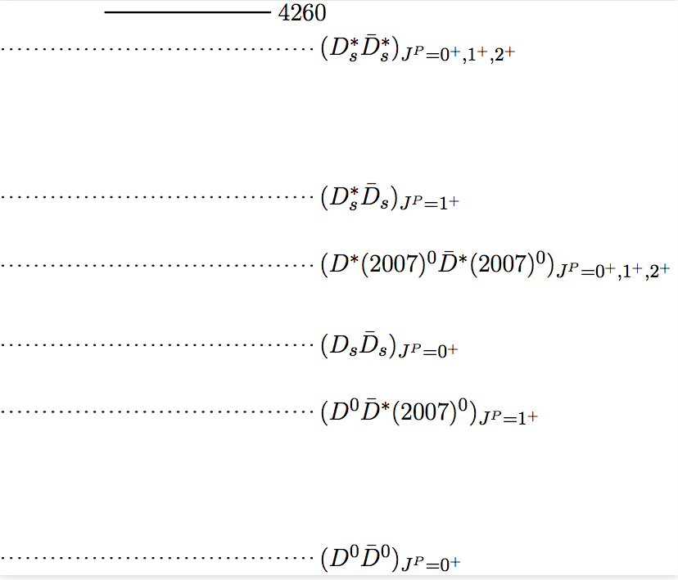
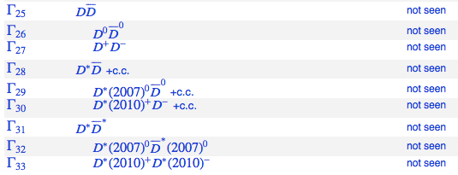
Introduction
Y(4260)
Data from PDG

Slide 4
Possible decay modes of Y(4260) in molecular and tetraquark pictures have been discussed in Refs:
Gang Li and Xiao-Hai Liu Phys. Rev. D 88, no. 9, 094008 (2013)
Li Ma, Wei-Zhen Deng, Xiao-Lin Chen and Shi-Lin Zhu arXiv:1512.01938 [hep-ph].
Because of lack of experimental results, the nature of Y(4260) as a charmonium is still not excluded:
Bai-Qing Li and Kuang-Ta Chao, Phys. Rev. D 79, 094004 (2009)
J. M. Dias, R. M. Albuquerque, M. Nielsen and C. M. Zanetti, Phys. Rev. D 86, 116012 (2012)

Slide 5
Motivation
Ratios of open charm decay widths for different channels may give some information on Y(4260).
The ratios may also be helpful to distinguish charmonia from resonances with exotic nature.
The above considerations motivate us to explore systematically the ratios of open charm decay widths for a charmonium.

Slide 6
Basic method
at hadron level: we construct the effective Lagrangian to get the ratios of different channels.
at quark level: we adopt 3P0 model to describe the created light quark-antiquark pair, then have the amplitudes by overlapping the final and initial states, and the ratios of different channels.

Slide 7
at hadron level
The orbit angular momentum and the light quark spin couple together as a light degree of freedom(LDF).
In the infinite limit of the heavy quark mass, the heavy quark spin with different directions has no affect on the LDF. It is the so called heavy quark spin symmetry.
Then there is a doublet for two mesons with the same LDF.

Slide 8
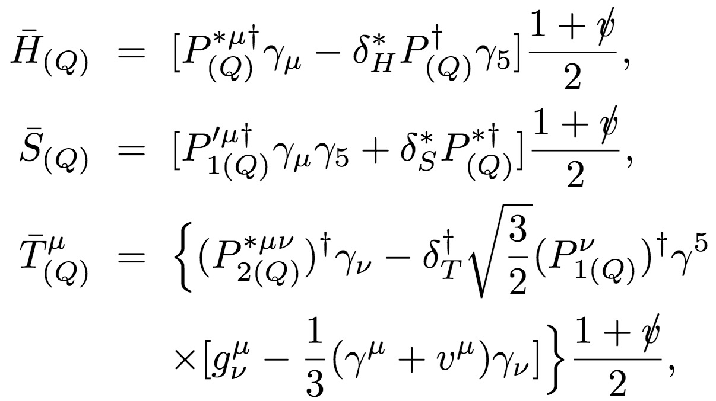
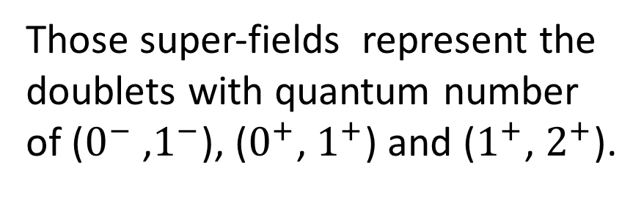
at hadron level
For the heavy quark mesons, we consider ground and first orbital excited sates.
Those super-fields represent the doublets with quantum number of ($0^{−}$ ,$1^{−}$), ($0^{+}$, $1^{+}$) and ($1^{+}$, $2^{+}$).

Slide 9
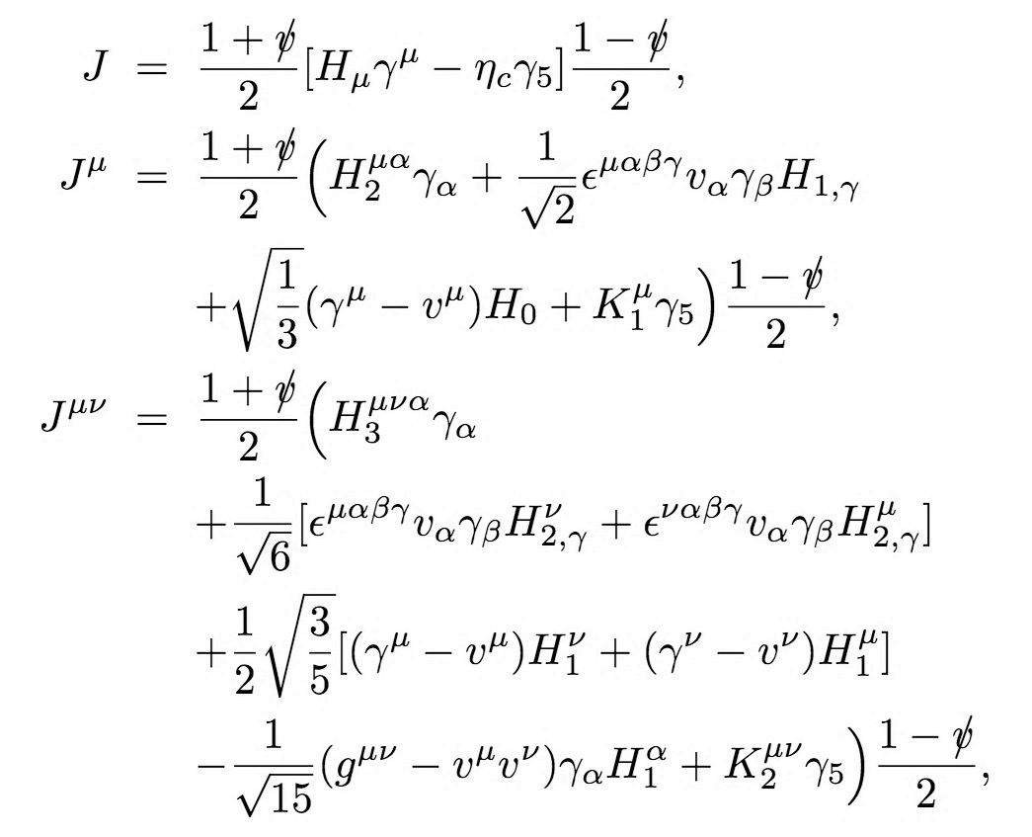
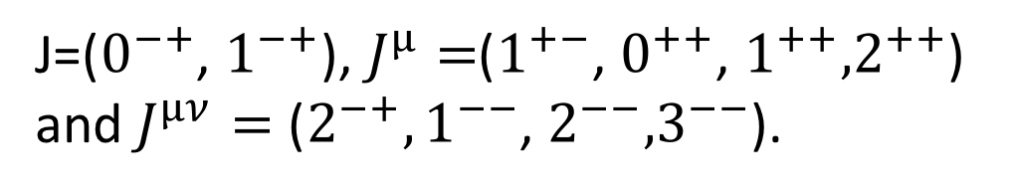
at hadron level
In the heavy quark limit, the heavy quark spin symmetry is not broken for the charmonium states.
There is a degenerate state about the spin 0 and 1 of the charmonium.
J=($0^{−+}$, $1^{−+}$), $J^{µ}=$($1^{+−}$, $0^{++}$, $1^{++}{,2}^{++}$) and$J^{µν}=$ ($2^{−+},1^{−−}$, $2^{−−}{,3}^{−−}$).

Slide 10
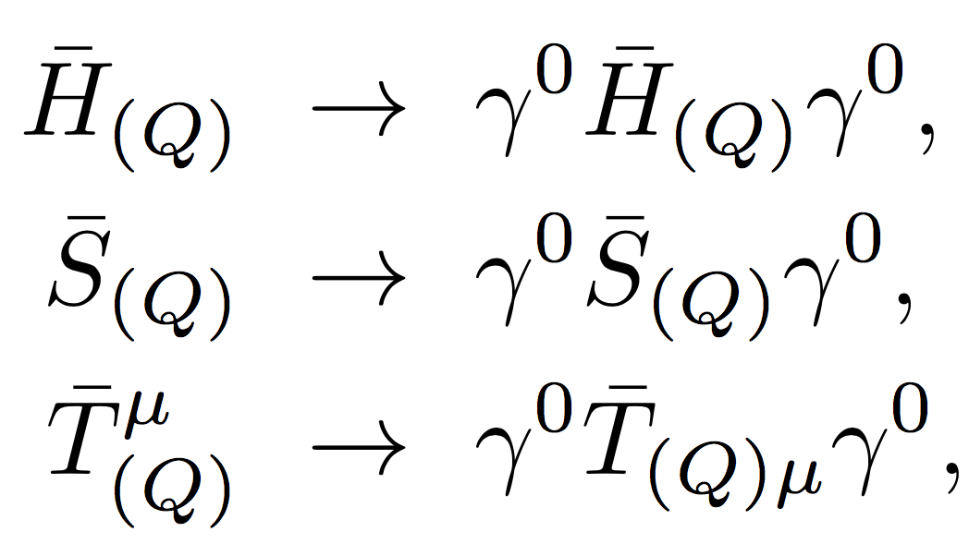
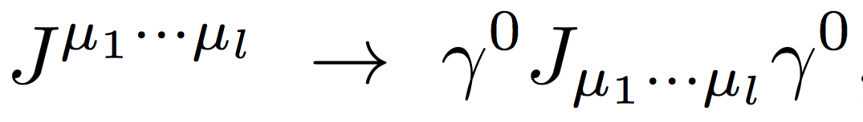
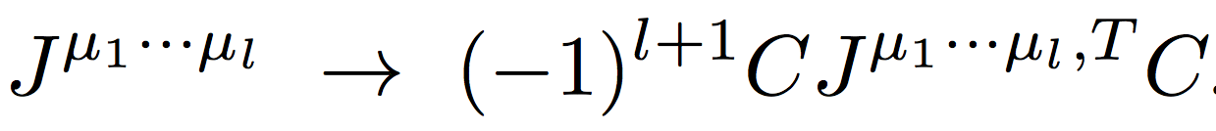
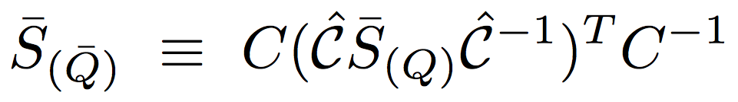
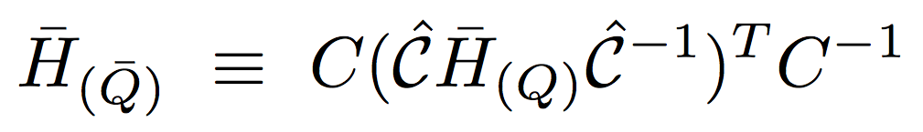
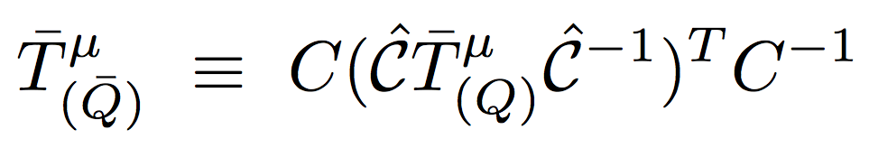
at hadron level
Parity transformation
C-parity transformation:

Slide 11
at quark level
For the initial state, we adopt the 3P0 model to describe the creation of the light quark-antiquark pair.

Slide 12
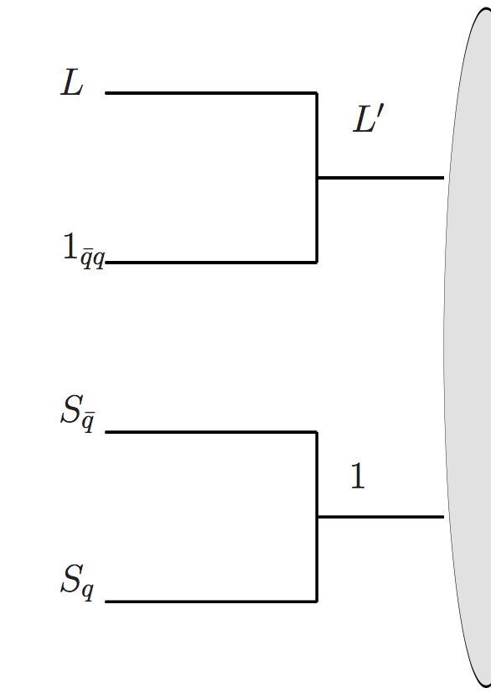
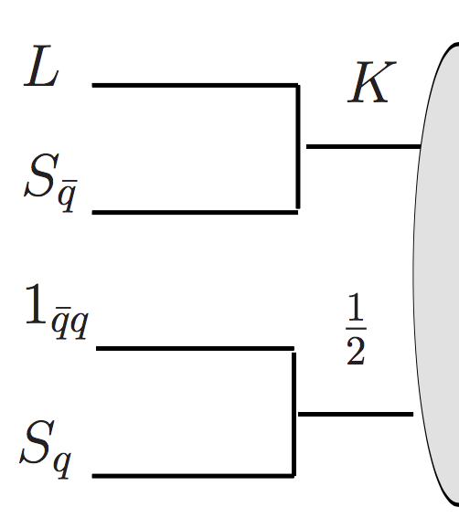
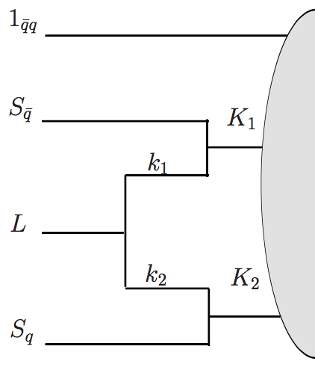
at quark level
Considering different coupling schemes of the initial angular momenta, one totally gets 10 figures :
10

Slide 13
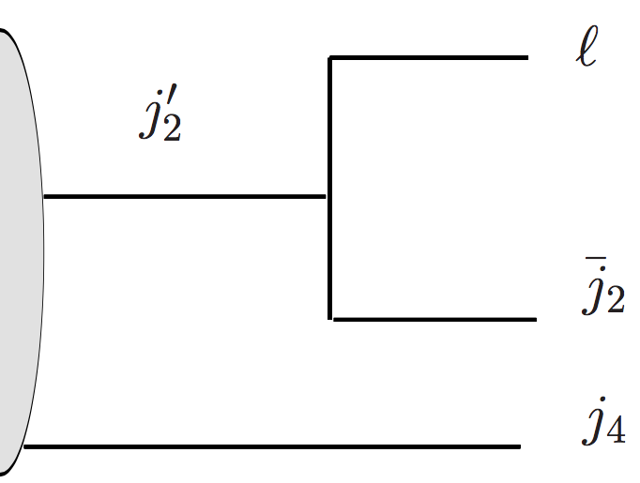
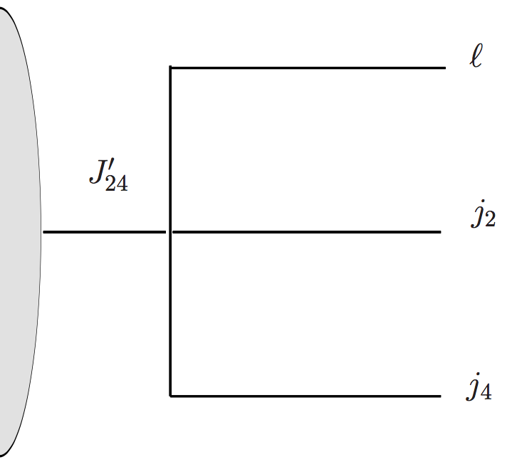
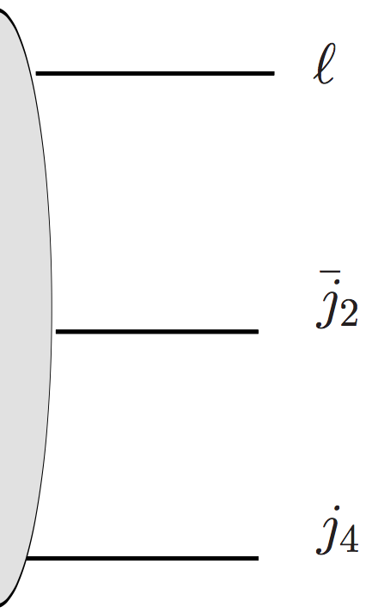
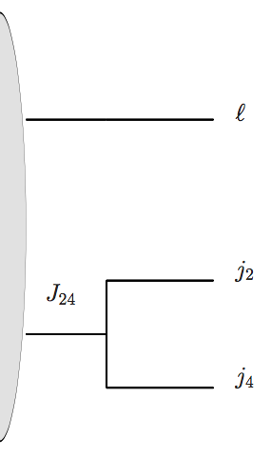
at quark level
For the final states, we get four kinds of coupling schemes with the notation of effective quark.

Slide 14
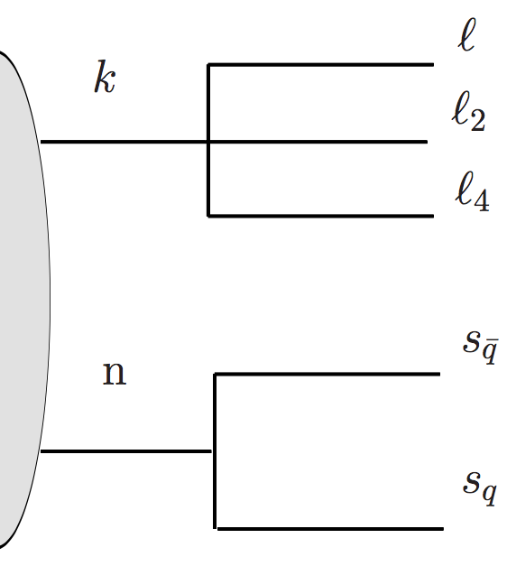
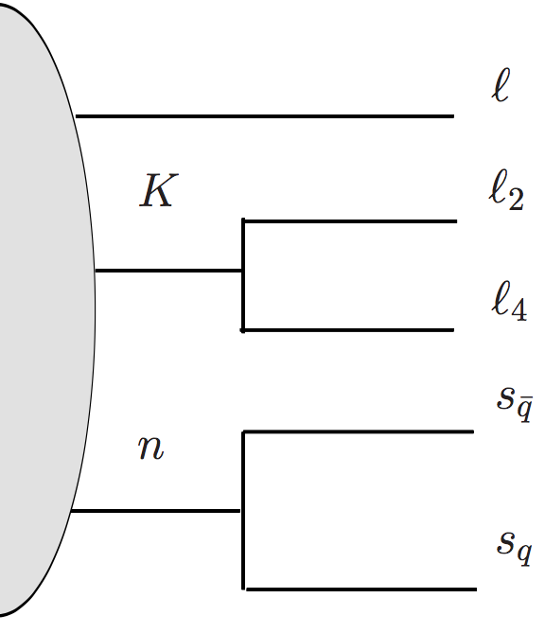
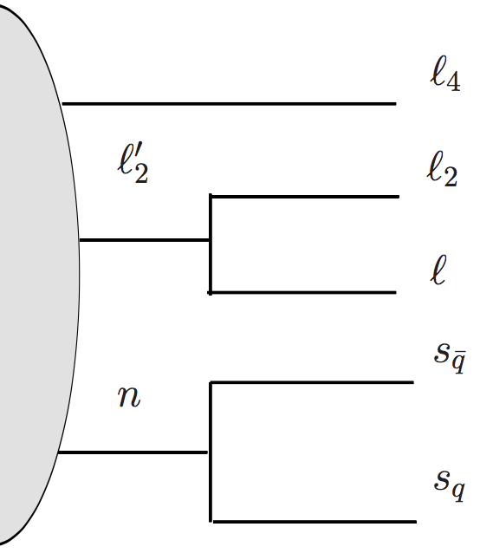
at quark level
And three independent schemes without the notation of “effective quark”.

Slide 15
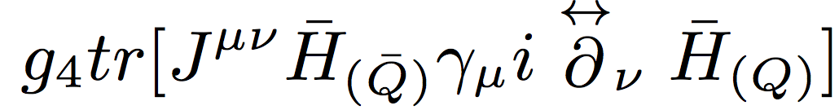
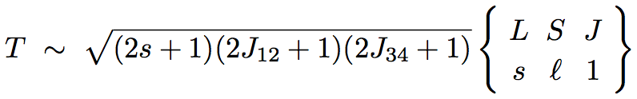
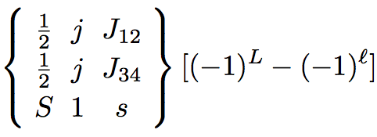

Discussion
For the decay of $J^{µν}$ to H + H
Compare

Slide 16
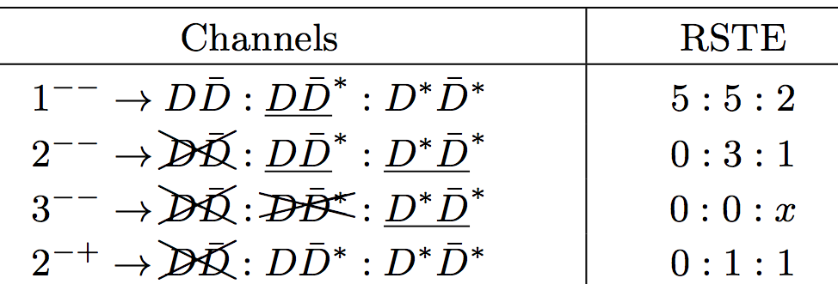
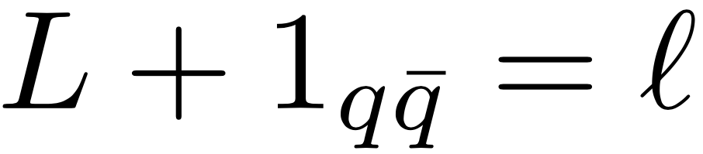
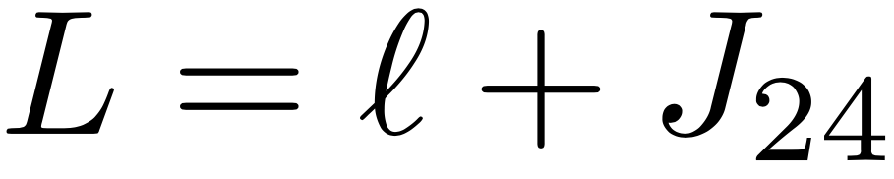


Discussion
Above two methods product the same channel ratios.
We assume that $g_{4}$ Lagrangian represent an angular momentum coupling scheme which is
By the recoupling schemes, we get a constraint
The $g_{4}$ Lagrangian correspond to $J_{24}$= 1.

Slide 17
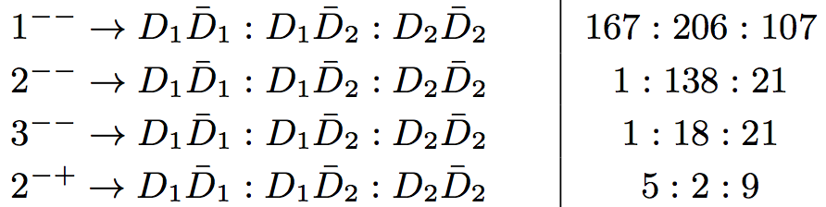
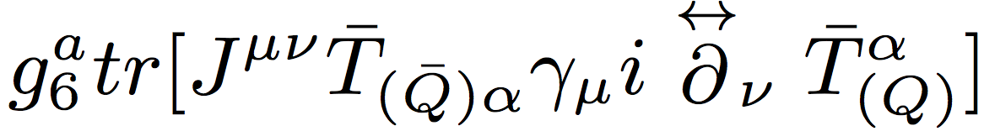
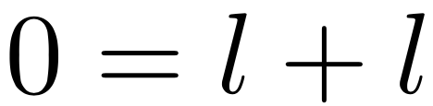
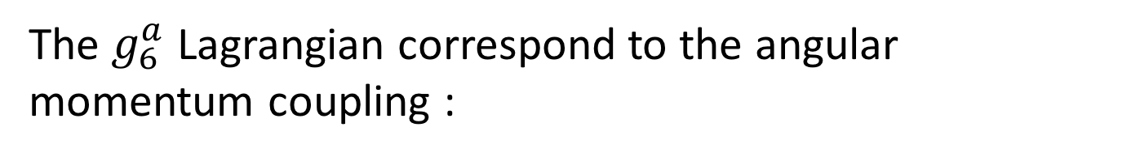

Discussion
For the decay of $J^{µν}$ to $T^{µ}$ + $T^{ν}$, there are three independent Lagrangians.
The $g_{6}^{a}$ Lagrangian correspond to the angular momentum coupling :
Basing on the quark level analysis, we have $J_{24}$=1.

Slide 18
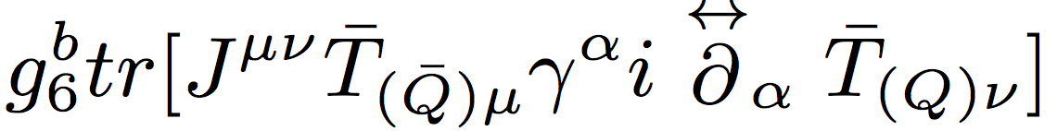
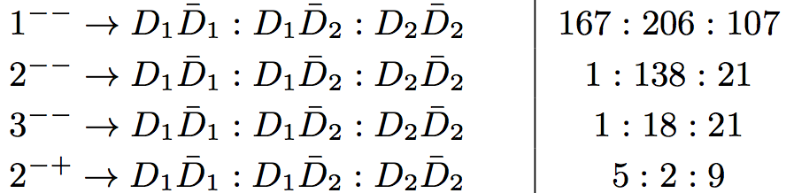
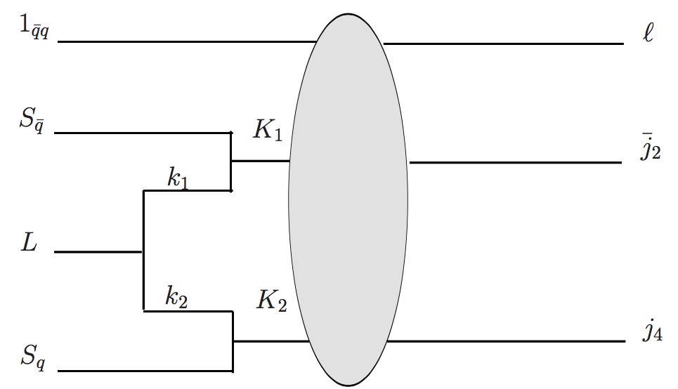
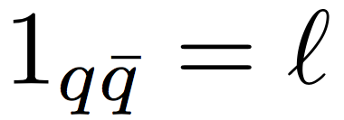
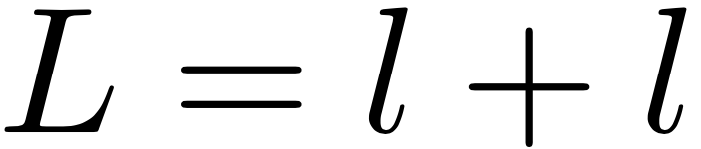

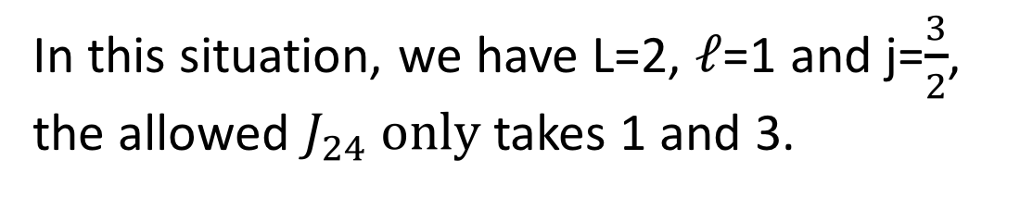
Discussion
The $g_{6}^{a}$ Lagrangian correspond to the coupling model
In this situation, we have L=2, $ℓ$=1 and j=$\frac{3}{2}$,
the allowed $J_{24} only$takes 1 and 3.

Slide 19
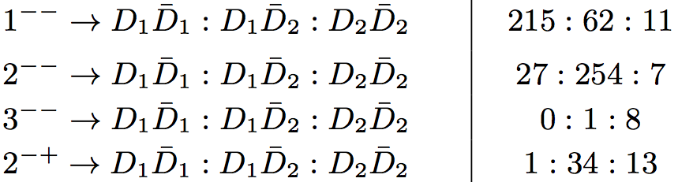
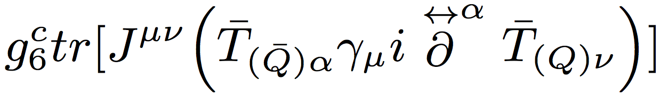
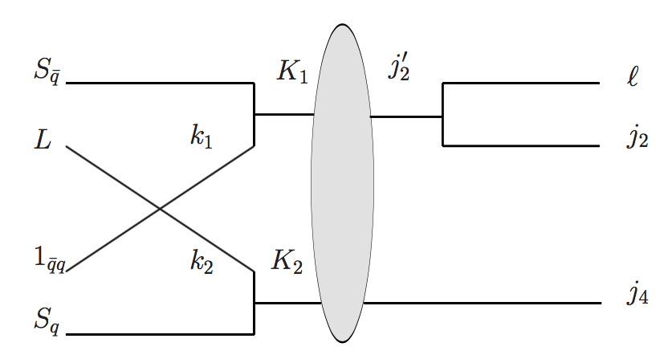
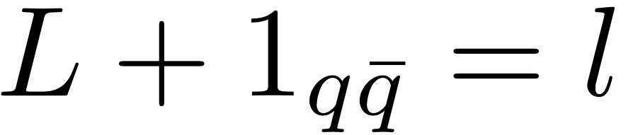
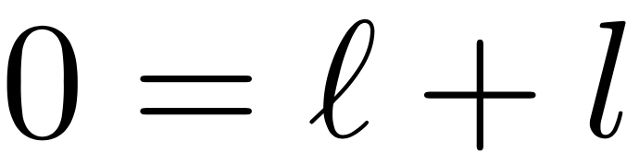
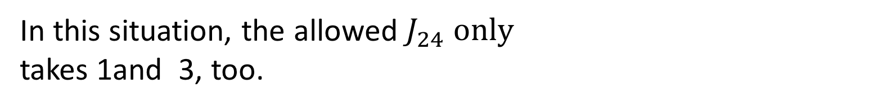
Discussion
The angular momentum recoupling behaviour is
In this situation, the allowed $J_{24} only$
takes 1and 3, too.

Slide 20
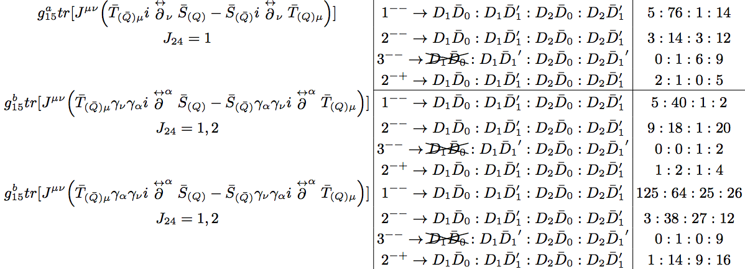
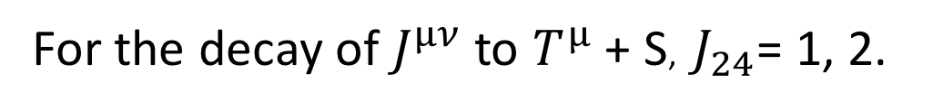
Discussion
For the decay of $J^{µν}$ to $T^{µ}$ + S, $J_{24}$= 1, 2.

Slide 21
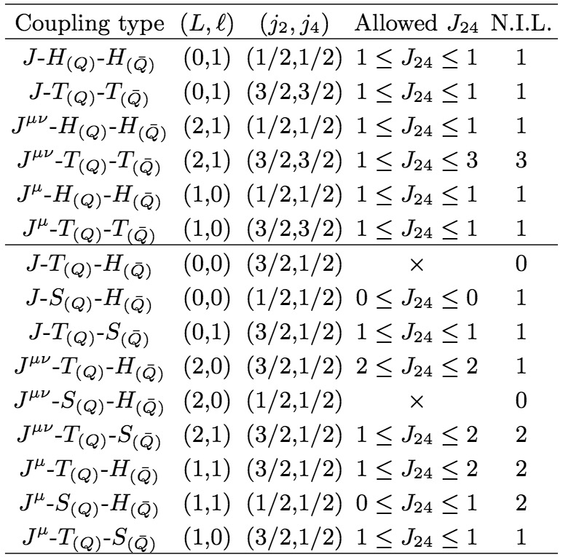
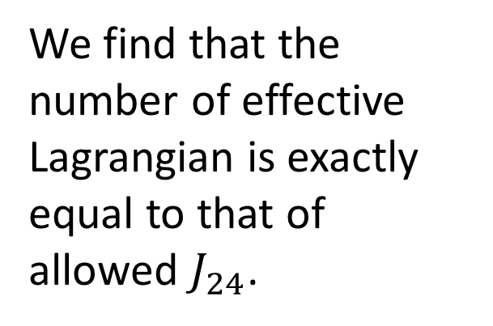
We find that the number of effective Lagrangian is exactly equal to that of allowed $J_{24}$.

Slide 22
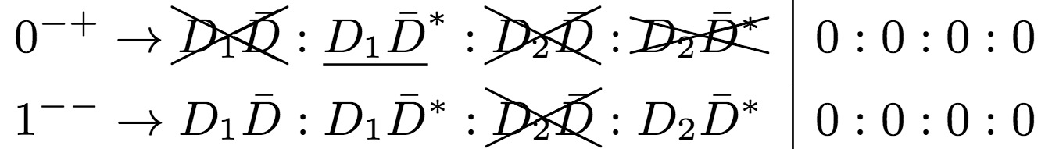






Three kinds of explanation for the vanishing of decay channel.
1, the broken of the LDF conservation:
L=0$≠$
L=2 $≠$

Slide 23






2, cancellation from different values of $J_{24}$.
Above two channels’ amplitude are counteracted
by $J_{24}$= 1 and $J_{24}$= 3.
that channel’s amplitude is canceled by $J_{24}$= 1 and $J_{24}$= 3.

Slide 24



3, triangle condition $δ$(S, $J_{24}$,s) is not satisfied.
For the channel of , s = 2, $J_{24}$= 1 and S=0. then $δ$(0,1,2) is not satisfied.

Slide 25

Summary
The number of independent effective Lagrangian is exactly equal to the number of allowed $J_{24}$.
There are three reasons why some channels vanish although the conservation of quantum numbers at the hadron level is not violated.
From the effective Lagrangian, we can predict the possible quark level coupling schemes.
Such a comparison study will help us to understand deeper the non-perturbative strong interactions.

Slide 26
Thanks for your attention !

Slide 27







Considering different coupling schemes of the initial angular momenta, one totally gets the following figures :

