Slide 1




DA study at FCC-hh
B. Dalena
on behalf of the FCC-hh Study team,
T. Pugnat, A. Simona, L. Bonaventura and R. De Maria

Slide 2
Outline
Introduction to FCC-hh and motivation of the study
Tools for DA study at FCC-hh
Main dipole field quality and DA calculation
Development in field quality modelling
Conclusion and perspectives

Slide 3
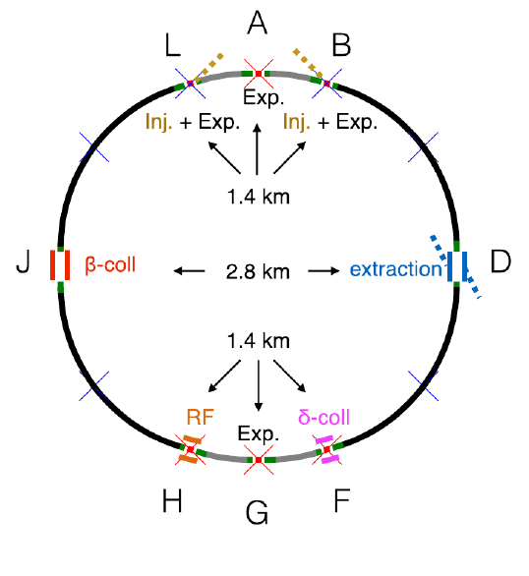
FCC-hh
D. Schulte FCC week 2017
 | FCC-hh Baseline | FCC-hh Ultimate
Luminosity L [10³⁴cm⁻²s⁻¹] | 5 | 20-30
Background events/bx | 170 (34) | <1020 (204)
Bunch distance Δt [ns] | 25 (5)
Bunch charge N [10¹¹] | 1 (0.2)
Fract. of ring filled η_{fill} [%] | 80
Norm. emitt. [μm] | 2.2(0.44)
Max ξ for 2 IPs | 0.01 (0.02) | 0.03
IP beta-function β [m] | 1.1 | 0.3
IP beam size σ [μm] | 6.8 (3) | 3.5 (1.6)
RMS bunch length σ_{z} [cm] | 8
Crossing angle [σ] | 12 | Crab. Cav.
Turn-around time [h] | 5 | 4
Luminosity (Ultimate): 5ab⁻¹ per 5 year cycle
= 8fb⁻² per day
Baseline injection energy 3.3 TeV

Slide 4
Motivation
Design correction schemes for non-linear errors of main magnets of the arcs
Provide tolerances for the main high order multipoles components of magnets or the arcs
Key issues:
- Reserve space for correctors in the arc cells
- Get order of magnitude of correctors strengths to identify possible R&D needed
- Define tolerances on arcs magnets field quality to ensure DA > 12 σ at injection and much more at collision
⇒ focus on main dipoles of FCC arcs

Slide 5
Tools
MadX to SixTrack
  the FCC thin lattice used by SixTrack is created in MadX, taking into account
    Phase advances of each arc cell
    Phase advance of insertions
    Main dipoles, quadrupoles and sextupoles are represented by 2 slices (inner triplet of High Luminosity IR with 4 slices)
SixTrack
  The size of few arrays had to be increased to match the FCC size!
  The simulation environment had to be upgraded to take into account FCC tunes
⇒ FCC needs are considered by the SixTrack teams

Slide 6
Dipole Field Quality
= random number with Gaussian distribution cut at 1.5 (U) and 3 (R)
Model:
the same seed for all dipoles of the same arc for U is used (no mixing)
different seed for each dipole is used for R
symmetries with respect to chambers (AP1/AP2):
  b_{n}(AP1) = b_{n}(AP2), n=1,3,5…
  b_{n}(AP1) = -b_{n}(AP2), n=2,4,6…
  a_{n}=0, n=1,2,3,4,5…
⇒ Conservative, we don’t know the number of firm yet
⇒ Not valid for all dipoles design, OK for the baseline
3 tables (v0,v1,v2) for 50 TeV and 3.3 TeV
1 table (v2) for 1.3 TeV
R_{ref} = 0.017 m

Slide 7
Simulations inputs
60 seeds
30 particle pairs
Emit norm 2.2e⁻⁶ m rad
Q’ = 2
dp/p = 0.00075/ 0.00027 (LHC)
dp/p max = 0.002
σ step = 2 σ
5 angles ∈ [0,90º]
10⁵ turns
⇒ Not optimized yet
⇒ Conservative, at FCC smaller values expected
⇒ Same angles considered for LHC design
⇒ < 1 σ DA difference with 10⁶ turns
b₂ and a₂ not considered
linear imperfections not considered
⇒ Require dedicated corrections

Slide 8
Optics
Optimization of first order optics of Arcs and insertions is on going
  DA is evaluated for the different optics generated
Integer part of the tunes can considerably change with optics
  Number of cells depends on layout constraints and optimization of cell length (dipoles field): 19-20-21 for short arcs, 76-78-79 for long arcs
  The phase advance of the short arcs cell is exactly 90°, the long arcs cells slightly change to match the fractional part of the tunes:
Q_{x} = .28, Q_{y} = .31 injection
Q_{x} = .31, Q_{y} = .32 collision
  Phase advance between High Luminosity IR and the first sextupole of the short arcs is adjusted to 90° (modulo 180°) in the H(V) planes.
  Phase advances between the two High Luminosity IR have been not fixed
  Phase advances of insertions not fixed

Slide 9
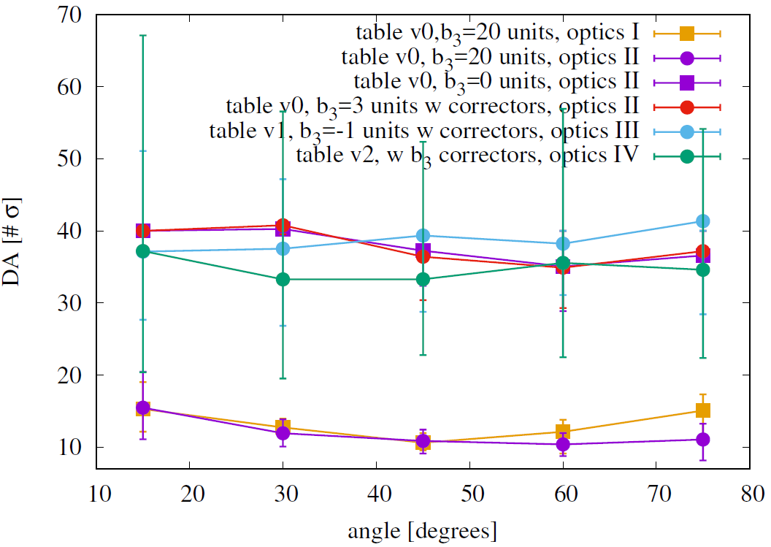
DA at collision (β*=0.3m)
DA at collision is dominated by the systematic b₃ dipole error
Max gradient 4430 T/m2, Length =0.11 m, one corrector at each dipole ⇒ systematic component of b₃ < 3 unit at collision
Uncertainty on DA value for table v2 due to bigger random components
⇒ Minimum DA at collision due to dipole field quality (table v0, table v1, table v2) > 20 σ
Optics I : 97.97 km layout, L*=36 m, Qx=113.31, Qy=111.32, #cell SAR/LAR=21/76
Optics II : 97.97 km layout, L*=45 m, Qx=111.31, Qy=109.32, #cell SAR/LAR=20/76, FODO cell for momentum collimation section
Optics III: 97.75 km layout, L*=45 m, Qx=111.31, Qy=109.32, #cell SAR/LAR=19/79, LHC scaled momentum collimation section
Optics IV: 97.75 km layout, L*=40 m, Qx=110.31, Qy=108.32, #cell SAR/LAR=20/78

Slide 10
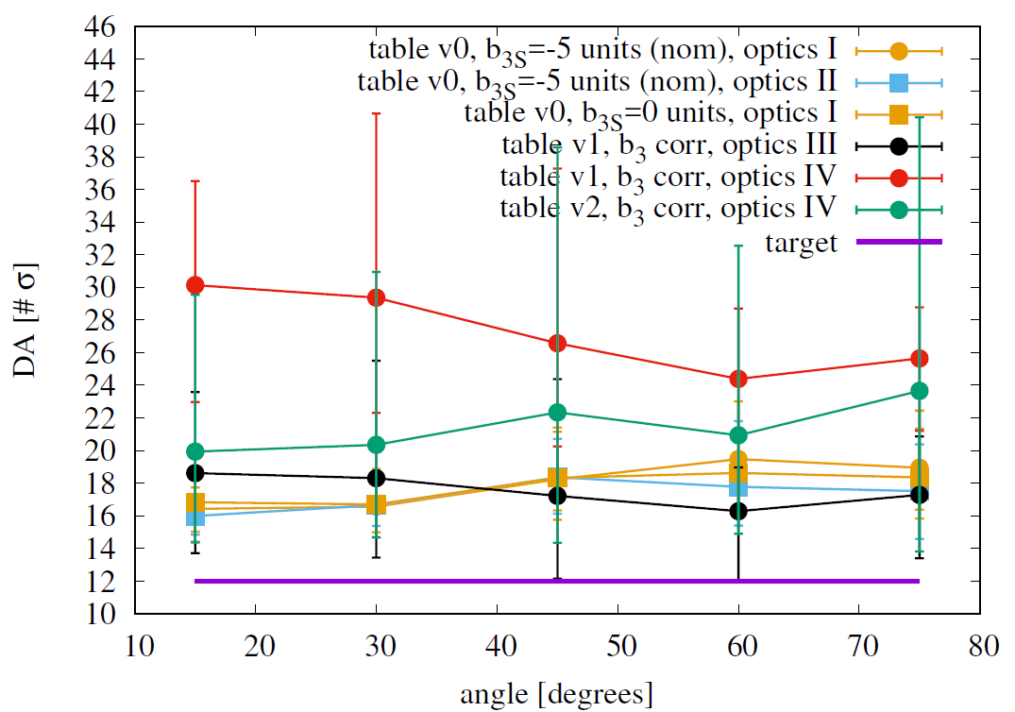
DA at injection (3.3 TeV)
DA at injection is dominated by the random dipole errors
~60 unit of systematic b₃, due to persistent current, can be corrected
Min DA 13.9 σ (table v0, optics III)
12.1 σ (table v1, optics III)
20.2σ (table v1, optics IV)
13 σ (table v2, optics IV)
Big impact of first order optics on DA
No need for b₄ and b₅ correctors
Optics I : 97.97 km layout, L*=36 m, β* = 4.6 m, Qx=111.28, Qy=110.31, #cell SAR/LAR=21/76
Optics II : 97.97 km layout, L*=36 m, β* = 3.5 m, Qx=111.28, Qy=110.31, #cell SAR/LAR=21/76
Optics III: 97.75 km layout, L*=45 m, β* = 4.6 m, Qx=111.28, Qy=109.31, #cell SAR/LAR=19/79
Optics IV: 97.75 km layout, L*=40 m, β* = 4.6 m, Qx=110.28, Qy=108.31, #cell SAR/LAR=20/78

Slide 11
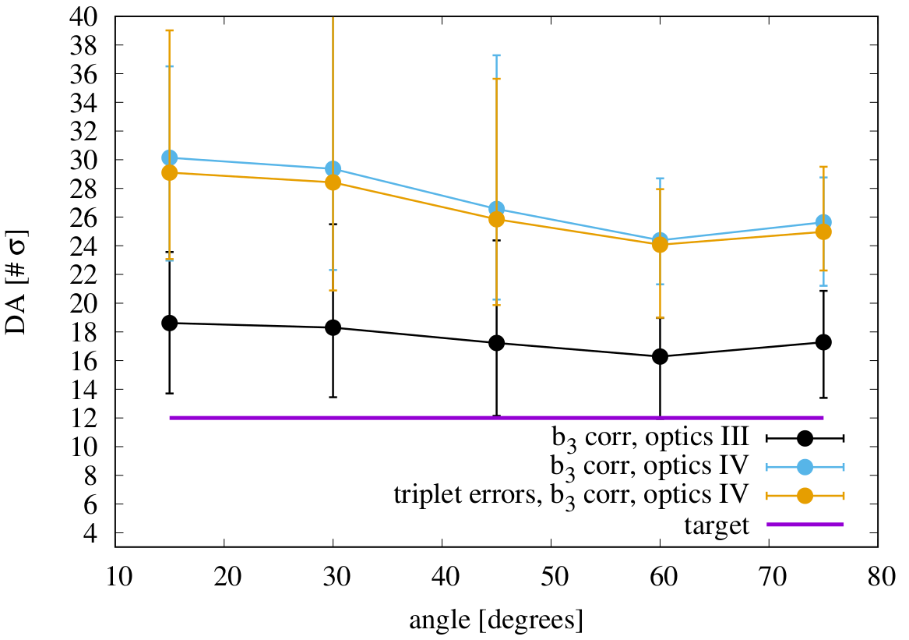
Impact of inner triplet IPA&IPG
Minor impact of triplet errors (E. Cruz) on DA
Min DA 20.2 σ (table v1, MB errors only)
19. σ (table v1, MB and MQX errors)
Optics III: 97.75 km layout, L*=45 m, Qx=111.28, Qy=109.31, #cell SAR/LAR=19/79
Optics IV: 97.75 km layout, L*=40 m, Qx=110.28, Qy=108.31, #cell SAR/LAR=20/78

Slide 12
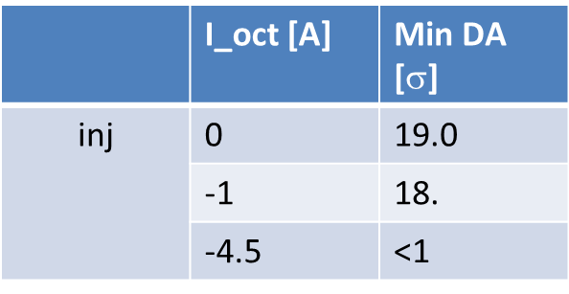
Impact of Landau Damping Octupoles
452 octupoles installed in the long arcs new lattice (+~64 possible if trims not installed at all)
G_max = 220000 T/m³, Length = 0.32 m, I_max =720 A (D. Schoerling)
K_MO = (G_max/Br) (I_oct/I_max)(50/energy [TeV])
F and D Octupoles with same polarity
I_oct = 4.5 A at injection (C. Tambasco)
important reduction of DA!
 | I_oct [A] | Min DA [$$]
inj | 0 | 19.0
 | -1 | 18.
 | -4.5 | <1
Main dipoles (table v1) and triplet errors included

Slide 13
Injection energy
For FCC-hh two energies are considered:
Baseline: 3.3 TeV (LHC as injector)
Alternative: 1.3 TeV (superconducting SPS as injector)
Field quality at 1.3 TeV injection energy is very poor (in particular for b₃)
Maximum strength of b₃ correctors not enough to compensate the systematic component
DA too low
⇒ 1.3 TeV injection energy excluded from DA point of view

Slide 14
Developing field quality modeling
FCC magnets technology will be different from the LHC one
There is time to improve the modeling of magnet design details in simulations
Impact of dipoles types
Impact of longitudinal harmonics of main dipoles
Impact of longitudinal harmonics of other magnets

Slide 15
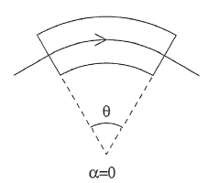
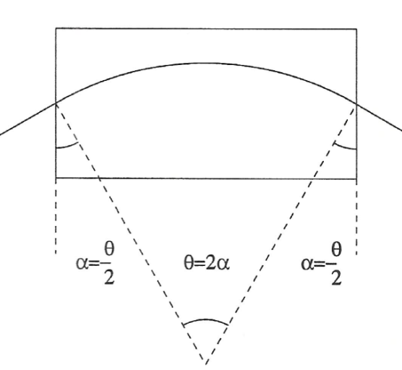

Impact of dipole type
The effect is negligible if the b₅*0.13 is less than the random b₃, that dominates DA at injection
The additional error is systematic for each dipole ⇒ is correctable by b₃correctors

Slide 16
Longitudinal b₃ of main dipoles
b₃
Usual magnet design
(without persistent current)
z
MadX/SixTrack model
b₃
Improved magnet design
z
Study the impact using a simple model in SixTrack
Possibility to see effects in measurements?

Slide 17
Longitudinal harmonics of other magnets
HL-LHC example:
Big change of beta function along the magnet, particle offset due to crossing angle and longitudinal asymmetry in field lines between the two magnet ends
⇒ full tracking model to take into account longitudinal harmonics
By S. Izquierdo Bermudez
G. Ambrosio @ 4th HiLumi meeting
Longitudinal pseudo harmonics of HL-LHC inner triplet prototype

Slide 18
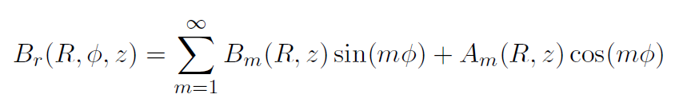
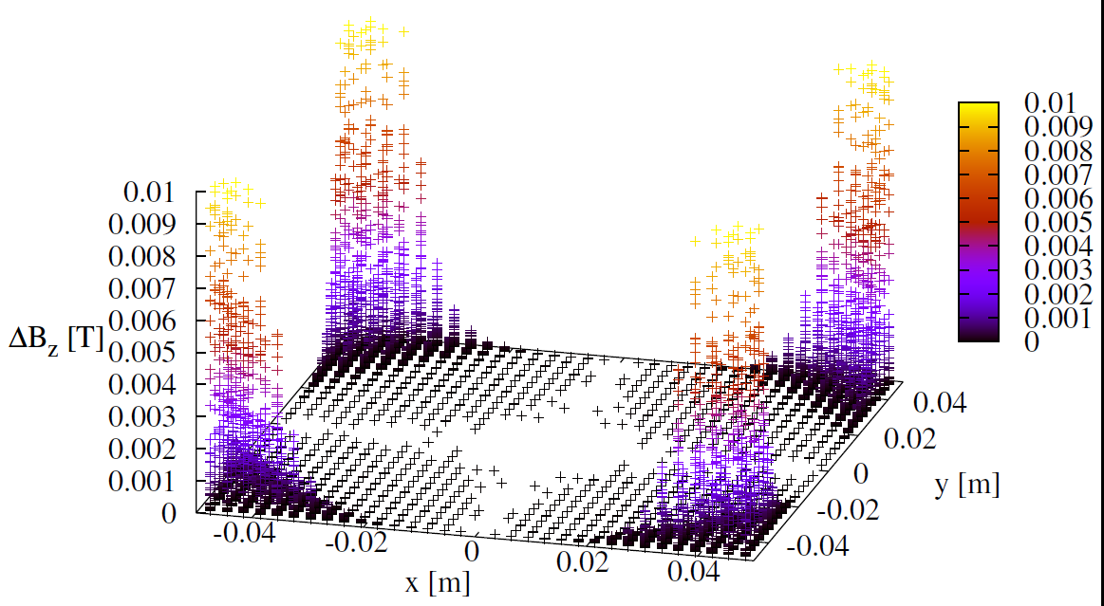
Fitting realistic field/harmonics
Using field maps or filed harmonics
Reconstruct the generalized gradients
use a radius as larger as possible, without loosing homogeneity of the field
study alternative field fitting procedures

Slide 19
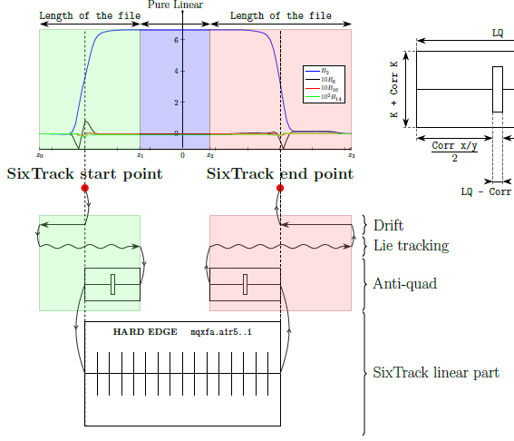
Model for full tracking
Second order Lie tracking integrator compared to higher order tracking is a good compromise between speed and accuracy
Computation of the anti-quad parameters has an important impact on tracking. Needs to compensate all the linear effects introduced by the Lie tracking without changing non linear ones.

Slide 20
Conclusion
Tools
LHC tools for DA simulations are good starting point for FCC-hh, they are getting up-to-date according to FCC needs
First DA results
DA at collision due to dipole field quality > 20 σ with corrected b₃
b₃ correctors feasible in NbTi technology if systematic b₃ < 3 unit
First and second order optics details can have a significant impact on DA at injection
Landau Damping Octupoles gives big reduction of DA at injection
DA is above the target of 12 σ at 3.3 TeV injection energy while 1.3 TeV seems to be excluded from DA point of view
Developments
FCC-hh will be build with a new technology and is a long term project ⇒ there is space to add details in the models (ex.: longitudinal distribution of harmonics) to see their impact

Slide 21
Outlook
Follow up of present studies
Tolerances and corrections for high order multipoles
Tune scan at injection
Impact of Main Quadrupole field quality

Slide 22
Thank you!

Slide 23
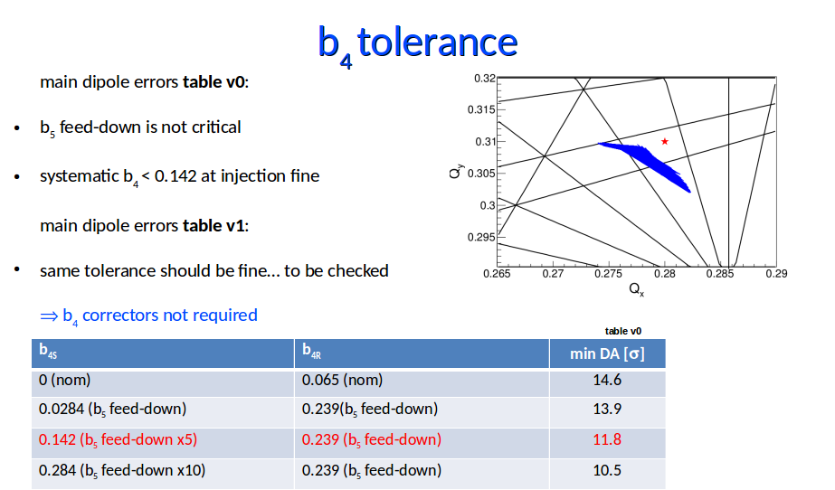
Thank you!

Slide 24
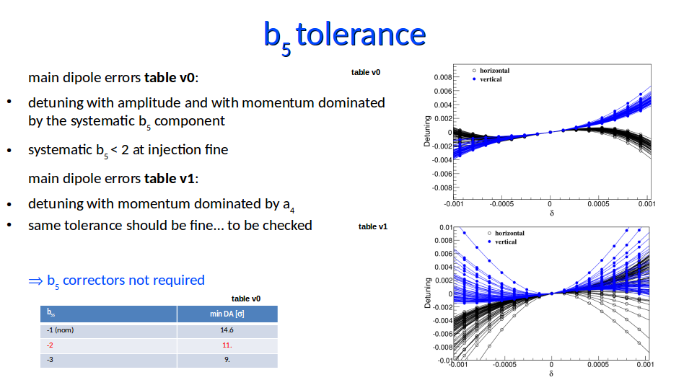

Slide 25
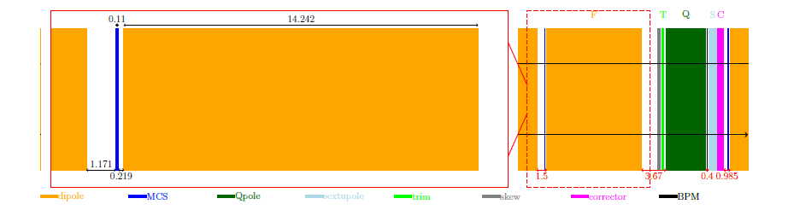
b3 correctors and tolerance
max gradient 4430 T/m2, Length =0.11 m, one corrector at each dipole
tolerance of systematic component of b3 < 3 unit at collision
a3 correctors/tolerance not defined yet
⇒ DA at collision due to dipole field quality (table v0 & table v1) > 26 s

Slide 26
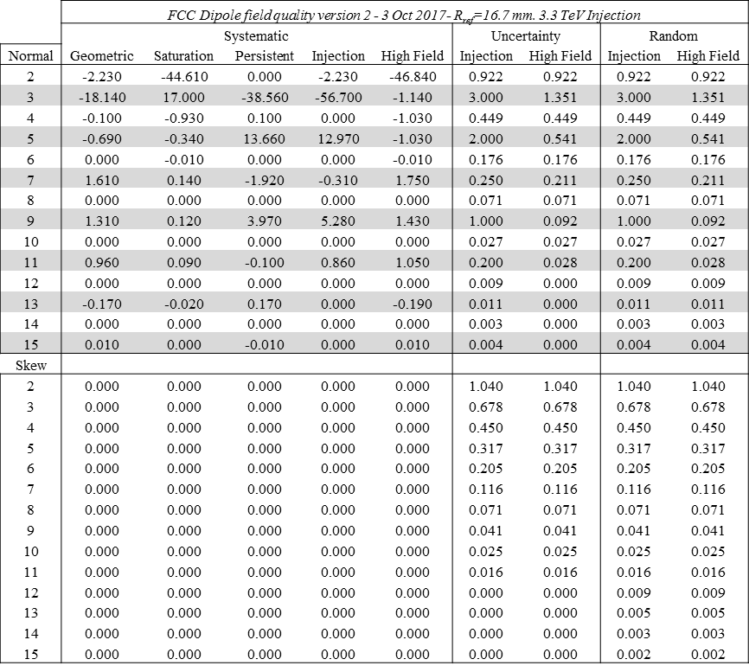
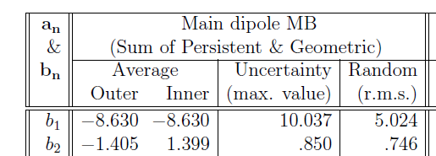
Normal and skew quadrupole errors in main dipoles
FCC table v2
In all DA simulations shown b2 and a2 dipole errors are not taken into account (as well as mis-alignment).
Need dedicated correction before to be considered in DA simulations.
For status of orbit correction see D. Boutin talk
LHC project report 501

Slide 27
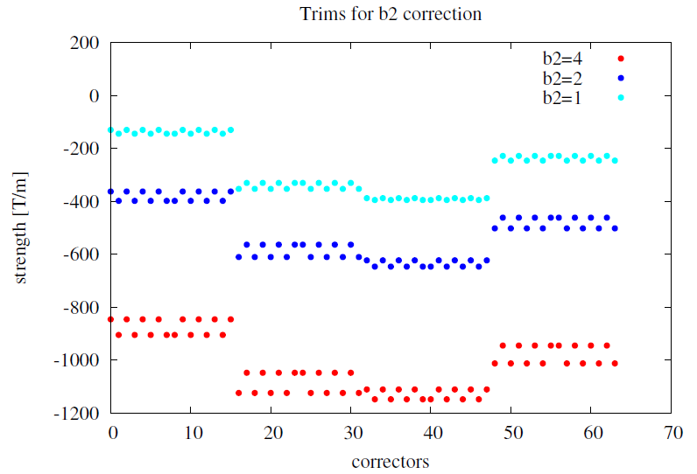
Systematic b2 correction (1/2)
8+8 normal trims installed at the entrance and exit of long arcs (same scheme as LHC)
Max 4 unit of systematic b2 matched so far
Too strong trims required (even rescaling for the length)

Slide 28
Systematic b2 correction (2/2)
b_{2S} =10 10⁻⁴ units | SAR AB KQF/KQD [T/m] | LAR BC KQF/KQD [T/m] | β change
nominal | 376.8/-376.8 | 376./-377.4
Arc by arc | 379.8/-373.6 | 373.4/-380.3 | 30%
global | 377.1/-377.1 | 376.3/-377.7 | 60%
Few % of main quadrupole gradient give a big change in β
⇒ need to re-match all insertions
⇒ need to check the impact on apertures calculation
Match more than 10 unit of systematic b2 needs even more work/thinking

Slide 29

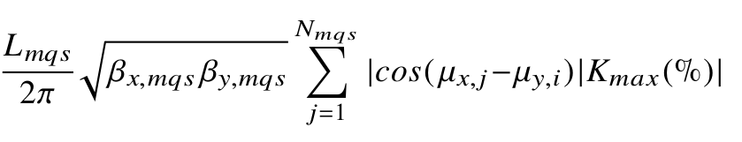
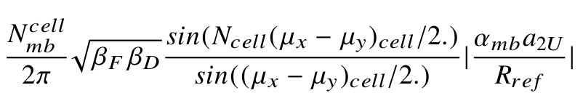
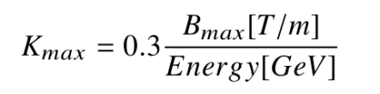
a_{2U} tolerance
Analytic calculation for one arc*
A factor 1/7 with respect to LHC
A factor 3 or 4 bigger than LHC
L mqs [m] | B max [T/m] | # mqs in one LAR | a_{2U} 10⁻⁴ (50% kmax) | comment
0.32 | 120 | 4 | ~0.06 | LHC correctors
1** | 140** | 16 | ~0.9 | FCC equivalent tolerance of LHC
1.4 | 140 | 16 | ~1.2 | To correct a_{2U} of table v0/v2
to efficiently correct the coupling of the short arc in the long arc: in the insertions
*LHC project report 501
** D. Schoerling

Slide 30
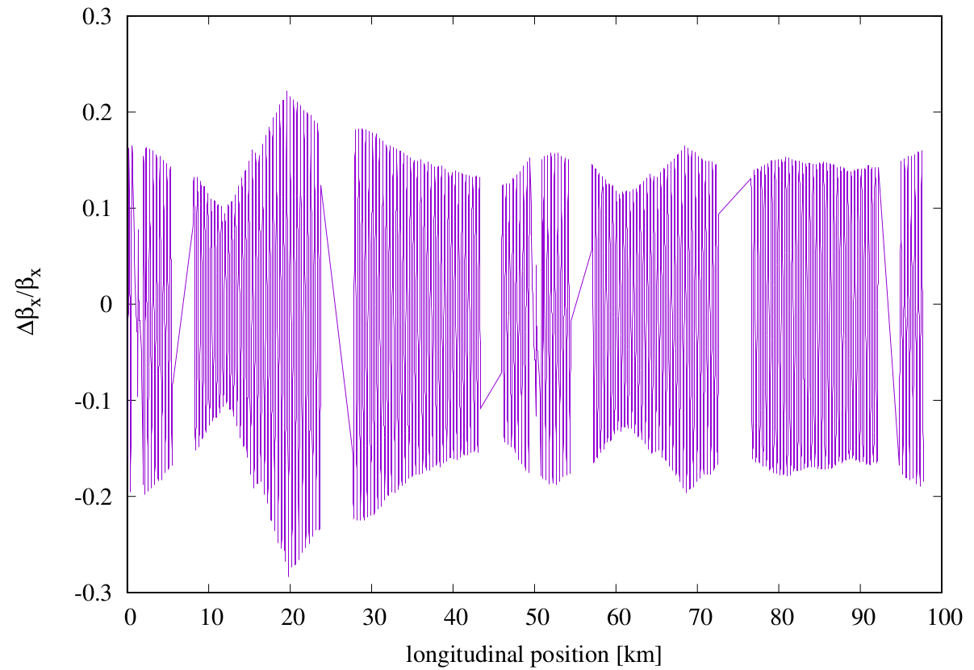
a_{2U} correction
16 correctors in long arc only with mid arc symmetry and
180° phase advance
for a_{2U} = 1.1 unit : max correctors strength so far is 250 T/m with L=0.32 m ⇒ i.e. ~80 T/m for L=1 m
Δβ/β =30%
if Δβ/β =10% at injection for aperture requirements ⇒ dedicated beta-beating correction is required
⇒ Rogelio and Jaime shown interest in applying the LHC coupling and beta-beating correction to FCC

