Slide 2
DA Simulations for LHC and HiLumi LHC in presence of beam-beam
Nikos Karastathis
CERN
Acknowledgements:
F. Antoniou, G. Arduini, S. Fartoukh, R. de Maria, Y. Papaphilippou, D. Pellegrini
our OP & MP Colleagues and all the LHC@Home volunteers!
ICFA Mini-Workshop on Dynamic Apertures of Circular Accelerators
02/11/2017
IHEP, Beijing, China

Slide 3
Outline
Introduction to multi-parametric Dynamic Aperture (DA) scans
LHC
  Working point optimization
  Identification of margins and performance enhancement based on DA simulations
    Reduction of β* in 2017
    Crossing anti-levelling in 2017
    Observations from operation
HL-LHC
  Adaptive levelling scenario

Slide 4
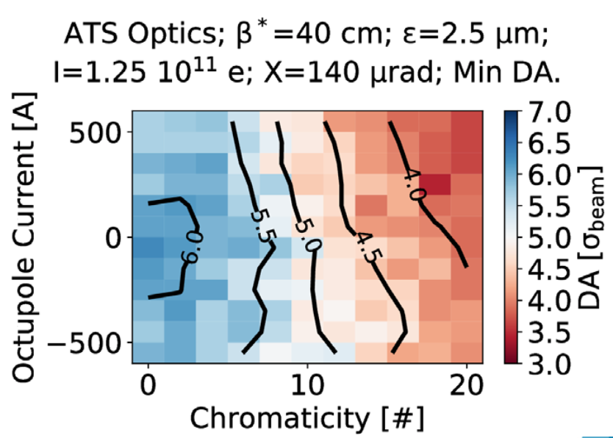
Setting the Stage: DA Scans
Weak-Strong Approximation
MAD ➔ SixTrack ➔ Minimum “Real world” DA
Dynamic Aperture Scans:
  Choose the machine model (lattice, optics, etc);
  Specify the available parameter space;
  Choose two parameters to study their correlations in terms of DA;
  Fix the rest of the parameters to a constant value for the scan;
  “Time evolution” can be folded in by evolution of the “fixed” parameters (i.e. Intensity evolution, emittance evolution etc);
  Unperturbed case (errors ∼0.5σ spread).
Is this perfect?
  Tracking for 1M turns is only ~90s of machine time
  The initial longitudinal action is fixed
  No diffusion information...
DA multi-parametric response: Tool to assist in performance optimization by defining a target DA & identifying and approaching the limits
  Operational experience is fed back
No, but captures all the necessary dynamics!

Slide 5
LHC

Slide 6
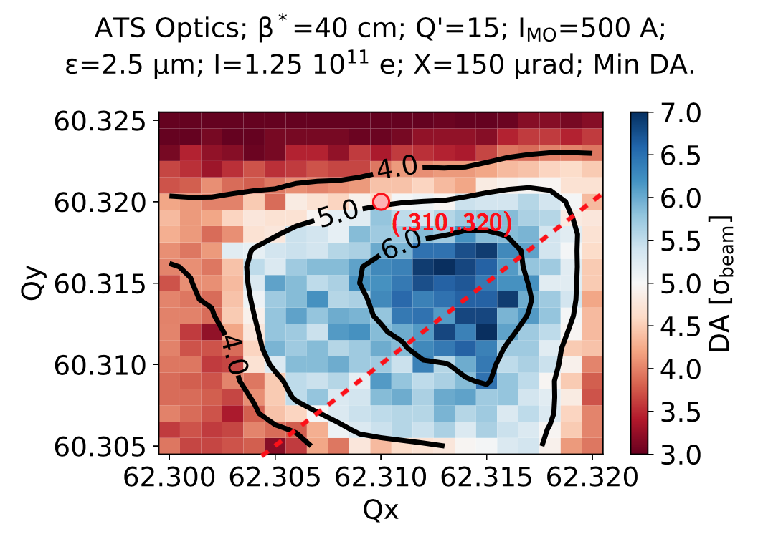
Optimizing Tunes
Recommended 2017 Operational Settings.
Operating close to the diagonal frees some space

Slide 7
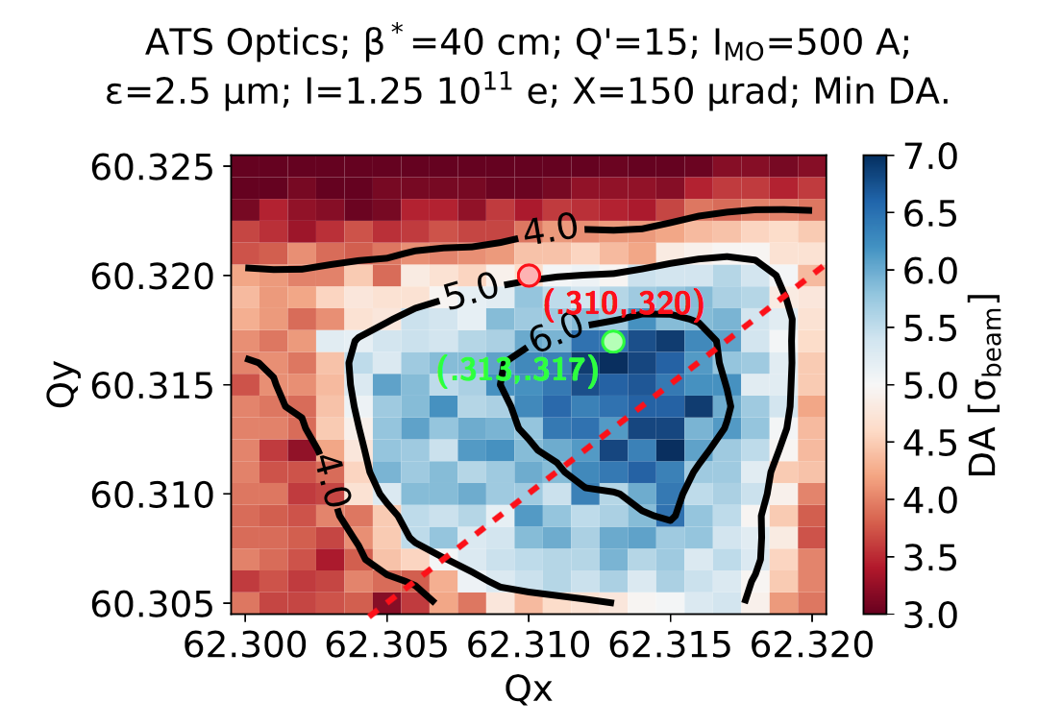

Optimizing Tunes
∼ 1σ of DA can be gained (or lost) by just a few ${10}^{−3}$ tune trims
How does this affect me in operation?

Slide 8
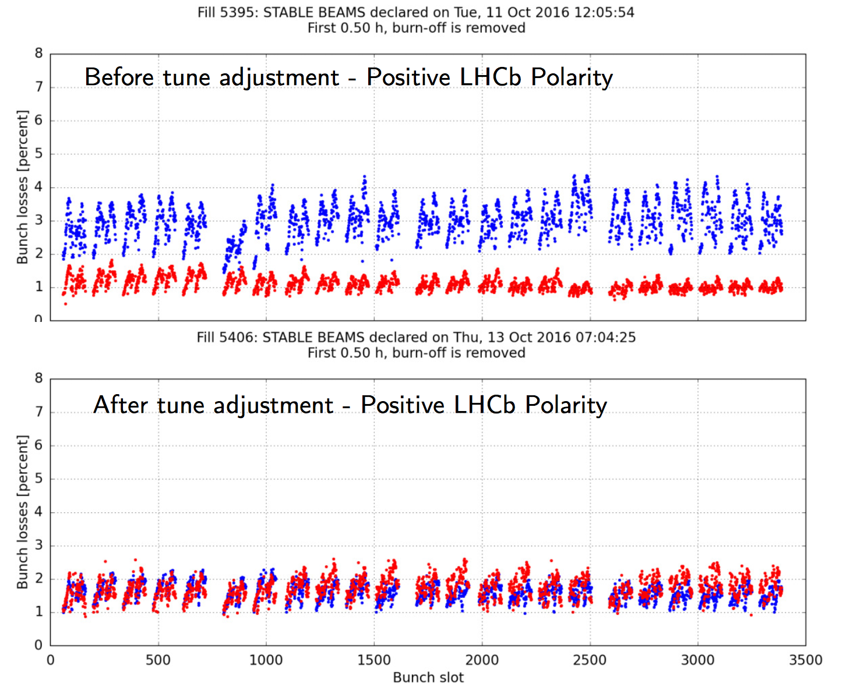
Optimizing Tunes
Reduced losses by 50%

Slide 9
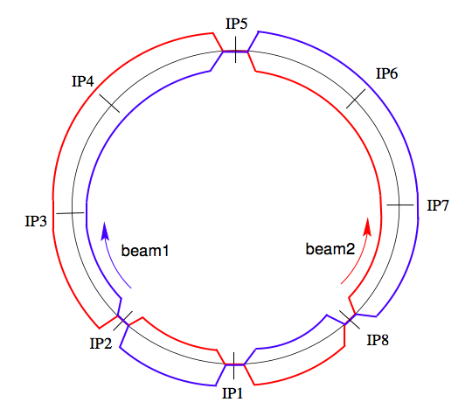
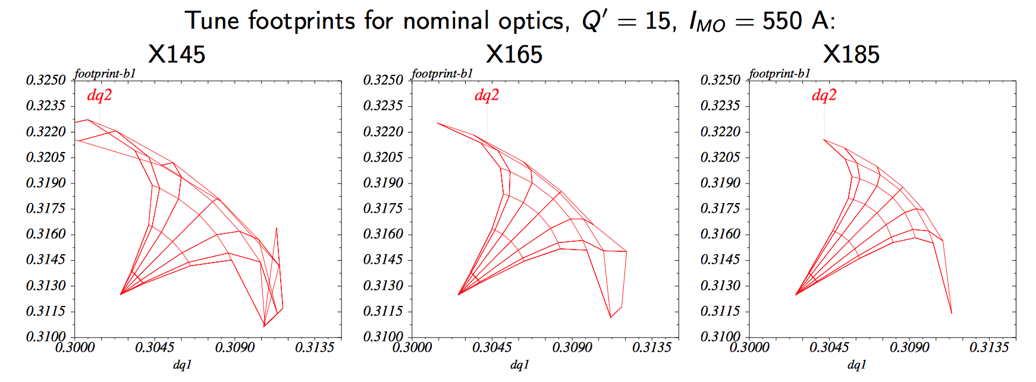
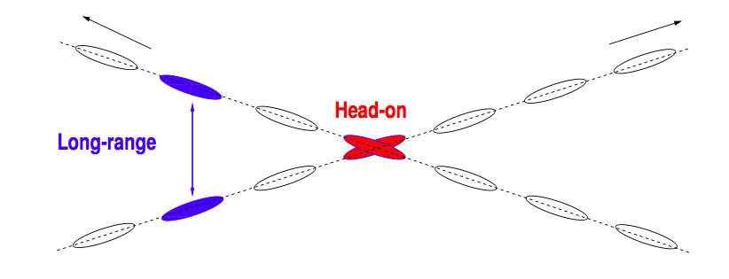
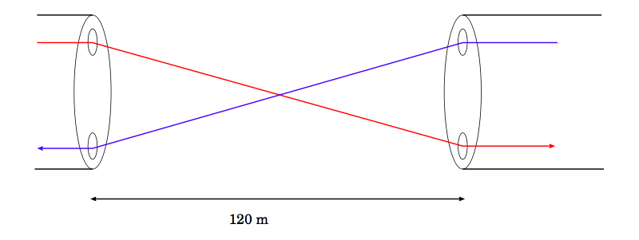
Interlude: LHC Crossing Scheme
CMS
Two counter rotating beams in two separate rings…
RF
DUMP
(H)
come into collision using separation bumps at the 4 main IP
Cleaning
  ATLAS, CMS: experiments requiring high luminosity
  ALICE, LHCb: lower luminosity
(V)
(H)
Collider Performance : Luminosity
(V)
LHCb
ALICE
ATLAS
To increase performance, assuming constant
brightness, I could…
Reduce β*
Reduce φ
But can I?
➔ Dynamic Aperture Simulations
as Lifetime indicator

Slide 10
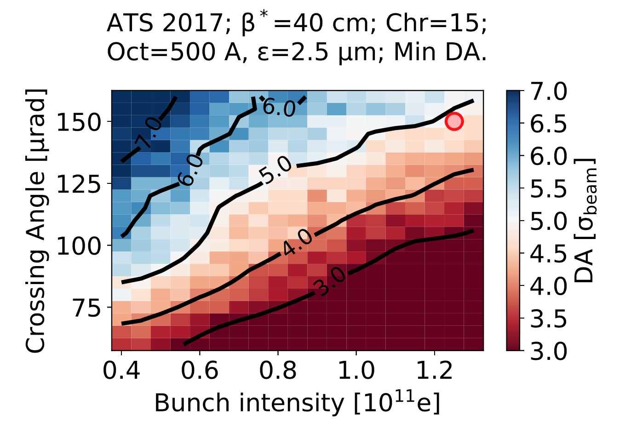
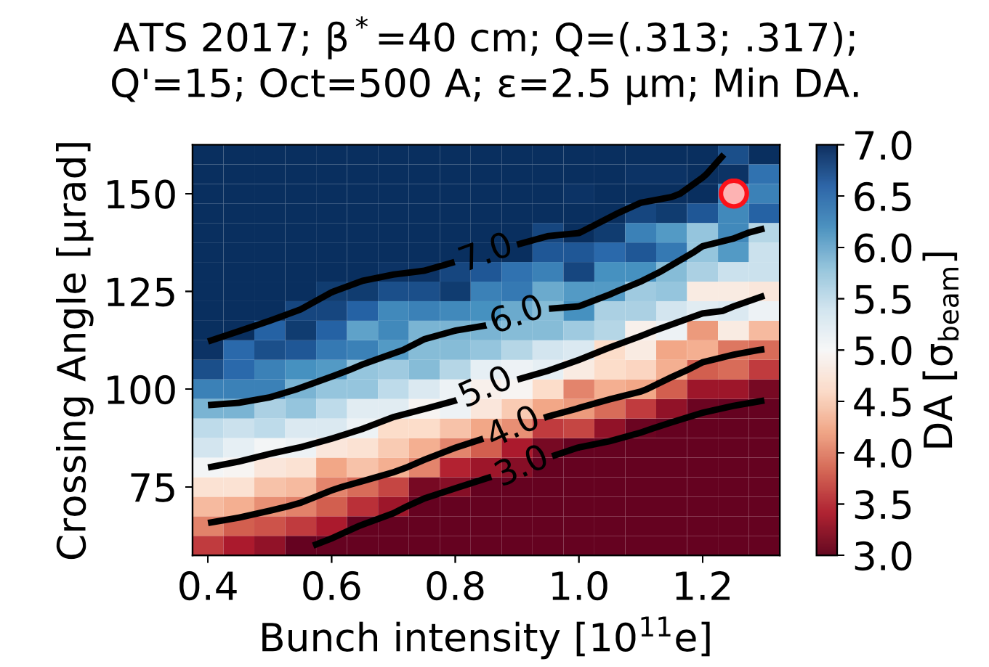
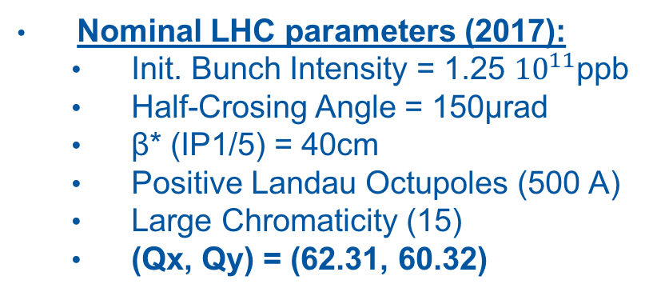
Which crossing for my intensity?
Nominal LHC parameters (2017):
  Init. Bunch Intensity = 1.25 ${10}^{11}$ppb
  Half-Crosing Angle = 150μrad
  β* (IP1/5) = 40cm
  Positive Landau Octupoles (500 A)
  Large Chromaticity (15)
  (Qx, Qy) = (62.31, 60.32)
Optimized Tune LHC:
  (Qx, Qy) = (62.313, 60.317)
  ➔ Margin to push for performance

Slide 11
What about 30cm β*?
The suggestion from the DA simulations to push the tune towards the diagonal
30cm totally feasible with 175μrad
175μrad
150μrad are within reach (no change)
Based on operational experience could even push for 140μrad at start of the fill!
  ➔ it have been tested durng operation
150μrad
How can I push performance even more?

Slide 12
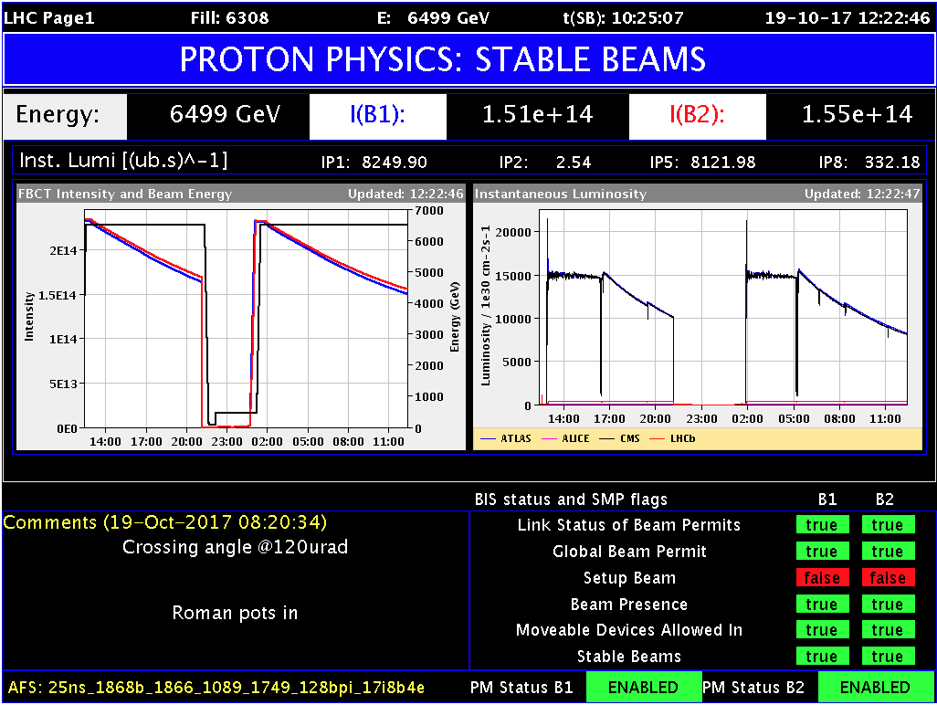
Crossing Anti-Levelling

Slide 13
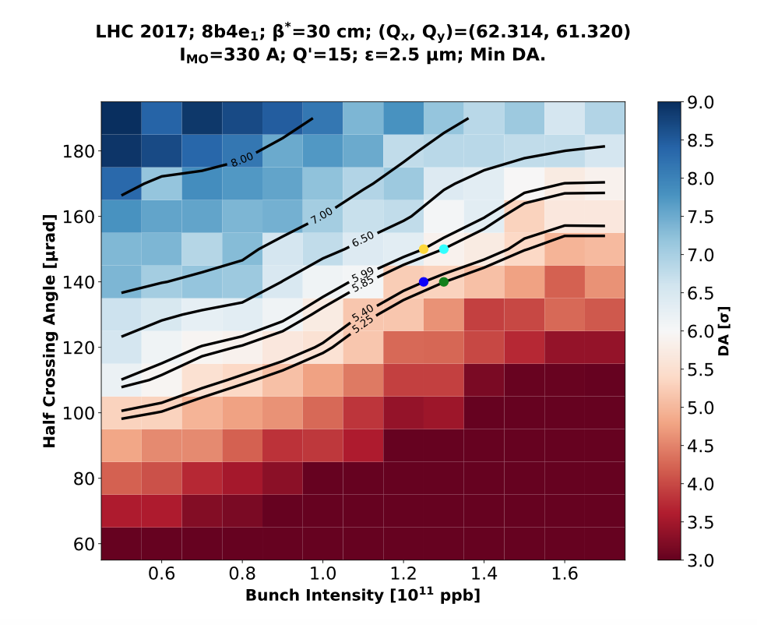
Crossing Anti-Levelling

Slide 14
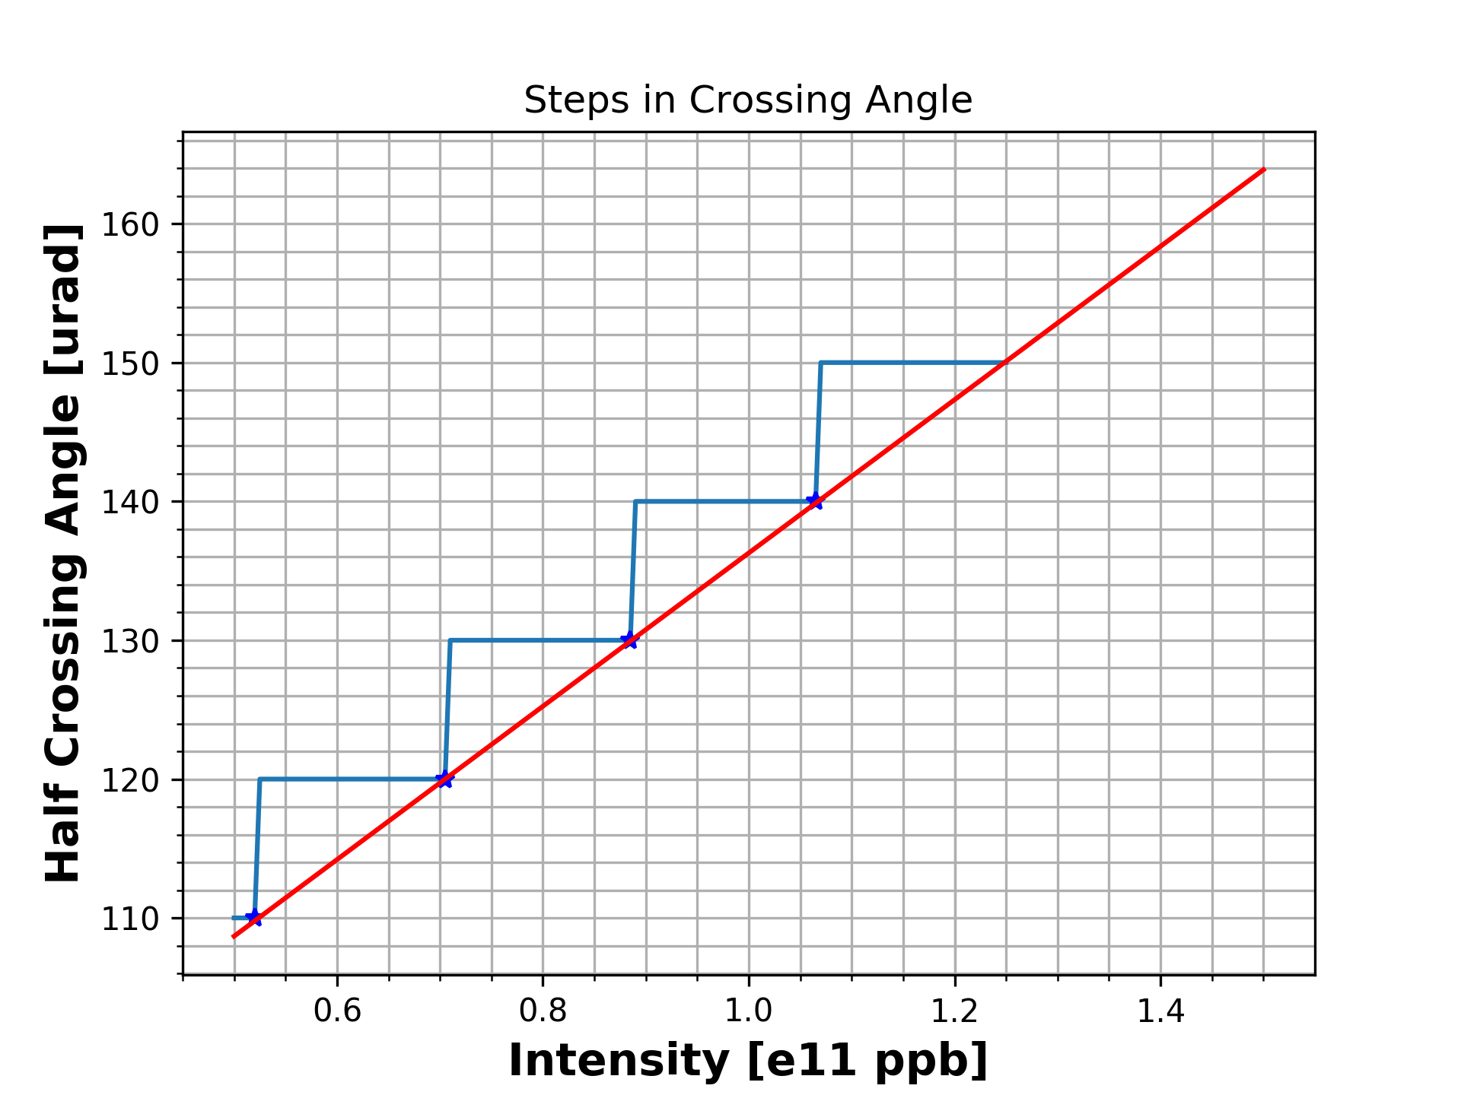
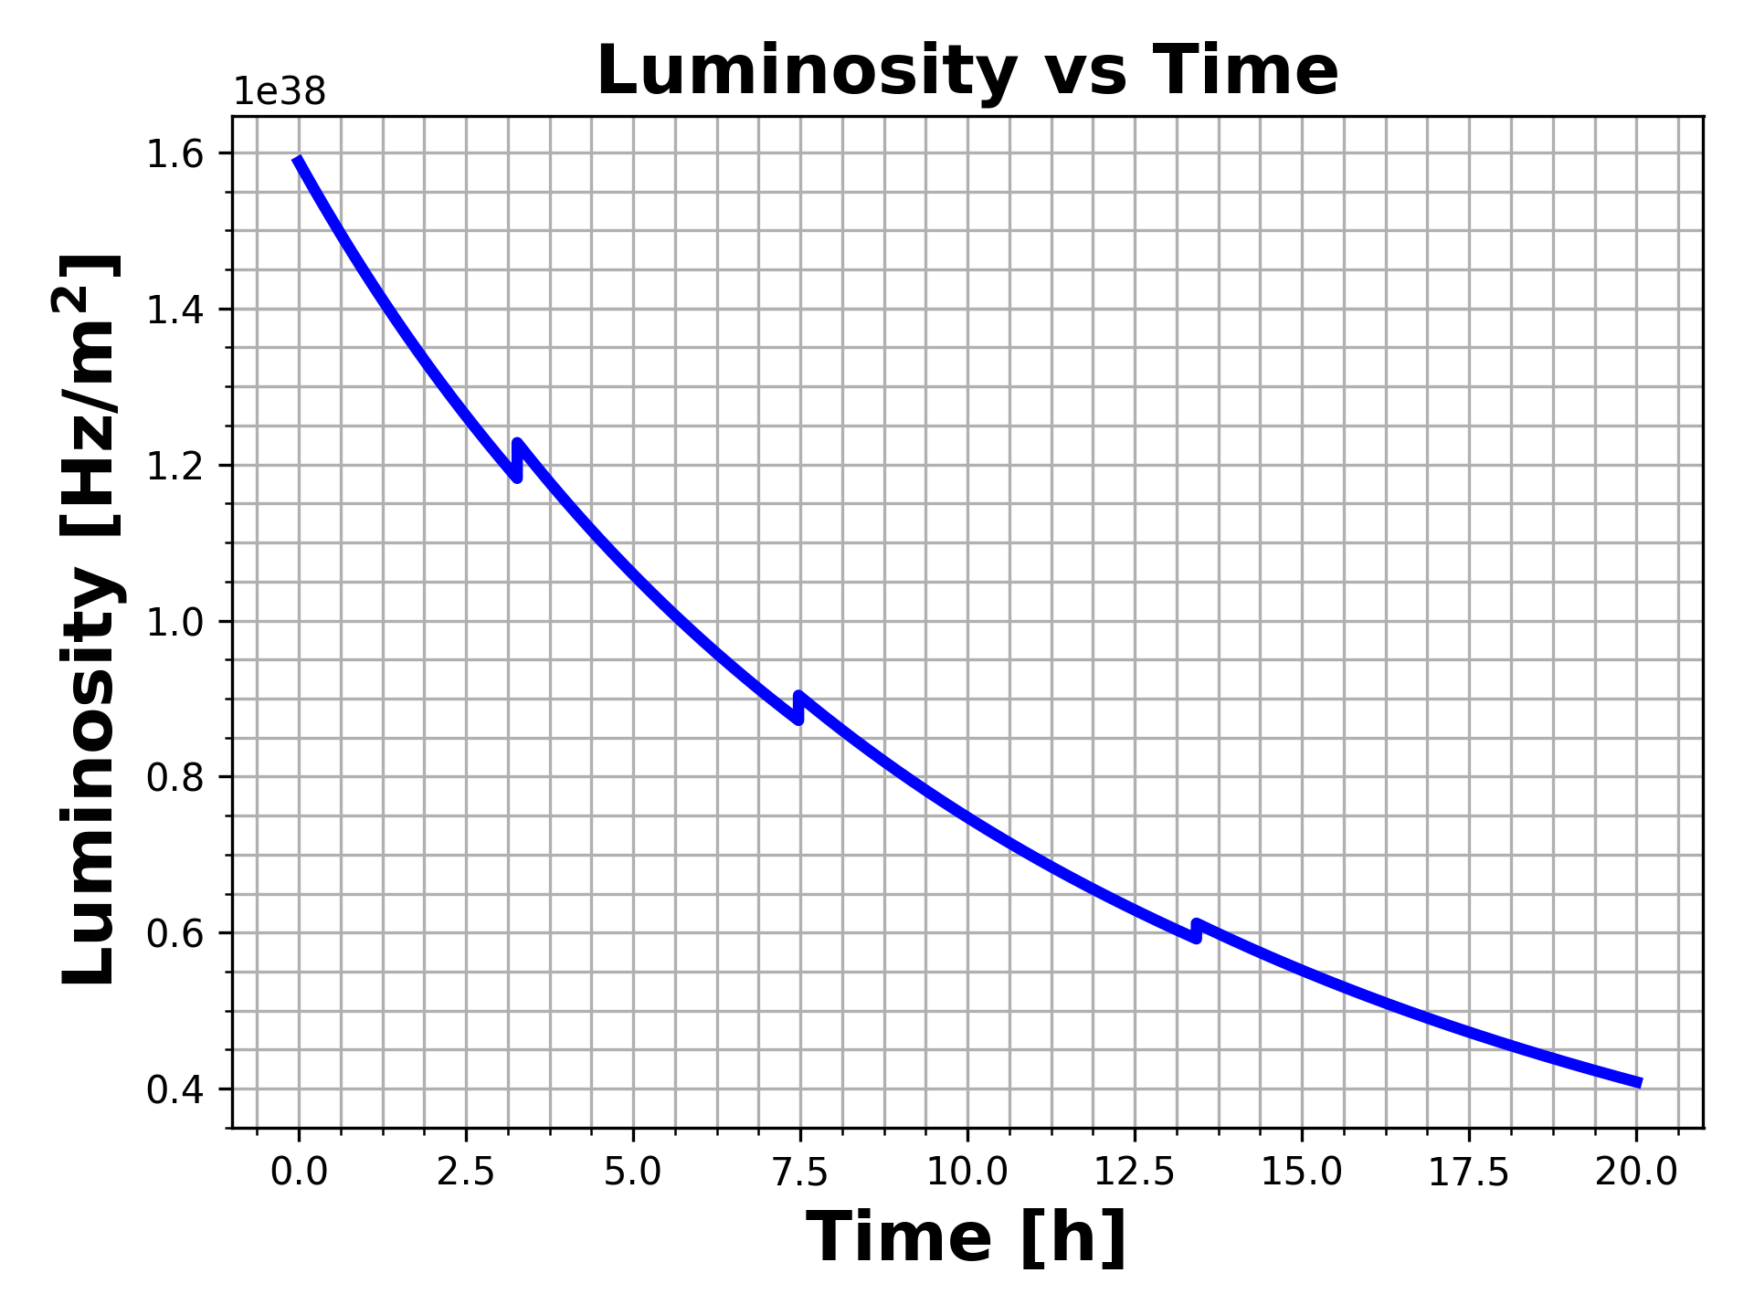
Crossing Anti-Levelling
With careful steps, gain in integrated luminosity of ~5% for 10h in Stable Beams

Slide 15
Crossing Anti-Levelling

Slide 16
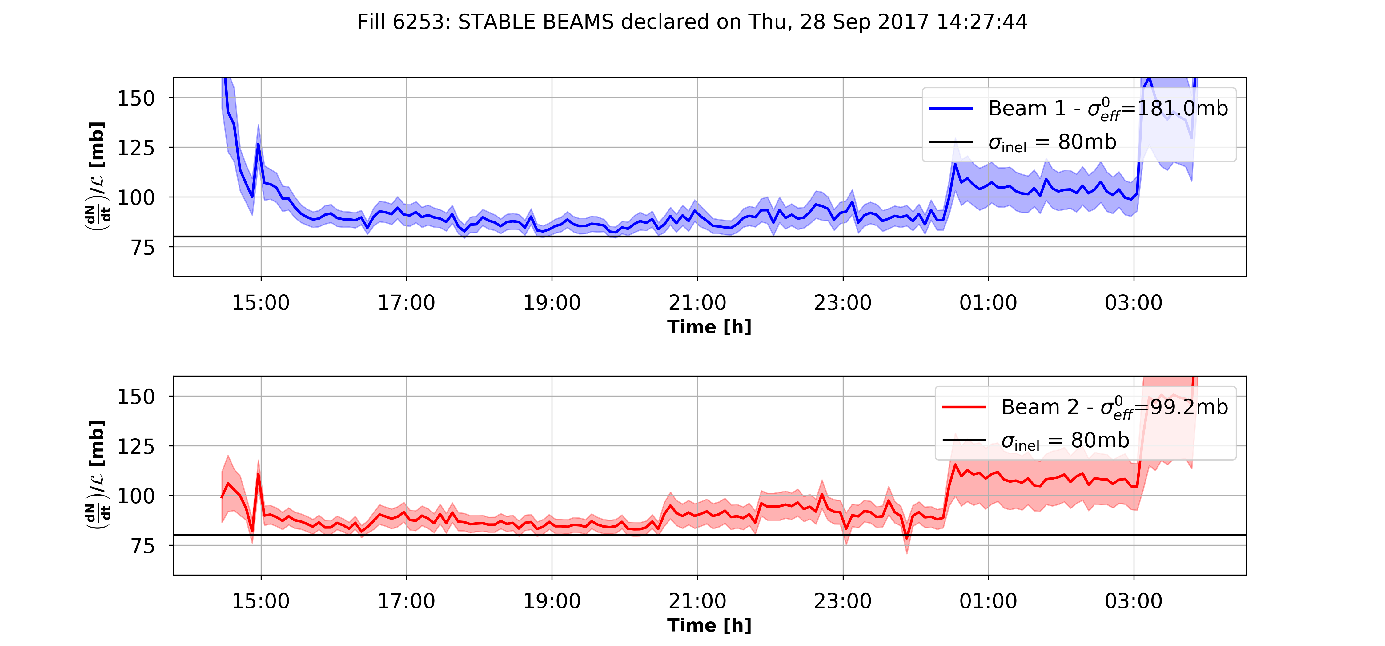
Crossing Anti-Levelling
110μrad
100μrad
When you are in a regime with reduced DA beam lifetime suffers and losses appear!
Careful handling is required, but experience on changing the crossing angle in operation is very valuable for the future...

Slide 17
HL-LHC

Slide 18



HL-LHC Era: Adaptive Levelling
HL-LHC TDR:
“Both the consideration of energy deposition by collision debris in the interaction region magnets, and the necessity to limit the peak pile-up in the experimental detector, impose an a priori limitation upon peak luminosity. The consequence is that HL-LHC operation will have to rely on luminosity levelling."
Levelling Scenarios:
  So far LHC has successfully operated levelling by separation.
  HL-LHC design includes the installation of crab cavities around the IR1/IR5.
  The size of the luminous region can be modified by changing the β* at the IP.
✔︎
✔︎
✔︎
Levelling Proposal:
  “Adaptive Levelling Scenario”
    Depending on the time within the fill (during levelling, i.e. bunch intensity) and driven by the available DA, adapt the crossing angle and β* at the interaction points to keep the target 5 Hz/cm/cm.

Slide 19
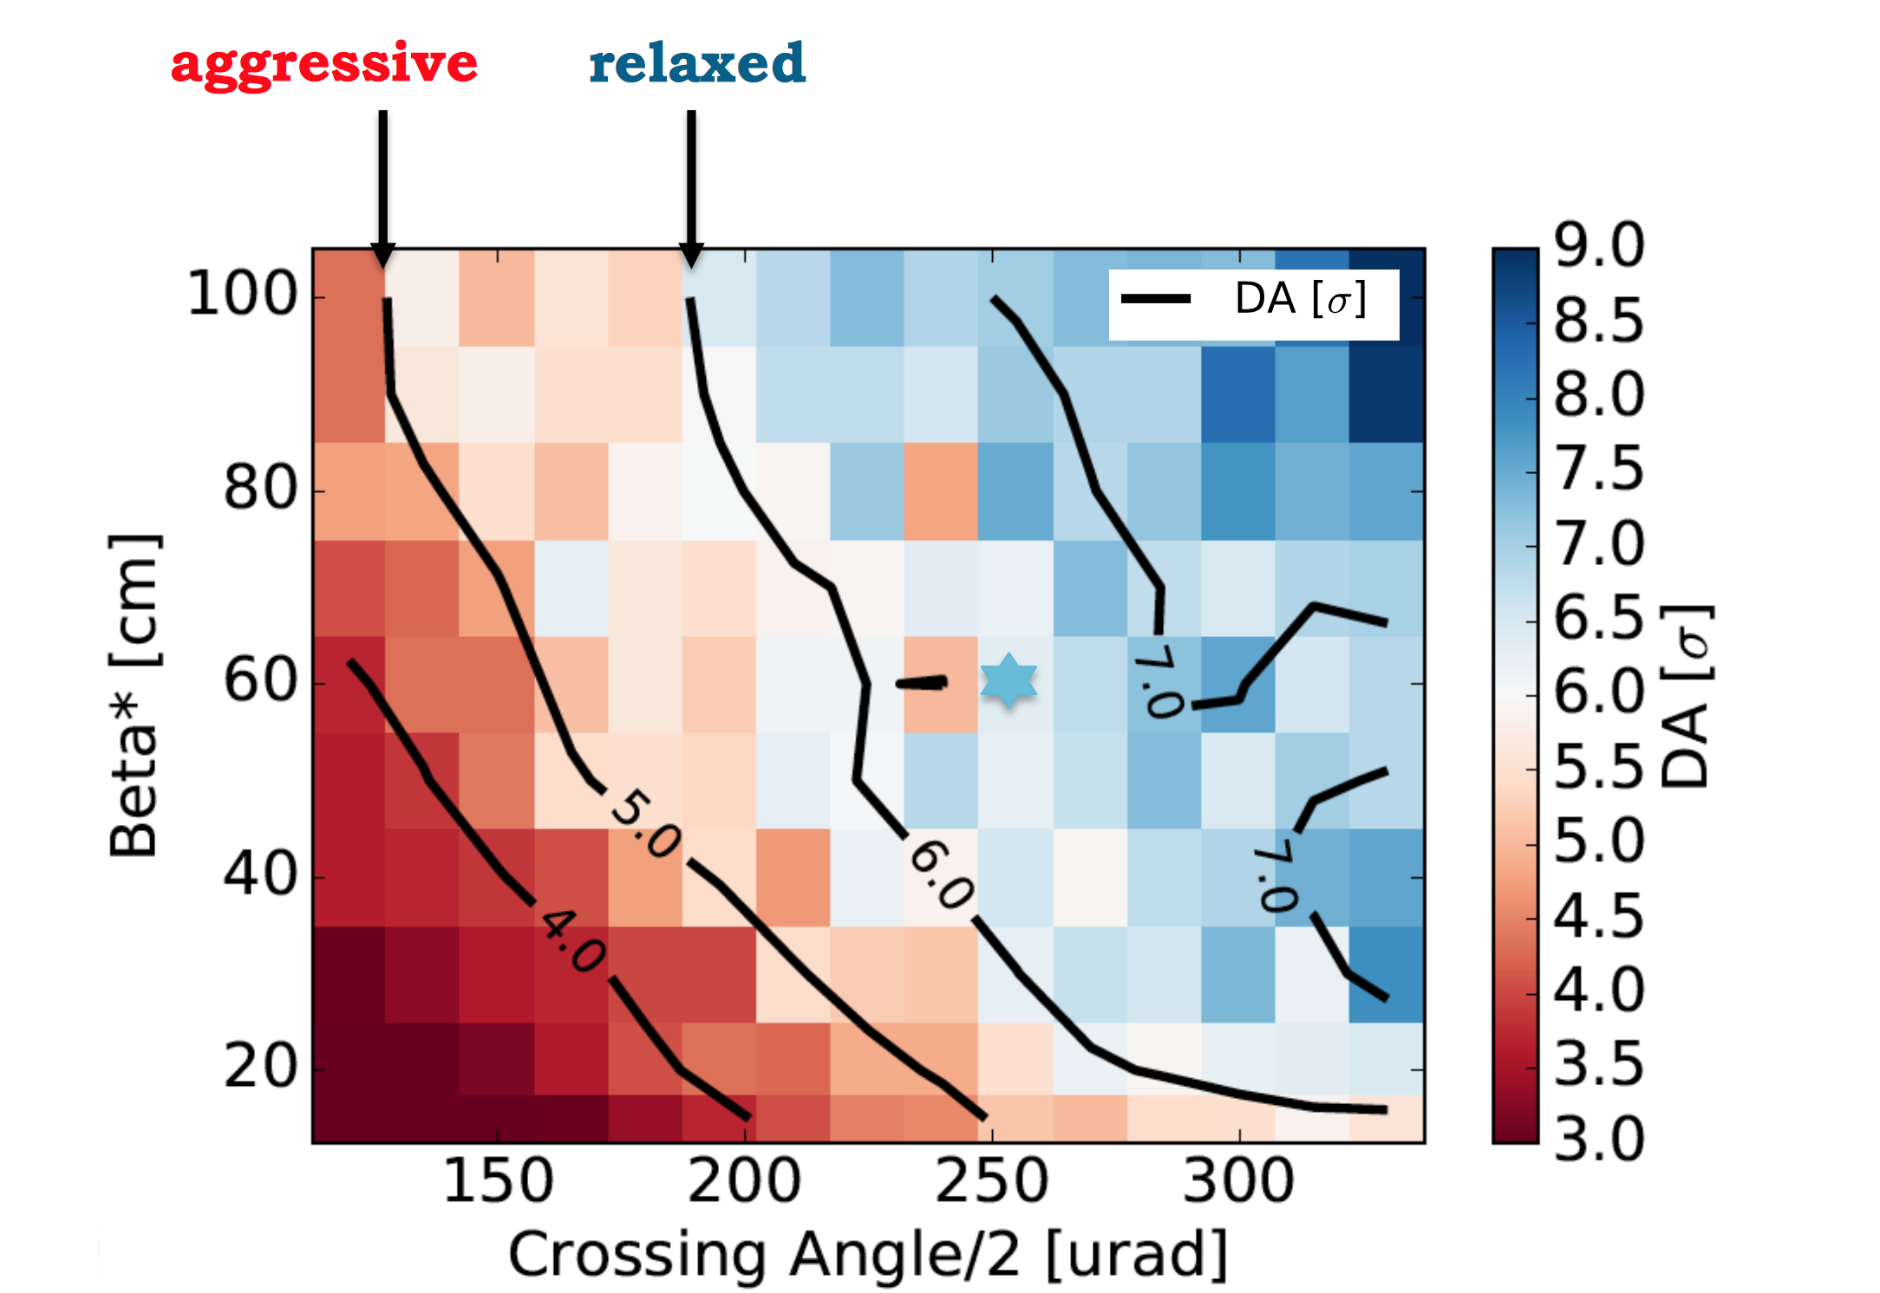
Adaptive Levelling
Min DA Scan for Half Crossing Angle and β* at the start of the collisions.
Start of Collisions
I=2.2e11 ppb

Slide 20
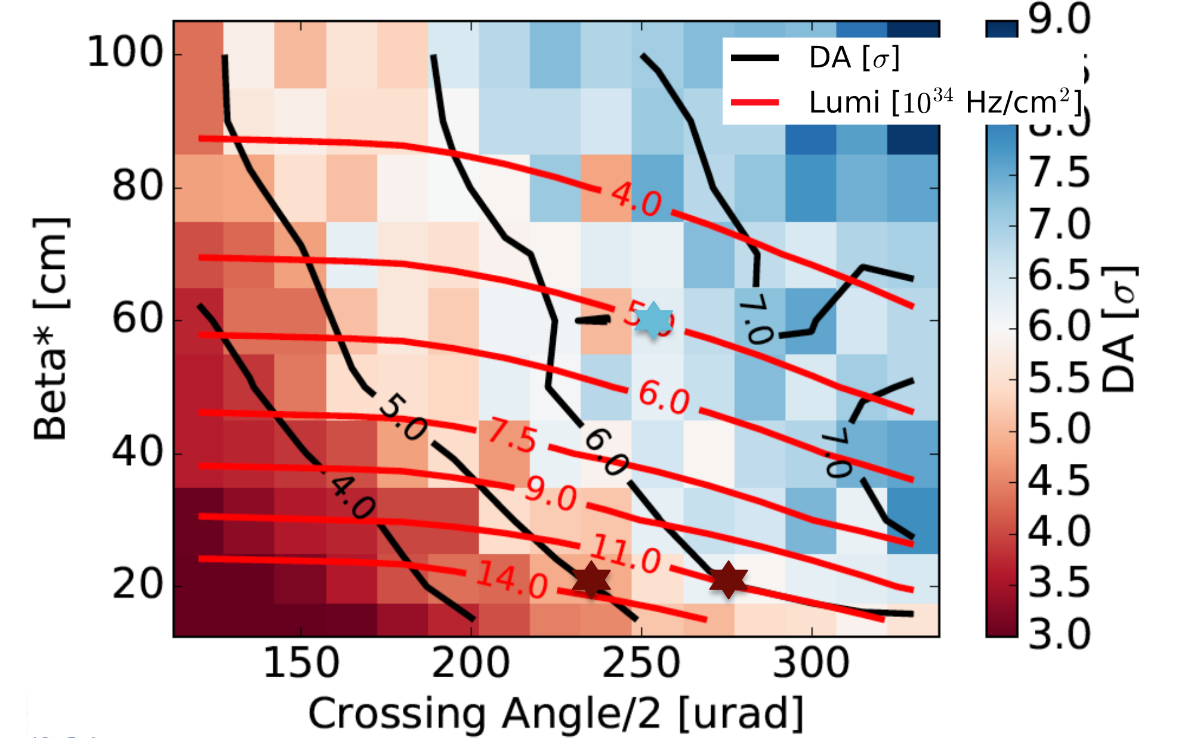
Adaptive Levelling
Overlay iso-luminosity lines.
Peak luminosity 1.1-1.4e35 Hz/cm/cm can be achieved with 20cm β* ... but with PU>300 events.

Slide 21
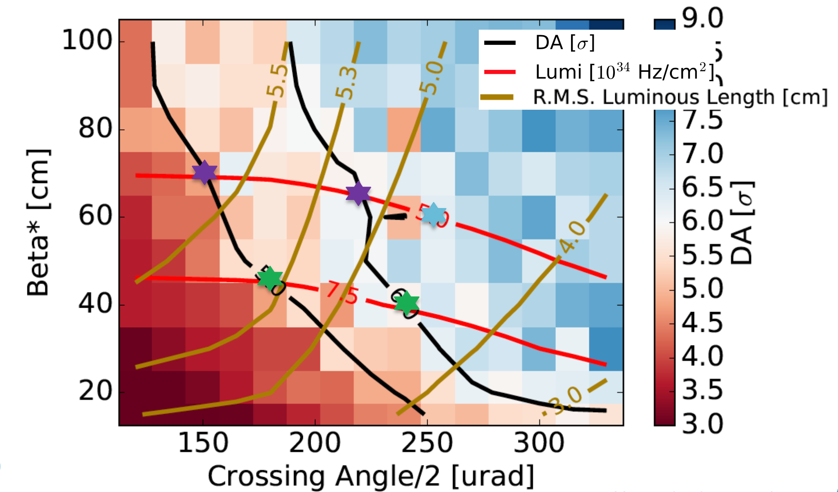
Adaptive Levelling
Overlay iso-length of luminous region lines.
Reduction of crossing angle at constant luminosity enables the reduction of PU density (increase of luminous region) and triplet irradiation.

Slide 22
Adaptive Levelling
Time evolution can be folded in in terms of bunch intensity.

Slide 23
Adaptive Levelling

Slide 24
Adaptive Levelling
Following the intersection of the iso-luminosity and iso-DA lines one can define a levelling path

Slide 25
Adaptive Levelling – What do I gain?
Comparing:
Constant crossing at 510μrad
Adaptive scenario of 6σ DA
Adaptive scenario of 5σ DA
Assuming a cross-section of 80mb
In terms of crossing angle, I can operate with less voltage in the crab cavities (max crabbing 380μrad).
In terms of β* delayed exit from the levelling (here: 20cm target, design: 15cm).

Slide 26
Adaptive Levelling – What do I gain?
This provides me with a bit of gain in terms of integrated luminosity.
  Bit more if I continue with “anti-levelling” after the levelling is finished.
... while the experiments are recording data comfortably at a reduced pileup density.

Slide 27
Summary
DA Simulations in the form of parameter scans are successfully used even during the Run to optimize performance, whenever margin is available, and to construct operational scenarios.
Correlation of DA with lifetime ➔ efforts to quantify it.
LHC: DA driven operational scenarios have been proven to be successful when tested in operation:
    WP optimization ➔ free some space
    reducing β* ➔ increased performance
    crossing angle anti-levelling ➔ increased performance
HL-LHC: Proposal of adaptive luminosity levelling:
    Viable building the experience & preferable in terms of pile-up
    Additional studies on high chromaticity, octupoles, LHCb scenarios ongoing...

Slide 28
Thank you for your attention!

Slide 30
SPARE SLIDES

Slide 31
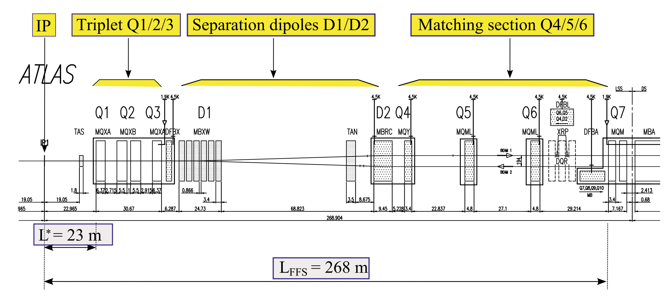
IR1

Slide 32
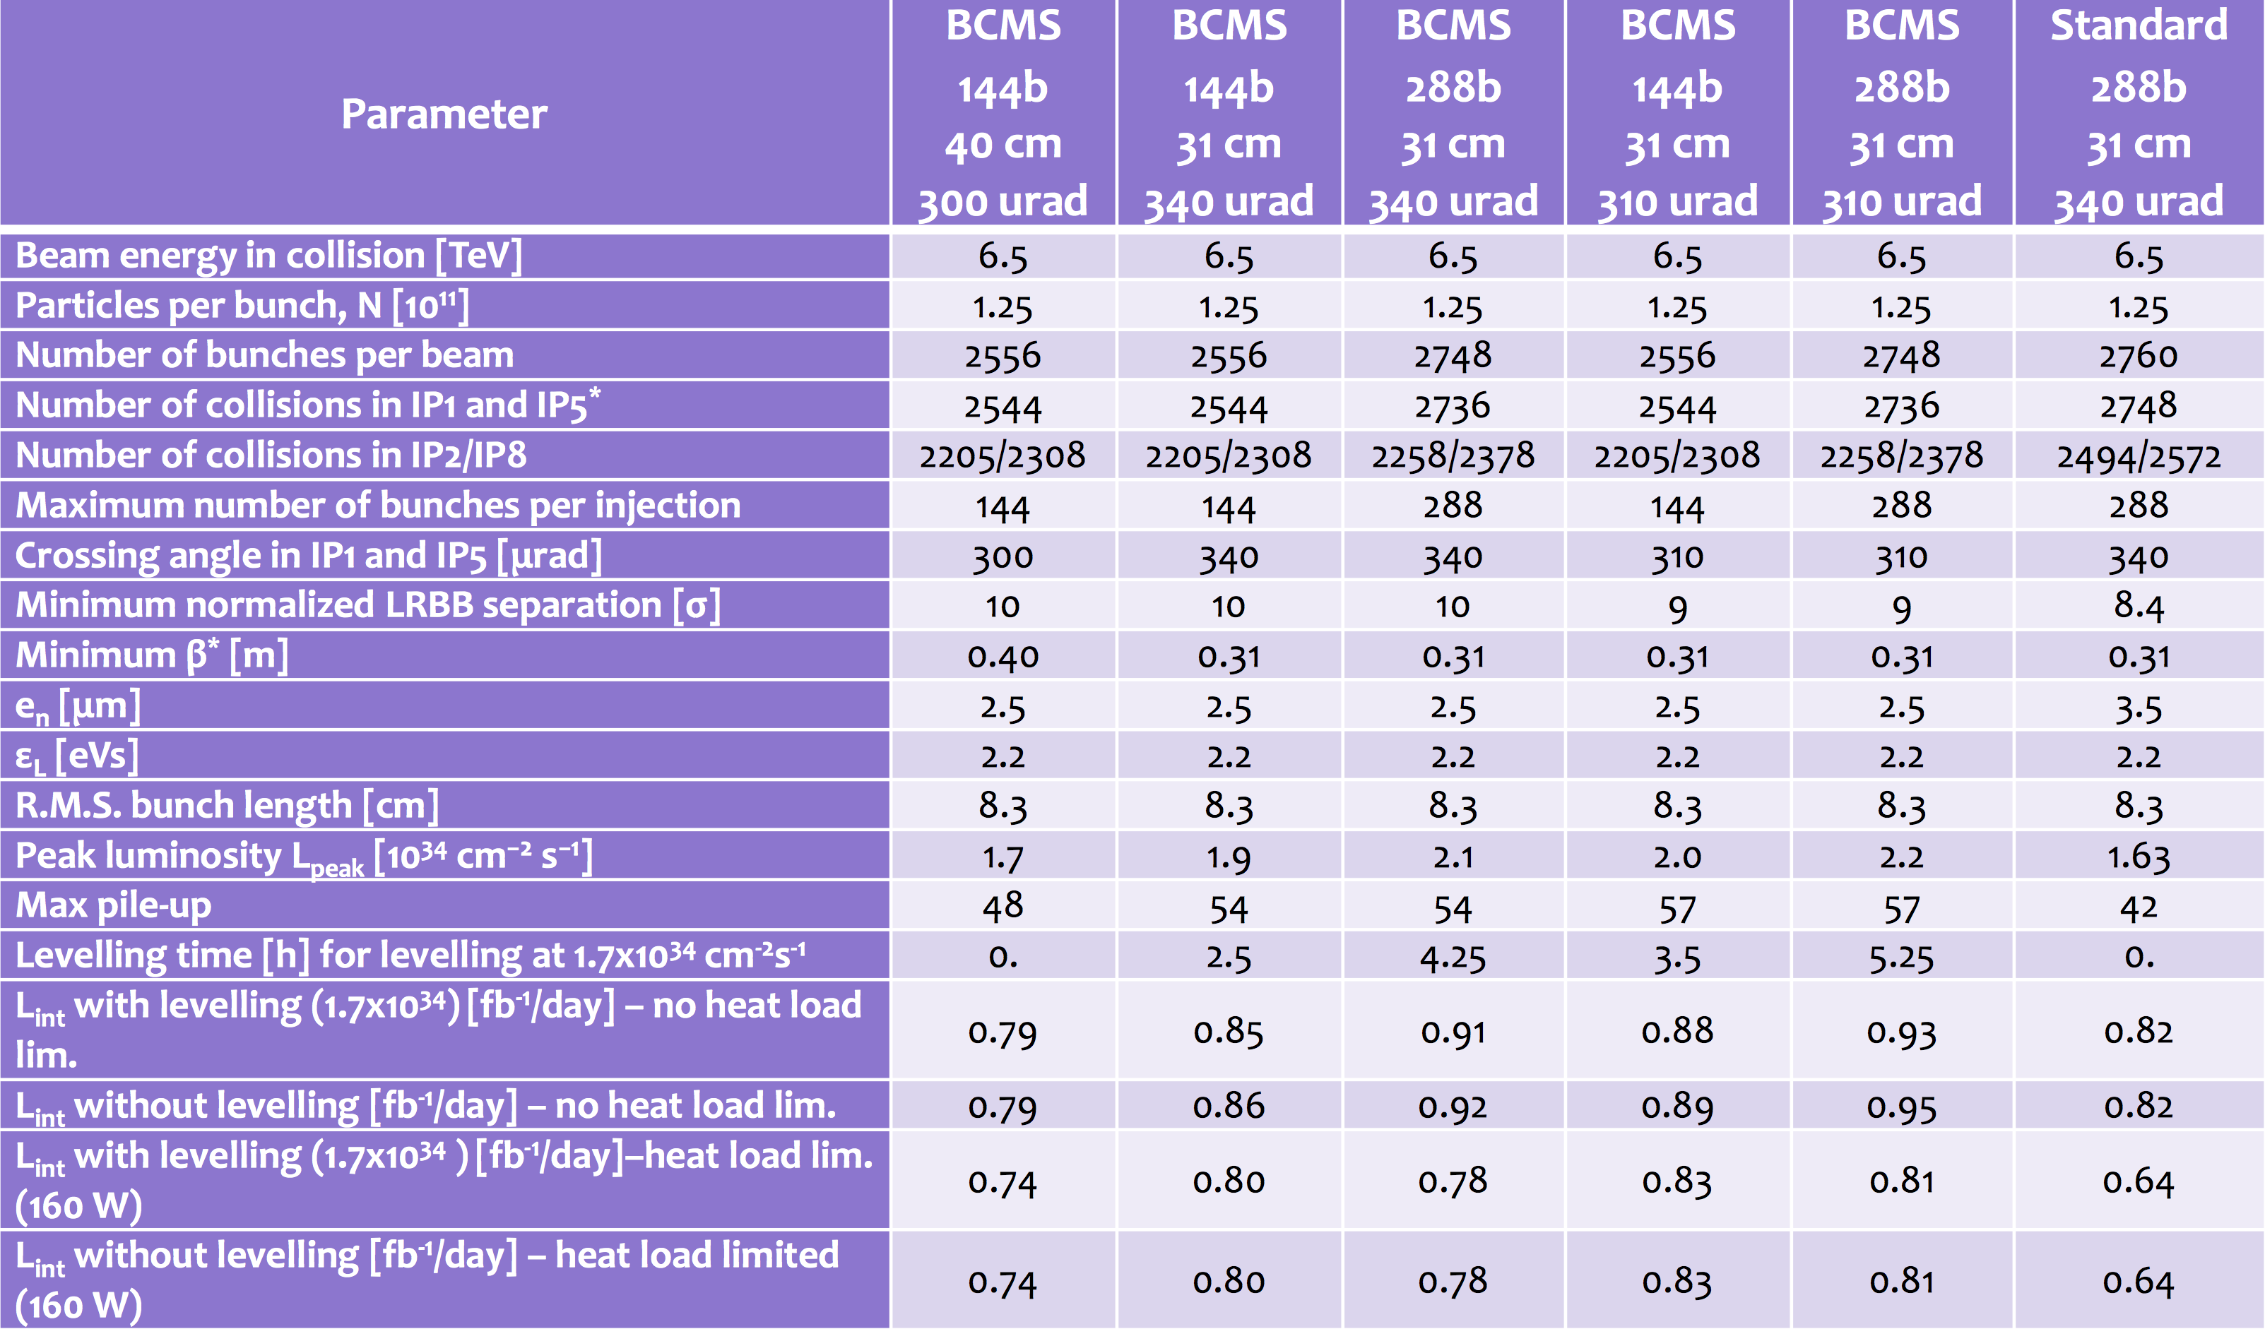
2017 Settings

Slide 33
Setting the Stage: DA Scans
Weak-Strong Approximation:
The strong beam generates the fields while the weak beam just probes them, without reciprocal perturbation ➔ computationally easier;
Dynamic Aperture Scans:
  Choose the machine model (lattice, optics, etc);
  Specify the available parameter space;
  Choose two parameters to study their correlations in terms of DA;
  Fix the rest of the parameters to a constant value for the scan;
  “Time evolution” can be folded in by evolution of the “fixed” parameters (i.e. Intensity evolution, emittance evolution etc).
DA multi-parametric response: Tool to assist in performance optimization by defining a target DA & identifying and approaching the limits
  Operational experience is fed back
The non-linear nature of higher order machine multipoles, the beam-beam force, etc can be comfortably accommodated by the DA description.

Slide 34
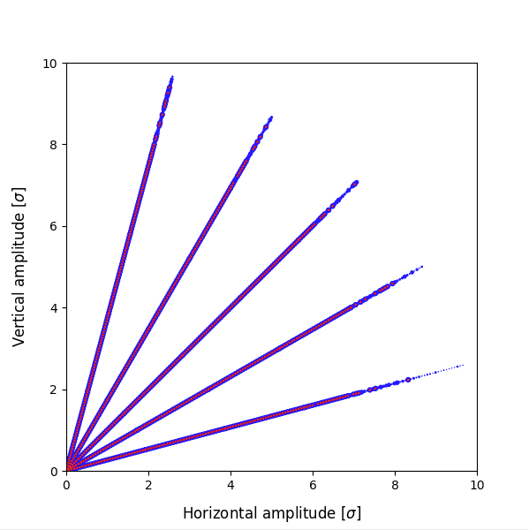
Setting the Stage: DA Scans
Which Tools & How?
  The geometry and basic optics are generated using MADX;
  The tracking is done in SixTrack
    Particles (weak beam) are tracked through the lattice under the impact of the external fields;
    The particles are uniformly distributed in terms of amplitude... (here: 2σ-10σ);
    ... and laying on a number of angles (here: 5 angles);
    … the longitudinal initial conditions of the weak beam are fixed;
    The particles are tracked for a number of turns (here: 1M), with the view to find the survival at 1M turns ➔ DA;
    The final result is quoted in terms of rms transverse beam size units (LHC: protons ~ round beams).
Is this perfect?
  Tracking for 1M turns is only ~90s of machine time
  The initial longitudinal action is fixed
  Beam phase space distribution is not taken into account, no diffusion information
No.
... but it captures all the relevant
aspects of beam dynamics

Slide 35
Which crossing for my intensity?
I would need 175μrad to have the same normalized separation at the start of the fill
For β*=30cm and nominal tune gives me DA < 5σ
175μrad
150μrad

Slide 36
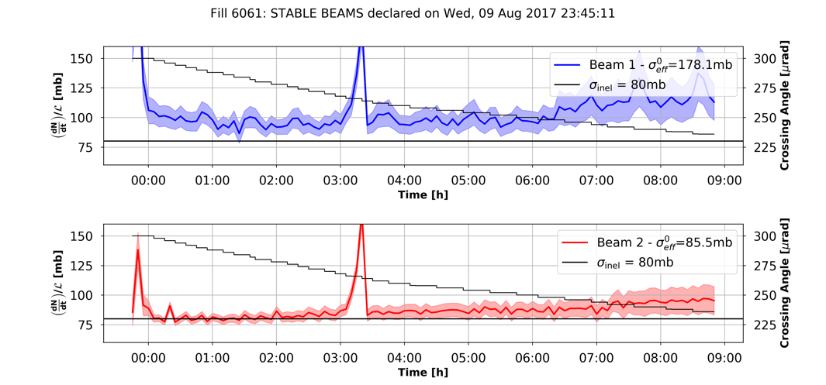
Continuous crossing

