Slide 1
AGS Dynamic Aperture Issue with Partial Siberian Snake Inserted
H. Huang, F. Meot, N. Tsoupas
Nov. 2, 2017
ICFA-DA2017, Beijing

Slide 2
AGS as Polarized Proton Injector for RHIC
Partial Siberian Snake helical dipole magnets are needed for intermediate energy synchrotrons to preserve polarization of polarized proton beams. Such strong magnets are not easily rampable for fast synchrotron. So the strong field at injection causes inevitably shrinking of dynamic aperture. The quadrupoles are inserted to compensate the optical distortion due to the strong helical dipole fields.
The AGS used to be a high intensity synchrotron: 1.2E13 ppb. The energy range is 1.5GeV to 25GeV.
AGS dipole magnets are combined function and the natural tune is about 8.7 in both plane. The beam pipe size is 3inch(V) by 7inch(H).
In the high intensity operation period, beam pipe is filled at injection due to space charge. For polarized proton beam operation, the AGS serves as the injector to RHIC, and the required intensity is 2E11 at RHIC top energy.
For polarization preservation, a pair of partial snake magnets(helical dipole magnets) are inserted in the AGS: 2.1T and 1.5T. For the injection, this caused huge optical distortion and the dynamic aperture is greatly reduced.
Without any compensation, the intensity was down to 0.6E11ppb.

Slide 3
AGS as Polarized Proton Injector for RHIC (2)
To RHIC Injection
Pol. H⁻ Source
Gγ= 2.2... 4.5
Jump quads in adjacent super-periods I &J
LINAC
BOOSTER
Warm Helical Partial Snake
AGS
200 MeV Polarimeter
Gγ= 4.5 … 45.5
For proton, G=1.7982
AGS Polarimeter
Cold Helical Partial Snake
AGS has been running as RHIC polarized proton injector with dual partial snakes and two horizontal tune jump quads. It has delivered ~70% polarization with ~2*10¹¹/bunch intensity with 80% as input polarization.
[1] H. Huang, et al., Phys. Rev. Lett .99, 154801(2007).
[2] F. Lin, et al., Phys. Rev. ST AB 10, 044001 (2007).
[3] H. Huang, et al., Phys. Rev. ST AB 17, 081001 (2014).
Notes:
Show layout & point of polarimeters and experimental locations
Emphasize bunch polarizations prepared at source going through AGS etc. to RHIC
Time spacing between them ~100 ns
Transverse polarization in ring, longitudinal at experiments (optional) using spin rotators
Emphasize none of these techniques existed just 4-5 years ago, all developed here at RHIC with international collaborations led by US and Japanese teams.

Slide 4
Tune Measurement on Ramp
-1+ν_{y}
0+ν_{y}
12+ν_{y}
36-ν_{y}
24+ν_{y}
48-ν_{y}
35+ν_{y}
36+ν_{y}
1+ν_{y}
37+ν_{y}
(Jeff Wood)
8.98
For polarization preservation, the vertical tune needs to stay about 8.98, or as high as 8.99.

Slide 5
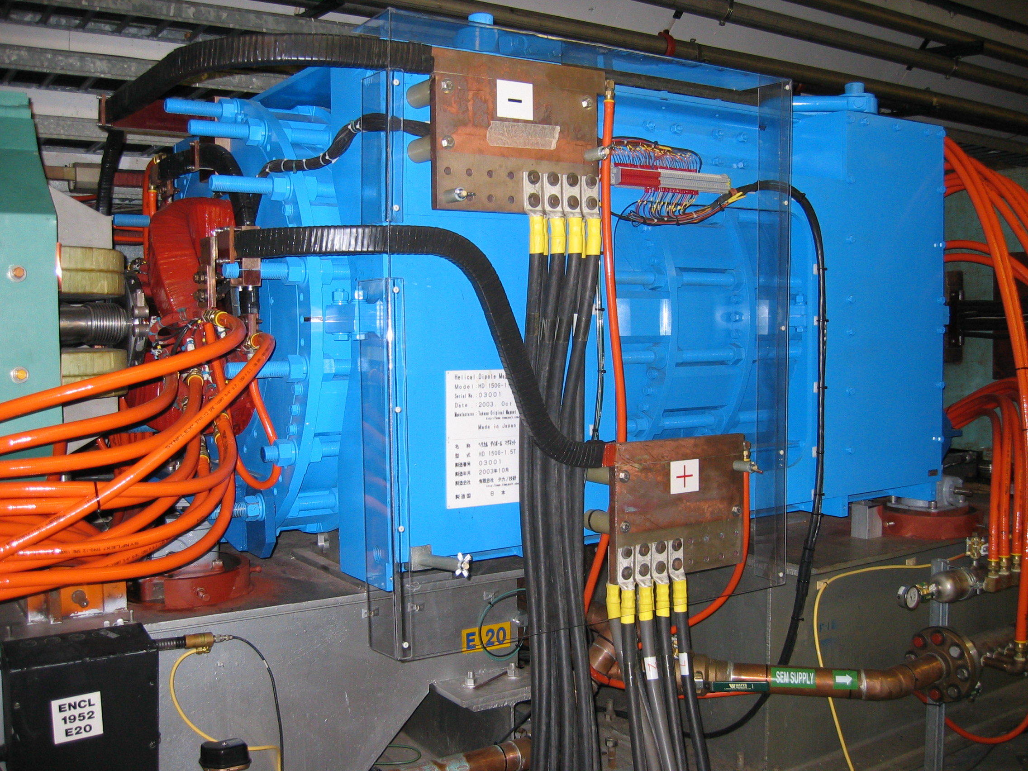
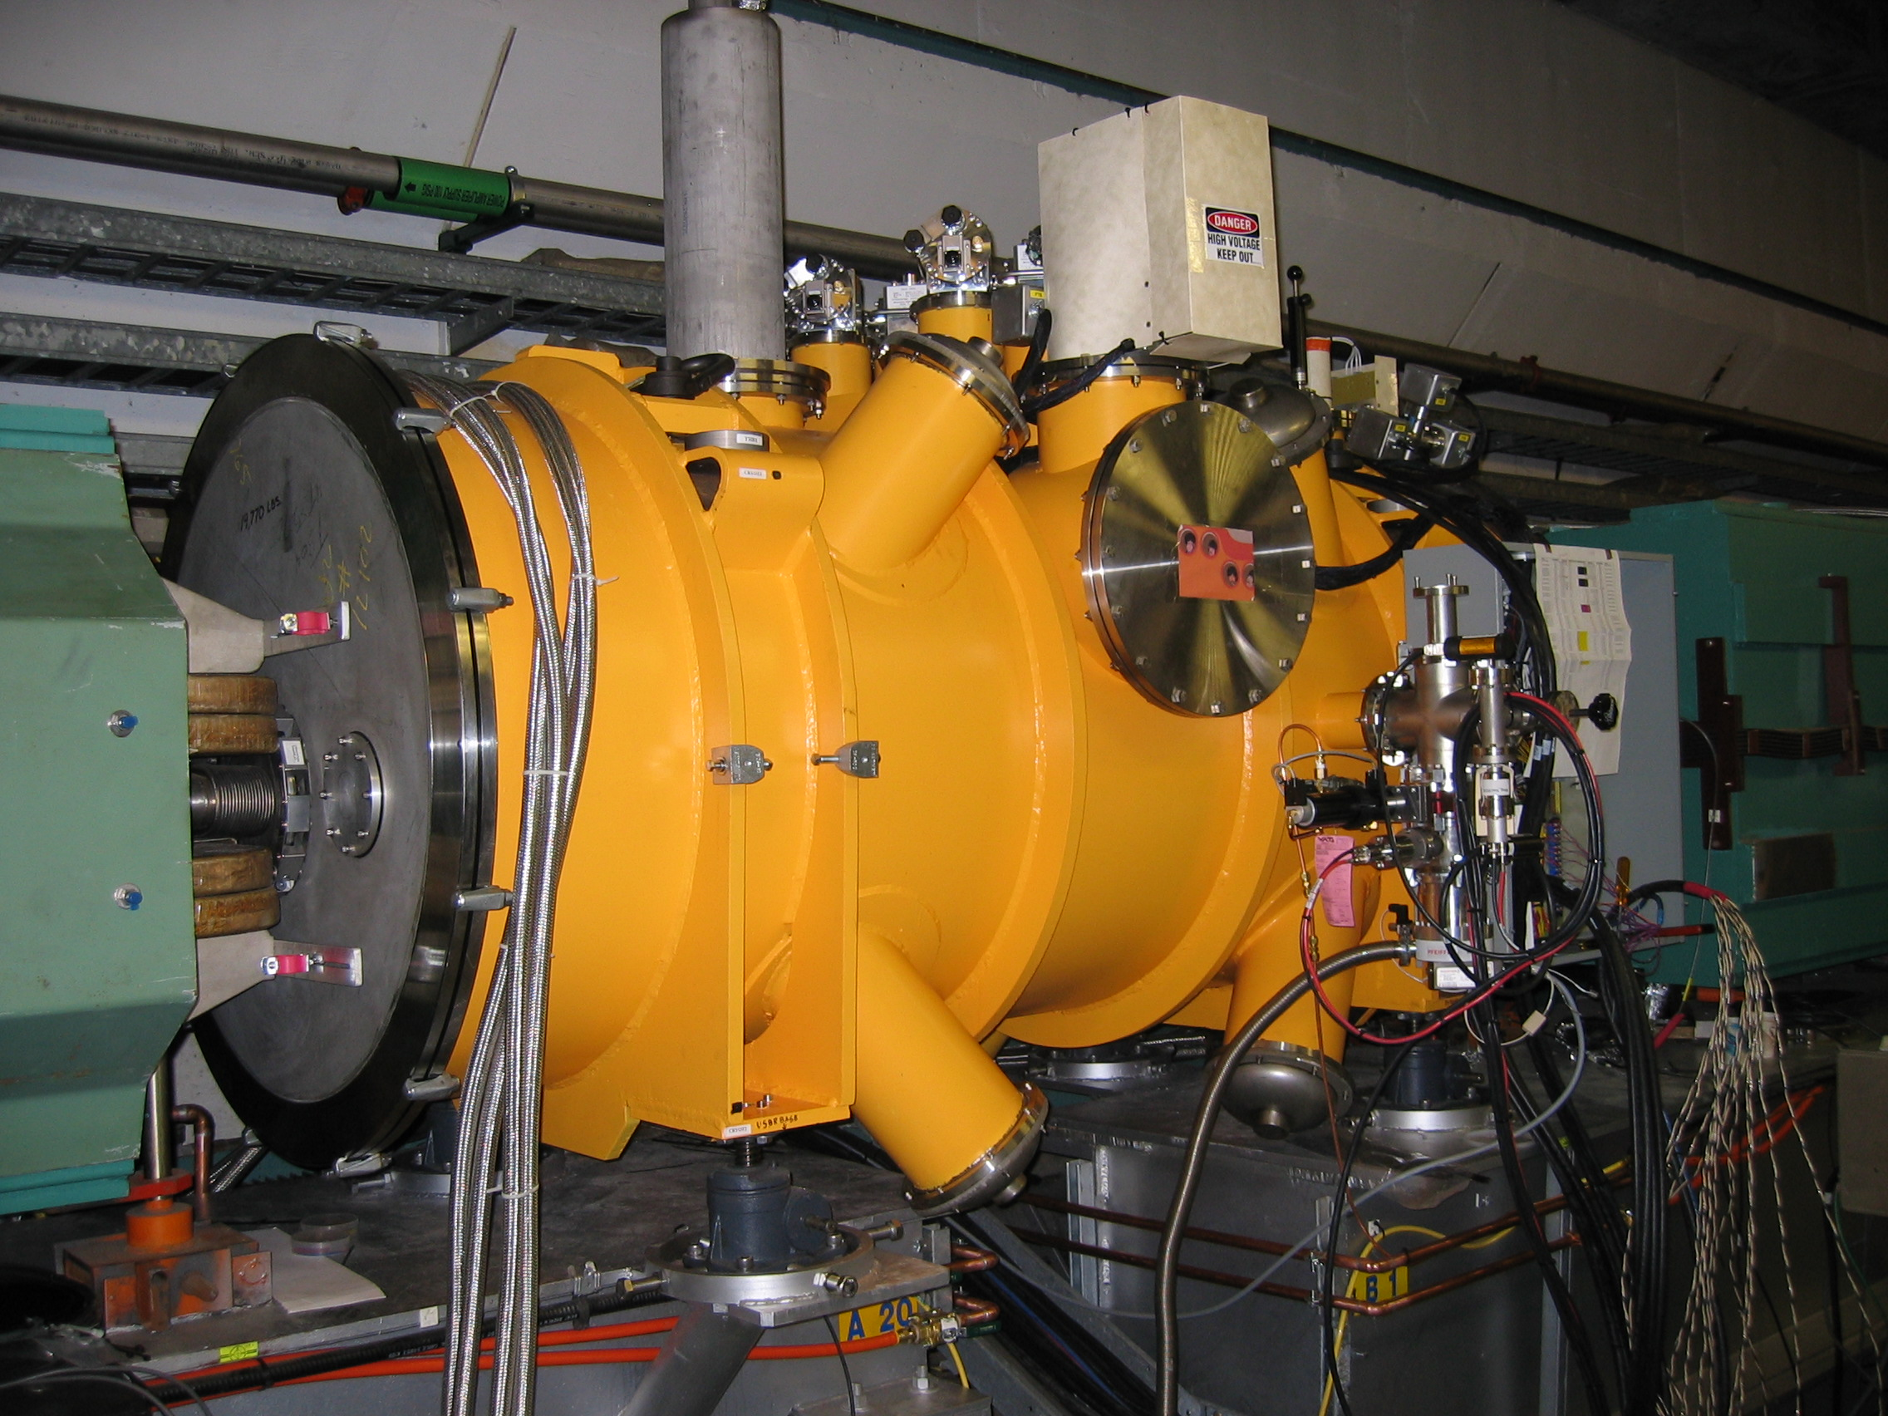
AGS Partial Snakes
The two-snake solution provides better spin match at injection and extraction.
E20
A20

Slide 6
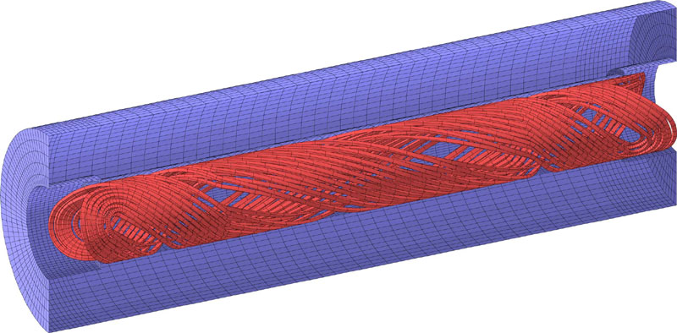
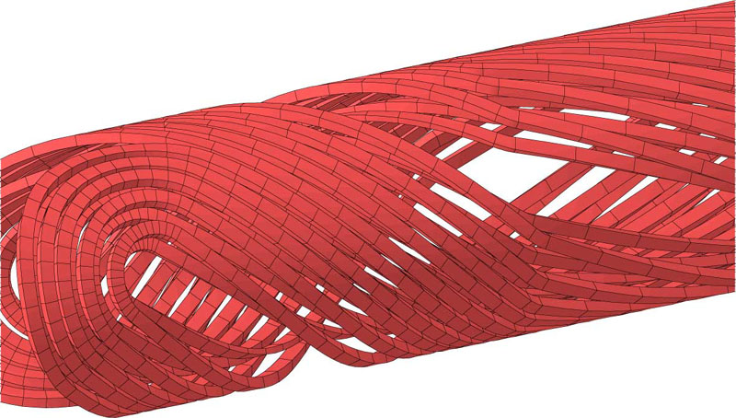
2-3T AGS Super-Conducting Helical Snake
2.6 m
15 cm warm bore
Helix with changing pitch

Slide 7
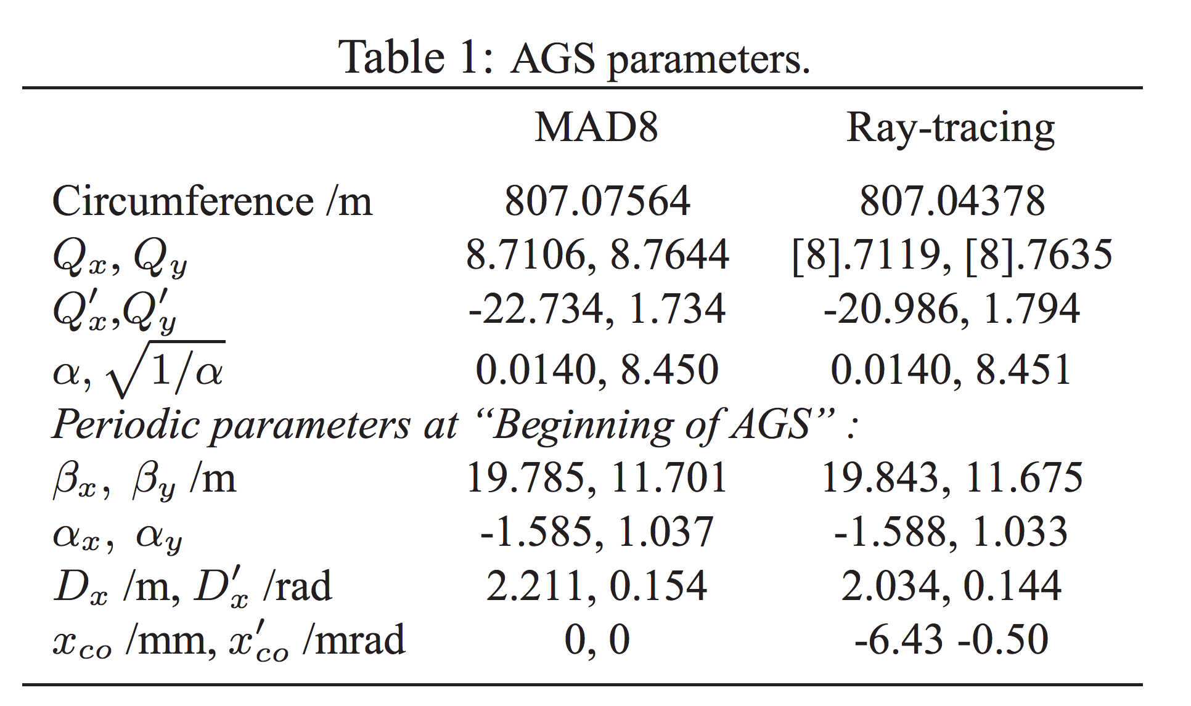
AGS Parameters

Slide 8
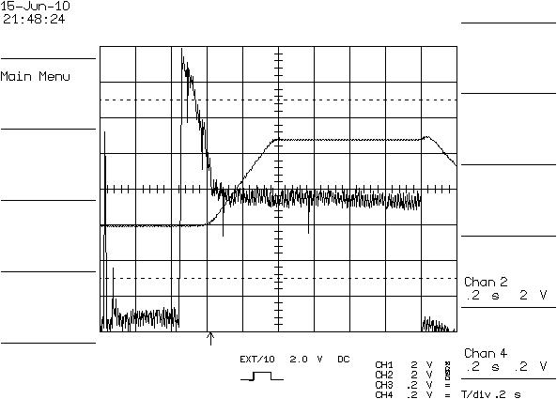
Intensity with Limited Compensation: 6E10
Main magnet
Intensity
To compensate the large optical distortion from helical magnets, a pair of thin quads were added next to the cold snake. But this is not enough: still huge beam loss near injection.

Slide 9
Compensation Quads Setting vs. Beam Energy
Notes:
K = quad strength (B’/B

Slide 10
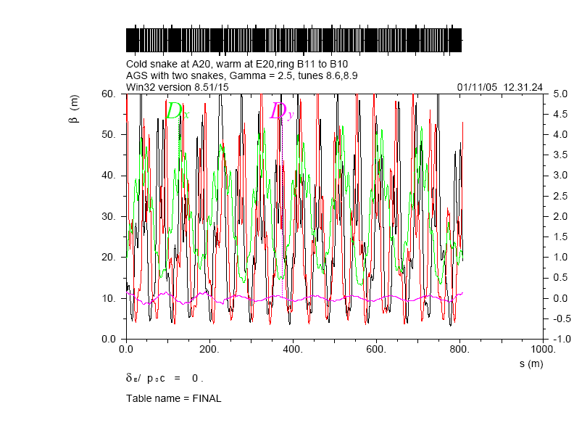

Slide 11
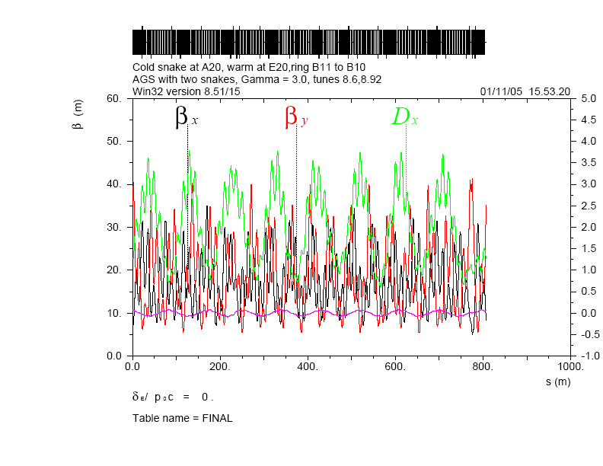

Slide 12
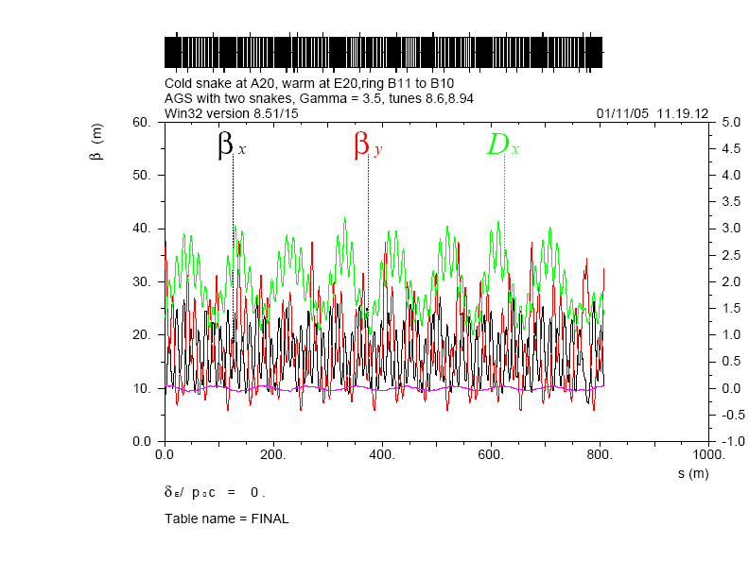

Slide 13
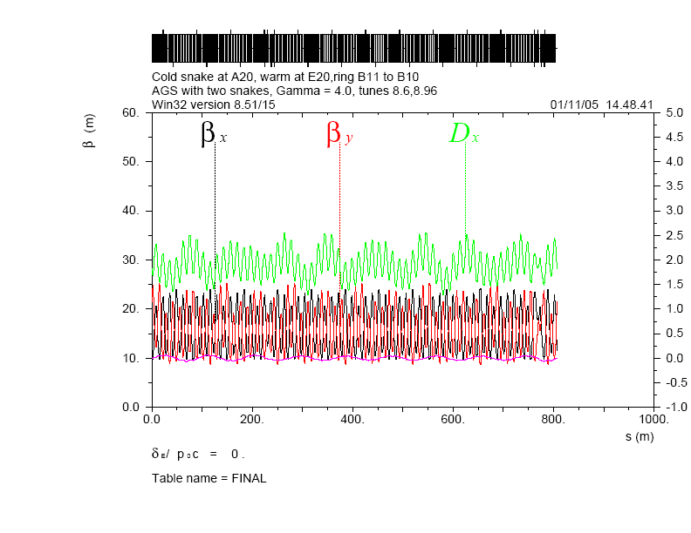

Slide 14
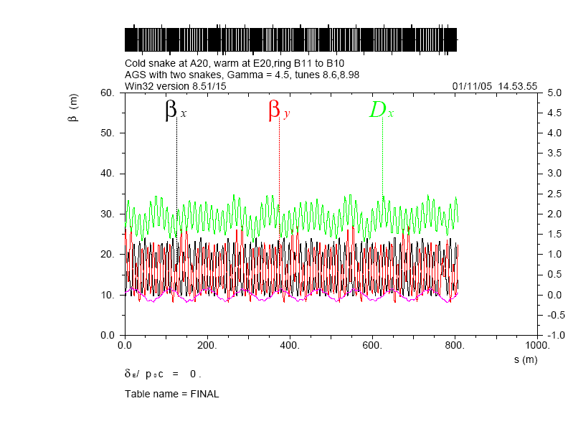

Slide 15


Slide 16


Slide 17
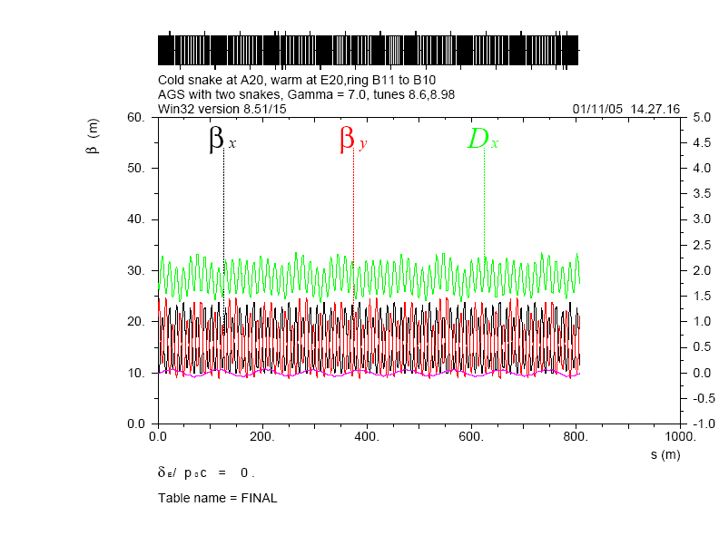

Slide 18
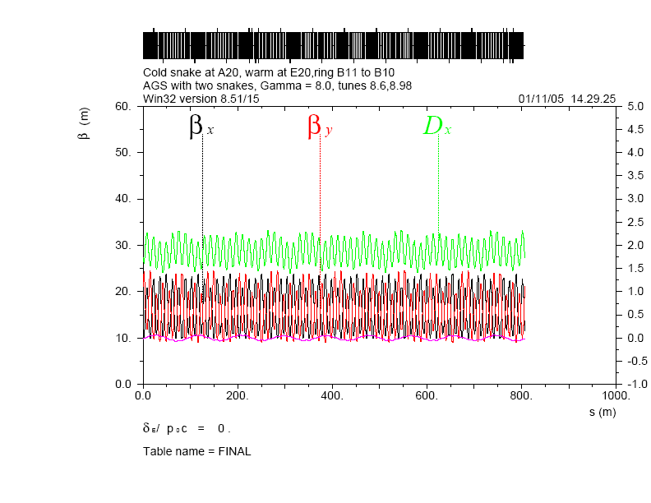

Slide 19


Slide 20


Slide 21
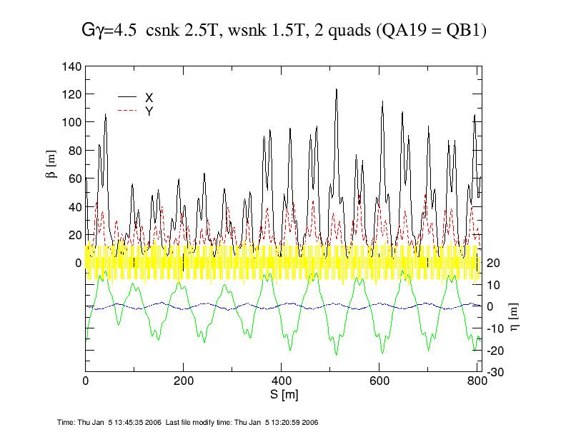
AGS Injection Lattice (2 Quads)

Slide 22
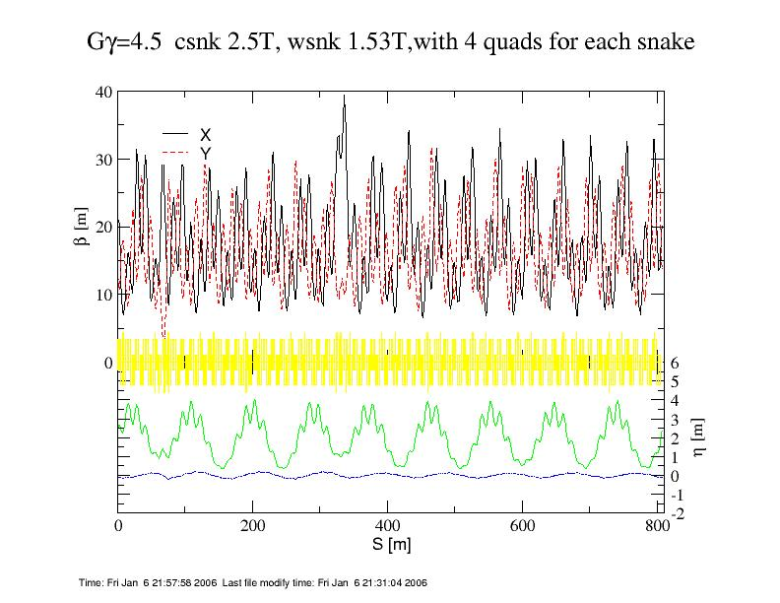
AGS Injection Lattice(4 Quads)

Slide 23
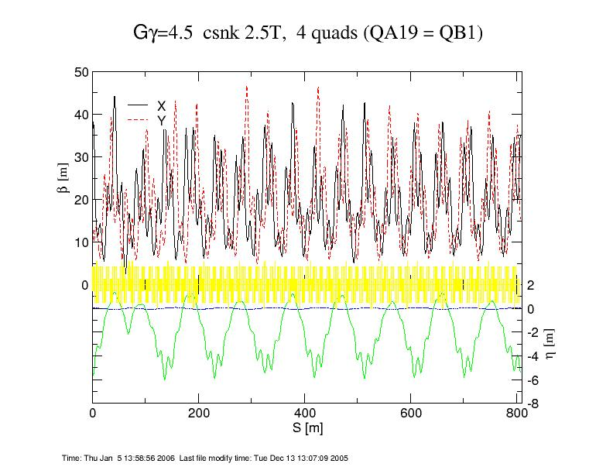
AGS Injection Lattice (CSNK only, 4 Quads)

Slide 24
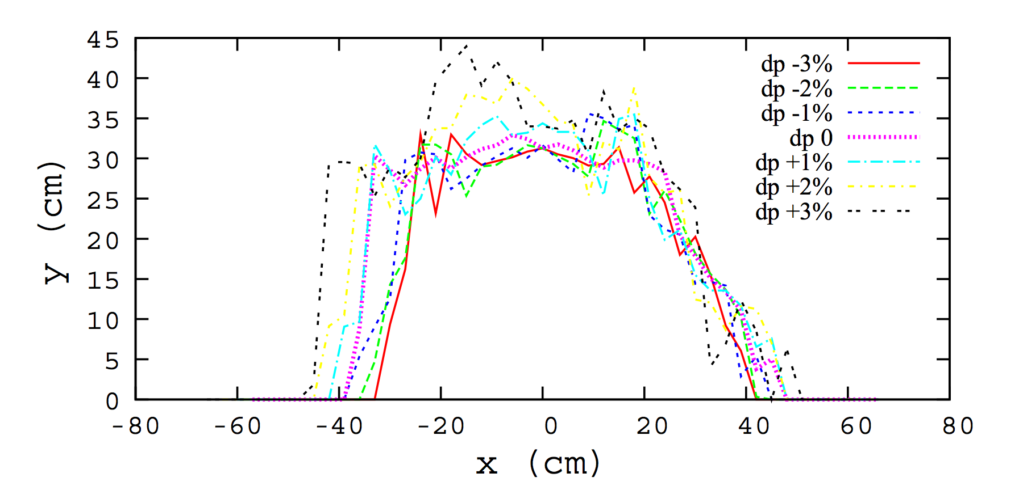
AGS Dynamic Aperture w/o Snakes
Ray-tracing code ZGOUBI is used to calculate the dynamic aperture. The dynamic aperture of the ring for δp/p = 0, ± 1, ±2, ±3%. These (x, y) limits are obtained by scanning the x-axis, step size 3 cm, and looking, at each x-step, for the maximum vertical stable amplitude upon 1000-turn tracking, with 2 mm precision on that y-limit.

Slide 25
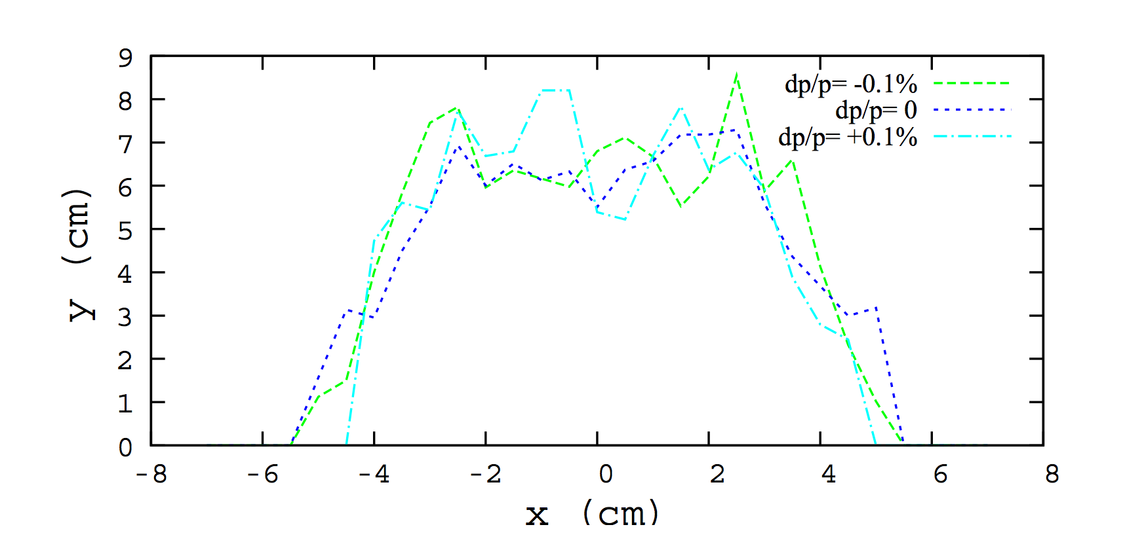
AGS Dynamic Aperture with Snakes
[1]Spin dynamics simulations at the AGS, H. Huang, W. W. MacKay, F. Meot, T. Roser, Proc. IPAC 2010, Kyoto.
[2] Modeling of the AGS using Zgoubi - status, F. Meot et al., Proc. IPAC 2011, San Sebastian.
[3] Development of a stepwise ray-tracing based, on-line model of the AGS, F. Meot et al., Proc. PAC 2011, New York.
[4] Modeling of the AGS using Zgoubi - status, F. Meot et al., Procs PAC 2012, New Orleans.

Slide 26
Summary
AGS polarized proton operation requires two helical dipole magnets (partial Siberian Snakes). These two magnets caused significant optical distortion near injection.
Two compensation quads at the stronger dipole magnet is not enough to restore the lattice.
Four thin quads were added to both helical dipole magnets. The beta beat was greatly reduced in this case, and the vertical aperture is improved enough to get required intensity (more than doubled in the first test: 0.6E11-> 2.2E11).
Over years, various improvement has increased the bunch intensity to 3E11, which is critical for RHIC high intensity operation (2.5E11) in the e-lens operation mode.

Slide 27
Backup Slides

Slide 28
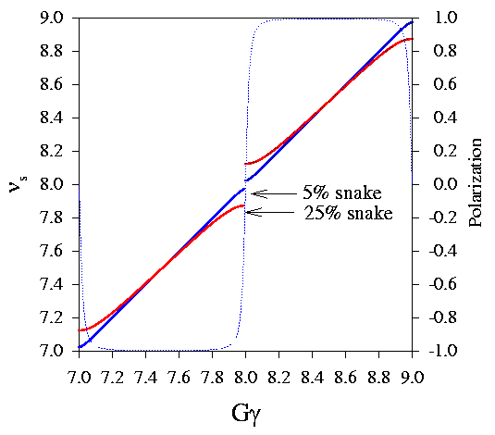
Spin Dynamics
Spin tune is given by
cosπν_{s}=cos (δ/2) cos Gγπ
δ =0.05π in AGS, ν_{s} can not be an integer, avoided all imperfection resonances;
δ =π in RHIC, ν_{s} =1/2, avoided all imperfection and intrinsic resonances.
Polarization after passing an isolated resonance with strength ε and passing speed α =Gdγ/dθ is given by Froissart-Stora Formula
P_{f}/P_{i}=2exp[-π|ε|²/(2α)]-1
π|ε|²/(2α)<<1, P_{f}/P_{i}→1;
π|ε|²/(2α)>>1, P_{f}/P_{i}→-1.

