Slide 1
Beam Optics & Dynamic Aperture of FCC-ee
Nov. 1, 2017 @ DA Workshop
K. Oide (KEK) on behalf of the FCC-ee Collaboration

Slide 2
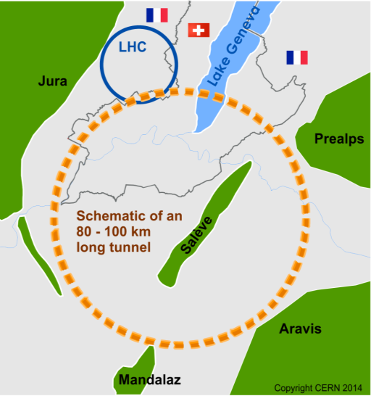
The FCC Design Study
Requested from European Strategy (2013)
“Ambitious post-LHC accelerator project”
Study kicked off in Geneva in Feb. 2014
International collaboration to study circular colliders (111 institutes)
Fitting in a new 100 km infrastructure, in the Geneva area
Ultimate goal: 100TeV pp collider (FCC-hh)
Requires R&D for 16T magnets
Defines the infrastructure
Possible first steps
e⁺e⁻ collider (FCC-ee) at the intensity frontier
High luminosity, √s = 90-400 GeV
pp collider (HE-LHC) in the LEP/LHC tunnel
With FCC-hh technology (16T → 28 TeV)
Possible add-on
e-p option (FCC-eh)
European Strategy update (2019)
Conceptual design report (CDR)
Cost review for tunnel and each collider
Schedules and operation models
Academic Training
11 Oct 2017

Slide 3
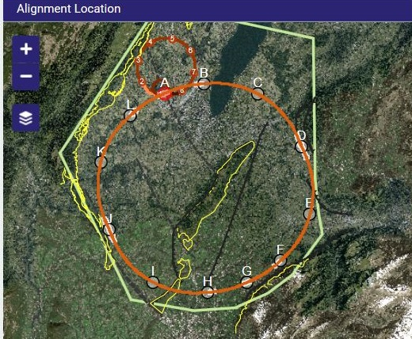
The FCC Home
Optimized length: 97.5 km
Accessibility, rock type, shaft depth, etc.
Tried different options from 80 to 100 km
Tunneling
Molasse 90% (easy to dig)
Limestone 5%, Moraines 5% (tougher)
Shallow implementation
30m below Leman lakebed
Only one very deep shaft (F, 476m)
Alternatives studied (e.g. inclined access)
Academic Training
11 Oct 2017

Slide 4
FCC-ee Beam Optics
A baseline optics* for FCC-ee was once established in Oct. 2016 characterized by:
100 km circumference, 2 IP/ring
Common lattice for all energies
90°/90° FODO cell in the arc with non-interleaved sextupole pairs (294 families)
30 mrad crossing angle at the IP, with the crab-waist scheme
Local chromaticity correction for y-plane, incorporated with crab sextupoles
100 MW total SR power for all energies
Limit the SR toward the IP below 100 keV at 175 GeV, up to 450 m upstream
Tapering of magnets along the ring to compensate the effects of SR on orbit/optics
Sufficient dynamic aperture for beamstrahlung and top-up injection
Motivations for changes in 2017:
Mitigation of the coherent beam-beam instability at Z
Smaller βx* at Z, W, Zh.
60°/60° cell in the arc at Z
Longer bunch lengths by SR and beamstrahlung.
The baseline beam energy for ttbar is set at 182.5 GeV.
Adopt the “Twin Aperture Quadrupole” scheme for arc quadrupoles
Fit the footprint to a new FCC-hh layout
*Phys.Rev.Accel.Beams 19 (2016) no.11, 111005

Slide 5
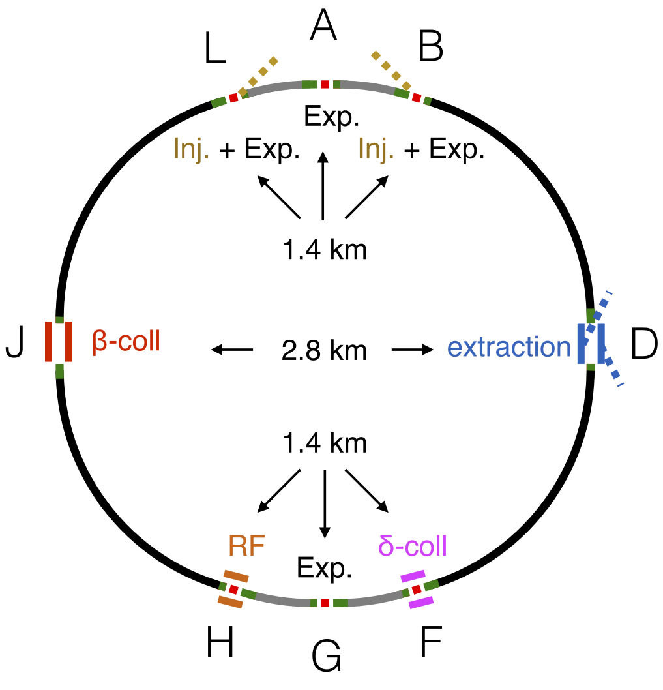
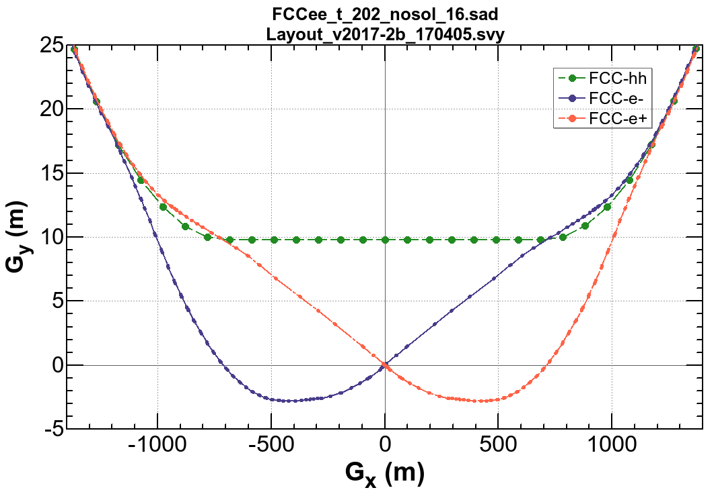
Layout of FCC-ee
IP (A)
30 mrad
“Middle straight”
∼1.4 km
L
FCC-hh/
Booster
B
13.5 m
10.7 m
FCC-hh
0.3 m
Beams must cross over through the common RF (@ tt) to enter the IP from inside.
Only a half of each ring is filled with bunches.
“90/270 straight”
∼2.8 km
J
RF
RF
D
e⁺
e⁻
Ring 1
Ring 2
H
F
IP (G)

Slide 6
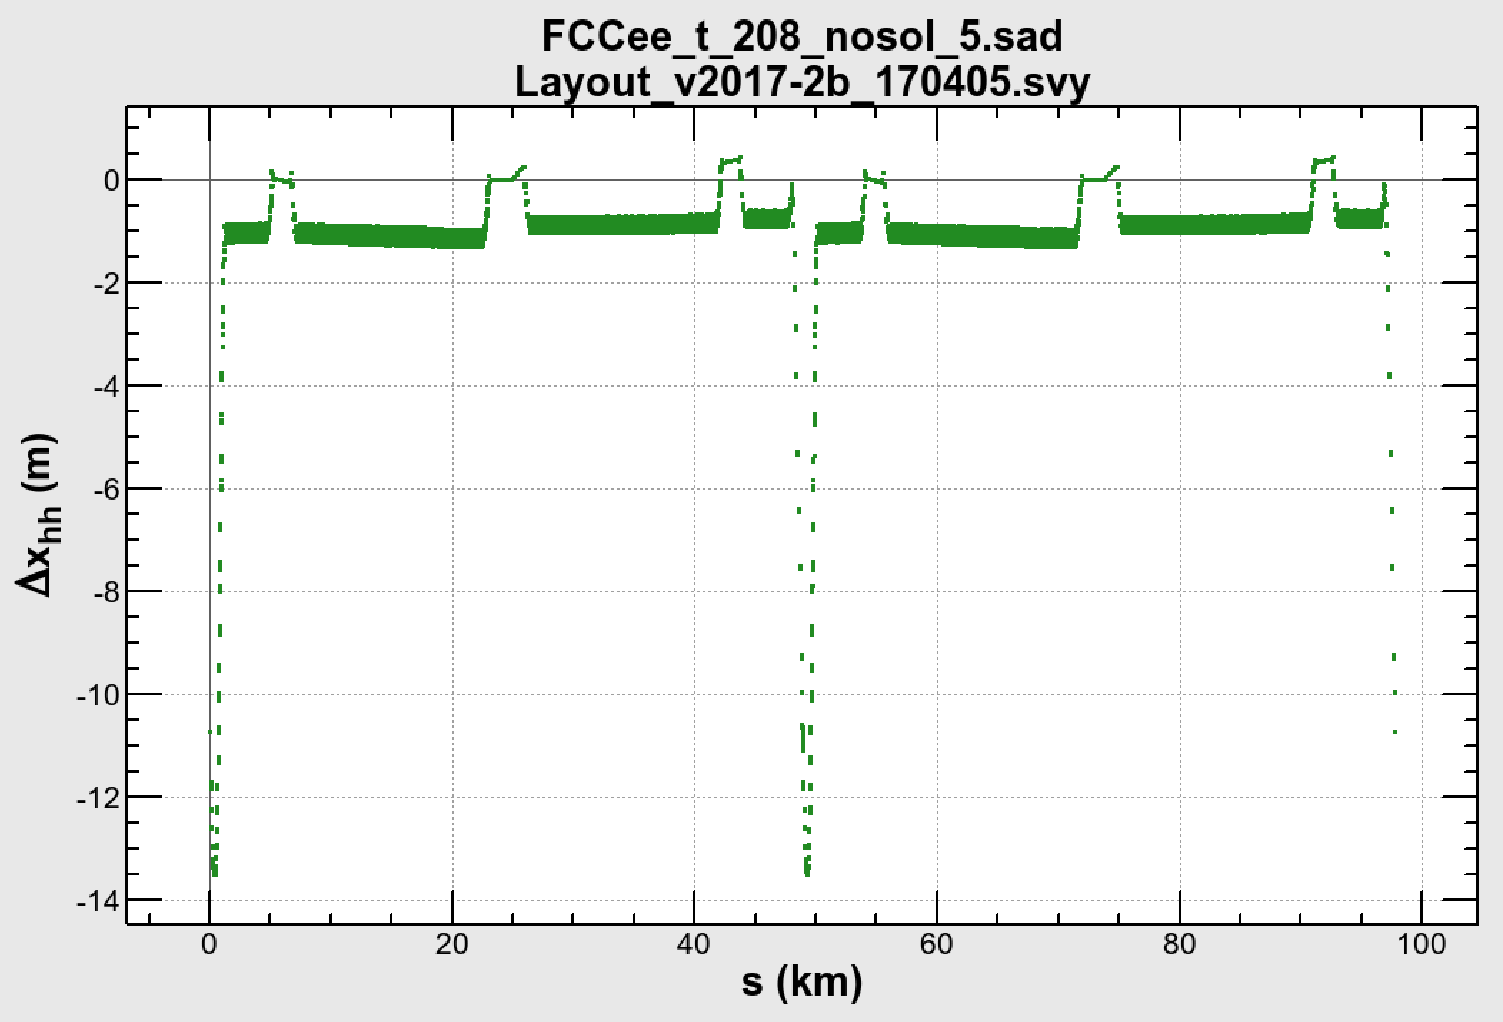
Layout in the tunnel
Volker Mertens
A new layout of the FCC-ee collider and booster has been proposed by V. Mertens as above.
The main booster sits right on the FCC-hh footprint.
The collider comes outside of the booster/FCC-hh by 1 m.
The collider optics has been modified to fit the new layout.
The shift of the ee's IP from the hh’s IP is 10.7 m.
The layouts in the straight sections are subject to change.
IP
IP

Slide 7
Parameters 2017
parameter | Z | W | H (ZH) | ttbar
beam energy [GeV] | 45.6 | 80 | 120 | 182.5
Circumferene [km] | 97.756
arc cell optics | 60/60 | 90/90
momentum compaction [10⁻⁵] | 1.48 | 0.73
horizontal emittance [nm] | 0.27 | 0.28 | 0.63 | 1.43
vertical emittance [pm] | 1.0 | 1.0 | 1.3 | 2.9
horizontal beta* [m] | 0.15 | 0.2 | 0.3 | 1
vertical beta* [mm] | 0.8 | 1 | 1 | 2
length of interaction area [mm] | 0.42 | 0.5 | 0.9 | 2.0
tunes, half-ring (x, y) | (0.569, 0.60) | (0.577, 0.61) | (0.565, 0.60) | (0.552, 0.588)
synchrotron tune (half ring) | 0.0124 | 0.0114 | 0.0180 | 0.0340
long. damping time [ms] | 414 | 77 | 23 | 6.6
SR energy loss / turn [GeV] | 0.0360 | 0.334 | 1.69 | 9.05
total RF voltage [GV] | 0.096 | 0.43 | 1.96 | 10.6
RF acceptance [%] | 1.9 | 1.9 | 2.3 | 4.7
energy acceptance [%] | ±1.3 | ±1.3 | ±1.5 | -2.8/+2.4
energy spread (SR / BS) [%] | 0.038 / 0.132 | 0.066 / 0.153 | 0.099 / 0.151 | 0.153 / 0.195
bunch length (SR / BS) [mm] | 3.5 / 12.1 | 3.3 / 7.65 | 3.15 / 4.9 | 2.5 / 3.3
Piwinski angle (SR / BS) | 8.2 / 28.5 | 6.6 / 15.3 | 3.4 / 5.3 | 1.0 / 1.3
bunch intensity [10¹¹] | 1.7 | 1.5 | 1.5 | 2.8
number of bunches / beam | 16640 | 2030 | 401 | 40
beam current [mA] | 1390 | 150 | 29.6 | 5.5
luminosity [10³⁴ cm⁻²s⁻¹] | > 200 | > 30 | > 7 | > 1.3
beam-beam parameter (x / y) | 0.004 / 0.133 | 0.0065 / 0.118 | 0.016 / 0.108 | 0.090 / 0.148
luminosity lifetime [min] | 70 | 50 | 42 | 39
time between injections [sec] | 122 | 44 | 31 | 32
allowable asymmetry [%] | ±5 | ±3 | ±3 | ±3
required lifetime by BS [min] | 29 | 16 | 11 | 12
actual lifetime (w) by BS [min] | > 200 | 20 | 20 | 25
Z

Slide 8
Luminosity vs. Energy
Z

Slide 9
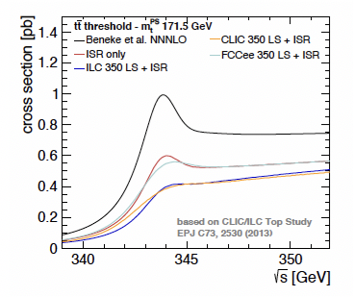
Why 365 GeV CM for ttbar?

Slide 10
conservative revised operation model
working point | luminosity/IP [10³⁴ cm⁻²s⁻¹] | total luminosity (2 IPs)/ year | physics goal | run time [years]
Z first 2 years | 100 | 26 ab⁻¹/year | 150 ab⁻¹ | 4
Z later | 200 | 52 ab⁻¹/year
W | 30 | 7.8 ab⁻¹/year | 10 ab⁻¹ | ~1
H | 7.0 | 1.8 ab⁻¹/year | 5 ab⁻¹ | 3
top | 1.3 | 0.34 ab⁻¹/year | 1.5 ab⁻¹ | 5
total run time: 12-13 years
F. Zimmermann

Slide 11
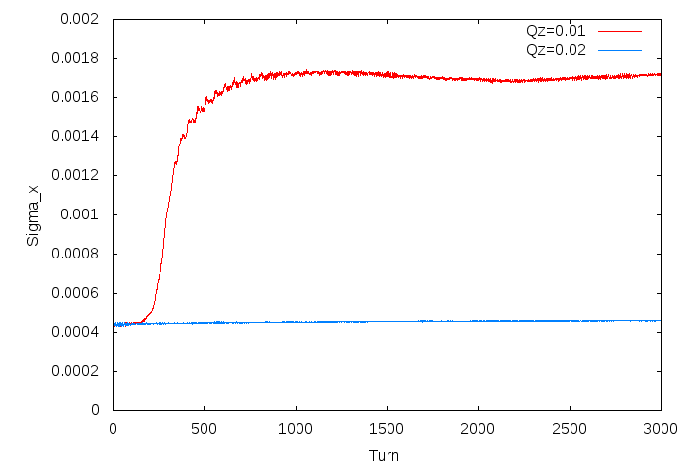
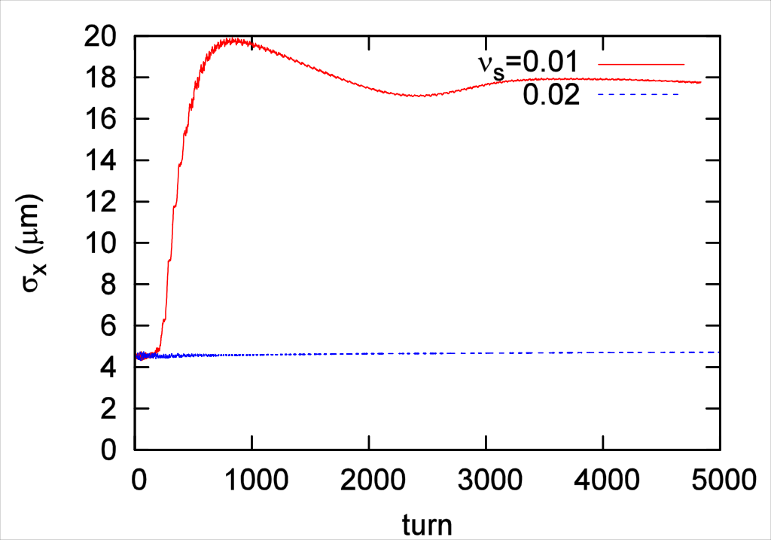
Mitigation of Coherent Beam-Beam Instability
A new coherent instability in x-z plane was first found by K. Ohmi by FCC Week 2016 with a strong-strong beam-beam simulation.
D. Shatilov confirmed their phenomenon by a completely independent simulation, with a turn-by-turn alternating quasi-strong-strong method. The results of these two agree to each other very well.
A semi-analytic scaling the threshold bunch intensity has been derived by K. Ohmi:
Thus a smaller βx* and a larger momentum compaction αp are favorable. The latter can be achieved by changing the phase advances to 60°/60° of the arc at Z.
Longer bunch lengths by SR as well as beamstrahlung stabilizes the instability.
This instability appears up to Zh (120 GeV). A longer bunch length by a strong beamstrahlung can mitigate it, then an imbalance in the charges of the two colliding bunches may cause flip-flop: a “bootstrap” injection is necessary (D. Shatilov).
D. Shatilov
K. Ohmi
K. Ohmi, et al., Phys.Rev.Lett. 119 (2017) no.13, 134801

Slide 12
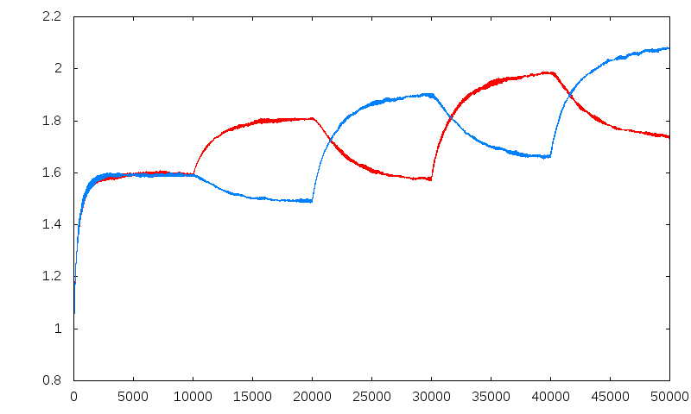
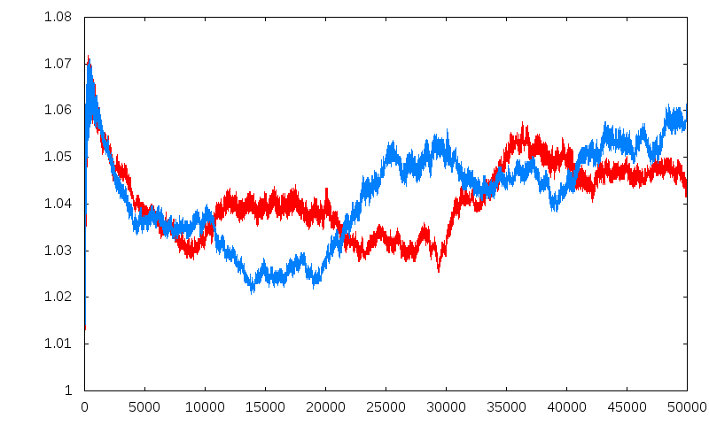
Bootstrapping
D. Shatilov
σ_{z1} /σ_{z0}
σ_{z2} /σ_{z0}
N_{p} = 4.0⋅10¹⁰
N_{p} = 4.0⋅10¹⁰
N_{p} = 5.0⋅10¹⁰
N_{p} = 5.0⋅10¹⁰
N_{p} = 6.0⋅10¹⁰
N_{p} = 4.0⋅10¹⁰
N_{p} = 4.5⋅10¹⁰
N_{p} = 4.5⋅10¹⁰
N_{p} = 5.5⋅10¹⁰
N_{p} = 5.5⋅10¹⁰
ε_{x1} /ε_{x0}
ε_{x2} /ε_{x0}
The maximum bunch charge is determined considering the balance of beamstrahlung, momentum acceptance, and the capability of injector.

Slide 13
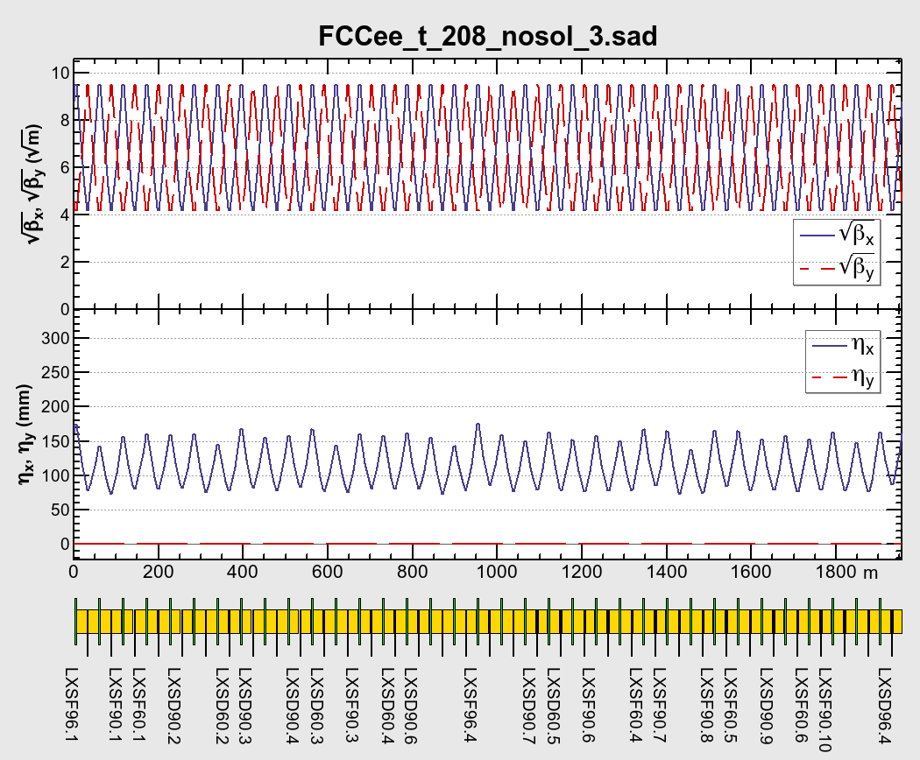
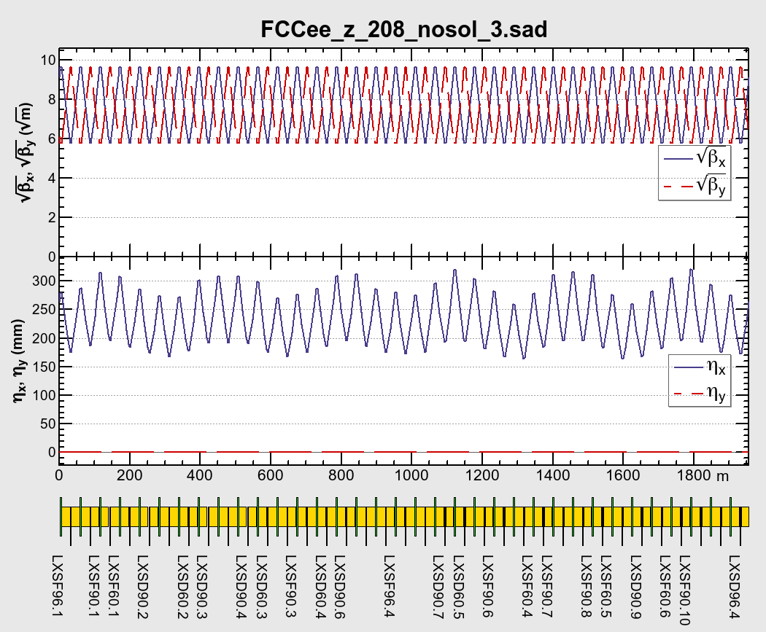
The arc cells
90°/90° (tt, Zh, WW)
60°/60° (Z)
14 sext pairs / 28 FODOs
10 sext pairs / 28 FODOs
The length of dipoles are adjusted to fill spaces, with three lengths of dipoles (21.84 m, 23.54 m, 24.44 m) with equal bending radius.
While the β-functions are more or less uniform, there appear some wiggling in the horizontal dispersion.
Sextupoles are made longer, from 0.7 m to 0.8 m (Z), and from 2.1 m to 2.4 m (tt).
The resulting packing factor of the dipoles in the arc has been improved from 81.7% to 83.2%.

Slide 14
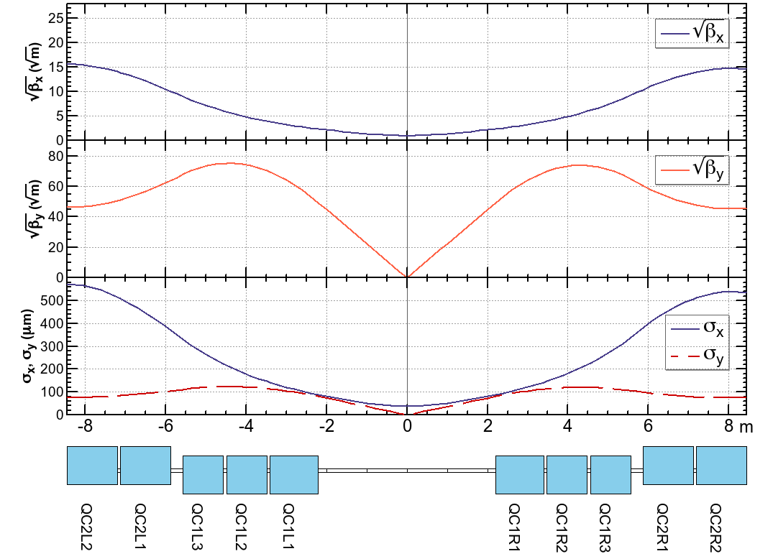
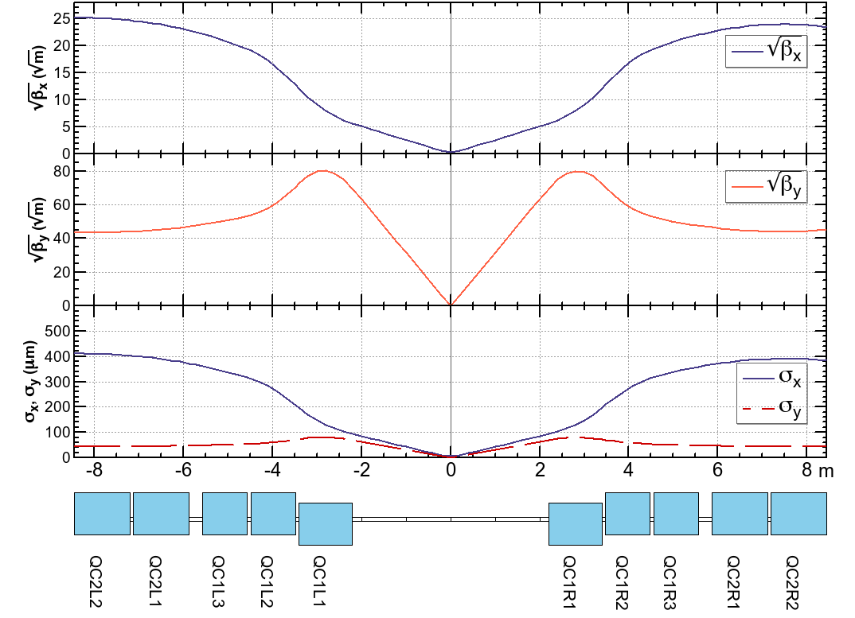
Reduction of βx* at Z, W, Zh
βx,y* = (1 m, 2 mm) @ tt
βx,y* = (15 cm, 1 mm) @ Z
IP
Divide QC1 into three independent pieces, reverse the polarity at Z.
 | L (m) | B’ @ tt (T/m) | B’ @ Z (T/m)
QC1L1 | 1.2 | -94.4 | -96.3
QC1L2 | 1 | -92.6 | +50.3
QC1L3 | 1 | -96.7 | +9.8
QC2L1 | 1.25 | +45.8 | +6.7
QC2L2 | 1.25 | +74.0 | +3.2
 | L (m) | B’ @ tt (T/m) | B’ @ Z (T/m)
QC1R1 | 1.2 | -99.9 | -97.2
QC1R2 | 1 | -99.9 | +51.2
QC1R3 | 1 | -99.9 | +12.0
QC2R1 | 1.25 | +78.6 | +7.3
QC2R2 | 1.25 | +76.2 | +7.2
IP
By this split the chromaticity and the peaks of βx,y around the IP are suppressed for the reduction of βx,y* at Z to (1/7, 1/2) at tt.

Slide 15
Quad
Sext
0.8 m
1.6 m
A sext consists of two pieces, 0.8 m and 1.6 m long with same field strength.
Only the thinner piece of the sext is used at Z.

Slide 16
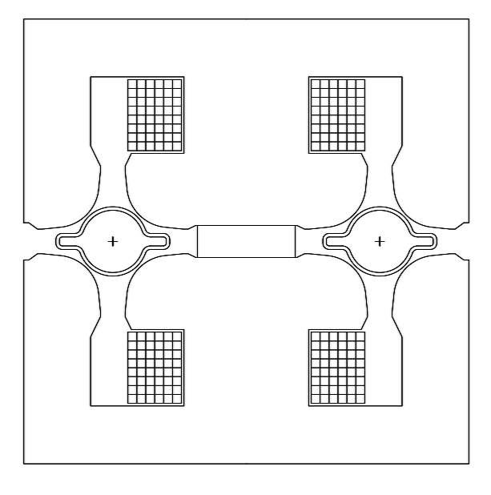
Twin Aperture Quadrupole
An idea of “twin aperture quadrupole” has been developed by A. Milanese to save the power consumption of quadrupole magnets.
The currents in the magnet are always surrounded by iron to maximize the usage.
An example of the cross section of a twin aperture quadrupole for FCC-ee (A. Milanese).
The separation between two beams is 30 cm.
The power consumption of the twin aperture quad: 22 MW at 175 GeV with Cu coil = half of single-aperture quads.
Dipoles are also “twin”: power consumption = 17 MW at 175 GeV with Al bus bar.

Slide 17
Dipole Prototype @ CERN
Measurement of field quality is going on.
A prototype of quadrupole comes soon.
A. Milanese

Slide 18
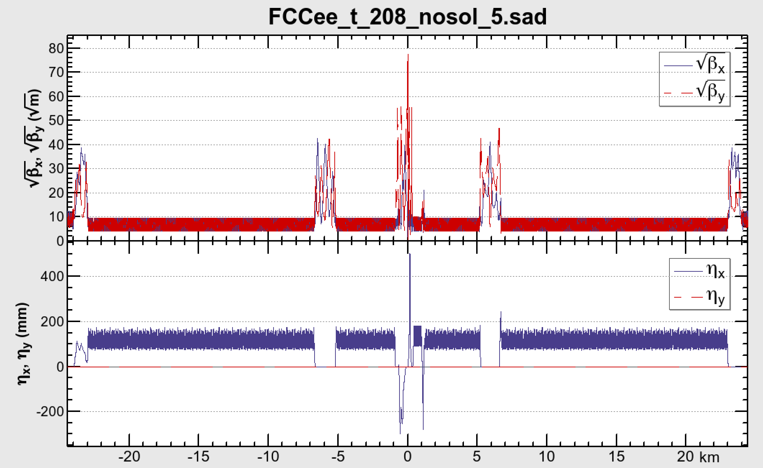
Half Ring Optics
IP
RF
RF
Above are the half optics β*x/y = 1 m / 2 mm at ttbar.
2 IPs / ring.
The optics for straight sections except for the IR are tentative, to be customized for injection/extraction/collimation/polarimeter/beam instumentation, etc.

Slide 19
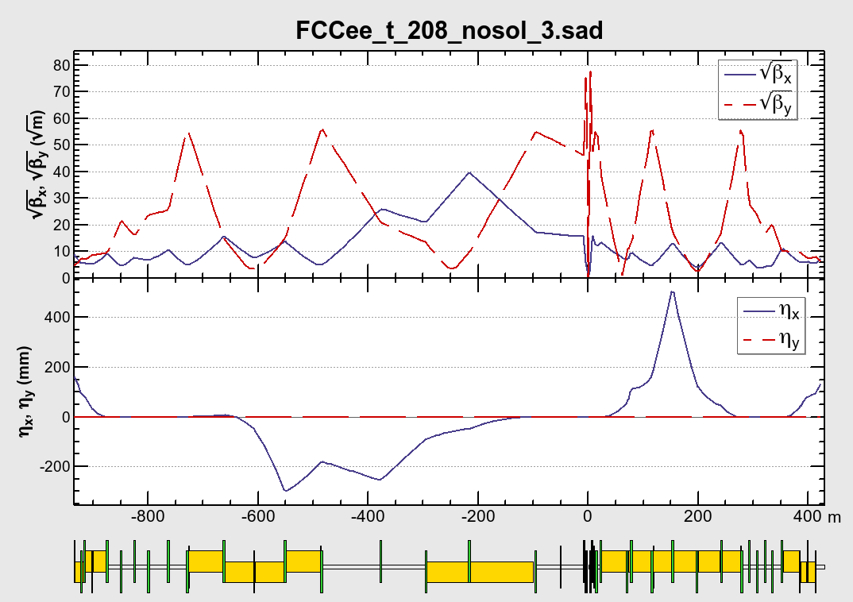
Synchrotron radiation toward the IP @ 182.5 GeV
Local CCS
+ crab waist
Local CCS
+ crab waist
RF
RF
Beam
IP
uc (keV)
PSR (kW)
1460
24.2
571 472 572 226
7.9 7.9 7.9 1.5
88.9 93.2
0.28 0.47
741 648 1004 175 917 …
11.5 0.75 15.9 0.47 0.16 …
uc < 100 keV up to 480 m from the IP.

Slide 20
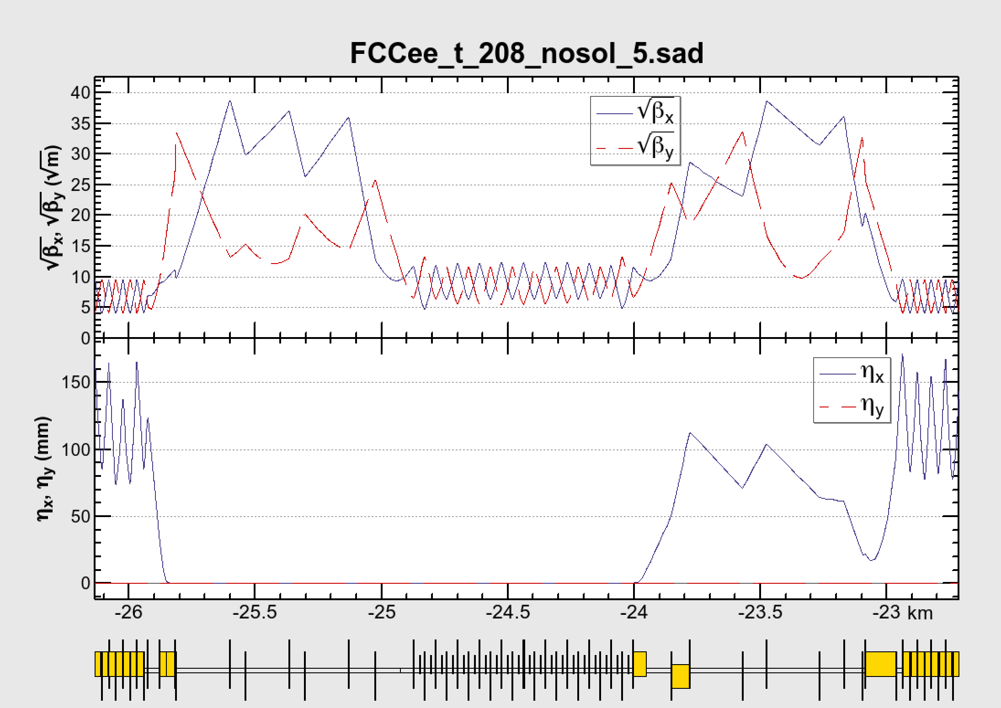
The RF section (FCC-ee @ 182.5 GeV)
beam
Beams cross over through the RF section.
RF cavities: 5.3 GV / section
An electrostatic separator, combined with a dipole magnet
The usage of the straights on the both sides of the RF is to be determined.
If the nominal strengths of quads are symmetrical in the common section, it matches to the optics of both beam.
This section is compatible with the RF staging scenario. For lower energy, the common RF and cross over will not be necessary.

Slide 21
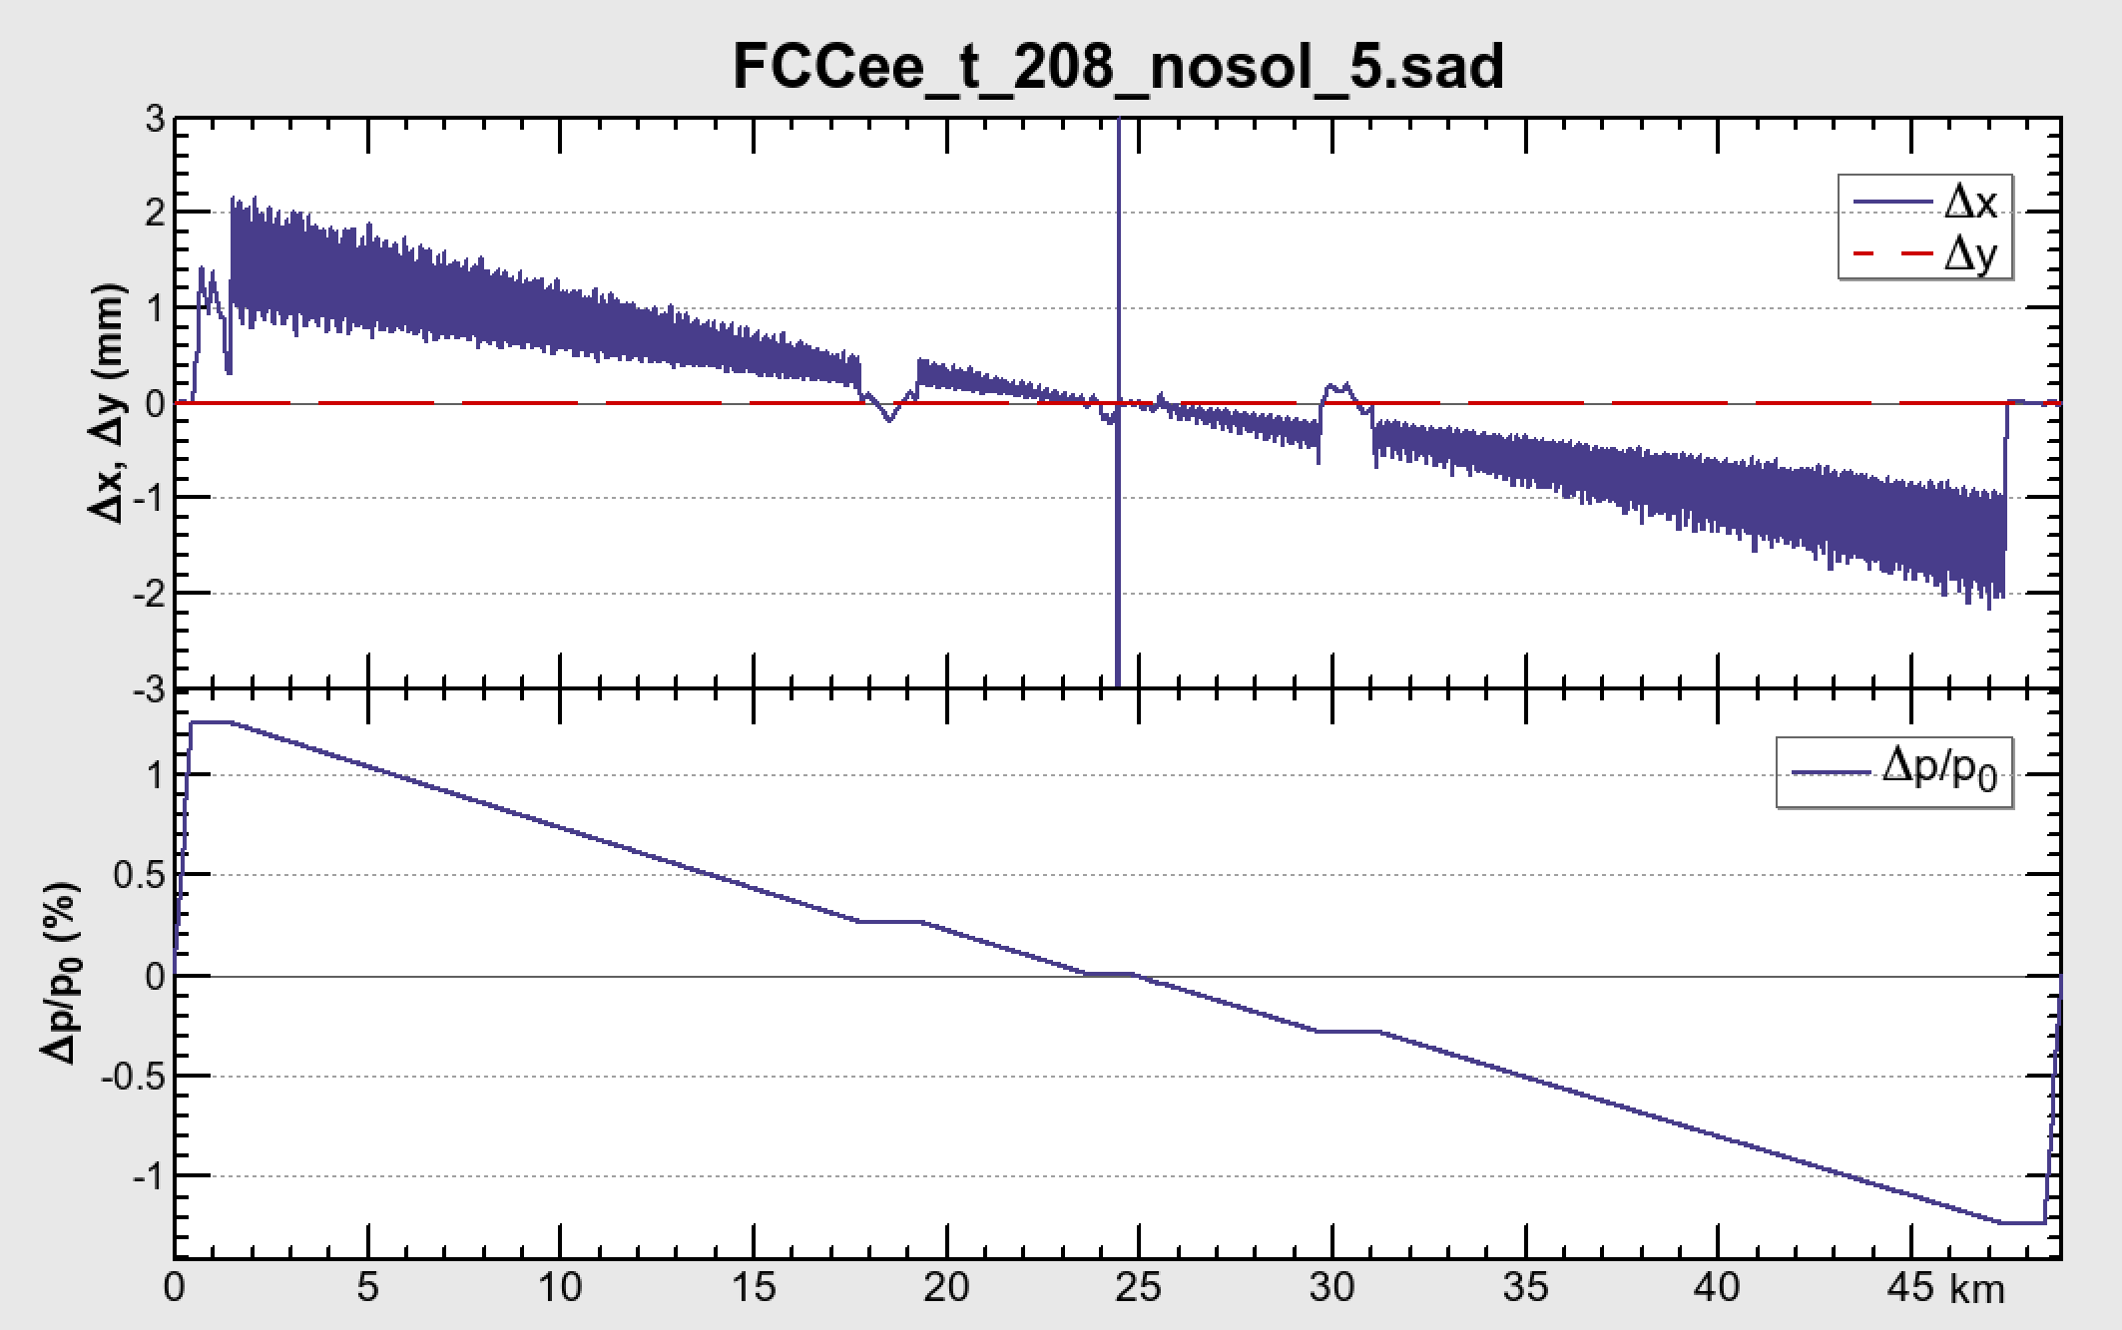
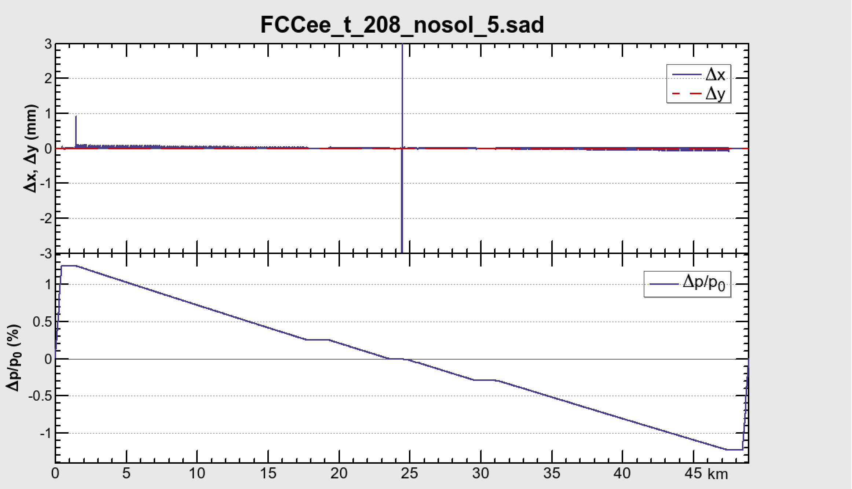
The Sawtooth & Tapering (FCC-ee @ 182.5 GeV)
No Taper
Tapered
The change of the orbit due to energy loss along the arc causes serious deformation on the optics, causing the loss of the dynamic aperture.
Everything can be cured almost completely by “tapering”, i.e. scaling the strengths of all magnets along the local energy of the beam: this is one of the best merits of a double-ring collider (F. Zimmermann).

Slide 22
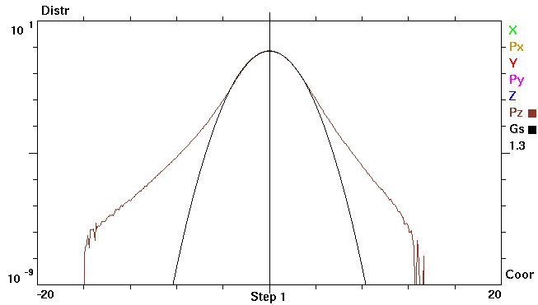
Asymmetric acceptance (ttbar)
E = 182.5 GeV
σ_{E0} = 0.00153, σ_{E} = 0.00193,
Black line: Gauss with σ_{E} = 1.3 σ_{E0}
Energy acceptance: 2.5% = 16.3 σ_{E0}
D. Shatilov
δE/σ_{E0}
The expected energy distribution of the beam has asymmetric tail due to beamstrahlung (D. Shatilov, as above).
Thus the required momentum acceptance should be asymmetric: Wider aperture in the negative side.
The aperture of the positive side can be expressed as the summation of damping and diffusion terms in a half synchrotron period:
with the damping rate .

Slide 23
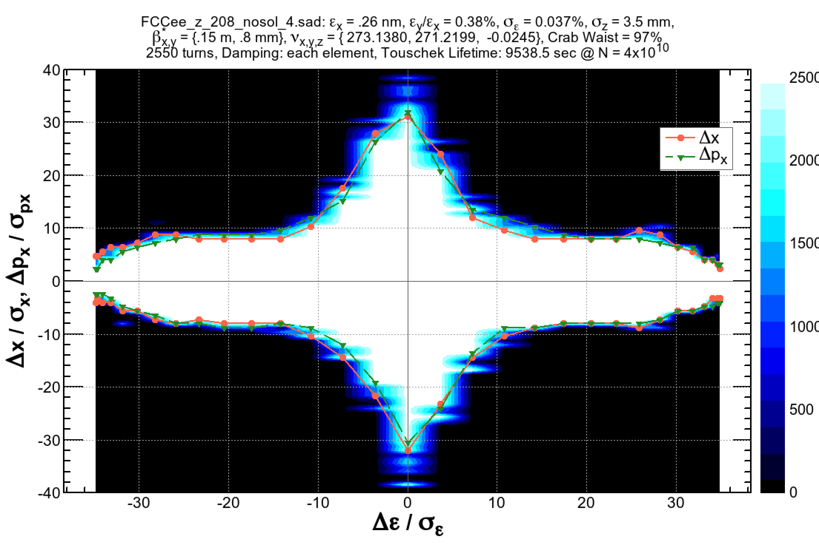
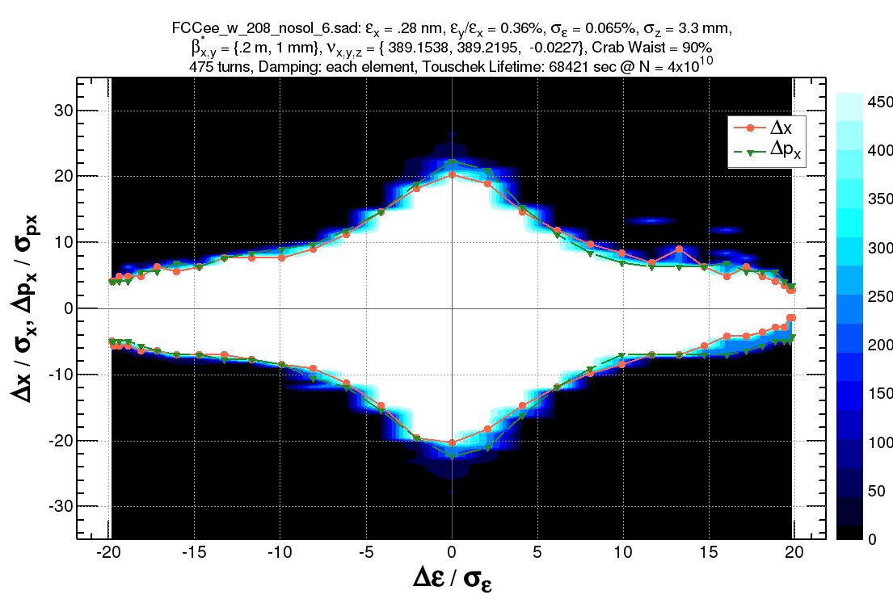
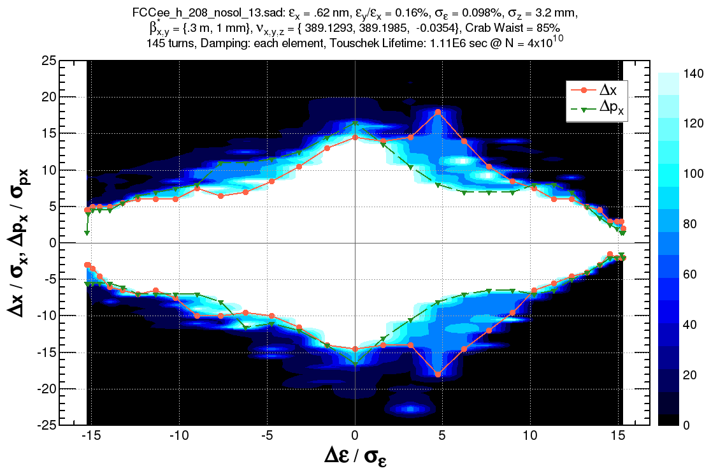
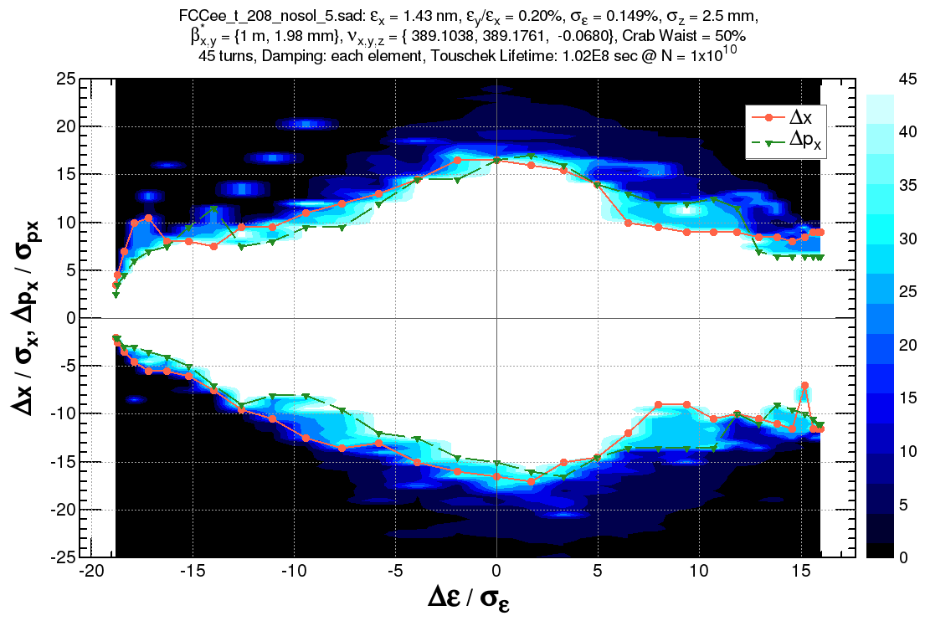
Dynamic Aperture
±1.3%
±1.3%
±1.5%
-2.8 +2.4%

Slide 24
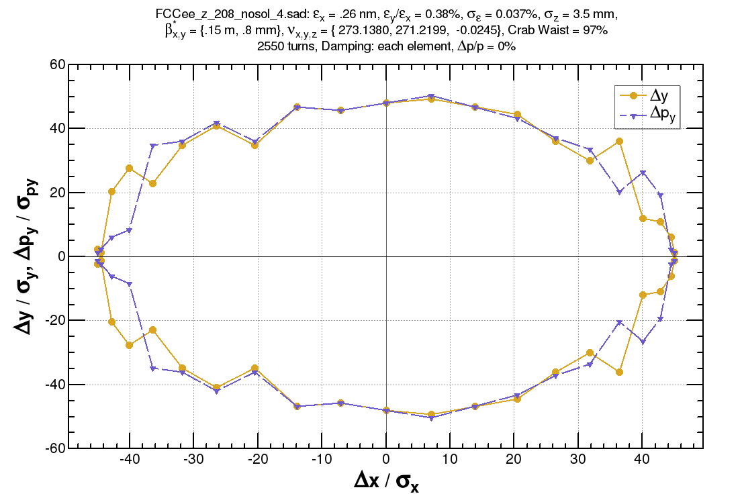
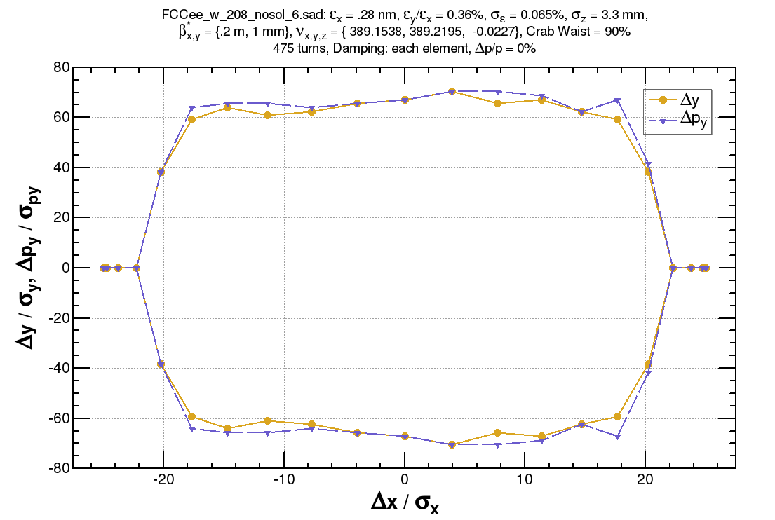
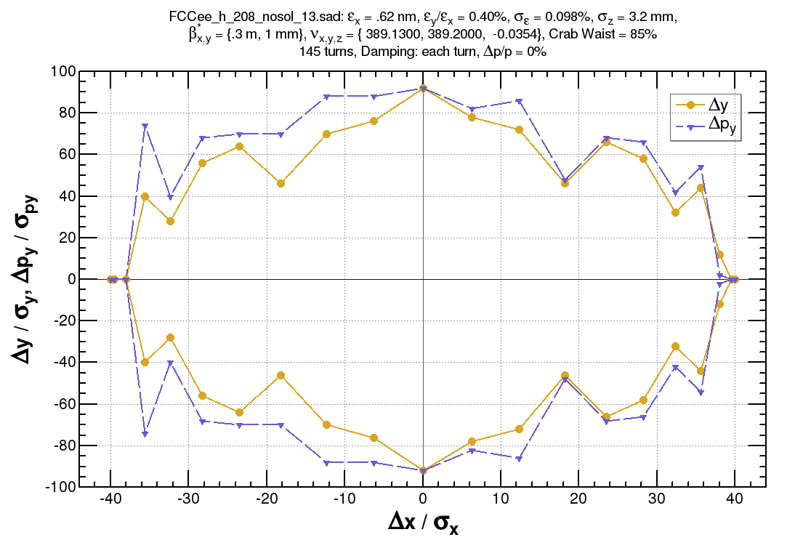
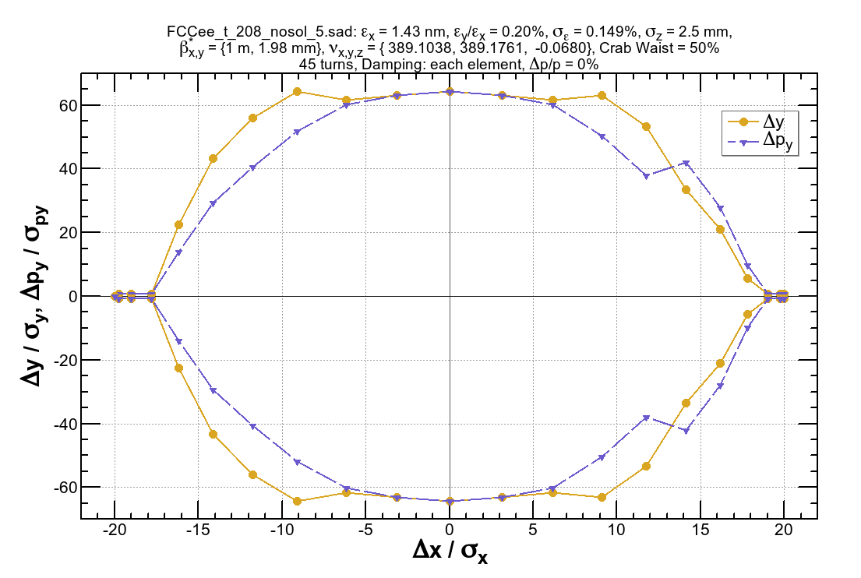
Dynamic Aperture (cont’d : on-momentum transverse)

Slide 25
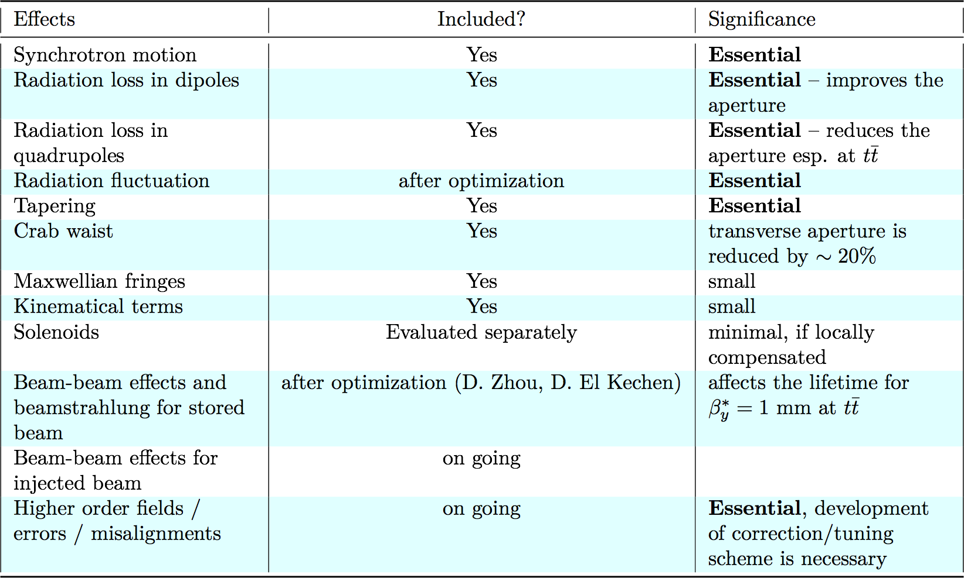
Effects included in the dynamic aperture survey

Slide 26
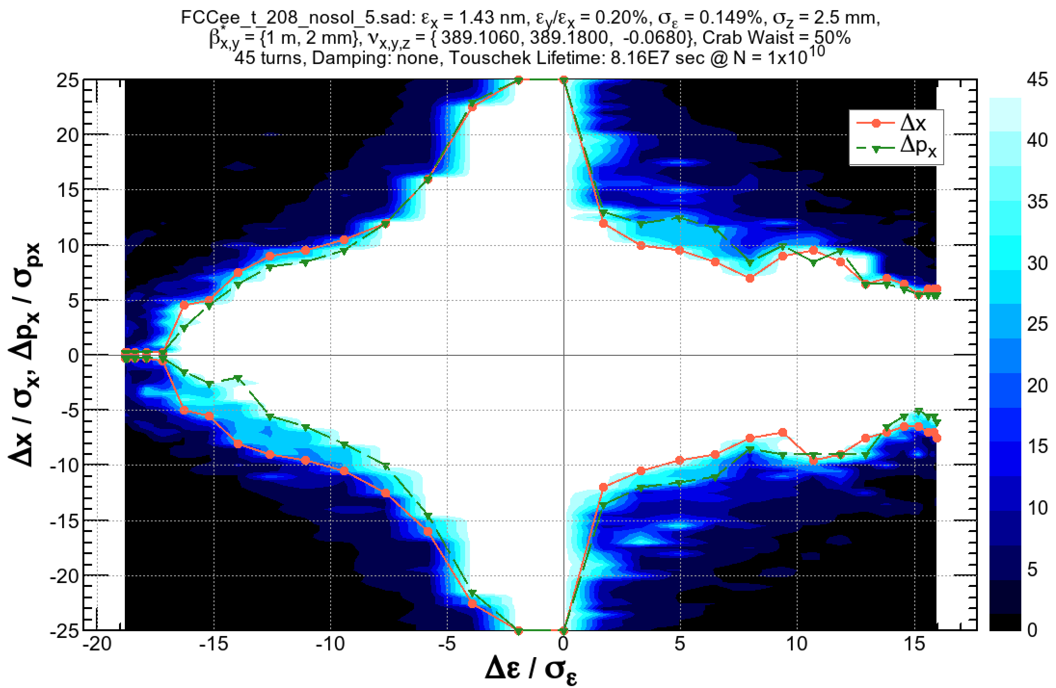
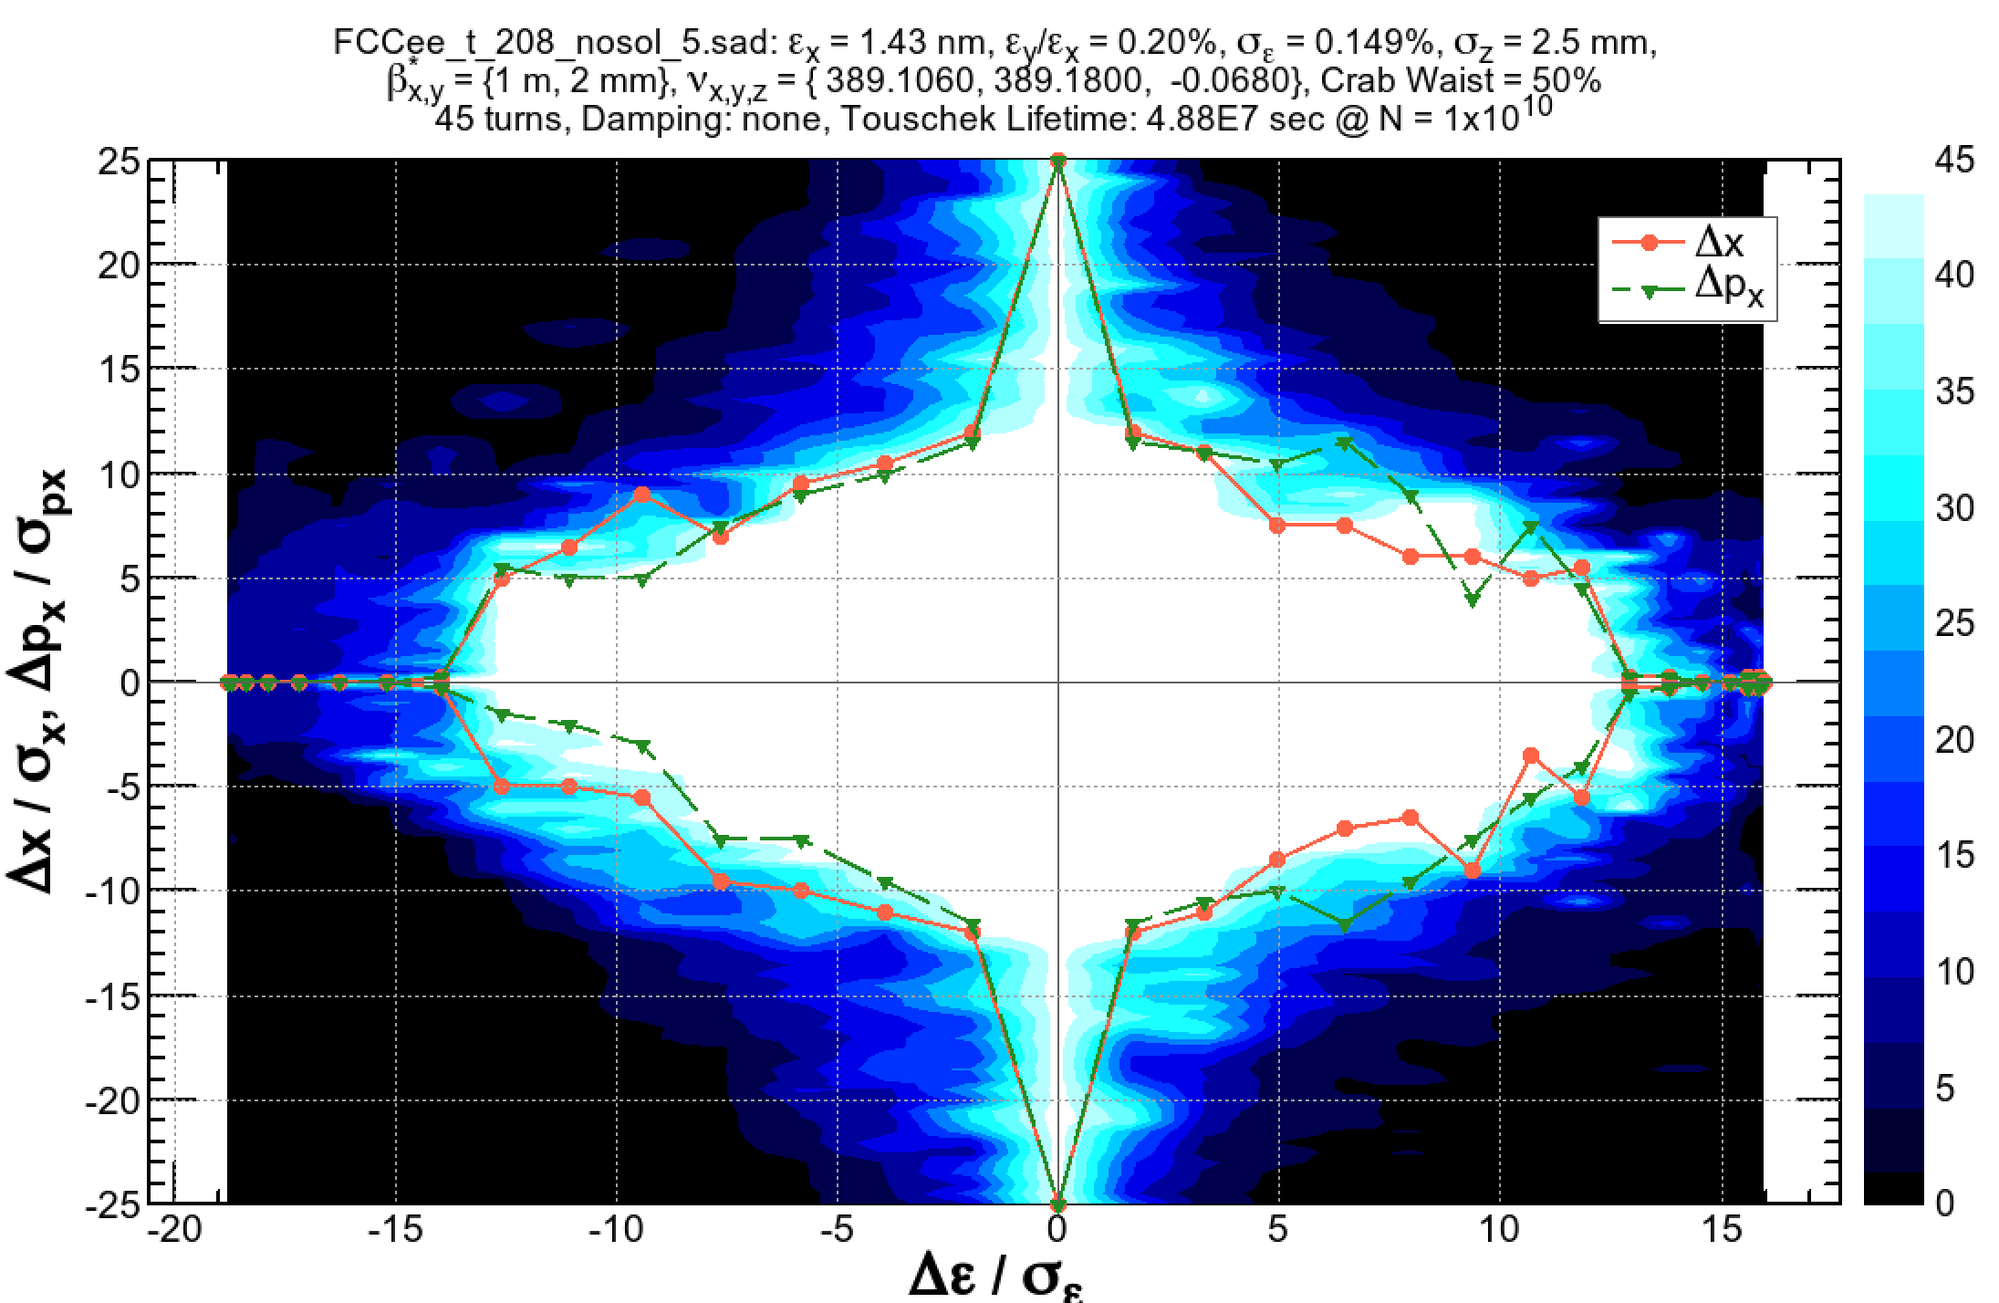
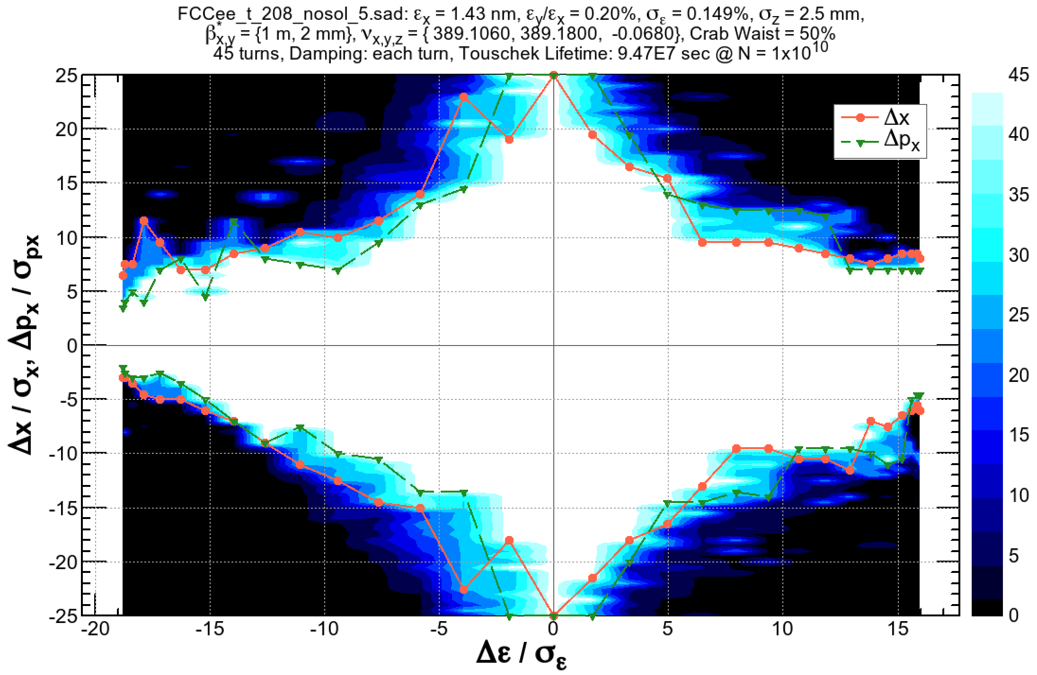
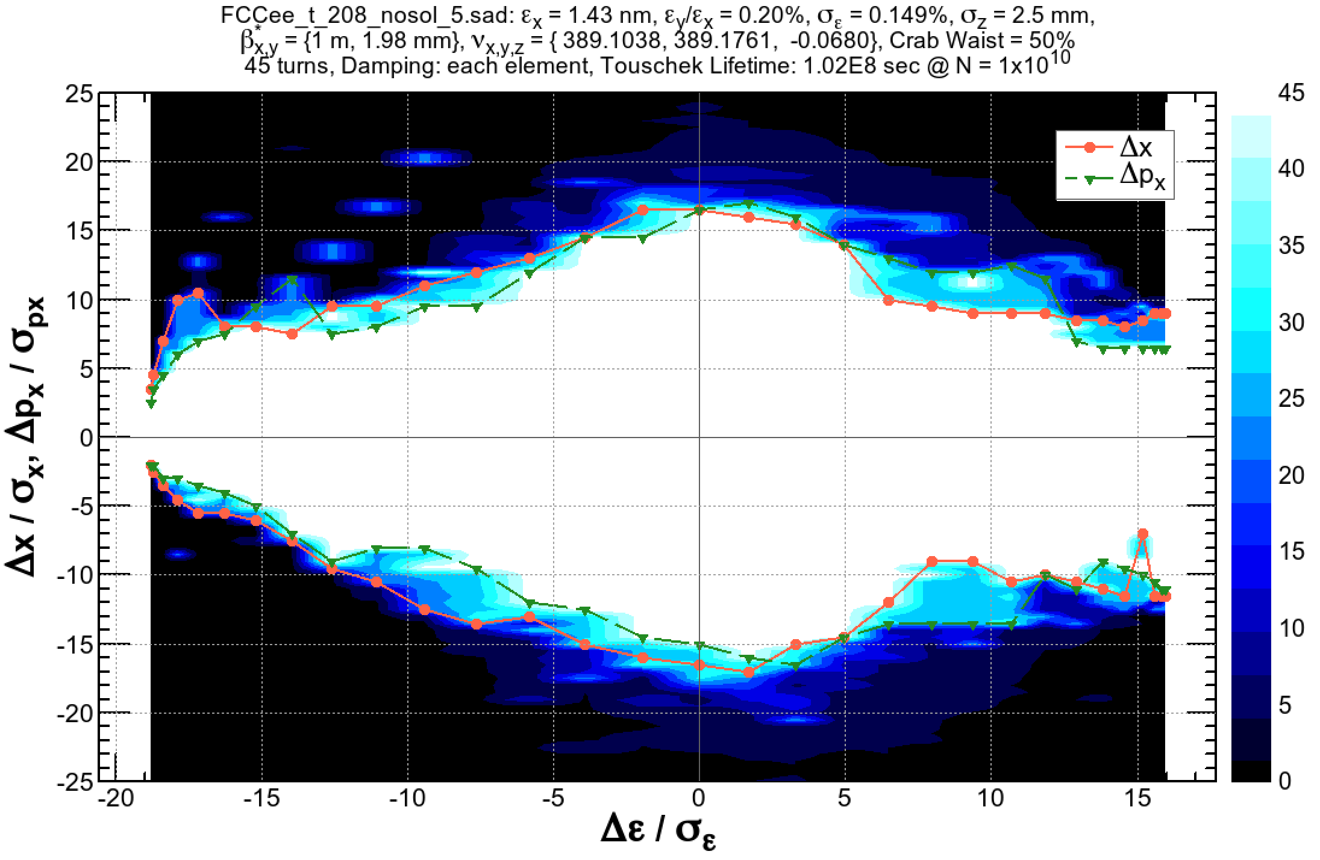
Several effects on the dynamic aperture (ttbar)
No RF, No radiation
RF, No radiation
-2.8, +2.4%
-2.8, +2.4%
RF, radiation damping each turn
RF, radiation in each element

Slide 27
Synchrotron radiation in quadrupoles
0
0
1
1
2
2
Horizontal betatron oscillation (left) causes a synchrotron motion (right) due to the energy loss by the synchrotron radiation in arc quadrupoles.
Such particles can not stay on momentum: reduction of the dynamic aperture.

Slide 28
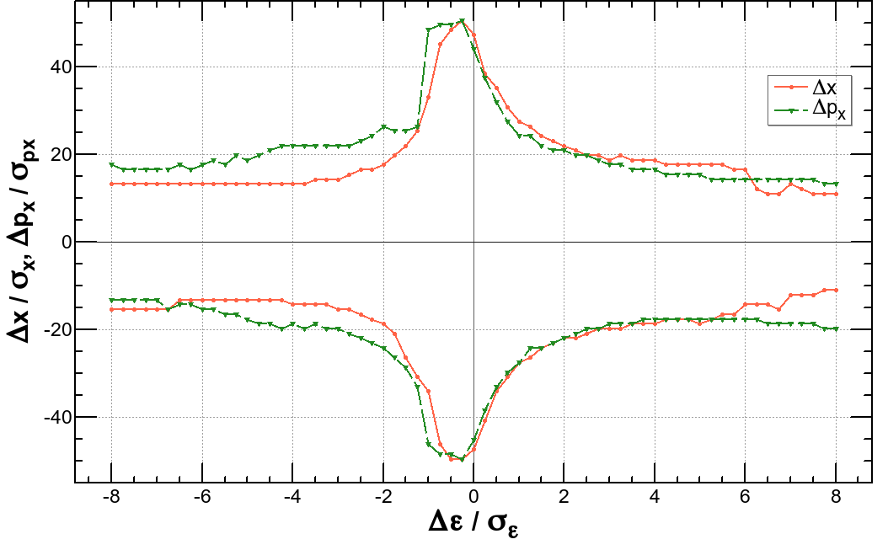
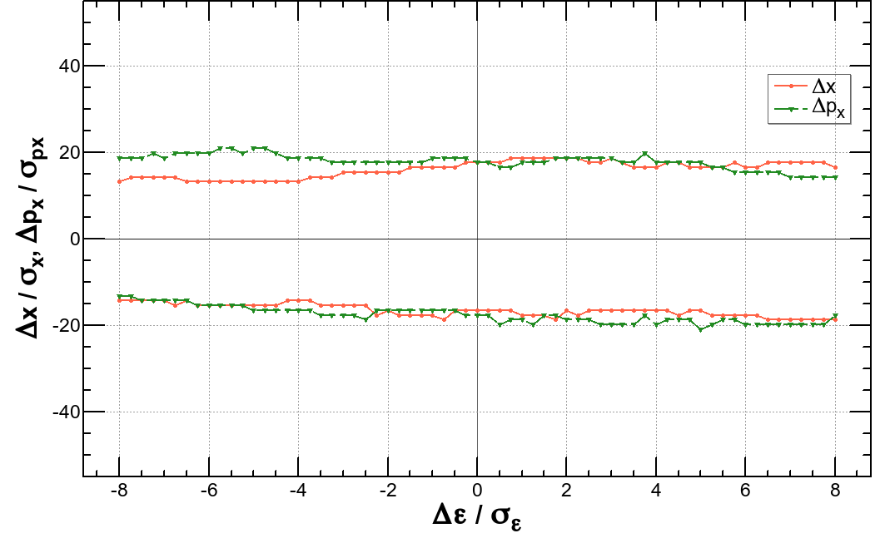
Synchrotron radiation in quadrupoles (cont’d)
E = 175 GeV, βx,y = (1 m, 2 mm)
The dynamic aperture without radiation loss in quadrupoles (left) has a sharp peak at on momentum.
The peak is destroyed if the radiation in quads is turned on (right).
The parabolas on the left show the amplitude of the synchrotron motion due to the radiation in the quadrupole. For a given transverse amplitude, if the parabola is beyond the DA, the particle with that amplitude will be lost.
More effects will be presented by A. Bogomyagkov in this workshop.

Slide 29
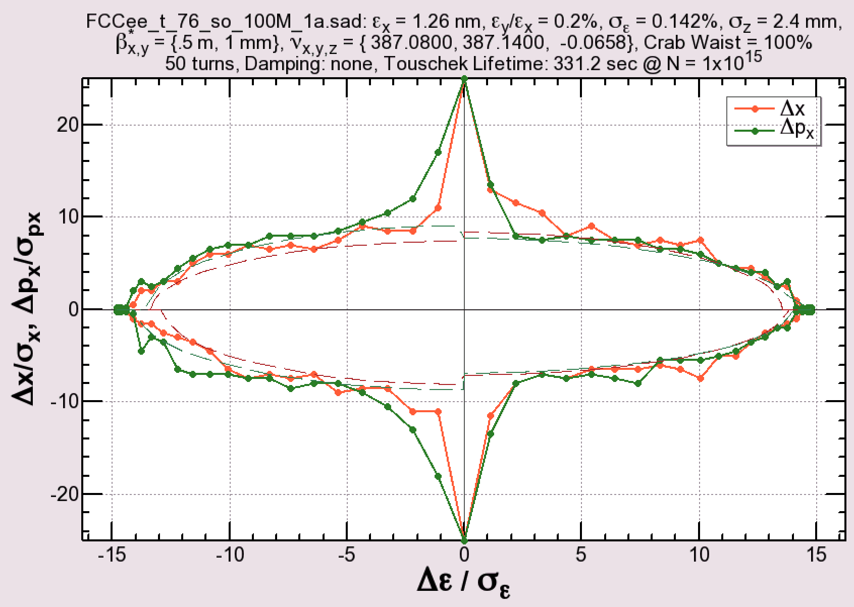
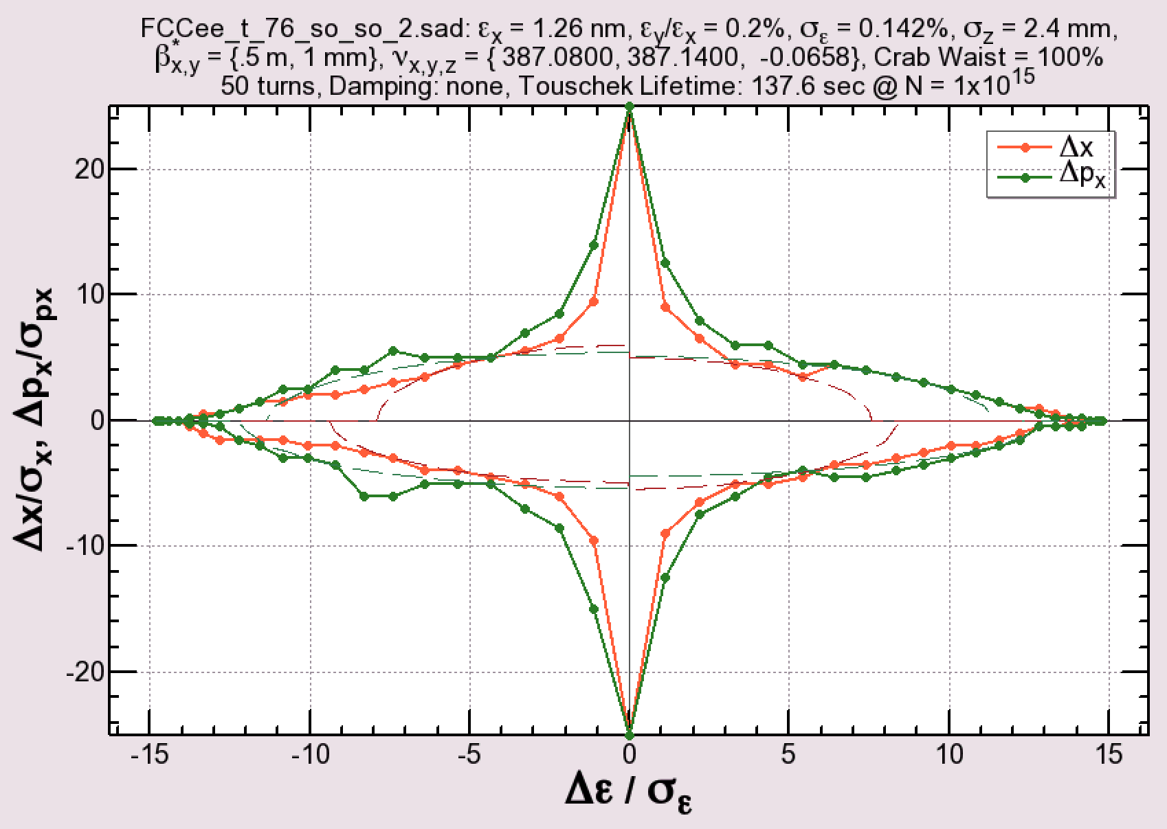
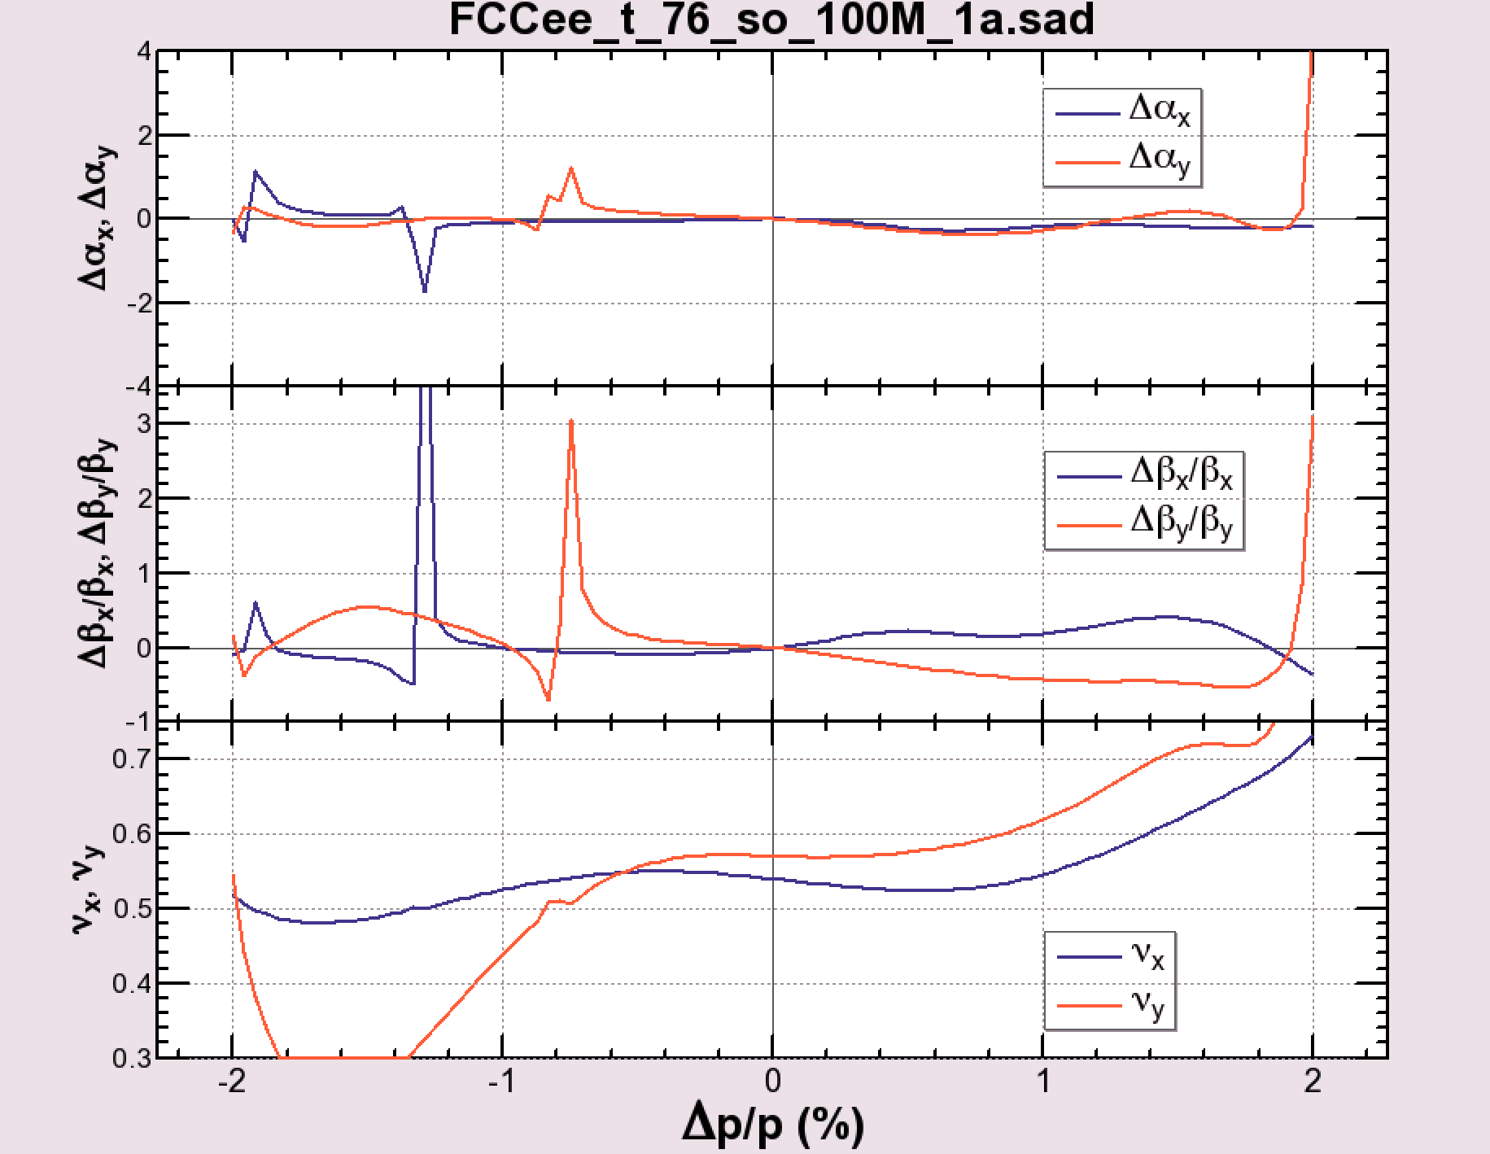
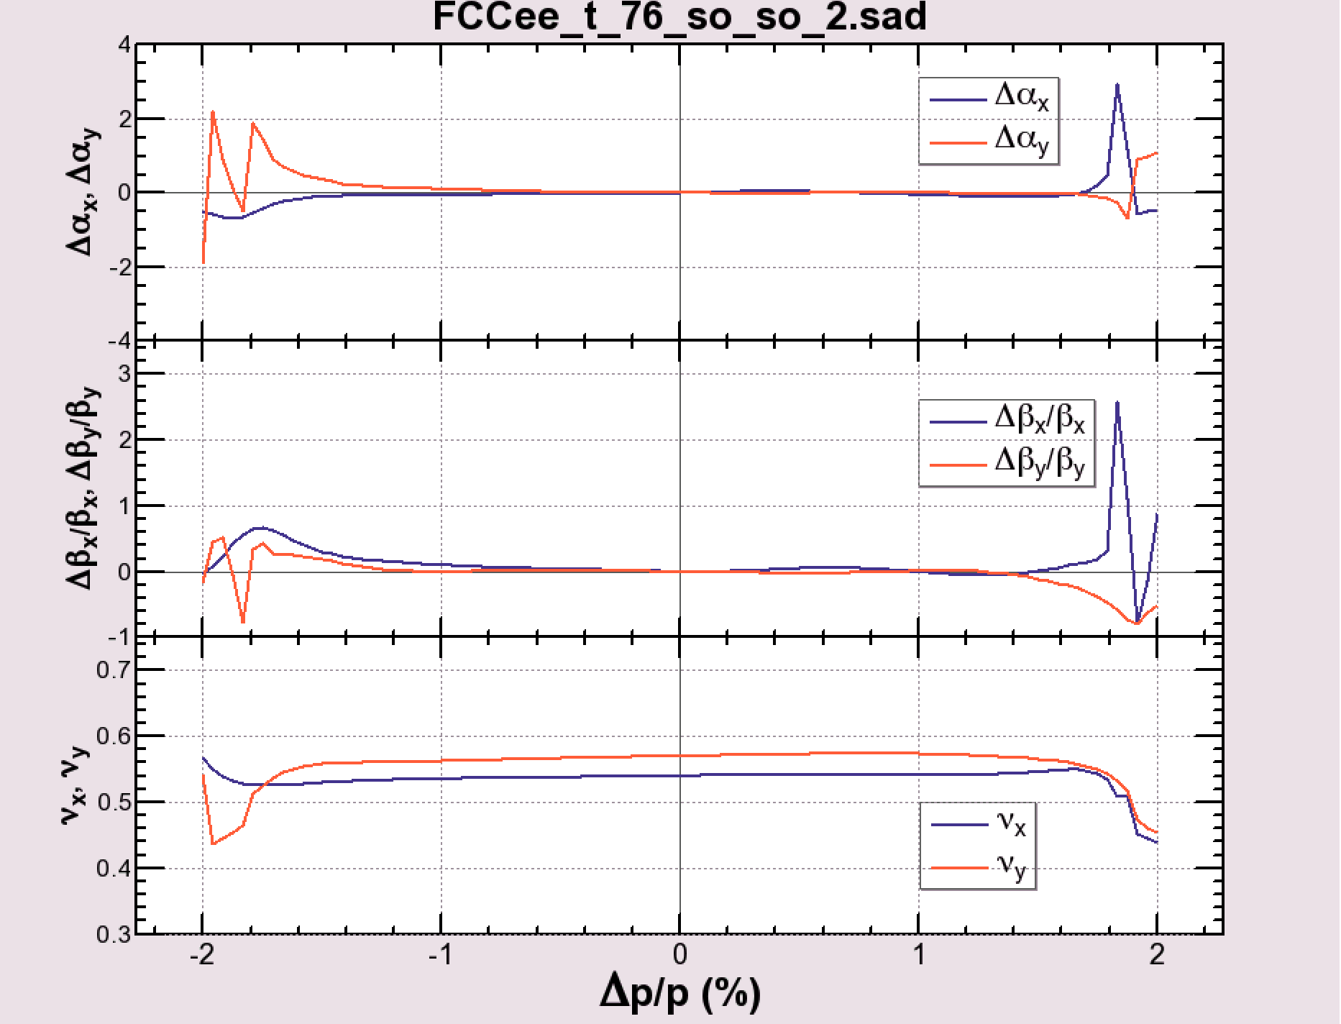
Less chromaticity ≠ better dynamic aperture
β*x,y = (0.5 m, 1 mm), no radiation damping
DA-optimized
Chromaticity
-optimized

Slide 30
Effect of Radiation Fluctuation
E = 182.5 GeV, βx,y = (1 m, 2 mm)
Radiation damping only
Radiation damping + fluctuation
-2.8, +2.4%
(Right figure) 100 samples are taken to evaluate the dynamic aperture with radiation fluctuation.
Within the lines: particles survive for 75% of the samples.
Error bars correspond to the range of survival between 50% and 100% of the samples.
It may reasonable that the 50% loss corresponds to the original aperture.
The thickness between 50% and 100% survival can be attributed to the fractal structure of unstable orbits or resonances in the phase space.

Slide 31
Summary
Modification of the beam optics for FCC-ee has been performed over the base line optics 2016:
Mitigation of the coherent beam-beam instability at Z
By achieving smaller βx* at Z, W, Zh.
Applying 60°/60° cell in the arc, only at Z, compatible with 90°/90° cell at higher energies.
The base energy for tuba is raised to 182.5 GeV, keeping the SR to IP below 100 keV.
Adopt the “Twin Aperture Quadrupole” scheme for arc quadrupoles.
Fit the footprint to a new FCC-hh layout.
The resulting dynamic aperture is sufficient for the beamstrahlung and top-up injection.

