Slide 1
On the dynamics of beam slip-stacking
Motivation & Review
Problem set up
Solution & Applications
Conclusion
S.Y. Lee
Dept of Physics, IU, Bloomington, IN 47405
Engineering Physics, Tsinghua University
Motivation: Beam intensity is limited by space-charge effects at low energies. Rapid cycling synchrotrons (RCS) can be used to increase beam power. However, RCS is usually limited by its achievable energy and a second-stage accelerator is required to increase both energy and beam power. Slip-stacking injection may be a necessary method to achieve high power through doubling the beam intensity. Experimental trial on slip-stacking had been carried out in the CERN SPS to accumulate beams from the CERN PS. It had been applied in the Fermilab Tevatron Run IIB, where proton bunches from the Booster were slip-stacked in the Main Injector in order to increase antiproton production, when the slip-stacked proton beam is extracted to hit a target. At the moment, slip-stacking is also employed in the Fermilab Recycler Ring to increase the proton beam power for neutrino production.
S.Y. Lee, K.Y. Ng, PRAB 20, 064202 (2017)

Slide 2
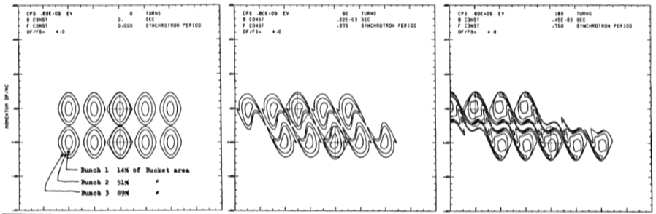
F.E. Mills, BNL 15936 (1971).
D. Boussard* and Y. Mizumachi, Production of beams with high line-density by azimuthal combination of bunches in a synchrotron
IEEE Transactions on Nuclear Science, Vol. NS-26, No. 3, June 1979

Slide 3
Dynamical stability of slip-stacking particles
Jeffrey Eldred and Robert Zwaska, PRSTAB 17, 094001 (2014)
The equations of motion for a single particle under the influence of two rf cavities with identical voltage and different frequencies are

Slide 4
Stability map for α_{s} = 4.4
0.003
0.002
0.001
0
-0.001
-0.002
-0.003
100
30
10
3
1
0.3
Initial momentum δ
-3 -2 -1 0 1 2 3
Initial phase φ
The color corresponds to the number of synchrotron periods a particle at the initial coordinates survives before it is lost.

Slide 5
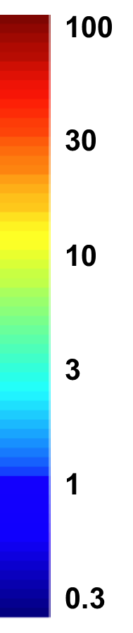
0.003
0.0025
0.002
0.0015
0.001
0
-0.0005
α_{s}=3.6
α_{s}=4.1
Initial momentum δ
-3 -2 -1 0 1 2 3
Initial phase φ

Slide 6
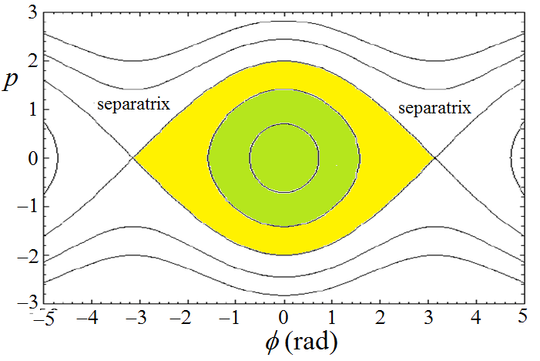
Slip-Stacking Equation of motion and Hamiltonian
When there is only one rf system in a synchrotron, the Hamiltonian describing the longitudinal motion is
Here θ serves as the time coordinate advancing 2π in each revolution, and the normalized conjugate phase space coordinates are p and φ given by
Here, P the momentum of the particle and P₀ the momentum of the beam, h the harmonic number of the rf system, and η the phase-slip factor of the slip-stacking ring, V_{rf} is the rf voltage, and βc and E are the nominal speed and energy of the beam particles.

Slide 7
During slip-stacking, there is another rf system at an rf frequency lower or higher than the fundamental one by f_{slip}. In order for slip-stacking to work, these two rf systems must generate buckets which slip by exactly one train or one batch of rf buckets in consecutive injections from the rapid-cycling booster synchrotron. This condition fixes the rf frequency difference to f_{slip} = h_{B}f_{B}, where f_{B} is the repetition frequency of the RCS. For Fermilab, h_{B} = 84 is the rf harmonic numbers for the Booster and f_{B} = 15 Hz is the repetition rate of the Booster. The harmonic number of the Recycler ring is h_{R} = 588. For convenience, we introduce a slip-tune ν_{slip} = f_{slip} /f₀, where f₀ is the revolution frequency of the Recycler Ring.
In the presence of the two rf systems, the Hamiltonian becomes
The fractional momentum that separates the upper and lower bucket series is
where ΔP_{sep} is the momentum difference of the two slip-stacking beams, P₀ is the nominal momentum of the beams. The separation of the centers of the upper and lower buckets in the normalized off-momentum coordinate p is

Slide 8
The slip-stacking parameter α_{s} is proportional to (V_{rf})^{−1/2}. The unperturbed
bucket height is |p| ≤ 2, which is independent of α_{s}. Therefore the unperturbed rf buckets of the two rf systems just touch each other at α_{s} = 4. The two unperturbed rf buckets are separated from each other when α_{s} > 4, and they overlap when α_{s} < 4.

Slide 9
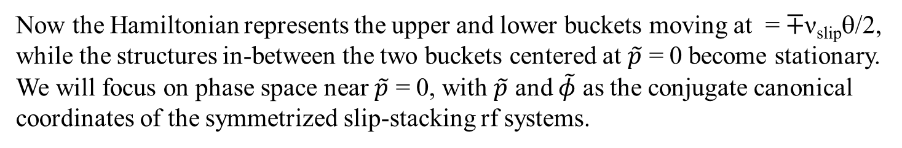
The interaction of these two rf systems will produce resonances and chaos in-between the upper and lower buckets. If one can find a compensation rf system to cancel the driving term, these additional resonances can be eliminated or minimized, and one may be able to recover the slip-stacking buckets for the injection bunches. To simplify the derivation, we first symmetrize the Hamiltonian to a frame with the upper and lower buckets centered at p = +½ α_{s}, or with frames moving at +½ ν_{slip}θ. This can be accomplished by a canonical transformation using the generating function:
The resulting Hamiltonian is
Now the Hamiltonian represents the upper and lower buckets moving at = ∓ν_{slip}θ/2,
while the structures in-between the two buckets centered at $\tilde{p}$ = 0 become stationary. We will focus on phase space near $\tilde{p}$ = 0, with $\tilde{p}$ and $\tilde{φ}$ as the conjugate canonical coordinates of the symmetrized slip-stacking rf systems.

Slide 10
We simplify notation by reidentifying phase-space coordinates with $\tilde{p}$→ p and $\tilde{φ}$→ $φ$, the Hamiltonian is
Because we wish to study the phase structure in-between the upper and lower rf buckets, we perform a canonical transformation to cancel the potential-energy part of the Hamiltonian using the generating function
Choosing
we obtain the Hamiltonian:
The resonance term

Slide 11
To cancel the resonance driving term from the upper and lower buckets, we add the 2nd order rf to the slip-stick rf system. The resulting Hamiltonian becomes
with
Comparison of correction coefficient above and those by Eldred.

Slide 12
Effects of the compensation rf

Slide 14
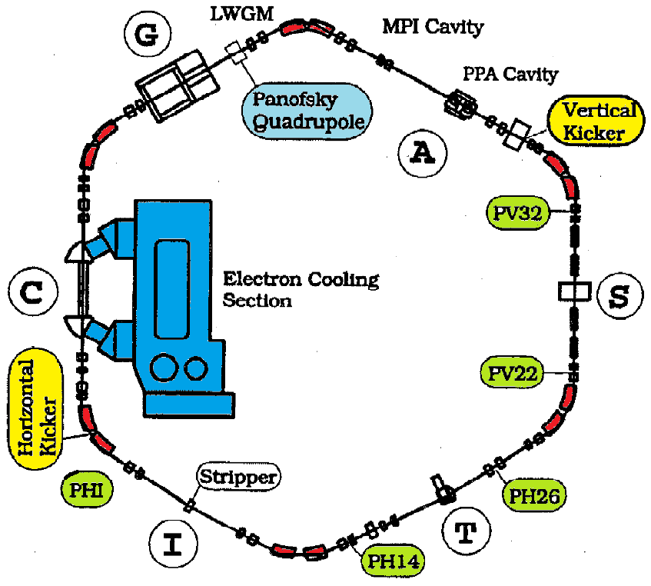
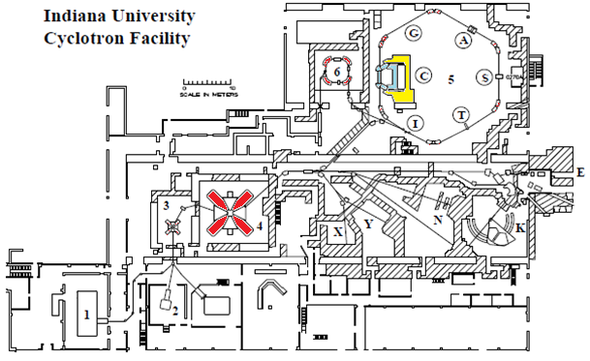
Parametric resonances
Resonances produced by periodic perturbation to a dynamic system is called the parametric resonances. For example, A time dependent modulation, e.g. rf noise, rf phase modulation, dipole field modulation, quadrupole vibration, rf voltage modulation, etc., on the synchrotron motion can cause resonance excitation to particles inside the rf bucket.
Some IUCF experimental data are shown below:
C (m) 86.82
ε_{rms} (μm) 0.05
Δp/p (FWHM) 10⁻⁴
Tunes 3.8/4.8
Damping time
Transverse 3±1s
Longitudinal 0.34 s
2 rf cavities

Slide 15
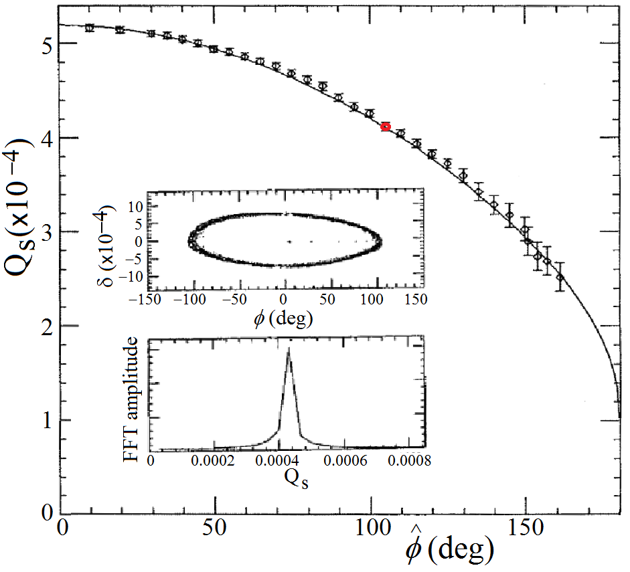
The synchrotron tune:

Slide 16
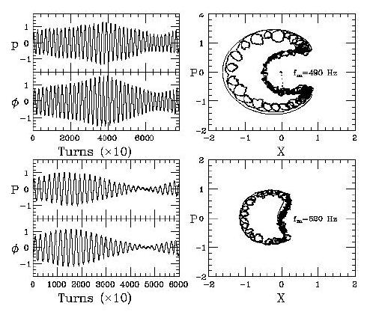
In this experiment, the synchrotron oscillation frequency was chosen to be about 540 Hz, or about 1910 revolutions n the accelerator. An rf phase modulation amplitude of 1.45° after an initial phase kick of 42° at modulation frequencies of 490 Hz (upper) and 520 Hz (lower). Fitted synchrotron frequency is 535±3 Hz.
Data in normalized phase space Poincare surface of section

Slide 17
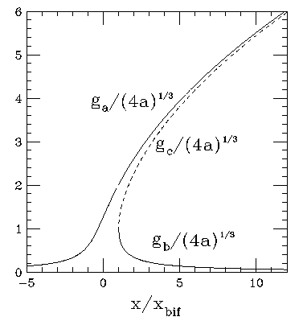
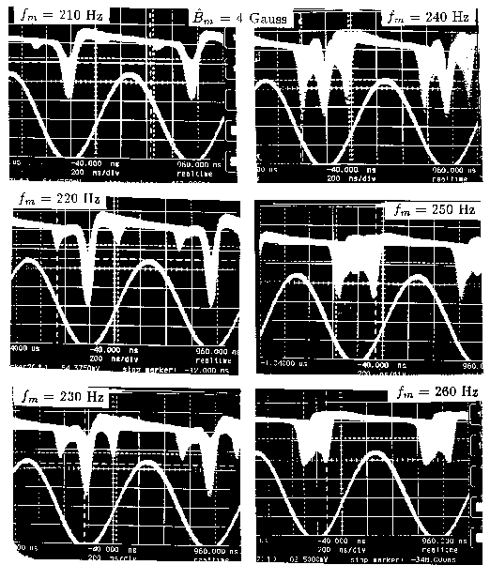
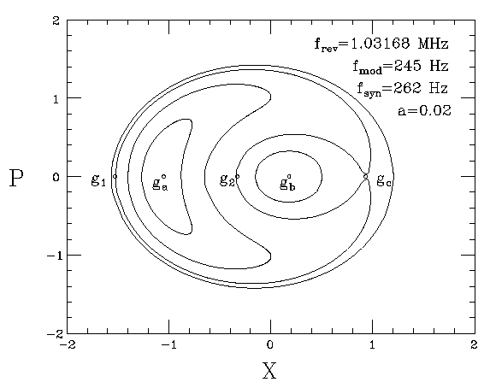
Set the synchrotron frequency at 262 Hz and apply modulation frequencies from 210-260 Hz. The oscilloscope traces of accumulated BPM sum signals show the splitting of a beam bunch into beamlets below the bifurcation frequency at about 250 Hz. The dipole field is modulated by sine wave at an amplitude of B_{m}=4G.
Using a fast sampling digital oscilloscope for a single trace, we found that the beam profile was not made of particles distributed in a ring of large synchrotron amplitude, but was composed of two beamlets. Both beamlets rotated in the synchrotron phase space at the modulating frequency, as measured from a fast Fourier transform (FFT) of the phase signal.

Slide 18
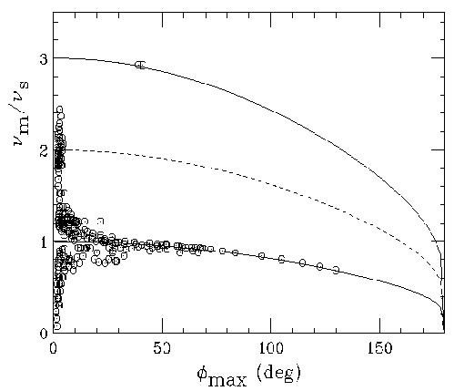
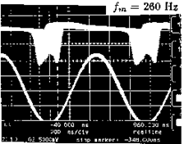
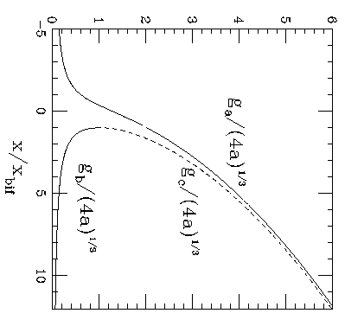
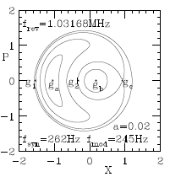
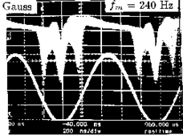

Slide 19
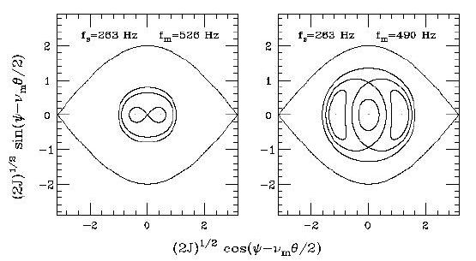
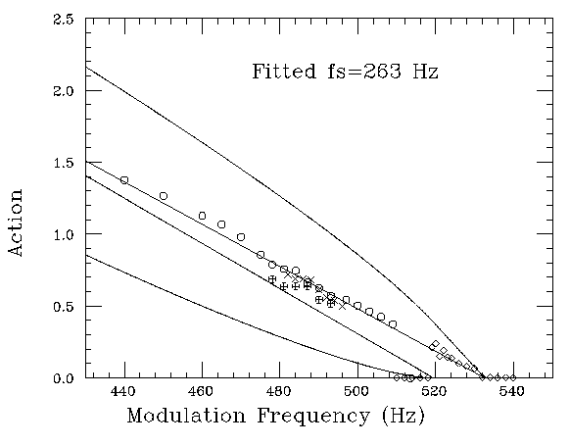
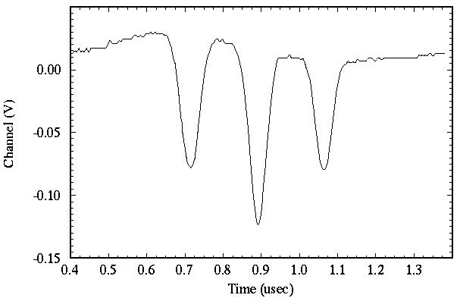
The island action vs modulation frequency.
The beam bunch was observed to split into three beamlets in a single rf bucket measured from a fast sampling scope in (μs). The voltage modulation amplitude is b = 0.05 at modulation frequency f_{m}=480 Hz with synchrotron tune f_{s}=263 Hz. Note that the outer two beamlets rotated around the center beamlet at a frequency equal to half the modulation frequency.

Slide 20
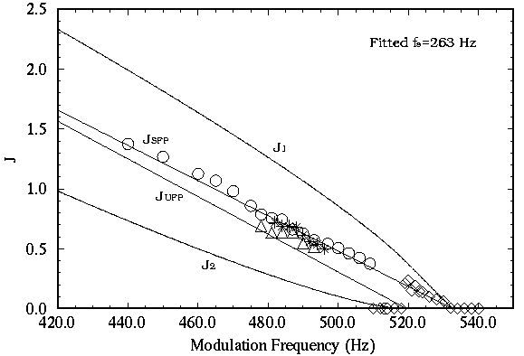
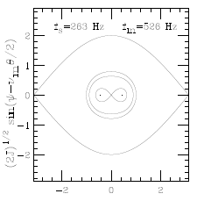
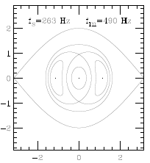
Quadrupole mode!

Slide 21





Sextupole 3rd resonance

Slide 22
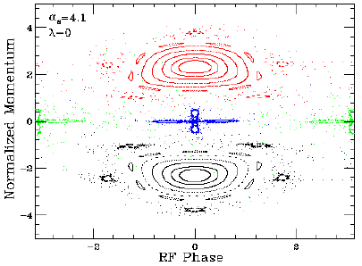
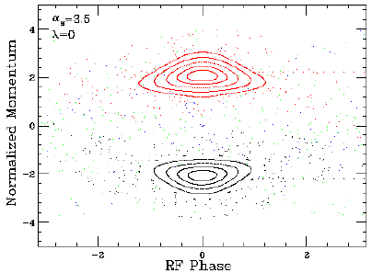
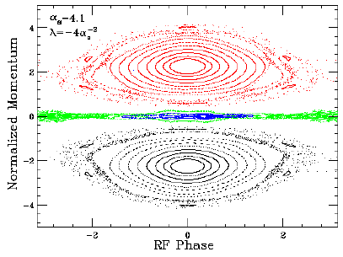
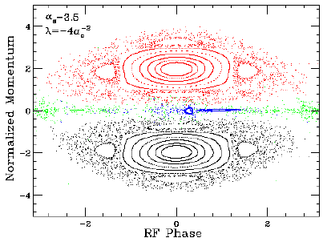

Slide 23
Application to Fermilab accelerator complex
Recycler kinetic energy (E) 8 GeV
Recycler reference rf frequency (f) 52.8 MHz
Recycler harmonic number (h) 588
Recycler phase-slip factor (η) −8.6 × 10⁻³
Maximum Recycler rf voltage (V) 2 × 150 kV
Booster harmonic number (h_{B}) 84
Booster cycle rate (f_{B}) 15 or20 Hz
Difference in Recycler rf frequency (f_{slip}) 1260 or1680 Hz
Nominal Booster emittance (ϵ97%) 0.12 eV s
Nominal Booster aspect ratio 3.00 MeV/ns
Nominal Recycler aspect ratio (100 kV) 1.06 MeV/ns
Nominal Recycler aspect ratio (57 kV) 0.80 MeV/ns

Slide 24
α_{s}= 5.5 5.1 4.4 4.1 4.0

Slide 25
Summary and conclusions
The Hamiltonian dynamics is applied to analyze the slip-stacking dynamics. It provides clear physics understanding on the second order compensation on the slip-stacking dynamics.
We carry out numerical simulations to verify the Hamiltonian dynamics.
We apply the slip-stacking Hamiltonian to the Fermilab Booster-Recycler complex. We have derived the optimal range of the slip-stacking parameter and its dependence on the phase-space area at the Booster extraction. To improve the slip-stacking efficiency, it is important to minimize the phase-space area of the Booster extracted beam, but the key problem is the aspect-ratio matching of the RCS and the slip-stacking ring.
S.Y. Lee, K.Y. Ng, PRAB 20, 064202 (2017)
Many thanks for your attention

