Slide 1

Effects of detector solenoid & magnet imperfections on dynamic aperture of JLEIC ion collider ring
Vasiliy Morozov, Fanglei Lin, Guohui Wei, Yuhong Zhang (Jefferson Lab)
Yunhai Cai, Yuri Nosochkov (SLAC)
ICFA Mini-Workshop on Dynamic Apertures of Circular Accelerators
Institute of High Energy Physics, Beijing, China
November 1, 2017
Notes:
F. Lin
1

Slide 2
Outline
JLEIC overview
Chromaticity compensation
Dynamic aperture
Alignment and field errors
Multipoles
Detector solenoid

Slide 3


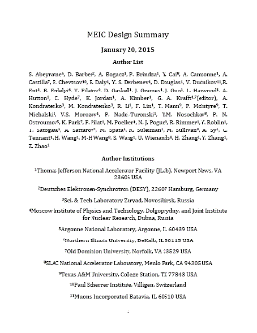
JLEIC Layout
Electron complex
  CEBAF
  Electron collider ring
Ion complex
  Ion source
  SRF linac (285 MeV/u for protons)
  Booster
  Ion collider ring
Optimum detector location
for minimizing background
8-100(400) GeV
3-12 GeV
8 GeV
SRF Linac &
2015
arXiv:1504.07961
May 17 update:
https://eic.jlab.org/wiki/index.php/Main_Page

Slide 4
Key Design Concepts
High luminosity: high collision rate of
short modest-charge low-emittance bunches
  Small beam size
    Small β* ⇒ Short bunch length ⇒
    Low bunch charge, high repetition rate
    Small emittance ⇒ Cooling
  Similar to lepton colliders such as
  KEK-B with L > 2×10³⁴ cm⁻²s⁻¹
High polarization: figure-8 ring design
  Net spin precession zero
  Spin easily controlled by small
  magnetic fields for any particle
  species
Full acceptance primary detector including far-forward acceptance
Beam Design
High repetition rate
Low bunch charge
Short bunch length
Small emittance
Damping
Synchrotron radiation
Electron cooling
IR Design
Small β*
Crab crossing

Slide 5
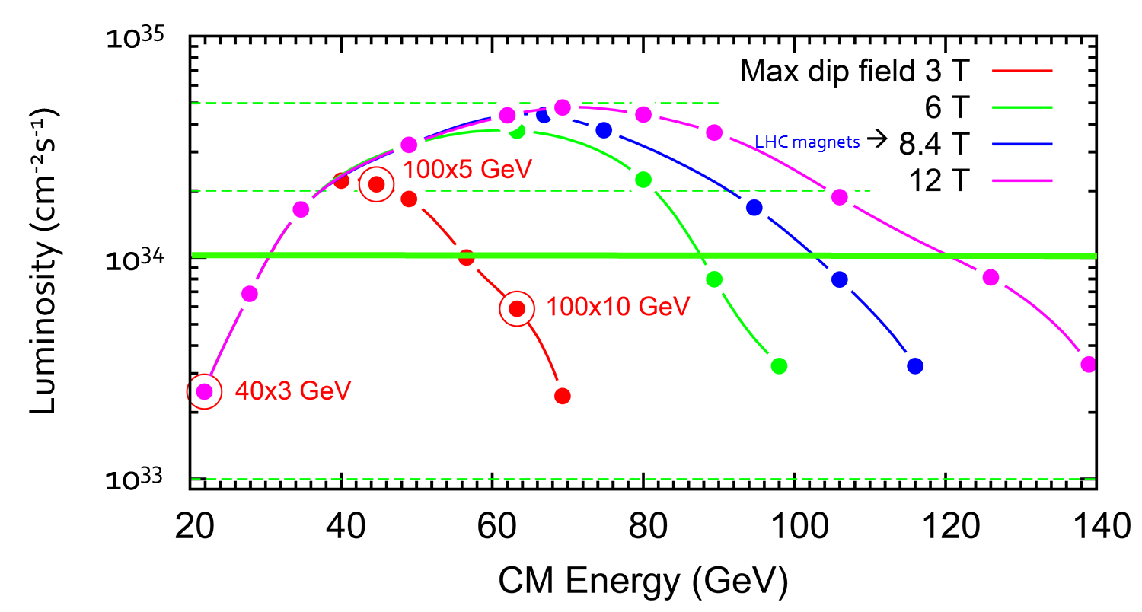
JLEIC Energy Reach and Luminosity
CM Energy (in each scenario) | Main luminosity limitation
low | space charge
medium | beam-beam
high | synchrotron radiation

Slide 6
JLEIC Parameters (3T option)
CM energy | GeV | 21.9 (low) |  | 44.7 (medium) |  | 63.3 (high)
 |  | p | e | p | e | p | e
Beam energy | GeV | 40 | 3 | 100 | 5 | 100 | 10
Collision frequency | MHz | 476 |  | 476 |  | 476/4=119
Particles per bunch | 10¹⁰ | 0.98 | 3.7 | 0.98 | 3.7 | 3.9 | 3.7
Beam current | A | 0.75 | 2.8 | 0.75 | 2.8 | 0.75 | 0.71
Polarization | % | 80% | 80% | 80% | 80% | 80% | 75%
Bunch length, RMS | cm | 3 | 1 | 1 | 1 | 2.2 | 1
Norm. emittance, hor / ver | μm | 0.3/0.3 | 24/24 | 0.5/0.1 | 54/10.8 | 0.9/0.18 | 432/86.4
Horizontal & vertical β* | cm | 8/8 | 13.5/13.5 | 6/1.2 | 5.1/1.0 | 10.5/2.1 | 4/0.8
Ver. beam-beam parameter |  | 0.015 | 0.092 | 0.015 | 0.068 | 0.008 | 0.034
Laslett tune-shift |  | 0.06 | 7x10⁻⁴ | 0.055 | 6x10⁻⁴ | 0.056 | 7x10⁻⁵
Detector space, up/down | m | 3.6/7 | 3.2/3 | 3.6/7 | 3.2/3 | 3.6/7 | 3.2/3
Hourglass(HG) reduction |  | 1 |  | 0.87 |  | 0.75
Luminosity/IP, w/HG, 10³³ | cm⁻²s⁻¹ | 2.5 |  | 21.4 |  | 5.9

Slide 7
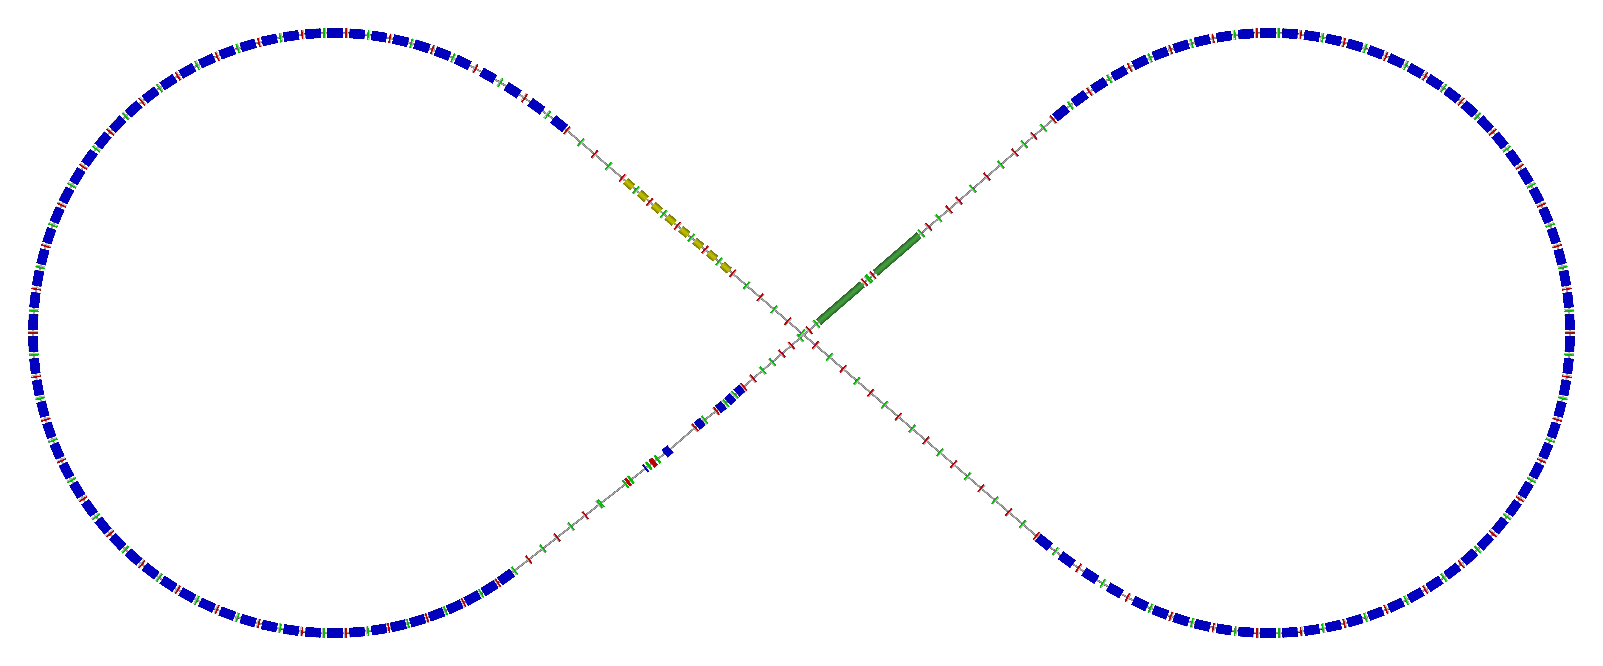
Ion Collider Ring Layout
Protons: 100 GeV/u (63 GeV/u in COM with 10 GeV e)
Lead: 40 GeV/u (40 GeV/u in COM with 10 GeV e)
Super-ferric magnets (cosθ under consideration as risk mitigation)
disp. supp./
geom. match #3
disp. supp./
geom. match #2
norm.+
SRF
Arc, 261.7°
elec. cool.
tune
tromb.+
match
81.7°
R = 155.5 m
future 2nd IP
Polarimeter
det. elem.
disp. supp.
ions
beam exp./
match
IP
disp. supp./
geom. match #3
disp. supp./
geom. match #1

Slide 8
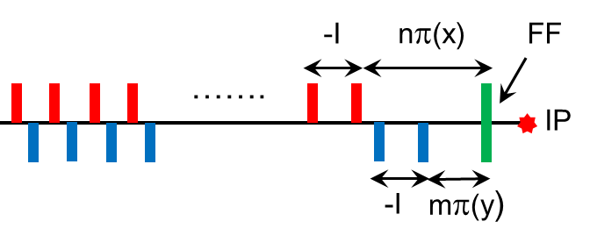
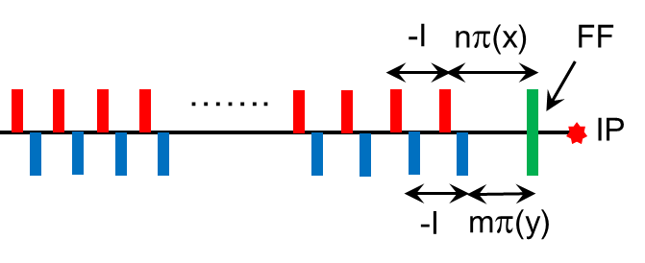
Chromaticity Compensation Schemes
Large βη at CCB sextupoles for reasonable sextupole strength
Large β_{x}/β_{y} (or β_{y}/β_{x}) ratio at X (Y) sextupoles for orthogonal X & Y correction
Compensation of sextupole non-linear geometric effects
Linear chromaticity correction → Conventional two family interleaved sextupoles in periodic arc cells. Number of cells with sextupoles is chosen to make the total phase advance of 2π*integer for compensation of the sextupoles non-linear effects.
FF sext
Linear-ξ sext
Arc cells
CCB with two non-interleaved –I pairs of sextupoles with high β at the sextupoles.
Good chromatic correction, cancellation of sextupole geometric effects.
Preferred scheme
Distributed interleaved –I sextupole pairs with small to moderate β.
Less efficient correction, residual amplitude-dependent tune shift due to pairs overlap.

Slide 9
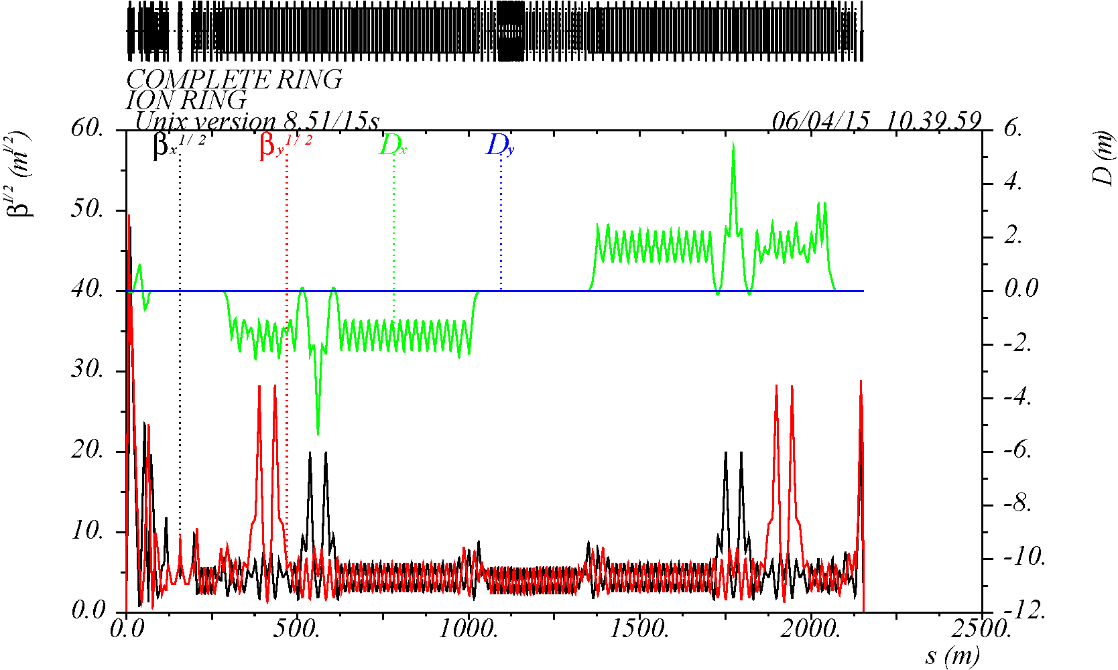
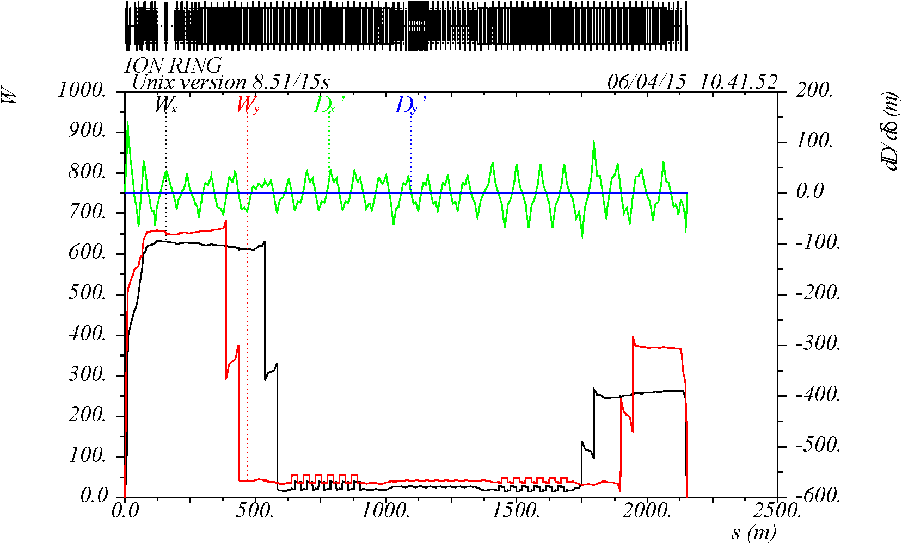
Chromaticity Compensation
CCB is based on regular 90 degree FODO arc cells with increased β at –I sextupole pairs
π/2+nπ phase advance between CCB sextupoles and IP
12 x 90 degree cells in each arc for linear chromaticity sextupoles
W-function at IP is cancelled for minimum variation of β∗(δ)
Adequate chromatic compensation over 10σ_{p} range
IP

Slide 10
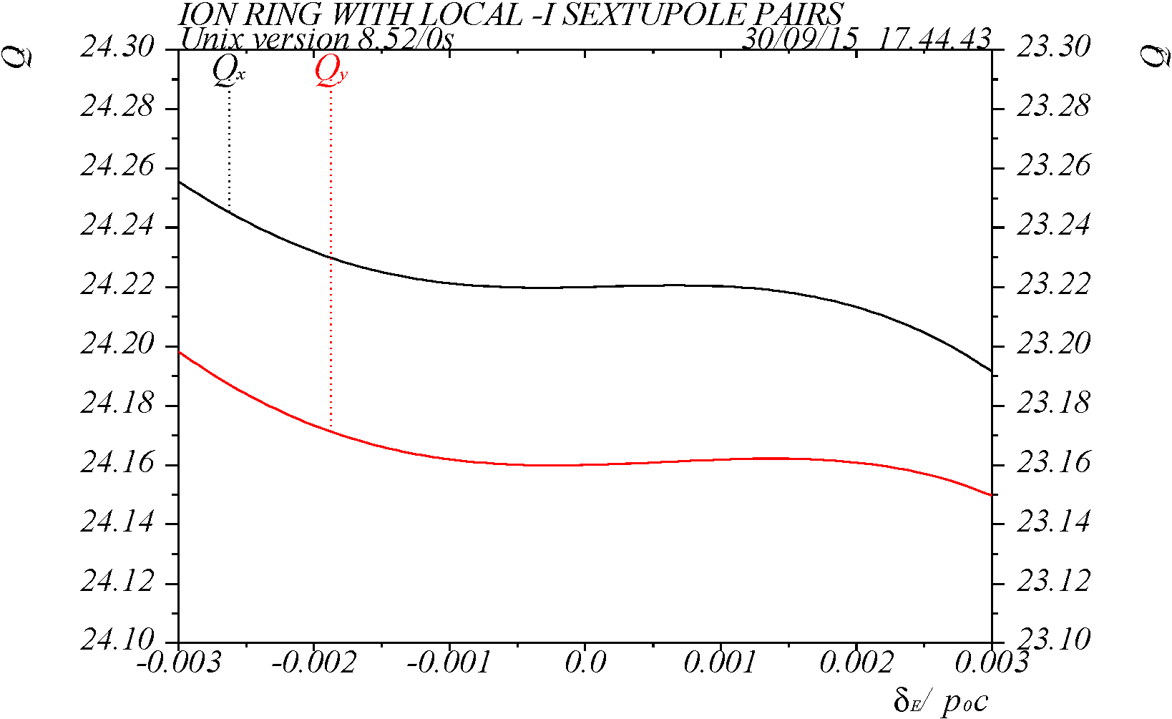
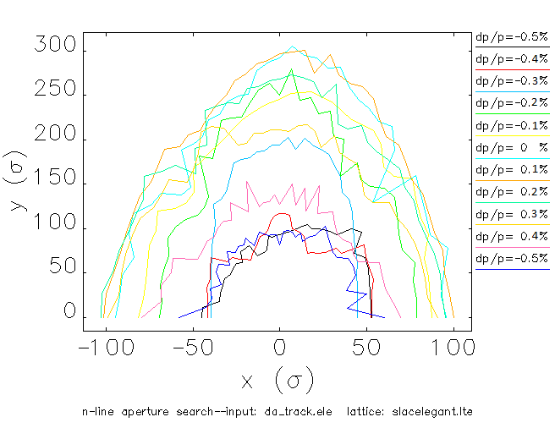
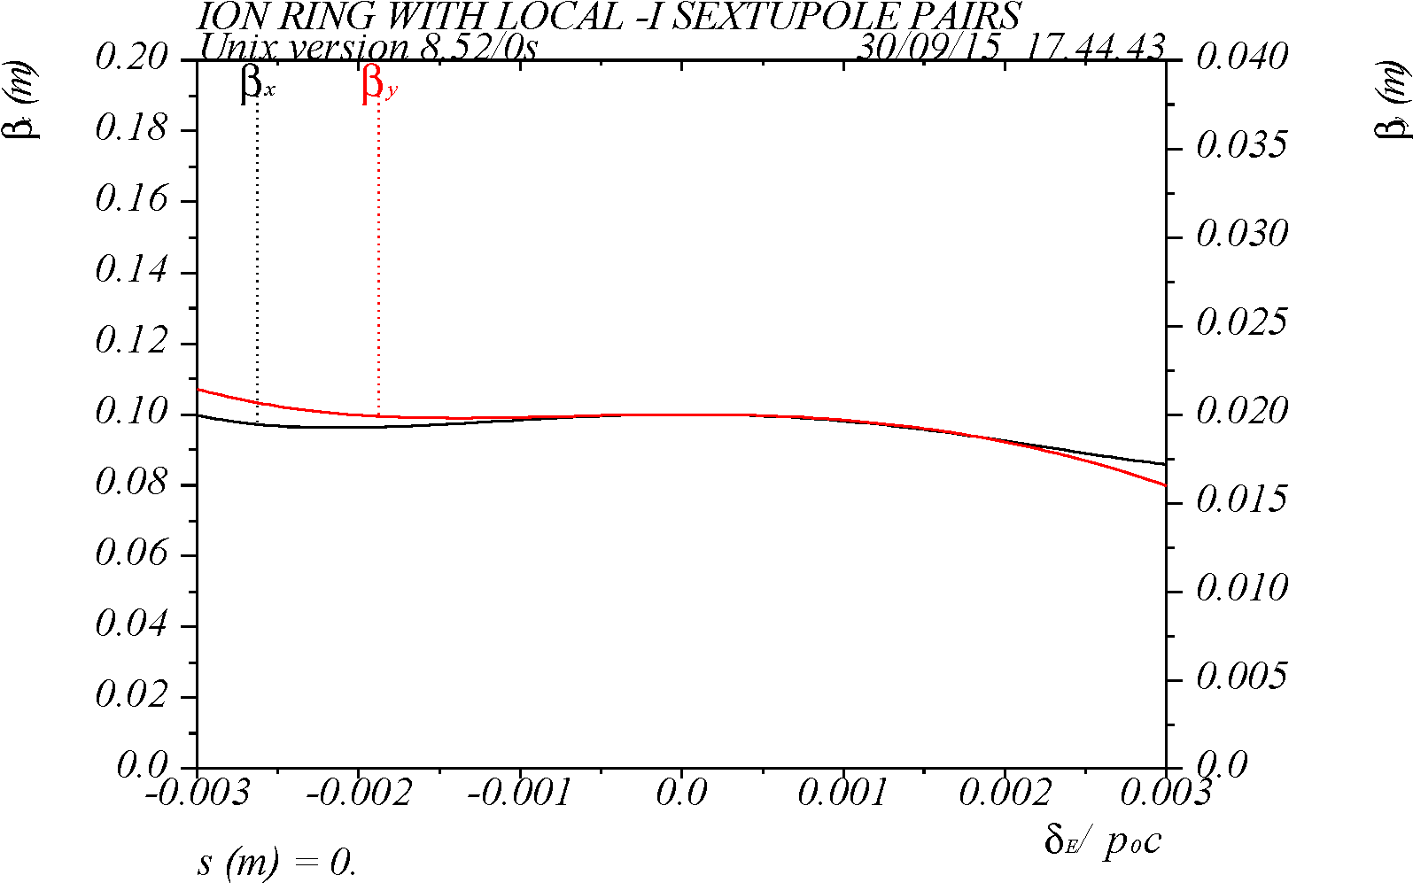
DA & Momentum Acceptance
DA without errors (shown at IP)
Elegant tracking
Tune = 24.22, 23.16 selected based
on optimal chromatic correction
On-energy DA ≈90σ
Large energy range of at least ±0.5%
Q(δ)
Q_{x,y} = 24.22 / 23.16
±10σ
β*(δ)
Q_{x,y} = 24.22 / 23.16
6

Slide 11
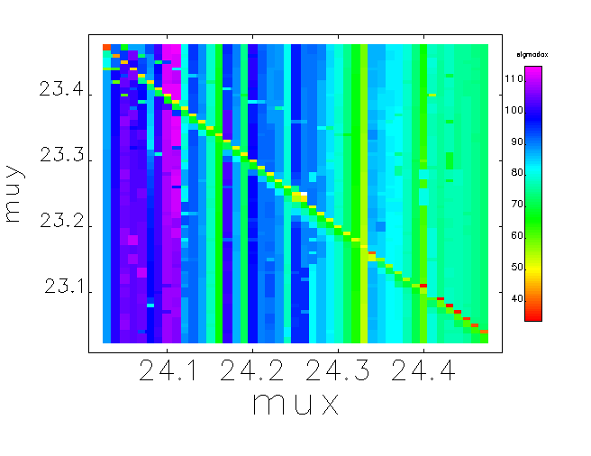
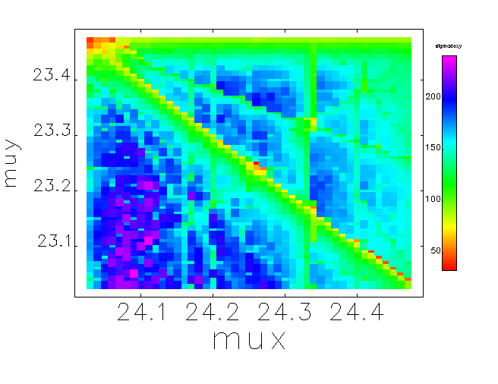
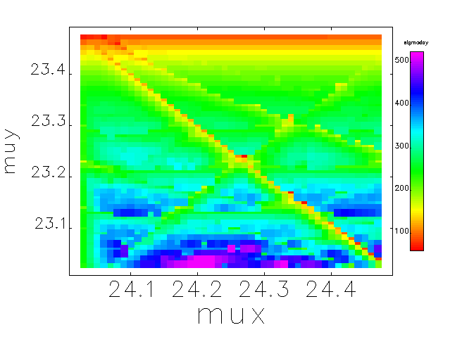
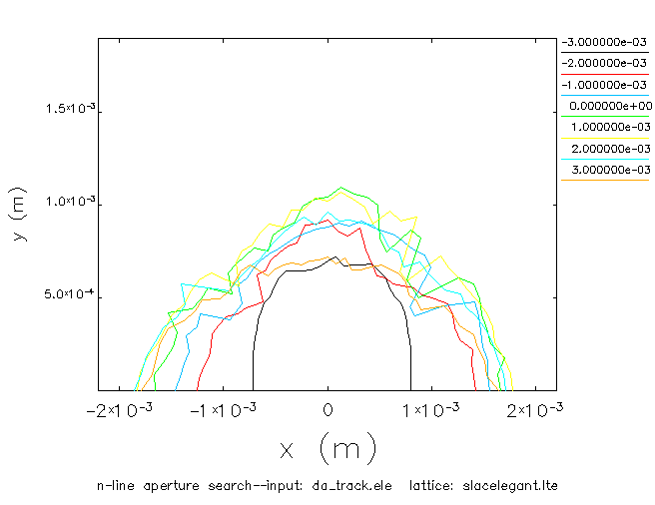
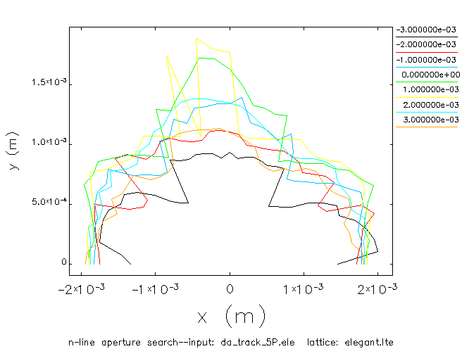
Tune Scan
DA without errors is scanned vs tune
Elegant tracking
Good on-energy DA at tune of 24.10, 23.14
However, energy range is reduced
Horiz. DA
DA at 45 deg
Vert. DA
24.22, 23.16
24.10, 23.14
13

Slide 12
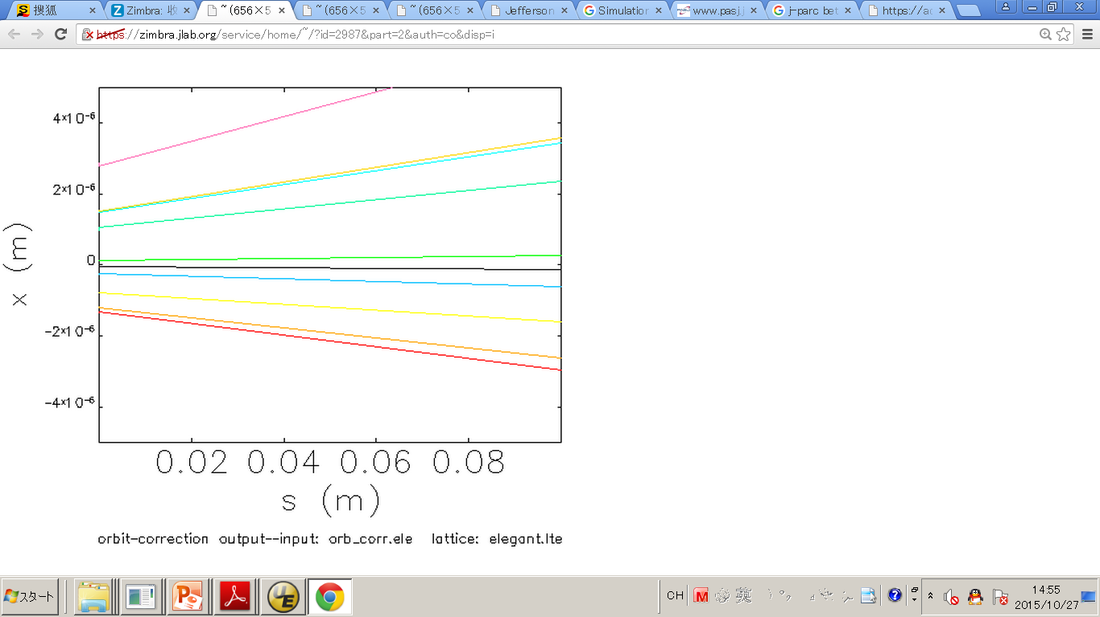
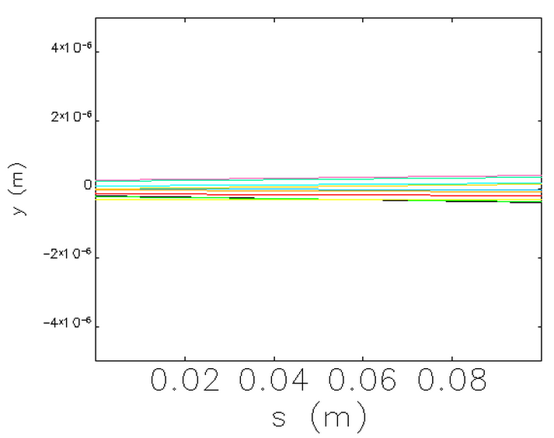
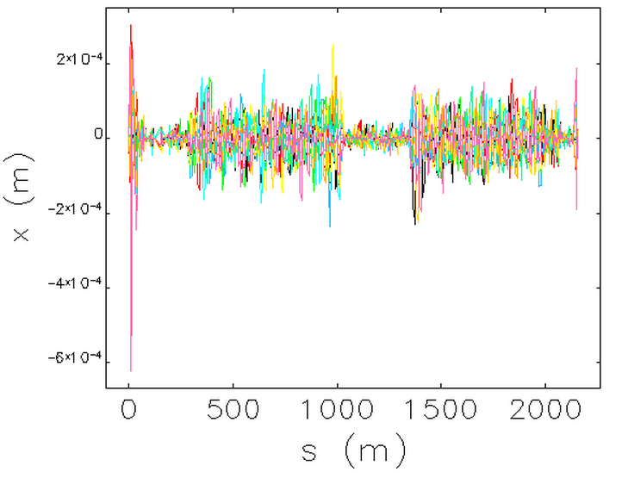
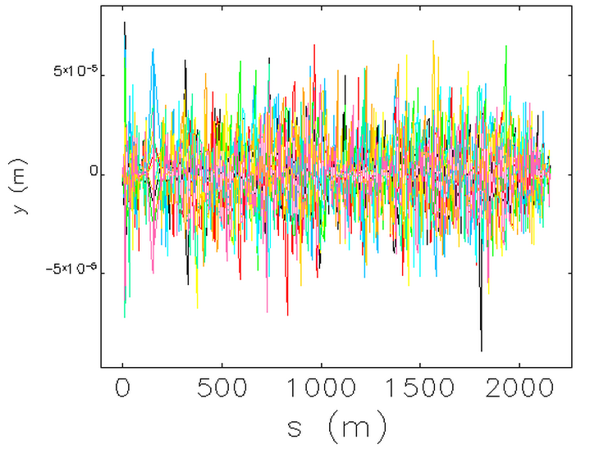
Alignment & Field Errors
Thread the beam through, find closed orbit and minimize distortion using BPMs and correctors
 | Dipole | Quadrupole | Sextupole | BPM (noise) | Corrector
X (mm) | 0.3 | 0.3, FFQ 0.03 | 0.3 | 0.05 | -
Y (mm) | 0.3 | 0.3, FFQ 0.03 | 0.3 | 0.05 | -
Roll (mrad) | 0.3 | 0.3, FFQ 0.05 | 0.3 | - | 0.3
Z (mm) | 0.3 | 0.3, FFQ 0.03 | 0.3 | - | -
Field (%) | 0.1 | 0.2, FFQ 0.03 | 0.2 | - | 0.01
5×10⁻⁶
5×10⁻⁶
< 4×10⁻⁴
< 1×10⁻⁴

Slide 13
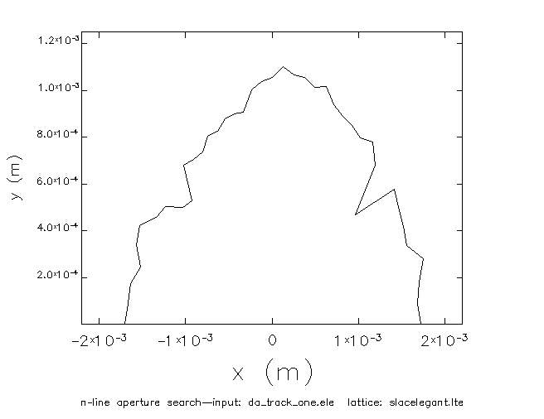
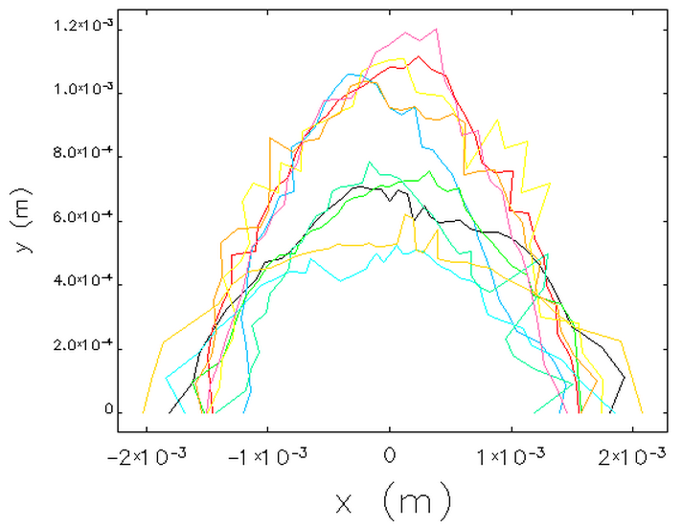
DA with Errors
Corrections: orbit, tune, chromaticity, coupling, beta beat
10 seeds of random errors using Elegant
No errors
With errors and corr.

Slide 14
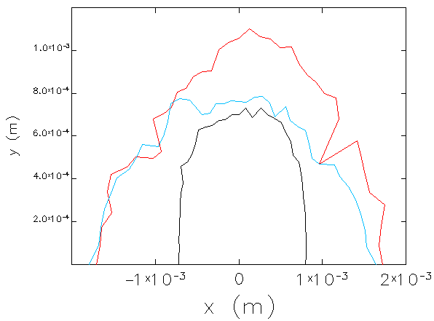
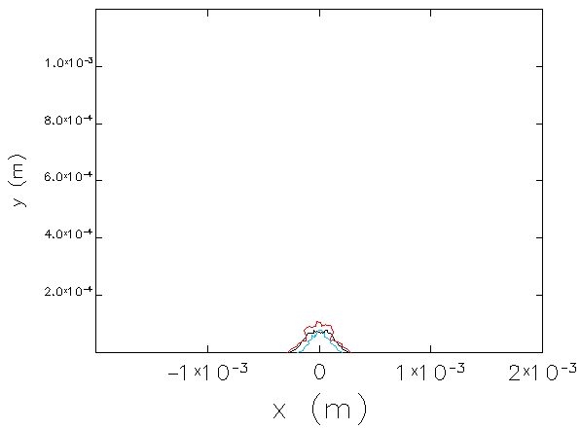
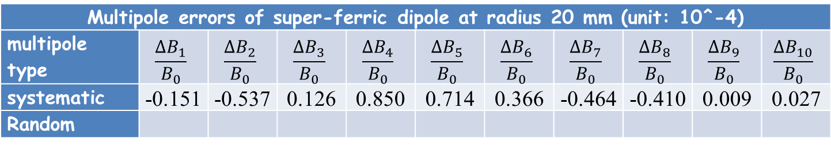
Dipole Multipoles
Systematic multipoles of super-ferric arc dipoles
When applied to all dipoles in the ring
Multipole errors of super-ferric dipole at radius 20 mm (unit: 10^-4)
multipole type
systematic | -0.151 | -0.537 | 0.126 | 0.850 | 0.714 | 0.366 | -0.464 | -0.410 | 0.009 | 0.027
Random
Without multipoles
With multipoles
Δp/p = 0
Δp/p = 0.3%
Δp/p = −0.3%

Slide 15
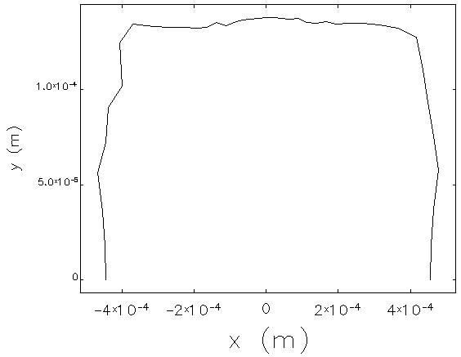
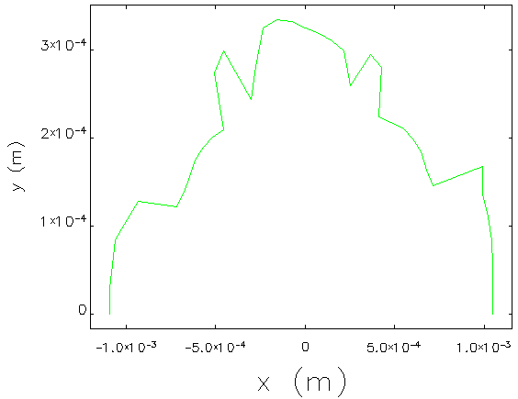
Dipole Multipoles
Different categories of magnets
Different specifications for different categories
 | D | Q | S
ALL | 133 | 205 | 75
IR area, β > 1 km | 2 | 6 | 0
β > 200 m | 21 | 19 | 8
only β < 1 km
> (±20σ) in x & y
only β < 200 m
~ (±50σ) in x & y

Slide 16
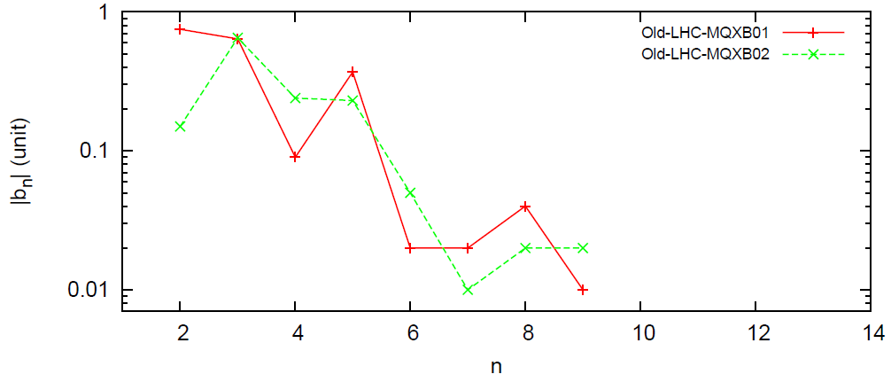
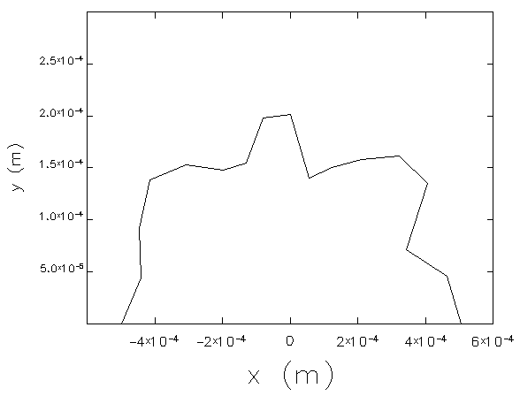
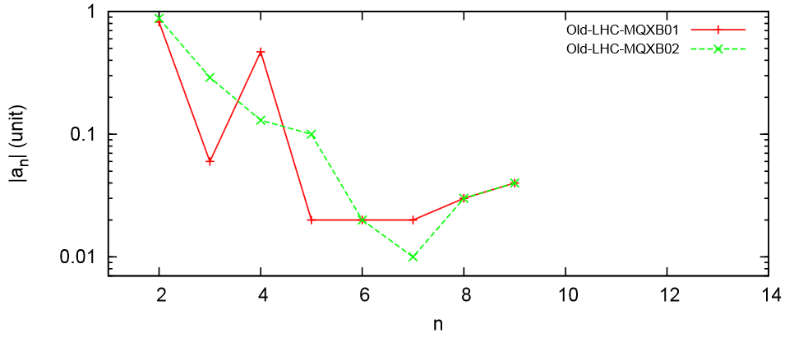
FFQ Multipoles
Using LHC FFQ multipole data

Slide 17
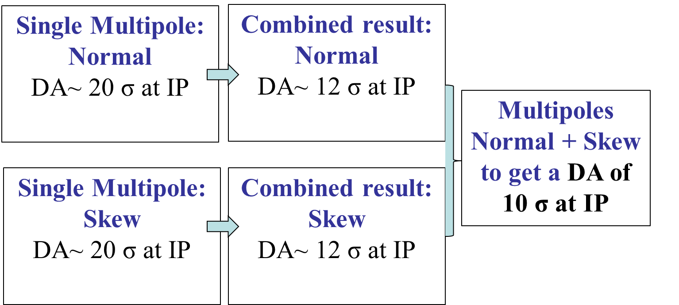
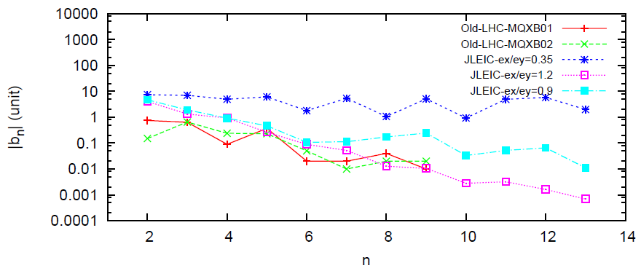
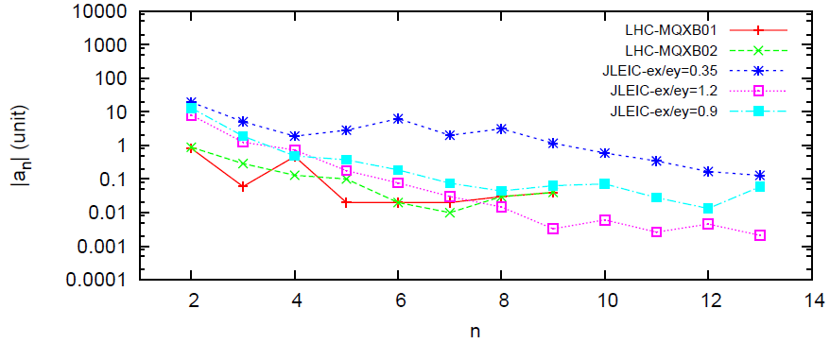
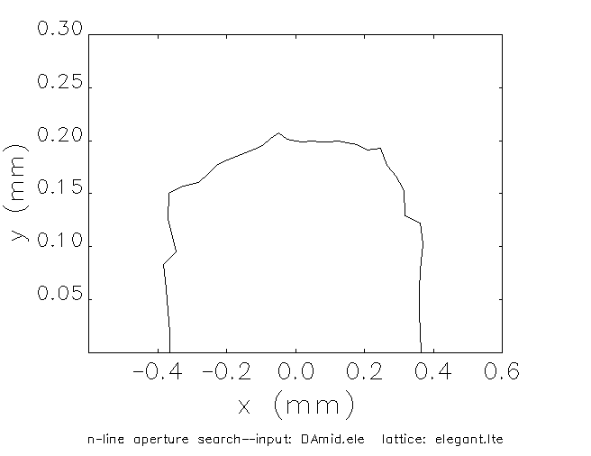
FFQ Multipoles
Dynamic aperture is scanned versus systematic b_{n} and a_{n} non-linear field terms in FF quads (one term at a time)
b_{n}, a_{n} “tolerances” are determined
based on DA of 20σ (corresponding to
one term at a time)
DA with “tolerance” settings of all b_{n}, a_{n}
terms is 10σ
Performed for different emittance settings
Tolerances are comparable to or looser than LHC MQXB magnet data
DA with FFQ non-linear
field “tolerances”
DA = 10σ

Slide 18
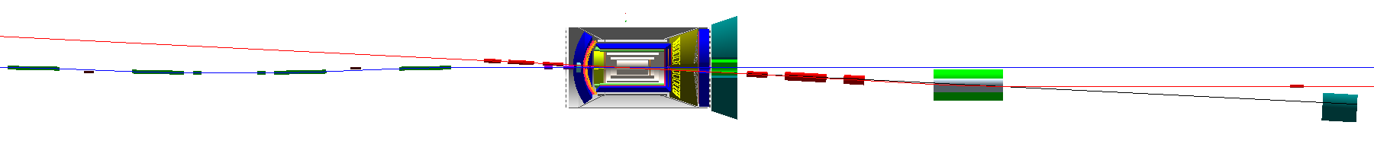
Detector Solenoid Effects
JLEIC Detector solenoid
Length | 4 m (1.6 m-IP-2.4 m)
Strength | < 3 T
Crossing Angle | 50 mrad
Ion
e
Effects | e ring | ion ring
Coherent orbit distortion | N | Y
Coupling | Y | Y
Rotates crabbed beam planes at IP | Y | Y
Generates vertical dispersion | N | Y
Linear and non-linear optics perturbation | Y | Y
Violation of figure-8 spin symmetry | Y | Y

Slide 19
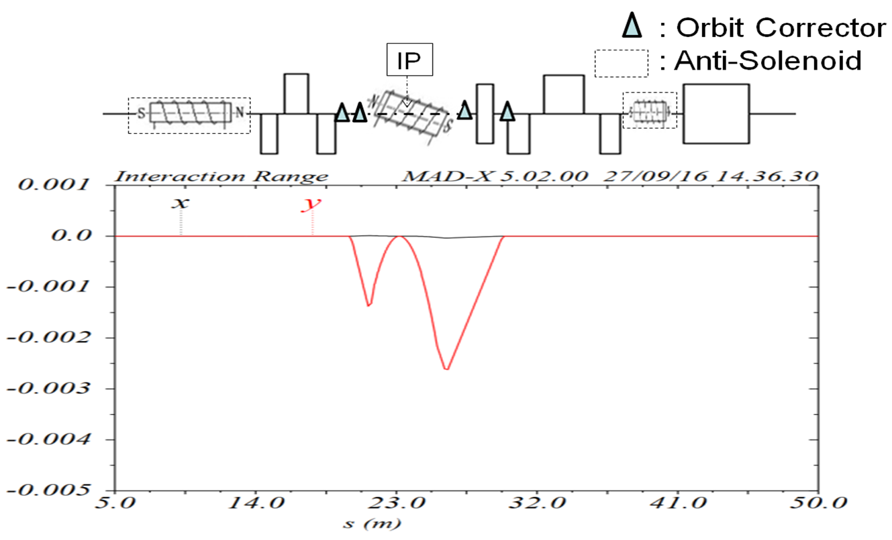
Solenoid Integration Scheme
Two dipole correctors on each side of IP for closed orbit correction
Anti-solenoid & 4 small skew quads on each side of IP for decoupling
: Skew Quadrupole
Notes:
19

Slide 20
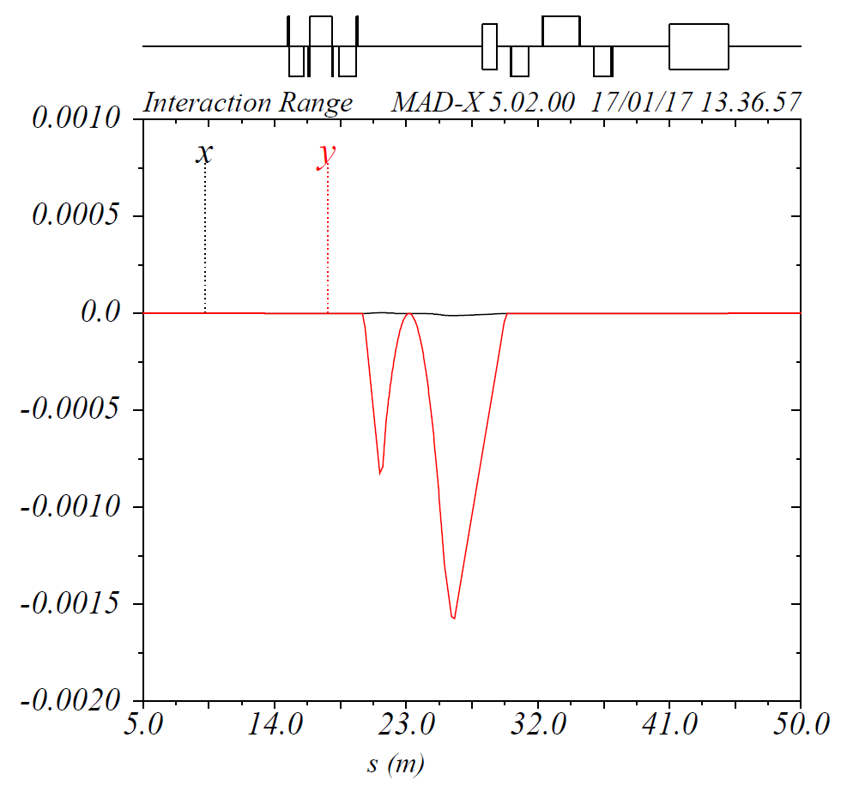
Closed Orbit Correction
Two x/y dipole correctors on each side of IP correct not only x/y beam offsets at IP but orbit x/y slopes as well

Slide 21
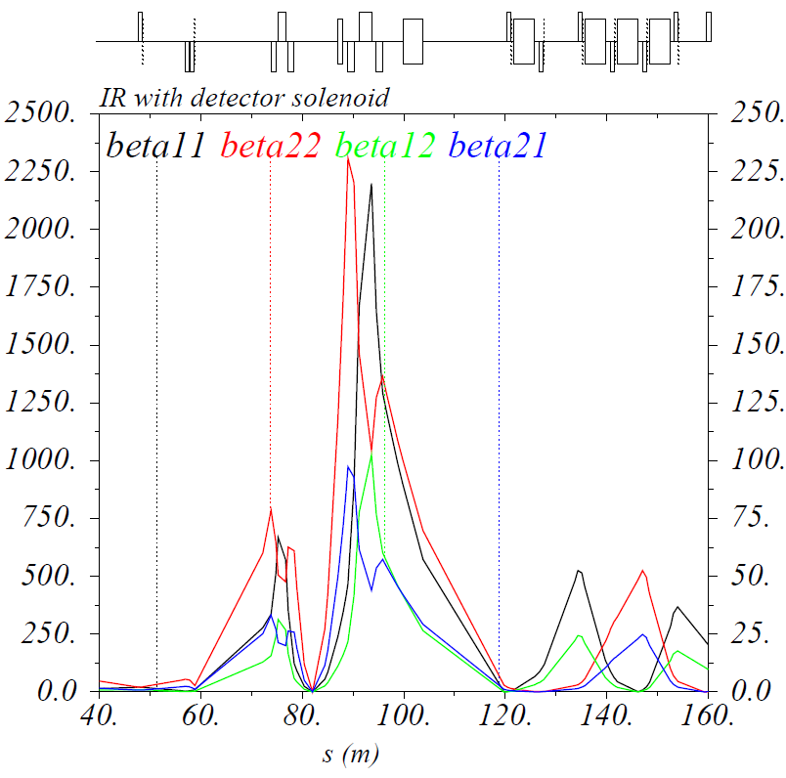
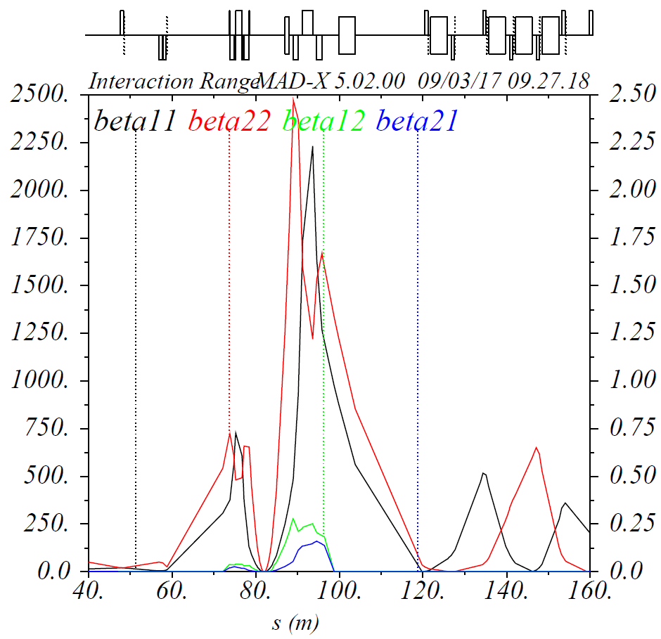
Coupling Compensation
Skew quads produce effect equivalent to FFQ rotation needed to compensate the detector solenoid by an anti-solenoid
Coupling is not only compensated locally in IR but locally at IP as well
Before compensation
After compensation

Slide 22
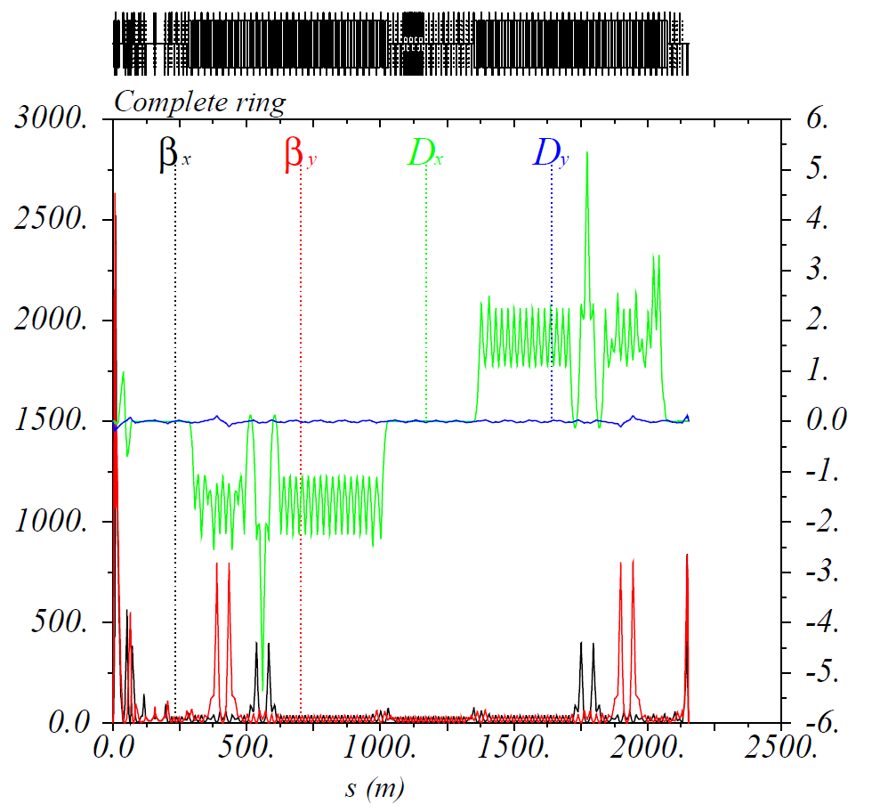
Optics Rematch
Additional solenoid focusing is compensated locally leaving the rest of the optics unchanged
Vertical dispersion is not yet compensated by it is small, <0.2 m
Δϕ_{y} = 7.5π
Δϕ_{y} = 5.5π
Δϕ_{x} = 12.5π
Δϕ_{x} = 8.5π

Slide 23
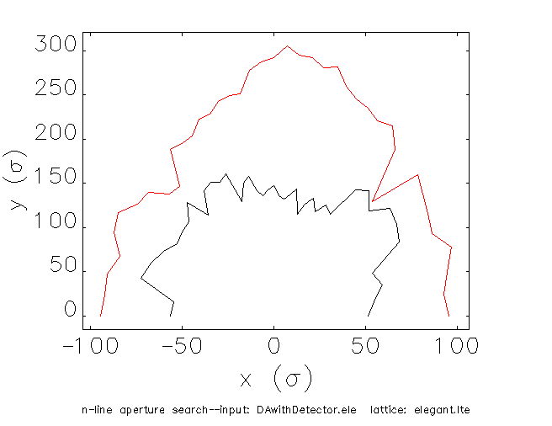
Dynamic Aperture
After solenoid compensation, DA shrinks to ~±50σ but is still acceptable
Red: no solenoid
Black: with solenoid

Slide 24
Summary
Non-linear dynamics optimization of JLEIC ion collider ring is complete
Misalignment and strength error effects studied, error tolerances specified, correction scheme implemented
FFQ multipole tolerances studied and specified
Detector solenoid integrated into the lattice and its effects compensated

