Slide 1
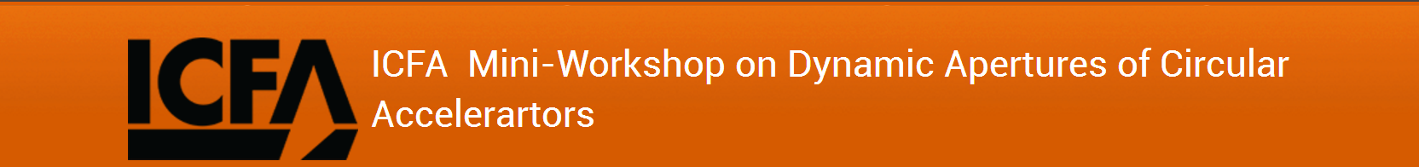
DA Studies in HEPS
Jiao, Yi
Institute of High Energy Physics, CAS, Beijing, China
2017-11-03

Slide 2
Outline
1
Brief Introduction of the HEPS
2
Recent HEPS DA Optimization
3
A Few DA Optimization Experiences
4
Conclusion

Slide 3
Brief Introduction of the HEPS
HEPS: High Energy Photon Source
The aim is to realize ultralow emittance (e.g., approaching 10 pm) and high-brightness ring light source
Almost 10 years’ evolution of the HEPS design
Layout: Linac + Booster + Ring

Slide 4
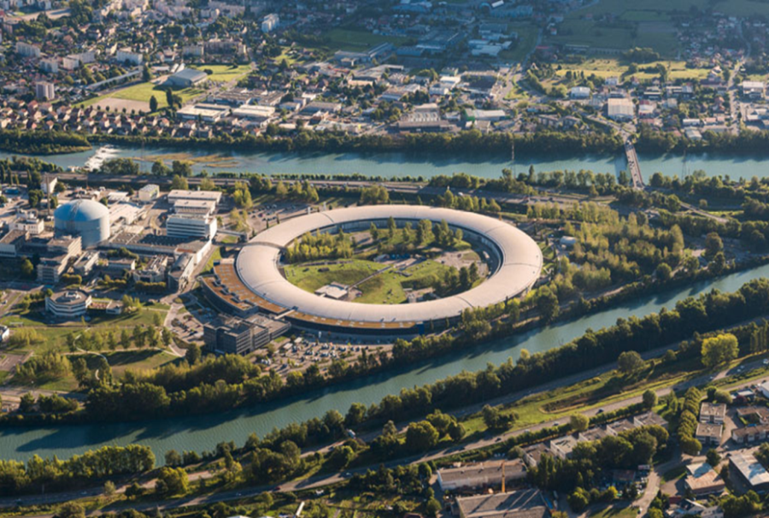
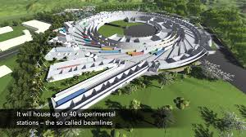
Trend of ring light source
MAX-IV, Sweden, 528 m, 3 GeV, 0.2-0.4 nm
Sirius,Brazil, 518 m, 3 GeV, 0.27 nm
ESRF-EBS, France, 844 m, 6 GeV, 0.13 nm
Lower emittances (  ∼0.1 nmrad)
Higher brilliances (↗2~3 orders)
More advanced beam lines and end-stations (Better resolutions, higher speeds, etc.)
SR-based research centers

Slide 5
Low emittance
Expected Ring performance
Reasonable budget
Strong focusing
Small circumference
[1] see, e.g., R. Hettel, J. Synchrotron Radiat. 21, 843-855 (2014).
[2] ESRF-EBS: Farvacque L, et al., In: Proc. of IPAC2013. Shanghai: 2013. 79-81
Compact MBA
Low dispersion
Large natural chromaticity
Compact magnets
Strong sextupoles
Small aperture magnets
higher dispersion
Strong nonlinearities
Bad beam dynamics (e.g., DA, MA, etc.)
Small aperture vacuum chamber
NEG-coating
Distributed bumping
Hybrid MBA design
To reach high brightness (ultralow emittance) and to simultaneously obtain large ring acceptance are both important & challenging …
Even strong focusing
Short lifetime or low inj. efficiency
stronger collective effects
Limited beam current
Not a full list …

Slide 6
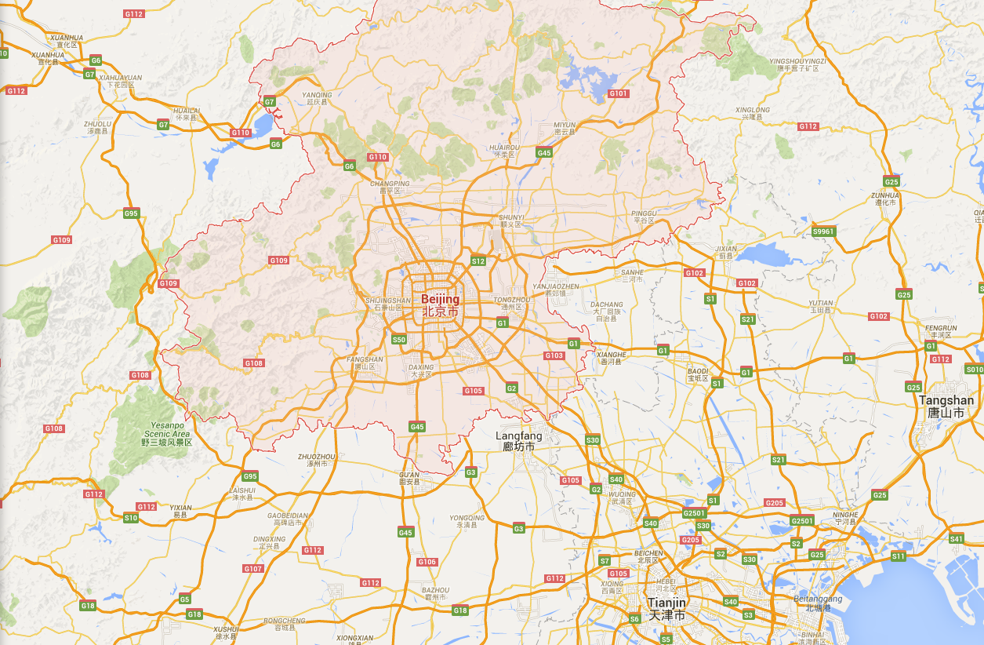

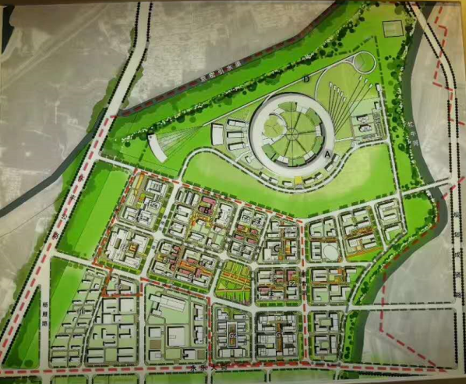

HEPS: The Next Ring Light Source in China
A new photon science research center at the north of China
HEPS
IHEP
HEPS
BSRF
About 80 km from the IHEP
Preliminary studies started on 2008
The HEPS-test facility (TF) project (2016-2018)
R&D on the accelerator and beam line techniques for a DLSR.
HEPS Project (from 2018?)
  Selected in the 13th 5-year plan (2016-2021) of the National Development and Reform Commission of China
Finish conceptual design report and the feasibility study report
HLS
SSRF
Notes:
In the research area, today’s most used and successful photon source is the storage ring based synchrotron radiation light source.
Till now, there are more than 50 facilities, and the light sources has evolved with three generations.
In china mainland, there are three ring based light sources, there are in Beijing, Hefei, and Shanghai.

Slide 7
HEPS Design Evolution (2008-)
Lattice Structure | Time | Brief Description
DBA | 2008-2012 | 48*DBA, 1200 m, 1.5 nm.rad w/o DW, 0.5 nm.rad w/DW [1]
Nominal 7BA | 2012-2013 | 36*7BA, 1370 m, 51 pm.rad, 10 pm w/DW & local round beam production [2]
TBA | 2014 | 60*TBA, 1280 m, 0.46 nm.rad, 0.15 nm.rad w/ID & DW [3]
Nominal 7BA w/ H.G. quadrupole | 2014-2015 | 44*7BA, 1294 m, 90 pm.rad @ 6 GeV (62 pm.rad @ 5 GeV) [4]
Hybrid 7BA | 2015- | 40*7BA, 1295 m, 60 pm.rad @ 6 GeV (42 pm.rad @ 5 GeV) [5,6,7]
7BA with novel layout | 2016- | 1360.4 m, as low as possible emittance, & as large as possible DA, underway [8]
Pioneer or on-phase studies: MAX-IV, Sirius, PEP-X, ESRF-EBS, SPring8-II, APS-U, ALS-U, etc.
  [1] X.M. Jiang et al., internal report, 2012 (in Chinese).
  [2] G. Xu, Y. Jiao, Chin. Phys. C, 37(5), 057003 (2013).
  [3] G. Xu, Y. Peng, Chin. Phys. C, 2015, 39(3): 037005.
  [4] Y. Jiao, G. Xu, Chin. Phys. C, 39(6), 067004 (2015).
  [5] G. Xu, Y. Jiao, Y. Peng, Chin. Phys. C, 40(2): 027001 (2016).
  [6] Y. Jiao, Chin. Phys. C, 40(7): 077002 (2016).
  [7] Y. Jiao, G. Xu, Chin. Phys. C, 41(2): 027001 (2017).
  [8] Work to be submitted.

Slide 8
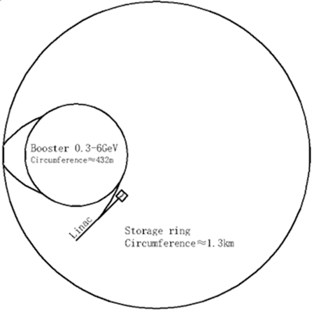
Schematic view of HEPS
Mainly consider Swap-out injection, and if possible, compatible with longitudinal and/or off-axis injection
Booster:
300 MeV to 6 GeV
Rep. rate: 1 Hz
FODO structure
Emittance: ~40 nm
max. bunch charge: ~2 nC
Storage Ring:
6 GeV, 48*7BAs
Circumference: 1360.4 m
Natural emittance: 30-60 pm
Beam current: 200 mA
For high-charge operation mode, the beam extracted from the ring is merged with the bunch from the Linac and re-injected to the ring

Slide 9
Recent HEPS Designs with Optimized DA
HEPS-TF (HEPS-test facility) baseline, hybrid-7BA design. Small DA, just enough for on-axis swap-out injection
With the same layout, brightness can be 30% higher, or DA area can be three times larger (w/ the similar brightness or emittance)
With improved 7BA design, brightness can be 30% even higher, and DA can be kept the same (if not larger)

Slide 10
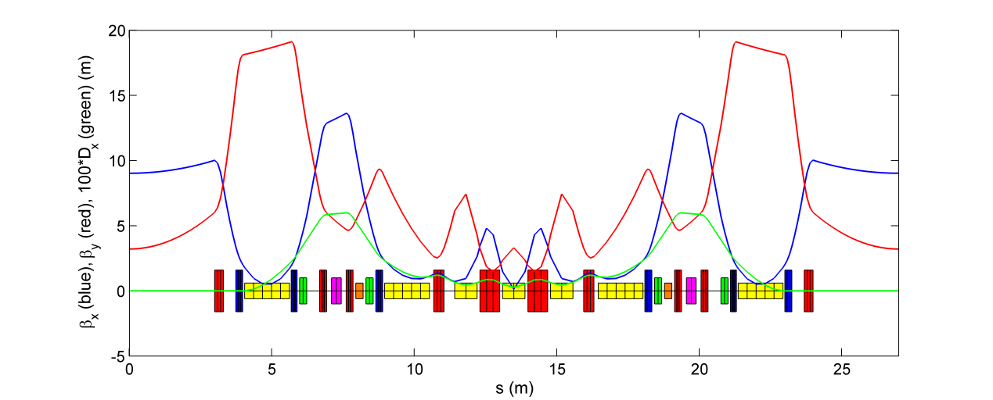
Baseline for the HEPS-TF
6 GeV, ~1.3 km, 60 pm
This type of lattice is able to create dispersion bumps which facilitate compensation for very large natural chromaticities, it also adopts aggressively strong focusing which results in a compact layout as well as an ultralow emittance. These features allow practical and cost effective storage ring designs, even when the natural emittance is reduced down to approaching the diffraction limit of hard X-rays.
First used in ESRF-EBS, and now adopted in the design of APS-U, HEPS, ALS-II, etc.

Slide 11



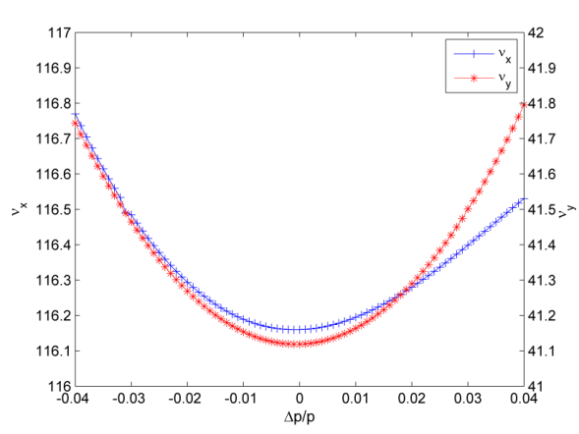
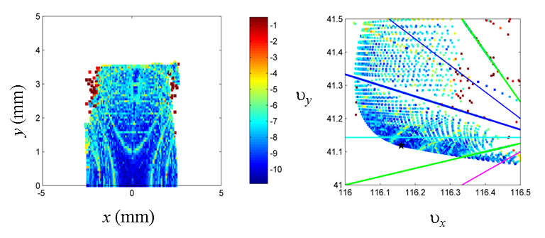
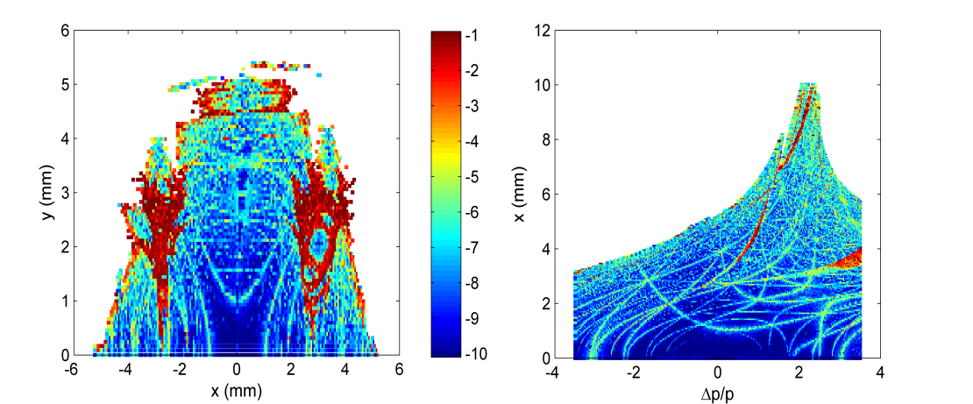
Very Difficult DA Optimization
Still hard to get large DA even with:
Local cancellation
→ Approximately −I transportation between each sextupole pair (interleaved)
Global cancellation
→ Quasi-4th order geometric achromat (the whole ring, tune close to [113, 41])
Optimization of tunes, sextupole/octupole strengths (grid scan)
→ ‘Effective’ on-momentum DA (x/y): ~2.5/3.5 mm, ~100/250 σ_{x/y}; effective MA: ~3%.
Injection with high efficiency:
On-axis swap-out injection
On-axis longitudinal accumulation
Off-axis injection & accumulation
υ_{x}
υ_{y}
x (mm)
y (mm)
δ
x (mm)
‘Effective’ DA/MA: DA bounded by nearest integer and half-integer resonances.
(Y. Jiao, et al., IPAC17-WEPAB055)

Slide 12
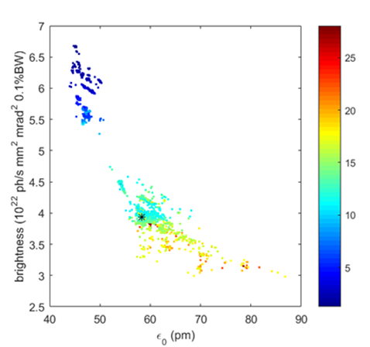
Global Optimization of Hybrid-7BA
All tenable parameters scanned & linear and nonlinear dynamics simultaneously optimized
Color bar: Effect. DA area×MA/3% (mm²)
If keeping 60 pm emittance, the DA can be increased to be close to (if not larger than) 8 mm in x plane.
If considering only on-axis swap-out injection scheme, the emittance can be further pushed down to ~45 pm.rad
G. Xu, et al., IPAC2017, WEPAB052

Slide 13
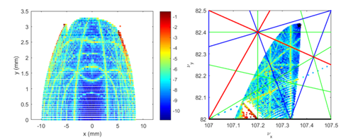
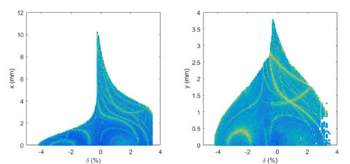
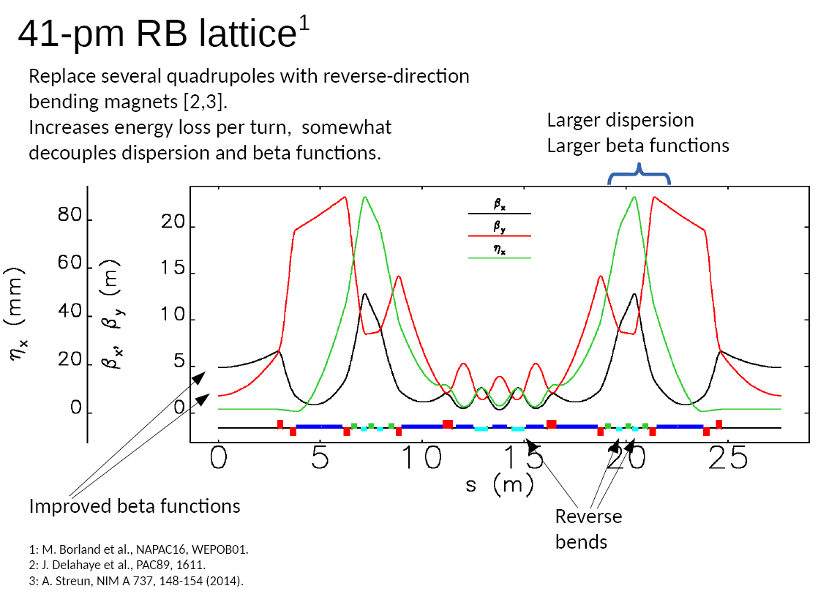
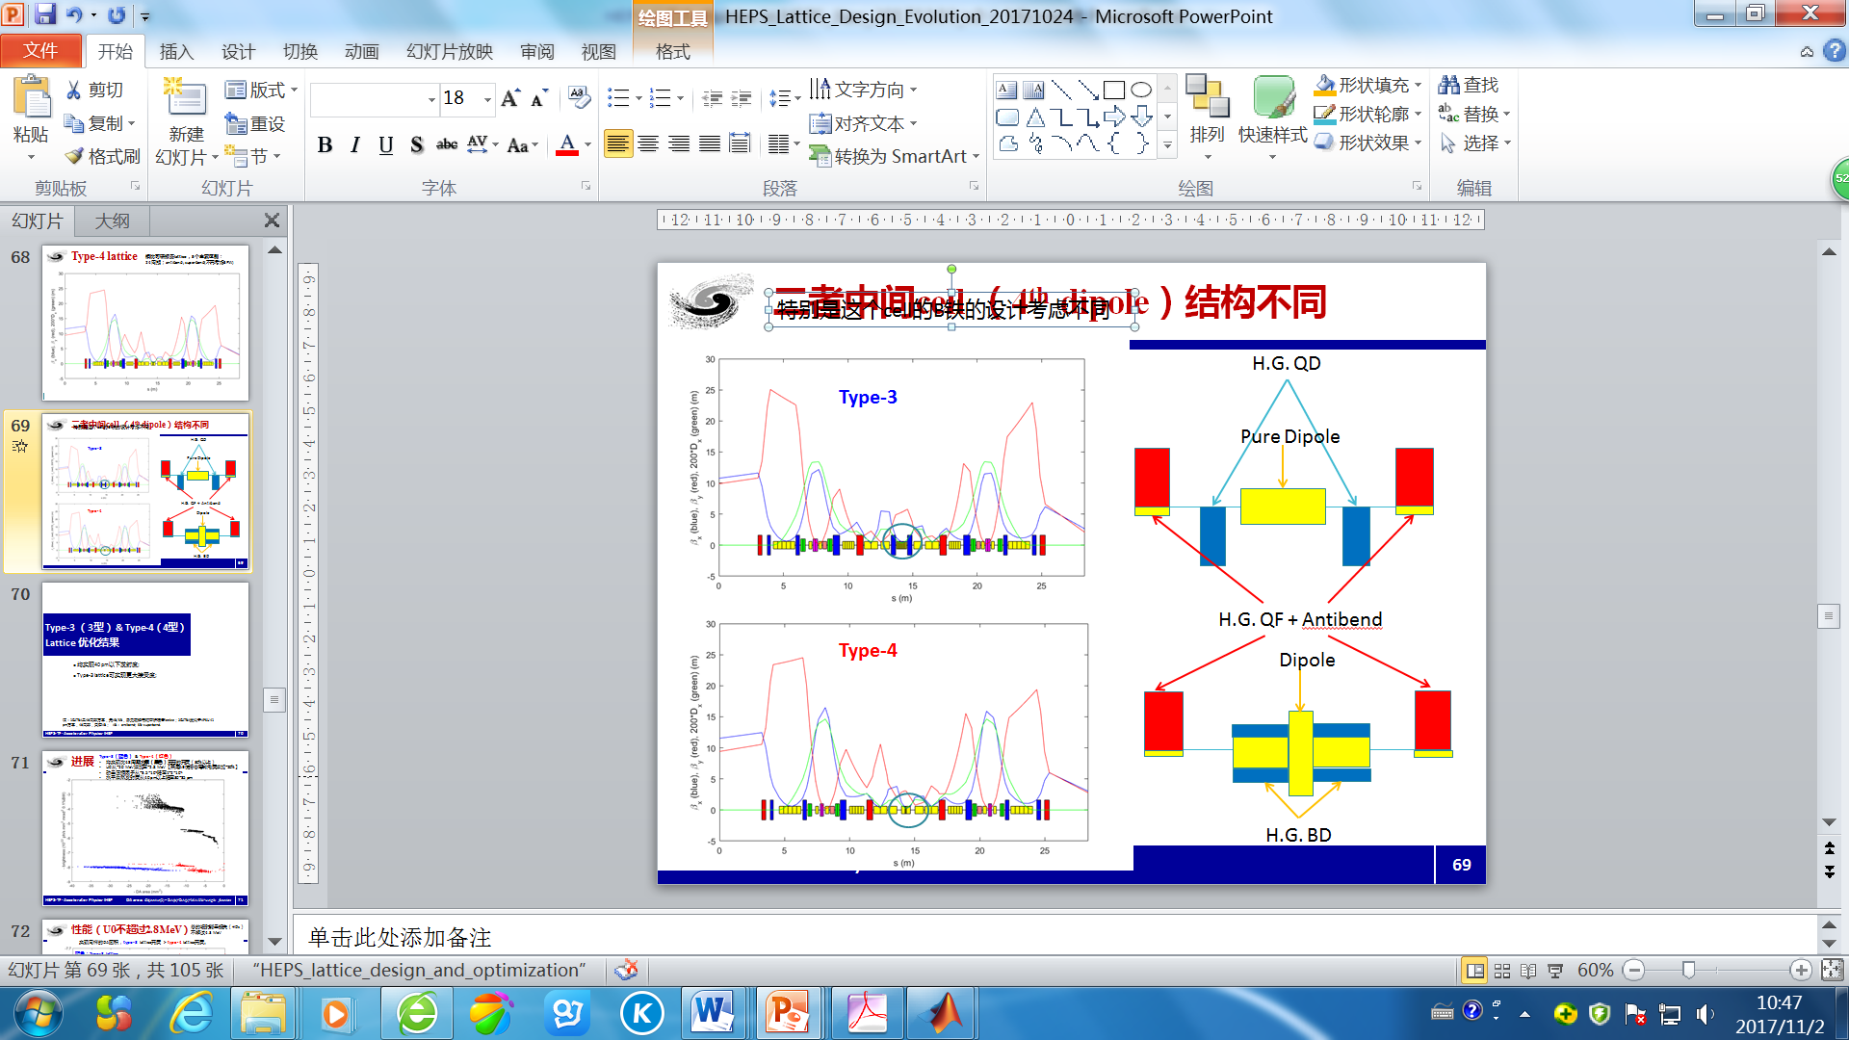
Even Possible for off-axis injection at 60 pm
w/o high-β section, effective DA (x/y): 8/3.3 mm, ~350/200 σ_{x/y}, effective MA size > 3.5%
Very good, but can be even better!
30-35 pm w/ Antibend & Superbend
Courtesy of M. Borland
Recent work, unpublished.

Slide 14
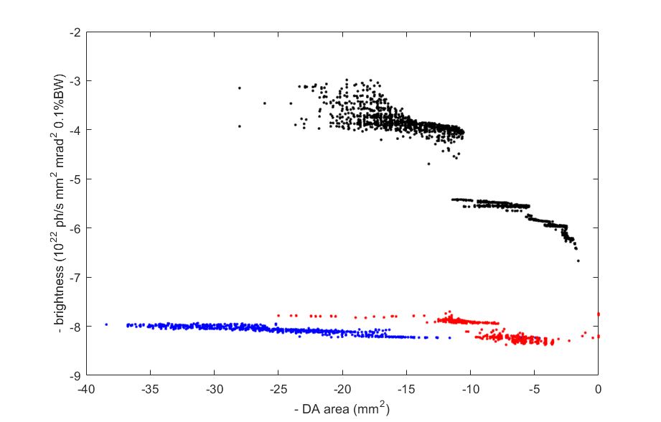
Higher Brightness & Large DA w/ new 7BA Design
Solutions for Hybrid-7BA
Emittance: 40~60 pm
DA(x/y): up to ~300 σ_{x/y}
Solutions for new 7BA designs
Emittance: 30~40 pm
DA(x/y): up to ~250/400 σ_{x/y}
Optimization study is underway
Objective(2): - weighted DA area = DA(x)*DA(y)*MA/3%*weight functions

Slide 15
A Few DA Optimization Experiences
Dependence relations between DA and the related parameters are very complex
Global optimization is essentially required with stochastic optimization algorithms
Ways of avoiding local optima …

Slide 16
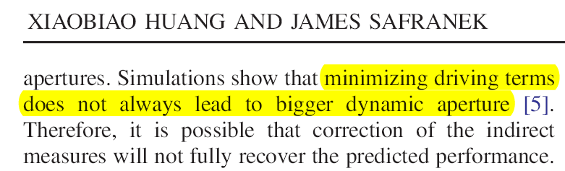
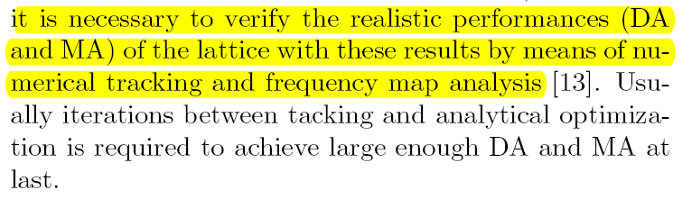
Smaller Driving Terms → Good Nonlinear performance?
Not definitely true.
L. Yang, Y. Li, W. Guo, S. Krinsky, Multiobjective optimization of dynamic aperture, PRST-AB 14, 054001 (2011)
Similar experience in HEPS
Objectives: Analytically derived detuning, chromatic, and resonance driving terms
X. Huang, J. Safranek, Online optimization of storage ring nonlinear beam dynamics, PRAB, 18, 084001 (2015)
  G. Xu, Y. Jiao, Chin. Phys. C, 37(5), 057003 (2013).
  Y. Jiao, G. Xu, Chin. Phys. C, 39(6), 067004 (2015).

Slide 17
Global Cancellation → Good Nonlinear performance?
It appears not definitely.
HEPS Hybrid-7BA baseline
Closed to the 4th order geometric achromat condition (Tunes: 113.20/41.28)
Effective DA (x/y): 2.5/2 mm
Effective MA: 2.4%
  G. Xu, Y. Jiao, Y. Peng, Chin. Phys. C, 40(2): 027001 (2016).
Optimization tuning quadrupole & multipole strengths
Away from the 4th order geometric achromat condition (Tunes: 116.16, 41.12)
Effective DA (x/y): 2.5/3.5 mm
Effective MA: 3.0%
  Y. Jiao, Chin. Phys. C, 40(7): 077002 (2016).
Additionally, the MA size is highly dependent on choice of the fractional tune.

Slide 18
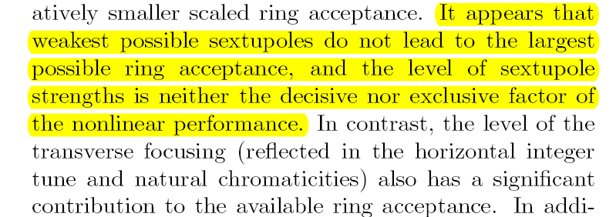
Weaker focusing & sextupoles → Good Nonlinear performance?
It appears not definitely.
HEPS Hybrid-7BA baseline,
Except quadrupoles, sextupoles, and octupoles, drft lengths also changed.
Solutions with weakest possible sextupoles
Max. DA area: ~2.5 mm² at ~60 pm
Solutions with largest possible acceptance
Max. DA area: ~4.5 mm²
  Y. Jiao, G. Xu, Chin. Phys. C, 41(2): 027001 (2017).

Slide 19
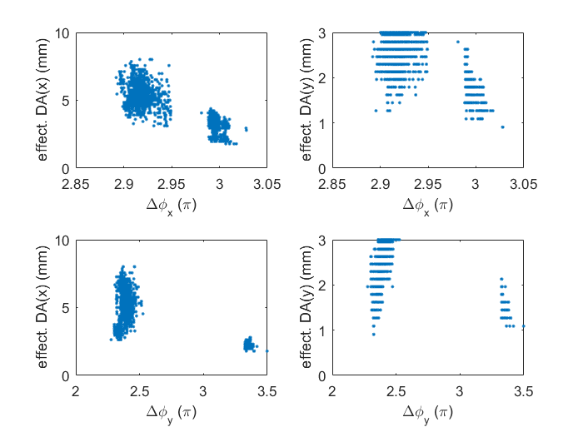
Local Cancellation → Good Nonlinear performance?
It appears not definitely.
HEPS Hybrid-7BA,
Global scan of all tunable parameters
Keeping condition of –I transportation between sextupole pairs first
But then release this condition in the last iterations of optimization
Color bar: Effect. DA area×MA/3% (mm²)
The horizontal phase advance is not exactly on the –I transportation condition.
The vertical phase advance is away from the –I transportation condition.
Recent work, unpublished.

Slide 20
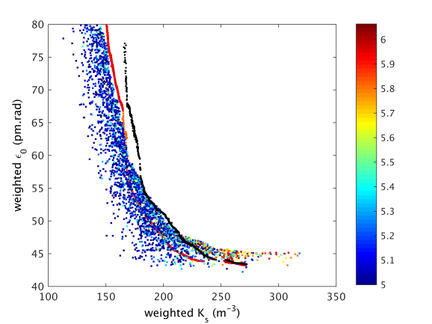
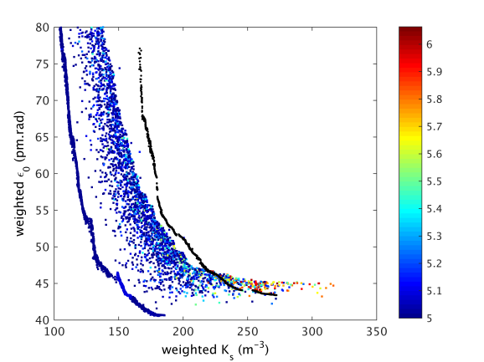
Global Optimization w/ Stochastic Algorithms
Evolve with PSO for 800 generations as well
Test MOGA (NSGA-II) and PSO performance in an optimization problem with a known answer.
MOGA solutions with variable L_{ss}
MOGA solutions with fixed L_{ss}
Fix the lattice structure and circumference, shortening the long straight section results in lower emittance and better dynamics?
Yes. (more room for variation of magnetic parameters).
PSO solutions with variable L_{ss}
PSO breeds more diversity. And once with enough diversity, MOGA reach better convergence.
Further Evolve with PSO and MOGA for 500 more generations
MOGA solutions with variable L_{ss}
A rational combination of the PSO and MOGA is more effective than either of them alone, in approaching the true global optima of an explorative multi-objective problem with many optimizing variables and local optima.
  Y. Jiao, G. Xu, Chin. Phys. C, 41(2): 027001 (2017).
MOGA solutions with fixed L_{ss}
PSO solutions with variable L_{ss}
Such a way helps a lot in HEPS optimization.

Slide 21
In Closing …
To design a ring light source with high brightness and robust nonlinear dynamics is a challenging but also an exciting work
After 10 years’ evolution, for HEPS, we can achieve emittance of 30~60 pm, and at the same time, ensure large enough ring acceptance
The DA optimization work is and will always be underway, even after the beginning of the HEPS project construction.

Slide 22
Thanks:
A. Chao, Y. Cai, X. Huang (SLAC), M. Borland (APS), S.Y. Lee (Indiana U.), L. Yu, Y. Li (BNL), S. Liuzzo, N. Boaz (ESRF), S. Tian, B. Jiang (SSRF), Z. Bai (HLS), etc. for their enthusiastic help, discussions and guidance for the HEPS design.
Thanks for your attention!

