Slide 1
Simulations and Measurements of the impact of collective effects on dynamic aperture
Seunghwan Shin (PLS-II/PAL) V. Sajaev, R. Lindberg and M. Borland (APS/ANL)
ICFA Mini-Workshop, IHEP, 2017

Slide 2
Content
Introduction.
Impedance model.
Elegant simulation.
Measurement of dynamic aperture.
Analysis.
Summary.

Slide 3
Introduction: Motivation
The simulation for collective effect on dynamic aperture - It must be very important issue for USR.

Slide 4
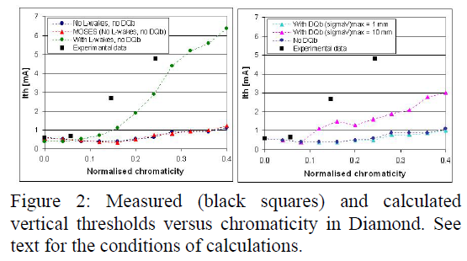
Introduction: Motivation
Benchmark study for collective effect on dynamic aperture - Some results show discrepancy between simulation and measurement. - Therefore, thorough benchmark study is necessary and this presentation will describe its result in APS.
Proc. of PAC09, Vancouver, BC, Canada

Slide 5
Impedance model
Wake potential computations with a short bunch - The shorter bunch is the better. (1 mm)
R. Nagaoka

Slide 6
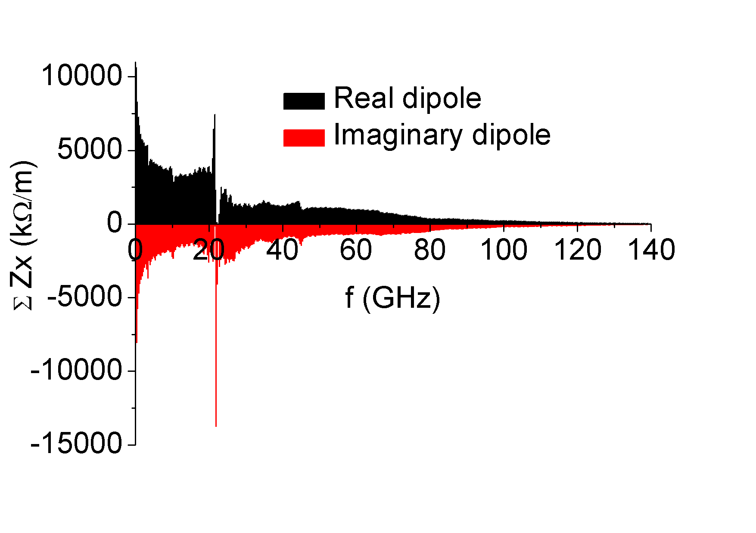
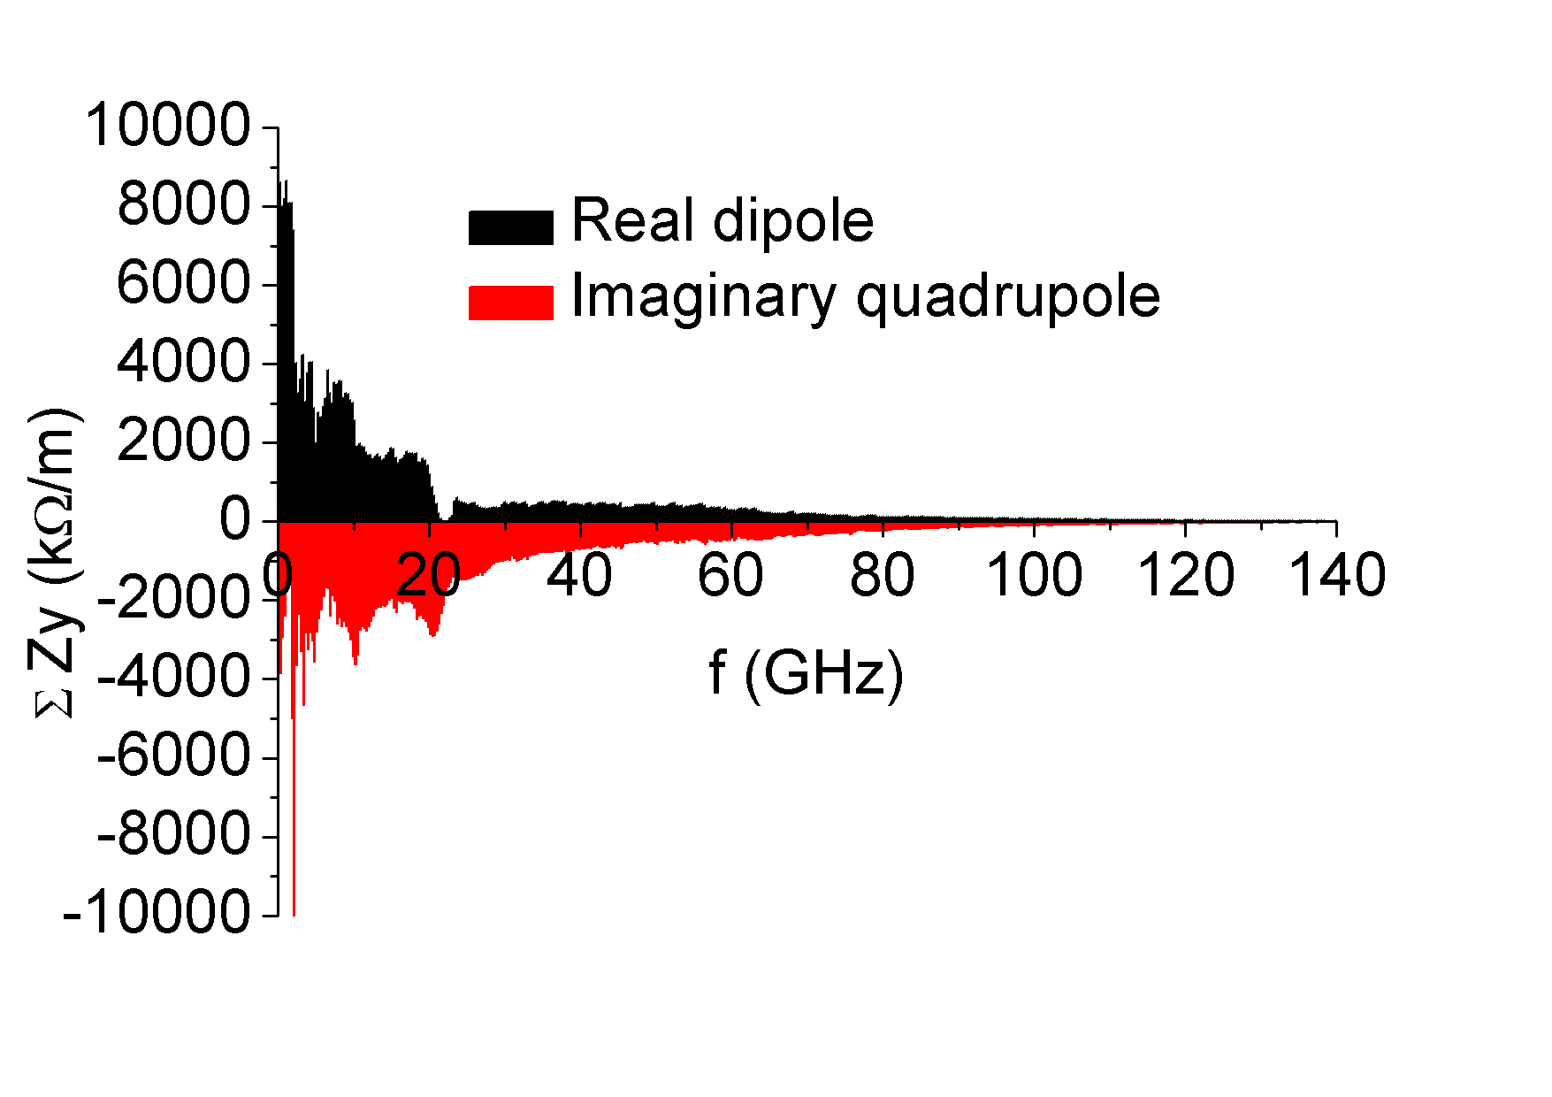
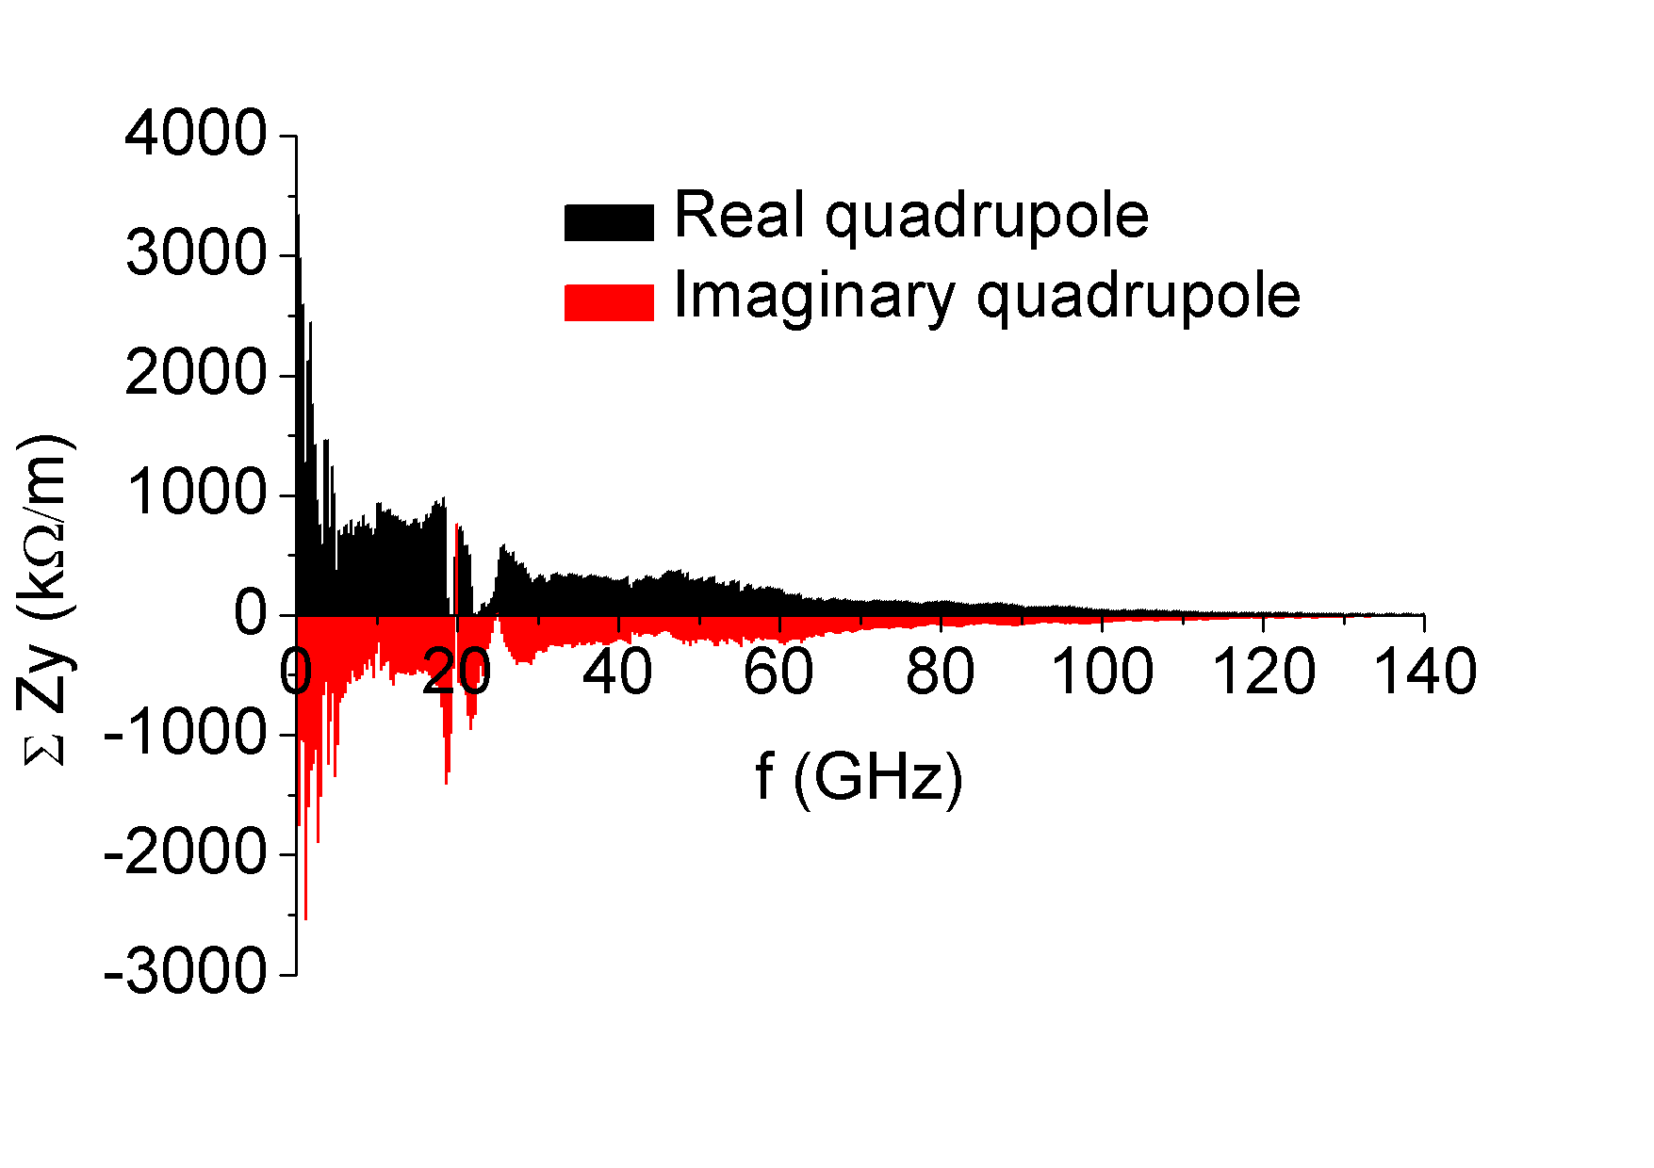
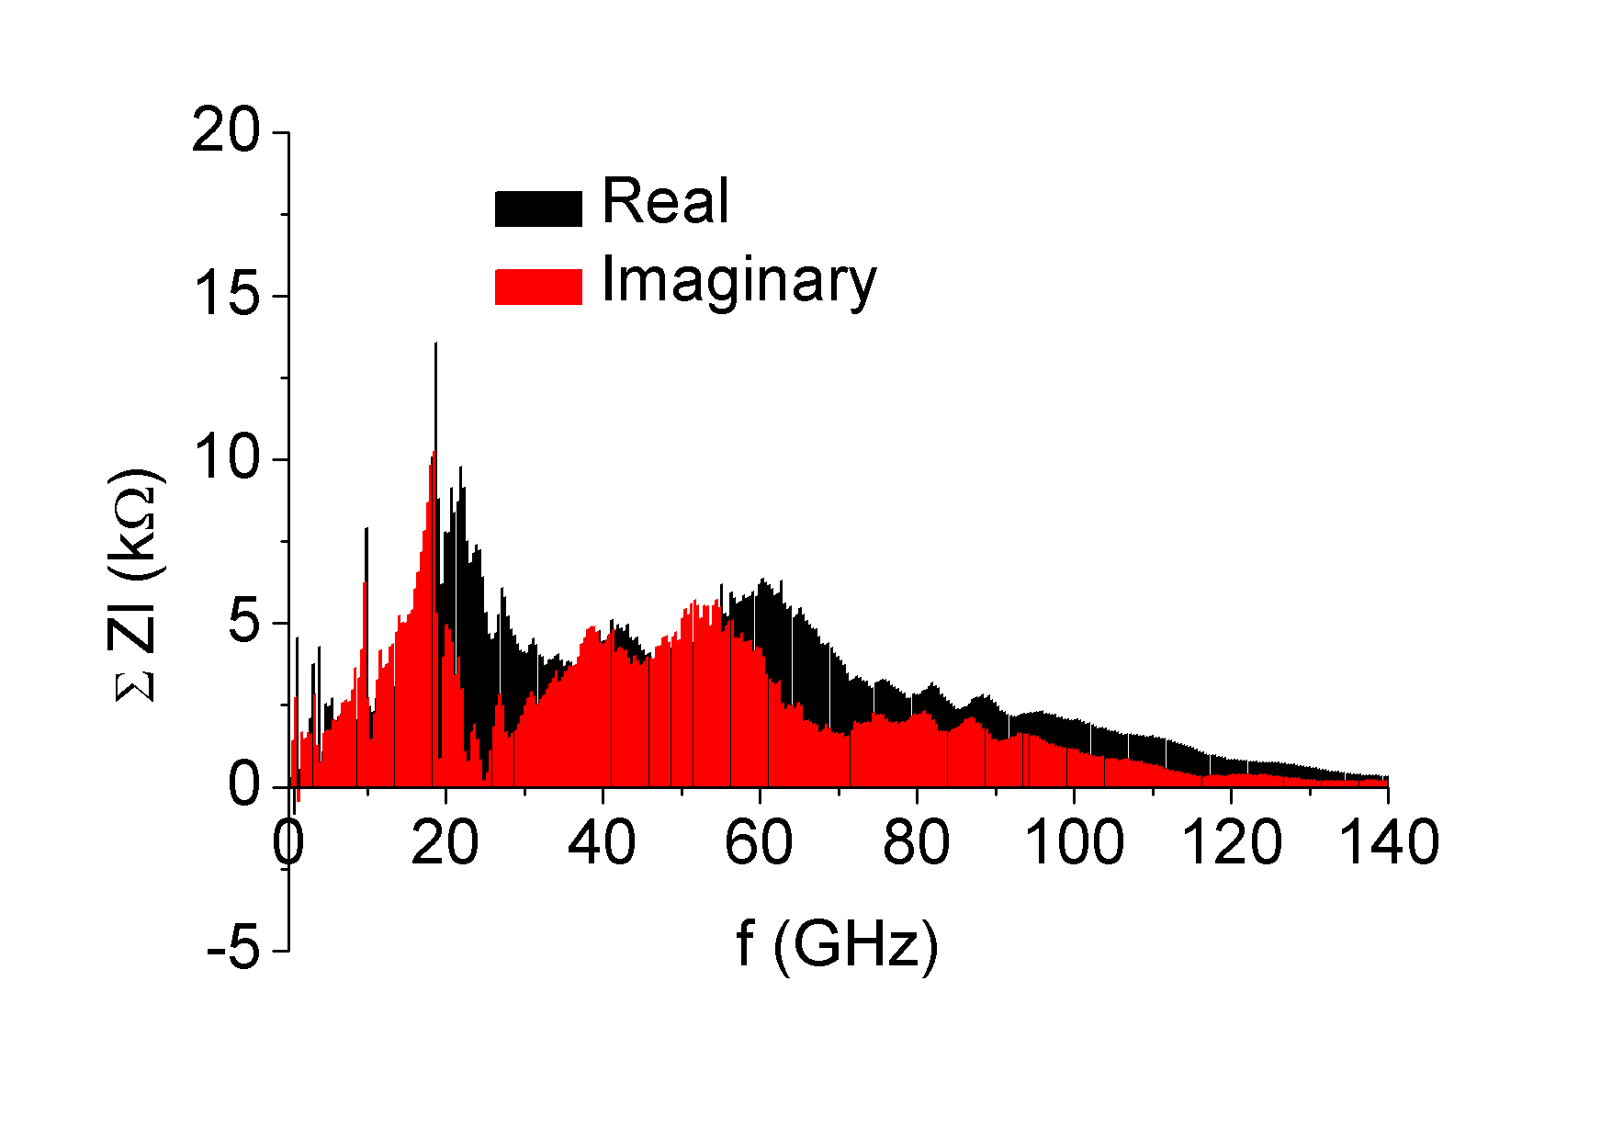
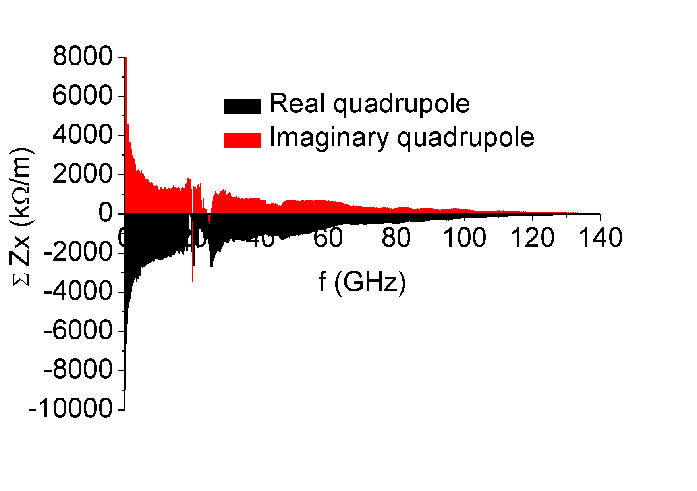
Impedance model
Impedance data in APS - Longitudinal impedance - Transverse impedance (dipole and quadrupole)

Slide 7
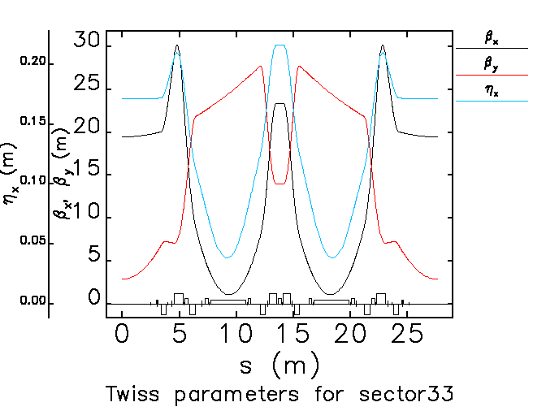
APS parameter & lattice function
APS parameter - Beam energy: 7 GeV, Periods: 40, C: 1104 m, h: 1296, V_{rf,0}: 9.5 MV, emittance: 2.514 nm, Tune: 36.20 / 19.27
Lattice function

Slide 8
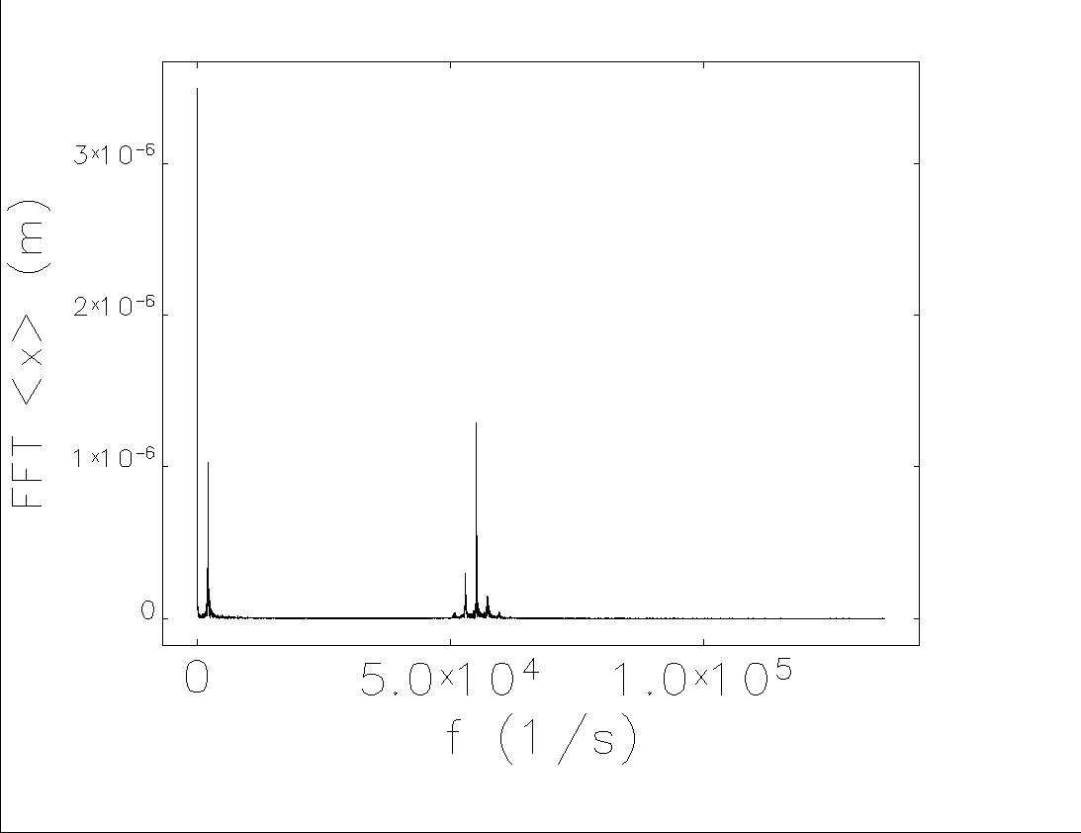
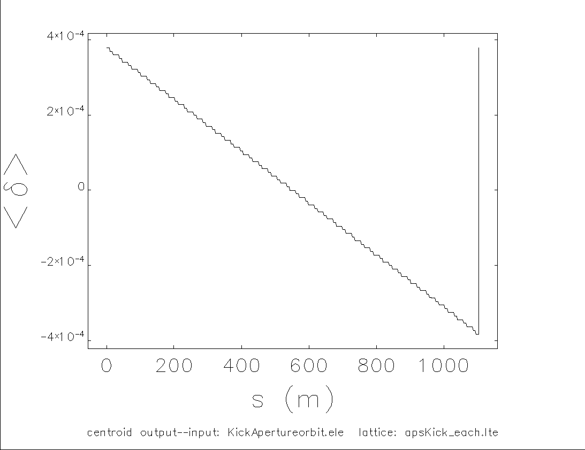
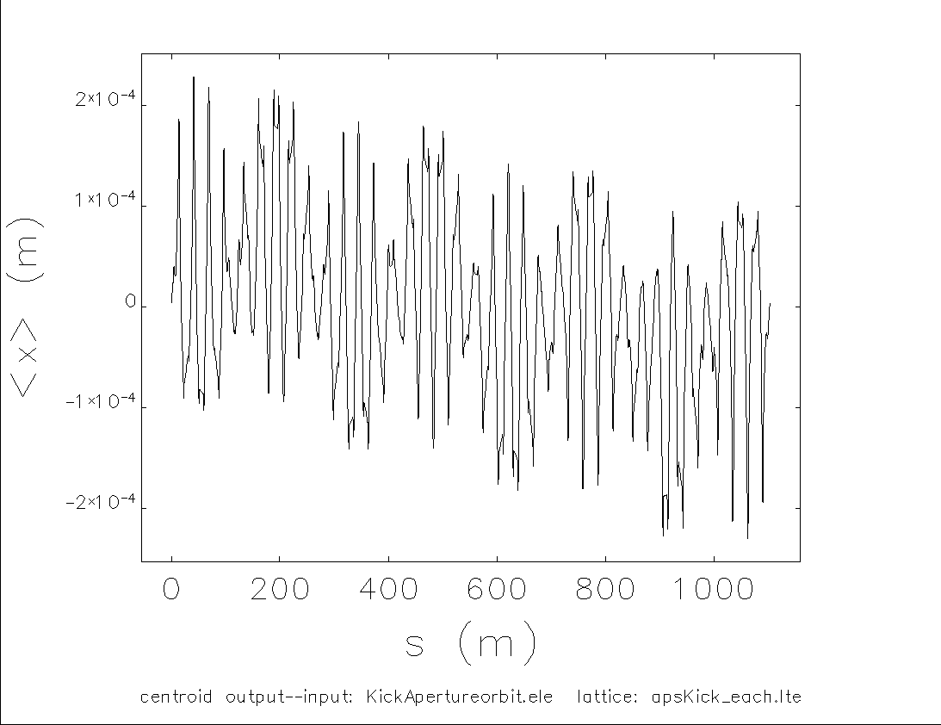
Element by element tracking: Closed orbit
Initial particles (10,000) - generated from Twiss function.
Orbit distortion after 10, 000 turns - RF cavity in finite dispersion function. (less than ~ 200 µm. Dynamic aperture is ~ 10 mm) - A few µm orbit noise with synchro motion and betatron motion.

Slide 9
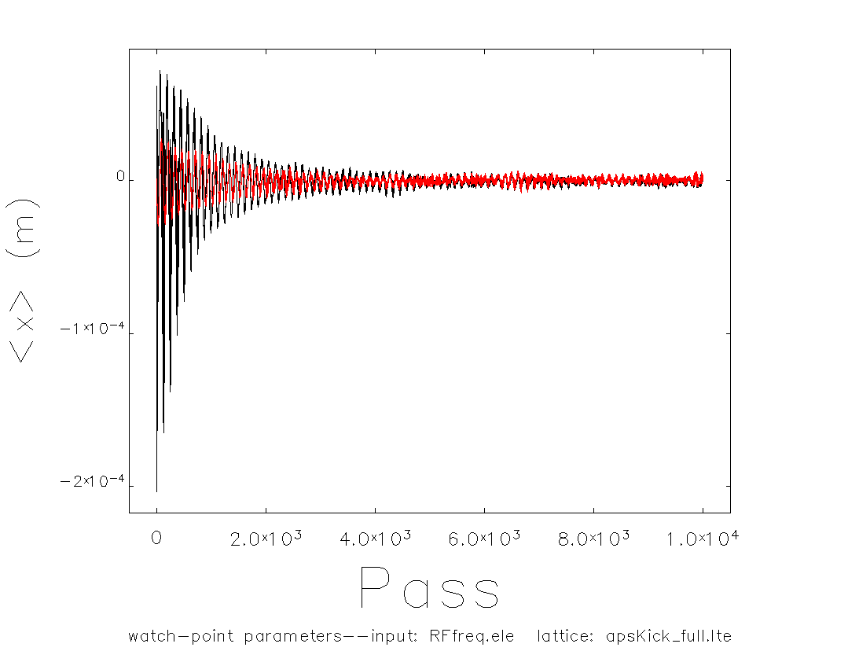
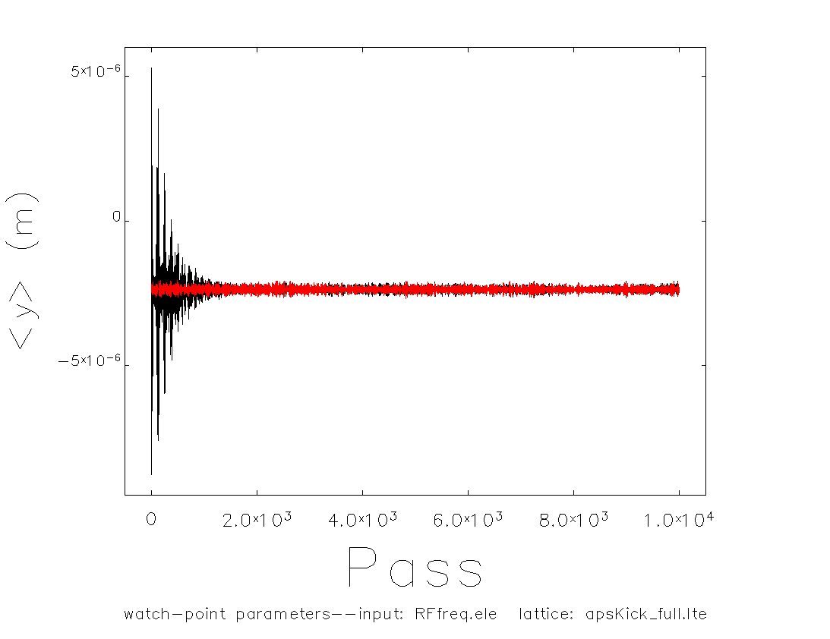
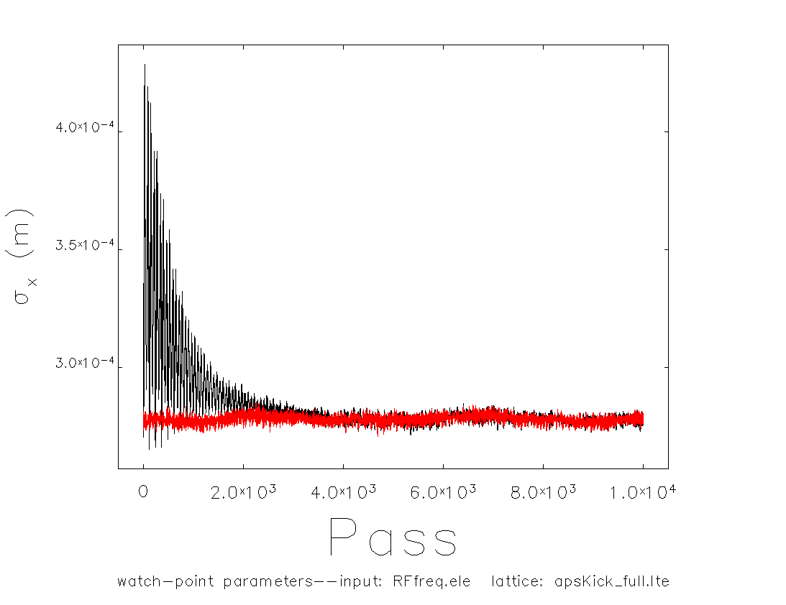
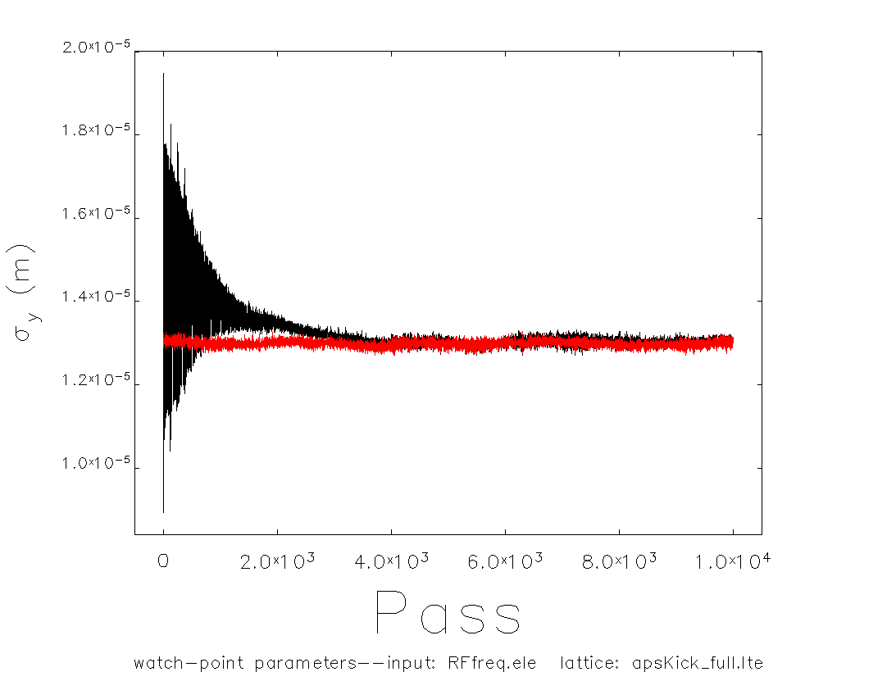
Element by element tracking: Equilibrium beam
Equilibrium beam (10,000 particle) - Initial particles from Twiss function => Equilibrium beam after 10,000 turns

Slide 10
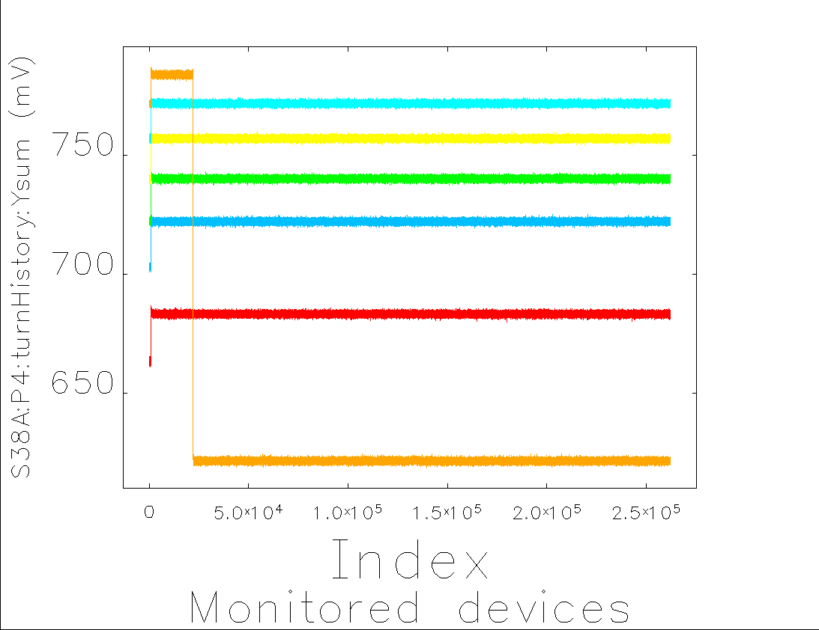
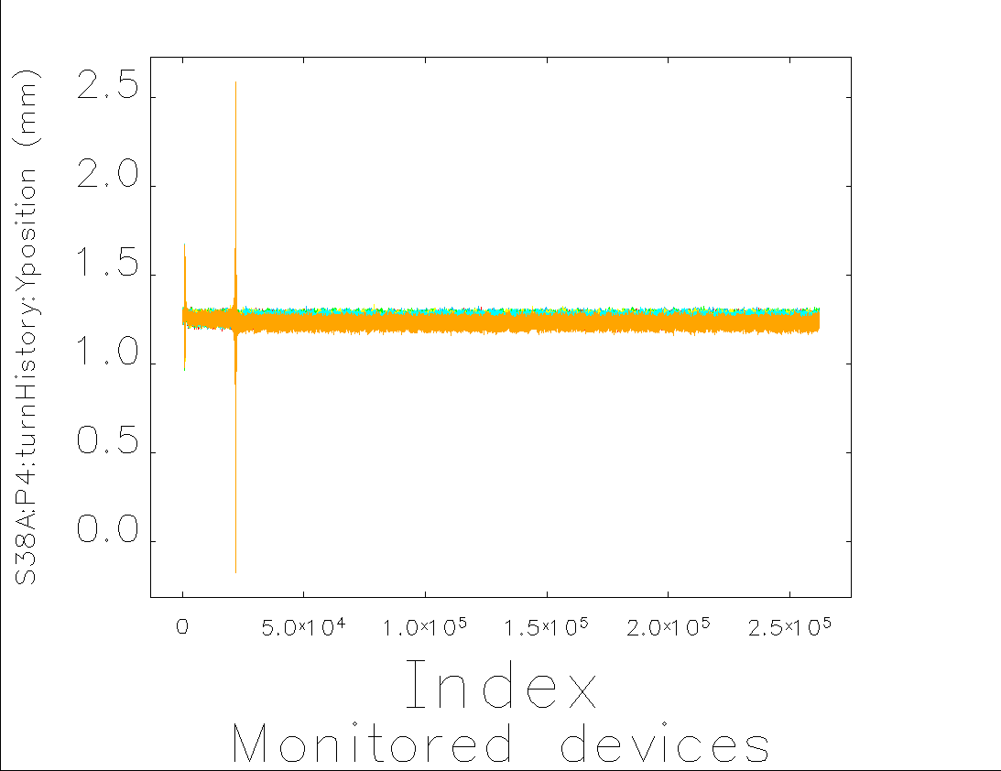
Measurement
1st MS: Kick aperture measurement - 2017. 01. 26. 10:00 pm ~ - Kick aperture measurement at 0.9, 2.3, and 4.1 mA with two turn by turn BPM data - Tune: 0.171 / 0.223, RF voltage: 9.5 MV - Coupling: 1 % - Chromaticity: 6.59 / 5.85
Stable with 5.33 mA => Equilibrium beam is validated up to 5.33 mA

Slide 11
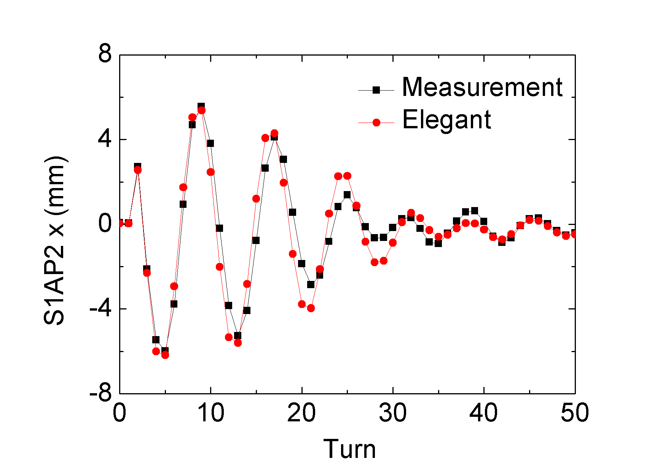
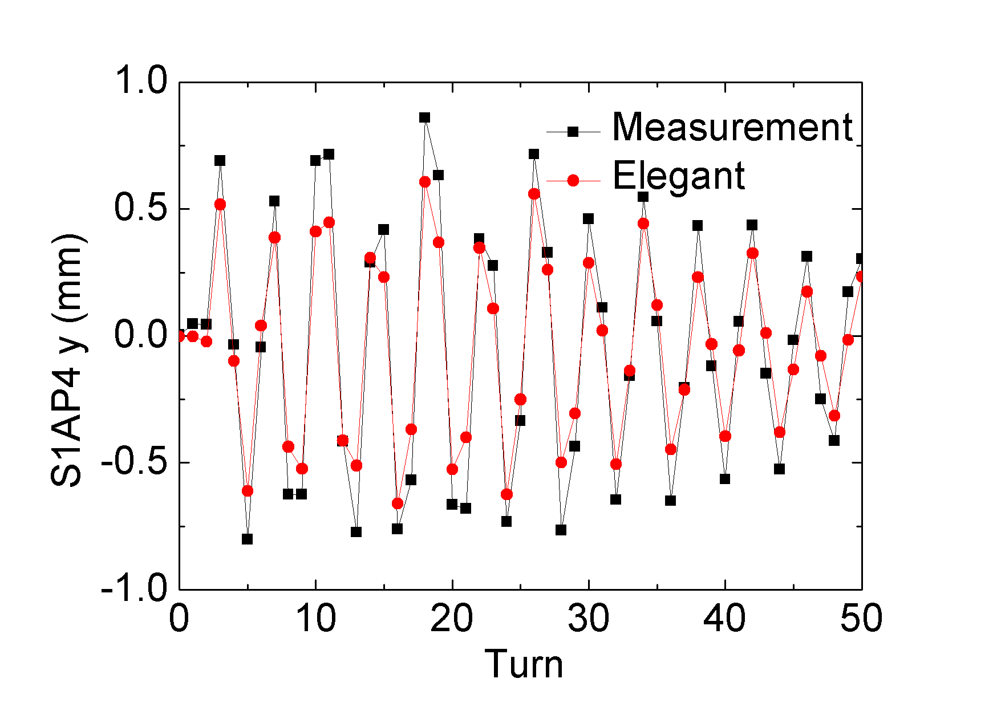
Orbit comparison and tune correction
Horizontal orbit: decoherence - Energy spread beam - High chromaticity
Vertical orbit: coupling
Tune correction by comparison

Slide 12
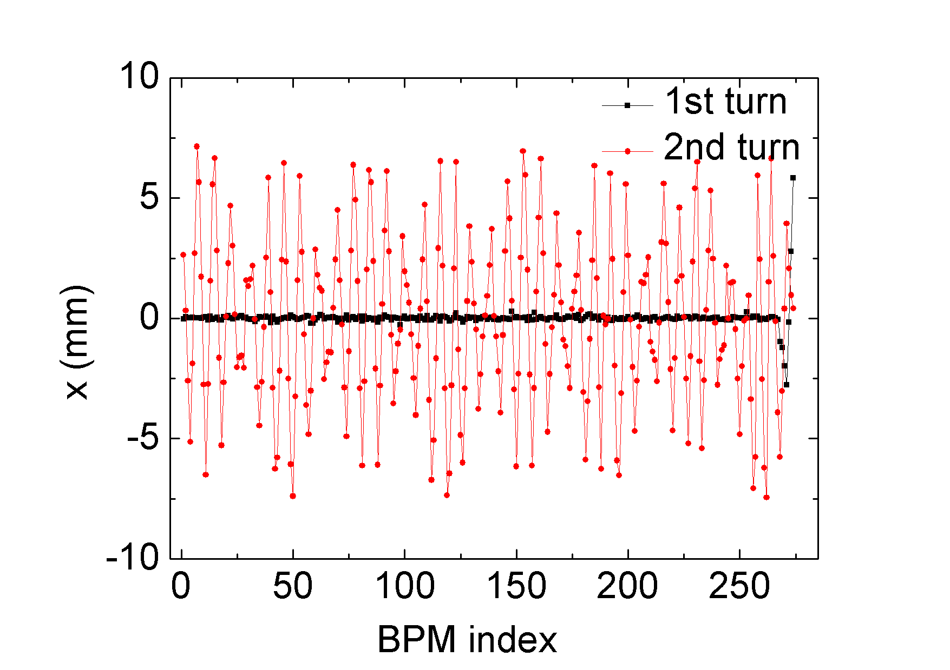
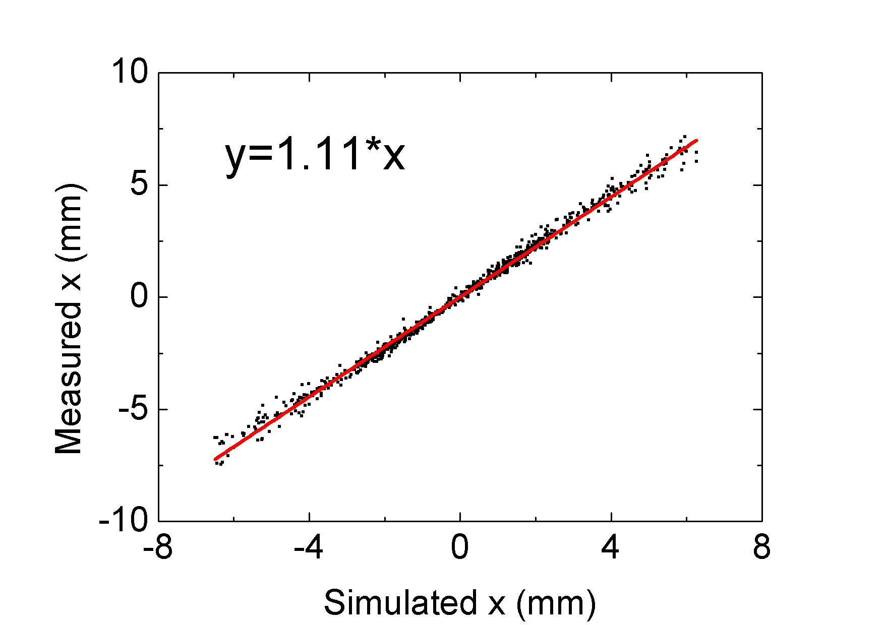
Calibration of kick
Calibration condition - 2nd turn data, All BPMs, three kicks (2,2.5 and 3 kV) - Error can be averaged out.
Calibration factor: 1kV = 0.111 mrad

Slide 13
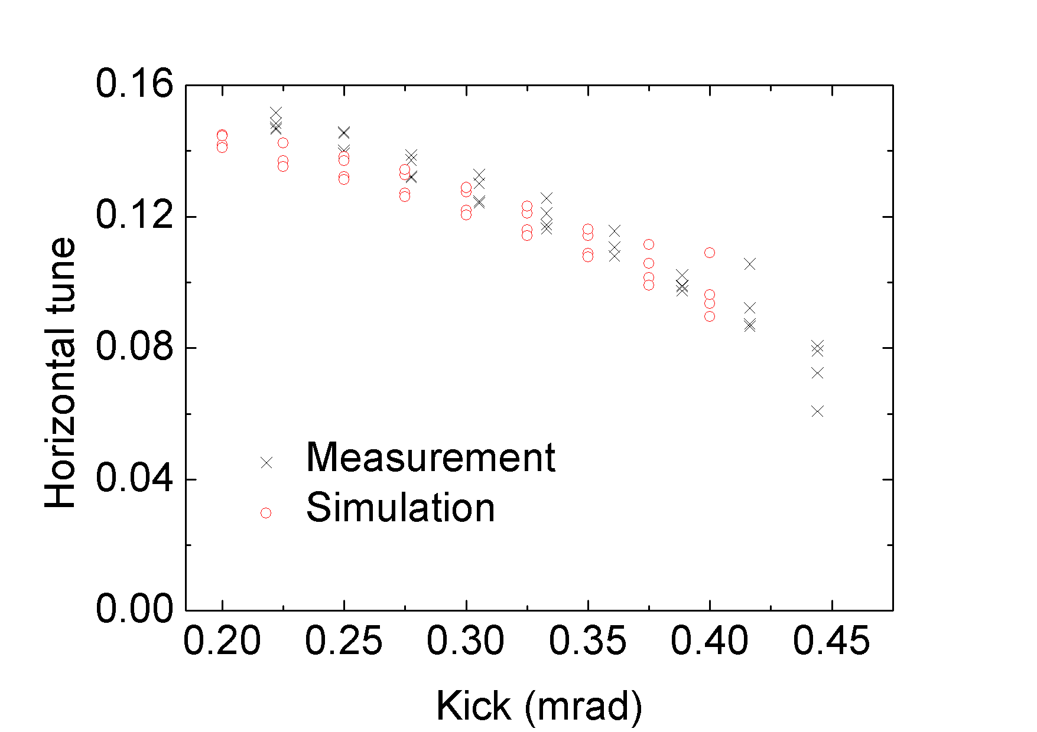
Amplitude dependent tune shift
Horizontal tune - Not easy to measure due to decoherence - 5 zero crossing data are used to 4 tune data for each kick
Vertical tune - Only small amplitude due (horizontal kick) and not distinguishable

Slide 14
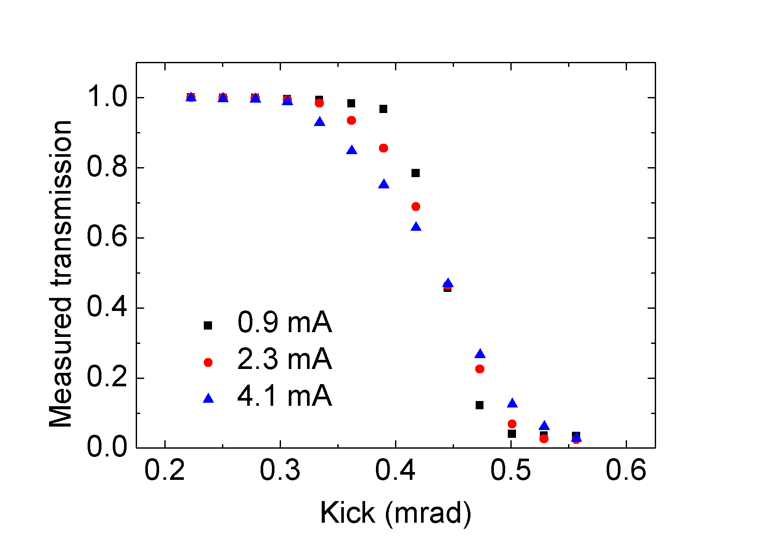
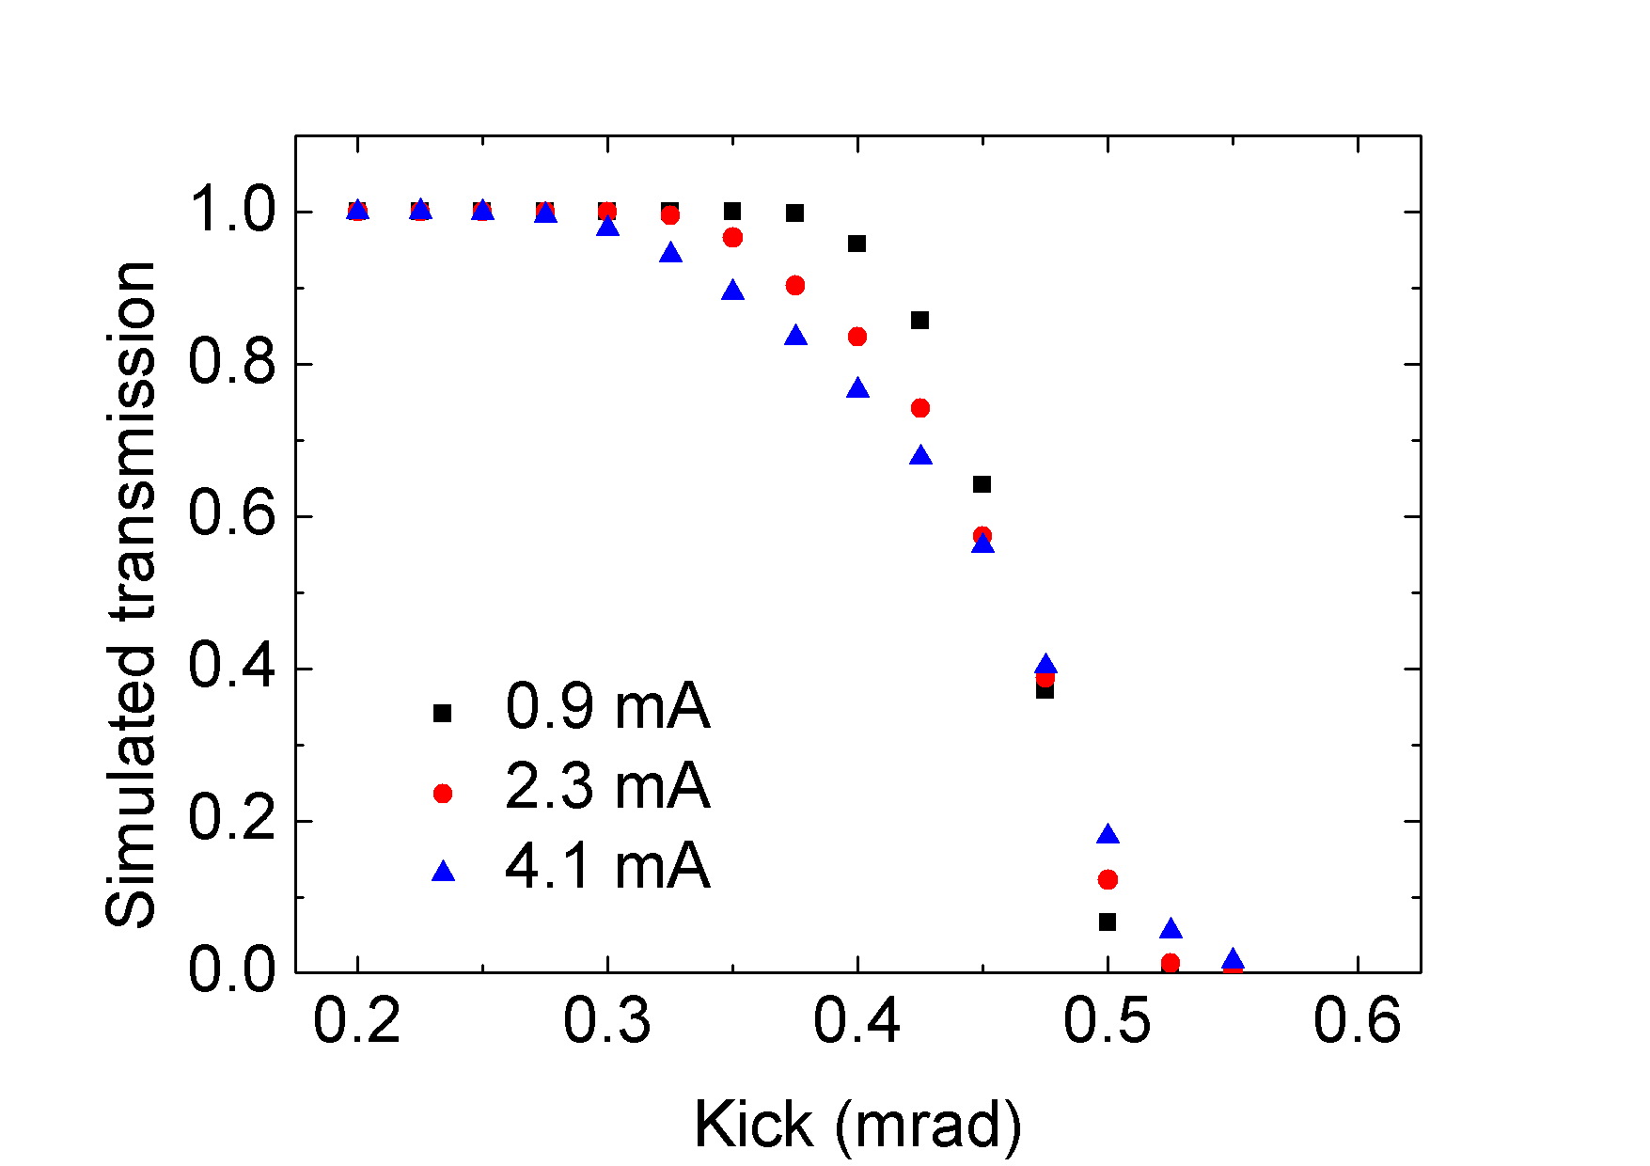
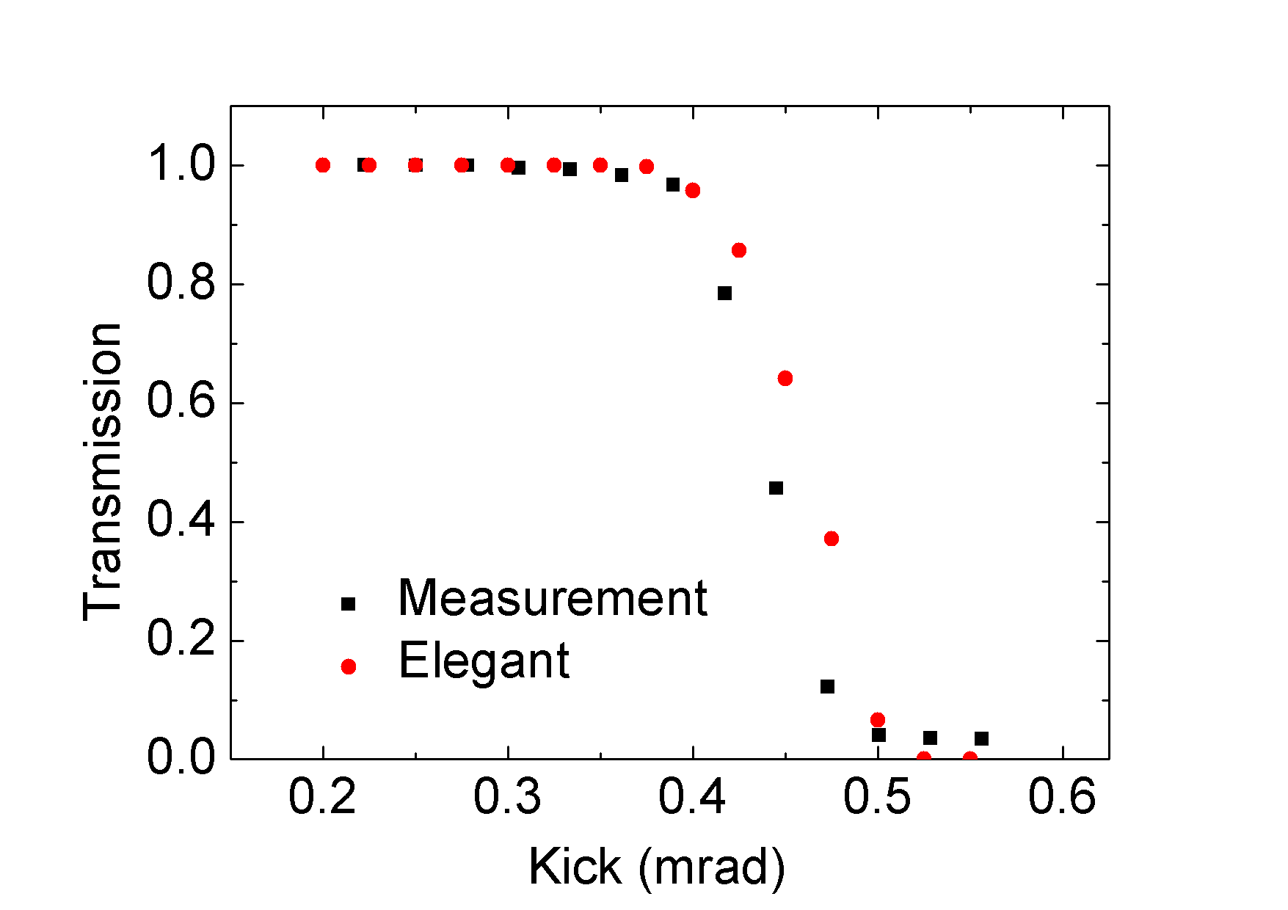
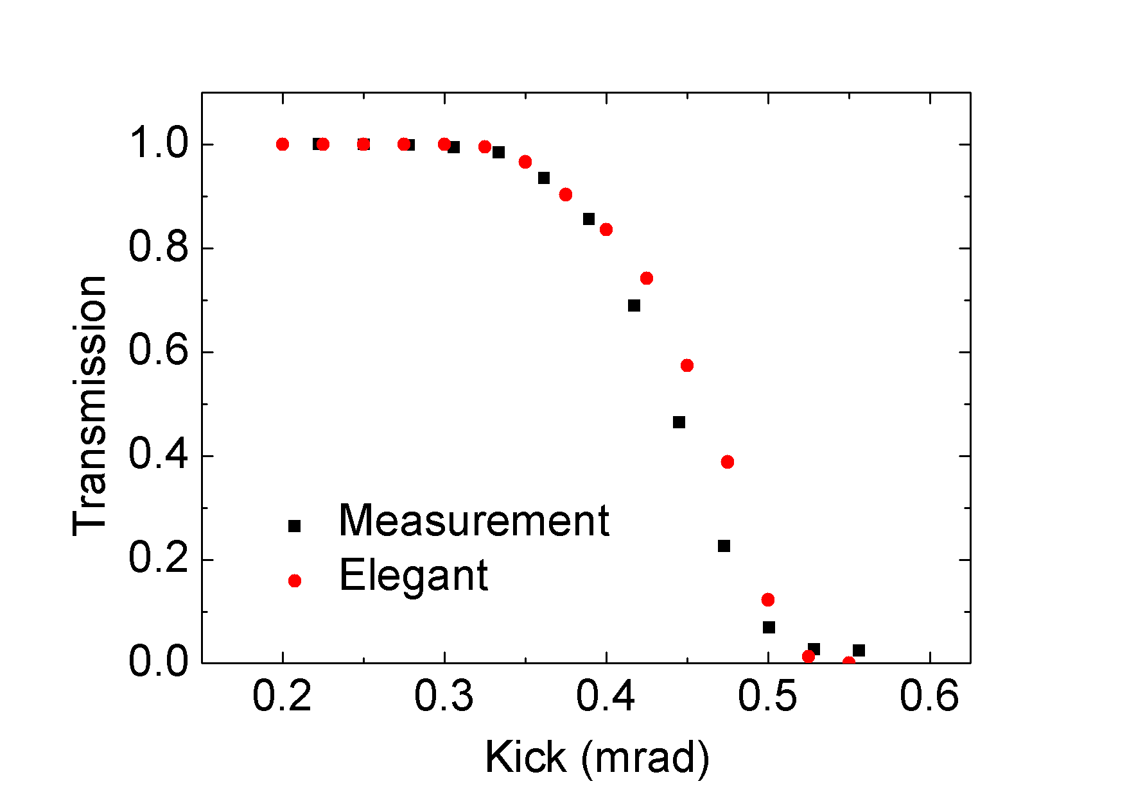
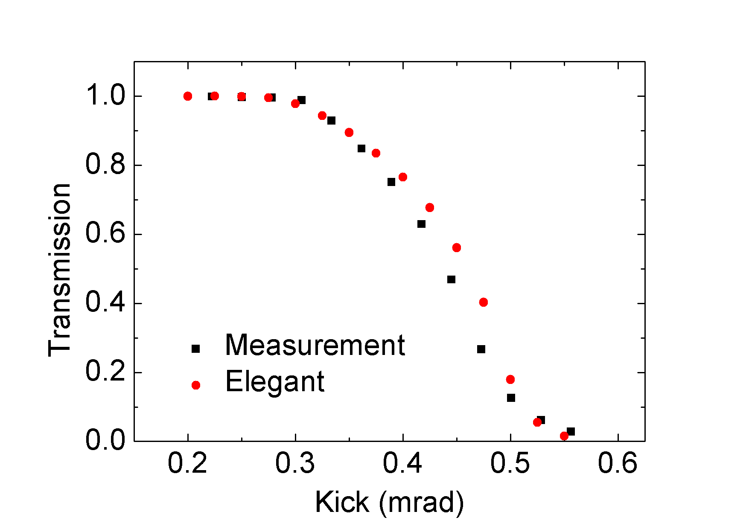
Kick aperture
Kick aperture - Beam loss measurement for different kick and current
All current crossing same point

Slide 15
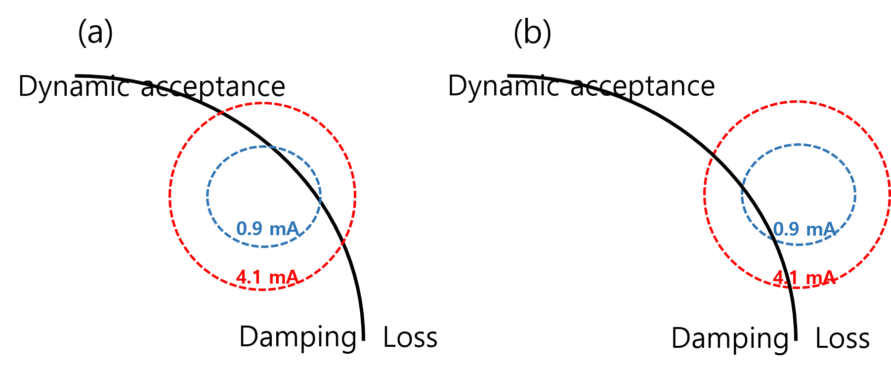
Beam loss analysis
Explanation - Why higher charge more loss at (a) - Why higher charge less loss at (b)
(a)
(b)

Slide 16
Head-tail instability: why emittance increase?
2 particle model - Chromaticity > 0 (left figure) => Relative oscillation => Projection emittance increase - Chromaticity < 0 (right figure) => Center of motion oscillation
T. Nakamura (Spring-8) simulation

Slide 17
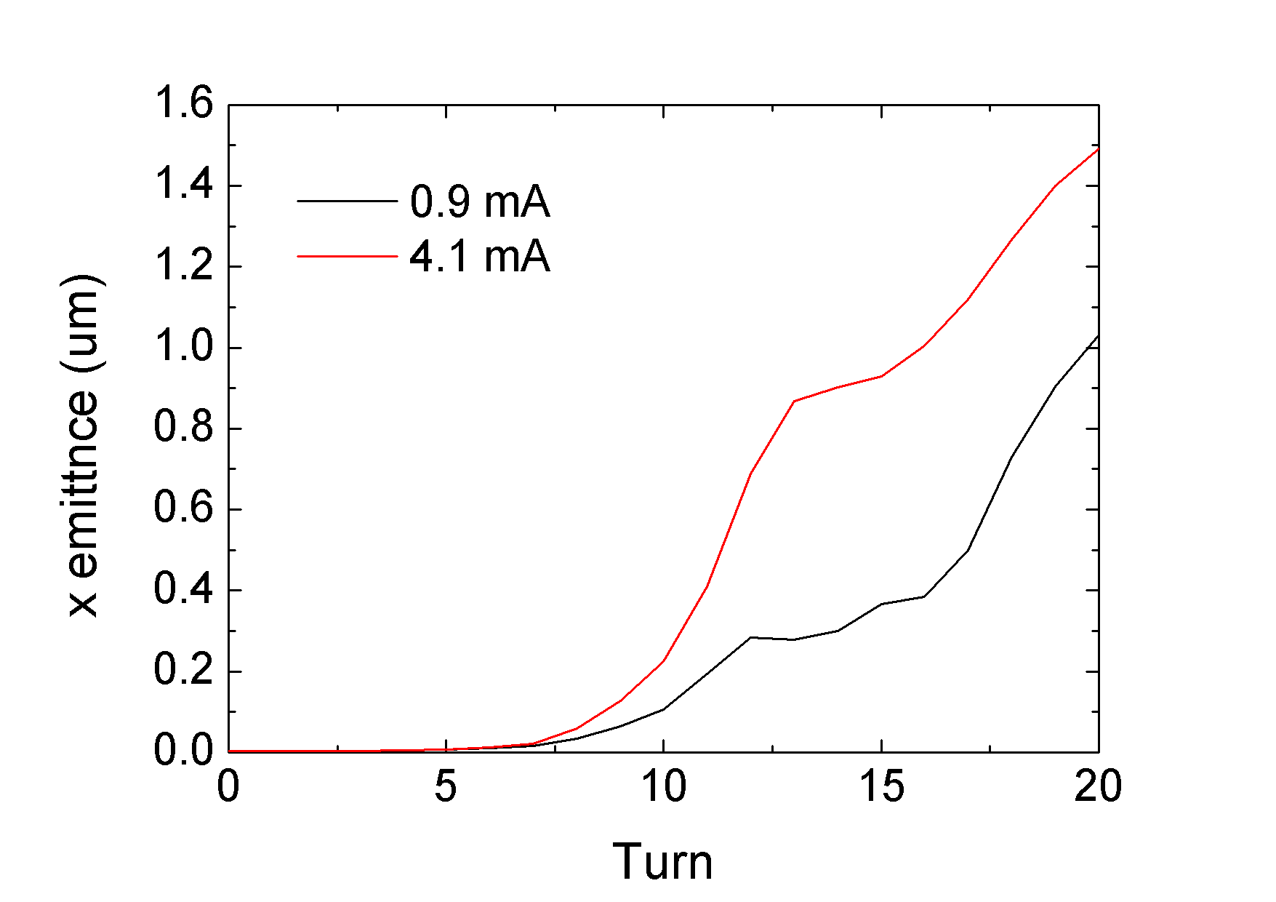
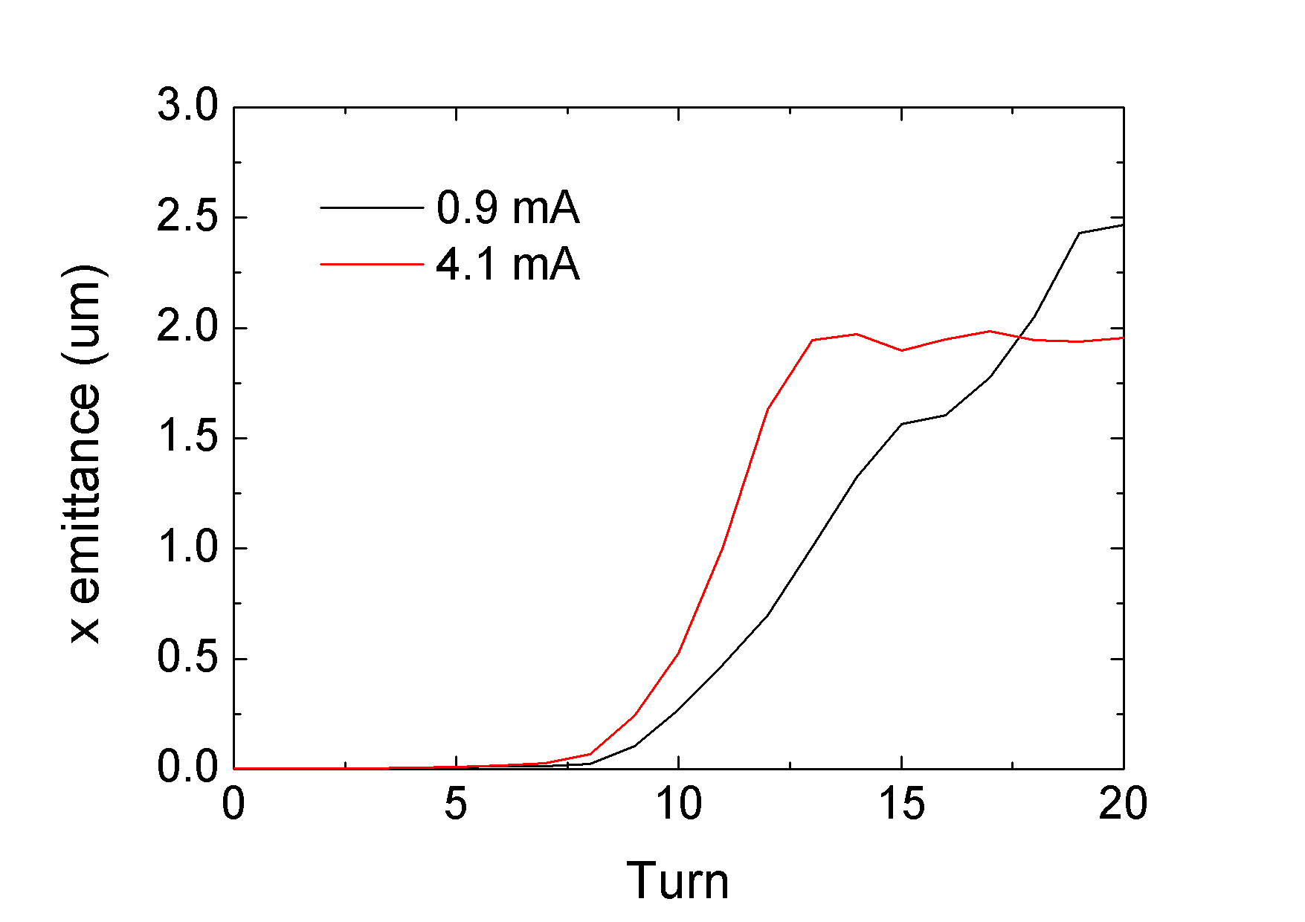
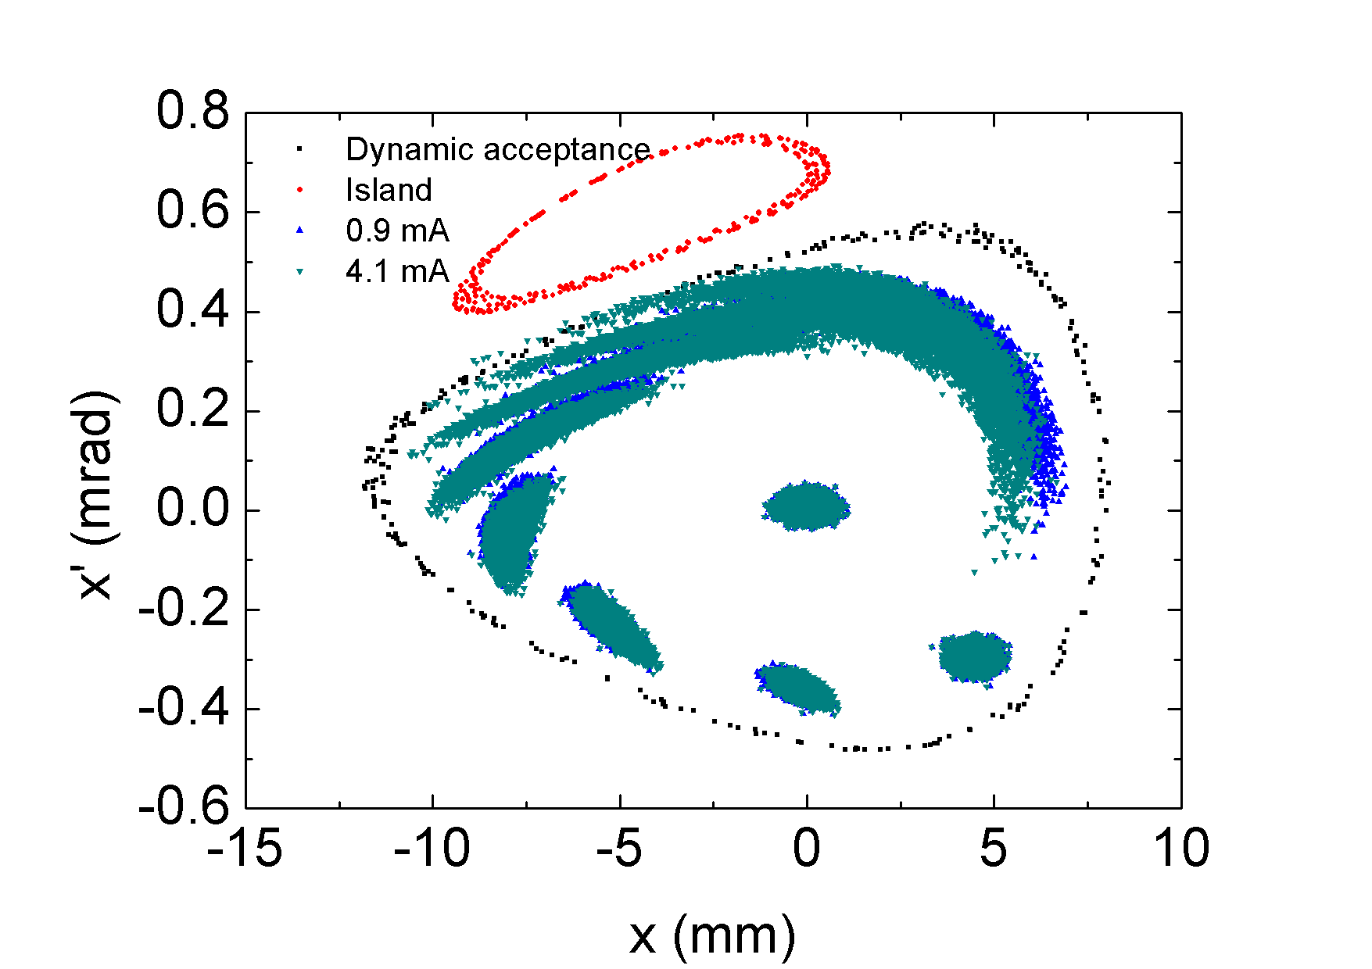
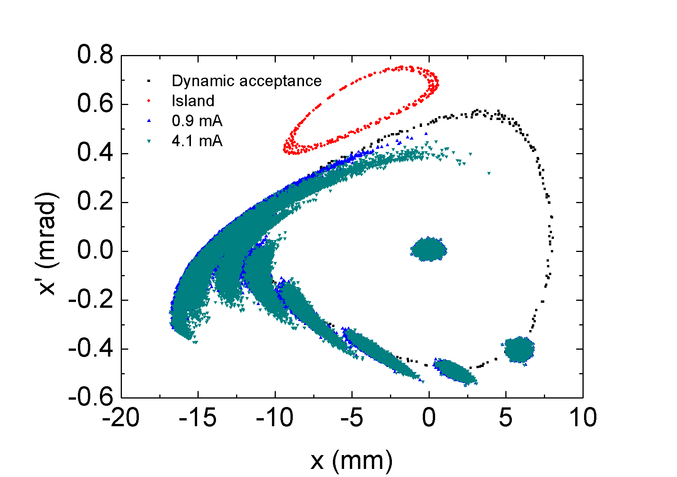
Beam loss analysis
(a)
Explanation - Why higher charge more loss at (a) - Why higher charge less loss at (b)
(b)
(a)
(b)

Slide 18
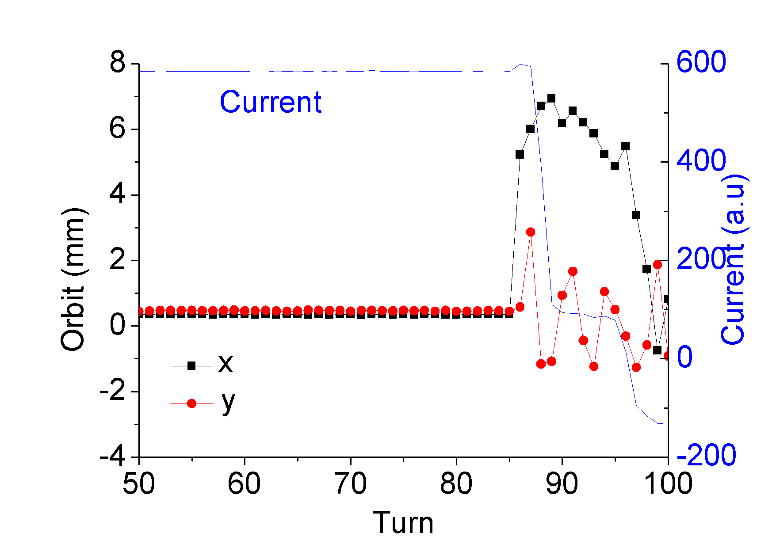
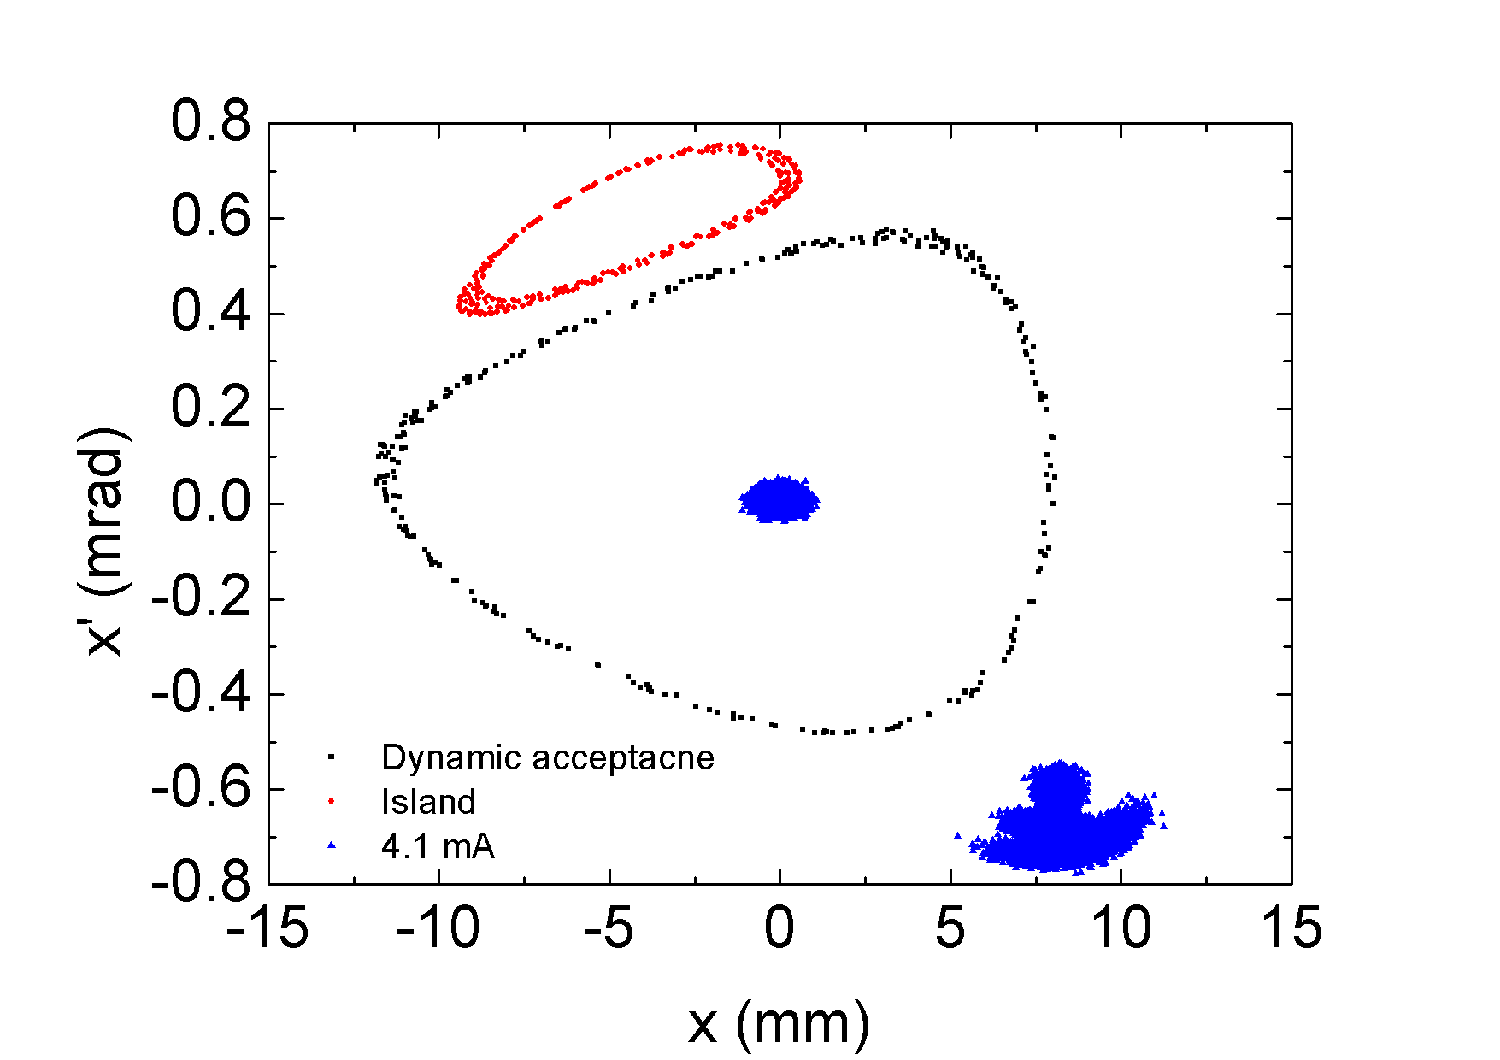
Beam loss at higher kick
Beam loss at higher kick - Close integer tune due to amplitude dependent tune shift. - Horizontal centrode motion stay temporally around 7 mm. - Large vertical betatron oscillation causes first beam loss.

Slide 19
Summary
The simulation for collective effect on dynamic aperture is very important issue for USR.
Thorough benchmark study is necessary and have been performing at APS.
The result of current dependent kick aperture between elegant simulation and measurement show good agreement within 5 %.
Based on the good agreement, reasonable explanation for measurement data was described by the help of elegant simulation.
Short bunch (1 mm) for calculating impedance is essential.
Element by element particle tracking with distributed impedance is desirable for a certain condition. (closed on integer tune, etc.)

