Slide 1
Introduction of THU CMS group
Wang Yi
Department of Engineering Physics
Tsinghua University
BUAA-PKU-THU-ULB Mini-workshop
2017.6.8

Slide 2
Introduction of Department of Engineering Physics, Tsinghua University
Established on 1956, 120 faculties, about 600 undergraduate students and 600 master and Ph.D students
Research area: Nuclear technology
Medical Physics
Nuclear and Particle physics
Astrophysics
Plasma physics
Safety science and engineering

Slide 3
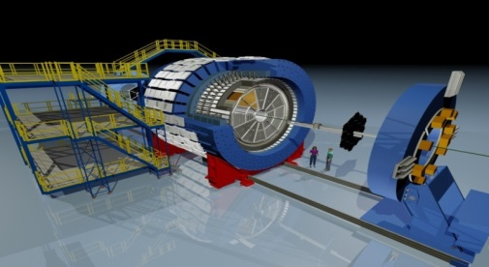
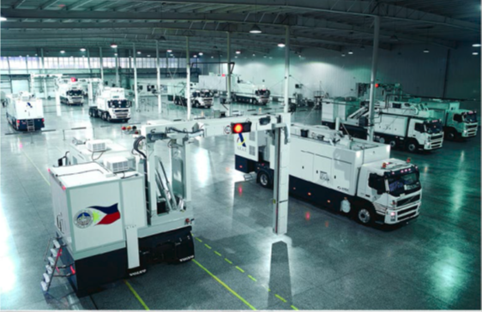
Research on nuclear technology
Center of High energy physics
Center of Astrophysics physics
  FAIR-CBM
  RHIC-STAR
  CMS
  LHCb
  Super-Kamiokande
  BES III
  DayaBay and JUNO
Radiation imaging and safety inspection
Accelerator
Detector
Radiation protection
NUCTECH

Slide 4
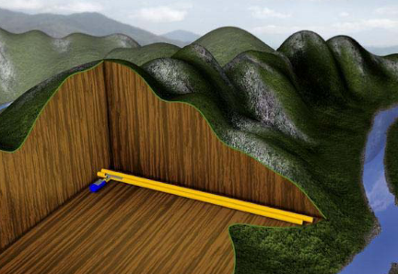
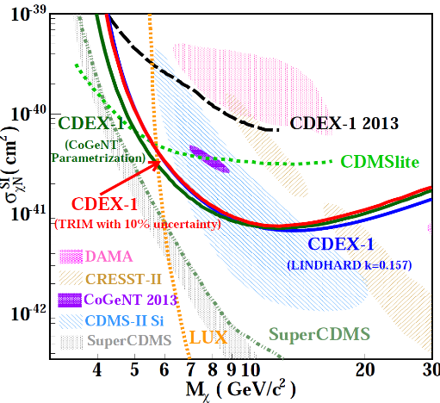
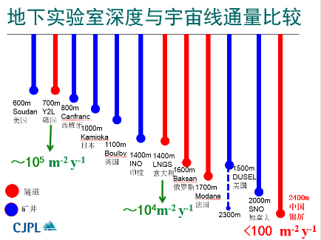
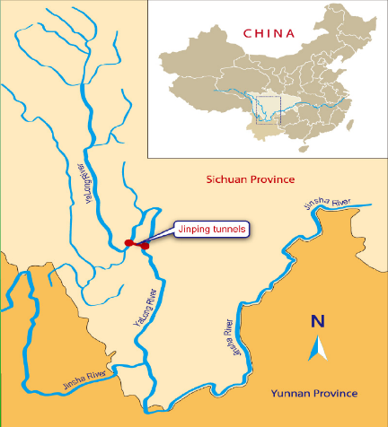
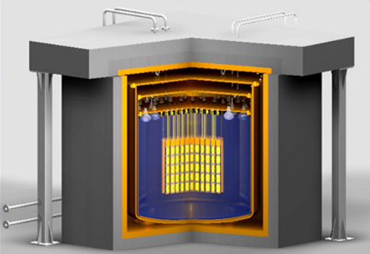
Dark matter direct detection
2014,2015年CDEX合作组在Physical Review D发表最新成果，获得了点电极高纯锗探测器在10GeV以下能区最灵敏的暗物质实验结果，排除了美国CoGeNT实验组几年前给出的暗物质存在区域。

Slide 5
Activity in nuclear physics experiments
Hadron physics
R&D and production of MRPC
Low resistive glass and high rate MRPC
R&D and production of ECAL
International collaboration:
RHIC-STAR
FAIR-CBM
CMS
Jlab-SoLID
NICA-MPD

Slide 6
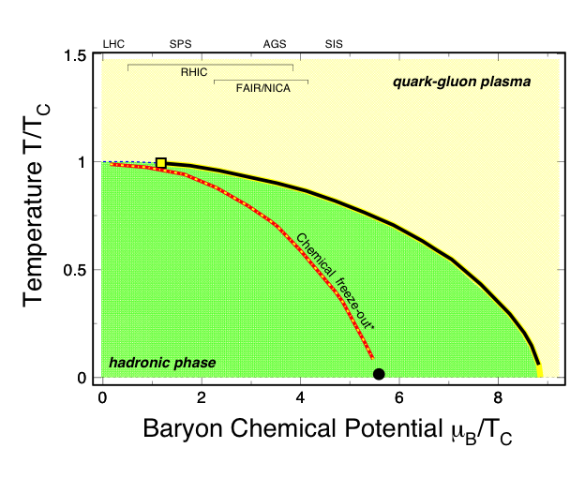
High-Energy Nuclear Collisions and QCD Phase Diagram
1
T_{ini}, T_{C}
LHC, RHIC
2
T_{E}RHIC,
SPS, FAIR
3
Phase boundary
RHIC,FAIR, NICA, CSR
1
2
3

Slide 7
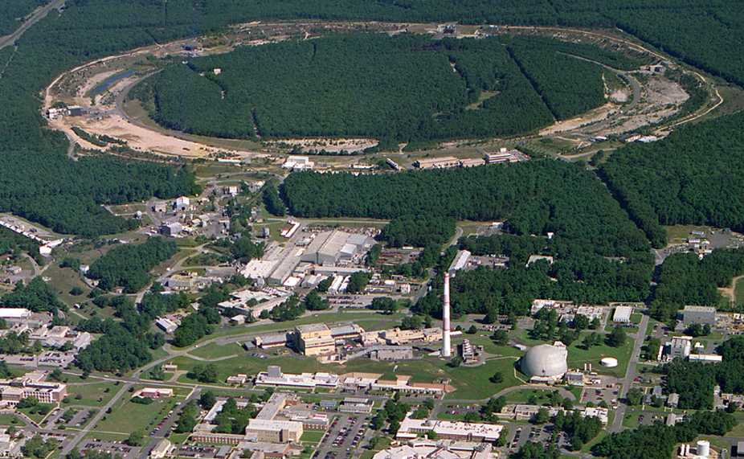
RHIC-STAR @BNL
1 km
PHOBOS
BRAHMS
RHIC
PHENIX
STAR
AGS
TANDEMS

Slide 8

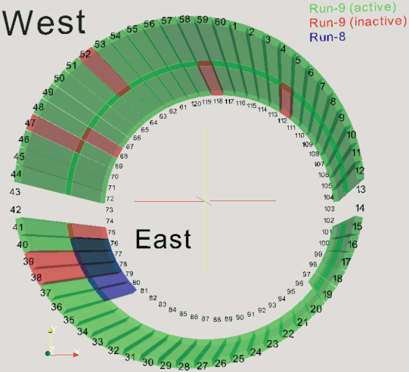
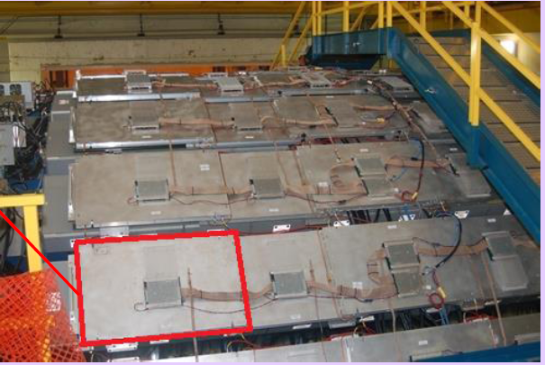
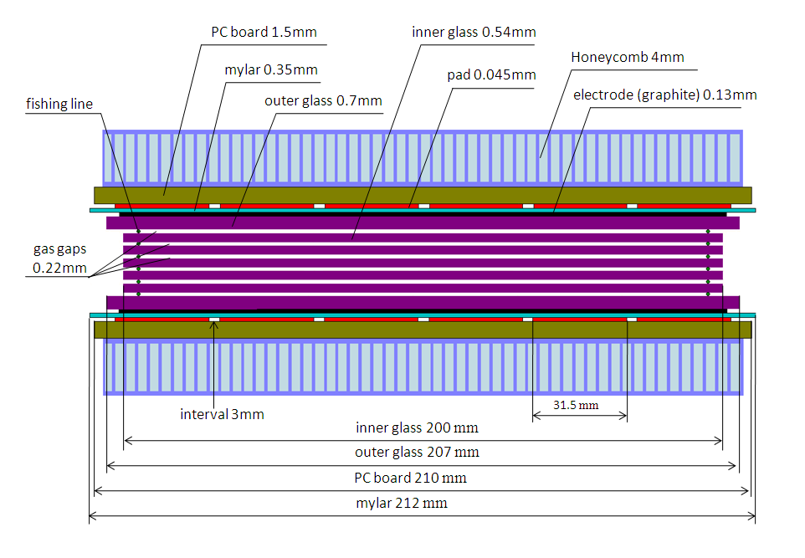
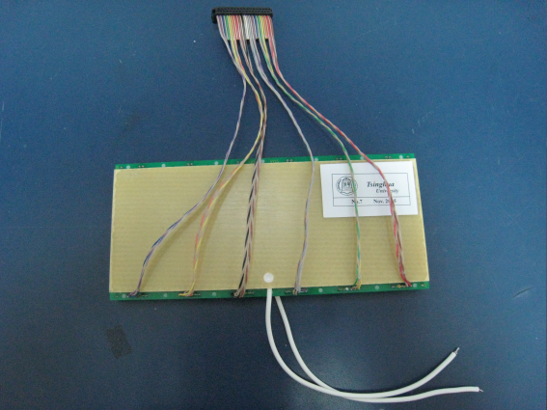
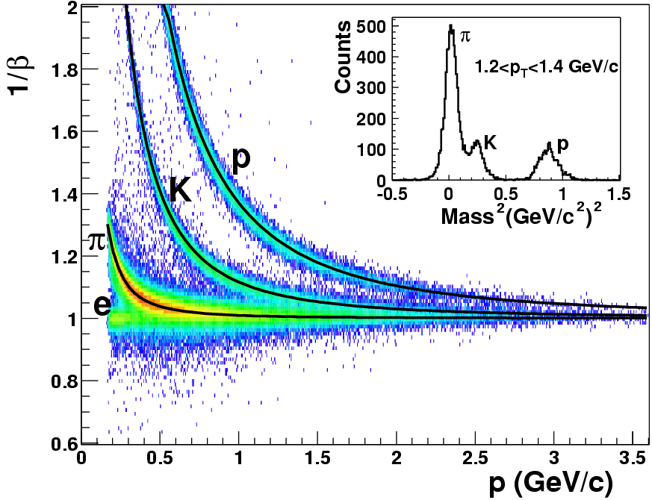
STAR TOF and MTD
MTD
TOF
Construction of RHIC-STAR TOF system and muon telescope detector (MTD).

Slide 9
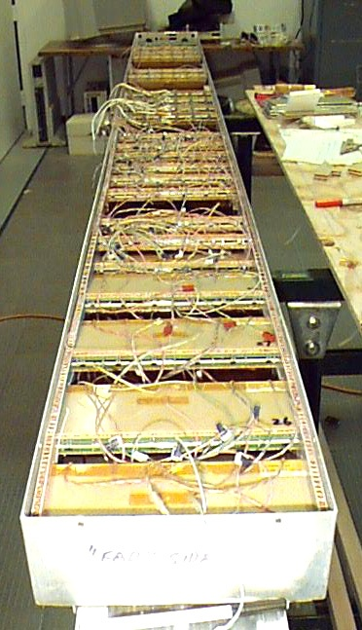

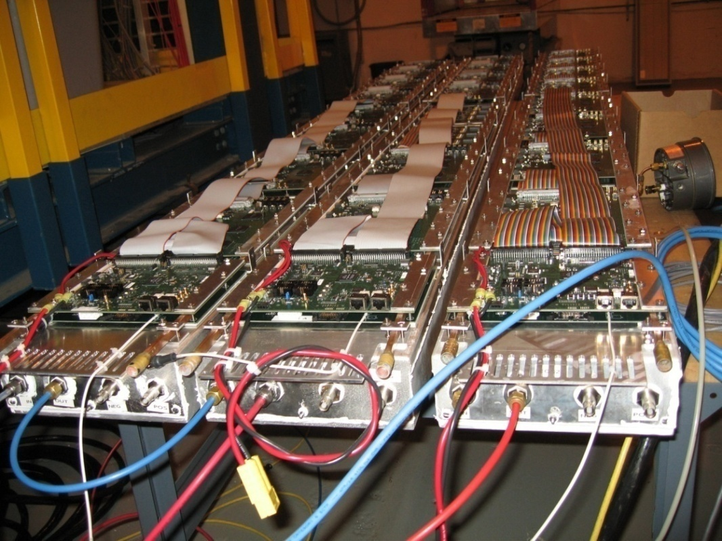
MRPC used in STAR barrel TOF
Long side view
9

Slide 10


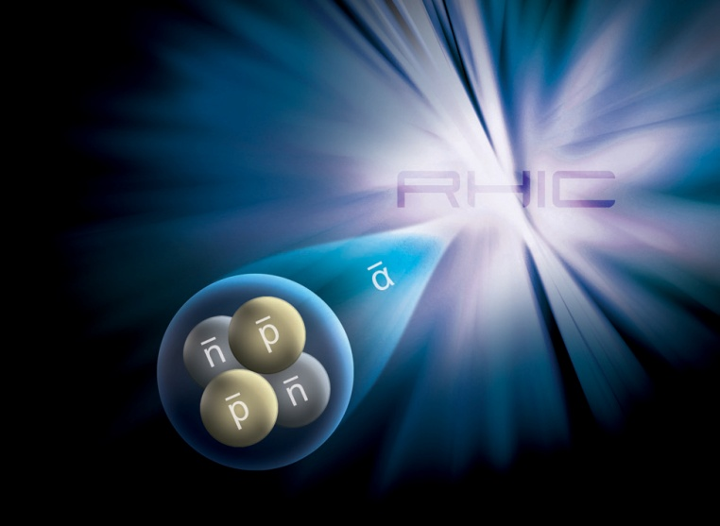
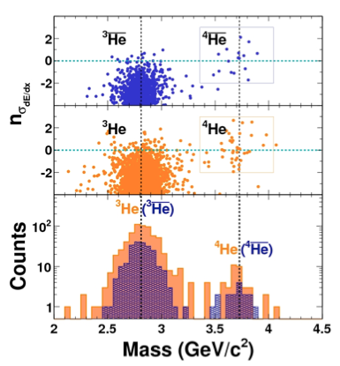
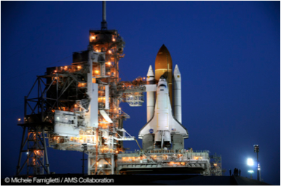
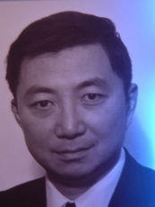
Observation of Anti-Helium
Nature 473 (2011) 353
Mass ID with TOF

Slide 13
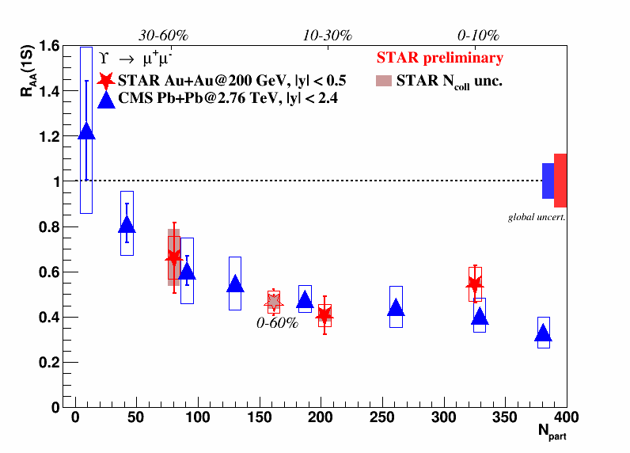
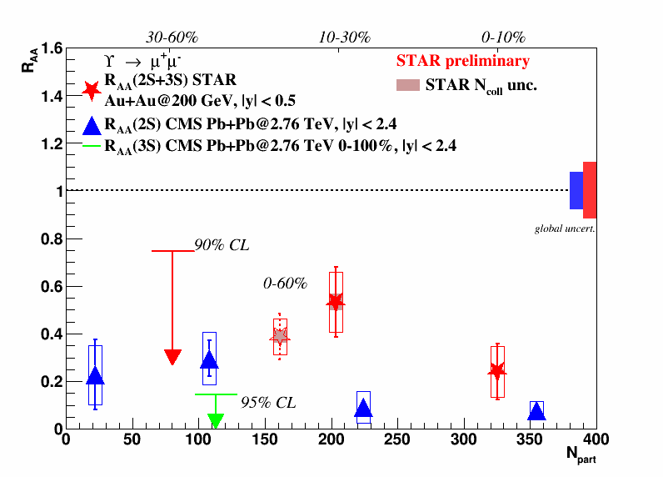
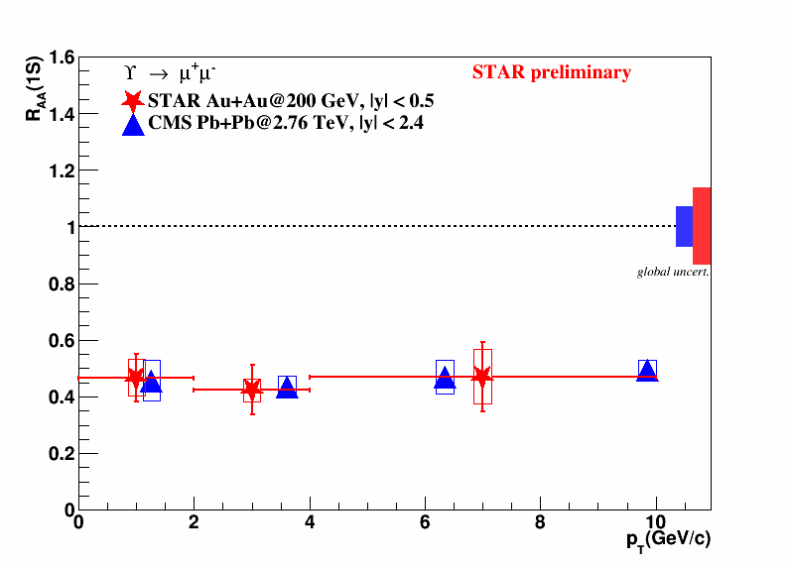
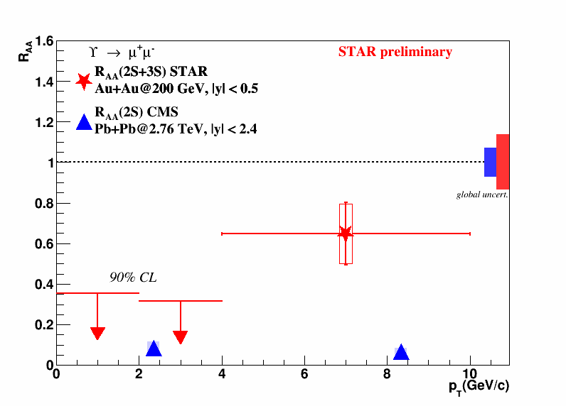
R_{AA} obtained with STAR-MTD
13

Slide 14
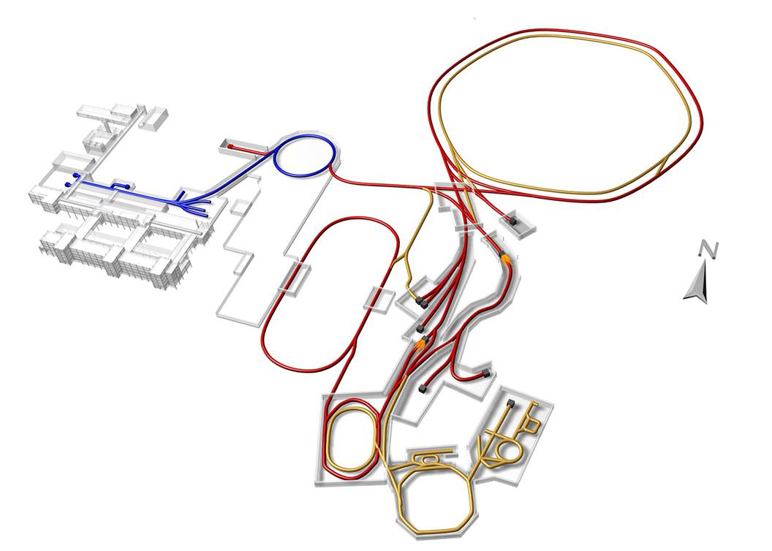
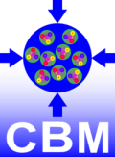
FAIR @GSI
SIS18
SIS100/300
p-Linac
Atomic, Plasma, Applied Physics
Compressed Baryonic Matter
HESR
Anti-Proton Physics
Super Fragment-Separator:
Nuclear Structure and Astrophysics
CR
FAIR phase 1
FAIR phase 2
100 m

Slide 15
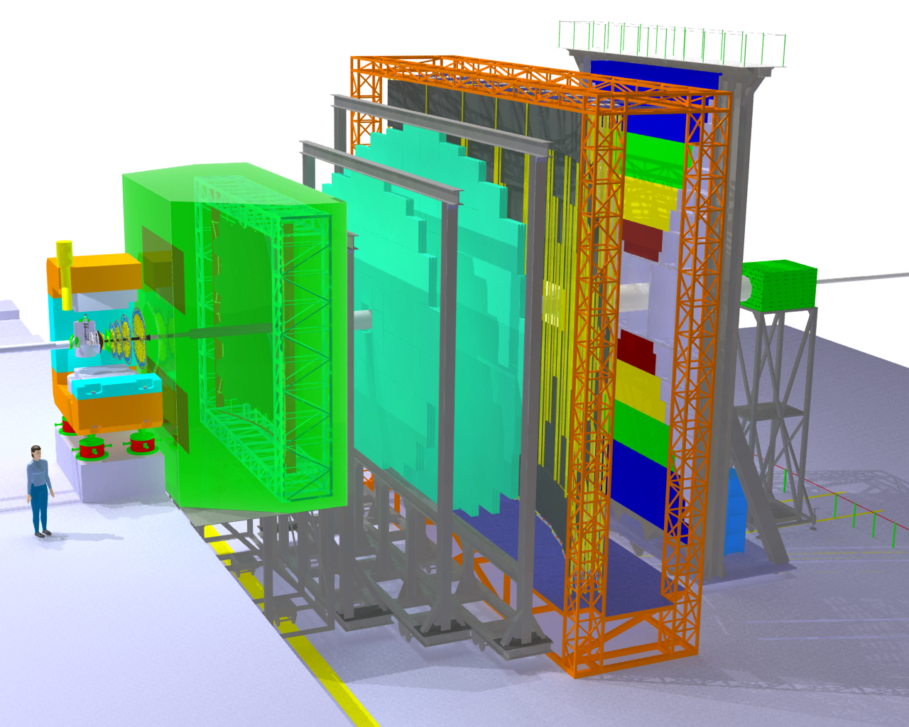
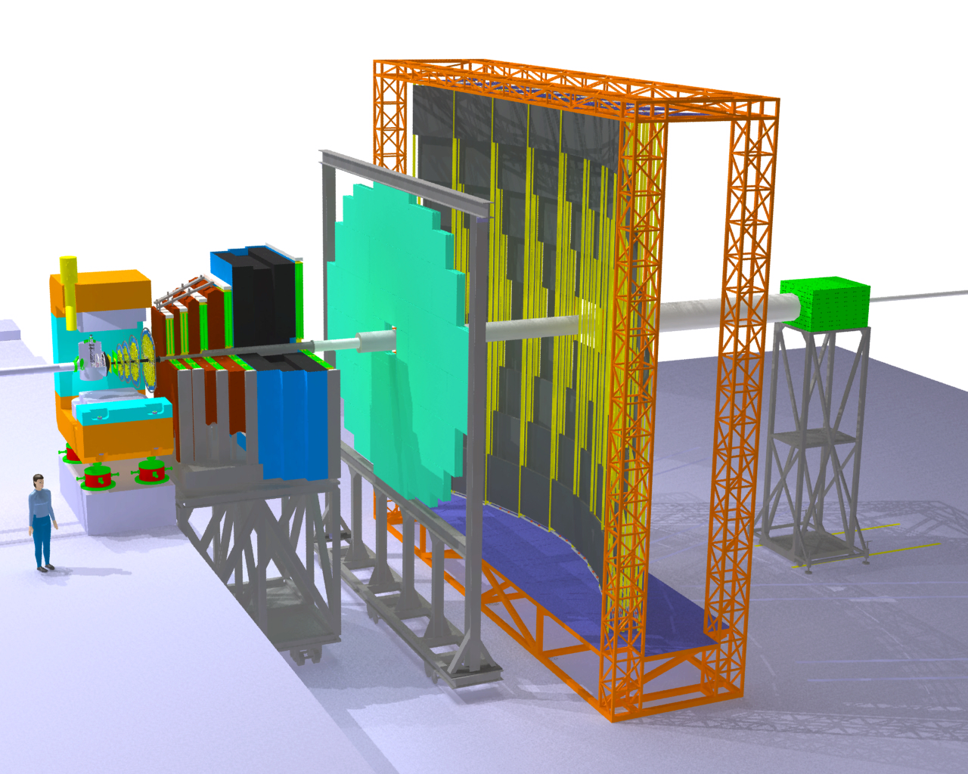
The Compressed Baryonic Matter Experiment
Transition
Radiation
Detectors
Tracking
Detector
Muon
detection
System
Electro-
magnetic
Calorimeter
Ring Imaging
Cherenkov
Detector
Silicon
Tracking
Stations
Vertex
Detector
Projectile
Spectator
Detector
(Calorimeter)
Dipol
magnet
Resistive
Plate
Chambers
(TOF)
15

Slide 16
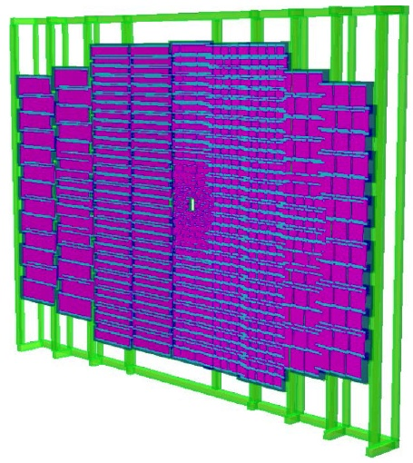
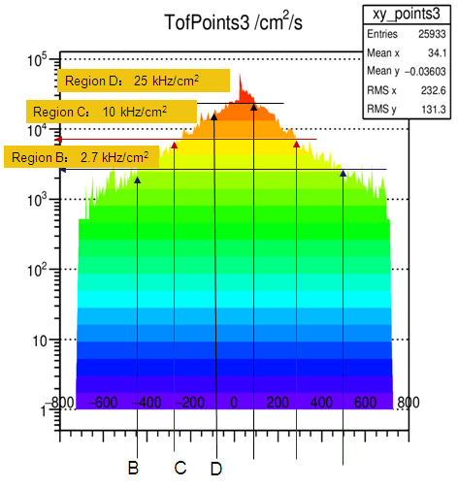
The structure of CBM-TOF wall
CBM-ToF Requirements
Full system time resolution σ_{T} ~ 80 ps
Efficiency > 95 %
Rate capability ≤ 30 kHz/cm²
Polar angular range 2.5°– 25°
Occupancy < 5 %
Low power electronics
(~100.000 channels)
Free streaming data acquisition
Au+Au, Center, 10AGeV
Simulated with CBM ROOT
16

Slide 17
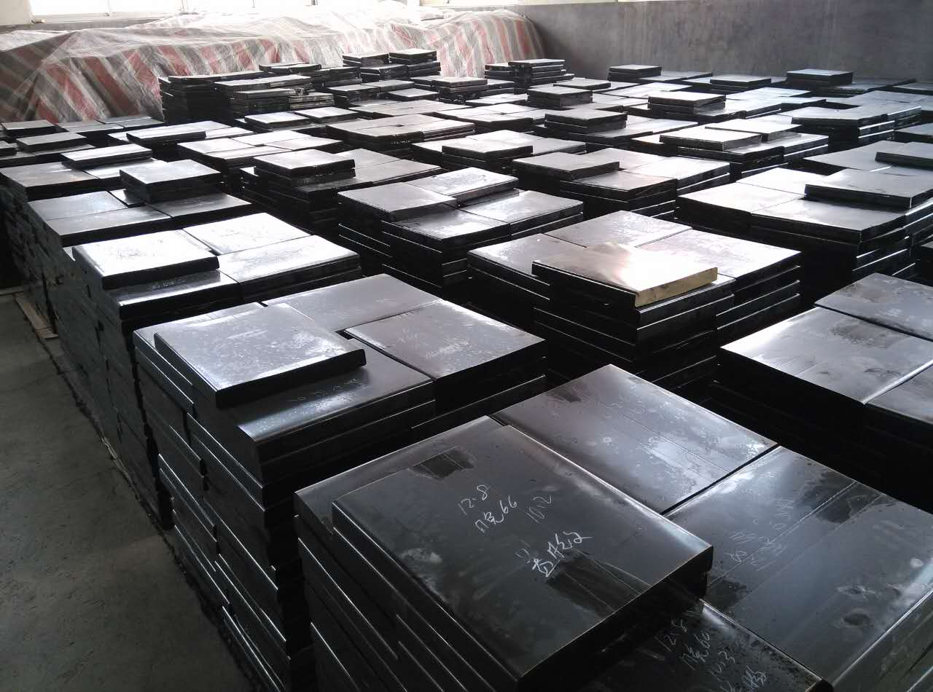
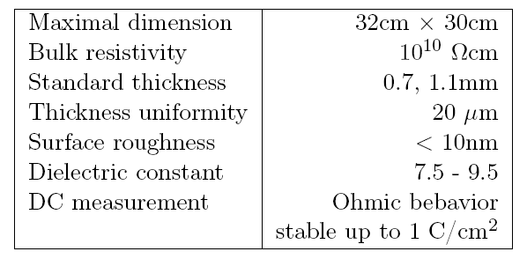
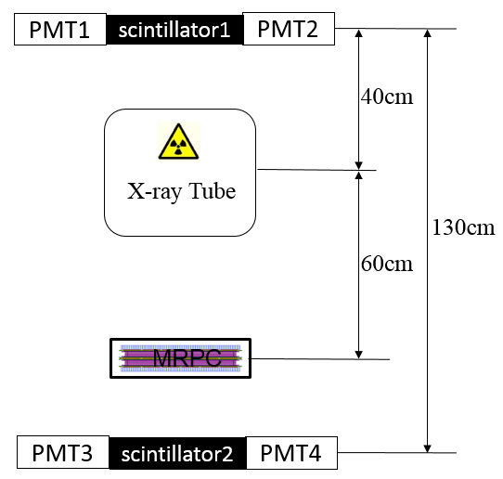
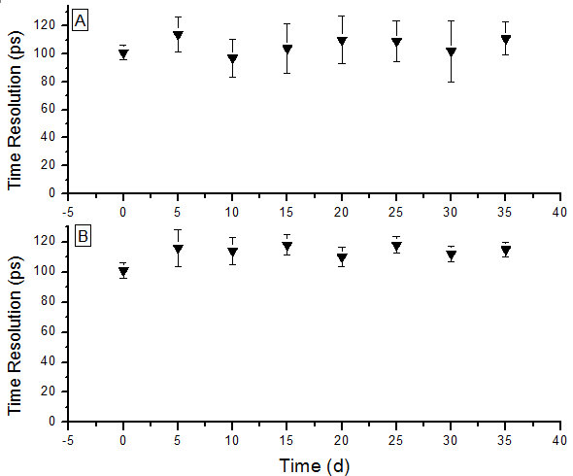
Development of low resistive glass
Performance of the glass
Glass mass production
Yield >100m²/month
Online test system. The efficiency and time resolution can be obtained by cosmic ray while irradiated by X-rays. 0.1C/cm² charge is accumulated in 35 days.
Aging test with X-ray source
17

Slide 18
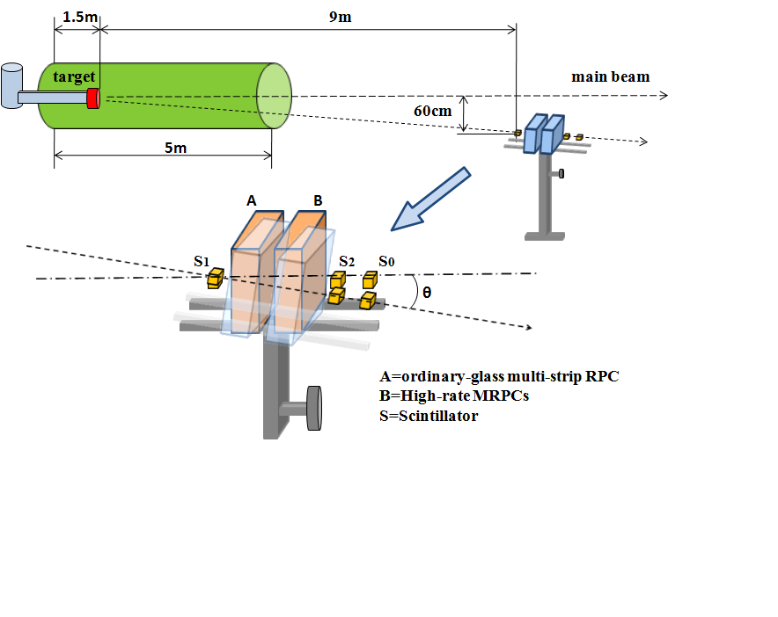
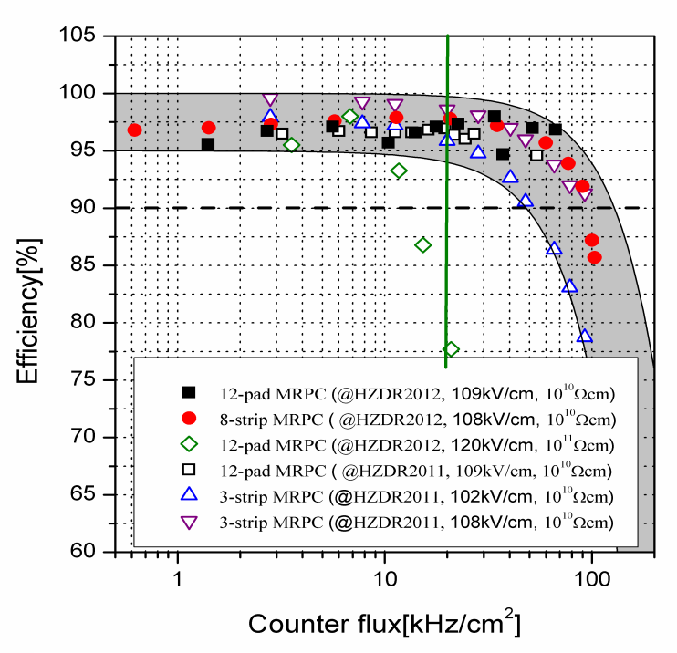
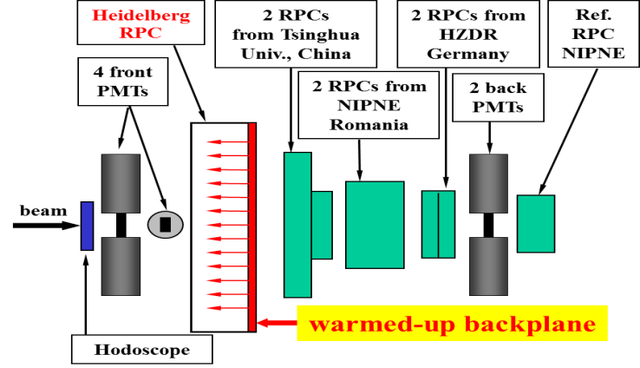
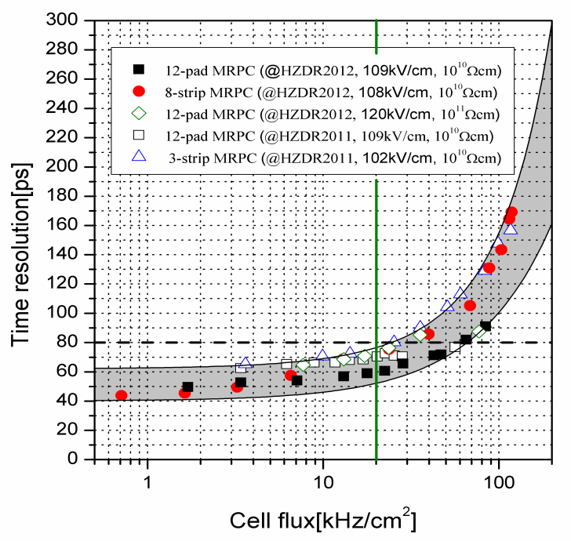
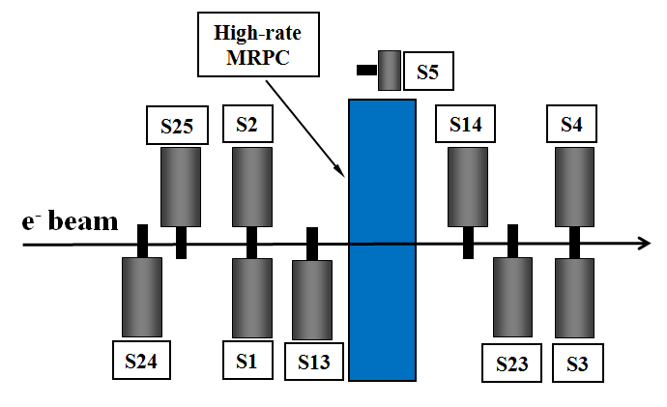
Test results of high rate MRPC
GSI Apr/Aug 2009
MRPC计数率世界分布图
Cosy 2011
Rate: 60-70kHz/cm²
Time resolution: 40 ps
HZDR 2011/2012
18
18

Slide 19
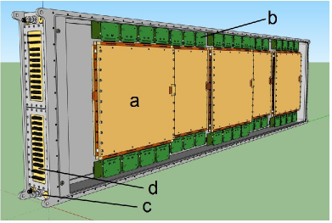
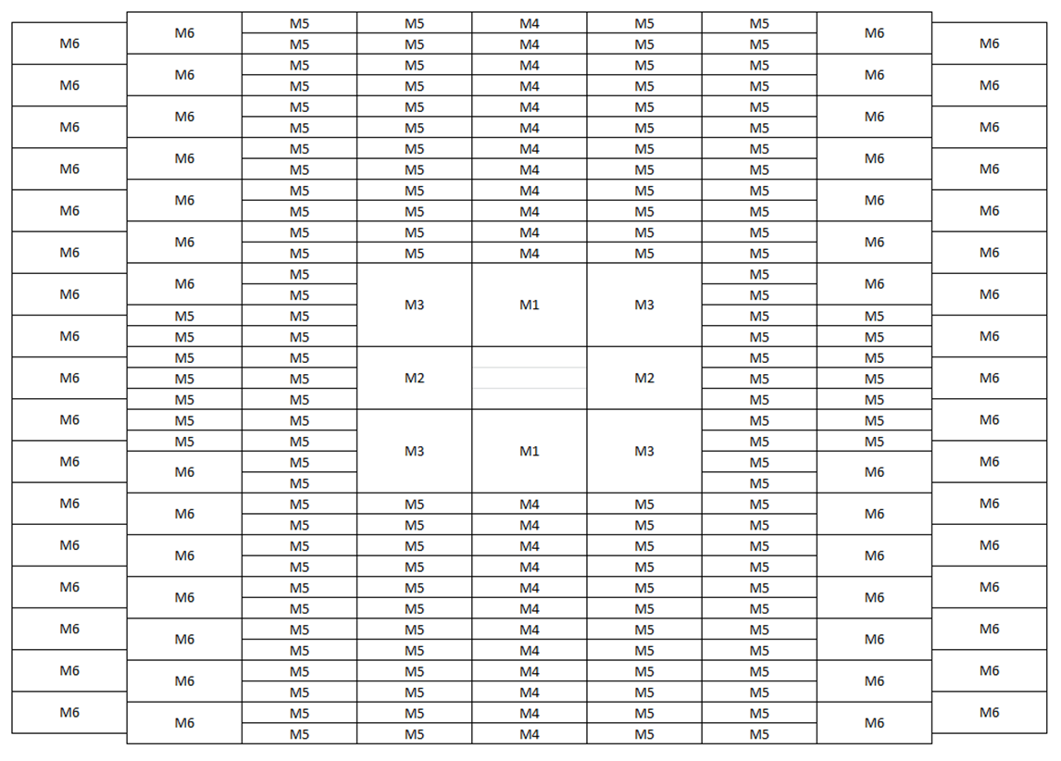
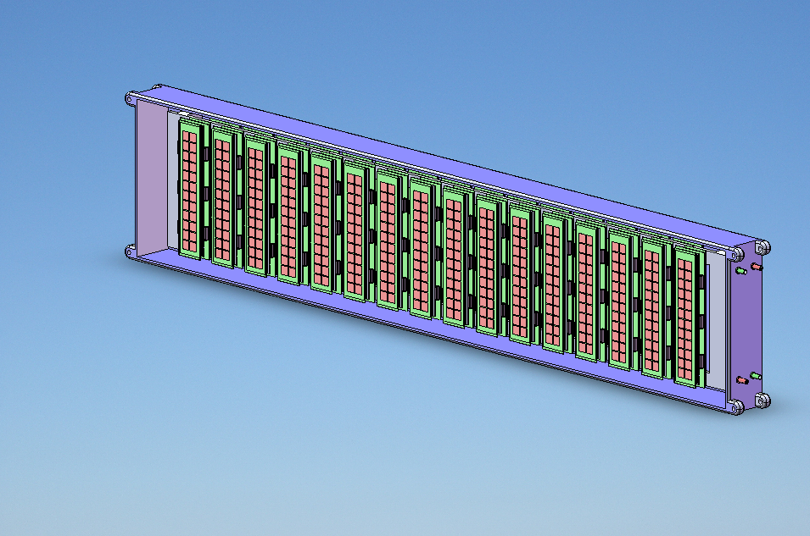
Prototype design for CBM-TOF
Strip-MRPC
Pad-MRPC

Slide 20
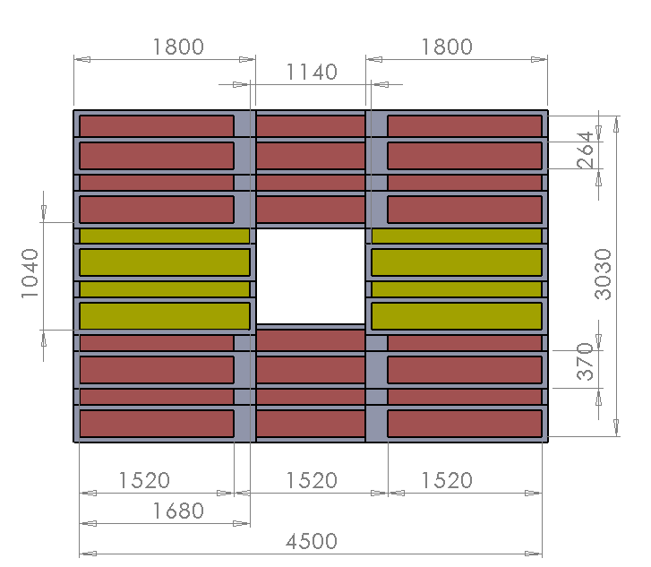
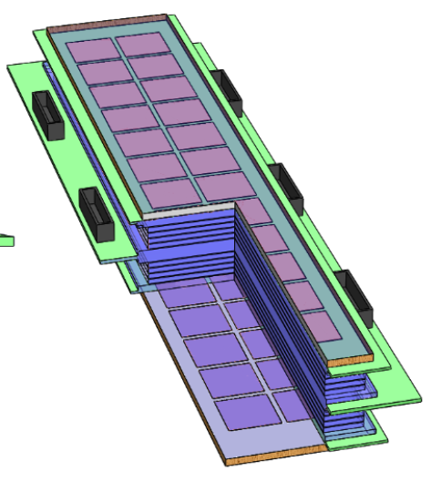
Design of inner wall based on pad-MRPC
Glass: 0.7mm, 5.2cm x 19.5cm
Pad: 2cm x 2cm, 16pads
Gas gap: 10 x 0.22mm

Slide 21
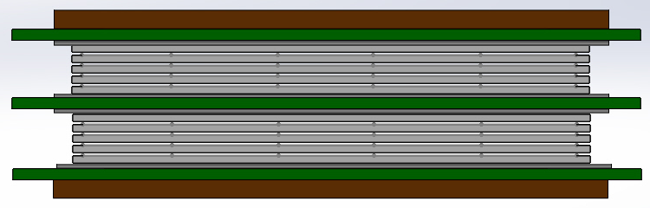
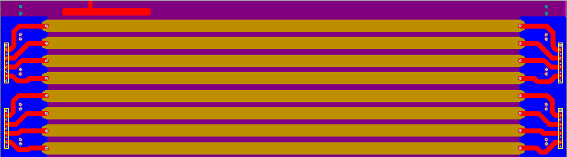
Design of strip-MRPC for high rate region
Glass: low resistive glass
0.7mm thick, 27cm x 25cm
Strip: 27cm x 0.7cm, 0.3cm interval, 24 strips
Gas gap: 8 x 0.25mm, two stacks
Gas box: 600mm x 500mm x 72mm
w
t
h
ground
Differential strip: 7mm wide+3mm interval
Feed trough: Micro-strip, 50Ω
21
21
21

Slide 22
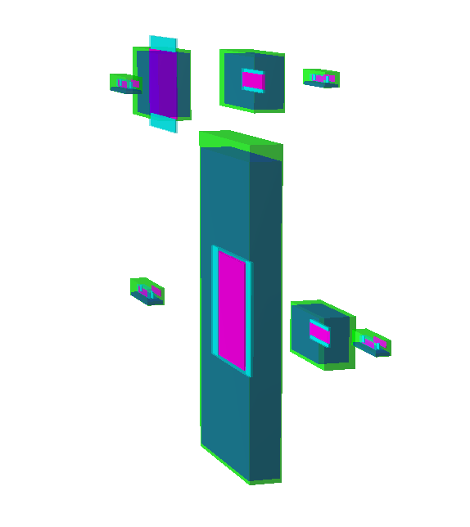
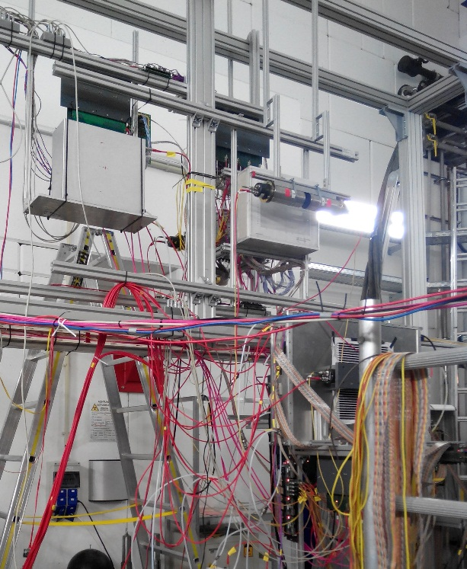
Beam test @GSI, Oct.2014
Experimental Setup:
Buc-2013
THU-Pad
BEAM
BEAM
Buc-Ref
PMT
THU-Strip
HD-P2
BEAM
HD-Ref
Beam time in October 2014 at GSI
1.1 GeV ¹⁵²Sm beam On 0.3mm/4mm/5mm Pb target
Flux rate several hundreds Hz/cm²
22
22
22

Slide 23
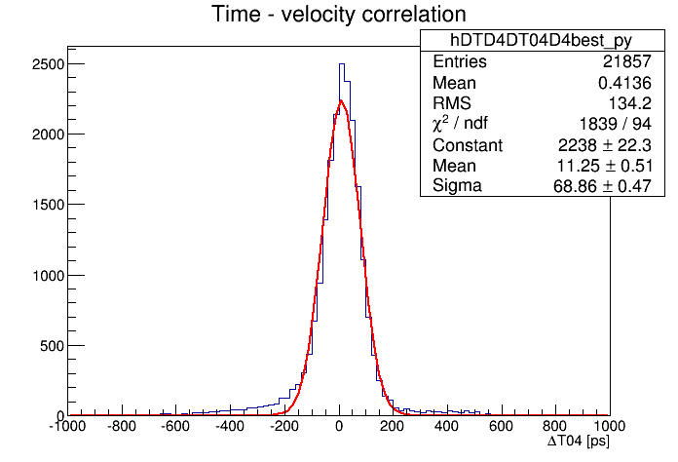
Performance of prototype
Run: Sun1205 – 5500V Time Resolution
Efficiency:
Around 97%
Analysis Result under Different Threshold
Threshold | Efficiency | Time Resolution | Cluster Size
170mV | 97.0% | 71.6ps | 1.7
180mV | 97.0% | 68.9ps | 1.7
190mV | 97.0% | 71.0ps | 1.6
200mV | 96.7% | 68.9ps | 1.6
Time resolution:
Around 70ps
23

Slide 24
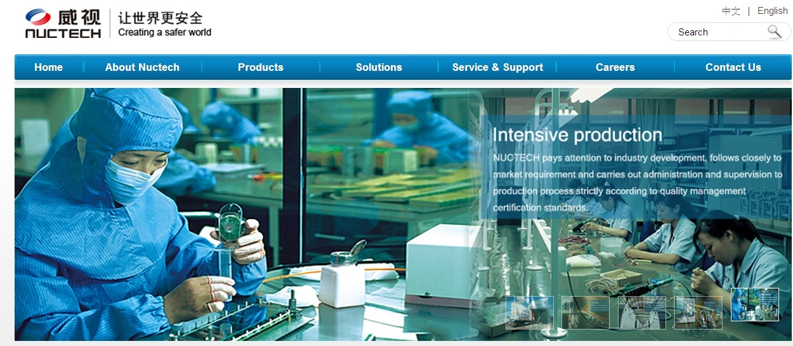



MRPC mass production
24

Slide 25



Production milestone of STAR MRPC
2006
2007
2008
1/2
3/4
5/6
7/8
9/10
11/12
1/2
3/4
5/6
7/8
9/10
11/12
1/2
3/4
5/6
7/8
Prod Start
132 MRPCs
768 MRPCs
1856 MRPCs
2944 MRPCs
4032 MRPCs

Slide 26

CMS-Muon upgrade
In CMS PhaseII upgrade, station 3 and 4 of Muon system is intended to be constructed with RPC.
Requirement:
Rate >2kHz/cm²
Trapezoidal, space limit
Time resolution ~100ps
26

Slide 27

Using the time resolution the RPC we expect to do much better
27
27

Slide 28


Milestone of R&D
Big mosaic, low resistive glass
Mosaic interface
20cm
212 mm
330 mm
330 mm
27cm
256 mm
330 mm
25 cm
Small mosaic, low resistive glass
gMRPC, thin glass

Slide 29


Performance of big mosaic MRPC
Rate: 11 kHz/cm²
S1
MRPC
S3
S24
S14
S6
e- beam
S13
S25
S2
S4
Beam test at HZDR

Slide 30

Performance of big mosaic MRPC
Working gas: 90% Freon+5% iso-butane+5% SF6
Problem: big current and high noise at CMS dry gas (0.3% SF6)

Slide 31
Comparison of different technology
Material | Detector | gas | rate | timing | Aging | Cost
Bakelite | Double gap | √ | √？ | X | X | √
Low resistive glass | Multi- gap | X | √ | √√ | √ | X
Thin float glass | Multi-gap | √ | √ | √ √ | √ √ | √

Slide 32


Previous results of thin gMRPC
Beam test at NICA, March, 2013
It can be seen the thinner the glass, the higher of the rate. For the 0.35mm common glass, the rate of MRPC can reach 3kHz/cm², which can be used in CMS muon system.

Slide 33

Structure of thin gMRPC
gMRPC prototype.
Parameter | Value
Dimension | 360 x 332 mm²
Active area | 117 x 270 mm²
Gas gap size | 0.250 mm
Gas gap num | 5
Glass type | Float glass
Glass thickness | 0.280 mm
Strip num | 32
Strip num test | 12
Strip length | 270 mm
Strip width | 7 mm
Strip interval | 3 mm
Active area: 117 mm x 270 mm (12 among 32 strips)

Slide 34


Comic test @904
2017/04/29: Apply HV on counter
Current trip at 6900 V.
±6800 V: - 20nA, + 0 nA.
Good signal observed on each channel.

Slide 35
2017/05/01~2017/05/02: Current scan

Slide 36


Test @GIF⁺⁺
WP
The efficiency is around 80% at working point 6.7kV, the main reason is the big amplitude attenuation of 40 meters of ribbon cable!

Slide 37

Test @GIF⁺⁺
Exciting results:
HV=6.9kV, Efficiency: 82% source off
80% 2kHz/cm²
70% 3kHz/cm ²

Slide 38

Next to do
Produce a medium size thin glass MRPC
Use ATALAS FEE
Best time at GIF++ at July, 2017
…..
Si BJT
SiGe BJT

Slide 39
Thanks for your attention!

