Slide 1
Current IHEP-CMS Team
Team leader：Hesheng CHEN, Guoming CHEN
12 Faculty Members:
Hesheng CHEN, Guoming CHEN, Jianguo BIAN, Zhenan LIU, Xiaoli DONG, Zhen WANG, Hongbo LIAO, Ye CHEN, Junquan TAO, Huaqiao ZHANG, Mingshui CHEN, Jinzhou ZHAO
7 Post-doc
Francesco ROMEO, Aniello SPIEZIA, Duncan LEGGAT, Armad, Efe YAZGAN, Joshuha THOMAS-WILSKER, Feng WANG(HGCal)
Left already: Roko PLESTINA, Tongguang CHEN, Mengqing WU
6 Students
Sarmad SHAHEEN, Sijing ZHANG, Binghuan LI, Na PENG, Taozhe YU, Javaid Tahir

Slide 2
Current activities
Active Physics analysis (mostly in 2016 only)
Higgs
New Physics
Single top
B physics (not included here)
Active Hardware
L1 Trigger
HGCal
Caveat: The following summary is based on a 2016 summary provided by Guoming, all incomplete activities are due to my limit communication with IHEP colleagues
Sorry

Slide 3
Study on Higgs properties

Slide 4
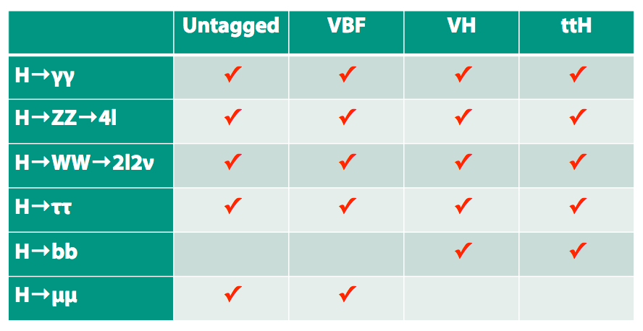
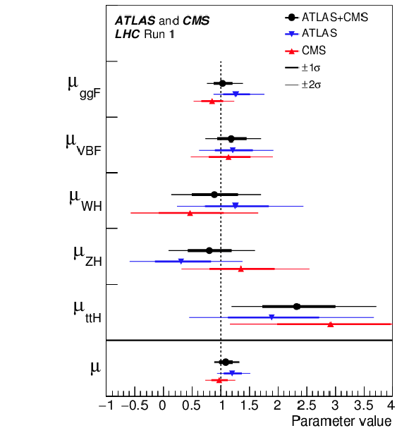
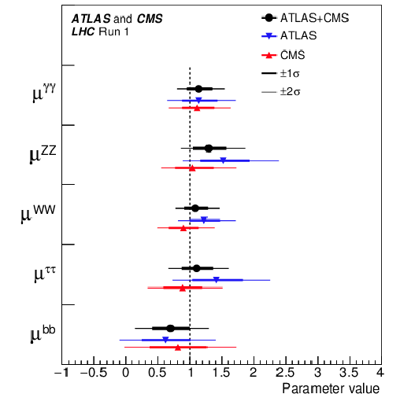
Run1 LHC Higgs coupling combination
Mingshui Chen
Combination of ATLAS and CMS Run 1 Higgs analyses
Extract maximally information from Run 1 data by combining two experiments
Expect a reduction of 1/√2 on statistics uncertainties
Mingshui Chen from IHEP served as one of the CMS contacts/editors
CMS-PAS-HIG-15-002 & arXiv:1606.02266

Slide 5
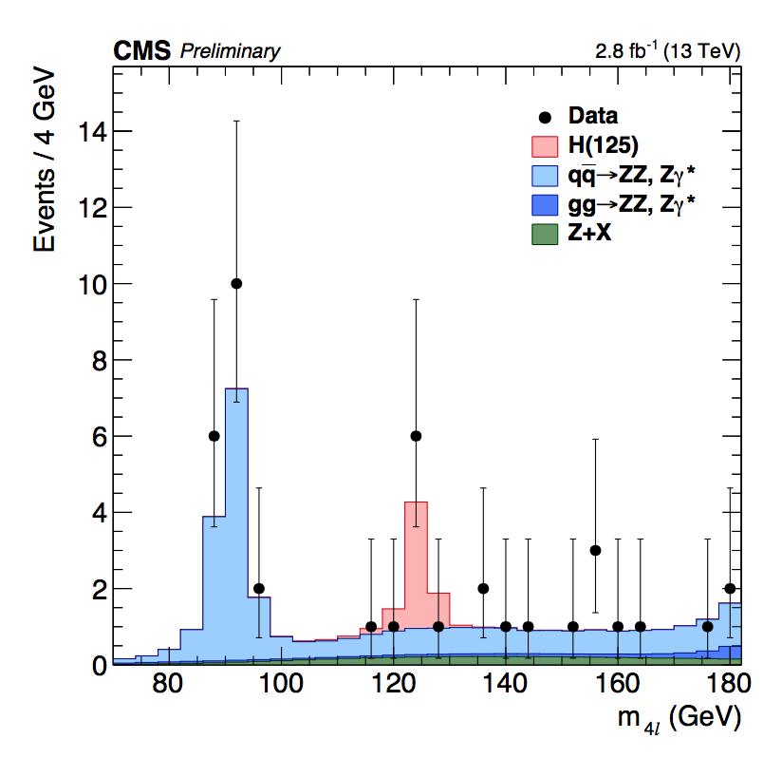
H—>4l analysis
Mingshui Chen
Run 1: IHEP postdoc Tongguang Cheng is one of the editors and gave the pre-approval talk
13 TeV rediscovery: IHEP postdoc Roko Plestina gave preapproval talk
2015 data cross-section: IHEP student Ahmad gave preapproval talk
At 125.09 GeV, which is the Run 1 LHC measurement of the Higgs boson mass, the observed significance is 2.5σ, for an expectation of 3.4σ , and signal strength is 0.82 ^{+0.57} _{-0.43}
Mass is measured to be 123.4^{+0.8}_{-0.7} GeV, compatible with the Run 1 LHC measurement at the 1.6σ level

Slide 6
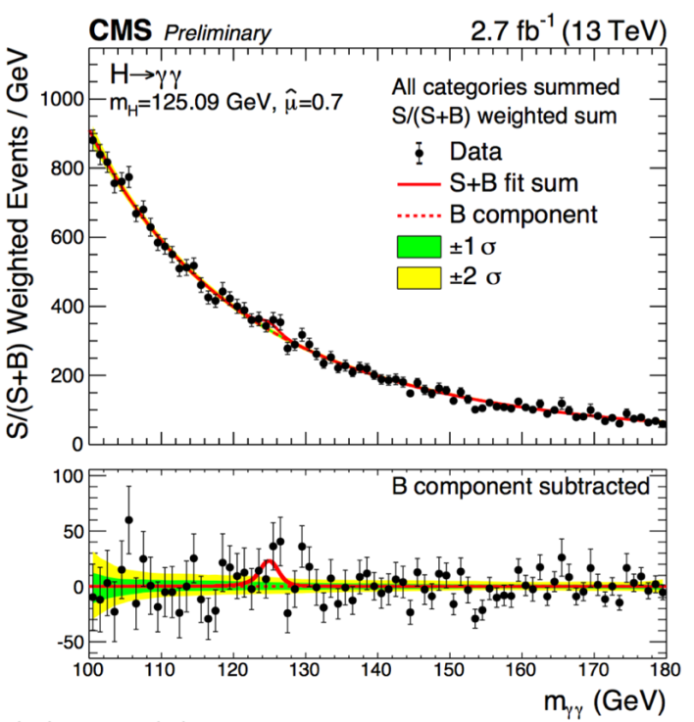
2015 data H--> γγ rediscovery
Junquan Tao
Junquan Tao from IHEP is one of the editors (CMS AN-14-280, CMS PAS HIG-15-005)
Contributions from IHEP group
analysis framework
Diphoton trigger scheme
Photon identification
Selection efficiency
Observed significance at 125.09GeV is 1.7 σ, with expected significance 2.7 σ

Slide 7
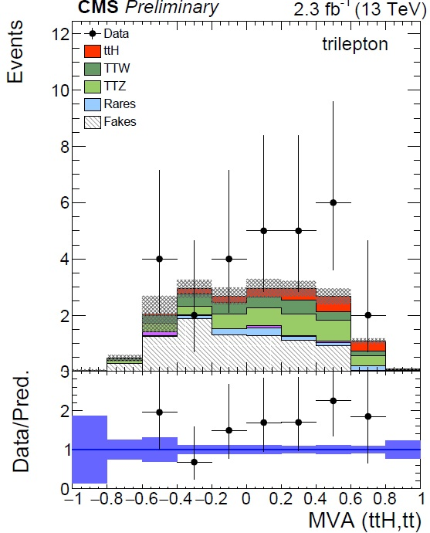
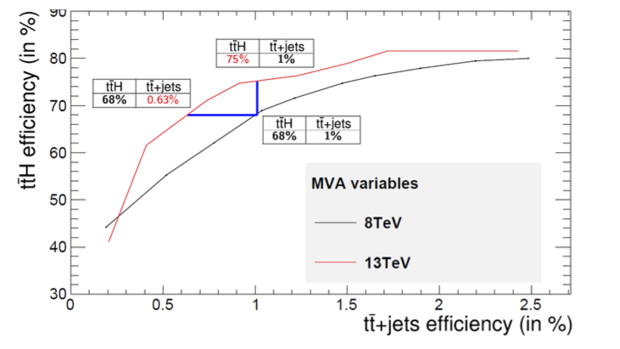
Run2 ttH H→multilepton
Huaqiao ZHANG
PAS HIG-17-004
PAS HIG-15-008
PAS HIG-16-022
40% improvement
IHEP postdoc Francesco Romeo is one of the editors for run 2 analysis PAS
and gives pre-approval talk for Moriond 2017
IHEP provided MVA for lepton isolation, the separation power improved by 40% compared to run1, and invent higgs jet tagger to tag jets from higgs decay. Higgs mass regression

Slide 8
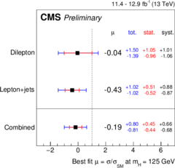
Run2 ttH,H→bb
Hongbo LIAO
PAS HIG-16-004
PAS HIG-16-038
Lepton+jets channel
1 muon(electron) with Pt>25(30) GeV
>=4 jets with Pt>30 GeV
2 lepton channel
1 lepton Pt>20 GeV, 1 lepton Pt> 15 GeV
3 jets with Pt > 30,30,20 GeV
Categorize events with
jets and b-jets multiplicities
Combined likelihood fitting
set limit on signal strength
μ<2.5 (expected 3.6)
IHEP provided sig/back separation, Bjetness variabls

Slide 9
New particle search

Slide 10
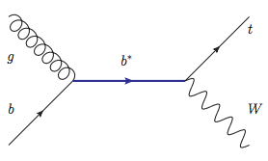
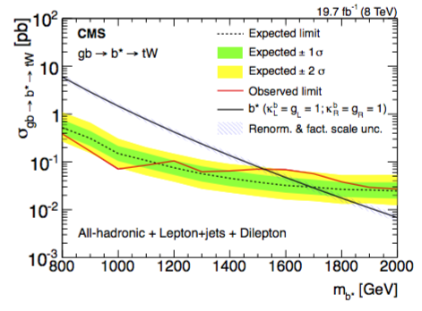
8TeV data Excited bottom quark Search
Huaqiao ZHANG
Search for excited 3rd generation bottom quarks：gb→b*→tW
Excited quark indicate quark substructure
First b* searches at CMS （B2G-14-005)
IHEP contributions
Contact person: IHEP Huaqiao Zhang
Approval talk by IHEP Huaqiao Zhang
3 final states / analysis teams
Lepton+jets (AN2014/103): IHEP
Dilepton (AN2013/415): NTU, IHEP, UVB
Full hadronic (AN2014/049): JHU
Combination (AN2014/202): IHEP, JHU, NTU, UVB
Exclude b* mass < 1.5TeV
World best limit up to date
JHEP 01 (2016) 166

Slide 11
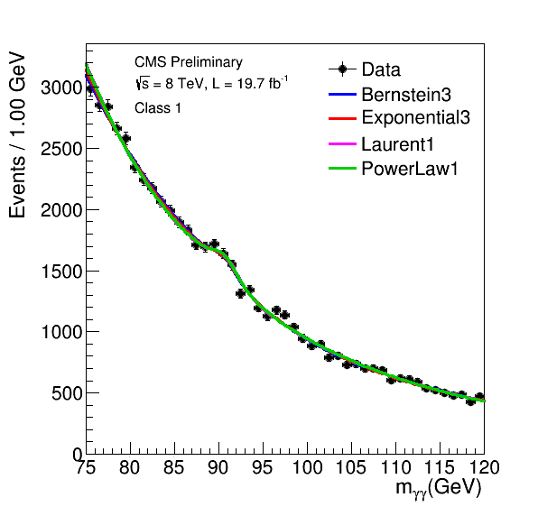
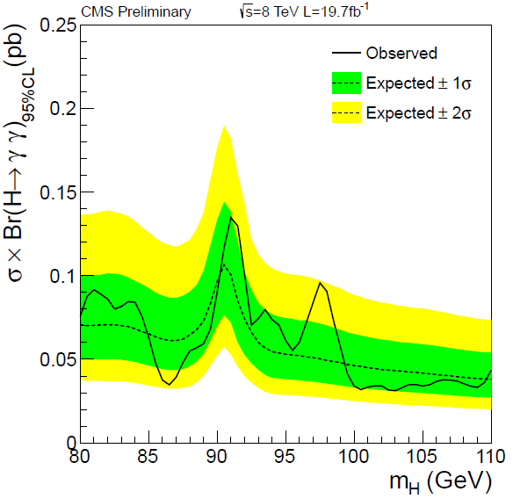
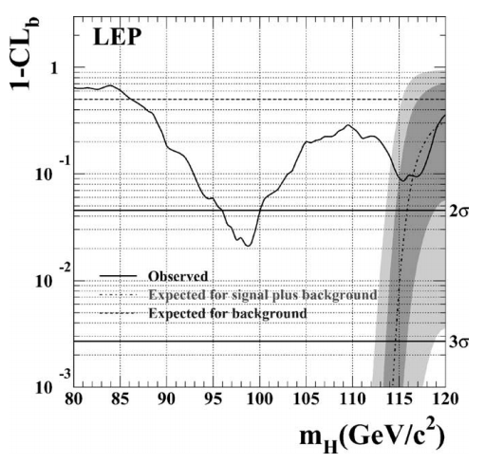
Junquan Tao
Additional low mass h →γγ search with 8TeV data
LEP >2σ excess at m_{H}=~98GeV
No obvious excess and set upper limit on σ×BR
2 σ excess at 98GeV
The analysis is dominated by IHEP
Phys. Lett. B, 565 (2003):61-75

Slide 12
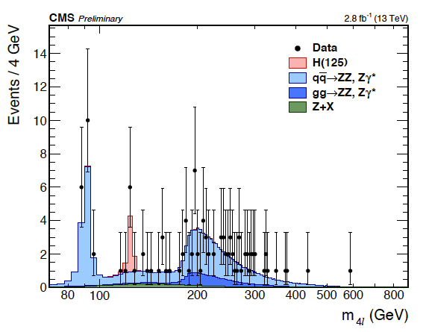
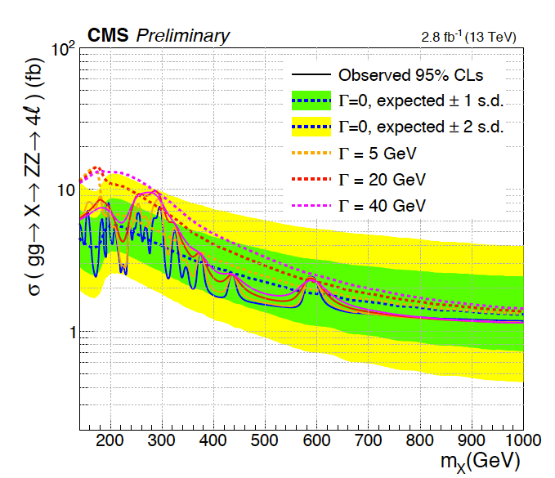
2015 data ZZ(4l) resonance search
Mingshui Chen
PAS HIG-16-022
No hint for new resonance in this channel
IHEP postdoc Tongguang Cheng is the contact person, he takes responsibility of the analysis

Slide 13
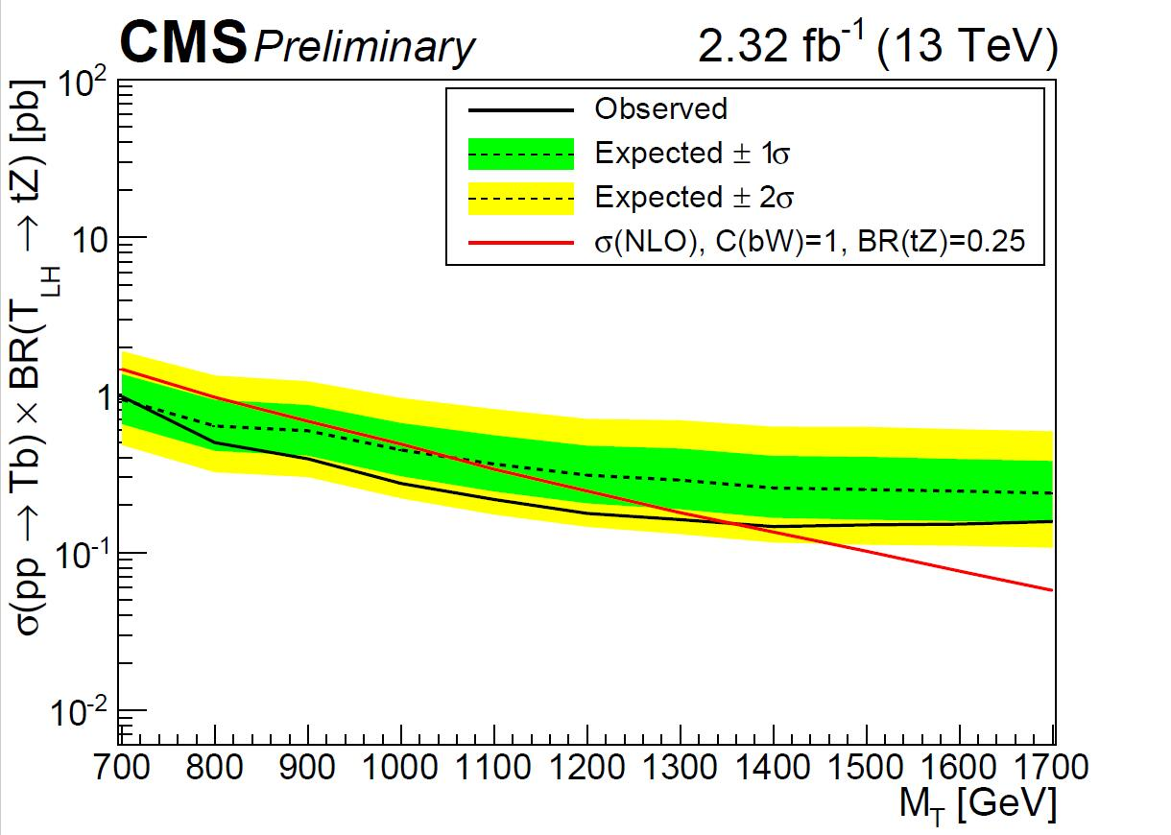
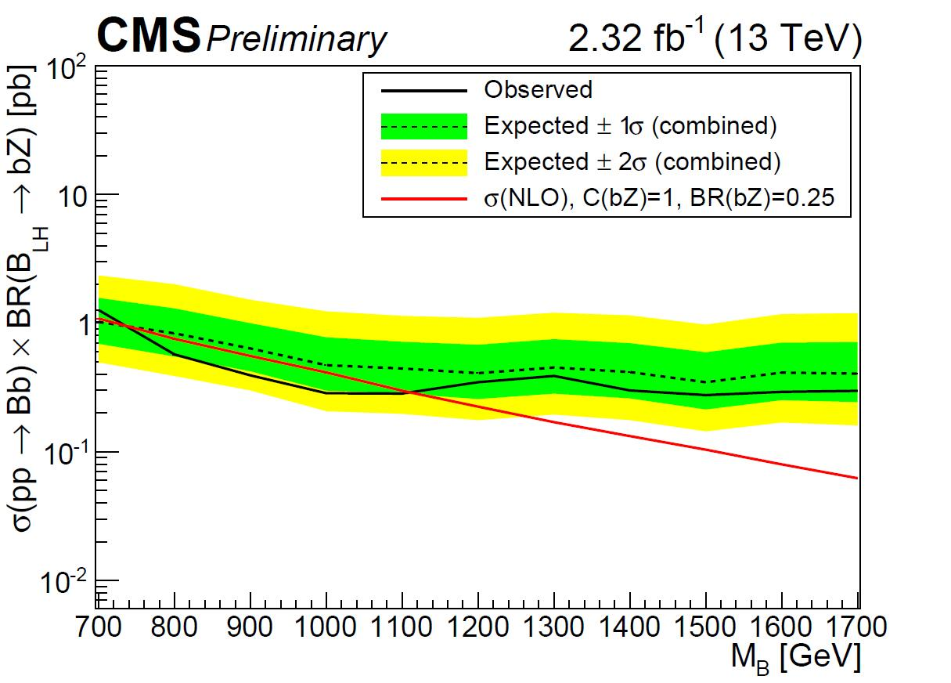
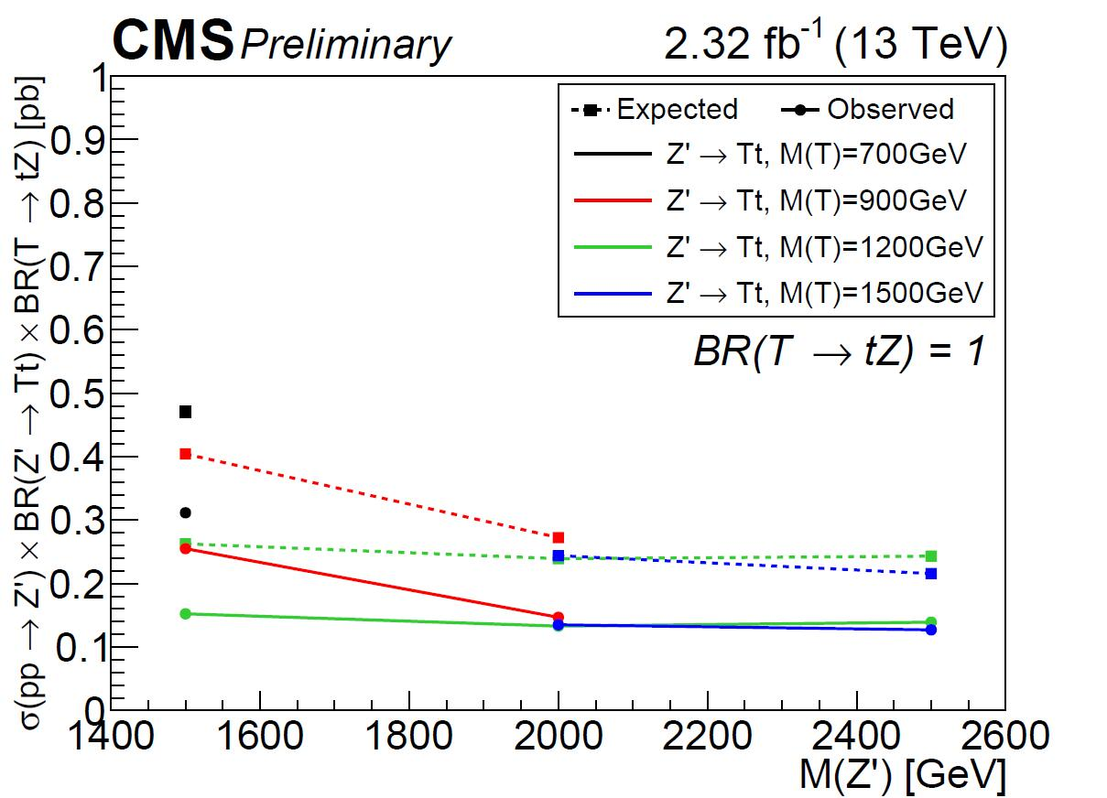
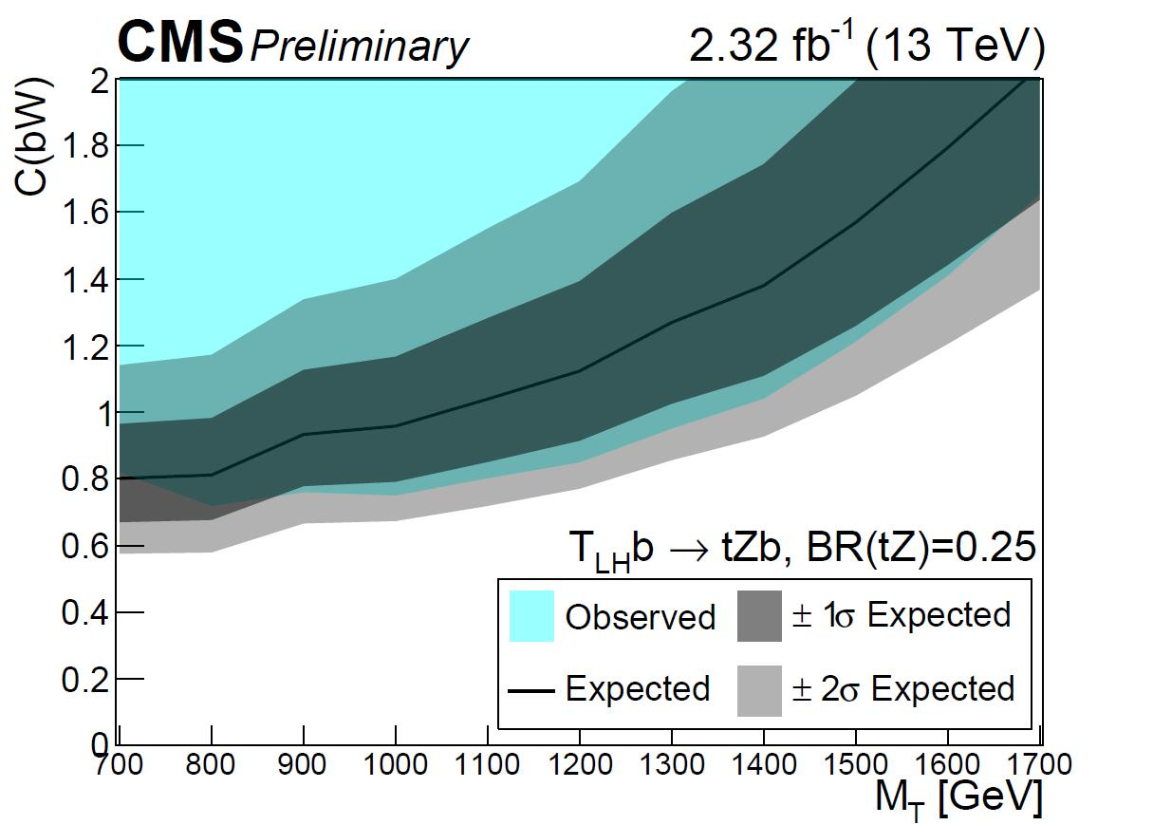
Hongbo LIAO
search for vector-like quarks, T’ and B’
LH Tb ➙tZb
LH Bb ➙bZb
Z’ ➙tZt
JHEP05(2017)029
CMS-PAS-B2G-17-007
CMS-PAS-B2G-16-001
No excess was seen, we set limit on the cross section times branching ratio
IHEP dominates the whole analysis

Slide 14
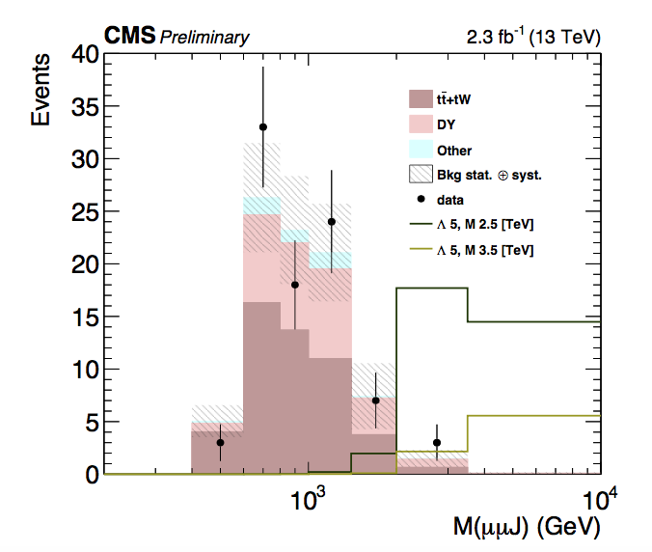
Heavy Neutrinos Search
Huaqiao ZHANG
We did not see any excess in the data, and exclude N below 2.3TeV
IHEP contribution: IHEP postdoc Francesco Romeo is the contact person of the ee/mumu analysis and gave approval talk(EXO-16-026)
Also JHEP 03 (2017) 077

Slide 15
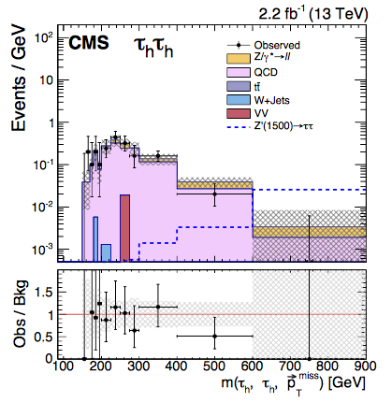
Di-tau resonance searches
Huaqiao ZHANG
JHEP 02 (2017) 048
We did not see any excess in the data, and exclude Z’ below 2.1TeV
IHEP significant contribution

Slide 16
Study on single top

Slide 17
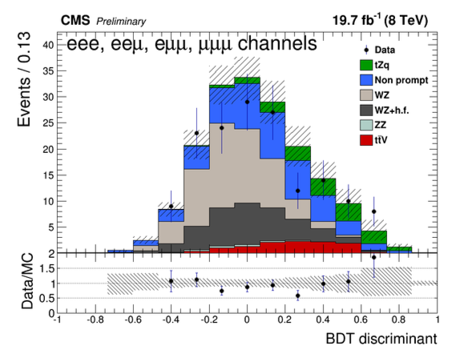
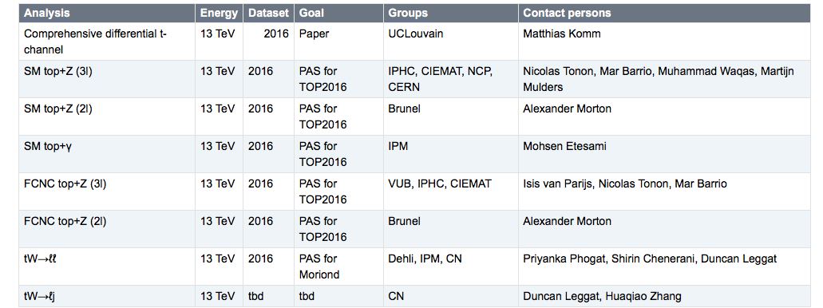
Single top：tW/tZq
Huaqiao ZHANG
SM tZq and FCNC tZ
Obs 2.4σ SM tZq
PAS Top-12-039 in 2016
Submitted to JHEP(arXiv:1702.01404)
IHEP Post-doc Duncan Leggat gives the pre-approval talk, and approval talk
SM tW
Direct measure |Vtb|
First CMS 13 TeV analysis
Dilepton
Lep+jets (new)
Analysis contact(no CADI yet): Duncan Leggat and Huaqiao Zhang

Slide 18
L1 Trigger hardware

Slide 19
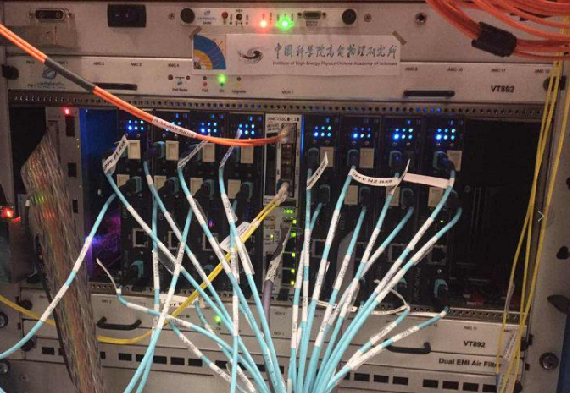
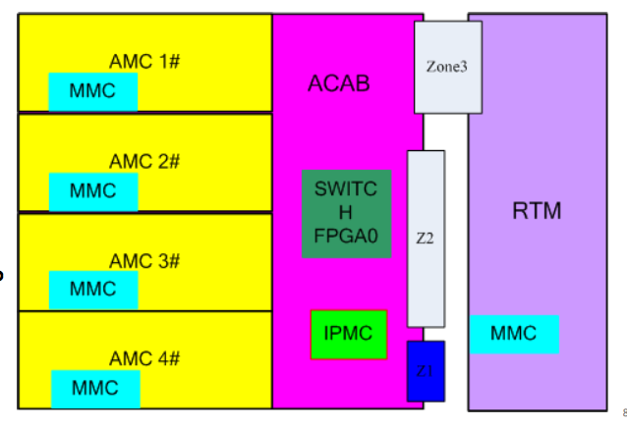
L1 Trigger upgrade
Zhenan LIU
Phase I:
VME ➔ MTCA
Single link
1.6 GGbps ➔10 Gbps
CPPF hardware designed at IHEP and integrated in CMS L1 trigger system in 2017-3
Commissioning and firmware
Plan to continue contribute on Muon trigger Phase II
New ATCA Prototype design

Slide 20
HGCal hardware

Slide 21
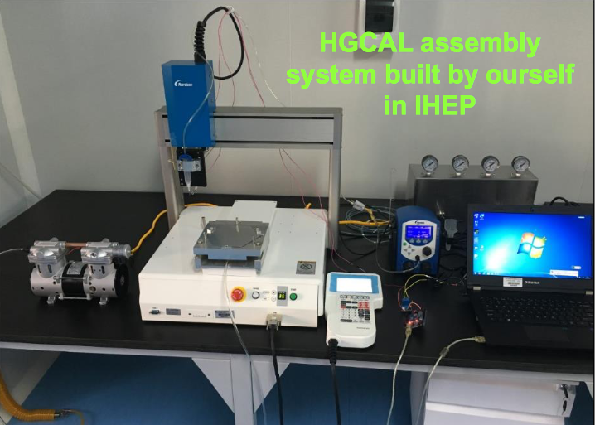
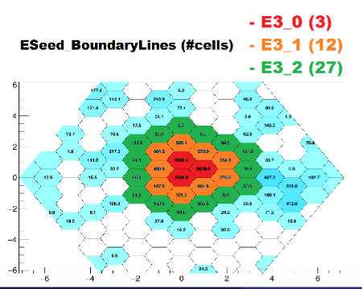
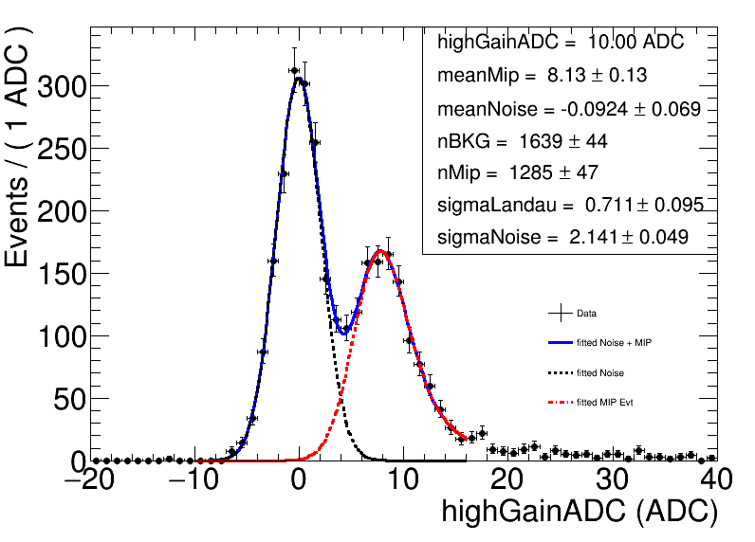
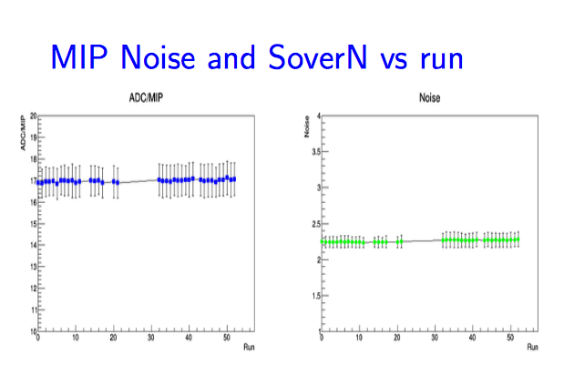
High Granularity Calorimeter
Huaqiao ZHANG
A brand new 5D radiation hard calorimeter inherit from ILC
Plan to have a Silicon module assembly center at IHEP-Beijing
Activities including HGCal prototyping test-beam, Silicon Module assembly
Coll. With CERN and UCSB
CERN实验束clustering
CERN实验束MIP分析
首个MIP信号:费米实验束: Calor2016

Slide 22
Contact information
Team leaders
Hesheng CHEN: chenhs@ihep.ac.cn
Guoming CHEN: chengm@ihep.ac.cn
Analysis or hardware in this report
Mingshui CHEN: chenms@ihep.ac.cn
Hongbo LIAO: liaohb@ihep.ac.cn
Zhenan LIU: liuza@ihep.ac.cn
Junquan TAO: taojq@ihep.ac.cn
Huaqiao ZHANG: zhanghq@ihep.ac.cn
IHEP: http://english.ihep.cas.cn

Slide 23
Thanks

