Slide 1
Synchrotron radiation of Final doublet in CEPC
Sha Bai, Chenghui Yu,
Qinglei Xiu, Yiwei Wang, Dou Wang, Jie Gao
CEPC-AP-meeting
2017-05-26

Slide 2
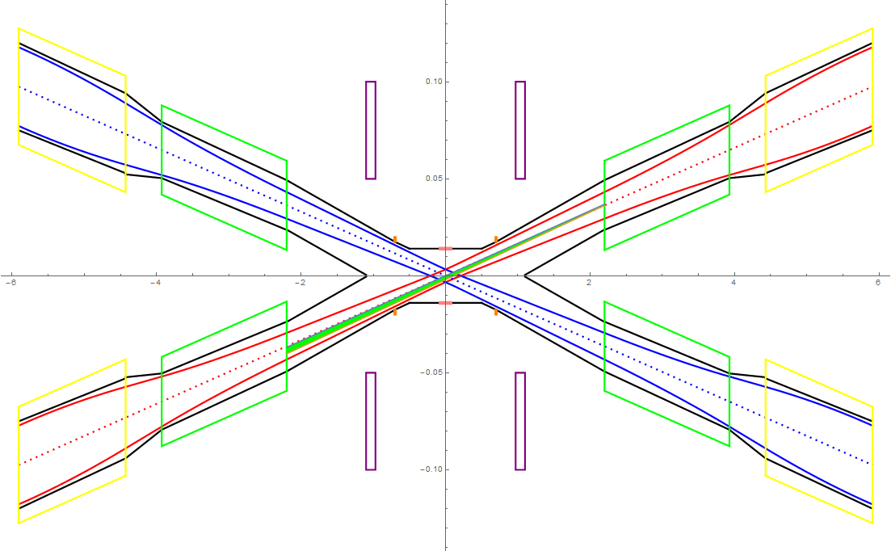
SR from QD0 in horizontal plane
QF1
In the Gaussian distribution beam, particles in 3σ occupies 99.7% of the total amount, 1σ occupies 68.7%, and 2σ occupies 95.5%.
The total SR power generated by the QD0 magnet is 1466.5W in horizontal. The critical energy of photons is about 1973.7keV. (Slice into 6 pieces)
Lumical
QD0

Slide 3
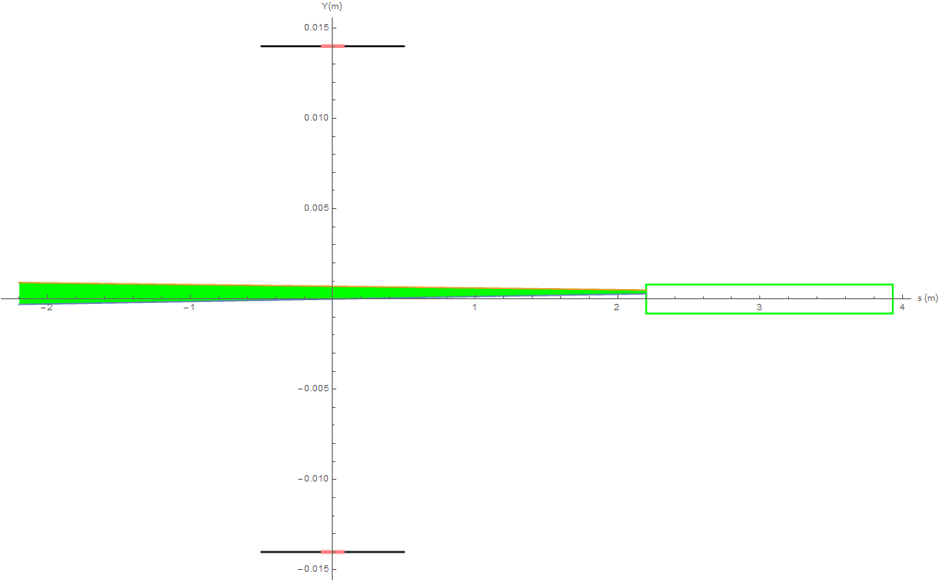
SR from QD0 in vertical plane
In the Gaussian distribution beam, particles in 3σ occupies 99.7% of the total amount, 1σ occupies 68.7%, and 2σ occupies 95.5%.
The total SR power generated by the QD0 magnet is 185.8W in vertical. The critical energy of photons is about 444keV. (Slice into 6 pieces)

Slide 4
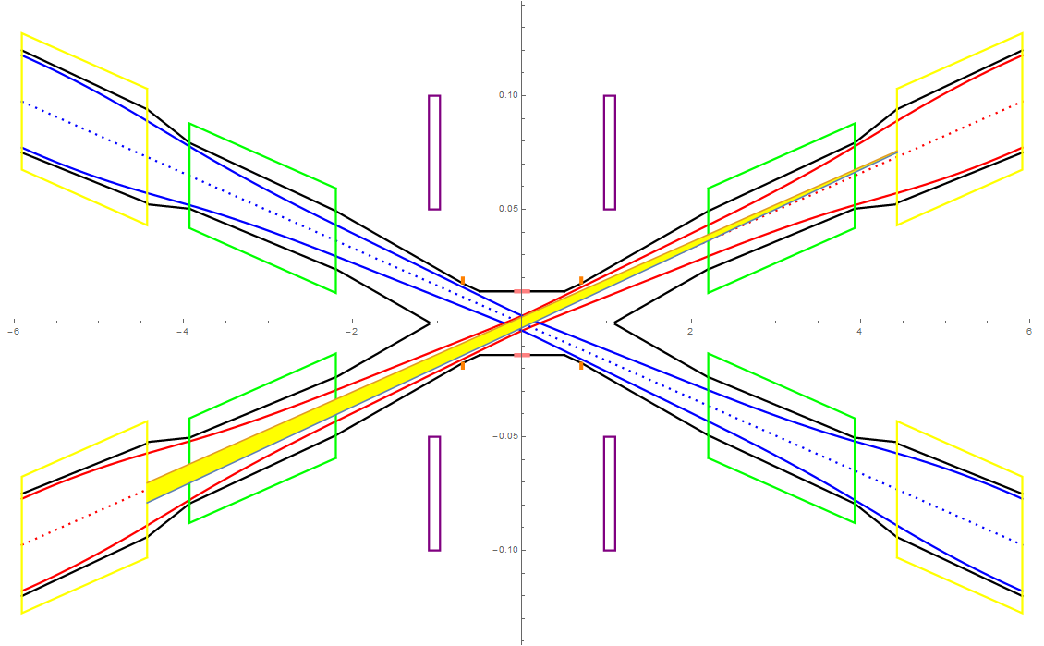
SR from QF1 in horizontal plane
QF1
In the Gaussian distribution beam, particles in 3σ occupies 99.7% of the total amount, 1σ occupies 68.7%, and 2σ occupies 95.5%. Slice into 6 pieces.
The total SR power generated by the QF1 magnet is 3488.6W in horizontal. The critical energy of photons is about 2361.96keV.
The total SR power generated by the QF1 magnet is 36.5W in vertical. The critical energy of photons is about 201.4keV.
Lumical
QD0

Slide 5
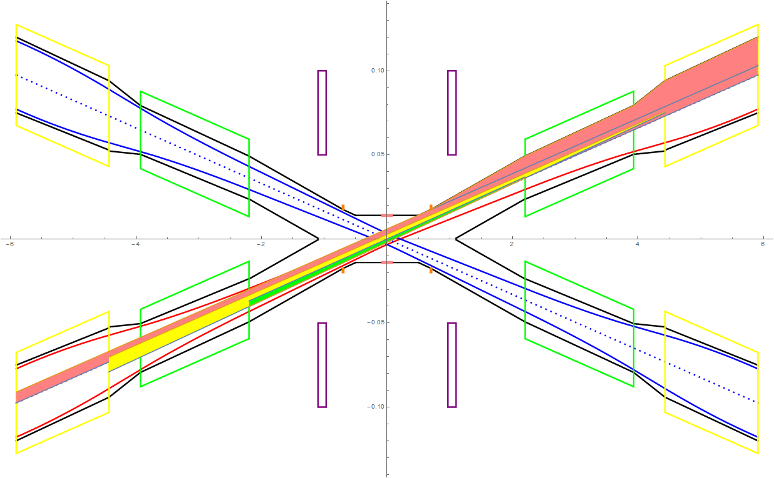
SR from B, FD in horizontal plane ~ last bending magnet upstream of IP and final doublet

Slide 6
SR power and critical energy of FD in different slices
Slices(3sigma) | QD0_SR_power_X (W) | QD0_SR_power_Y (W) | QD0_critical_energy_X(KeV) | QD0_critical_energy_Y(KeV)
3 | 1554.35 | 196.97 | 1794.3 | 403.69
6 | 1466.47 | 185.83 | 1973.73 | 444.06
9 | 1450.27 | 183.78 | 2033.54 | 457.52
12 | 1444.6 | 183.06 | 2063.44 | 464.25
18 | 1440.55 | 182.55 | 2093.35 | 470.97
Slices(3sigma) | QF1_SR_power_X (W) | QF1_SR_power_Y (W) | QF1_critical_energy_X(KeV) | QF1_critical_energy_Y(KeV)
3 | 3697.65 | 38.69 | 2147.23 | 183.09
6 | 3488.6 | 36.5 | 2361.96 | 201.4
9 | 3450.05 | 36.1 | 2433.53 | 207.5
12 | 3436.57 | 35.96 | 2469.32 | 210.56
18 | 3426.94 | 35.86 | 2505.11 | 213.61

