Slide 1
Progress on
DA Optimization with MODE
ZHANG, Yuan WANG, Yiwei WANG, Dou GENG, Huiping
2017-05-26

Slide 2
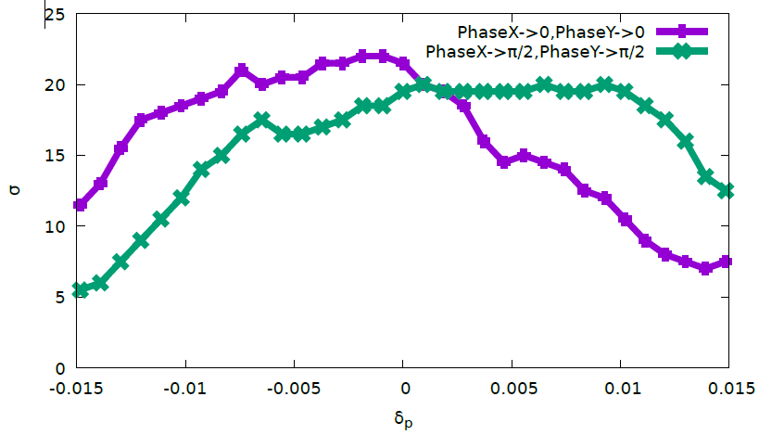
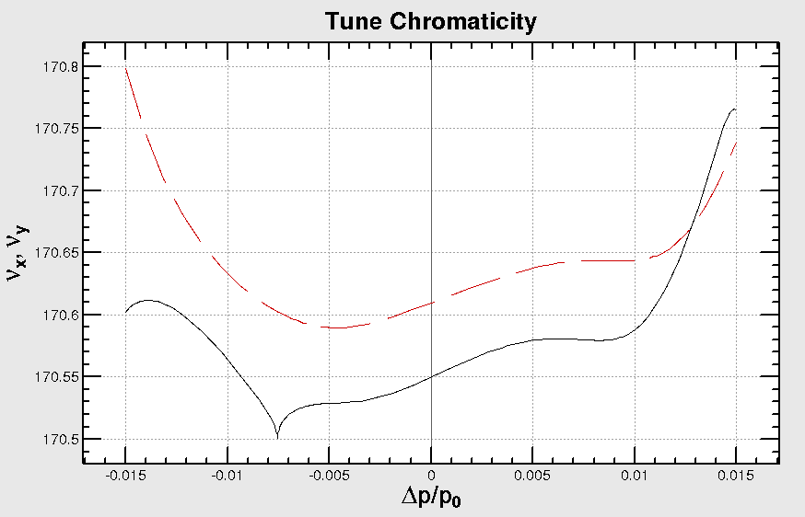
IV.3 Optimize DA with IR sext/mult and 4*(SFO/SDO)+4*(SFI/SDI)+IR knobs(Cai)
200 turns
Keep IP Optics
DAMPONLY
0519
58 Knob: 8 IR sext + + 4 IR multipoles(K1/K2/K3) + 22 IR Mult(k2) + 16 arc sextupoles

Slide 3
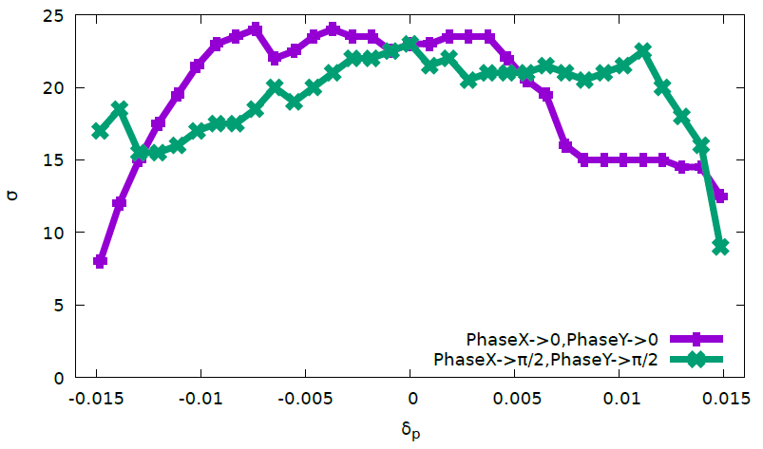
IV.4 Optimize DA with IR sext/mult and 8*(SFO/SDO)+8*(SFI/SDI)+IR knobs(Cai)
200 turns
Keep IP Optics
DAMPONLY
70 Knob: 8 IR sext + 4 IR multipoles(K1/K2/K3) + 18 IR Mult(k2) + 32 arc sextupoles
Notes:
Cai-match-4-cont/

Slide 4
Sawtooth/Taper

Slide 5
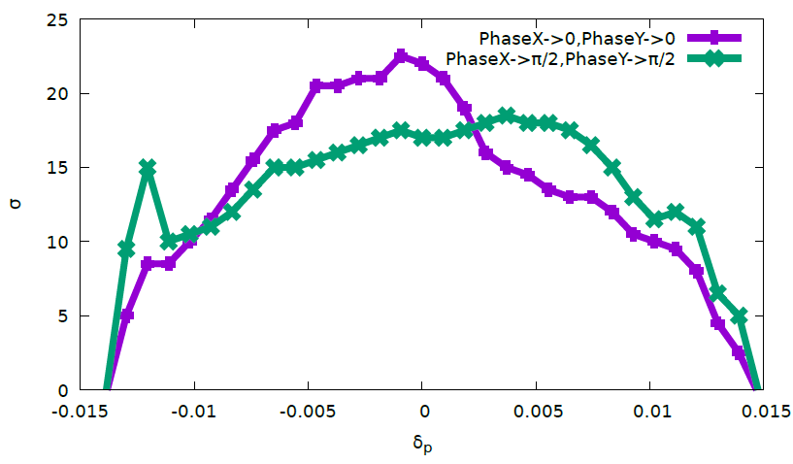
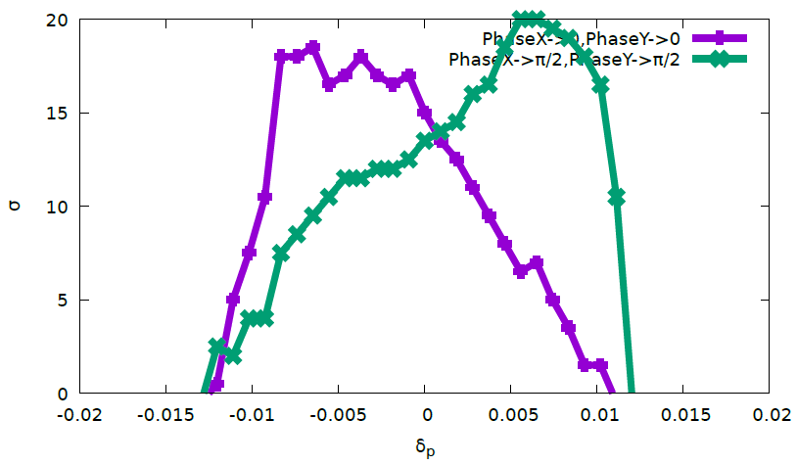
DAMPONLY VS
DAMPONLY-SAWTOOTH-TAPER
200 turns
Notes:
cai-match-1-x.88.27

Slide 6
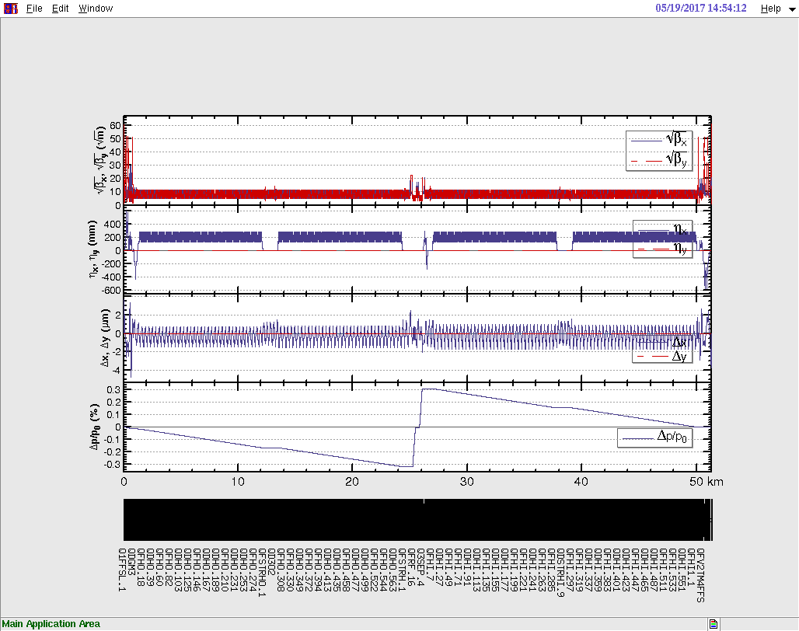
Sawtooth with Taper – Ring

Slide 7
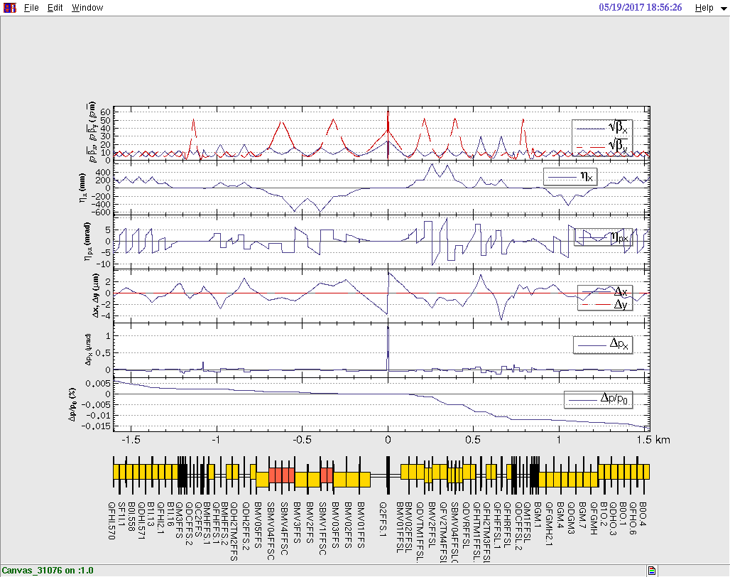
Sawtooth with Taper – IR

Slide 8
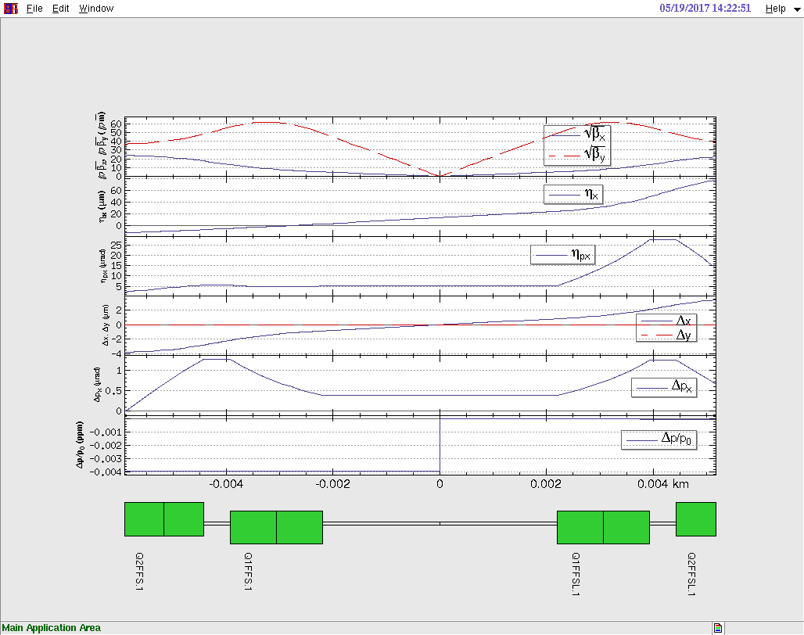
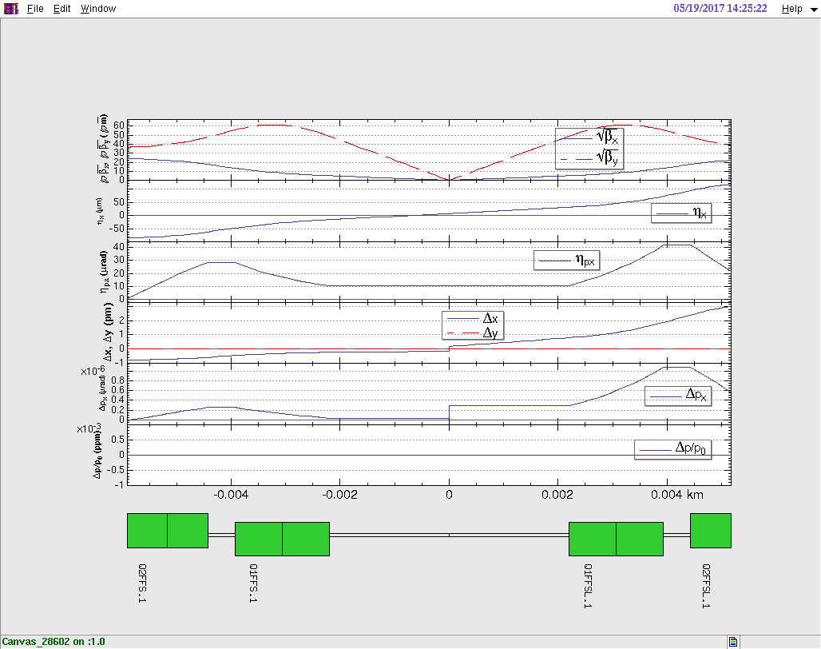
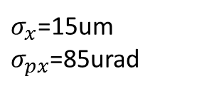
Sawtooth with Taper – IP
RADOFF
EX = 14um
EPX= 5 urad
DX = 0
DPX= 0.4urad
$σ_{x}$=15um
$σ_{px}$=85urad

Slide 9
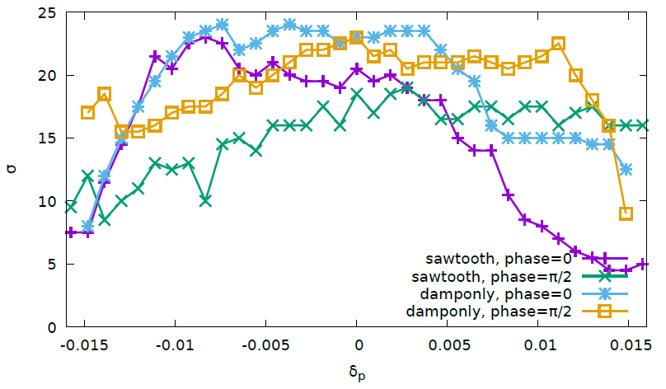
IV.4 damponly vs sawtooth/taper/damponly
200 turns

Slide 10
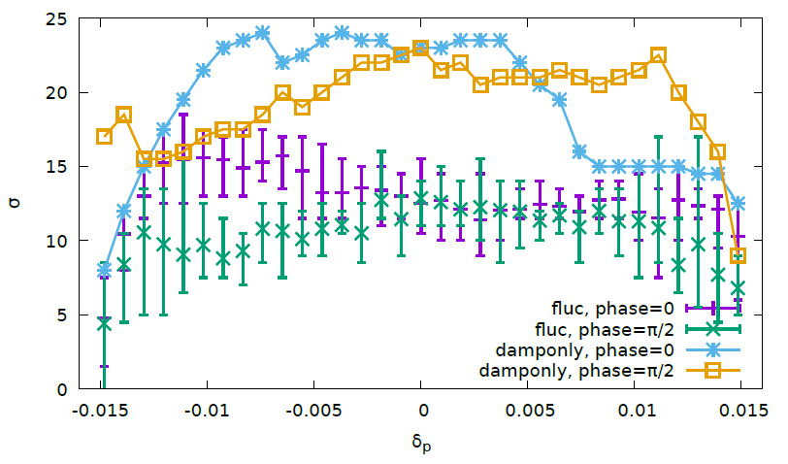
IV.4 damponly vs fluc/radtaper
(nosawtooth orbit)
200 turns

Slide 11
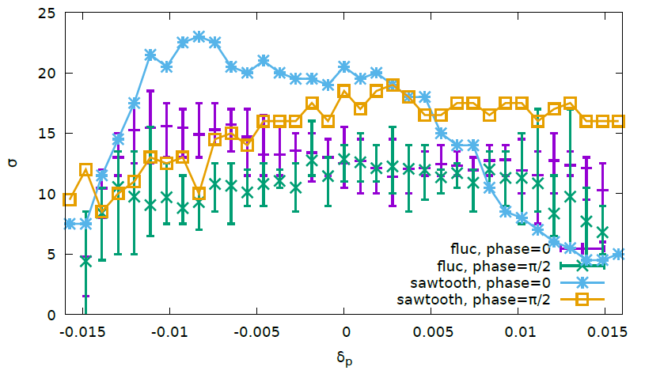
IV.4 sawtooth/taper/damponly vs fluc/radtaper (nosawtooth orbit)

Slide 12
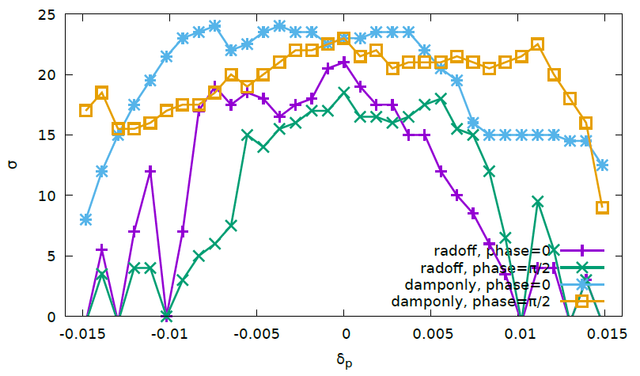
IV.4 damponly vs radoff
200 turns

Slide 13
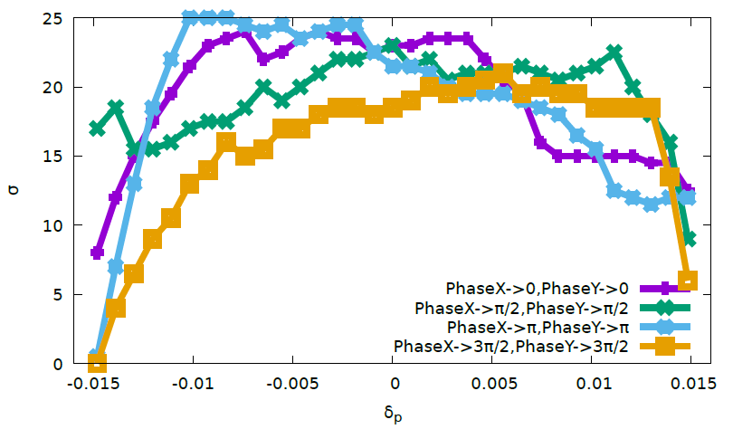
IV.4 damponly – more initial conditions
200 turns

Slide 14
K. Oide, 2016

Slide 15
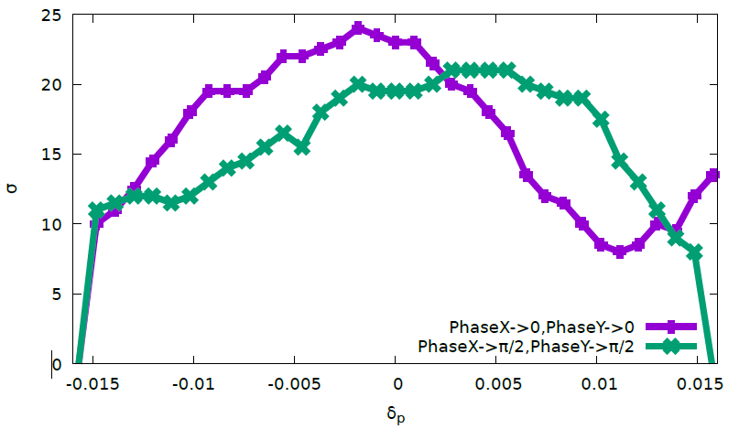
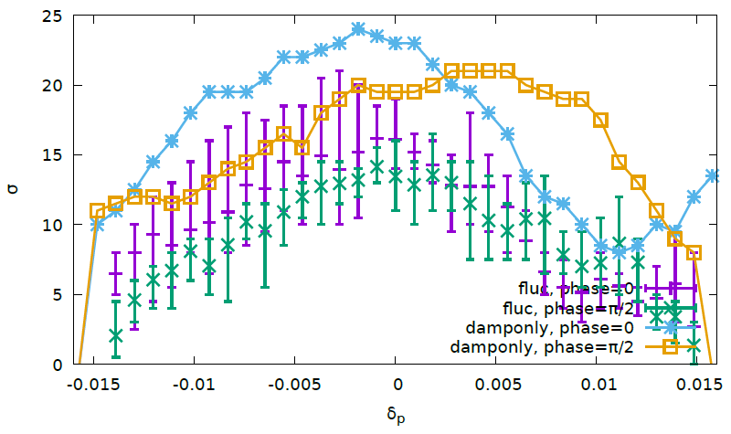
V.2 Optimize DA with IR sext + 4*(SFO/SDO)+4*(SFI/SDI) + IR knobs(Cai)
50 turns
Keep IP Optics
Sawtooth orbit
damponly
36 Knob: 8 IR sext + 16 arc sextupoles + 4 IR multipoles(K1/K2/K3)
Notes:
Cmst-2

Slide 16
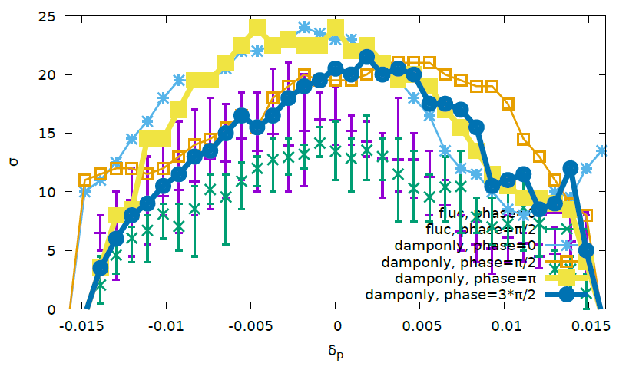
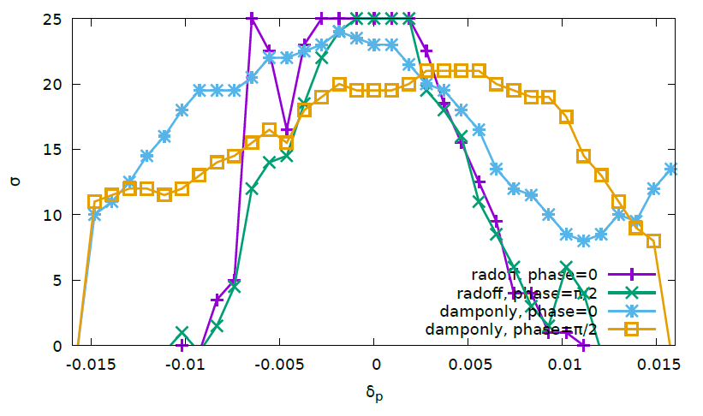
V.2
50 turns
Keep IP Optics
Sawtooth orbit
damponly

Slide 17
V.3 Optimize DA with IR sext/mult and 4*(SFO/SDO)+4*(SFI/SDI)+IR knobs(Cai)
50 turns
Keep IP Optics
Sawtooth orbit
damponly
58 Knob: 8 IR sext + + 4 IR multipoles(K1/K2/K3) + 22 IR Mult(k2) + 16 arc sextupoles

Slide 18
Summary
Clear DA difference between sawtooth orbit off/on(with taper)
Serious DA drop with FLUC after damponly(no sawtooth orbit) optimization
It seems less DA drop after optimization with sawtooth on
Better objective: sawtooth on(with taper) or rad off ?
Test is ongoing

